Slide 1
Preparing for Success in HE
Searching for academic information & Reading strategies

Slide 2
Before we start…
Have you got everything you need?
  Notebook and pen
  And a laptop
Financial support for available for getting a laptop:
Laptop bursary is called “digital connectivity bursary”
Information and application form can be found here:
https://www.uwtsd.ac.uk/bursaries/undergraduate/
Notes:
We’ve been asked to advise all students to get a laptop and highlight these bursaries – please don’t skip this slide!

Slide 3
In this session we will:
.
.
.
.
.
Discuss how to work together
Take an overview of the module
Learn how to find academic sources of information
Learn about reading strategies
Make our first reflective journal entries

Slide 4
Searching for
academic sources of information

Slide 5
What is academic information?
Good quality information we can trust
Information that can be used as evidence
Written by authors we can rely on e.g. subject specialists, academics who do research, experienced professionals, industry experts
Often in the form of academic books and journal articles
Notes:
NB We are learning about the CRAAP test (Blakeslee, 2004) for evaluating sources in Session 2
Journals are explained on the following slides

Slide 6

What types of academic information are available?
Notes:
Journal Articles
Books

Slide 7

What is a journal?
Picture:
Nature (2019) Available at: https://www.nature.com/articles/d41586-019-01493-z (Accessed: 15 October 2023).

Slide 8
What is a journal?
A journal has several volumes (often one per year)
Each volume has several issues/parts (e.g. 4 per year or 12 per year)
Each issue contains a number of articles on different topics by different authors
Most journals are now online, but they are still organised and referenced by using the volume and issue number

Slide 9
Books vs Journal Articles
Academic Books | Academic Journal Articles
Can be holistic – give a comprehensive overview of a topic | Often about one specific aspect of a topic
Longer | Shorter
Written at one point in time – may not be current/up to date | New articles are being published all the time – based on recent research
Published once (maybe with revised editions every few years) | New volumes/issues published regularly with new articles
Peer-reviewed (if it is an academic book)* | Peer-reviewed (if it is an academic journal – not a professional journal/trade magazine)
*Peer review = evaluated by experts in the same field before publication

Slide 10
Discuss in pairs
Would you use the following to find academic information, and how would you use them?
BBC News
Books from the library
ChatGPT/other AI (artificial intelligence)
Google
Google Scholar
Government websites e.g. NHS
Journals
Office for National Statistics
Social media
Specialist sources of information for the subject e.g. NSPCC
TED Talks
The Financial Times
The Sun
Wikipedia
YouTube
Notes:
Pre-activity – please check students understand what each of these are (show websites if necessary and ask them to work out what they are e.g. ONS)
Post-discussion – you could choose some to discuss e.g. bias in the media (what do they think about the BBC etc?), the difference between the FT and the Sun, why would we trust the NSPCC etc?

Slide 11


Some sources are not reliable
Wikipedia can be edited by anyone and is not checked for academic quality.
YouTube and blogging websites are also not checked for academic quality. You may be able to watch an expert giving a talk on their specialist subject, but you should be very careful!
A post on social media by a professional organisation may lead you to an appropriate source of information (e.g. a link to a research report), but you should not take information directly from social media posts.

Slide 12
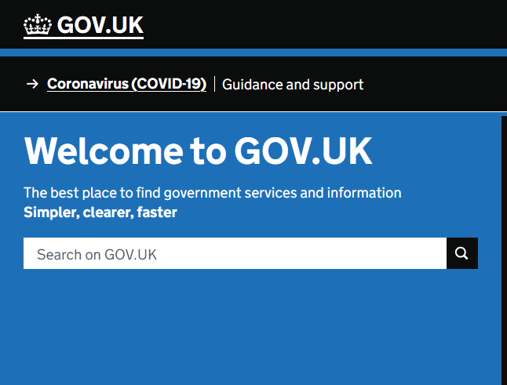
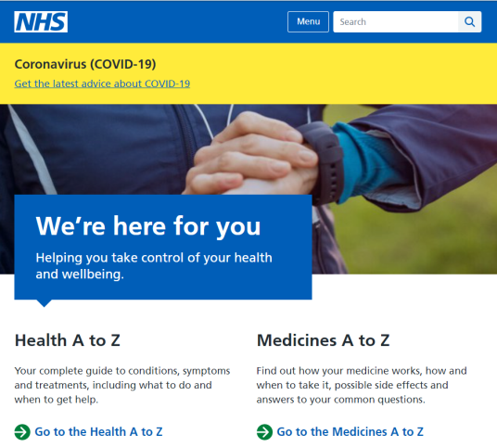
Some websites may be suitable sources of information
For health and social care students there are other valuable and relevant sources that you might use.
The UK government website www.gov.uk
The NHS website www.nhs.uk

Slide 13
What’s the problem with Google?
Adapted from Newcastle University (2024)
Too much information (which is not organised for academic work)!
Information can be incorrect, misleading or biased
The origin of the information may not be transparent
Can be hard to locate academic sources, such as peer-reviewed journal articles
You may need to pay, for example to access some academic journal articles
Some search results are sponsored adverts
Google’s search algorithm personalises your results, which also creates bias
BUT it can be useful for finding reliable websites, such as government websites, professional organisations etc
NB later we will discuss Google Scholar, which is recommended as it searches a wide range of academic literature

Slide 14
Why is the library so much better?
Easy to find peer-reviewed publications
Collated by subject experts including academic librarians
Offers subject guides/specialist databases for specific areas
Access to resources is paid for by the university

Slide 15
Best places to find academic information
Module Reading List
Library Search
Advanced Web Search (e.g. Google Scholar)
Let’s practice using them…

Slide 16
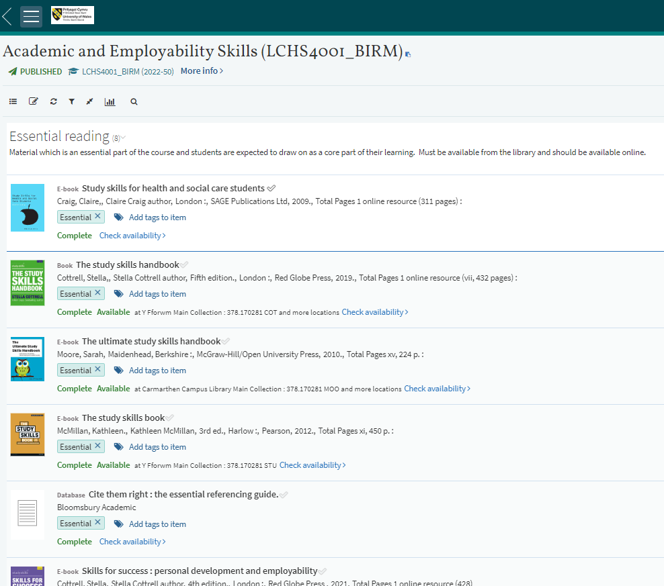
Module Reading List
Notes:
Please explain that each module the students will study will have a reading list. And please demonstrate how to access the list (including from the module homepage) and HOW TO OPEN A BOOK!!

Slide 17
Practice opening the module reading list
Use your device
to check you can find the module reading list
and open a book!
Notes:
If possible, demonstrate one of the books where you can listen to the text being read as well as read it. The Moore et al. (2010) book - The ultimate study skills handbook – is one you could demonstrate.

Slide 18


Library search or advanced web search
The UWTSD online library can be found at www.uwtsd.ac.uk/library
Google Scholar is a useful tool for finding academic sources. https://scholar.google.co.uk/

Slide 19
Beginning a search strategy
Search terms (keywords and alternative terms)
  e.g. “mental health” wellbeing
Inverted commas (search for a phrase or expression)
  e.g. “mental health” [not mental and health]
And/Or/Not
  e.g. “mental health” AND wellbeing (NB this will only find sources that contain both words)
  e.g. “mental health” OR wellbeing (doesn’t matter which term the sources use – they will all be found)
  e.g. “mental health” NOT wellbeing (will find sources that use the term “mental health” but exclude any that use the term wellbeing)
Filters (especially publication date)
Notes:
Lecturers – please choose a topic and demonstrate thinking of search terms and putting them in the library search box – build up a search slowly (key words including alternatives – and show the use of inverted commas) – also please show how to filter by date
Possible examples: “asylum seekers” and refugees (OR/NOT migrants)
“national health service” OR NHS
“higher education”
“social media” “health information”

Slide 20
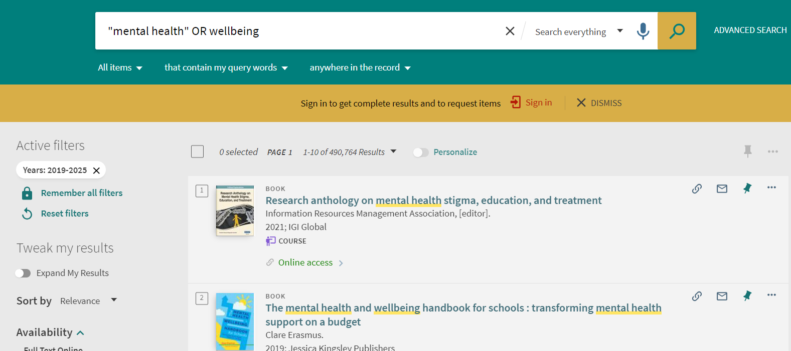
Beginning a search strategy
Notes:
Lecturers – please choose a topic and demonstrate thinking of search terms and putting them in the library search box – build up a search slowly (key words including alternatives – and show the use of inverted commas) – also please show how to filter by date
Possible examples: “asylum seekers” and refugees (OR/NOT migrants)
“national health service” OR NHS
“higher education”
“social media” “health information”

Slide 21
Search strategy practice
Write a list of search terms for the following question
Experiment using them in a library search
How can we promote physical activity in care homes for older people?
Notes:
i.e. think of alternatives to physical activity; care homes; older people – think of where we need the inverted commas; do we need to use OR or NOT

Slide 22
BREAK

Slide 23
Reading strategies
(how to approach a lot of information!)

Slide 24

Class survey
How many people enjoy reading?
  If not, why not?
Who can read a long article quickly?
What do you do if you don’t know a word?

Slide 25
Reading Strategies
Prediction
Surveying
Skimming
Scanning
Guessing unknown words
Reading for detail
Guess what the text is about
See how it is organised
Look for the main ideas
Look for specific information
Use the context (not a dictionary)
Understanding exactly what a section is saying

Slide 26
Activity – surveying
Surveying can include using the contents page, headings and subheadings, introduction, conclusion and index
Today we will just focus on contents pages. Look at the contents pages for the following two books:
Cottrell, S. (2019) The study skills handbook. 5th edn. London: Red Globe Press.
Craig, C. (2009) Study skills for health and social care students. London: SAGE.
What study skills do the books discuss?
How are the books organised – what are the differences in how they are organised?
Which section would you like to explore further?
Notes:
NB Lecturers will need to print out the contents pages because several students are unlikely to have laptops in Week 1.
You could display the books on the screen and show other elements e.g. point out examples of headings and subheadings, show the index.
Please get some feedback from the class on their answers to the questions… especially the first one – to reinforce the kinds of skills that are ‘study skills’/’academic skills’ (i.e. the topic of the module (or half of it – employability skills coming next week)).

Slide 27
Activity - skimming and scanning
Skim pages 49-50 (i.e. the beginning of Chapter 6) from the following book:
Craig, C. (2009) Study skills for health and social care students. London: SAGE.
Skimming (for the main ideas)
What are the main messages of this section?
Tip for skimming: look at the structure - try reading the first and last sentences of each paragraph only
Then scan the same pages (for specific information)
What does the author say good time management is about?
Tip for scanning: look for key words or phrases
Notes:
Please print the extract for students who don’t have a laptop

Slide 28
Additional preparation for reading
(taking control by asking questions!)
Why am I reading this!? Is this article relevant to me/my studies?
What do I already know?
How is this article related to what I already know about the topic/concept?
What do I need to find out?
How will I know when I have read enough?
Happy Reading!

Slide 29
Keeping a reflective journal
We suggest you keep a journal to:
  Record your journey as a student through higher education
  Reflect on the development of your skills
  Help you write your reflective report at the end of term (more information next week)

Slide 30
Final activity – reflective journal entry
Write the first entry in your reflective journal. You could consider:
How did I feel when I arrived today and how do I feel now?
What was the most surprising thing I learnt today?
What was easy today?
What do I need to get further help with?
How will I use my self-study time this week (e.g. review the slides, read (or listen to) a few pages from a book on the reading list, do a quiz on Moodle etc)?

Slide 31

Summary
Can you remember three places where you can you search for academic information?
What do you need to start a search strategy?
Can you name a reading strategy?
Finally… don’t forget… we have added extra activities – this week some quizzes – on Moodle which we hope you will enjoy in your self-study time!

Slide 32
References
Cottrell, S. (2019) The study skills handbook. 5th edn. London: Red Globe Press.
Craig, C. (2009) Study skills for health and social care students. London: SAGE.
Newcastle University (2024) Google vs Google Scholar vs Library Databases. Available at: https://www.ncl.ac.uk/mediav8/academic-skills-kit/file-downloads/Google%20versus.pdf (Accessed: 5 January 2024).

Slide 33

Next session…

