Slide 1
Compassionate Leadership
Julie Thomas

Slide 2
Learning Outcomes for Today
The main principles of compassionate management
The importance of self-compassion

Slide 3
Definition- Compassionate Leadership
Leaders who listen, understand and help
This creates a supportive environment that encourages the greater wellbeing of staff, leading to higher levels of innovation, engagement and ultimately performance
(West, 2019)
A good source – www.kingsfund.org.uk
Notes:
Move from top-down, controlling leadership to compassionate, collaborate leadership.

Slide 4
Four Behaviours of Compassionate Leaders
Attending (listening with fascination)
Understanding (needs of staff)
Empathising (caring for staff)
Helping (enabling staff to do their jobs)
The most important skill is listening and the most important task is helping staff to do their jobs.
Emotional Intelligence skills!

Slide 5
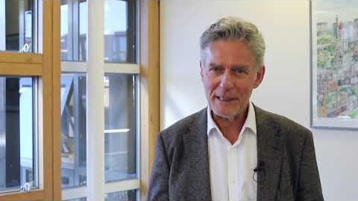
Michael West on Compassionate Leadership

Slide 6
Group Discussion
What issues might there be in the NHS that affect wellbeing?
How might compassionate leadership help?
Notes:
Long hours
Stress
Not having time to attend to basic needs – eating, toilet
Dealing with aggressive patients
Afraid of speaking up
Command and control leadership
Blame culture
Dealing with negative patient outcomes such as death and disability
Presenteeism
Absenteeism
High turnover of staff
Bullying
Harassment

Slide 7
The ABC of Staff Needs
Autonomy and control over what they do
Belonging (part of a team, feeling cared for)
Contribution (being able to do your job)
Notes:
Nurse and midwives have three core work needs that must be met to ensure wellbeing and motivation at work, and to minimise workplace stress.

Slide 8
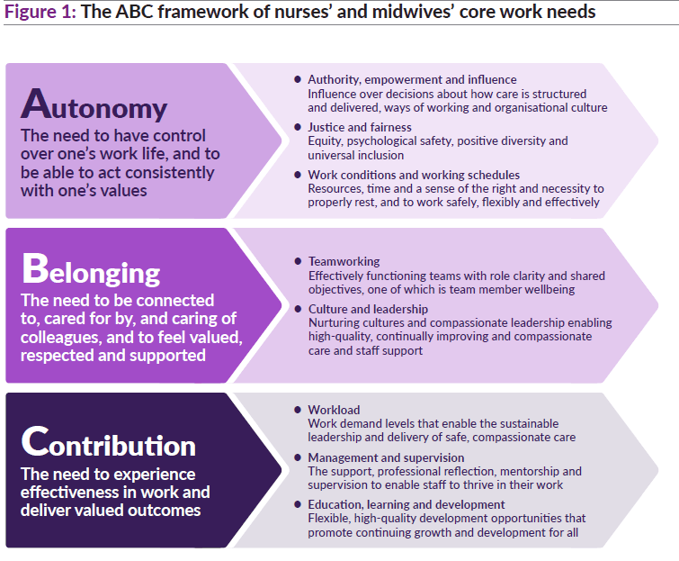
Notes:
Compassionate leadership provides an environment in which these staff needs can be met.

Slide 9
Recommendations (The KingsFund, 2020)
1: Authority, empowerment and influence
2: Justice and fairness
3: Work conditions and working schedules
4: Teamworking
5: Culture and leadership
6: Workload
7: Management and supervision
8: Learning, education and development
Notes:
Key recommendation 1: Authority, empowerment and influence
Introduce mechanisms for nursing and midwifery staff to shape the cultures and processes of their organisations and influence decisions about how care is structured and delivered.
Key recommendation 2: Justice and fairness
Nurture and sustain just, fair and psychologically safe cultures and ensure equity, proactive and positive approaches to diversity and universal inclusion.
Key recommendation 3: Work conditions and working schedules
Introduce minimum standards for facilities and working conditions for nursing and midwifery staff in all health and care organisations.
Key recommendation 4: Teamworking
Develop and support effective multidisciplinary teamworking for all nursing and midwifery staff across health and care services.
Key recommendation 5: Culture and leadership
Ensure health and care environments have compassionate leadership and nurturing cultures that enable both care and staff support to be high-quality, continually improving and compassionate.
Key recommendation 6: Workload
Tackle chronic excessive work demands in nursing and midwifery, which exceed the capacity of nurses and midwives to sustainably lead and deliver safe, high-quality care and which damage their health and wellbeing.
Key recommendation 7: Management and supervision
Ensure all nursing and midwifery staff have the effective support, professional reflection, mentorship and supervision needed to thrive in their roles.
Key recommendation 8: Learning, education and development.
Ensure the right systems, frameworks and processes are in place for nurses’ and midwives’ learning, education and development throughout their careers. These must promote fair and equitable outcomes.

Slide 10
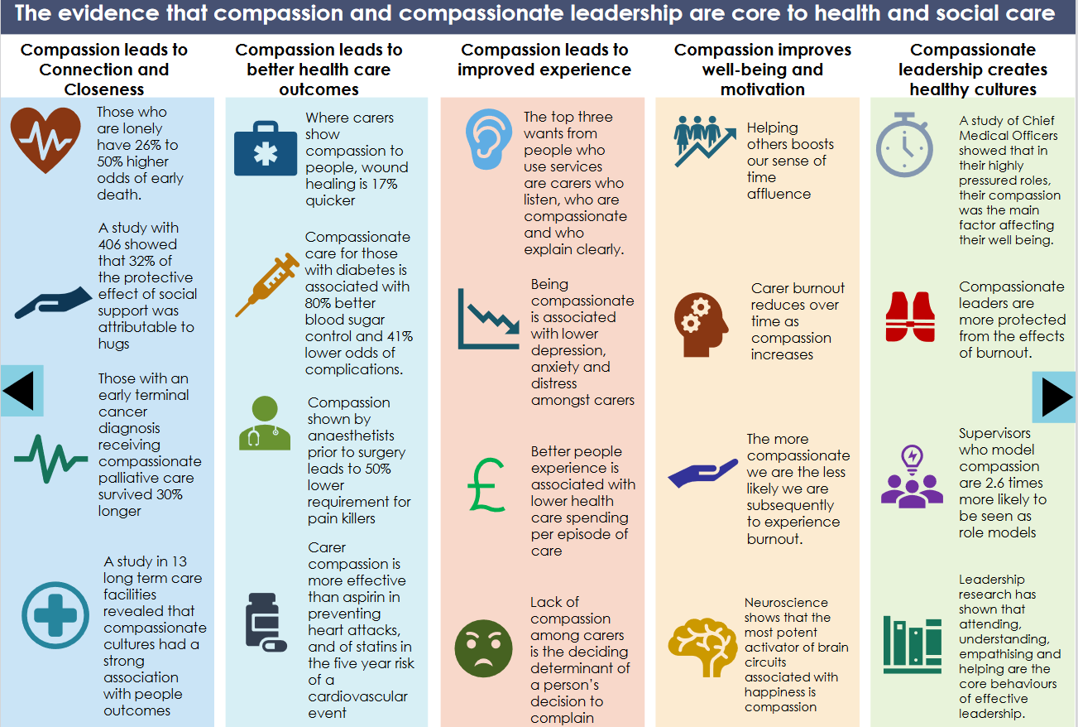
Notes:
Taken from the Draft leadership principles for health and social care in Wales.

Slide 11
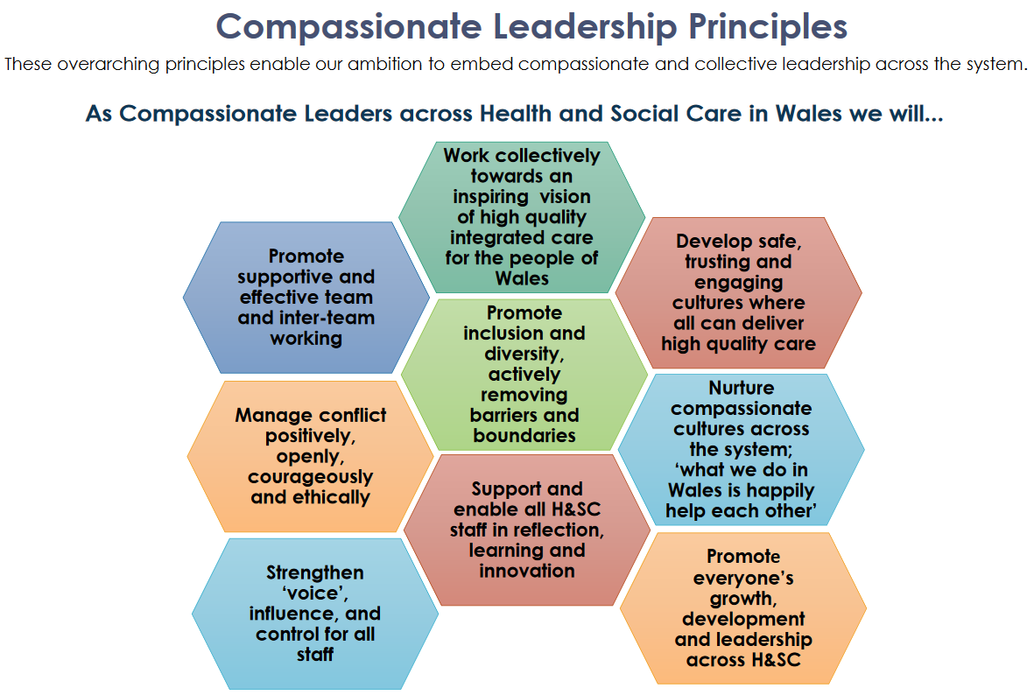
Notes:
HEIW, 2020
For more information, please visit the HEIW website.

Slide 12
Leaders need to start with Self-compassion
What are your stressors?
What are your needs?
You need to be a good role model and also be in a good place yourself to lead others
Also important to show vulnerability, which breeds trust

Slide 13
Activity – Self-Compassion
How could you be more self-compassionate?
In pairs, think of a few phrases you could say to yourself the next time you make a mistake or feel guilty about something that may have been your fault.
What phrases could you say to yourself to motivate yourself to get through a hard or challenging time?

Slide 14
Activity
Form pairs
Play one round of ‘rock, paper, scissors’ in your pair
If you lose, your job is to support (cheer on!) the winner in the next round
Winners keep on playing each other and losers keep on supporting the winners, until there is an overall winner
Purpose of activity – to practice healthy competition and an overall supportive culture which supports wellbeing.

Slide 15
Useful Source
Leading with Compassion Has Research-Backed Benefits (hbr.org)

