Slide 1
ECEY6006C
Cynorthwyo Plant ag Anghenion Dysgu Ychwanegol
Rhwystrau
ECEY6006 Supporting Children with Additional Learning Needs
Barriers

Slide 2
Cynnwys
Contents
Model meddygol o anabledd;
Esiamplau o rhwystrau;
Model cymdeithasol o anabledd;
Medical model of disability;
Examples of barriers;
Social model of disability;

Slide 3
Cynnwys
Contents
Esiamplau o rhwystrau;
Ymchwil;
Tasgau trafod.
Examples of barriers;
Research;
Discussion tasks.

Slide 4
Sgiliau Cyflogadwyedd/Trosglwyddadwy
Employability/Transferable Skills
Trefn;
Cynllunio;
Ymchwilio;
Cymryd nodiadau;
Cyfathrebu.
Organisation;
Planning;
Researching;
Note taking;
Communication.

Slide 5
Adnoddau
Resources
PP ar gyfer y ddarlith;
Ymchwil;
Leganto/Moodle;
Llyfrgell/Google Scholar.
PP for the lecture;
Research;
Leganto/Moodle;
Library/Google Scholar.

Slide 6

Rhwystrau?
Barriers?
Beth yw’r ‘rhwystrau’ yn eich bywyd chi?
What are the ‘barriers’ in your life?

Slide 7
Model meddygol o anabledd
Medical model of disability
Lluniwyd y term yn y 1950au;
Yn gysylltiedig â'r proffesiwn meddygol.
"Mae anabledd yn rhywbeth sydd angen diagnosis, triniaeth a’i gwella trwy adsefydlu neu normaleiddio“.
Term was coined in the 1950s;
Linked to the medical profession.
“Disability is something to be diagnosed, treated and cured through rehabilitation or normalization”.
(Toro et al., 2020, p. 1).

Slide 8
Model meddygol o anabledd
“Mae’r model meddygol (hefyd) yn ystyried anableddau fel “drasiedi bersonol, sy’n awgrymu bod anabledd yn ddigwyddiad ofnadwy sy’n digwydd ar hap i unigolion anffodus.” Yn unol â hynny, mae'r model hwn yn trwsio'r “broblem” o fewn yr unigolyn, ac ar yr un pryd, yn maddau cymdeithas o unrhyw ystyriaeth bellach. Yn y pen draw, mae hefyd yn bytholi ystrydebau, gan ystyried bod pobl ag anableddau yn anghyflawn neu wedi'u difrodi ac angen eu trwsio i gyflawni unrhyw dasg dan sylw. Mae'r model hwn hefyd yn ystyried bod angen teimlo trueni dros yr unigolyn, ei weld yn ddiffygiol, neu fel rhywun sydd â nam y mae'n rhaid ei ddileu, ei drin neu ei wella. Mae'r fframio hwn yn lleihau'r anrhegion cudd a'r gwerth cynhenid ​​y mae pobl ag anableddau yn eu darparu gan y rhai sy'n bodoli eisoes.”
(Guevera, 2021, p. 277)

Slide 9
Medical model of disability
“The medical model (also) lends itself to considering disabilities a “personal tragedy, which suggests that a disability is some terrible chance event that occurs at random to unfortunate individuals.” Accordingly, this model fixates the “problem” within the individual while simultaneously absolving society from any further consideration. It also ultimately perpetuates stereotypes, perceiving people with disabilities as incomplete or damaged and needing fixing to accomplish any task at hand. This model also views the individual with pity, as defective, or as having an impairment that must be eliminated, treated, or cured. This framing diminishes the hidden gifts and intrinsic value people with disabilities provide by existing.”
(Guevera, 2021, p. 277)

Slide 10
Model meddygol o anabledd
Medical model of disability
Gweld anableddau fel diffygion sydd angen triniaeth;
Corff medrus yw'r norm;
Bytholi stigma a gwahaniaethu;
Cyfyngu gwerthoedd unigolion.
Disabilities are seen as defects that need treatment;
The able body is seen as the norm;
Perpetuates stigma and discrimination;
Limits the values of individuals.
(Guevera, 2021)

Slide 11
Rhwystrau Ffisiolegol
Physiological Barriers
Enghreifftiau:
Nam ar y clyw;
- Tympan y glust wedi'i ddifrodi;
Geneteg.
Nam gweledol;
- Colli golwg ganolog;
- Colli golwg ymylol;
- Nam gweledol yr ymennydd.
Examples:
Hearing impairment;
Damaged ear drum;
Genetics.
Visual impairment;
Loss of central vision;
Loss of peripheral vision;
Cerebral visual impairment.

Slide 12
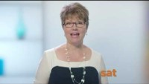

Slide 13
Rhwystrau Gwybyddol
Cognitive Barriers
Esiamplau:
Diffyg canolbwyntio;
Gwrthdroad i ryngweithio corfforol;
Iselder neu bryder;
Anhawster canolbwyntio, yn dueddol o dynnu sylw;
Examples:
Poor concentration;
Aversion to physical interaction;
Depression or anxiety;
Difficulty focusing, prone to distraction;

Slide 14
Rhwystrau Gwybyddol
Cognitive Barriers
Esiamplau:
Anhawster dysgu, heriau llythrennedd;
Anallu i fynegi meddyliau yn gyflym, prosesu gwybodaeth;
Anallu i adnabod synau;
Ffrwydradau o dymer;
Examples:
Difficulty learning, literacy challenges;
Inability to express thoughts quickly, process information;
Inability to recognise noises;
Outbursts of temper;

Slide 15
Rhwystrau Gwybyddol
Cognitive Barriers
Esiamplau:
Cof byrrach;
Amwysedd cymdeithasol, trafferth rhyngweithio ag eraill;
Trafferth dehongli gofynion synhwyraidd;
Trafferth ymateb i eraill (llai o blastigrwydd ymennydd).
Examples:
Shortened memory span;
Social ambivalence, trouble interacting with others;
Trouble interpreting sensory demands;
Trouble responding to others (reduced brain plasticity).

Slide 16
Rhwystrau Ieithyddol
Language Barriers
Esiamplau:
Nam lleferydd;
- Mudandod;
- Apracsia.
Examples:
Speech impairment;
Muteness;
Apraxia.

Slide 17
Mudandod
Muteness
Mudandod Niwrolegol
- Nam geni;
- Damwain;
- Anaf i'r pen/gwddf;
- Cyflwr Sbectrwm Awtistig;
- Byddardod.
Neurologically based mutism
Birth defect;
Accident;
Head/neck injury;
Autistic Spectrum Condition;
Deafness.

Slide 18
Mudandod
Muteness
Mudandod Seicolegol
- Pryder;
- Swildod eithafol;
- Ofn embaras cymdeithasol;
- Amygdala wedi'i or-ysgogi (ymladd neu hedfan).
Psychologically Based Mutism
Anxiety;
Excessive shyness;
Fear of social embarrassment;
Over-stimulated Amygdala (fight or flight).

Slide 19
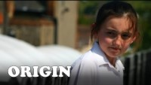
Fideo
Video

Slide 20
Apracsia – rhwystr?
Apraxia – barrier?
Anhwylder lleferydd anghyffredin;
Nabyddir hefyd fel ‘dyspracsia geiriol’;
Oedi gyda geiriau cyntaf;
Uncommon speech disorder;
Also known as ‘verbal dyspraxia’;
Delayed onset of first words;

Slide 21
Apracsia – rhwystr?
Apraxia – barrier?
Nifer cyfyngedig o eiriau;
Gallu ffurfio ychydig o synau yn unig.
Limited number of words;
Can only form a few sounds.

Slide 22
ADCG - Ardaloedd Potensial o Amhariad
ADHD - Potential Areas of Impairment
Injuries
Childhood
Adulthood
Occupational/
vocational
Academic
limitations
Legal
difficulties
ADHD
Relationships
Motor vehicle
accidents
Low self
esteem
Smoking and
substance abuse
Adolescence

Slide 23
Gwrthdaro corfforol ac ymosodol
Physical confrontation and aggression
Heriol;
Ingol;
Medru bod yn beryg i’w hunain;
Medru bod yn beryg i eraill.
Challenging;
Stressful;
Can be a danger to themselves;
Can be a danger to others.

Slide 24
Awtistiaeth - Ymddygiad hunansymbyliadol
Autism - Self-stimulatory behaviour
‘Stimming’;
'Arwydd amlwg' o awtistiaeth;
Ymdawelu i blentyn;
pryderus;
cyffrous;
profi emosiynau dwys.
‘Stimming’;
A ‘classic sign’ of Autism;
Calming to child;
anxious;
excited;
experiencing intense emotions.

Slide 25
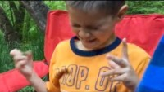
Ymddygiad hunansymbyliadol - fideo
Self-stimulatory behaviour - fideo
Autism Family (2016) Autism Stimming Examples. Available at: https://www.youtube.com/watch?v=4ALy6I1J1uo [Accessed: December 10 2018].

Slide 26
Diddordebau dwys
Intense interests
Cyffredin iawn;
Gallu newid dros amser neu aros yr un fath;
Gallu bod yn anarferol;
Very common;
Can change over time or remain the same;
May be unusual;

Slide 27
Diddordebau dwys
Intense interests
Ymennydd yn fwy anhyblyg;
Fwy anodd i fod yn hyblyg a cael sawl diddordeb gwahanol.
Brain is more rigid;
Harder to be flexible and have several interests.

Slide 28
Diddordebau dwys
Intense interests
Pleserus;
Dull o ymdopi;
Darparu strwythur, trefn a dibynadwyedd;
Hanfodol ar gyfer eu lles a’u hapusrwydd.
Enjoyable;
A coping mechanism;
Provides structure, order and predictability;
Essential for their well-being and happiness.

Slide 29
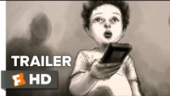
Diddordebau arbennig - Disney
Special interests - Disney
Movieclips Indie (2016) Life, Animated Official Trailer 1 (2016) - Owen Suskind Documentary HD. Available at: https://www.youtube.com/watch?v=4n7fosK9UyY [Accessed: December 10 2018].

Slide 30
Cyfathrebu
Communication
Anhawster ryngweithio ag eraill;
Anhawster wrth ddechrau ryngweithiadau;
Anhawster ymateb i eraill;
Difficulty interacting with others;
Difficulty with initiating interactions;
Difficulty responding to others;

Slide 31
Cyfathrebu
Communication
Anhawster deall bywyd bob dydd;
Ychydig, neu ddim, cyswllt llygad.
Difficulty understanding everyday life;
Little, or no, eye contact.

Slide 32
Diffyg cyswllt llygad
Lack of eye contact
Ydy cyswllt llygaid yn bwysig ar gyfer cyfathrebu/
rhyngweithio?
Pam?
Beth yw ein barn ni o bobl sydd yn methu rhoi cyswllt llygad?
Pam?
Is eye contact important for communicating/
interacting?
Why?
What do we think of people who do not give eye contact?
Why?

Slide 33
Diffyg cyswllt llygad
Lack of eye contact
Rhoi ychydig o sylw i wynebau pobl;
Achosi straen;
Tynnu sylw;
Gorlwytho synhwyraidd;
Wynebau yn cael eu canfod fel bygythiad.
Pay little attention to people’s faces;
Stressful;
Distracting;
Sensory overload;
Faces perceived as a threat.

Slide 34
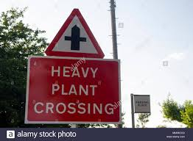
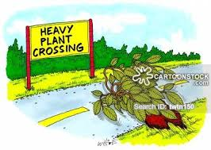
Iaith
Language

Slide 35
Cyfathrebu Dieiriau
Non-verbal Communication
Iaith ohiriedig;
Gallent defnyddio'r canlynol:
ystumiau;
llefain;
cymryd eich llaw at y gwrthrych maent eisiau;
Delayed language;
May use the following:
gestures;
crying;
take your hand to the object they want;

Slide 36
Cyfathrebu Dieiriau
Non-verbal Communication
Gallent defnyddio'r canlynol:
edrych ar y gwrthrych maent eisiau;
ymestyn;
defnyddio delweddau;
ymddygiad heriol;
- ecoleferydd.
May use the following:
look at the object they want;
reach;
use pictures;
challenging behaviour;
- echolalia.

Slide 37
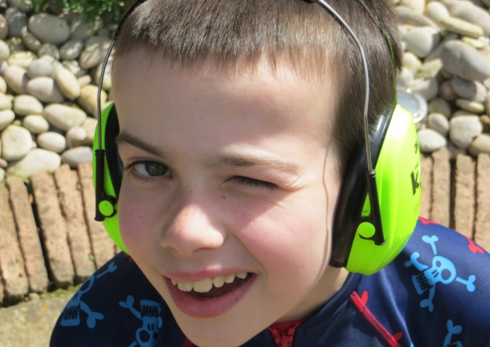
Anhwylder Prosesu Synhwyraidd
Sensory Processing Disorder
Gorymateb/tanymateb i fewnbwn gweledol, clywedol a cyffyrddol.
Overreact/underreact to visual, aural and tactile input.

Slide 38
Dyslecsia - Ymddygiadau
Dyslexia – Behaviours
Defnyddio tactegau osgoi gwaith, fel hogi pensiliau a chwilio am lyfrau;
Ymddangos yn ‘freuddwydiol’, nid yw’n ymddangos ei fod yn gwrando;
Tynnu sylw'n hawdd;
Uses work avoidance tactics, such as sharpening pencils and looking for books;
Seems ‘dreamy’, does not seem to listen;
Easily distracted;

Slide 39
Dyslecsia - Ymddygiadau
Dyslexia – Behaviours
Clown y dosbarth neu'n aflonyddgar neu'n tynnu'n ôl;
Wedi blino'n ormodol oblegid yr angen i ganolbwyntio ac ymdrechu.
Is the class clown or is disruptive or withdrawn;
Is excessively tired due to amount of concentration and effort required.

Slide 40
Astudiaeth achos
Case study
Mae David yn 6 oed ac yn mynychu ei ysgol leol. Nodwyd ei fod yn 'cael problemau.'
Mae staff yr ysgol yn aml yn ei ddisgrifio’n aflonyddgar ac yn ddiog. Mae'n ymddieithrio oddi wrth dasgau ysgrifenedig. Mae'n aml yn cael ei dynnu allan o'r dosbarth am gymorth ychwanegol.
Mae David yn rhagori mewn Hanes; Mae'n cofio'r rhan fwyaf o ffeithiau ac mae'n cywiro staff yn aml.
David is 6 years old and attends his local school. He has been identified as ‘having problems.’
Staff at the school often describe him as disruptive and lazy. He disengages from written tasks. He is often withdrawn from class for additional support.
David excels in History; he remembers most facts and often corrects staff.

Slide 41
Astudiaeth achos
Case study
Beth yw'r rhwystrau mae David yn wynebu?
A oes tegwch?
Beth yw manteision/anfanteision o gael cymorth ychwanegol?
Beth fyddech chi'n ei wneud?
What are the barriers faced by David?
Is there equity?
What are the advantages/disadvantages of having additional support?
What would you do?

Slide 42
Masgio
Masking
Mae llawer o blant yn ‘masgio’ eu cyflyrau…
Beth all y goblygiadau o hyn fod?
Many children ‘mask’ their conditions…
What could the implications of this be?

Slide 43
Cuddweddu awtistiaeth
“Diffinnir cuddweddu cymdeithasol fel ‘y defnydd o strategaethau gan bobl awtistig i leihau gwelededd eu awtistiaeth mewn sefyllfaoedd cymdeithasol.’ Gall y strategaethau hyn gynnwys cuddio nodweddion awtistig, er enghraifft trwy atal, yn fwriadol, ymddygiad ysgogol yn gyhoeddus. Mae cuddweddu cymdeithasol hefyd yn cwmpasu ymddygiad cydadferol, lle mae pobl awtistig yn datblygu rhestrau ymddygiadol i'w helpu i reoli sefyllfaoedd cymdeithasol. Mae enghreifftiau cyffredin o ymddygiadau cydadferol yn cynnwys dysgu sut i ddefnyddio ymddygiadau cymdeithasol di-eiriau penodol, fel cyswllt llygad, a datblygu sgriptiau y gellir eu defnyddio i lywio rhyngweithiadau. Mae cuddweddu cymdeithasol yn elfen eang o brofiadau byw pobl awtistig, yn enwedig ymhlith y rhai sy'n fenywod a'r rhai sydd â deallusrwydd yn yr ystod gyfartalog neu'n uwch. ”
(Hull et al., 2021, p1).

Slide 44
Camouflaging autism
“Social camouflaging is defined as ‘the use of strategies by autistic people to minimise the visibility of their autism in social situations’. These strategies can involve masking autistic characteristics, for example by deliberately suppressing stimming behaviour in public. Social camouflaging also encompasses compensatory behaviour, whereby autistic people develop behavioural repertoires to help them manage social situations. Common examples of compensatory behaviours include learning how to use specific non-verbal social behaviours, such as eye contact, and developing scripts that can be employed to navigate interactions. Social camouflaging is a widespread element of the lived experiences of autistic people, especially among those who are female and those who have intelligence in the average range or above.”
(Hull et al., 2021, p1).

Slide 45
Fodd bynnag...
However...
Mae cuddweddu yn arwain at broblemau iechyd meddwl;
Llafurus;
Straenus;
Yn erydu ymdeimlad o hunaniaeth;
Efallai na fydd anghenion yn cael eu diwallu.
Camouflaging leads to mental health problems;
Exhausting;
Stressful;
Erodes sense of identity;
Needs may not be met.

Slide 46
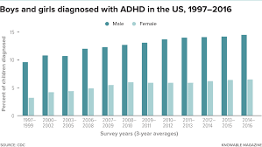

Slide 47
ADCG mewn merched
ADHD in girls
Mewndroëdig;
“breuddwydiwr”;
Tynnu sylw'n hawdd;
Siaradus;
Mewnoli symptomau.
Introverted;
“a dreamer”;
Easily distracted;
Talkative;
Internalize symptoms.
(Ortega, 2020)

Slide 48
Model Cymdeithasol o Anabledd
Social model of Disability
Datblygwyd yn yr 1970au;
Cyfyngwyd gweithgareddau plant gan yr amgylchedd, nid eu hADY;
Rhwystrau yn ganlyniad o ddiffyg trefn cymdeithasol.
Developed in the 1970s;
Children’s activities are limited by the environment, not by their ALN;
Barriers are a consequence of a lack of social organisation.

Slide 49
Model Cymdeithasol o Anabledd
“Datblygwyd y Model Cymdeithasol gan bobl anabl i nodi a gweithredu yn erbyn gwahaniaethu, ac i ganoli cydraddoldeb a hawliau dynol. Mae'r Model Cymdeithasol yn cymryd y ffocws oddi wrth nam; mae'n gosod cyfrifoldeb ar y llywodraeth, sefydliadau, busnesau ac unigolion ar draws pob sector o'r gymdeithas i nodi a gweithredu newidiadau adeiladol i gael gwared ar rwystrau a chynyddu mynediad. O dan y Model Cymdeithasol, mae anabledd wedi'i fframio fel lluniad cymdeithasol a grëwyd gan rwystrau y gellir eu newid a'u dileu, gan ddarparu model deinamig a chadarnhaol sy'n nodi achosion gwahardd ac anghydraddoldeb ac yn cynnig datrysiad. Cyfrifoldeb cymdeithas yw gwneud newidiadau, nid ar yr unigolyn anabl; i unigolion a sefydliadau ddeall ac yna gwneud yr addasiadau sy'n ofynnol i roi'r gorau i ymyleiddio ac eithrio pobl sydd gyda cyrff a meddyliau sydd ddim yn cydymffurfio â syniad cymdeithas o'r hyn sy'n normal ac yn dderbyniol. “
(Shape Arts, no date, p.1)

Slide 50
Social model of Disability
“The Social Model was developed by disabled people to identify and take action against discrimination, and to centre equality and human rights. The Social Model takes the focus away from impairment; it places responsibility on government, organisations, businesses and individuals across all sectors of society to identify and implement constructive changes to remove barriers and increase access. Under the Social Model, disability is framed as a social construct created by barriers which can be changed and eliminated, providing a dynamic and positive model which identifies the causes of exclusion and inequality and proposes a solution. It is on society to make changes, not on the disabled person; for individuals and organisations to understand and then make the adjustments required to stop marginalising and excluding people whose bodies and minds don’t comply with society’s idea of what is normative and acceptable.”
(Shape Arts, no date, p.1)

Slide 51
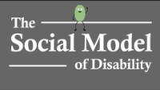
Model Cymdeithasol o Anabledd - fideo
Social model of Disability - video

Slide 52
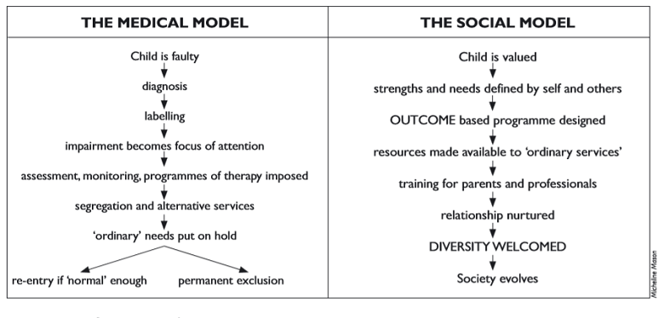
Medical model vs Social model

Slide 53
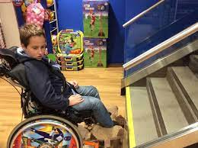
Yr amgylchedd
The environment

Slide 54
Darllen
Reading
Contact a Family (2021) Wheelchair Services for Children and Young People in Wales. Available at: https://contact.org.uk/wp-content/uploads/2021/03/wheelchair_services_for_young_people_in_wales.pdf [Accessed: December 17 2021].
The Guardian (2019) ‘Anything but inclusive’: No school places for three disabled sisters. Available at: https://www.theguardian.com/society/2019/jul/19/adopters-disabled-children-send-crisis-special-education-provision [Accessed: December 17 2021].
Welsh Government (2018) Planning to increase access to schools for disabled pupils. Available at: https://gov.wales/sites/default/files/publications/2018-04/planning-to-increase-access-to-schools-for-disabled-pupils.pdf [Accessed: December 17 2021].

Slide 55
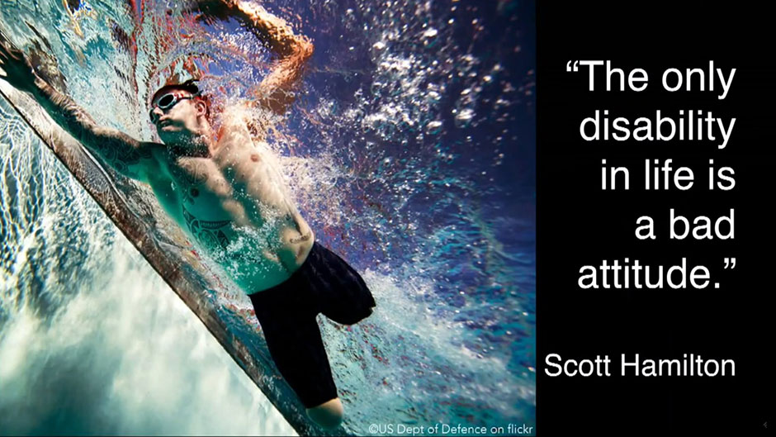
Rhwystrau yn ymwneud ag Agweddau
Attitudinal Barriers

Slide 56
Rhwystrau yn ymwneud ag Agweddau
“Yn aml, plant ag anableddau yw’r targed o ragfarn gan eu cyfoedion. Gall rhagfarn a gwahaniaethu arwain at ganlyniadau iechyd niweidiol, cynyddu unigrwydd a phryder dioddefwyr, a lleihau eu hunan-werth. Mae ymchwil diweddar wedi dangos nad yw llawer o ysgolion yn y DU yn gwneud llawer i hyrwyddo agweddau cadarnhaol tuag at anabledd ymhlith disgyblion, ac y gallai fod angen mwy o adnoddau ar athrawon i'w cefnogi i ddatblygu strategaethau i annog agweddau cadarnhaol.”
(Armstrong et al., 2017, p. 12)

Slide 57
Attitudinal Barriers
“Children with disabilities are often the target of prejudice from their peers. Prejudice and discrimination can have harmful health consequences, increasing victims' loneliness and anxiety, and reducing their self-worth. Recent research has demonstrated that many schools in the UK do little to promote positive attitudes towards disability in pupils, and that teachers may require more resources to support them in developing strategies to encourage positive attitudes.”
(Armstrong et al., 2017, p. 12)

Slide 58
Cysylltiad = Agwedd gadarnhaol
Contact = Positive attitude
“Rhagdybiaeth cyswllt”;
Rhyngweithio wyneb yn wyneb = effaith gadarnhaol ar agweddau;
Llai o rhagfarn;
Cyswllt anuniongyrchol hefyd yn ymyrraeth effeithiol.
“Contact hypothesis”;
Face-to-face interaction = positive impact on attitudes;
Decrease in prejudice;
Indirect contact also an effective intervention.

Slide 59
Darllen - ADCG
Reading - ADHD
Greenway, C. & Rees Edwards, A. (2021) Teaching assistants’ facilitators and barriers to effective practice working with children with ADHD: a qualitative study. Available at: https://nasenjournals.onlinelibrary.wiley.com/doi/pdfdirect/10.1111/1467-8578.12377?casa_token=ePEIecFGcx8AAAAA:GsMrzYwxIIJttMXbWu_LBRb06SNlTFoBSfqYG3aJTIq0itfHHXyrj2tJ_PBhZxI4UQb_KyklsGbgiw [Accessed: December 17 2021].
Greenway, C. & Rees Edwards, A. (2021) Agweddau Athrawon tuag at ADCG: Adolygiad ac Argymhellion ar gyfer y Dyfodol. Available at: https://repository.uwtsd.ac.uk/id/eprint/1625/1/Agweddau%20Athrawon%20tuag%20at%20ADCG.%20Adolygiad%20ac%20Argymhellion%20ar%20gyfer%20y%20Dyfodol.pdf [Accessed: December 17 2021].
Greenway, C. & Rees Edwards, A. (2020) Knowledge and attitudes towards attention-deficit hyperactivity disorder (ADHD): a comparison of teachers and teaching assistants. Available at: https://www.tandfonline.com/doi/abs/10.1080/19404158.2019.1709875 [Accessed: December 17 2021].

Slide 60
Iaith
Language
Ystyriwch yr iaith rydych yn defnyddio wrth siarad am/i plant gydag ADY…
Consider the language you use when speaking about/to children with an ALN…

Slide 61
Iaith wahaniaethol
Discriminatory language
Pedwar o bob deg oedolyn yn defnyddio'r geiriau 'spaz', 'spastic', 'retard' neu 'mong' mewn sgwrs 'achlysurol’;
70% o’r athrawon a holwyd yn clywed eu disgyblion yn defnyddio'r geiriau 'spaz', 'spastic', 'retard' neu 'mong' yn yr ysgol.
Four in ten adults use the words 'spaz', 'spastic', 'retard' or 'mong' in 'casual' conversation;
70% of teachers polled hear their pupils using the words 'spaz', 'spastic', 'retard' or 'mong' at school.

Slide 62
Anghytundebau semantig
“Mae geiriau ac iaith yn offer pwerus lle gall unigolyn fynegi syniadau, p'un a ydynt yn haniaethol, yn weithredadwy neu'n goncrit. Mae iaith a'r ystyron rydyn ni'n eu rhoi wrth eiriau yn cael effaith fawr, yn dylanwadu, yn datblygu ac yn newid yr agweddau sydd gennym ni tuag at y pynciau trafod. Dyna pam mae’n hawdd sarhau pobl neu eu cynhyrfu gan ein dewis o eiriau. Mae newid ymadrodd - hyd yn oed os yw'r un ystyr lythrennol iddo - yn newid arwyddocâd a naws cynnil yr araith, ac yn cyfleu ystyr a chyd-destun gwahanol na'r ymadrodd gwreiddiol.”
Felly...plentyn ASA, neu plentyn gydag ASA
Plentyn byddar, neu plentyn sydd yn fyddar?
Babi Down’s, neu babi gyda Syndrom Down?

Slide 63
Semantic disagreements
“Words and language are powerful tools by which an individual can express ideas, whether abstract, actionable, or concrete. Language and the meanings we attach to words very much impact, influence, develop, and change the attitudes that we have toward the subjects of discussion. That is why people are easily insulted or upset by word choices. Changing a phrase — even if it holds the same literal meaning — alters the subtle connotations and nuances of the speech, and communicates a different meaning and context than the original phrasing.”
So….ASD child, or child with ASD?
A deaf child, or child who is deaf?
A Down’s baby, or a baby with Down Syndrome?

Slide 64
Rhieni
Parents
Dim yn deall yr ADY;
O dan bwysau;
Teimlo’n unig;
Teimlo ar fai;
Do not understand ALN;
Stressed;
Isolated;
Felt blamed;
(Holland et al., 2018)

Slide 65
Rhieni
Parents
Rhwystredig/Crac;
Yn isel/Yn pryderu;
Teimlo embaras;
Gwneud esgusodion;
Frustrated/Upset;
Depression/Anxiety;
Embarrassed;
Made excuses;
(Holland et al., 2018)

Slide 66
Rhieni
Parents
Cwympo mas/Straen ar berthnasau o dan straen;
Dim yn credu bod ADY ar eu plentyn;
Effaith niweidiol ar frodyr neu chwiorydd;
Ofn o’r anadnabyddus.
Arguments/Strained relationships;
Do not believe child has ALN;
Detrimental impact on siblings;
Fear of the unknown.
(Holland et al., 2018)

Slide 67
Stigma
Plant/Rhieni yn:
Cael eu gweld yn negyddol;
Yn profi dicter, ffieidd-dod neu wrthodiad;
Diffyg cydymdeimlad;
Diffyg cymorth.
Children/Parents are:
Viewed negatively;
Shown anger, disgust or rejection;
Not given sympathy;
Not offered help.

Slide 68
Stigma trwy gysylltiad
“Pan fydd plant ag anableddau yn peri pryder, eu rhieni fel rheol sy’n profi gwarthnodi gan eraill. Cyfeirir at hyn yn aml fel stigma trwy gysylltiad. Fodd bynnag, mae un grŵp o rieni yn benodol wedi denu llawer o feirniadaeth a stigma; y rhai sydd â phlant â BESD. Mae cyfoeth llethol o ymchwil wedi nodi bod rhieni plant â BESD yn cael eu gwarthnodi trwy gysylltiad, gan fod eu plant yn aml yn arddangos ymddygiad yr ystyrir ei fod yn gymdeithasol amhriodol, ac eto mae eu AAA yn ‘anweledig’ i wylwyr. ”
(Broomhead, 2019, t. 127)

Slide 69
Courtesy stigma
“When children with disabilities are of concern, it is usually their parents who experience stigmatisation from others. This is often referred to as courtesy stigma. However, one group of parents in particular have attracted much criticism and stigma; those who have children with BESD. An overwhelming wealth of research has reported that parents of children with BESD are courtesy stigmatised, as their children frequently display behaviour deemed to be socially inappropriate, yet their SEN is ‘invisible’ to onlookers.”
(Broomhead, 2019, p. 127)

Slide 70
Cyfryngau
Media
Ystyriwch eich hoff rhaglen ar deledu/Netflix/
Prime ag ati…
Eich hoff ffilm?
Sawl cymeriad sydd gydag ADY?
Pam?
Consider your favourite programme on television/Netflix/
Prime etc…
Favourite movie?
How many characters have ALN?
Why?

Slide 71
Effaith y cyfryngau
“Gall delweddau a straeon yn y cyfryngau ddylanwadu'n ddwfn ar farn y cyhoedd a sefydlu normau cymdeithasol. Anaml y mae pobl ag anableddau yn cael sylw yn y cyfryngau, a phan fyddant yn cael sylw, maent yn aml yn cael eu stereoteipio yn negyddol ac nid ydynt yn cael eu cynrychioli'n briodol. Nid yw'n anghyffredin gweld pobl ag anableddau yn cael eu trin fel pobl rydym yn teimlo trueni drostynt, achos elusennol neu driniaeth feddygol sy'n gorfod goresgyn cyflwr trasig ac analluog neu'n i'r gwrthwyneb, a gyflwynir fel archarwyr sydd wedi cyflawni campau gwych, er mwyn ysbrydoli'r rhai nad ydynt yn anabl.”
(United Nations, dim dyddiad, t. 1).

Slide 72
Impact of media
“Images and stories in the media can deeply influence public opinion and establish societal norms. Persons with disabilities are seldom covered in the media, and when they are featured, they are often negatively stereotyped and not appropriately represented. It is not uncommon to see persons with disabilities treated as objects of pity, charity or medical treatment that have to overcome a tragic and disabling condition or conversely, presented as superheroes who have accomplished great feats, so as to inspire the non-disabled.”
(United Nations, no date, p. 1).

Slide 73

Rose Ayling-Ellis
Cynnydd o 71% o ymweliadau i dudalen ar-lein BSL;
83,000 o bobl wedi edrych ar cyrsiau hyfforddi BSL ym mis Hydref – mwy na thriphlyg o’r 25,000 edrychodd ar y dudalen ym mis Medi.
71% increase in page views to the British Sign Language (BSL) online page;
83,000 people visited BSL training courses website in October - more than triple the 25,000 in September.

Slide 74
Proffesiwn feddygol
"Mae menywod fel chi yn fy ngwneud i'n sâl. Pam trafferthu cael eich sgrinio o gwbl os nad ydych chi'n mynd i wneud unrhyw beth am y peth?"
"Yn gwbl onest, cynigiwyd 15 terfyniad i ni, er i ni ei gwneud yn glir iawn nad oedd yn opsiwn i ni, ond roeddent fel petaent yn gwthio ac roedd yn ymddangos eu bod am i ni derfynu."
"Pan gawsom y diagnosis, roeddwn i'n poeni am ei dyfodol. Heb os, bydd yn wynebu rhai heriau wrth iddi fynd yn hŷn ond mae'n profi'n barhaus na ddylid ei thanbrisio."
"Ni chefais gynnig unrhyw gefnogaeth o gwbl i'w ailadeiladu," meddai. "Roeddwn i'n teimlo'n anobeithiol a dinistr llwyr. Roedd y baban hyfryd hwn wedi mynd, ac yn lle hynny fe'i disodlwyd gan yr endid anhysbys hwn. Dywedodd meddygon na fyddai byth yn gallu mynd ar drampolin, tra bod bydwraig gymunedol yn torri i mewn i ddagrau."
"Dechreuais ofyn i mi fy hun beth sydd mor anghywir gydag ef yn cael syndrom Down?"

Slide 75
Medical profession
“Women like you make me sick. Why bother having a screening at all if you're not going to do anything about it?”
"In all honesty we were offered 15 terminations, even though we made it really clear that it wasn't an option for us, but they really seemed to push and really seemed to want us to terminate.”
"When we got the diagnosis, I did worry about her future. She will undoubtedly face some challenges as she gets older but she is continuously proving that she shouldn't be underestimated.”
“I was offered absolutely no support to rebuild it," she says. "I felt complete and utter despair and devastation. Gone was this gorgeous baby and instead he was replaced with this unknown entity. Doctors said he would never be able to go on a trampoline, while a community midwife burst into tears.”
“I started to ask myself what is so wrong with him having Down's syndrome?”

Slide 76
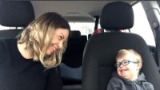

Slide 77
Eich aseiniad
Your assignment
Ydych chi wedi dewis pwnc ar gyfer y poster?
Ystyriwch yr heriau o adnabod a diagnosio ADY o'ch dewis;
Dewiswch 1 neu 2 rhwystr a thrafodwch eu heffaith ar blant gyda’r ADY o’ch dewis;
Adeiladwch ar gynnwys y ddarlith gydag ymchwil ehangach.
Have you chosen your topic for the poster?
Consider the challenges of identifying and diagnosing your chosen ALN;
Choose 1 or 2 barriers and discuss their impact on children with your chosen ALN;
Build on the content of the lecture with wider research.

Slide 78
Cyflwyniad/
Introduction
Adnabod a Diagnosio/
Identifying and Diagnosing
Eich pwnc dewisol/
Your chosen topic
Rhwystrau
Barriers

Slide 79
Cyfeiriadau
References
Anti-Bullying Alliance (2014) Tackling disablist language based bullying in school: A Teacher’s Guide SEN and disability: developing effective anti-bullying practice. Available at: https://anti-bullyingalliance.org.uk/sites/default/files/uploads/attachments/tackling-disablist-language-based-bullying-in-school-final.pdf [Accessed: December 18 2021].
Armstrong, M. et al. (2017) ‘Interventions utilising contact with people with disabilities to improve children's attitudes towards disability: A systematic review and meta-analysis.’ Science Direct, 10, 1, pp. 11-22.
Broomhead, K. E. (2019) ‘The influence of the nature of children's disabilities on societal reactions experienced by their parent.’ Journal of Research in Special Educational Needs, 19(2), pp.126-134.
Brown, L. (2021) Identity-First Language. Available at: https://autisticadvocacy.org/about-asan/identity-first-language/ [Accessed: December 18 2021].
Guevera, A. (2021) ‘The need to reimagine disability rights law because the medical model of disability fails us all,’ Wisconsin Law Review. Available at: Section Head (uwlaw-omeka.s3.us-east-2.amazonaws.com) [Accessed: December 5 2021[.
Holland, J. et al. (2018) Children with SEND and the emotional impact on parents. Available at: https://nasenjournals.onlinelibrary.wiley.com/doi/pdfdirect/10.1111/1467-8578.12240?casa_token=7KVIydw0JG4AAAAA:mgzKiW2NphqX2If86beRkF-JHCtei6HcvwT2kICxo6ZIsMqkA_6th3Y-ztl7SPv9WwolcEuchQk7nw [Accessed: December 18 2021].
Hull, L. et al. (2021) Is social camouflaging associated with anxiety and depression in autistic adults? Available at: https://molecularautism.biomedcentral.com/articles/10.1186/s13229-021-00421-1 [Accessed: December 17 2021].

Slide 80
Cyfeiriadau
References
The Aphasia Center (2021) What is Apraxia? Available at: What is Apraxia? | The Aphasia Center [Accessed: December 15 2021[.
Toro, J. et al. (2020) ‘The Ecological-Enactive Model of Disability: Why Disability Does Not Entail Pathological Embodiment’, Frontiers in Psychology. Available at: https://doi.org/10.3389/fpsyg.2020.01162 [Accessed: December 5 2021].
United Nations (no date) Disability and the Media. Available at: https://www.un.org/development/desa/disabilities/resources/disability-and-the-media.html [Accessed: December 18 2021].
Wouldn’t Change a Thing (2018) 50 Mums | 50 Kids | 1 Extra Chromosome. [video]. Available at: 50 Mums | 50 Kids | 1 Extra Chromosome – YouTube [Accessed: December 4 2021].
Young, E. (2020) Understanding Hearing and Hearing Loss. [video]. Available at: https://www.youtube.com/watch?v=ITTB08oOvxA [Accessed: December 5 2021].

