Slide 1
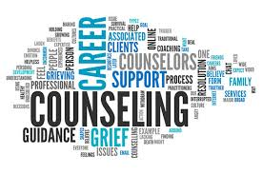
COUNSELLING
Saminah Ayub Chohan
(1807436)
Mehnaz Akhtar (1813781)
Ashiq Baz (1816380)
Anisah Khan (1808794)

Slide 2

INTRODUCTION
Counselling includes helping individuals make necessary improvements in ways of thinking, feeling, and actions, and is a collaborative mechanism focused on goals
A relationship of trust
Confidentiality
Helping a patient see things more clearly
(SFASU, 2021)

Slide 3

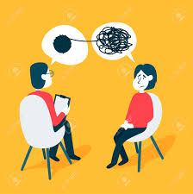

HISTORY
Counselling history can be traced back to tribal days when individuals in a group would come together and share their thoughts and visions often.
Counselling as a profession started to emerge in the 1900S.
(nhs.uk)

Slide 4

IMPORTANCE OF PRINCIPLES
VALUES
ETHICS
PERSONAL MORAL QUALITIES
(British Association for Counselling and Psychotherapy, 2010)

Slide 5

Principles of counselling
Addresses the concept of independence.
Two important considerations of Autonomy is:-
1. Helping someone to understand their actions and principles
2. Connected to the ability of a client to make reasonable and logical choices.
‘Treating equals equally and unequal's unequally but in proportion to their relevant differences’ (Kitcherner. 1984)
Represents the duty of the counsellor to contribute to the clients health and welfare.
Is the concept of not causing harm to other’s
Involves loyalty, faithfulness and honouring commitments to your role and to the client.
(Miller and Davis 1996)
AUTONOMY
JUSTICE
BENEFICENCE
NON-MALEFICENCE
FIDELITY

Slide 6





THE Role OF cOUNSELLING
The skills required
The Qualifications
The Registered Bodies
Association of Child Psychotherapists
Association of Christian Counsellors
British Association for Counselling and Psychotherapy
British Association of Play Therapists
British Psychoanalytic Council
COSCA (Counselling & Psychotherapy in Scotland)
Human Givens Institute
National Counselling Society Play Therapy UK
(The National counselling Society, 2021).

Slide 7

Critical Examination
To USE AN HOLISTIC APPROACH TO TREATMENT TO EVALUATE A PERSON’S NEEDS WHICH CARES FOR THE WHOLE PERSON, NOT JUST THEIR DISEASE OR PROBLEMS THE AIM IS TO CARE, SUPPORT THE PHYSICAL, EMOTIONAL, SPIRITUAL AND SOCIAL ASPECTS OF A PERSON’S LIFE.
Complementary therapist do not diagnose, cure or treat.
Based on CAM IT IS IMPORTANT TO DO MORE RESEARCH AND UNDERSTAND THE CONCEPTS AND THEORIES BEHIND IT, FUNDING IN THIS AREA IS SCEPTICAL AND THERFORE NO CLEAR OR CONCISE EVIDENCE EXISTS TO CONFIRM THE TRUE OUTCOME.
                (Ernst, 2000)

Slide 8
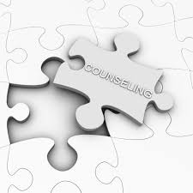
Positive Aspects of Counselling
Counselling can be used for almost everything that is mentally and emotionally based.
In 2015, 18% of the population presented with some form of mental health disorder or disruption (Gumport and Harvey, 2015).
That figure is set to increase due to Covid 19 causing consequences for mental health in both the short and long term. (Galea, Laurie and Merchant, 2020)
While people may receive pharmaceutical intervention, counselling can help them to thrive, recover or cope better.
The key goal of counselling is to help people become mentally healthy.
Behavioural counselling can improve physical health indicators among people with non‐communicable disease (Fraser et al, 2018).

Slide 9
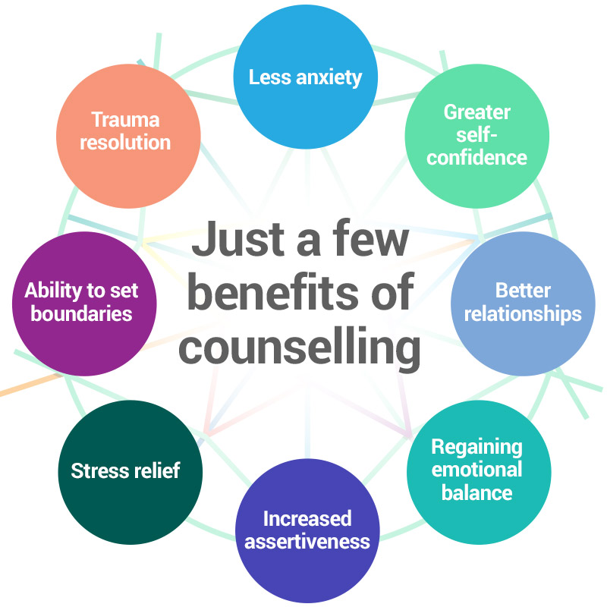
Benefits of being mentally healthy
Focus on affect and expression of emotions avoid distressing thoughts and feelings.
Identification of patterns and recurring themes in emotions.
Discussion of past experience with a developmental focus.
A focus on interpersonal relationships and communication
Reduction in pharmaceutical interventions.
Improved quality of life.
Reduction of suicidal ideation.
Improvement in emotional self regulation.

Slide 10
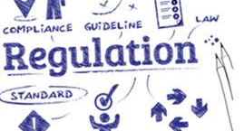
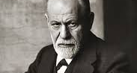

Some Negatives aspects of counselling
In the UK, counselling is not under statutory regulation.
Historically, the misinterpretation and stigma of “Freudian” counselling has tainted the modern understanding of the benefits of counselling.
Counselling and other psychological therapies can sometimes do more harm than good if they are of poor quality or the wrong type.
People may not want to physically attend counselling, however online counselling is on the increase.

Slide 11
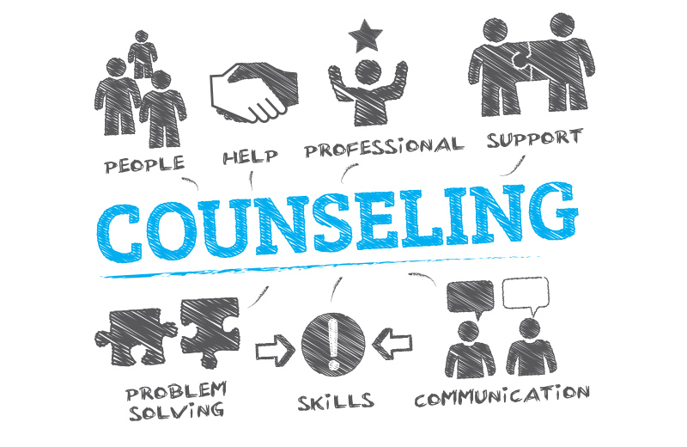
EVALUATION OF COUNSELLING
At least 1/5 of the UK population struggles with mental health.
There is strong empirical evidence internationally which supports the consistent and positive effects of counselling. (BCAP, 2021).
It is the most referred complimentary therapy amongst the medical profession.

Slide 12

QuestionS???

Slide 13
REFERENCES
British Association for counselling and psychotherapy, (2010) Ethical Framework for Good Practise in Counselling & Psychotherapy. (online) Available at: http://ethics.iit.edu/ecodes/node/5132 (Accessed on 18th February 2021).
British Association for Counselling and Psychotherapy (2021). Promoting Research.’(online) Available at:
https://www.bacp.co.uk/about-us/advancing-the-profession/research/
Accessed on 18 February 2021
Ernst, E. (2000) ‘The role of complementary and alternative medicine’, BMJ (Clinical research ed.), 321(7269), pp. 1133–1135.
DOI: org/10.1136/bmj.321.7269.1133.
Fraser, S.J., Brown, W.J., Whiteford, H.A. and Burton, N.W. (2018) Impact of nurse‐led behavioural counselling to improve metabolic health and physical activity among adults with mental illness. International journal of mental health nursing, 27(2), pp.619-630.
DOI:10.1111/inm.12343
Galea, S., Lurie, N., and Merchant, R.M. (2020).The mental health consequences of COVID-19 and physical distancing: the need for prevention and early intervention. JAMA internal medicine, 180(6), pp.817-818. doi: 10.1001/jamainternmed.2020.1562.
DOI: 10.1001/iamainternmed.2020.1562
Harvey, A. G., and Gumport, N. B. (2015). Evidence-based psychological treatments for mental disorders: Modifiable barriers to access and possible solutions. Behaviour Research and Therapy, 68, 1–12.
DOI:10.1016/j.brat.2015.02.004

Slide 14
Kitchener, K. S. (1984). Intuition, critical evaluation and ethical principles: The foundation for ethical decisions in counseling psychology. Counseling Psychologist, 12(3), 43-55. https://doi.org/10.1177%2F00110000841230055.
Miller, H.F and Davies, T. (1996). ‘A Practitioner Guide to Ethical Decision Making. Available at: https://www.counseling.org/docs/ethics/practitioners_guide.pdf.
Accessed on 18th February 2021.
National Health Service (2021) Counselling. (online) Available at: <https://www.nhs.uk/conditions/counselling/> (Accessed 19 February 2021).
Sfasu.edu. (2021) What is Counselling? About Counselling (online)Available at: http://www.sfasu.edu/counselingservices/182.asp
(Accessed 19 February 2021)
The National counselling Society (2021) What is the Accredited Register. Available at: https://nationalcounsellingsociety.org/counselling-directory/what-is-the-accredited-register
(Accessed: 20th February 2021).
Therapy For Thinking. (2020) Counselling. (Online) Available at:
https://www.therapyforthinking.co.uk/pages/counselling.html
(Accessed: 20th February 2021).

