Slide 1
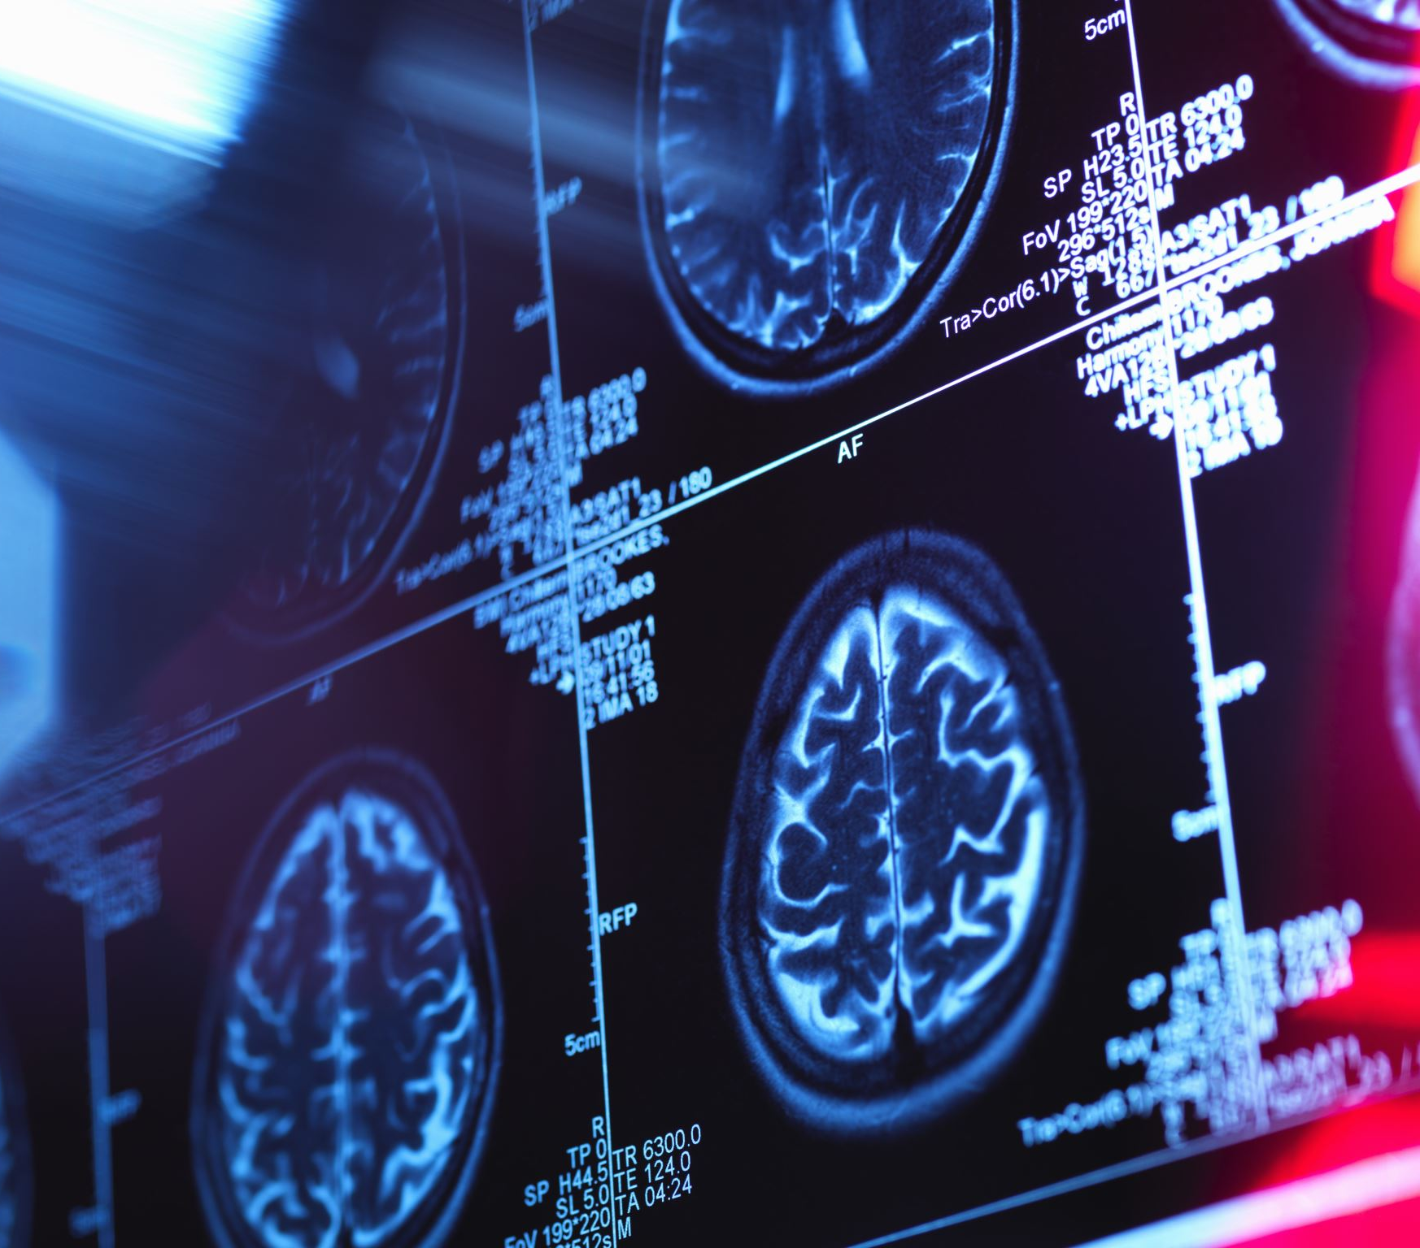
Counselling PTSD Presentation
Discuss how the treatment and care of patients/clients has developed throughout the centuries. Consider changes in societal attitudes and our understanding of interdisciplinary practice.

Slide 2

The understanding of PTSD greatly evolved after World War Two with advances in neuroscience and psychology that have led to many new and improved evidence-based therapies medications and treatments.
The official diagnosis of PTSD is relatively recent, the condition itself is as old as human conflict and disaster.
Societal attitudes have changed greatly, war veterans are no longer seen as weak or cowards, but rather greatly respected and treated with compassion.
PTSD today is recognised as a mental health condition and is viewed with understanding and acceptance.
(NeuroLaunch editorial team, 2024b)

Slide 3
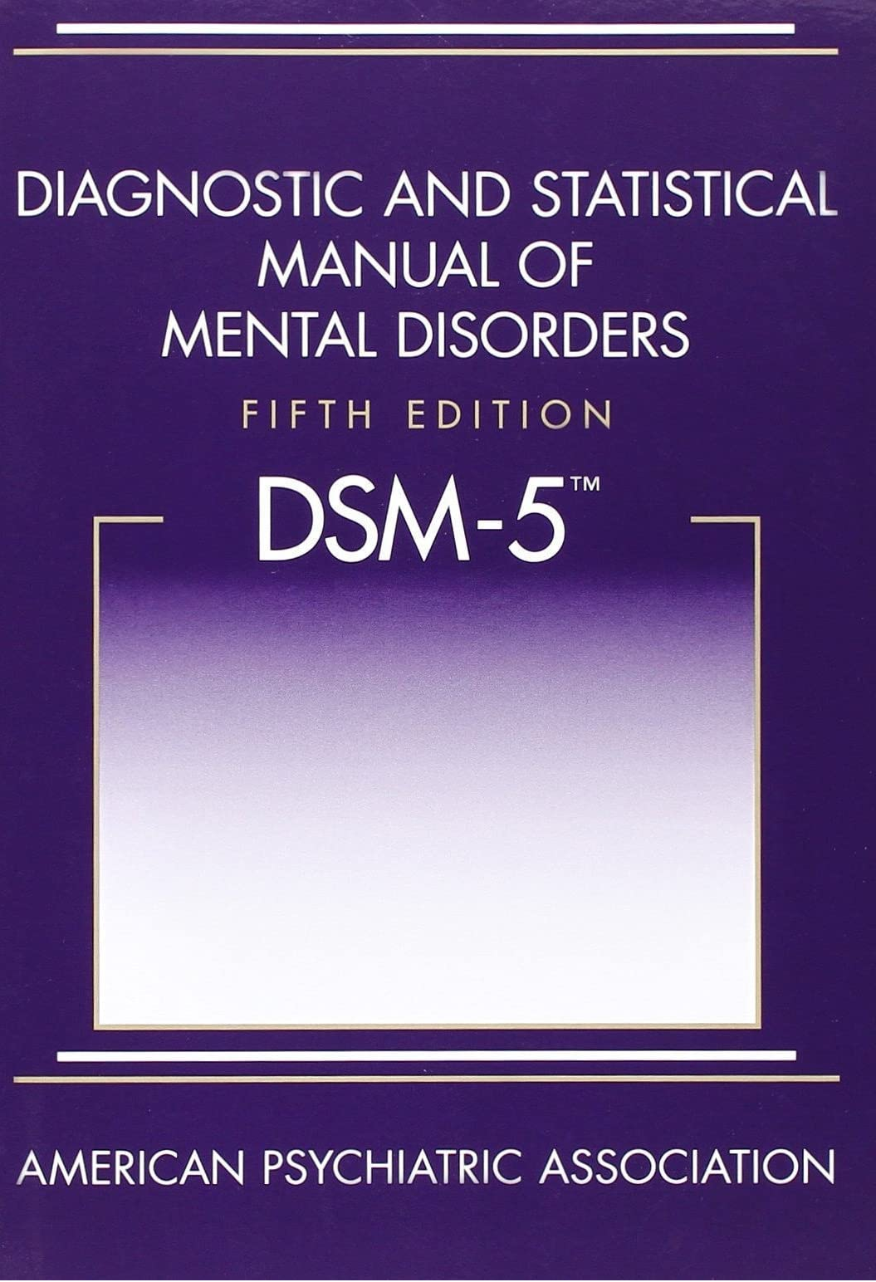
Post-Traumatic Stress Disorder (PTSD), as we know it today, is the culmination of centuries of observations, theories, and evolution.
The term "Post-Traumatic Stress Disorder" was officially recognised in the DSM-III in 1980 by the American Psychiatric Association. PTSD. This recognition spurred extensive research and the development of more effective treatments.
(NeuroLaunch editorial team, 2024a)
Mental health professionals now have greater flexibility in assessing and diagnosing PTSD. They recognize that trauma can manifest in various ways, not just in war casualties. This change enables earlier intervention and more accurate diagnoses.
(NHS, 2022)
This Photo by Unknown Author is licensed under CC BY-SA

Slide 4

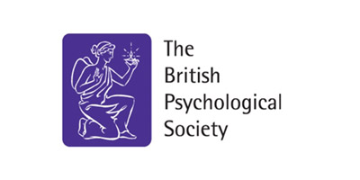
The British Psychological Society (BPS) was established in 1901 as a professional body for Psychologists
(BPS, n.d)
The British Association for Counselling and Psychotherapy
( BACP) was established in 1977
Professional body to provide training, and research development to raise the standards and ethics within the profession.
(BACP, 2025)

Slide 5

Societal Attitudes
Society used to view individuals with mental health conditions as morally inferior and something to be feared and excluded from society. Today society is educated to recognise, help and integrate these individuals into society.
(NHS, 2024)
In previous centuries, people suffering from PTSD were often considered casualties of war. Understanding of the condition and treatment was very limited.
( Simalchik, J. 2021).
Advocacy groups are working to address remaining gaps in care and support, with a focus on further reducing stigma and improving public awareness of PTSD.
Specialised programs and resources have been developed to support veterans and first responders, who are often at higher risk of developing PTSD.
(Neuro Rehab VR, 2024).

Slide 6

Interdisciplinary practice
PTSD treatment requires professionals to collaborate to address clients' needs. Psychologists, psychiatrists, social workers, occupational therapists, counsellors, and other specialists work together to create a comprehensive treatment plan.
The goal is to provide care that addresses the psychological, physical, social, and emotional aspects of PTSD.
Modern treatments use an interdisciplinary approach; talking therapies, medications and complementary treatments
(Simalchik, J, 2021).

Slide 7
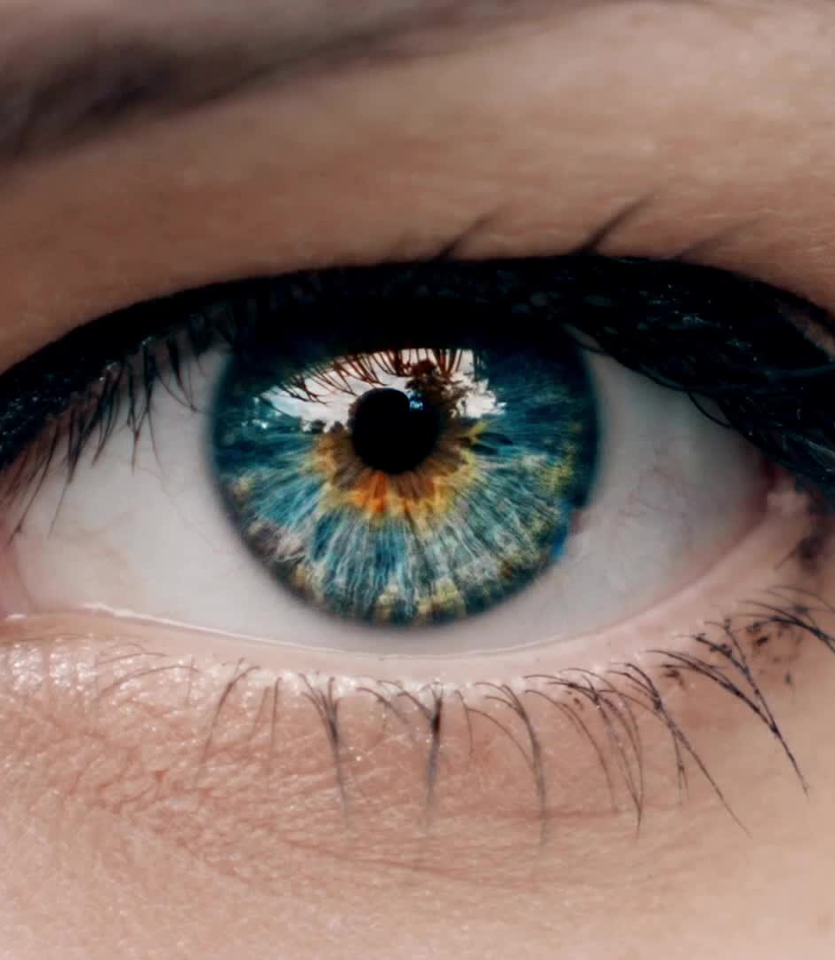
Conventional Approaches
Eye Movement Desensitization and Reprocessing (EMDR): This technique uses guided eye movements to help process and reduce the impact of traumatic memories.
Exposure Therapy: Involves repeated, detailed imagining of the trauma or exposure to trauma reminders to reduce the power they have over the individual.
Cognitive Behavioural Therapy (CBT): Focuses on changing negative thought patterns and behaviours.
Dialectical Behavioural Therapy (DBT): Combines CBT with mindfulness techniques to manage emotions and improve relationships.
(Lee et al., 2022)

Slide 8

Conventional approaches:
Narrative Exposure Therapy: Helps individuals create a coherent life story to process traumatic experiences. It is known for its use in group treatment for refugees.
Emotion Processing Therapy (EPT): Helps individuals explore and modify their emotional responses and narrative techniques
Imaginary Rehearsal Therapy: Visualising and mentally practising new positive responses to stressful situations. It helps reframe reactions and emotions
Hypnotherapy: Guided relaxation used to heighten a state of awareness to explore thoughts
feelings and memories
(Lee et al., 2022)

Slide 9

Virtuality Reality Therapy PTSD: 21st Century Treatment
Virtual Reality Exposure Therapy (VRET) uses advanced technology to create realistic, controlled virtual environments where patients can confront their fears and traumatic experiences without real-world risks. VRET has three stages:
Immersive Experience: Patients wear a VR headset and are transported into a computer-generated peaceful setting such as a tropical forest or a relaxing beach.
Controlled Exposure: Under the guidance of a therapist, patients are gradually exposed to their traumatic memories in a safe and controlled manner.
Reduced Emotional Intensity: Studies have shown that VRET can significantly reduce PTSD symptoms by allowing patients to engage with their triggers in a less emotionally intense way compared to traditional exposure therapy.
(Neuro Rehab VR, n.d).

Slide 10

Alternative therapies in PTSD treatment are a progressive area introduced in the last century. It has been recognised that traditional talk therapy and medication alone may not be effective in treating all individuals.
(Neuro Rehab VR, 2024).

Slide 11

Non-Conventional Approaches:
Yoga: Combines physical postures, breathing exercises, and meditation to improve mental and physical well-being.
Music Therapy: Uses music to address individuals' emotional, cognitive, and social needs.
Art Therapy: Uses art to address individuals' emotional, cognitive, and social needs.
Acupuncture: Involves inserting thin needles into specific points on the body to alleviate pain and treat various physical, mental, and emotional conditions.
Emotional Freedom Techniques: Fingertips are used to stimulate different energy points on the body by tapping.
(Lee et al., 2022)

Slide 12

Psychopharmacology:
Modern Psychotherapy was established in the 1950s and radically changed the treatment of mental illness.
Current drug therapies recommended by the NHS to treat the symptoms of PTSD are Paroxetine and Sertraline. (SSRIs)
They are types of antidepressants known as selective serotonin reuptake inhibitors. They work by increasing the levels of a mood-enhancing chemical called serotonin in the brain. (NHS, 2022)
SSRIs were first introduced in the 1980s and have greatly improved the treatment of mental health conditions.
(Encyclopaedia Britannia, n.d)

Slide 13

Serotonin-norepinephrine reuptake Inhibitors (SNRIs)
Venlafaxine and duloxetine work similarly to SSRIs but also affect norephedrine levels, helping to alleviate depressive and anxiety symptoms.
Prazosin is often prescribed to treat nightmares associated with PTSD by blocking receptors in the brain that contribute to sleep disturbances.
Benzodiazepines such as Diazepam may also be prescribed to treat severe anxiety.
Medications are recommended to manage chemical imbalances and symptoms alongside psychotherapy to teach coping strategies.
A combined approach is important.
(Well Wisp, 2024)

Slide 14
References
British Association for Counselling and Psychotherapy.(2025) About BACP. Retrieved from: https://www.bacp.co.uk/about-us/about-bacp/
British Psychological Society. (n.d.). History of Psychology Centre. Retrieved January 9, 2025, from https://www.bps.org.uk/history-psychology-centre
Encyclopaedia Brittanica. (n.d). Psychopharmacology medicine. Retrieved from: https://www.britannica.com/science/psychopharmacology/
Lee, E., Faber, J. & Bowles, K. A Review of Trauma Specific Treatments (TSTs) for Post-Traumatic Stress Disorder (PTSD). Clin Soc Work J 50, 147–159 (2022). Retrieved from: https://doi.org/10.1007/s10615-021-00816-w
NeuroLaunch editorial team (2024a).History of PTSD: Ancient Times to Modern Diagnosis: Retrieved from: http://neurolaunch.com/history-of-ptsd/
NeuroLaunch editorial team. (2024b). PTSD Treatment Evolution: A Journey Through Time. Retrieved from: https://neurolaunch.com/how-was-ptsd-treated-in-the-past/
Neuro Rehab VR. (2024). PTSD Law Changes: A Comprehensive Guide to Recent Legislation Updates. Retrieved from: http://neurolaunch.com/new-ptsd-law/

Slide 15
Neuro Rehab VR. (n.d.). Virtual Reality for Rehab Specialists. Retrieved from: http://neurorehabvr.com?form=MGOAV3
NHS (2024). 3.2.Care Learning. Describe how social and cultural attitudes towards mental health have changed over time. Retrieved from: https://carelearning.org.uk/qualifications/level-2-cyp-mental-health/unit-01-cyp-context/3-2-describe-how-social-and-cultural-attitudes-towards-mental-health-have-changed-over-time/
NHS (2022). Treatment - Post-traumatic stress disorder (PTSD). NHS. Retrieved from: https://www.nhs.uk/mental-health/conditions/post-traumatic-stress-disorder-ptsed/treatment/
Simalchik, J. (2021).Disrupting legacies of trauma: Interdisciplinary interventions for health and human rights. Health and Human Rights Journal, 23(1), 11-25. Retrieved from: https://www.hhrjournal.org/2021/06/16/disrupting-legacies-of-trauma-interdisciplinaryinterventions-for-health-and-human-rights/
Well Wisp (2024) What Drugs Treat PTSD? Retrieved from: https://wellwisp.com/what-drugs-treat-ptsd/

Slide 16
AI Acknowledgement
I acknowledge the use of ChatGPT (https://chatgpt.com/) on 28th December 2024 using the following prompts:
Please find articles about the changing societal attitudes towards mental health conditions and PTSD in the 20th and 21st centuries and summarise the main points.
What are the most common treatments for PTSD? Please find articles about the changing treatment methods and care of PTSD in the 20th and 21st centuries.
What does interdisciplinary practice mean? Please find articles on modern interdisciplinary practices for mental health conditions with examples.
Please find articles about the development of psychopharmacology and medicines recommended for PTSD.
Please find articles about conventional, non-conventional, and holistic treatments for PTSD.
I acknowledge the use of Grammarly (https://www.grammarly.com/) on 28th December 2024 to check my work using the prompt:
1. Please use APA style to check my work for grammar, paragraphs, syntax, readability, and citations.
I confirm that I have not presented any AI-generated text as my work. I confirm that I have copies of my notes and other resources I used before and after using AI tools, which I may be asked to provide in evidence.

Slide 17
Counselling PTSD Presentation notes:
Discuss how the treatment and care of patients/clients with PTSD has developed throughout the centuries. Consider changes in societal attitudes and our understanding of interdisciplinary practice.
Post-traumatic stress disorder is a serious mental health condition resulting from experiencing a traumatic event. Experiences can be shocking, frightening, or dangerous, affecting individuals emotionally and physically. In previous centuries, people suffering from PTSD were often considered casualties of war, and understanding of the condition and treatments were very limited. Modern treatments however use an interdisciplinary approach; talking therapies, medications and complementary treatments are combined to treat the body. During the 20th and 21st centuries, increased awareness of different causes, and methods of treating PTSD have greatly improved.( Simalchik, J. 2021).
The criteria for diagnosing PTSD has broadened greatly to include a wider range of traumatic experiences beyond solely wartime experiences, such as childhood abuse and repeated exposure to trauma in high-risk professions, first responders, survivors of parental and spousal abuse, and individuals who have experienced or witnessed a life-threatening situation or natural disaster. (NeuroLaunch editorial team, 2024a)
Mental health professionals today have more flexibility in assessing and diagnosing PTSD, taking into account the diverse ways in which trauma can manifest. This shift allows for earlier intervention and more accurate diagnoses, potentially preventing the escalation of symptoms. Increased funding for PTSD research and treatment programs is currently available. There are currently more resources for scientific studies and clinical trials, aiming to advance our understanding of PTSD and develop more effective interventions

Slide 18
Alternative therapies in PTSD treatment are a progressive area introduced in the last century. It has been recognised that traditional talk therapy and medication alone may not be effective in treating all individuals, modern treatments support the incorporation of complementary approaches such as mindfulness-based stress reduction, yoga, and art therapy. (Neuro Rehab VR, 2024).
Updated legislation for PTSD sufferers acknowledges the evolving understanding of trauma and its effects on mental health. PTSD is now widely recognized as a legitimate mental health condition, rather than a sign of weakness or moral failing. Modern diagnosis is a testament to humanity’s evolving understanding of the mind’s response to trauma. The 21st century reflects advancements in medical and psychological knowledge and changes in societal attitudes. Post-Traumatic Stress Disorder (PTSD), as we know it today, is the culmination of centuries of observations, theories, and evolution. (NeuroLaunch editorial team, 2024) Modern diagnosis is a testament to humanity’s evolving understanding of the mind’s response to trauma. PTSD was officially recognized as a mental health condition in 1980 by the American Psychiatric Association in the DSM-III. This recognition spurred extensive research and the development of more effective treatments. The 21st century reflects advancements in medical and psychological knowledge and changes in societal attitudes. Post-Traumatic Stress Disorder (PTSD), as we know it today, is the culmination of centuries of observations, theories, and evolution. The official diagnosis of PTSD is relatively recent, the condition itself is as old as human conflict and disaster. Understanding of the human psyche. (NeuroLaunch editorial team, 2024a)

Slide 19
There are nineteen conventional and seven non-conventional treatments currently recognised and available to treat PTSD. Thirty-four Empirically supported studies found the following most beneficial to treat trauma patients: Conventional therapies include; cognitive behavioural therapy (CBT), sleep-specific CBT, trauma-focused CBT, internet CBT, virtual reality exposure therapy, prolonged exposure, narrative exposure therapy, cognitive processing therapy, eye movement desensitisation and reprocessing (EMDR), hypnotherapy, emotion-focused therapy, skills training in effect and interpersonal regulations (STAIR), interpersonal psychotherapy (IPT), dialectical behavioural therapy (DBT), accelerated resolution therapy (ART), metacognitive therapy, and imaginary rehearsal therapy. Non-conventional approaches included yoga, physical activities, emotion freedom techniques, acupuncture, mind-body therapy, and music therapy. (Lee et al., 2022) According to the Neurolaunch editorial team (2024Psychopharmacology: Current drug therapies recommended by the NHS to treat the symptoms of PTSD are Paroxetine and Sertraline. They are types of antidepressants known as selective serotonin reuptake inhibitors (SSRIs).They work by increasing the levels of a mood-enhancing chemical called serotonin in the brain. (NHS, 2022)
Since the introduction of SSRIs in the 1980s and antipsychotics in the 1990s mental health conditions have greatly improved (Encyclopaedia Britannia, n.d)

Slide 20
Serotonin-norepinephrine reuptake Inhibitors (SNRIs) Venlafaxine and duloxetine work similarly to SSRIs but also affect norephedrine levels, helping to alleviate depressive and anxiety symptoms. Prazosin is an alpha-blocker prescribed to treat nightmares associated with PTSD by blocking receptors in the brain that contribute to sleep disturbances. Benzodiazepines such as Diazepam may also be prescribed to treat severe anxiety. Medications are recommended to manage chemical imbalances and symptoms alongside psychotherapy to teach coping strategies. A combined approach is important. (Well Wisp, 2024)
Society used to view individuals with mental health conditions as morally inferior and something to be feared and excluded from society. Today society is educated to recognise, help and integrate these individuals into society. Laws such as The Equality Act 2010 protect individuals from discrimination. (NHS, 2024)

