Slide 1
Sleep and exercise
Week 18
Alison Connaughton

Slide 2
Introduction
1/3 of our lives spent asleep.
Therefore improving sleep quality is an important area of research.
General assumption that after a day’s hard work (manual labour), this should lead to a good night’s sleep?
U.S. National Sleep Foundation – recommendations
Still relatively little empirical research on exercise and disturbed sleep.

Slide 3
Areas to discuss:
What sleep is?
How sleep is measured?
What factors influence it?
Research on sleep and exercise and mechanisms for the influence of exercise on sleep.

Slide 4
Sleep disturbance
Approximately 70 sleep disorders
Main ones: insomnia and obstructive sleep apnoea
  Insomnia in various forms
  Onset insomnia
  Sleep maintenance insomnia
  Poor sleep quality

Slide 5
Risk factors for insomnia (Rosekind and Gregory, 2010)
Being female (especially during menopause transition)
Increasing age – 45-54
Over age 85
Shift work – can disrupt circadian sleep – wake cycles.

Slide 6
Sleep disturbance
Criteria
  Acute insomnia 1-3 days,
  Short-term 4 nights to a month
  Chronic problem longer than a month
Primary condition (low incidence) or secondary to other health conditions
National co-morbidity survey - Estimates from Roth et al. (2006) over 12 month.
Problems ranged from 16% - 25% for difficulty initiating or maintaining sleep, early morning awakening, and non-restorative sleep.
Worldwide, nearly 75% of insomnia patients report problems staying asleep or waking up too early.
60% have problems falling asleep and say sleep is poor quality.

Slide 7
Impact
Patients with insomina: more physician and emergency department visits, laboratory tests and medical prescriptions.
Negative effect on daytime functioning and work place productivity plus public and work safety (Rosekind and Gregory, 2010)
Estimated cost of insomnia to UK £24 Billion (Hafner et al., 2016)

Slide 8
Treatment
Only 5-20% people who experience sleep disturbance seek treatment
50% of these – typically hypnotic or anxiolytic benzodiazepine medication
And other options:
  Use caffeine to manage daytime sleepiness
  Use alcohol to get to sleep
(Kripke et al., 1998)
Over the counter options exist:
Melatonin
  Side effects: nausea, nightmares and headaches off setting potential benefits (Guardiola-Lemaitre 1997)
  ‘natural’ treatments (valerian, chamomile, St John’s wort)
Antihistamines – residual next day after-effects.

Slide 9
Task:
Choose three of these behaviours / options and identify an article (ideally a review) on how it impacts sleep.
Write a brief paragraph to summarise the findings:
Using and air purifier
Control of sleep climate
Using a dehumidifier
Getting rid of technology in the bedroom
Limiting caffeine
Avoiding alcohol
Having a bath
Improving your diet
Progressive muscular relaxation
Aromatherapy

Slide 10
Treatment
Benzodiazepine
  First line drug choice for short term management of insomnia – reducing time to sleep onset and nigh time awakenings.
  Long term – issues with memory and rebound sleepiness
Non-benzodiazepine hypnotics
  As above with fewer side effects
Tricyclics
Monoamine Oxidase Inhibitors
Tetracyclics
Melatonin Receptor Agonist
    (Rosekind and Gregory, 2010)

Slide 11
Treatment and mechanisms linked with exercise
Mechanisms of medication may point to the action of exercise behaviour

Slide 12
What is sleep?
‘a state of reversible consciousness characterized by little movement and reduced responses to external stimulus’ (Buckworth et al., 2013, p262)
Function: rest state for the brain
Acute sleep deprivation has a significant effect on cognitive function and mood
Chronic sleep deprivation impacts perceptual distortions and hallucinations

Slide 13
Stages of sleep
Defined by neural, physiological and behavioural patterns
REM and four stages of non-REM sleep

Slide 14
For more in-depth review see Buckworth et al. (2013) and others
A walk through the stages of sleep | Sleeping with Science, a TED series
https://www.youtube.com/watch?v=eM2VWspRpfk
Sleep stages
https://www.youtube.com/watch?v=0LNdsTrQJCs&t=1s

Slide 15
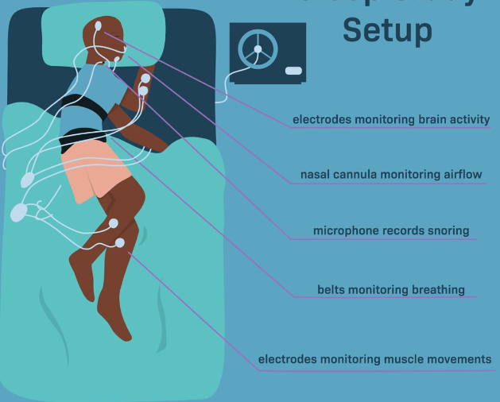
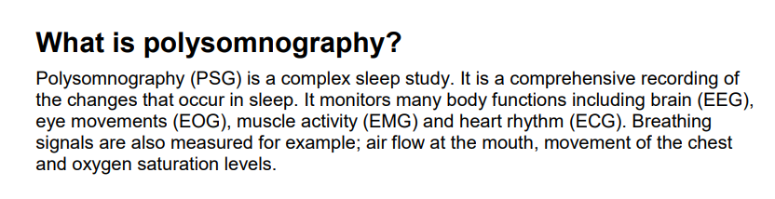
The Quality and Quantity of sleep
Measuring sleep
  Usually self-report
  Reliability varies according to condition
Movement sensor – estimation of sleep
  Can be accurate enough in large long-term studies/monitoring
Objective
  Polysomnography
    EEG of brain waves
    EMG of eye and chin muscles

Slide 16
Physical activity, Exercise and Sleep
Moderate evidence that physical activity improves sleep (Physical Activity Guidelines Advisory Committee, 2008)
Evidence from experimental studies that already good sleepers have small improvements in sleep as measured by polysomnography after single session of exercise.
Cross sectional observation studies - people who say they are more physically active report better sleep.
Reliance on self-report in large studies
Smaller studies use more objective measures though the number of studies are small

Slide 17
Meta Analysis of 38 studies:
Youngstedt, O'Connor and Dishman (1997)
Acute exercise did not alter:
  Time to fall asleep / wakefulness during night time
It did increase:
  Total sleep time (10 mins)
The effects of acute exercise on sleep: a quantitative synthesis
Summary: Effect Size (d)
Slow wave 0.19 (4.2 min)
REM 0.49 (7.4 min)
REM onset 0.52 (13.1 minutes)
Total sleep time 0.42 (9.9 min)
Cohen suggested that d = 0.2 be considered a 'small' effect size, 0.5 represents a 'medium' effect size and 0.8 a 'large' effect size. This means that if the difference between two groups' means is less than 0.2 standard deviations, the difference is negligible, even if it is statistically significant.

Slide 18
Youngstedt, O'Connor and Dishman (1997)
Limited impact of exercise overall
Exercise, heat load and sleep
Exercise associated with high heat load did not increase SWS above average effect of exercise.
High heatload associated with increased wakefulness after sleep onset.
+2hrs exercise associated with larger increases in total sleep time but decrease in REM sleep.
Average exerciser? 20-45 minutes a session?

Slide 19
Passos et al. (2010)
Purpose: Acute effects of three different modalities of physical exercise on sleep pattern of patients with chronic primary insomnia.
Forty-eight insomnia patients – thirty eight females / ten males - equally randomly assigned to 4 groups:
  control,
  moderate-intensity aerobic exercise,
  high-intensity aerobic exercise,
  moderate-intensity resistance exercise.
Measures sleep pattern by polysomnogram and daily sleep diary and anxiety (STAI) pre and post exercise bout.

Slide 20
Passos et al. (2010)
Findings:
Polysomnography:
  Reduction in the sleep onset latency (55%) and total wake time (30%);
  Increase in total sleep time (18%), and in sleep efficiency (13%) in the Mod Aerobic Activity group.
  The daily sleep log data showed increase in the TST (26%) and reduction in the SOL (39%).
  In addition, a reduction (15%) in anxiety was also observed after moderate-intensity aerobic exercise.
Acute moderate-intensity aerobic exercise appears to reduce pre-sleep anxiety and improve sleep in patients with chronic primary insomnia.

Slide 21
Observation and Cross- sectional studies
Few studies have examined the long-term effects of exercise on sleep for those with sleep disorders (Youngstedt and Kline, 2006)
. Questionnaire based data collection (Urponen et al., 1988)
  1200 middle-aged men and women (36-50) living in Finland
  Ranked exercise first when asked to list three practices or beahviours they thought would improve speed of falling asleep and perceived quality of sleep.
  Cultural differences – importance of exercise in different countries?
Sherrill et al., 1998 - Comparison of active and inactive showed positive differences between self reports of ‘any sleep problem’ and ‘daytime sleepiness’

Slide 22
Exercise training
Sleep disturbance observed in individuals who stop exercise
Early research tended to use ‘good sleepers’

Slide 23
King et al. (2008)
Paper looks at the effect of exercise training on sleep.
66 males and females 55 year olds and greater with moderate sleep disturbances randomised into two groups – exercise and equal contact control.
5 times per week (2 supervised, 3 unsupervised)
Moderate intensity defined by sub-max treadmill test
Endurance (aerobic)
12 month training

Slide 24
King et al. (2008)
Measures:
Qualitative
  subjective sleep quality,
  physical activity,
Quantitative
  polysomnographic sleep recordings
  physical ﬁtness – maximal fitness test
  BMI

Slide 25
Adherence
The dose:
Mean = 3.7 ± 1.8 of 5 prescribed exercise sessions per week (74%) - (based on instructor-reported class attendance logs and participant logs).
Home exercise sessions across 12 months (x=2.1 ± 0.9 weekly) and mean minutes of exercise per home session (x= 43.3 ± 19.4 weekly)

Slide 26
King et al. (2008)
Overall exercise improved some objective and subjective dimensions of sleep to a modest degree

Slide 27
General issues in the research area
Physical fitness
  How defined/measured?
Body heating
  How defined/measured/much?
Intensity and effect in population studies
  How defined/measured/much?
>1 hour associated with marked impact on sleep
        Youngstedt, O'Connor and Dishman (1997)
  However?
Time between exercise and sleep/sleep onset?
Vigorous exercise close to sleep time is suggested to be not detrimental to sleep
        O'Connor, Breus, and Youngstedt (1996)

Slide 28
Mechanisms
No single mechanism of cause
  Anti-anxiety/anti-depression effects
  Light exposure
  Circadian phase shifting
  Biochemical - Adenosine

Slide 29
Anti-Anxiety and Antidepressant effects
Anxiety disrupts sleep and exercise can reduce anxiety in some circumstances (see previous lecture notes).
Plausible that exercise improves sleep by reducing anxiety.
Regular exercise also has antidepressant effects which could indirectly improve sleep by reducing the symptoms of depression (Singh et al., 1997).

Slide 30
Light exposure
Low levels of light exposure linked to depression and sleep disturbance.
Exercising outdoors at midday accessing natural light – especially in the winter.
Additive effects of exercise and bright light have been reported (Golden et al., 2005).

Slide 31
Circadian Phase-Shifting Effects
Disruption to sleep / wake schedule.
Shift work / older age – 60+
Evidence that exercise can elicit substantial circadian phase-shifting effects, comparable to those that occur due to bright light (Buxton et al., 2003).

Slide 32
Biochemical Effects
Adenosine increases in muscles and interstitial fluids during exercise.
Thought to facilitate the dilation of blood vessels when low levels of fuel and oxygen are detected (Redgran and Helstan, 2000).
Youngstedt et al. (1999) found that increases in SWS after exercise were nearly 3x greater after a placebo treatment compared with caffeine (which blocks adenosine neuro transmission).

Slide 33
Conclusion
Generally held beliefs in the effect of exercise on sleep
Some of these are not supported by the evidence
Various mechanisms exist that would make separating their contribution out very difficult
Acute exercise presents little impact on various components of sleep
Chronic intense exercise training appears to have merit

Slide 34
Task ...
Critique of King et al’s., (2008) article

