Slide 1
LCBB4004
Marketing Fundamentals
Week 3 – Session 2
Marketing Strategies and Planning

Slide 2
The Strategic Hierarchy
Corporate Strategy – what businesses to be in?
Competitive Strategy – How are we going to be profitable?
Generic Strategy
Product Market Strategy
Directional Strategy
Functional Strategies – Marketing and Operations
Marketing Strategy – STP + 4/7P’s

Slide 3
Corporate Strategy
What business(es) is the company in?
What business(es) should the company be in?
What amount of total resources should the company devote to each business to achieve its overall goals and objectives?

Slide 4
Business-Level Strategy
What distinctive competencies can give the business unit a competitive advantage?
Which of these competencies best matches the needs and wants of the customers in the business target segment(s)?

Slide 5
Marketing Strategy
What target market(s) exist for each product?
How can the marketing mix elements best be tailored to the needs and wants of potential customers in each target market?

Slide 6
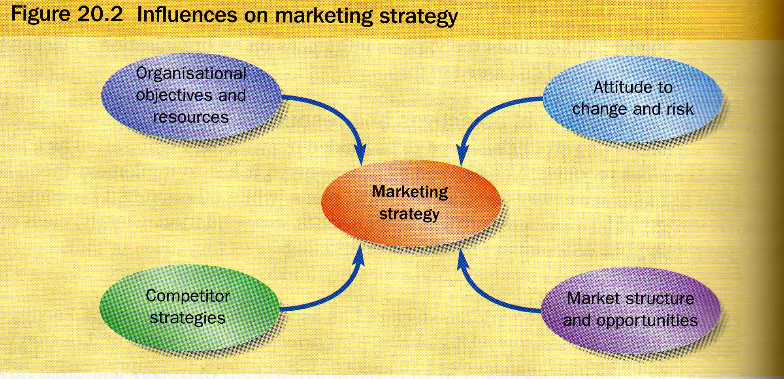
Influences on Marketing Strategy
4 Influences

Slide 7
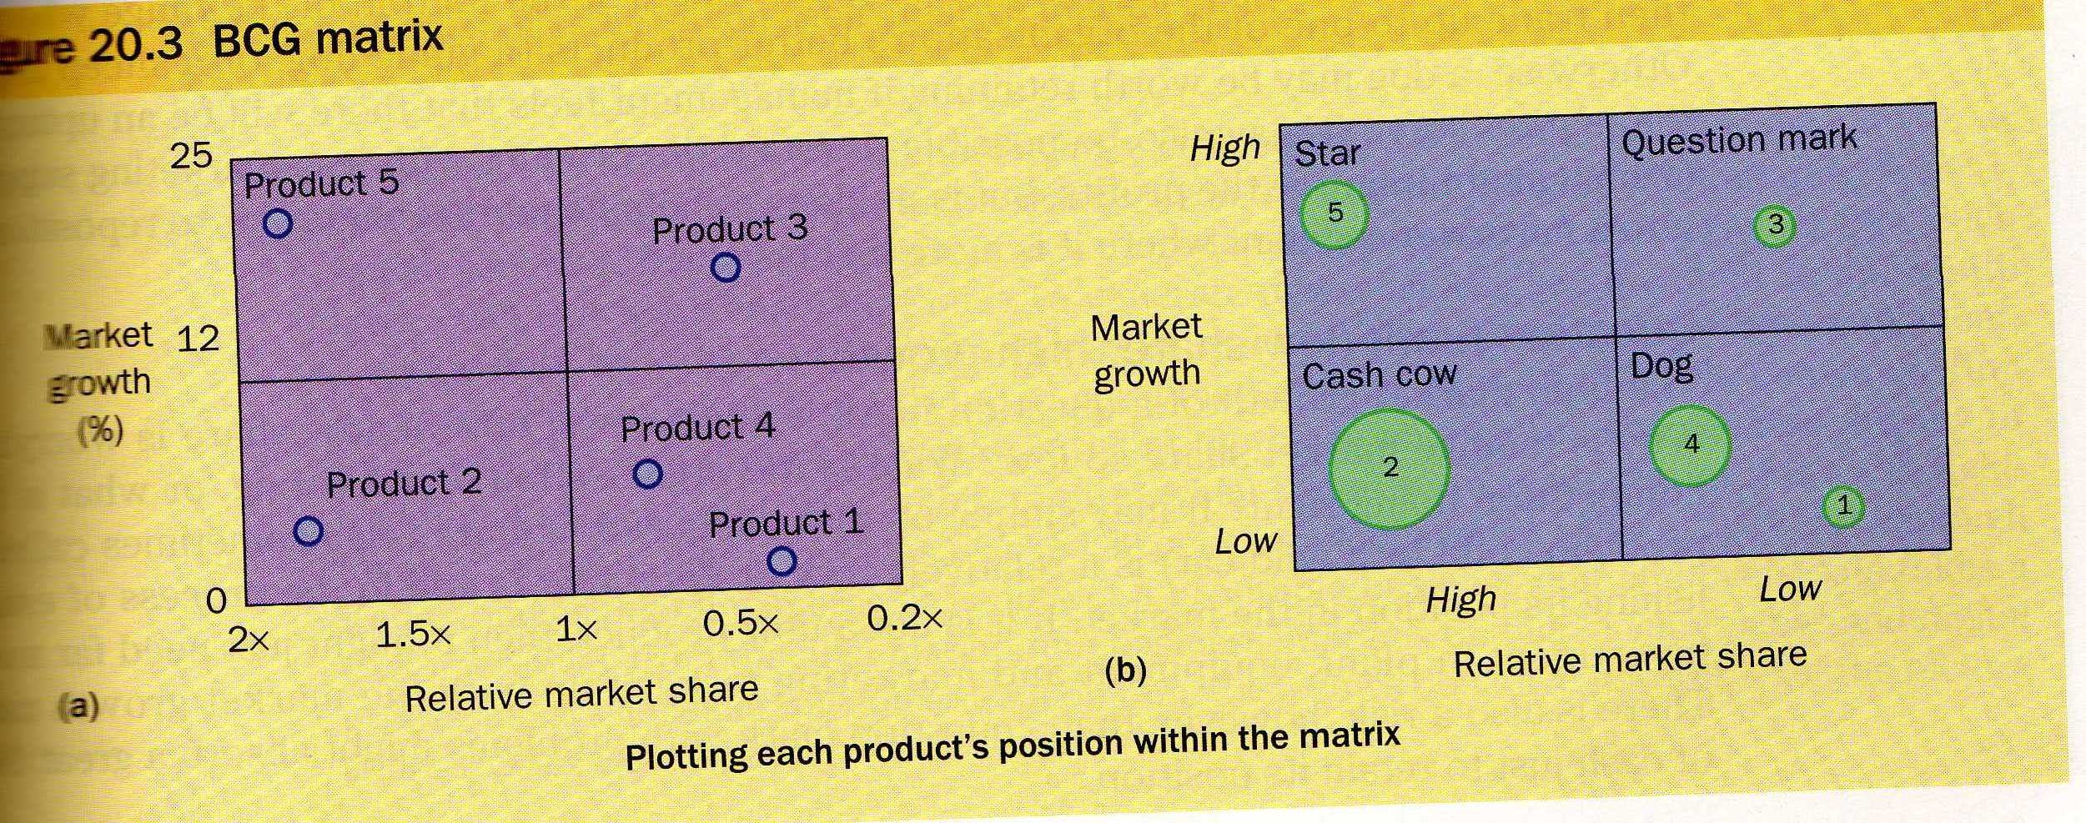
Product Portfolio’s
GE 9 Cell Matrix Strengths vs. Attractiveness
Boston Consulting Group Matrix

Slide 8
Ansoff Matrix
Directional Matrix
Current Product
New Product
Market Penetration
Product Development
Current Market
New Market
Market Development
Diversification

Slide 9
Postures and Positions
Market Leader
Market Challenger
Market Follower – close vs. distant
Market Nicher
Military Analogies:
Frontal Attack, Flank Attack, Encirclement Attack, Bypass attack, Guerrilla Attack
Fixed Position defence, Fixed Position defence, Mobile defence, Flanking defence, contraction defence, pre-emptive defence, counter-offensive defence
Cooperative – Alliances and Collusion

Slide 10
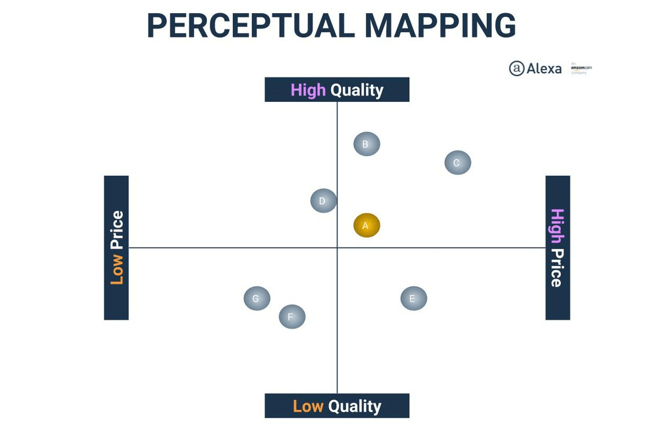

Slide 11
Competitor Analysis
Porter 5 force analysis
Competitive clusters/strategic groups

Slide 12
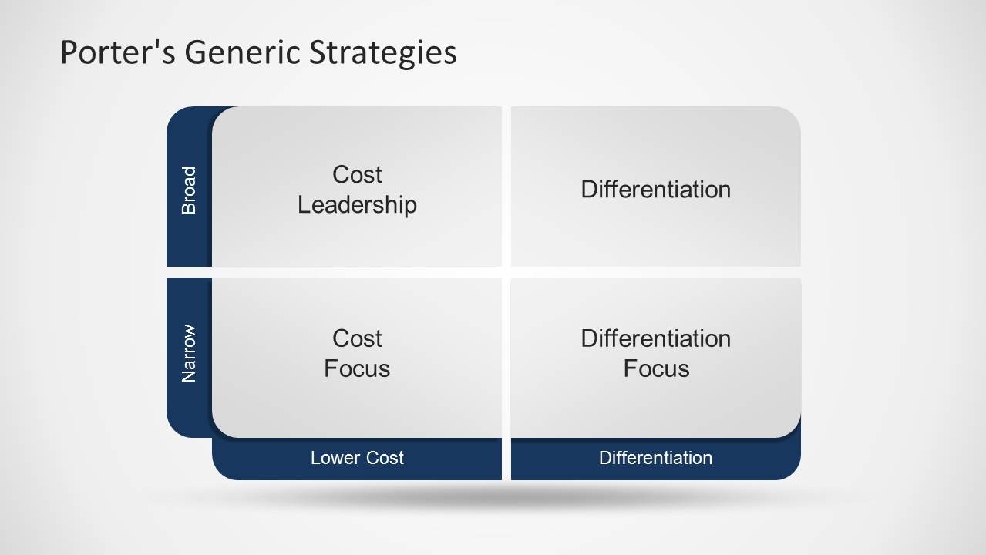
Porters Generic Strategy Model

Slide 13
Cost Leadership
Following this strategy means that the company aims to produce in large quantities, at the lowest cost possible and sell at lower prices.
By doing this they can capitalise on economies of scale and defeat any competitor who has not got equal production capacity, or who can keep prices to a minimum

Slide 14
Differentiation
This strategy involves offering some unique selling (service) proposition (USP) that the competition do not have.

Slide 15
Focus
The company aims at very select market sectors and will be charging higher prices or lower prices.

Slide 16
Attack strategies for Followers in the Growth stage of the PLC
Frontal Attack Strategy (A frontal attack strategy in marketing focuses on a challenger taking on the market leader head-on. This means focusing on your competitors' strengths and matching your own pricing, products, marketing, and promotions to the leading brand)
Leapfrog Strategy (Leapfrogging occurs when a nation bypasses traditional stages of development to either jump directly to the latest technologies (stage-skipping) or explore an alternative path of technological development involving emerging technologies with new benefits and new opportunities (path-creating)
Flank Attack (A competitive marketing strategy in which one company attacks another in a weak spot, commonly by paying maximum attention to either a geographic region or a market segment in which the rival is under-performing)
Encirclement strategy

Slide 17
Strategies in the Maturity stage of the PLC
Increased penetration strategy (Penetration strategy is the concept of taking aggressive action to greatly expand one's share of total sales in a market. The resulting increased sales volume typically allows a business to produce goods or obtain merchandise at lower cost, thereby allowing it to generate a higher profit percentage)
Extended Use Strategy (Extended use or brand stretching is a marketing strategy in which a firm marketing a product with a well-developed image uses the same brand name in a different product category. The new product is called a spin-off. Organizations use this strategy to increase and leverage brand equity (definition: the net worth and long-term)
Global market expansion strategy (International expansion strategies are formal, multi-level strategic plans that businesses use to enter an overseas market, establish a growing presence, and become quickly profitable. ... A competitive analysis, vetting your business offerings and operations against industry competition in the new market

Slide 18
Strategies in the Decline stage of the PLC
Harvesting Strategy (A harvest strategy is a marketing and business strategy that involves a reduction or a termination of investments in a product, product line, or line of business so that the entities involved can reap—or, harvest—the maximum profits)
Niche Strategy – (Niche marketing is an advertising strategy that focuses on a unique target market. Instead of marketing to everyone who could benefit from a product or service, this strategy focuses exclusively on one group—a niche market—or demographic of potential customers who would most benefit from the offerings)

Slide 19
Dimensions of a Plan
Organisational Level
Timescale – short, medium, long term
Situationality – campaign, project, contingency
Staying objective – plans are servants not masters, value free, right tool for analysing, interpreting, keeping assessment separate from analysis.

Slide 20
The Planning Process
Corporate Objectives
Marketing audit
SWOT analysis
Marketing objectives
Marketing Strategies
Marketing programmes
Budgets
Control and Evaluation

Slide 21
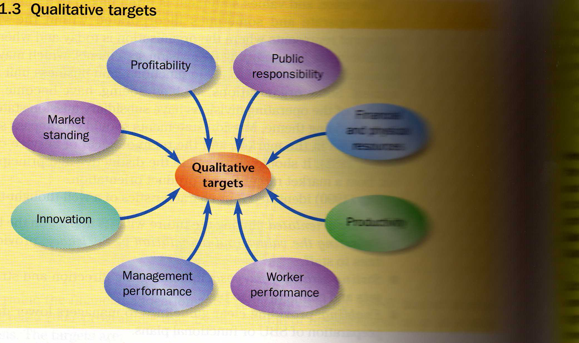
Corporate Objectives
Quantitative Targets
Philosophical Targets – vision and values
Qualitative Targets

Slide 22
The Marketing Audit
External – STEP , Competitors, Market
Internal – Existing Strategy, Resources, Structure etc.

Slide 23
SWOT Analysis
Integrated together
Major or minor
Contingent, dependent, latent or current
Critical Success Factors
Assumptions

Slide 24
Generate marketing options
Set objectives
Generate options – new marketing strategies
Criteria for selecting strategies

Slide 25
Marketing programmes
Actions, Events and Activities
Budgets
Proposed marketing measurement variables
Market size and Sales Potential
Total market size
Maximum level of demand
Competitor reaction and trends in marketing environment
Breakdown – Total market and work down
Build-up – add up all possible sales, survey, secondary data
Sales Forecasting: Management Judgement, Sales Force Surveys, Experts, Scenarios, Delphi technique. Time series analysis, Correlation method, Leading indicators, Test Markets, Primary research, Secondary Data

Slide 26
Organising for Marketing
Functional Organisation
Product Organisation
Regional or Segment Organisation
Matrix Organisation

Slide 27
Measurement and Control
Sales
Costs
Profitability

