Slide 1
EFFECTIVE TEAM WORKING
BY: DAAJA UNITY

Slide 2

Dolu Miah – 1809541 – Benefits of Team Working
Kayani Ghulam – 1807441 – Stages of team development
Asif Khan – 1808529 - Team Roles
Ayaz Ahmed Munir – 1807895 - Managing Conflict
Jhangeir Hussain – 1807897 – Effective Teamworking Skills

Slide 3

The outline of the presentation is based on the following points?

Slide 4
5 Key factors of effective team working:
Benefits of teamworking – Dolu Miah
Stages of team development – Kayani Ghulam
Team Roles – Asif Khan
Managing Conflict – Ayaz Ahmed Munir
Effective Teamworking Skills – Jhangeir Hussain

Slide 5
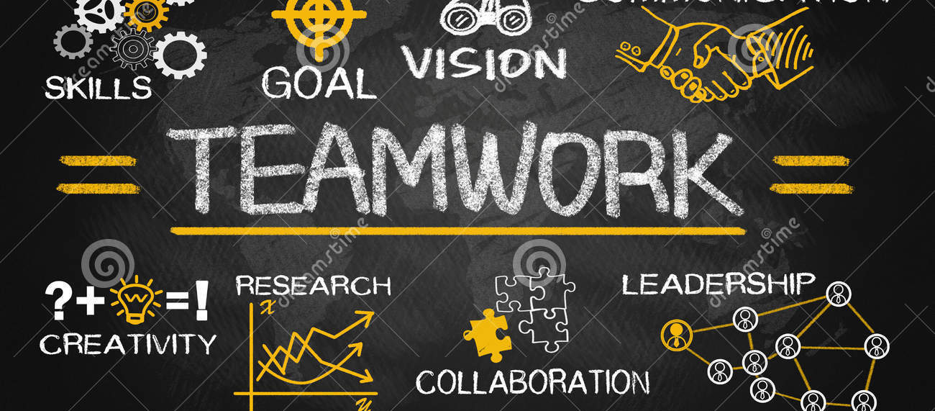
What is effective team work?
Its when individual contributors come together to work towards a common goal

Slide 6
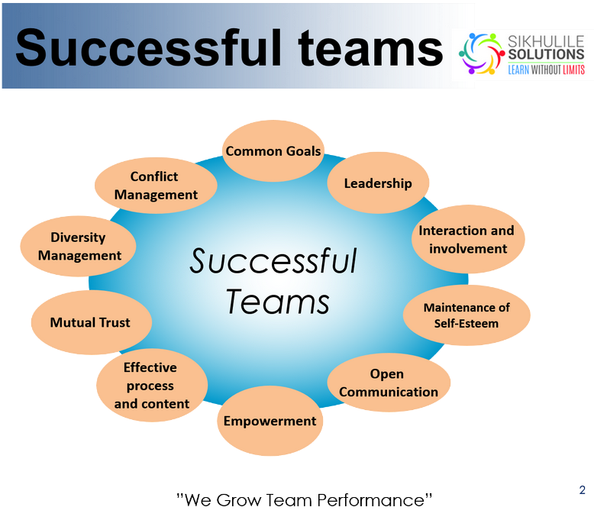

Slide 7

Benefits of team working
Individuals don’t possess all the skills to do something effectively
But we do have different skills to bring to the table
Shy individual - confidence
When workload is shared equally to all members and tasks are allocated according to strengths and skills of individuals
It improves performance / boosts productivity
It Encourages Collaboration / Improves Morale –
When members of a team collaborate it brings out efficient team working
When brainstorming individuals tend to feel more confident about coming up with unique ideas something you don’t do when working alone
It teaches conflict resolution skills – Different individuals have different habits and work styles and can frustrate one another. Because each member of the team works towards a common goal they learn to resolve disagreements
It establishes strong relationships – strong relationships among team members as a result of communicating more freely and openly as well as motivating and encouraging each other to work to their strengths.

Slide 8
Stages of team development
Why is it important to understand the different stages of team development?
What are the different stages of team development
Forming Stage
Storming Stage
Norming Stage
Performing Stage
Adjourning Stage
An example of this is when Fulham football club got relegated having been promoted the previous year.

Slide 9
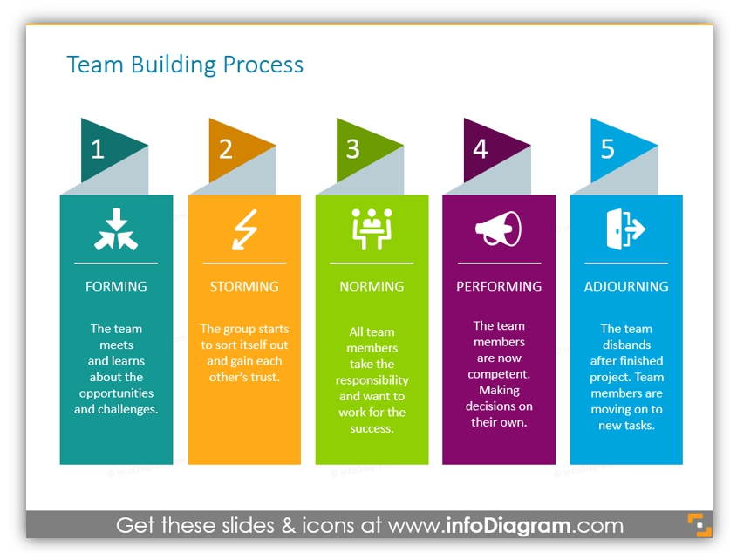

Slide 10
Team Roles
How team roles contribute towards effective teamworking?
Position or roles assigned to members of the group – its important to define roles based on personal strengths and preferences to bring out the best
Individual responsibility within the team/group - brings out a more balanced team
It’s an opportunity for individuals to contribute openly and freely within a group/team
Team functions effectively and enables all members to participate
It enables the team to perform better as a group than as a individual

Slide 11
Managing Conflict
What are the causes?
Different views/opinions - difference of opinions
Diverse group
Poor leadership
Disagreements
How can we reduce conflicts?
Team building exercises
Team morale
Better leadership/communication
Taking into account individual/team views before making a decision

Slide 12
Effective Teamworking Skills
What is effective teamworking skills?
Good understanding
Good leadership
Good interaction
Engaging with all members of the group
Listening to their views
Benefits of effective teamworking skills:
Better performance
More contribution from individuals
Different opinions
More ideas

Slide 13
Conclusion
Our presentation was based on effective team working
Why is team working important?
Teamwork motivates unity in the workplace
It fosters good friendship and promotes good atmosphere
Teamwork offers different perspectives and feedback / brings in diverse thoughts and creativity and allows individuals to brainstorm ideas
Teamwork improves productivity – when workload is shared reducing pressure on individuals
Teamwork provides great learning opportunities – learning from one another
How can you enhance team working?
Having a good team leader
Good communication
Exercise together – team building exercises
Focus on strengths and not weaknesses
Accept differences – listen to all views and not just dismiss them

Slide 14
References:
Benefits of teamwork:
Lee, T.H., 2016. Teamwork: the competitive differentiator for the new marketplace: teamwork can help healthcare organizations compete more effectively in today's marketplace. Healthcare Financial Management, 70(12), pp.46-51.
Available at: https://go.galegroup.com/ps/anonymous?id=GALE%7CA474767749&sid=googleScholar&v=2.1&it=r&linkaccess=abs&issn=07350732&p=AONE&sw=w
Effective Teamworking Skills:
O’Sullivan, J (2009) Leadership skills in the early years (p.57)
Published; 06 August 2009, London-England and New York-USA
Available at; https://www-dawsonera-com.ezproxy.uwtsd.ac.uk/readonline/9781855395060
Stages of Development:
Miller, D (2009) The stages of group development: A retrospective study of Dynamic Team Processes
Available at: https://doi.org/10.1111/j.1936-4490.2003.tb00698.x

Slide 15

Any Questions?

