Slide 1
Unit name: BMSW4002_Group Presentation – Strategies for Effective Communication in a Business Setting
Student name: Nikola Bundova
ID: 2111813
Student name: Ghafar Ahmed
ID: 2108365

Slide 2
Introduction
There are some specific issues need to understand over communication and effective communication. Effective communication shows the right channel dn mode are using in communication and there should be certain feedback does having in communication.
It is important to define different characteristic cess of effective communication like clarity, conciseness, coherence, correctness, completeness, courtesy, feedback need to be attach in the effective communication
Different benefits, theories, barriers and way to solve these barriers in effective communication discussed in alter part of this presentation

Slide 3
Benefits of effective communication
Effective communication helps to make better understanding between parties of communication .
Effective communication helps to make better decision making
Communication increase productivity of each individuals
Effective communication is playing key role in the business to keep better and strogn relationship between employees and Custoemrs too
Effective communication helps to increase collaboration between each parties
Effective communication helps to share information between parties
Effective communication also helps to provide right feedback to the right individual

Slide 4
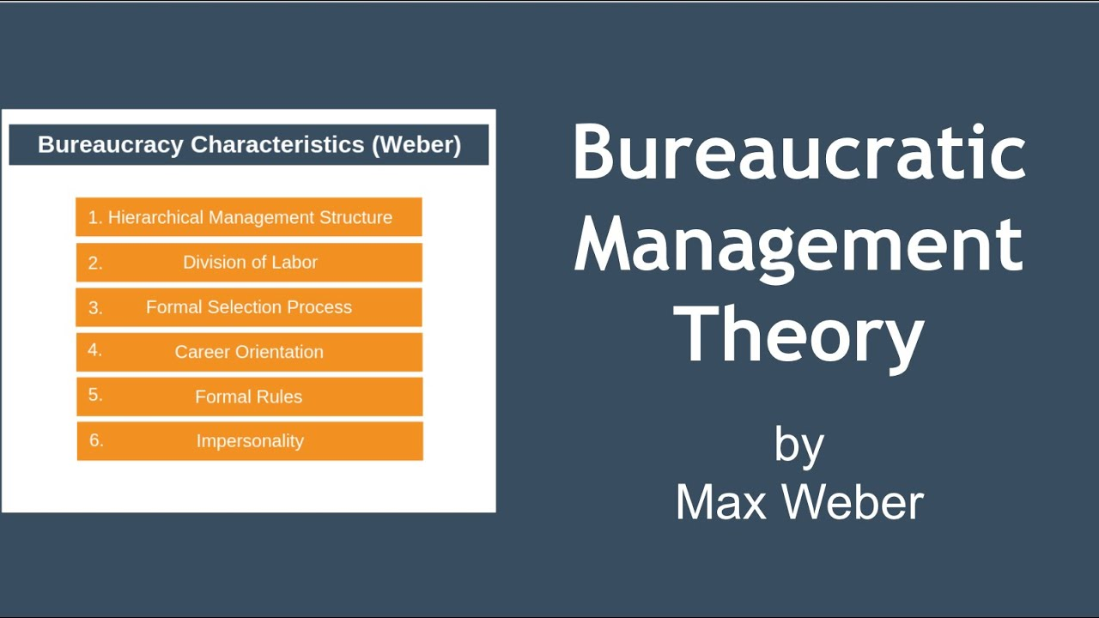
Organization use the theories relating to models of communication?

Slide 5
Organization use the theories relating to models of communication?
Benefits of Max weber bureaucratic theory:
It helps to make better breakdown of complex work into different piece of work.
It also help to set better hierarchy of authority that helps to make better chain of command and reach positive growth of the business
It helps to make better collaboration and also increase motivational dn training program to their emploeyes by management and get better understanding over skills and need of development of emploeyes by management
It makes linkage of different function with the common shared goal of the business

Slide 6
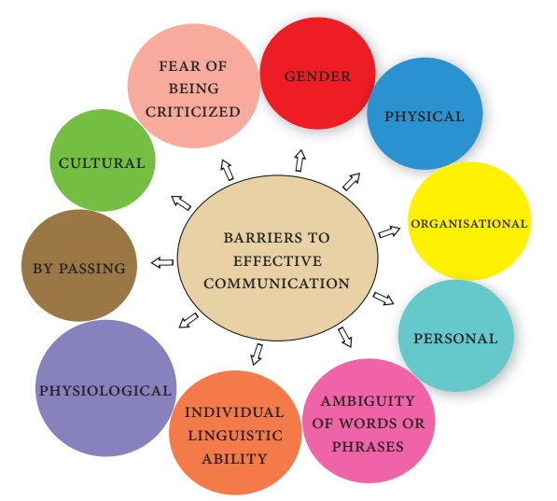
Barriers in effective communication

Slide 7
Overcome barriers in effective communication
It is important to use the right media in terms of communication.
It is important to connect with audience in communication time
Body language need to be positive
Need to understand the cultural differences
Need to use clear and concise language
Summarise the thinking before making communication
Should increase active listening skill
Should use right feedback channel
Should control over emotion

Slide 8
Channels of communication
Face to face communication
Emails
Video conferencing
Telephone conversation
Bogs
Written letters
Formal writing
Spreadsheet
Cloud computing
Networking

Slide 9
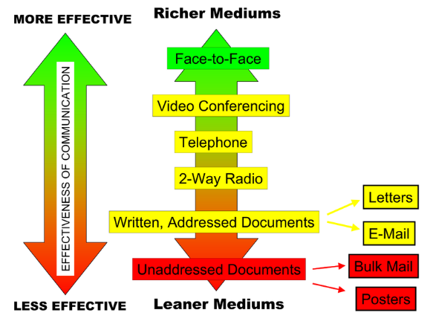
Channels that can use to improve communication

Slide 10
Reference
Shiboli, C (2020). Overcoming the barriers of effective communication. ELearning solutions.
ichael J. (2015)“Promoting Good Decisions: How Regulatory Focus Affects Group Information Processing and Decision Making.” Group Processes & Intergroup Relations
Scott P (2001). “Introduction: Communication and the Disposable Worker.” Communication Research, 24,
Goodall, L. (2001). Organizational Communication: Balancing Creativity and Constraint. New York: Bedford/St. Martin’s.

