Slide 1
Data Warehousing for Business Intelligence
M3XCP4
Lecture 16
Classification Using Decision Trees
Dr Nik Whitehead

Slide 2
Introduction
Process of Classification
Decision Tree Approach for Classification
ID3 Algorithm
Evaluating Performance of Decision Trees
Decision Tree Induction in Weka

Slide 3
Process of Classification
Training, Validation and Testing Examples
Training Records
Initial Model
Model Construction
Method
Training Set
Validation Records
(1)
2/3:1/3
Model Refinement
Method
Refined Model
50:50
(2)
Initial Model
Test Set
Final Model with
Measured Accuracy
Measuring
Model Accuracy
(3)
Refined Model

Slide 4
Process of Classification
Influential Factors for a Good Model
  Classification Accuracy
    Estimated accuracy during development stage vs. actual accuracy during practical use
  Classification Performance
    Time taken for model construction
    Time taken for classification
  Comprehensibility of the model
    Ease of interpreting decisions by the classification model

Slide 5
Decision Tree Induction
The Approach
Input Training Examples
Outlook
sunny
overcast
rain
Humidity
P
Windy
high
normal
true
false
N
P
N
P
Internal Nodes: Attributes
Links: Attribute values
Leaf Nodes: Class labels
Descriptive Attributes
Class attribute

Slide 6
Decision Tree Induction
Principle of Tree Construction
  If all examples are of the same class, create a leaf node labelled by the class
  If examples in the training set are of different classes, determine which attribute should be selected as the root of the current tree
  Partition the input examples into subsets according to the values of the selected root attribute
  Construct a decision tree recursively for each subset
  Connect the roots for the subtrees to the root of the whole tree via labelled links

Slide 7
Decision Tree Induction
Random Selection of Attributes
Temperature
cool
mild
hot
outlook
outlook
windy
sunny
o’cast
rain
sunny
o’cast
rain
true
false
P
P
windy
windy
P
humidity
N
humidity
true
false
true
false
high
normal
high
normal
N
P
P
N
windy
P
outlook
P
true
false
sunny
o’cast
rain
N
P
N
P

Slide 8
ID3 Algorithm
Algorithm Illustration
Outlook
sunny
overcast
rain
P
Gain(Outlook) = 0.246 bits
Gain(Temperature) = 0.029 bits
Gain(Humidity) = 0.151 bits
Gain(Windy) = 0.048 bits
∴ Outlook is chosen as the root.

Slide 9
ID3 Algorithm
Algorithm Illustration
Training Set(outlook=sunny)
Outlook
sunny
overcast
rain
Humidity
P
Gain(Temperature) = 0.571 bits
Gain(Humidity) = 0.971 bits
Gain(Windy) = 0.020 bits
∴ Humidity is chosen as the root.
high
normal
N
P

Slide 10
ID3 Algorithm
Algorithm Illustration
Training Set(outlook=rain)
Outlook
sunny
overcast
rain
Humidity
P
Windy
Gain(Temperature) = 0.020 bits
Gain(Humidity) = 0.020 bits
Gain(Windy) = 0.971 bits
∴ Windy is chosen as the root.
high
normal
true
false
N
P
N
P

Slide 11
Other Algorithms
Overview
  ID3 Family: C4.5 and C5 (See5)
  CART Algorithm
    Produce binary decision tree with nodes represent a test
    Use Gini Index of Impurity as attribute selection measure
  CHAID Algorithm
    Use Chi-square test (χ²) as attribute selection measure
The algorithms mainly differ in attribute selection measures adopted
Studies show that there are only marginal differences among the attribute selection measures w.r.t. model accuracy

Slide 12
The Problem of Model Overfitting
Problem Description
  Any algorithms that build a classification model based on a finite set of training examples tend to have the problem of model overfitting: the model induced from the training examples fits the training examples too well. It reflects the specific features of the examples than features of actual data at large.
  In decision tree induction, a fuller tree with more branches towards the leaf nodes may be built in order to classify those few examples.
  Using such trees often results in misclassification
  Causes of the problem include presence of noise data, lack of representative training examples, etc.

Slide 13
The Problem of Model Overfitting
Approaches to Tackle the Problem
  Early stopping rule (also known as pre-pruning): tree construction is halted at some stage
  Tree pruning (also known as post-pruning): to “cut back” certain subtrees and replace them with leaf nodes, making the tree smaller and more robust
  Use an independently sampled validation set to assist tree pruning
  Pruning methods:
    reduced error pruning
    cost complexity pruning
    pessimistic pruning and many others

Slide 14
The Problem of Model Overfitting
Reduced Error Pruning Method
  Classify all validation examples using the tree. Note down errors at non-leaf nodes
  For every non-leaf node, count the number of errors if the subtree is replaced by the best possible leaf.
  Choose the subtree that has the largest reduction of the number of errors to prune, if any of its subtree do not reduce the number of errors. Repeat this step until any further pruning increases the number of errors.
  (a) Prune the tree even when there is a zero reduction in errors.
  (b) There may be a number of subtrees with the same error reduction. In this case, choose to prune the largest subtree.

Slide 15
Evaluating Tree Accuracy
What to Evaluate?
  Accuracy is measured in terms of error rate
  Details of errors are shown in a confusion matrix.
e.g.
Overall error rate:

Slide 16
Evaluating Tree Accuracy
How to Evaluate?
  Normally, a separate independently sampled test set is used to measure accuracy of a classification model
  Evaluation methods:
    Holdout Method: divide data set 50-50 as training and test sets
    Random Subsampling: use the holdout method several times and take the average of the accuracy.
    Bootstrap: use sampling with replacement. Training examples are also test examples.
    Cross Validation: the data set is divided into k equal-size partitions. For each round of decision tree induction, one partition is used for testing and the rest used for training. After k rounds, the average error rate is used.

Slide 17
Decision Tree Induction in Weka
Many algorithms available
  ID3 (only work for categorical attributes)
  J48 (Java implementation of C4.5)
  RandomTree (with K attributes)
  RandomForest (a forest of random trees)
  REPTree (regression tree with reduced error pruning)
  BFTree (best-first tree, using Gain or Gini)
  FT (functional tree, logistic regression as split nodes)
  SimpleCart (CART with cost-complexity pruning)

Slide 18
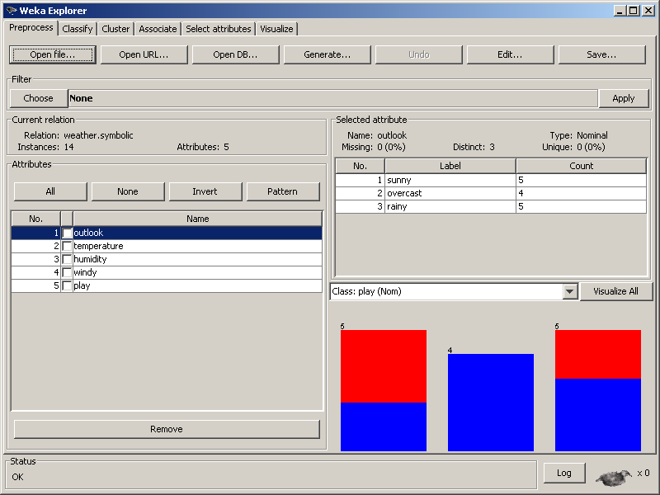
Decision Tree Induction in Weka
Preparation
Pre-processing attributes if necessary
Specifying the class attribute
Selecting attributes

Slide 19
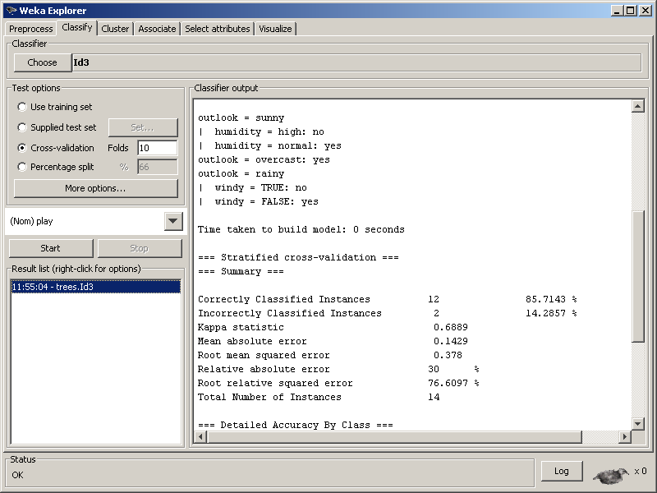
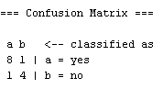
Decision Tree Induction in Weka
Constructing Classification Models (ID3)
1. Choosing a method and setting parameters
2. Setting a test option
4. View the model and evaluation results
3. Starting the process
5. Selecting the option to view the tree

Slide 20
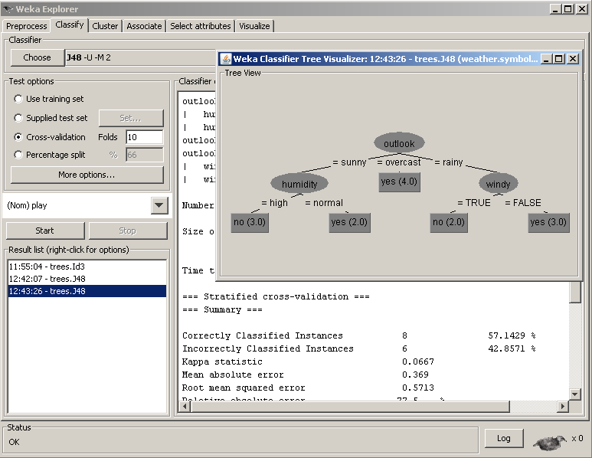
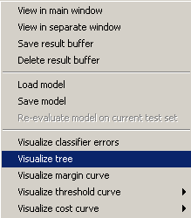
Decision Tree Induction in Weka
J48 (unpruned tree)

Slide 21
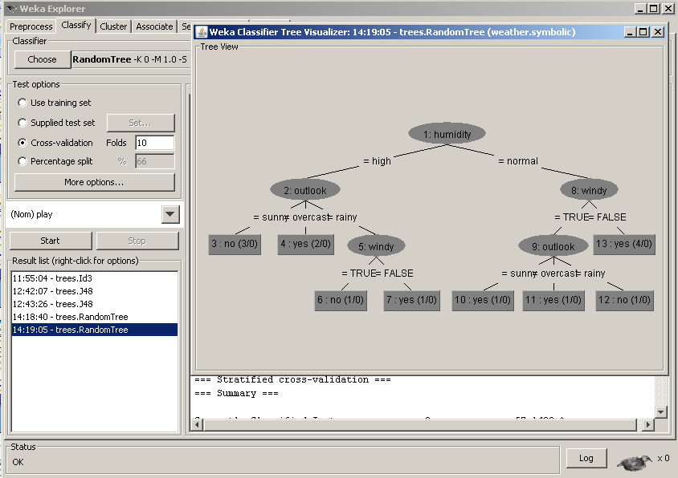
Decision Tree Induction in Weka
RandomTree

Slide 22
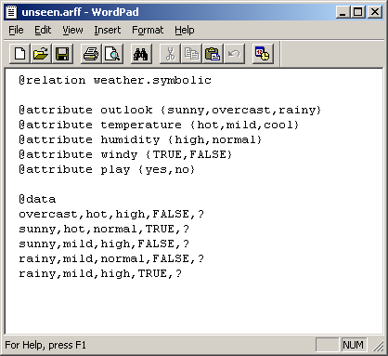
Decision Tree Induction in Weka
Classifying Unseen Records
  Preparing unseen records in an ARFF file
Class values are left as “unknown” (“?”)

Slide 23
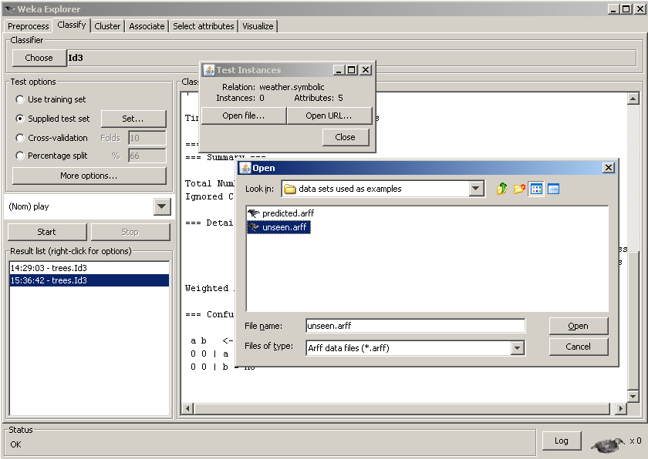
Decision Tree Induction in Weka
Classifying Unseen Records
  Classifying unseen records in the file
Selecting this option and click Set… button
Press the button and load the file
Press the button and load the file
Press to start the classification

Slide 24
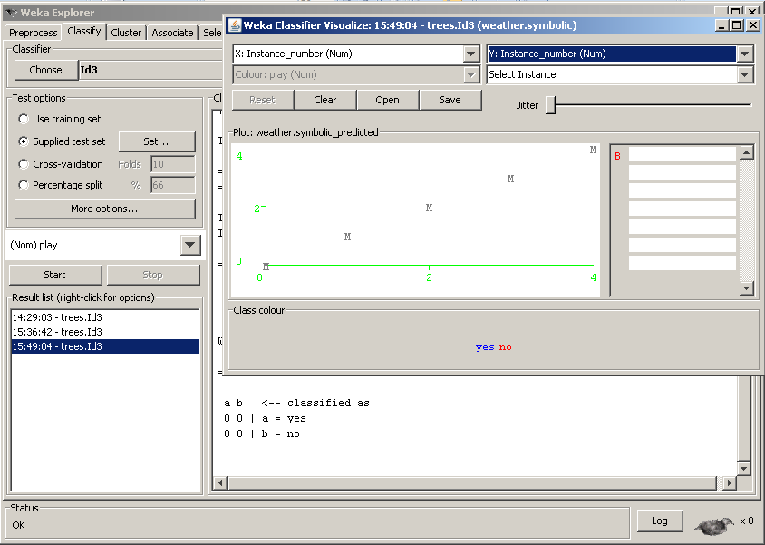
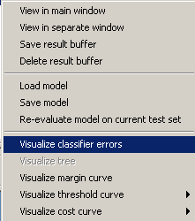
Decision Tree Induction in Weka
Classifying Unseen Records
  Saving Classification Results into a file
Setting both X and Y to instance_number
Saving the results into a file
Selecting the option to pop up visualisation

Slide 25
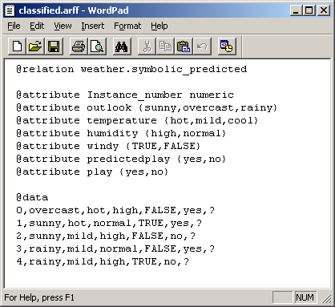
Decision Tree Induction in Weka
Classifying Unseen Records
  Classification Results in an ARFF file
Class labels assigned

Slide 26
Related Issues
Strengths and Weaknesses
  Capability of generating understandable rules
  Efficiency in classifying unseen data
  Ability to handle categorical and continuous attributes
  Ability to indicate the most important attribute for classification
  Error rate increases as the training set contains a small number of instances of a large variety of classes
  The computationally expensive to build
  Single attribute splitting results in class boxes in rectangular shapes.

Slide 27
Decision Tree Induction in Practice
Key Stages in a Classification Project with Decision Tree Induction
  Selection of class attribute
  Inclusion of descriptive attributes (manual selection of attributes to be used not recommended)
  Ensuring sufficient coverage of all classes and all descriptive values
  Data transformation, if necessary, to suit the solution
  Using a suitable test option
  Setting solution parameters (minimum number of leaf node examples, pruned or unpruned)
  Evaluating model accuracy (confusion matrix details)

Slide 28
Summary
Decision Tree is a form of classification model
A decision tree is induced from a set of training examples by using a tree induction algorithm such as ID3
There exists a common procedural framework for building a tree
Information gain is an attribute selection measure based on the idea of reduction of uncertainty over classification. There are other attribute selection measures
Tree pruning is a way of reducing the effect of model overfitting. There exists a number of tree pruning methods
Accuracy is a main evaluator for the performance of a model. Different aspects of accuracy (TP, FP, TN, FN) are important
There is a rich collection of tree induction solutions in Weka

Slide 29
Useful Further References
Coming next: Putting it all together
Chapter 6 of the main book
Tan, P-N., Steinbach, M. and Kumar, V. (2006), Introduction to Data Mining, Addison-Wesley, Chapters 4
Han, J. and Kamber, M. (2006), Data Mining: Concepts and Techniques, 2nd ed. Morgan Kaufmann, Chapter 6

