Slide 1

Research report writing
Week 9 – Digital Skills and Research methods.

Slide 2



During this session we will…
Explore each element of your research report
Provide time to attempt drafting of sections
Support with signposting to useful literature

Slide 3
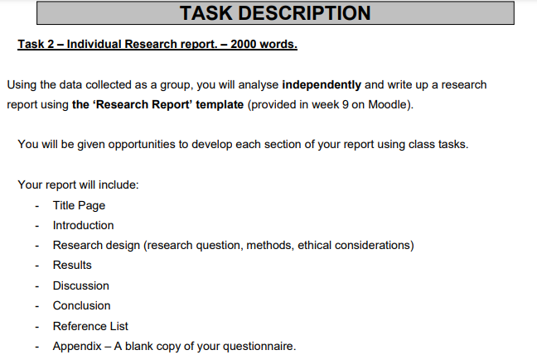


Component 2 Task – Research Report

Slide 4
Title page
All of your submissions must include a title page that clearly states: your name, your student number, the module code and title, your lecturer’s name, and your assignment title. The words in this section do not count towards your word limit. Save a copy of the Research Report Template and add your details to the title page. Remember to save a copy on to your one drive or desktop.
Notes:
For students that are in class and without a laptop could be directed to shared space computer room to complete the download and saving of the template. Emphasis the importance of completing this in class time as if students encounter issues, it is important to find out as soon as possible. Some students will already have completed this task during preceding weeks, but do allocate some time so all students have a supported opportunity to do this.

Slide 5
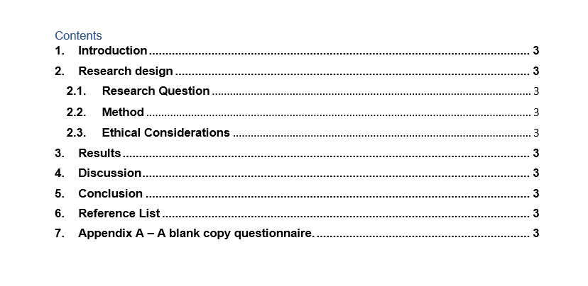
Contents page
List the different sections of your report with corresponding page numbers. The contents have been provided for you in the Research Report Template in the week 9 folder. The words in this section do not count towards your word limit.
Notes:
Explain how a contents supports the reader and adds to the professional look of a document.

Slide 6
Introduction
Introduction (≈200 words) | This section should introduce your reader to the content of your report, briefly stating what will be discussed and the context. Tell them what you’re going to tell them Here you will also provide background literature regarding the importance of digital skills either at work or when studying.
Within your introduction you can also state your chosen research question and your hypothesis.
Notes:
Remind students that the rationale that they developed during the research proposal presentation may be helpful here for providing relevant background literature.
Remind students what hypothesis means.

Slide 7
Research Design
Research design (≈600words) In this section you will need to describe:
Your chosen research question,(100 words)
The methods used in your research, including the questions asked and how you recruited participants. (400 words)
Any ethical considerations that were made. (100words)
Activity – 30 mins to begin planning or drafting your research design section of your report.
Notes:
Students should have all of this information as they have by week 9, completed their proposal and data collection.
The research question is one chosen from the three offered in the component 1 assignment brief.
The method of data collection for most will be MS Forms questionnaire.
The questions asked need to be listed, a blank copy of their questionnaire needs to be included in the appendix.
The ethical considerations should have been detailed in their group presentations – all students should have asked for consent for voluntary participation and all should have collected data anonymously. All student be committed to reporting their data ethically, not inventing or editing results.

Slide 8
Results
(≈250 words) In this section, you will detail the results from your questionnaire. To do this you might use chart, graphs or tables.
Report your results.
Are you able to create a pie or bar chart for each question?
Aim to report a result for each question asked in your questionnaire.
Here is an example chart…
Activity – 30 mins – begin or continue drafting your results section – ask your lecturer about aspects you are finding challenging.
Notes:
Last week students began to examine their results. Make it clear to students that to pass the assignment, there must be at least one result reported. Those students going for distinction marks need to demonstrate secure and varied skills so should aim to demonstrated the use of at least Pie and Bar charts which need to be labelled accurately.
Encourage students to try out different options to see what works for them. If students want to use the same type of bar chart or pie chart for each question that is fine as long as accurate and anonymised data is presented.
Results should only be reported and not discussed in the results section of the final report, discussion about what the results show should occur during the ‘discussion’ section of the report.

Slide 9



Discussion
(≈650 words) In this section you will discuss the results that have been reported in the results section..
What do your results appear to show?
  Do your question results have a clear mode?
  Is there any result which surprised you?
  How many participants took part in total?
How do your results fit with the literature that you have included in your introduction?
  Do your results agree with the results found by other researchers?
  Do your results contrast the results or ideas of other researchers?
Did your results confirm your hypothesis?
  Were you able to guess the results? Why might this be?
  Were your results a complete surprise to you?
Notes:
Make it clear to students that the discussion section is where they can begin to write about what they feel their result actually show. Those students that are aiming for merits and distinction marks will link their results with relevant literature. For example, if more participants used WhatsApp, is this expected? Have other studies found this?
Provide students with time to begin drafting their discussion section, students that do not appear to be engaging should share a plan or notes with their lecturer.
Let students know that they can mention the limitations of their study here, aim to keep information relating to limitation below 100 words.

Slide 10

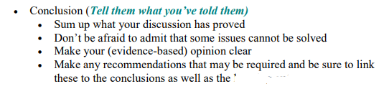
Conclusion
(≈150 - 200words) Summarise the important points that you have made in your discussion and conclude your answer to your research question.
My conclusions are…..
Notes:
Some students may already have some ideas about what their conclusions are, other student may not have analysed their results.
Allow students time to begin considering, planning or drafting their conclusive points.

Slide 11
Reference Page
All information sources should be listed in Harvard Style with a full reference for each. UWTSD Harvard referencing guide
References should be organised in alphabetical order.
You should have used a minimum of three credible and reliable sources of published information.
The words in this section do not count towards your word limit.

Slide 12
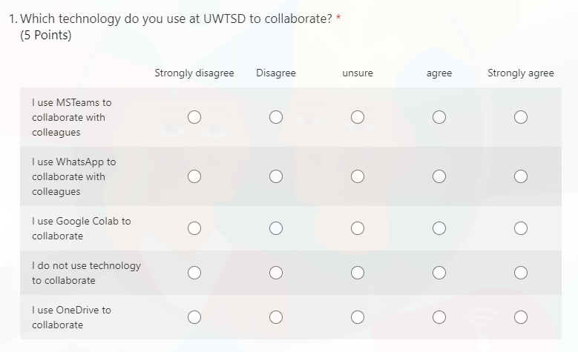
Appendix
A blank copy of your questionnaire needs to be included, this can be done by inserting an image of the questionnaire on MS Forms or by included the text of the questionnaire. All questions must be visible to the reader.
The snipping tool will help to you to take an image of each question to insert or paste into your appendix.
Alternatively, you can include just the text from the questionnaire, e.g. the list of questions.
Notes:
Demonstrate to students how they can include a blank version of their questionnaire in their appendix, text version or snipped images. All questions must be included as the assessor may use this as reference when grading the work.
Allow students time to attempt this themselves.

Slide 13
Useful literature
Different places to search for sources of information:
  The module Leganto reading list
  The UWTSD Library
  Google Scholar
Let us explore each of these together to locate relevant information sources.

Slide 14
Next week - Workshop
Bring a draft of your research report into class for feedback.
Alternatively email a copy of your draft to your lecturer for feedback.
Maximise your opportunity to gain feedback on your work in progress.

