Slide 1
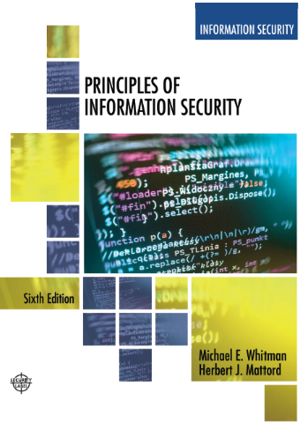
Modern Cybersecurity Governance, Business Risk & Organizational Security
Week 1
Adapted Text
Lecturer: Assoc. Prof. Carlene Campbell
Email: carlene.campbell@uwtsd.ac.uk
Website: https://www.knowledgewithprofit.com/
Notes:
“This module is designed to help you think strategically about cybersecurity, governance, risk, compliance, and organisational resilience — not just technical controls.”
Emphasise:
discussion
workplace application
critical thinking
real-world security challenges

Slide 2
Learning Objectives
Understand why cybersecurity is now a business issue, not only a technical issue
Recognise modern organisational security challenges
Understand governance vs technical security
Begin thinking strategically like a CISO/security consultant
Start connecting module concepts directly to the coursework

Slide 3
PROPOSED SESSION FLOW
Time | Activity Type
11:00–11:20 | Opening engagement discussion
11:20–11:50 | Strategic lecture segment
11:50–12:10 | Modern threat landscape discussion
12:10–12:20 | Comfort break
12:20–1:00 | Interactive case study + workshop
2:00–2:20 | Recap + assignment connection
2:20–2:50 | Governance & organisational security discussion
2:50–3:15 | Group workshop activity
3:15–3:25 | Comfort break
3:25–4:15 | Professional roundtable discussion
4:15–4:40 | Future cybersecurity discussion
4:40–5:00 | Reflection + short video

Slide 4
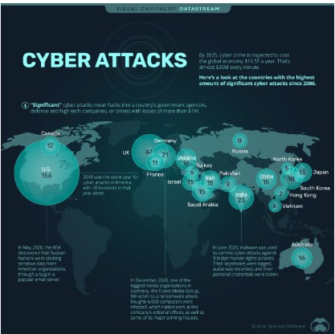
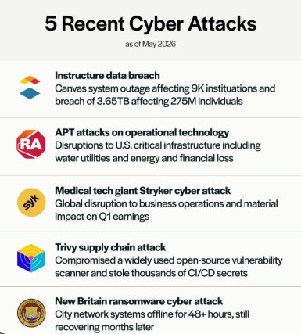
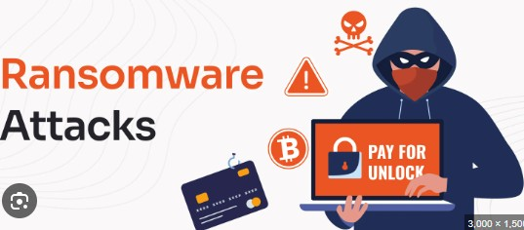
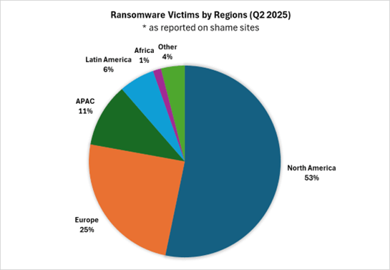
Why Cybersecurity is a Business Problem?
Cyber attacks affect:
  Operations, reputation, legal compliance, finance, customer trust
Interactive Question:
“Which causes more damage — the technical breach itself or the business disruption afterward?”
Notes:
What cyber threat worries organisations most today:
ransomware
phishing
insider threats
AI attacks
cloud breaches
Why do organisations still fail despite huge cybersecurity spending
poor governance
weak culture
compliance-only mindset
human behaviour
fragmented strategy
Examples:
NHS ransomware attacks
Change Healthcare breach
MGM Resorts attack
CrowdStrike outage implications
Students expected sample answers:
financial losses
downtime
reputational damage
regulatory fines
customer distrust
“Could a small technical weakness become a national-level crisis?”

Slide 5
Modern Cyber Threat Landscape
Modern threats:
  Ransomware-as-a-Service (RaaS)
  AI-driven attacks
  Deepfake phishing
  Insider threats
  Supply-chain attacks
  Cloud breaches
Discussion
“Is AI making cybersecurity harder or easier?”
Notes:
Cybercrime is now:
organised
professionalised
financially motivated
Automated
🔷 Ransomware-as-a-Service (RaaS)
A criminal business model where ransomware developers sell or lease ransomware tools to attackers, allowing even low-skilled criminals to launch ransomware attacks for profit.
🔷 AI-driven attacks
Cyber attacks that use Artificial Intelligence (AI) to automate, enhance, or personalise attacks such as phishing, malware creation, password cracking, and evasion techniques.
🔷 Deepfake phishing
A social engineering attack using AI-generated fake voices, videos, or images to impersonate trusted individuals and trick victims into revealing sensitive information or transferring money.
🔷 Insider threats
Security risks caused by individuals within an organisation, such as employees, contractors, or partners, who intentionally or accidentally misuse access to systems or data.
🔷 Supply-chain attacks
Attacks targeting third-party suppliers, vendors, or software providers to gain indirect access to a larger target organisation’s systems or data.
🔷 Cloud breaches
Unauthorised access, exposure, or theft of data stored in cloud environments due to misconfigurations, weak access controls, stolen credentials, or vulnerabilities.
Is AI making cybersecurity harder or easier:
Harder
automated phishing
AI-generated malware
deepfake fraud
Easier
AI threat detection
behavioural monitoring
automation of security operations

Slide 6
Business Needs vs Security Needs
https://www.youtube.com/shorts/JoCaUc3nNI4
Balance:
  usability
  accessibility
  productivity
  security
Real Example
MFA frustration:
  users want convenience
  security teams want protection
https://www.youtube.com/shorts/RdLZ89aCVJY
Interactive Question
“Should security ever slow down business operations?”
https://www.youtube.com/shorts/k_aqe2BDIQI
Notes:
Information security performs four important functions for an organization:
Protecting the organization’s ability to function
Protecting the data and information the organization collects and uses
Enabling the safe operation of applications running on the organization’s IT systems
Safeguarding the organization’s technology assets
Security teams often conflict with:
operations
productivity
business expansion
Should security ever slow down business operations?
YES
critical systems need protection
safety over convenience
NO
excessive controls reduce productivity
users bypass difficult controls

Slide 7
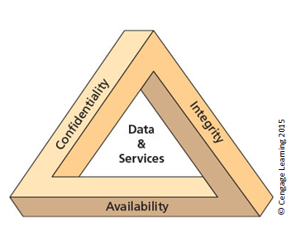
CIA Triad
Confidentiality
Integrity
Availability
“Is the CIA Triad enough for modern organisations?”
Notes:
The C.I.A. triad (see Figure above) has been the standard for computer security in both industry and government since the development of the mainframe.
This standard is based on the three characteristics of information that give it value to organizations: confidentiality, integrity, and availability.
The security of these three characteristics is as important today as it has always been, but the C.I.A.
Think about:
resilience
privacy
trust
governance
Accountability

Slide 8
Human Factors & Insider Threats
Human error
Social engineering
Phishing
Weak passwords
Misconfigurations
https://www.youtube.com/watch?v=lc7scxvKQOo
“What is the weakest security control in most organisations?”
Notes:
Threat: a potential risk to an asset’s loss of value.
Attack: An intentional or unintentional act that can damage or otherwise compromise information and the systems that support it.
Exploit: A technique used to compromise a system.
Vulnerability: A potential weakness in an asset or its defensive control system(s).
Important point:
Most breaches involve:
human behaviour
not advanced hacking
“What is the weakest security control in most organisations?”
Expected Answers
users
lack of awareness
poor culture
weak leadership

Slide 9
Governance vs Technical Security
Governance includes:
leadership
accountability
policies
risk management
compliance
decision-making
Discussion:
“Can an organisation be technically secure but poorly governed?”
Notes:
🔷 Leadership
The ability of management or executives to guide, influence, and support organisational cybersecurity strategy, culture, and decision-making.
🔷 Accountability
The responsibility of individuals or departments to answer for their actions, decisions, and security-related duties within an organisation.
🔷 Policies
Formal rules, procedures, and guidelines that define how security, data protection, and acceptable use should be managed within an organisation.
🔷 Risk Management
The process of identifying, assessing, prioritising, and reducing cybersecurity risks to an acceptable level.
🔷 Compliance
Ensuring that an organisation follows relevant laws, regulations, standards, and industry requirements related to security and data protection.
🔷 Decision-Making
The process of evaluating information, risks, and organisational priorities to make informed cybersecurity and governance choices.
Many organisations buy security tools without building security culture.
“Can an organisation be technically secure but poorly governed?”
YES:
poor policies
lack of accountability
weak incident response
poor risk ownership

Slide 10
Comfort Break (12:10 - 12:20)

Slide 11
Why Organisations Still Get Breached
Compliance-only mindset
Weak monitoring
Legacy systems
Poor patch management
Cloud misconfiguration
Third-party risk
Notes:
Compliance does not equal security.
Can an organisation pass audits and still be highly vulnerable?”
Expected:
YES.
“So is compliance useless?”
Suggested response:
“No — compliance provides baseline governance and accountability. The problem is when organisations stop at compliance instead of building resilience.”
Why do organisations still fail despite huge cybersecurity spending?”
poor governance
weak culture
compliance-only mindset
human behaviour
fragmented strategy

Slide 12
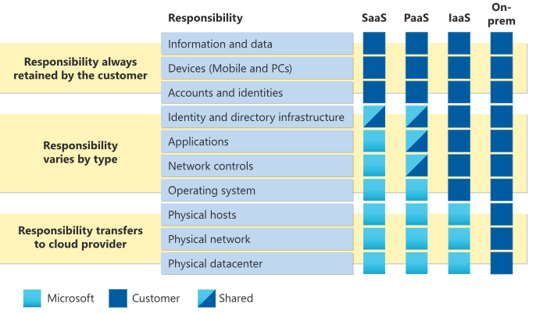
Shared Responsibility in Cloud Security
Cloud provider vs customer responsibilities
Layer | Provider | Customer
Physical Datacentre | ✅ | ❌
Network Infrastructure | ✅ | ❌
Operating System | Shared | Shared
Applications | ❌ | ✅
Data | ❌ | ✅
User Access | ❌ | ✅
Interactive Question
“Who is responsible after a cloud breach?”
Notes:
Very important for modern organisations.
cloud providers secure infrastructure
organisations still responsible for:
data
identities
access controls
configurations
IaaS (Infrastructure as a Service): You manage virtual machines, operating systems, and applications. Examples include Azure Virtual Machines, Azure Disk Storage, and virtual networks.
PaaS (Platform as a Service): You deploy applications without managing VMs or operating systems. Examples include Azure App Service, Azure Functions, Azure SQL Database, and Azure Storage.
SaaS (Software as a Service): You use ready-made applications. Examples include Microsoft 365, Dynamics 365, and other cloud applications.

Slide 13
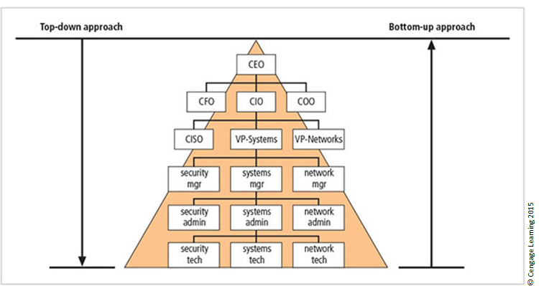
The Modern CISO Role
Modern CISOs manage:
governance
risk
compliance
board communication
resilience
strategy
NOT just firewalls.
Notes:
strongly to assignment Task 2.
Chief information security officer (CISO)‏
Has primary responsibility for assessment, management, and implementation of IS in the organization
Usually reports directly to the CIO

Slide 14
Lunch Break (1-2)

Slide 15
Assignment Introduction
Briefly Cover
Task 1 research report
Task 2 strategic proposal
emphasis on:
  analysis
  strategy
  governance
critical evaluation
Notes:
Strongly recommend topics:
Zero Trust
AI governance
cloud security
ransomware resilience
GDPR + DORA

Slide 16
Interactive Case Study
“The Company That Was Compliant but Still Breached”
Scenario
A financial organisation:
  passed audits
  had policies
  used MFA
  had annual training
BUT suffered:
  ransomware
  data theft
  operational shutdown
Discussion Questions
Why did compliance fail?
What governance weaknesses may exist?
What would YOU prioritise first?
Should leadership be blamed?
Notes:
SAMPLE ANSWERS
Q1 — Why did compliance fail?
Possible answers:
compliance may be checklist-driven
threats evolve faster than controls
employees still vulnerable
monitoring inadequate
Q2 — Governance weaknesses?
poor risk culture
lack of executive awareness
weak third-party oversight
insufficient testing
Q3 — First priorities?
isolate affected systems
activate incident response
preserve evidence
communicate internally
assess scope
Q4 — Should leadership be blamed?
Balanced discussion:
YES:
governance responsibility
underinvestment
poor culture
NO:
sophisticated attackers
some risk unavoidable

Slide 17
Group Workshop Activity
“You Are the Security Leadership Team”
Task
Identify:
  Top 5 organisational risks
  Immediate security priorities
  Governance recommendations
  Technical recommendations
Notes:
“Why?”
“What evidence supports that?”
“Would this work in reality?”
“How expensive would this be?”

Slide 18
Comfort Break (3:15 – 3:25)

Slide 19
Future of Cybersecurity
AI vs AI security
Zero Trust
behavioural analytics
cyber resilience
cloud-native security
quantum risks
https://www.youtube.com/shorts/UMb1qqps9SA
Discussion
“Will future security failures be caused more by technology or human decision-making?”
https://www.youtube.com/shorts/0TIJJuUQhho

Slide 20
Reflection
What is the single biggest cybersecurity challenge organisations face today?
What is ONE thing your organization could improve immediately?
https://www.youtube.com/watch?v=uvKTMgWRPw4
Notes:
open discussion
workplace examples
differing opinions

Slide 21
Reference Links
NIST Cybersecurity Framework
Excellent foundational governance framework.
NIST Cybersecurity Framework
UK NCSC Board Toolkit
Excellent governance-focused resource.
UK NCSC Board Toolkit
ENISA Threat Landscape
Strong modern cyber threat overview.
ENISA Threat Landscape
IBM Cost of a Data Breach Report
Excellent organisational impact discussion.
IBM Cost of a Data Breach Report
Verizon Data Breach Investigations Report (DBIR)
Excellent for statistics and trends.
Verizon DBIR
Shared responsibility in the cloud
https://learn.microsoft.com/en-us/azure/security/fundamentals/shared-responsibility

