Slide 1
Presentation for module:ECYW6003
By Laura Morrissey John :1904214
Date:22nd March 2022

Slide 2
Focus Group: Young people in Care
Adverse childhood Experiences (ACES)
Individual case study of ‘Jack’.
Application of theories (resilience, trauma, adversity and attachment) to Jack’s case study.
Role of the youth worker and interventions to reduce or limit risk of further adversity with Young people in care.
Policy, Frameworks and legislation.

Slide 3

What do we mean by Care?
Differences between ‘looked after’ people in foster care, and adopted young people.
Foster Care:
Short, Immediate, long term.
Birth parents still have legal parental responsibility.
Adopted:
Permanent
Parental responsibility is dissolved.
(Schofield and Simmons, 2009)
All young people who are aged 18 will no longer be classed as ‘looked after’. (NSPCC.Org, 2022)
Image: CYPNow, (2020

Slide 4
Facts and Statistics to consider
Approximately 62% of looked after young people are at risk of any type of abuse (sexual, physical, emotional or bullying).(Schofield and Simmons, 2009, p.120)
75% of mental health disorders develop before the age of 18 (Sanders, 2020)
Hillier et.al, (2019) argues that care givers are unable to adequately support young people in the care setting, which impacts on the emotional, social and educational development of that young person.
Risk of adopted young people facing further adversity such as being pushed back into the care system as a result of lack of support from relevant support networks and organisations. (Letten, 2020).

Slide 5

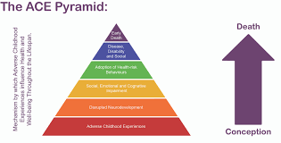
Adverse Childhood Experiences (ACES)
Negative, traumatic experience in childhood.
Potential to further disrupt lives of young people if left unaddressed or unmanaged.
Toxic stress.
Finkelhor et, al (2008) explains that there is a 69% chance Young people already experiencing adversity will go on to experience one or more.
Youth work helps to ‘buffer’ adversity.
Image Sources (top right to bottom): CCInform,(2020), Liverpool CAHMS, (2019).

Slide 6

Case Study: Jack
*Trigger Warning*
23 years old
Father of Three children (two with current partner)- supportive.
Not much success with employment. Currently unemployed
Always seems ‘absent minded’
Constantly in debt.
Image: MarketingDonut, 2022

Slide 7

Breakdown of Jack’s adversity
In foster care from the age of 5 until 18
Witnessed parental breakdown.
Taken from family- placed 200 miles away from father and brother to live with mother and stepfather.
Suffered emotional and physical abuse by stepfather, which resulted in hospitalization from injuries.
Social services intervention- placed in FOUR different care homes.
Finally settled, with the possibility for adoption, Jack moved 300 miles away.
Image: Lancashire Telegraph, 2019

Slide 8
Maladaptive Behaviour (Frydenberg and Lewis. 1991), and Coping Strategies.
Engaging in Risky behaviour, (Coleman, 2011, p.214) such as having Sexual relations, taking drugs, regularly running away.
Emotional and physical impact: Bed wetting, sleep disorders and denial and shame.
The Children’s Act (1989) contradicting policy?

Slide 9

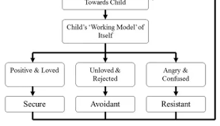
Resilience and Attachment theory
Resilience is the ability to ‘bounce back’ from adversity.
Resilience can be pre-determined by attachments made in early childhood.
Social and Environmental factors can impact on a young person’s resilience (Hobart and Frankel, 2009, p.35).
Girls and Boys different coping styles (Frydenberg and Lewis, 1991).
Image Sources: John Bowlby (1969) ‘Internal working model’, top right. Resilience, ‘Nottingham Trent University, (2022) Bottom Right.

Slide 10

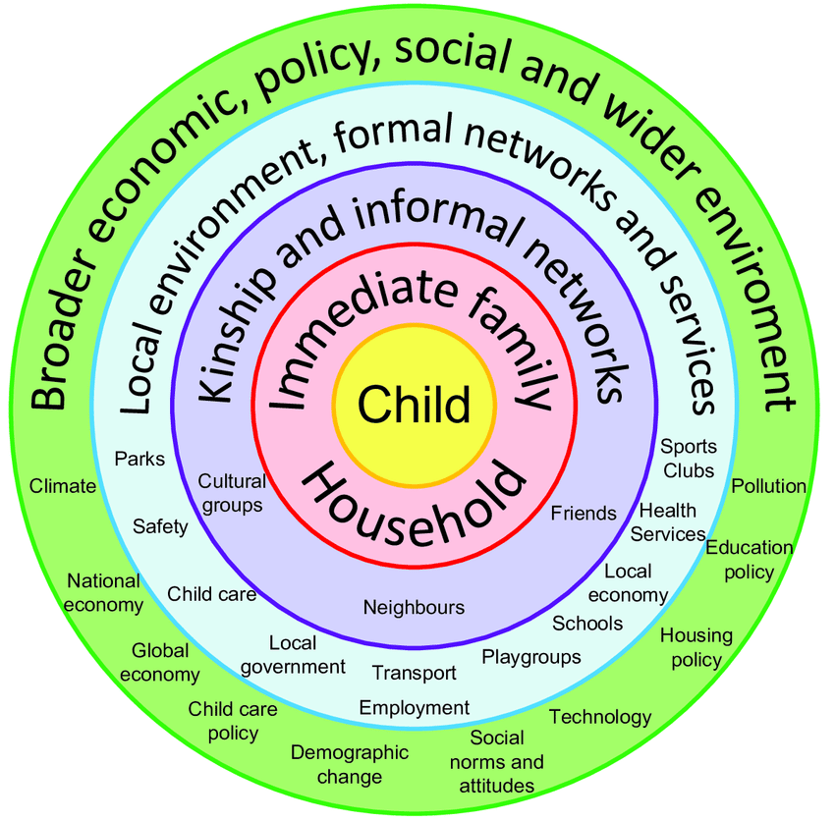
Protective Factors and Risk Factors
According to Protective factors approaches in child welfare framework (2020), and Bronfenbrenner’s ‘Ecological system theories model’ (1979)
Young people can be directly and indirectly affected by various factors that impact on their overall development and wellbeing.
Positive attributes:
Individual
Family
Community
(Garmezy and Rutter, 1983).
Image Sources from bottom to top: Bronfenbrenner’s ‘Ecological system theories model (1968), Researchgate, (2016). National Insititute on Drug Abuse, (2002)

Slide 11
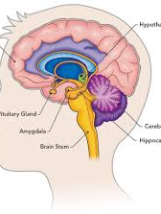

Adolescence:already a tough time for young people
Adolescence is a transitional phase (Coleman, 2011, P.10)
Physical and Psychological changes as a result of the developing brain and puberty. (Casey and Jones, 2011).
Impact these changes have on the social, emotional and educational lives of our young people.
ACEs adds to pressure and result in Toxic stress which has a destructive impact on brain development.(Center on the developing child, 2022).
Image Sources: Right to Left: Dreamstime.com, (2022). Lets talk science, (2019)

Slide 12

The unique role of youth work/youth worker
Youth work puts young people at the centre of everything we aim to do.
Strive to protect and enhance the holistic wellbeing of young people whilst providing opportunities that allow young people to thrive.
Youth work cares about how young people feel.
To help Buffer young people against adversity…
Image: Letham4all, (2021)

Slide 13

What support do young people need from youth work, and how do we intervene?
Youth work in itself is an intervention!
Welfare of the child is paramount (Childrens Act, 1989, 2004)
Youth work prides itself on staying true to the values and principles set out in the National Occupational standards for Youth Work in Wales (CLD Standards Council, 2019).
Sapin states the foundation of good youth work is building good, trusting relationships (2013, p.62).
Image: YouthLinkScotland, (2019)

Slide 14

Prevention strategies against:
Toxic stress and adversity

Slide 15
Take a ‘strength based approach’(2012).
Incorporating the ‘Five ways to wellbeing’ (NEF, 2008) throughout practice.
Promoting young people’s rights (UNCRC, 1989).
Safeguarding an protecting young people:
Summary of the functional map for youth Work in Wales (CLD Standards Council, Scotland, 2019)

Slide 16
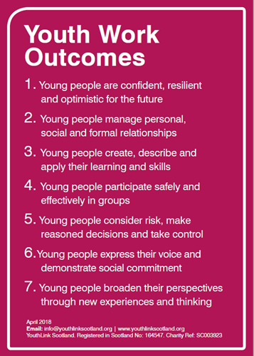
Youth work settings and contexts
Youth clubs as a preventative measure.
Targeted Youth provision
Learning skills and Resilience work
Youth Engagement work
Multi- agency working
Advocates for young people
Image: YouthLinkScotland, (2019)

Slide 17
Youth worker’s as researchers (Sapin, 2013)
The author states in community profile to explore the socio- economic impact on young people’s lives.
Develop the activities or project.
Varied throughout different youth work context.
Voluntary principle is paramount.

Slide 18

Summarisation

Slide 19
References
References.
Adebiyi, R., 2020. 'Working with adolescents requires a different skillset and mindset' - Community Care. [online] Community Care. Available at: <https://www.communitycare.co.uk/2020/07/09/working-adolescents-requires-different-skillset-mindset/> [Accessed 26 March 2022].
Banks, S., 2012. Ethical Issues in Youth Work. 2nd ed. Hoboken: Taylor and Francis, p.114.
Bowlby J. (1969). Attachment. Attachment and loss: Vol. 1. Loss. New York: Basic Books.
Bronfenbrenner, U., 1979. Ecology of Human Development. 1st ed. Cambridge: Harvard University Press.
Casey, B., Jones, R. and Somerville, L., 2011. Braking and Accelerating of the Adolescent Brain. Journal of Research on Adolescence, [online] 21(1), pp.21-33. Available at: <https://www.ncbi.nlm.nih.gov/pmc/articles/PMC3070306/> [Accessed 20 March 2022].

Slide 20
Center on the Developing Child at Harvard University. 2022. Toxic Stress. [online] Available at: <https://developingchild.harvard.edu/science/key-concepts/toxic-stress/> [Accessed 26 March 2022].
Cldstandardscouncil.org.uk. 2019. The Summary of the functional Map. [online] Available at: <https://cldstandardscouncil.org.uk/wp-content/uploads/YouthWorkNOS2019Intro.pdf> [Accessed 20 March 2022].
Coleman, J., 2011. The Nature of Adolescence. 4th ed. New York: Routledge, pp.10,214.
Education.vic.gov.au. 2012. strength based approach. [online] Available at: <https://www.education.vic.gov.au/documents/childhood/professionals/learning/strengthbappr.pdf> [Accessed 21 March 2022].
Finkelhor, D., Ormrod, R., Turner, H. and Hamby, S., 2005. The Victimization of Children and Youth: A Comprehensive, National Survey. Child Maltreatment, [online] 10(1), pp.5-25. Available at: <https://pubmed.ncbi.nlm.nih.gov/15611323/> [Accessed 18 March 2022].

Slide 21
Frydenberg, E. and Lewis, R., 1991. Adolescent coping: the different ways in which boys and girls cope. Journal of Adolescence, [online] 14(2), pp.119-133. Available at: <https://www.sciencedirect.com/> [Accessed 10 March 2022].
Hiller RM, Halligan SL, Meiser-Stedman R, et al:, Supporting the emotional needs of young people in care: a qualitative study of foster carer perspectives :BMJ Open 2020;10: e033317. doi: 10.1136/bmjopen-2019-033317
Hobart, C. and Frankel, J., 2009. A practical guide to activities for young children. 3rd ed. Cheltenham: Nelson Thornes, p.35.
Legislation.gov.uk. 1989. Children Act 1989. [online] Available at: <https://www.legislation.gov.uk/ukpga/1989/41/contents> [Accessed 21 March 2022].

Slide 22
Legislation.gov.uk. 2004. Children Act 2004. [online] Available at: <https://www.legislation.gov.uk/ukpga/2004/31/contents> [Accessed 21 March 2022].
Legislation.gov.uk. 2011. Education Act 2011. [online] Available at: <https://www.legislation.gov.uk/ukpga/2011/21/contents/enacted> [Accessed 17 March 2022].
Letten, R., 2020. Adoption Awareness.
New Economics Foundation. 2008. Five ways to wellbeing. [online] Available at: <https://neweconomics.org/2008/10/five-ways-to-wellbeing> [Accessed 21 March 2022].
NSPCC Learning. 2021. Statistics about looked after children | NSPCC Learning. [online] Available at: <https://learning.nspcc.org.uk/research-resources/statistics-briefings/looked-after-children> [Accessed 18 March 2022].

Slide 23
Sanders, R., 2020. Care experienced children and young people’s mental health. [online] Iriss. Available at: <https://www.iriss.org.uk/resources/esss-outlines/care-experienced-children-and-young-peoples-mental-health> [Accessed 20 March 2022].
Sapin, K., 2013. Essential skills for youth work practice. 2nd ed. Los Angeles, Calif.: SAGE, p.148.
Schofield, G. and Simmonds, J., 2009. The child placement handbook. 1st ed. London: BAAF, p.120.
Ukyouth.org. 2021. Benefits of youth work to current Government priorities: August 2021. [online] Available at: <https://www.ukyouth.org/wp-content/uploads/2021/08/Benefits-of-youth-work-to-current-govt-priorities.pdf> [Accessed 10 March 2022].
Unicef UK. 1989. UN Convention on the Rights of the Child - UNICEF UK. [online] Available at: <https://www.unicef.org.uk/what-we-do/un-convention-child-rights/> [Accessed 17 March 2022].
Young, K., 1999. The art of youth work. 1st ed. Lyme Regis: Russell House, p.96.

