Slide 1
QGIS Introduction
how it works

Slide 2
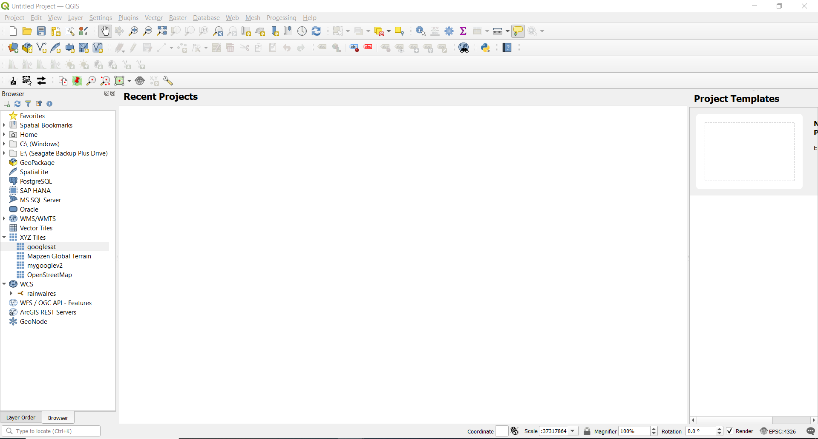
QGIS main SCreen

Slide 3
Tool bars
The largest main area data will be displayed. We will refer to this throughout the document as the map pane.
The area to the left of the map pane contains the Layers and Browser panels.
The Layers panel is the area where the individual layers of data will be displayed. The Browser panel allows us to navigate between data directories to search for and locate data. Below the map pane, we find important information such as (from left to right),
the current map coordinates, map scale, and the (currently inactive) project coordinate reference system (CRS)

Slide 4
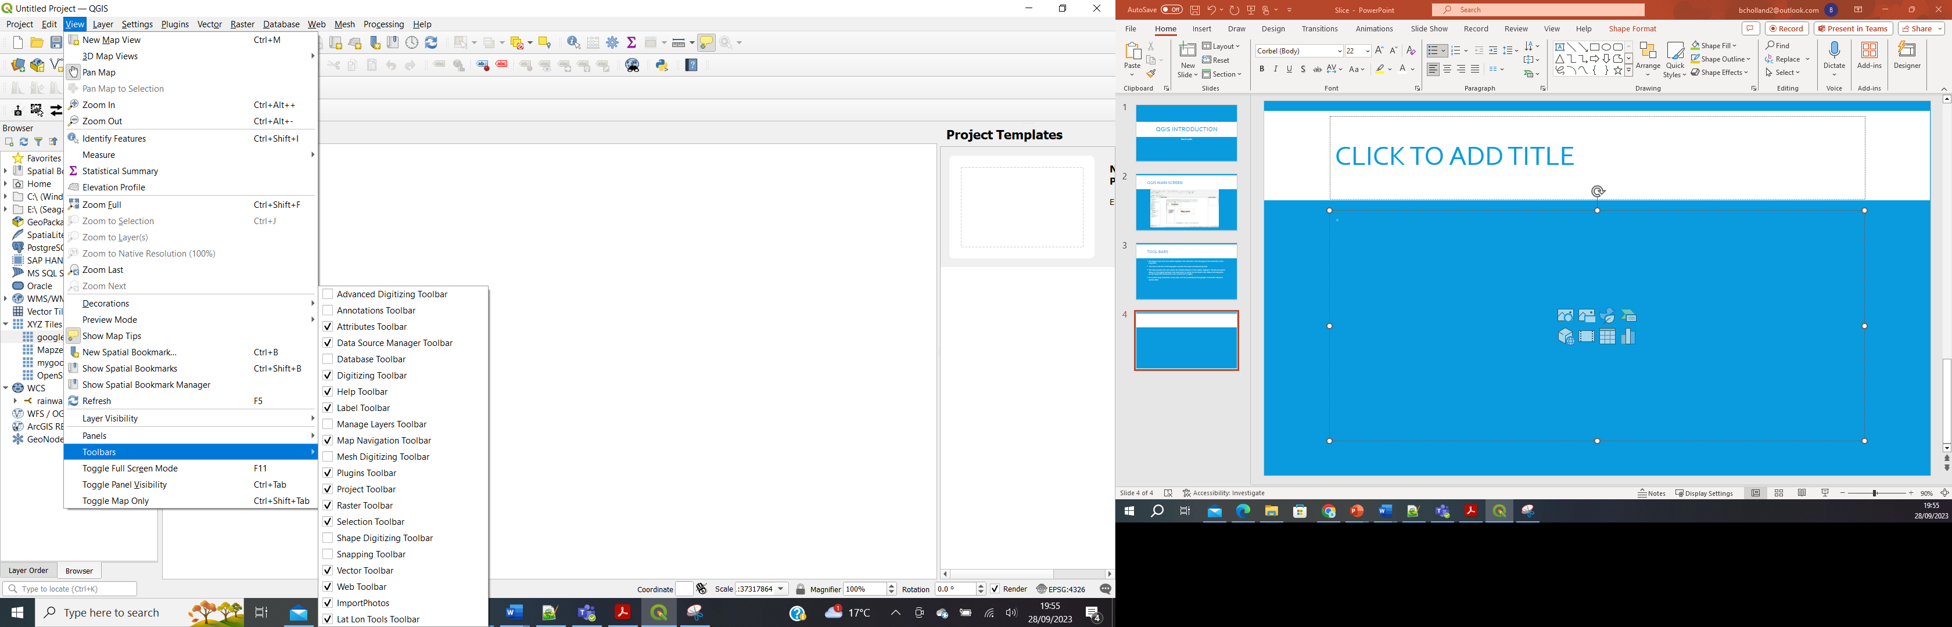
Looking at the tool bars

Slide 5
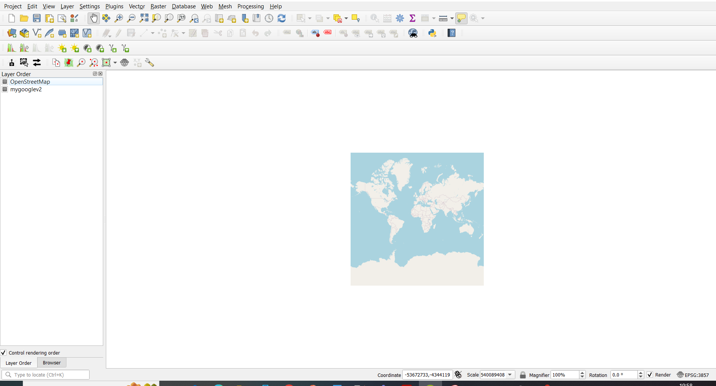
Looking at the layers
We have two layers open openstreetmap and goggle earth
We can also toggle between a browser view and a layer view

Slide 6
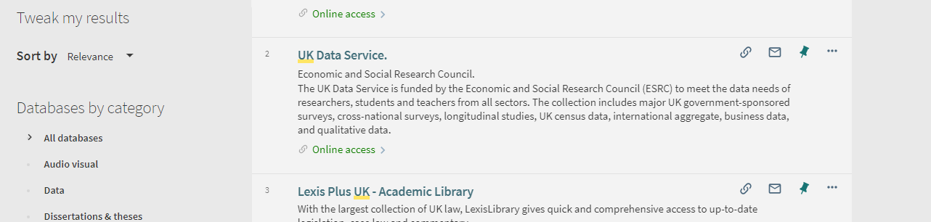
UK Data services

Slide 7
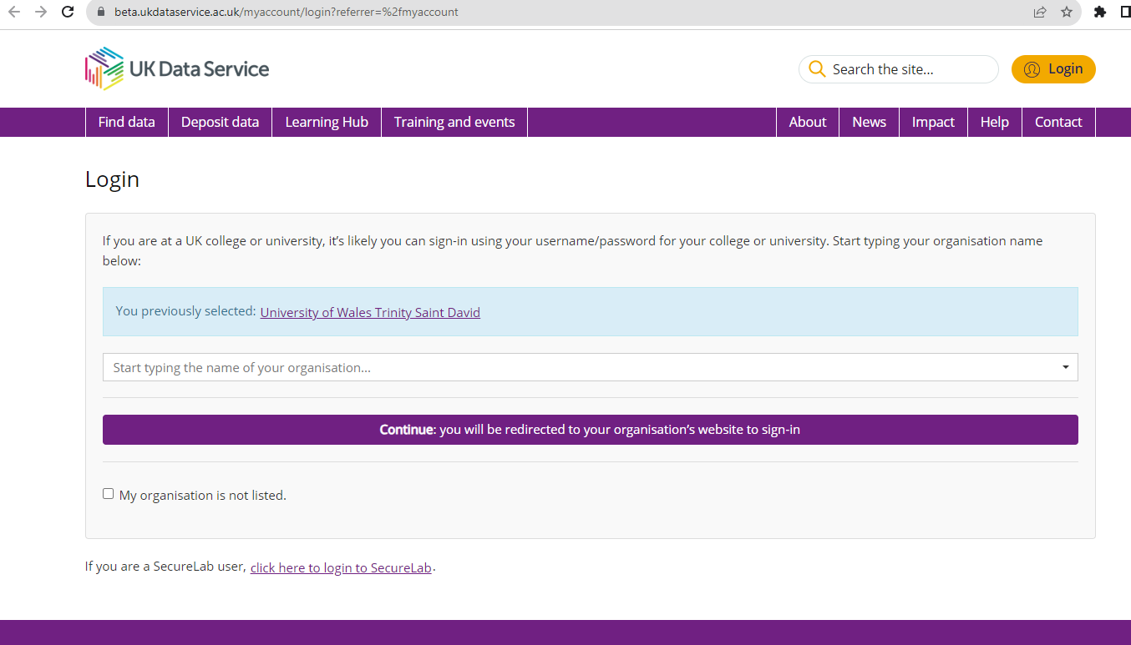
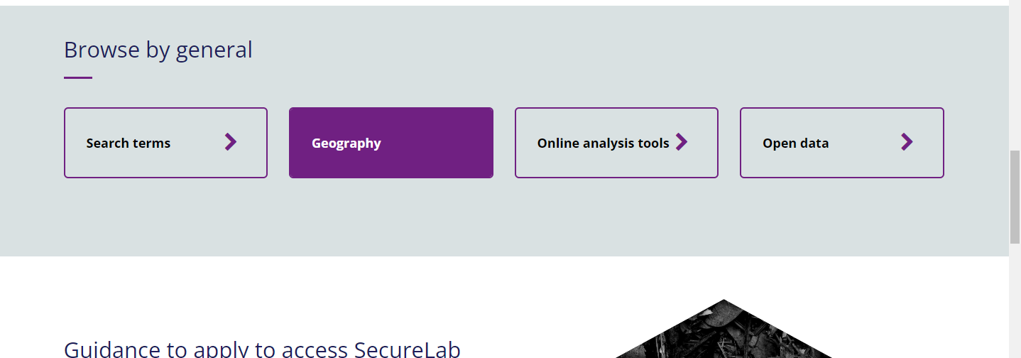
Scroll to Get Data

Slide 8
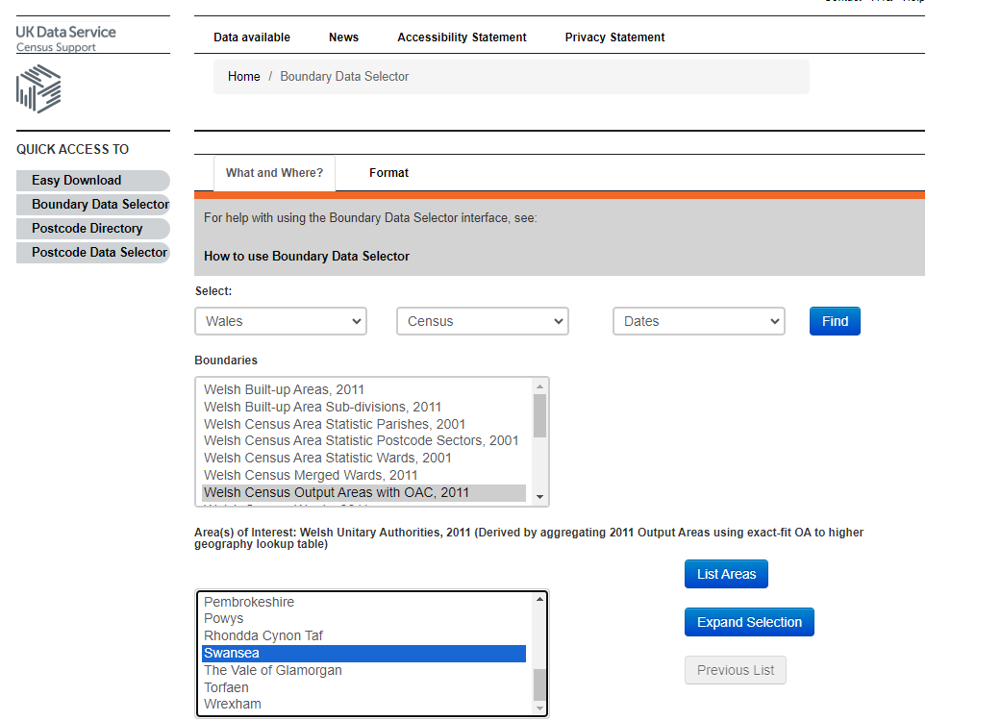
Using The Boundary data selector

Slide 9
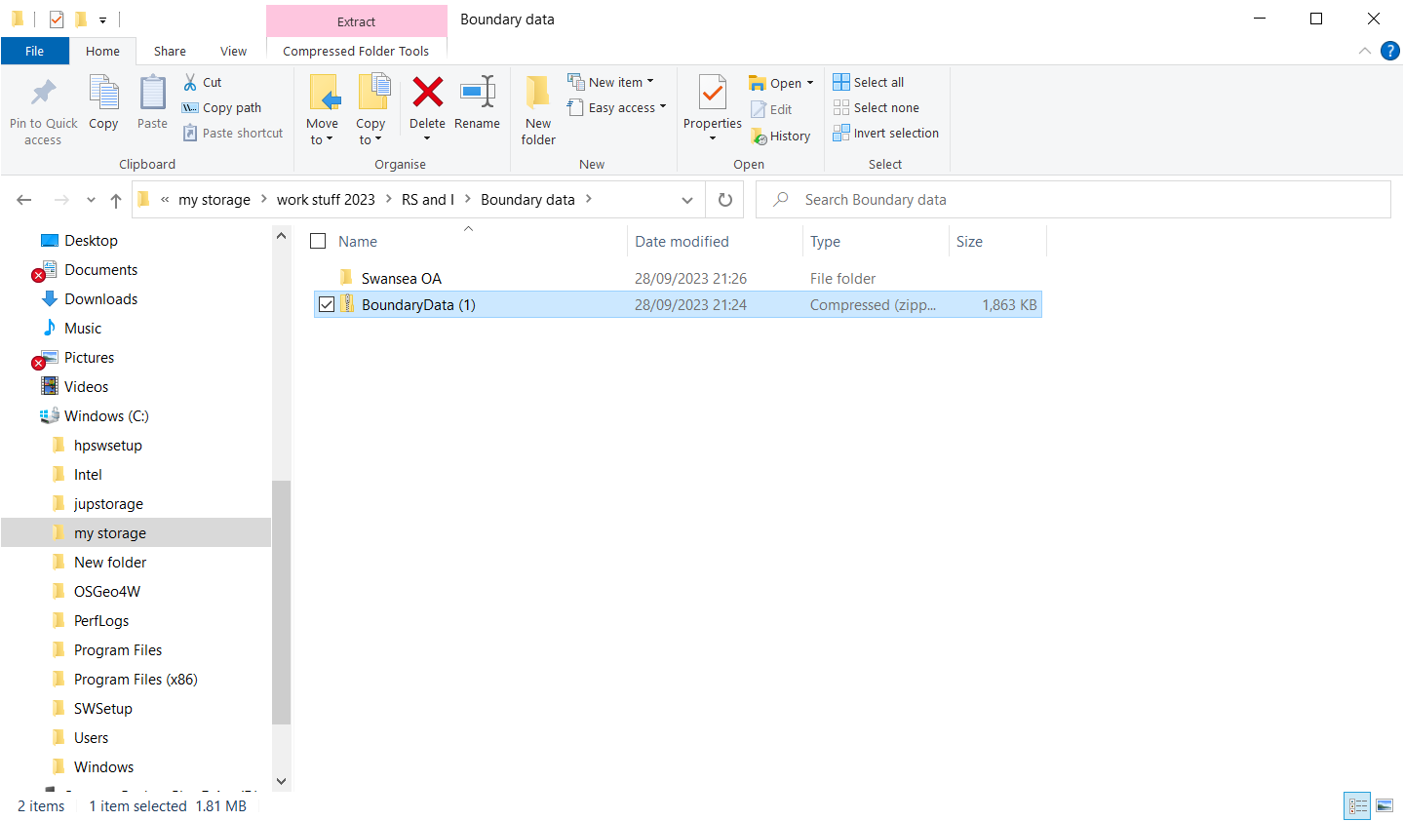
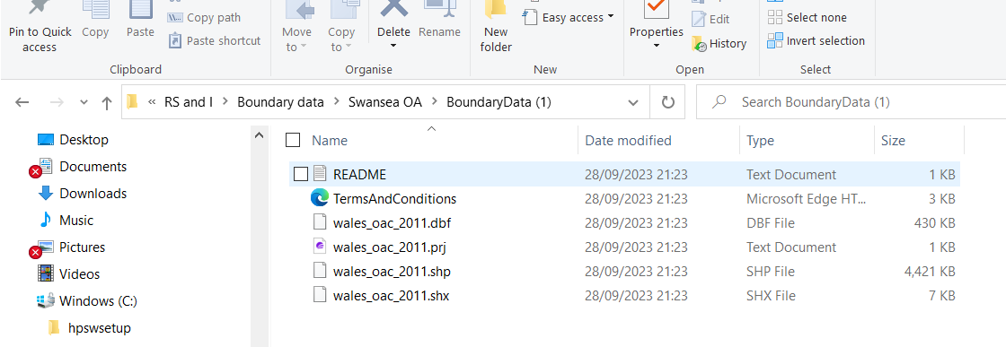
Setting up Directories for Map data downloads
Notice we have 4 files if you want to move a map file you have to move all 4 together

Slide 10
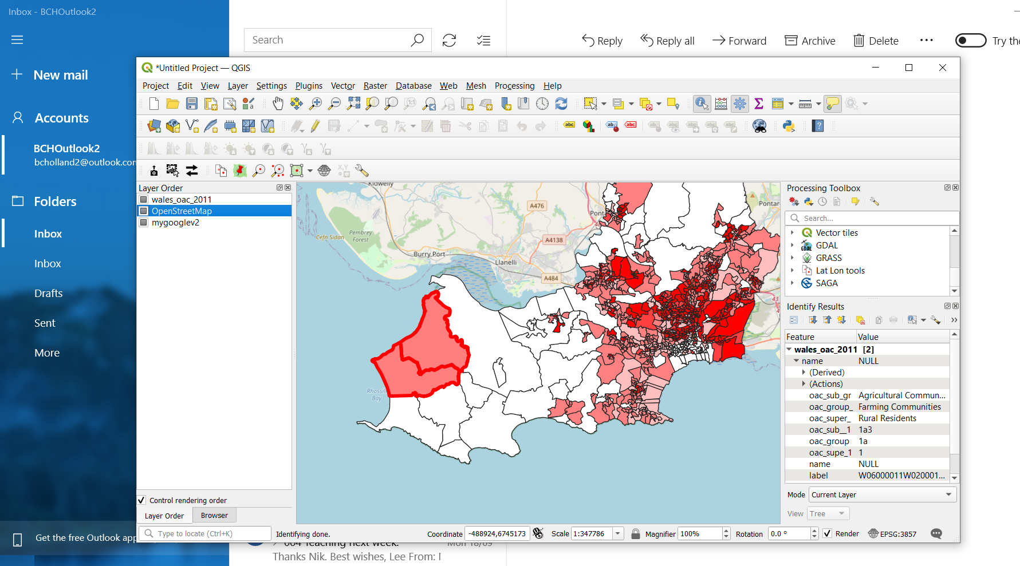
Layering the data on the qgis Map pane

