Slide 2
Critical Thinking
Module Name: Group Project
Module Code: ACBA4014
Applied Computing - WISA

Slide 3

Critical Thinking
Everything should be made as simple as possible, but not simpler…
[Albert Einstein]

Slide 4
Critical Thinking
What is thinking?
  Discuss the definitions, considering biological, psychological, cognitive and communicational descriptions.
Q. What do you consider to be critical thinking?

Slide 5
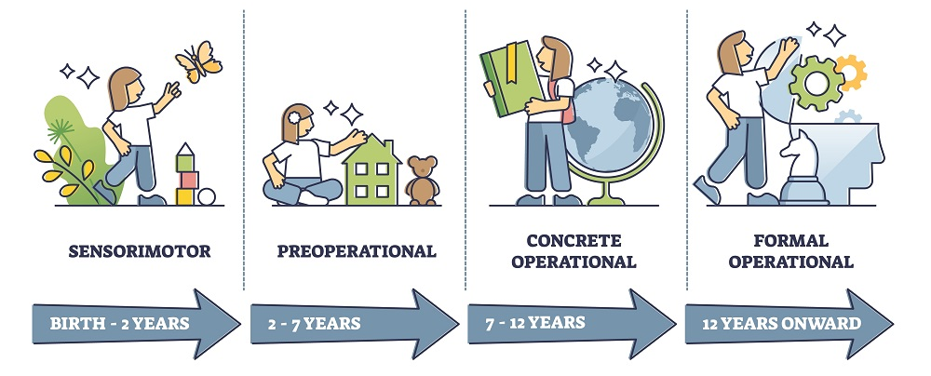
Cognitive Development
There are five stages to cognitive development as recognized by Piaget:
Notes:
The theory of cognitive development was proposed by psychologist Jean Piaget. He suggested that children move through four different stages of mental development. Here are the stages:
Piaget believed that children take an active role in the learning process, acting much like little scientists as they perform experiments, make observations, and learn about the world¹.
As kids interact with the world around them, they continually add new knowledge, build upon existing knowledge, and adapt previously held ideas to accommodate new information

Slide 6
Cognitive Development
Sensorimotor stage, Birth to 2 years old:
  No thinking structures (called schemas) and starts to develop such schemas through exploration of senses and experimentation with environment​.
  Understanding of object permanence, knowing that an object exists even if it is out of sight.

Slide 7
Cognitive Development
Preoperational Stage:
  Development of language skills and more sophisticated cognitive structures but still prelogical. ​
  Not capable of conservation-ability to understand that substance does not change although it changes shape or form.​
  Incapable of decentering-ability to see things from another perspective​.
Notes:
Children in this stage start to engage in symbolic play and learn to manipulate symbols.
However, they still struggle with logic and taking the point of view of other people

Slide 8
Cognitive Development
Concrete Operational:
  Begin to think more logically, grasp conservation and decentering.
  Begins to question life. Solves problems but haphazardly.​
  Lack of understanding for abstract or hypothetical concepts.
Notes:
Children in this stage begin to think more logically about concrete events, but have difficulty understanding abstract or hypothetical concepts

Slide 9
Cognitive Development
Formal Operations Stage:
  Now capable of sophisticated logical thought.
  Can think in abstract.
  Can think hypothetically and solve problems using the logic of combinations.
Notes:
Children in this stage begin to think more logically about concrete events, but have difficulty understanding abstract or hypothetical concepts

Slide 10
Cognitive Development
(Note: Many theorists postulate a fifth Stage: “postformal”)​
Dialectical Reasoning:
  Stage beyond logic where critical thinking lies.
  Ability to perceive the frequent paradoxes in life and question and analyse the assumptions that underlie logic.
Notes:
One proposed fifth stage is the “Postformal Stage” or "Problem-Finding Stage“

Slide 11
Critical Thinking
CRITICAL THINKING CONSISTS OF THREE STEPS:
Becoming aware that assumptions exist​
Making assumptions explicit​
Assessing their accuracy ​
  Do these assumptions make sense?​
  Do these assumptions fit reality as we understand and live it?​
  Under what conditions do these assumptions seem to hold true?
  Under what conditions do they seem false?

Slide 12
Critical Thinking
CRITICAL THINKING CONSISTS OF THREE STEPS:
Becoming aware that assumptions exist​
Making assumptions explicit​
Assessing their accuracy ​
  Do these assumptions make sense?​
  Do these assumptions fit reality as we understand and live it?​
  Under what conditions do these assumptions seem to hold true?
  Under what conditions do they seem false?

Slide 13
Discussion
Q. Why is critical thinking important within academia?

Slide 14
Discussion
Why is critical thinking important within academia?
  All actions, decisions, and judgments spring from assumptions - if they are unchecked or inappropriate, we will make poor decisions and wrong judgments.

Slide 15
Discussion
Why is critical thinking important within academia?
  All actions, decisions, and judgments spring from assumptions - if they are unchecked or inappropriate, we will make poor decisions and wrong judgments.
  In the workplace we avoid stagnation and are willing to challenge the current paradigms which are uncritically accepted and may have come down in the workplace from a time and thinking which is no longer relevant to our current reality.

Slide 16
Discussion
What does not thinking critically look like?

Slide 17
Discussion
What does not thinking critically look like?
  We blindly reproduce the damaging reactions we have learned​
  We blindly accept at face value all justifications given by organizations and political leaders​
  We blindly believe TV commercials​
  We blindly trust political commercials​
  We blindly accept and say that if the textbook says it, it must be so​
  We blindly accept and say that if the organization does it, it must be right

Slide 18
Discussion
What does thinking critically look like?
  Contextual sensitivity - being sensitive to stereotypes about people from a particular group and trying to accept others at face value unconditionally​
  Perspective thinking - trying to get into the other person's head, or walking in the other person's shoes so as to see the world the way that person sees and perceives the world.​
  Tolerance for ambiguity - ability to accept multiple interpretations of the same situation​
  Alert to premature ultimatums - invoking a powerful idea or concept which inspires such reverence that any further debate is forestalled. e.g. a politician invokes "democracy"

Slide 19
Critical Thinking – Cognitive Skills
Consider six cognitive skills for critical thinking:
  Interpretation​:
    Comprehend & express meaning or significance of wide variety of experiences, situations, data, events, judgments, conventions, beliefs, rules, procedures, or criteria.​
  Analysis​:
    Identify the intended & actual inferential relationships among statements, questions, concepts, descriptions, or other forms of representation intended to express belief, judgment, experiences, reasons, information, or opinion​
  Evaluation​:
    Assess the credibility of statements or other representations which are accounts or descriptions of a person’s perception, experience, situation, judgment, belief, or opinion; and to assess the logical strength of the actual or intended inferential relationships among statements, descriptions, questions, or other forms of representation

Slide 20
Critical Thinking – Cognitive Skills
Consider six cognitive skills for critical thinking:
  Inference:
    Identify and secure elements needed to draw reasonable conclusions; to form conjectures and hypotheses;
    to consider relevant information & to educe the consequences flowing from data, statements, principles, evidence, judgments, beliefs, opinions, concepts, descriptions, questions, or other forms of representation​
  Explanation​:
    State the results of one’s reasoning; justify that reasoning in terms of evidential, conceptual, methodological, criteriological, and contextual considerations upon which one’s results were based; and to present one’s reasoning in the form of cogent arguments.​

Slide 21
Critical Thinking – Cognitive Skills
Consider six cognitive skills for critical thinking:
  Self-regulation:​
    Self consciously to monitor one’s cognitive activities, the elements used in those activities, and the results educed, particularly by applying skills in analysis and evaluation to one’s own inferential judgments with a view toward questions, confirming, validation, or correcting either one’s reasoning or results.

Slide 22
Discussion
Put these in order:
  understand the logical connections between ideas​
  identify, construct and evaluate arguments​
  detect inconsistencies and common mistakes in reasoning​
  solve problems systematically​
  identify the relevance and importance of ideas​
  reflect on the justification of one's own beliefs and values

Slide 23
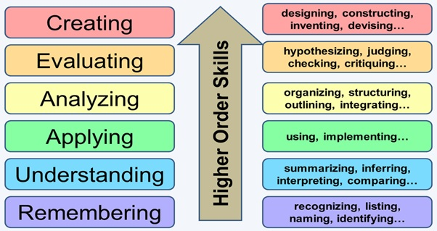

Slide 24
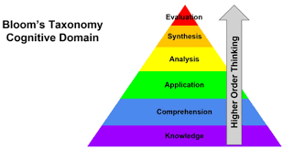

Slide 25
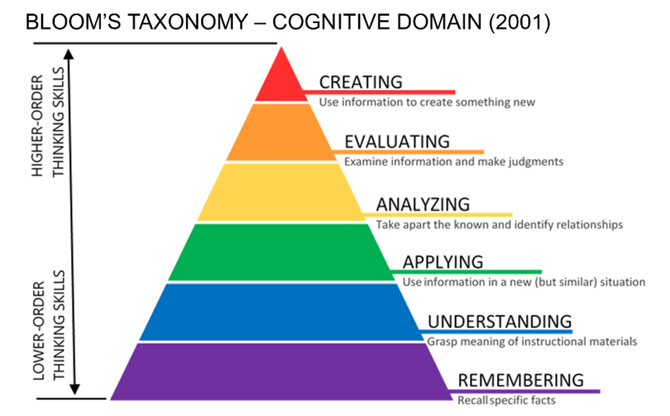

Slide 26
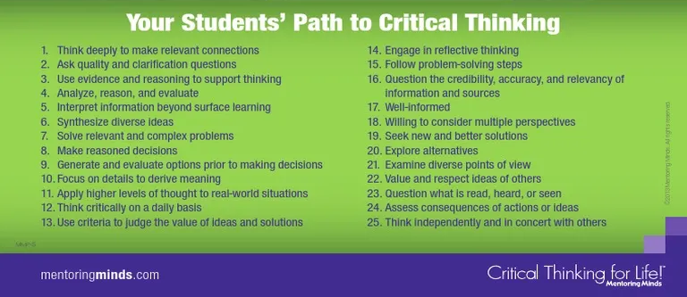

Slide 27
Any Questions?

