Slide 1
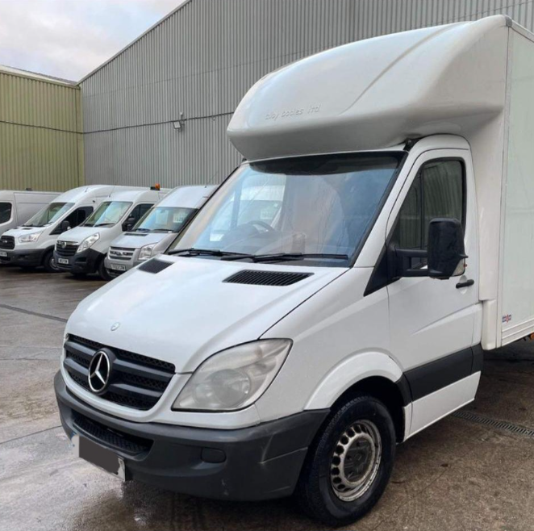
TITLE Page
Programme of Study: Certificate in Higher Education Business skills for the workplace -LCLM4006
Module Name and Code: Enterprise and Entrepreneurship
Assignment Title: Business Plan – 7-11 Couriers and Removal
Lecturer’s Name: Ejike Udeogu
Student Name: Shammica Dash
Student ID: 2428718
Submission Date: 16/03/2026

Slide 2
Overview of the business
7-11courier and removal will provide:
Same- day courier services
Student accommodation moves
Local house removals (3 bedrooms max)
Packing and unloading services
Delivery and collection of furniture
Relocation of small office
End of tenancy cleaning
This business will be operating mainly within Birmingham and nearby areas such as Solihull, Wolverhampton, Reddith and Cannock. The focus of this is to provide a trustworthy and kind service branding, a lot of people who may worry about unreliable services, damaged items, or hidden charges. 7-11's plan is to stand out by using an environmentally friendly electric van, being fully transparent about fees, punctual and taking good care of customer’s belongings.

Slide 3
Legal format and management structure:
7-11 courier and removal will be operating as a sole trader business, meaning the owner will control all decisions, keeps the profits and is solely responsible for any debts. A sole trader structure is suitable since it is easy to set up, keeps costs low in the early stages and limits the paperwork that a limited company would have.
Even though it is the owner’s responsibility for all debts, the financial threat is very low because the business size is small and does not need a large amount of cash for startup. Once the business grows, it can possibly become a limited organisation for more funding and protection.
The business will be registered with HMRC and be able to operate legally in the Uk under the Self-employment regulations.

Slide 4
Three important Pestel Analysis external factors
Economic Factor –This directly affects the removal industry, during strong economic periods, more
people buy homes and move. During recessions. fever house purchases may reduce demand.
However, rental moves still create steady demand even in difficult economic times.
Fuel prices will also be directly affected operating expenses.
Technological Factors- Technology plays a big role in marketing and communication. Customers
often search online for “removal companies near me.” Having a website and social media presence is
Essential. Online maps and route planning apps help reduce fuel costs and travel time.
Environmental Factors- Environmental awareness is increasing. Customers may prefer businesses
that: Use fuel-efficient vehicles
Recycles packing materials
Reduce waste
Fuel emission regulations may also affect vehicle choices in the future

Slide 5


Two Major Marketing strategies
Social Marketing – Instagram and Facebook accounts will showcase the business, promotional offers, customer reviews and completed jobs.
Word of Mouth- Customers that are satisfied will be confident in leaving online reviews and recommend the service to family or friends.

Slide 6
Funding requirement and allocation
7-11 Courier and Removals will need the estimated cost of £25,000 for their funding to cover all startup costs in Birmingham. This funding will support the van, equipment, insurance, branding and website. The estimated startup expenses are:
Funding sources:
. £15,000 business loan
. £10,000 personal savings
A loan will be suitable to use because the income will start immediately once jobs are being secured. Customer’s usually pay for the service after it is completed, which supports cash flow.
Monthly operating costs:
. Marketing: £200
. Maintenance: £300
. Miscellaneous: £300
. Insurance: £200
. Fuel: £1,200
Estimated monthly cost: £2,200

Slide 7
Items | Estimated cost
Used electric Van | £14,000
Insurance (goods in transit & vehicle | £2,500
Equipment ( (tools, straps, trolley & blankets | £1,500
Marketing | £1,500
Fuel (1st month) | £1,000
Branding and website | £1,000
Miscellaneous | £3,500
Total | £25,000

