Slide 1

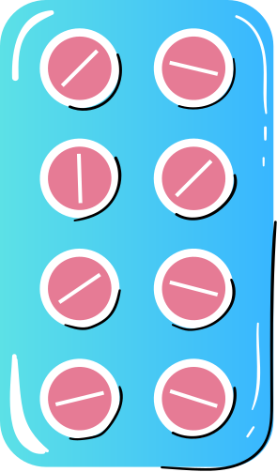




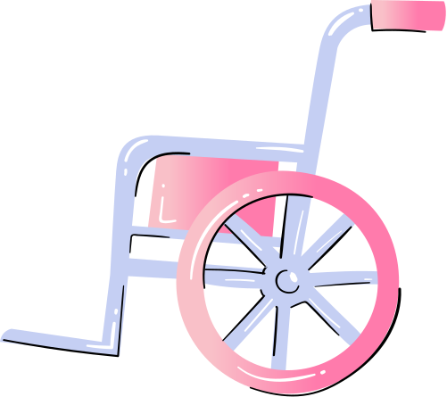
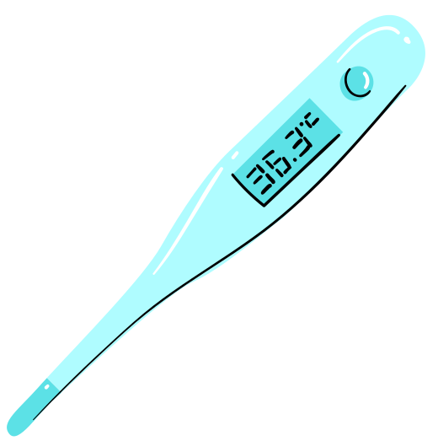



Lifestyle And Health: Life-course Perspective
Celeste Bryant
BMNS4014

Slide 2


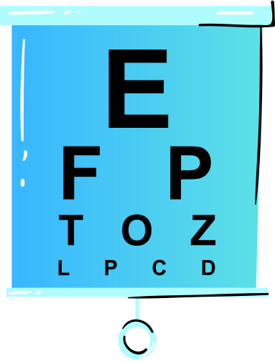
AGENDA
01
02
03
04
Early life impact
On aging.
Impact of lifestyle choices on aging.
References.
Life Course Approach

Slide 3
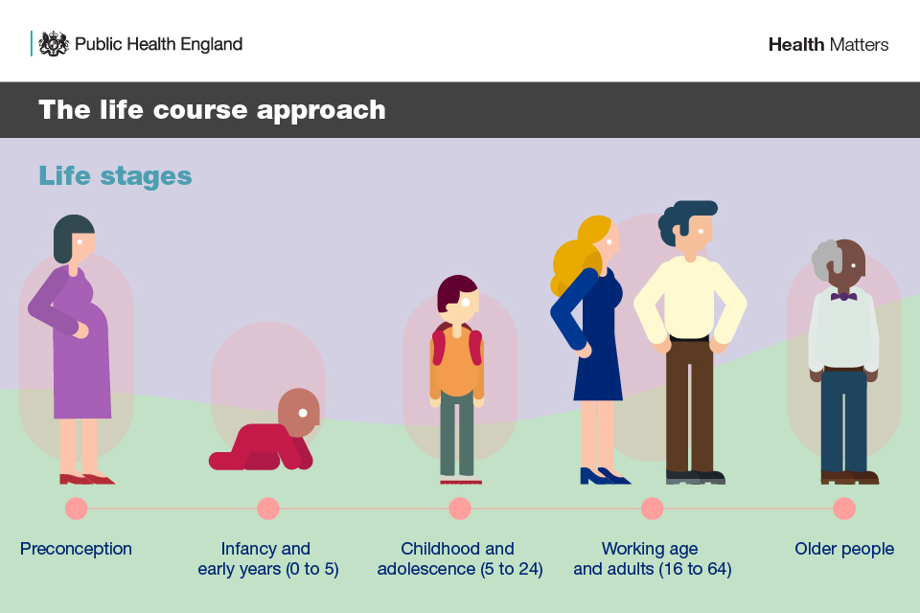
Life Course Approach
A Life course Approach in health is a framework that assess wellbeing and the effects of various determinants on health at various life stages. (Public Health England, 2019).
What does a healthy lifestyle look like?
Healthy Diet
Balanced physical activities
Healthy Body weight
No Smoking
Moderate Alcohol intake (Tello, 2020).

Slide 4


EARLY LIFE IMPACTS ON HEALTH
Nathan, age 6 years old. Diagnosed with Hearing impairment in both ears. No family history of hearing loss. He is the youngest of 2 older brothers. History of being bullied in school and mocked for his speech delay.
Diagnosis | Interventions
Hearing Impairment in Both ears | Universal newborn hearing screenin
Speech Delay | Speech and language therapy

Slide 5



Understanding Nathan
Evaluation
Intervention
Support
Universal newborn hearing screening tests aids in early identification. (NHS, 2021).
UNHS is 1 of 11 NHS national population screening programs. (NHS, England). .
"Prior to UNHS programs, the average literacy, social and speech development of children with Permanent hearing loss was lower than peers with normal hearing" (Yoshinaga-itano, Manchaiah & Hunnicutt, 2021).
Social polices aid ensures all people are included in society. Equality Act 2010(UK Government, 2010).
National Deaf children society, focuses on advocating for deaf children. (National Deaf Society, n.d).
Notes:
(Interventions)
Research on cohlear implant
- how serve re the diagnosis’s require a cohlear implant
-statistics on how technology has impacted health care world
Support
Link how in BSL has become mandatory in needed interviews, court proceedings, hearings, public forums etc(INCLUSION-

Slide 6




Nathan Life-course plan
Physical Activity
1.
"The majority of disabled children are able to participate in sport when they have access to facilities and appropriately trained staff to support them" (Xu,Li & Wang, 2020).
IT
Nutrition
2.
Poor nutrition occurs in children when their diets includes a high intake of fat, sugar and salt. (The royal children college Melbourne, N.D) .
Social Determinants
Studies show that Children with Hearing impairment or delayed access to speech interventions show regressed signs of Theory of mind (Fulcher et al., 2021).
3.
Health & Social Policies
British Sign Language Act of 2022 (gov.uk, 2023).
equality act of 2010 (gov.uk,2015).
4.
Timeline
Notes:
A review taken on the physical activity of disabled children to non sidabled children proved how more active non disbaled children are to diabled children. This brigns up the quaetion of saafegurding and how to create and inclusive enviroment for sports.
A key social determinant studied in children with Hearing impairment revealed children sjowed delayed patterns in Theory of mind concepts.Theory of mind(TOM) typically develops around ages 3-5 years.
Almost 21% of PHL children report to have at least one psychologicl condition (depression, social anxiety) compared to about 12% of hearing children. – link to national deaf society support groups

Slide 7
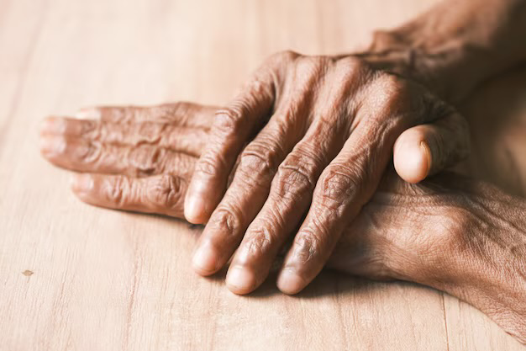
IMPACTS OF LIFESTYLE CHOICES ON AGING.
John is 75 years old. Grew up in a low income household.
Smoked 1 pack per day through his early teens, quit at 50
Worked a desk an IT desk job- minimal physical exercises.
Diet high in processed foods.
Diagnosis | Intervention
Type 2 Diabetes & Obesity | Insulin + Lifestyle change
Difficulty breathing and mobility | Oxygen Therapy

Slide 8

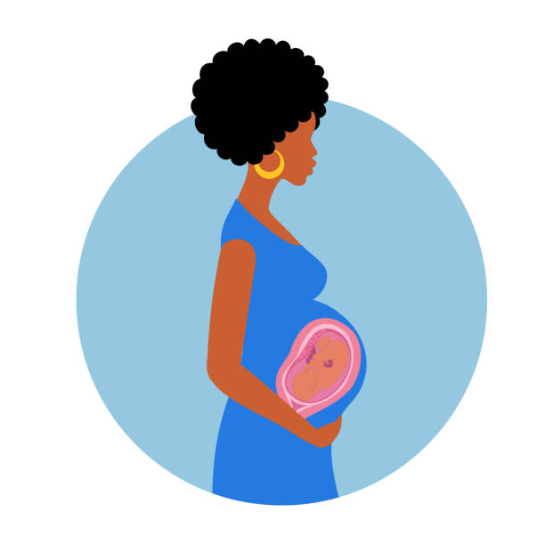

Understanding John
Puts forward the hypothesis that prenatal and postnatal environmental conditions have long term effects on health, growth and metabolism. (Fall, 2013).
Income
Fetal Programming
smoking
A low income household holds 70% below the median annual income. (welsh government, 2024).
Pensioners were most likely out of all age groups to be in persistent low income thresholds(government digital service, 2022).
A respiratory research results showed that smoking cigarettes, led to dysregulated aging related genes in the lungs lining as well as, shorter telomere in the airways (Walters et al, 2014).
Notes:
"Among white british people, Pensioners were most likely out of all age groups to be in persistent low income thersh (11%)" (governmenr digital service, 2022).

Slide 9
IMPACT OF LIFESTYLE CHOICES ON
AGING.
Income Support
AGE UK is one of the many financial programs set up to provide aid to older people (Age UK, 2024)
1.
IT
Treatment Intervention
A major treatment intervention associated with diabetes 2 is a full lifestyle change, its proves to lower blood sugar levels and possibly stopping diabetes. ( NHS, 2025).
2.
Social Support
3.
" You can go weeks without speaking to anyone. I don't see my neighbours- they are nearly all new neighbours and younger than me. If you don't go out by the end of the day in the house. You look at it and you think this place is making me scream" ( Lester et al., 2012).
Health Literacy
4.
poor health literacy is prevalent among elderly patients, with over 33% of adults aged 65+ and up to 80% of patients in public hospitals.
(Williams et al., 2002).
Timeline
Notes:
There are financial support groups, polices and pension schemes.

Slide 10


CONCLUSION
.
The life course approach to health is a continuous cycle. The case studies and data compiled highlights how early life experiences and lifestyle choices through adolescent years all interconnect and impact aging.
The benefits of Health professionals and the adaptive nature of technology all used to ensure better well being.

Slide 11
REFERENCE LIST
REFRENCE
Age UK, 2025. Benefits and entitlements. Available at: https://www.ageuk.org.uk/information-advice/money-legal/benefits-entitlements/ (Accessed: 19/02/25).
2. Fulcher, A., Sargeant, A., de Rosnay, M., Hopkins, T., Neal, K. and Davis, A., 2021. Communication That Leads to Successful Social Inclusion For Children With Hearing Loss: Are Excellent Speech and Language Skills Sufficient? Australasian Journal of Special and Inclusive Education, 45(2), pp. 108-121. (Accessed: 14/03/25).
3. Government Digital Service, 2022. Low income: Pay and income statistics. Available at: https://www.ethnicity-facts-figures.service.gov.uk/work-pay-and-benefits/pay-and-income/low-income/latest (Accessed: 19/02/25).
4. Government of Wales, 2023. Material deprivation and low income, April 2022 - March 2023. Available at: https://www.gov.wales/material-deprivation-and-low-income-april-2022-march-2023 (Accessed: 19/02/25).
5. Harvard Health Publishing, 2018. Healthy lifestyle: 5 keys to a longer life. Available at: https://www.health.harvard.edu/blog/healthy-lifestyle-5-keys-to-a-longer-life-2018070514186 (Accessed: 21/02/25).
6. Lester, H., Mead, N., Graham, C.C., Gask, L. and Reilly, S., 2012. An exploration of the value and mechanisms of befriending for older adults in England. Ageing and Society, 32(2), pp. 307-328. (Accessed: 14/03/25).
7. National Health Service (NHS), 2025. Health benefits of eating well. Available at: https://www.nhsinform.scot/healthy-living/food-and-nutrition/eating-well/health-benefits-of-eating-well/ (Accessed: 09/03/25).
.

Slide 12
9. National Health Service (NHS), 2025. Newborn hearing screening test. Available at: https://www.nhs.uk/conditions/baby/newborn-screening/hearing-test/ (Accessed: 12/03/25).
10. Public Health England, 2022. Health matters: Prevention - a life course approach. Available at: https://www.gov.uk/government/publications/health-matters-life-course-approach-to-prevention/health-matters-prevention-a-life-course-approach (Accessed: 19/02/25).
11. Royal Children’s Hospital Melbourne, 2025. Poor nutrition in older children. Available at: https://www.rch.org.au/kidsinfo/fact_sheets/Nutrition_older_children/ (Accessed: 21/02/25).
12. The Child Protection in Sport Unit (CPSU), 2025. Deaf and disabled young people in sport. Available at: https://thecpsu.org.uk/help-advice/topics/deaf-and-disabled/ (Accessed: 14/03/25).
13. UK Government, 2022. The British Sign Language (BSL) report 2022. Available at: https://www.gov.uk/government/publications/the-british-sign-language-bsl-report-2022/the-british-sign-language-bsl-report-2022 (Accessed: 19/02/25).
14. UK Government, 2025. Newborn hearing screening programme overview. Available at: https://www.gov.uk/guidance/newborn-hearing-screening-programme-overview#newborn-hearing-screening-tests (Accessed: 12/03/25).
15. Walters, M.S., De, B.P., Salit, J., Buro-Auriemma, L., Wilson, T., Rogalski, A.M., Lief, L., Hackett, N.R., Staudt, M.R., Tilley, A.E., Harvey, B., Kaner, R.J., Mezey, J.G., Ashbridge, B., Moore, M.A.S. and Crystal, R.G., 2014. Smoking accelerates aging of the small airway epithelium. Respiratory Research, 15. (Accessed: 13/03/25)
REFRENCE
.

Slide 13
16. Yoshinaga-Itano, C., Manchaiah, V. and Hunnicutt, C., 2021. Outcomes of Universal Newborn Screening Programs: Systematic Review. Journal of Clinical Medicine, 10(13), pp. 2784. (Accessed: 12/03/25).
REFRENCE
.

