Slide 1
Public Health and Social Care in Practice Dissertation Module
LCHS7004
Workshop 1
Structuring your dissertation
Week 1

Slide 2
Learning outcomes
Upon successful completion of this module, student should be able to:
Using the feedback on the proposal from the research module assessment. prepare a research/independent study protocol outlining how the proposal will be implemented, mapping the steps, activities and processes, required resources, time frames;
Plan, manage and execute an in-depth research, inquiry or investigation with a business and/or management focus by applying the principles of research design to the formulation of a research question including, where appropriate, formal hypotheses that can be tested and the selection of appropriate research methods for answering these questions;
Critically evaluate the appropriateness of qualitative/quantitative methods of data collection, in combination as necessary, to analyse, synthesise, interpret and present the resulting data and the applications of those methods by other researchers in other contexts;
Demonstrate the ability to conduct research under supervision in a Public Health and Social Care context including the ability to review published literature critically, show conceptual and theoretical understanding, identify research problems, use skills to promotion of digital health, manage systems and services in health and social care settings and other resources, handle data, interpret results and disseminate findings in a way that is consistent with professional public health and social care practice and normal principles of research ethics;
Exhibit the analytical, numerical, literacy, communication and computer skills to enable critical research to be undertaken and be able to apply those transferable skills to develop research-based inquiry in future employment settings.

Slide 3
Dates Key Deliverables
September 2026
Task​ | Date​ | Week​
1. Resubmission Research Proposal, Ethics form, Supporting research docs (Ethical approval)​ | By 5th October 2026 | 2​
2. Three-minute informal in class discussion PICO ​ | Workshop 2nd | 4
3. Start Research​ | Week of 12th October 2026 | 3​
4. Submission Dissertation​ | 22nd January 2027 | 16​ ​
5. Online Scheduled Skills Sesson (Librarian/ Digital Advisors) | 20th October 2026 17th November 2026 11.15am | Week 4 Week 8
6. Scheduled Workshops required attendance + Independent Learning Session | 21st October 2026 18th November 2026 | Week 4 Week 8
Notes:
If not in class will have to discuss your research in following weeks

Slide 4
Aims of the Session
To understand
Why a dissertation is written
Which elements are required as part of writing a dissertation
The structure of a dissertation
Why a research protocol is written
Engage with individual learning tasks
Please be mindful for these workshops to bring a laptop (if you have one) or borrow a laptop downstairs (8h30am) near the Library, or use the university computers

Slide 5
Reasons for a dissertation
Marks the end of a very important stage in an educational journey.
Provides the opportunity to collate all the analytical and critical thinking skills acquired during university studies.

Slide 6
Aim of a dissertation
To showcase your skills and ability to conduct your own research and present this in an original piece to the academic Public Health and Social Care community.

Slide 7
The writing process
Compiling a dissertation can be challenging
However, there are various things do that can help with getting dissertation-ready

Slide 8
Setting up the writing process
Make sure to find out all the resources and activities that the university offers to support through the dissertation,
Check out any study skills resources available on the module Moodle page,
Get support from the Library Services (e.g., Refwork)

Slide 9
Setting up the writing process
For help with Academic Writing, Language Writing, book appointments or attend drop-in sessions for Skills Support on campus, or online | Library Chat, Library Accessibility and Resources | University of Wales Trinity Saint David, Academic and InfoSkills | UWTSD Intranet
Check the free online English grammar resource for university academic writers at | NIC Library & Learning Commons and British Council LearnEnglish
Attend remotely Study Skills session | Learning Support | University of Wales Trinity Saint David
Attend Digital Skills Session to upskill in using IT | Digital skills for students - DigiCentre | University of Wales Trinity Saint David, or email digitalskills@uwtsd.ac.uk
Use LinkedIn learning for free online video tutorials, ranging from research design to digital tools | LinkedIn Learning - DigiCentre | University of Wales Trinity Saint David

Slide 10
The dissertation structure (1)
Can have slight variations of the dissertation structure,
Nonetheless, the overarching flow will always be the same,
This flow reflects the research process,

Slide 11
Reflecting the flow of the research process
The introduction chapter
  presents the core research question and aims.
The literature review chapter
  assesses what the current research says about this question.
The methodology, results and discussion chapters
  go about undertaking new research about this question.
The conclusion chapter
  (attempts to) answer the core research question.

Slide 12
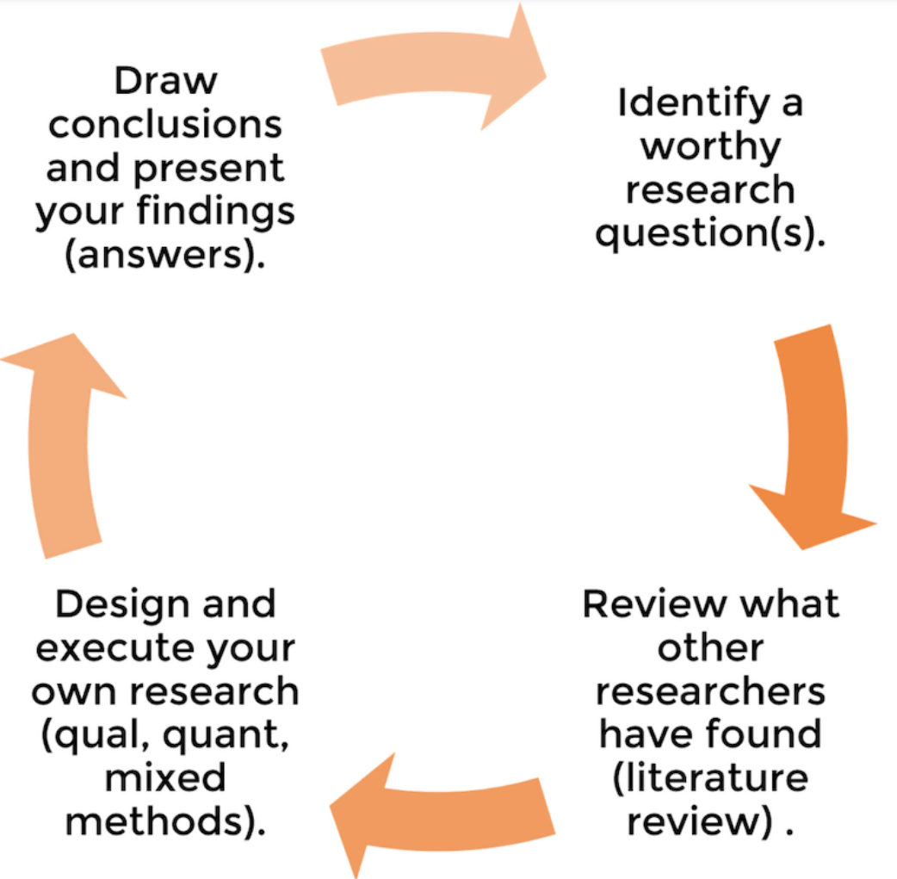
The dissertation structure (2)
In other words, the dissertation structure and layout reflect the research process of asking a well-defined question, investigating, and then answering the question
(Jansen, 2019)

Slide 13
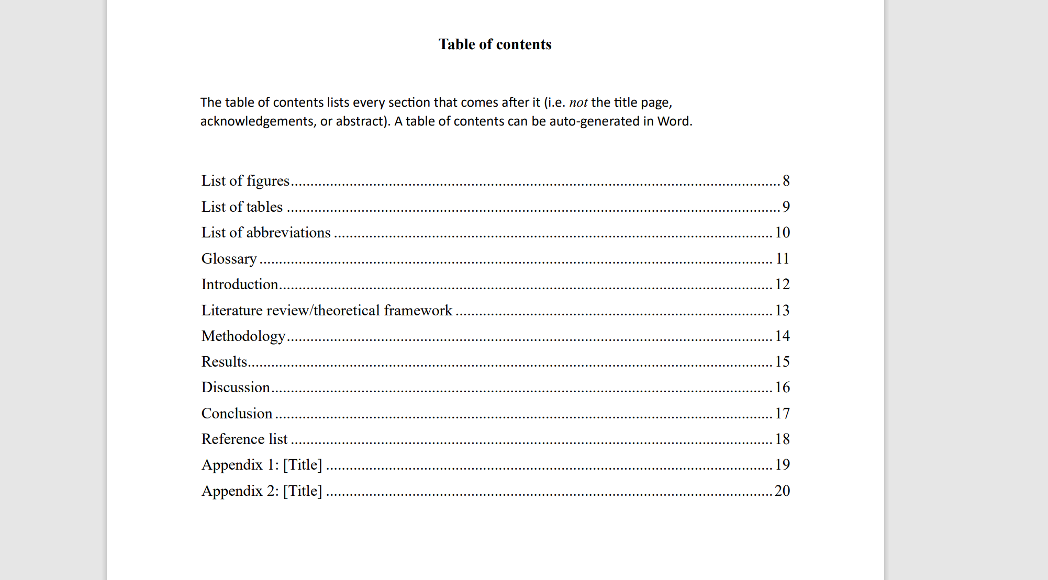
Dissertation Structure- Template
Download the template 👉: https://moodle.uwtsd.ac.uk/mod/resource/view.php?id=540033

Slide 14
The details (1)
Title page (first impression, succinct, specific, representative)
Acknowledgements (thank you supported during journey)
Abstract (big picture view of research, key insights, key findings, stand alone, write up as last)
Table of content (consider using Microsoft Word automatic generator)

Slide 15
The details (2)
Introduction – Chapter 1 (set clear direction, what you will investigate, why it is important, and how will investigate)
Literature Review – Chapter 2 (analyse the existing research, what does it say, what is lacking, well established, fit, contributes, conceptual framework)
Methodology – Chapter 3 (how will you carry out the research- the design, why chosen this way/design)
Results– Chapter 4 (present, describe results of analysis)
Discussion – Chapter 5 (discussion is interpret and analyse results in relation to research question)
Conclusion – Chapter 6 (answer research question from chapter 1, feels repetitive, needed to bring discussion full circle, explicit answer, recommendations, limitations)
Reference list (list of all resources cited in your dissertation, Harvard )
Appendix (supporting documents, nice to know”, depth-adding information)

Slide 16
Dissertation elements

Slide 17
PICO

Slide 18
PICO Tool
P – Population (the patient/population to which the recommendations would apply)
I – Intervention (the intervention under investigation – therapeutic, diagnostic)
C – Comparator (alternative intervention, control group intervention) (N/A)
O – Outcome (outcome or outcomes of interest)

Slide 19
Framing the Research Question
Population
  Condition - disease, including explicit diagnostic criteria
  Population - age race, sex
  Setting - community, hospital, outpatient
Intervention
  Timing of exposures, route of administration
  Dose, duration of exposure or therapy
  Components of a complex intervention
Comparison
  No intervention
  Standard therapy
  Placebo
  Active comparator
Outcomes
  Mortality
  Morbidity
  Patient reported outcomes, functional outcomes
  Individual level vs community level outcomes

Slide 20
Example
52 year old males with colon cancer and a remote history of DVT after trauma. Should they be on heparin to decrease the risk of developing a clot. What is your PICO?
  P – adult outpatient with cancer
  I – prophylactic heparin
  C – no heparin
  O – morbidity, VTE, major bleeding, quality of life
How do we frame the question?
Notes:
Question we want to answer: Should we use heparin for a patient who has colon cancer?

Slide 21

Research Protocol

Slide 22
Research protocol (identify)
Systematic review
Create a document proof of action, includes:
Research question,
Inclusion and exclusion criteria,
Intervention/exposure,
Quality assessment/appraisal method,
Analysis plan
To be provided to your supervisor
Download the template 👉: Tile: Week 1 Workshop session: Structuring your dissertation | Public Health and Social Care in Practice Dissertation (LCHS7004_LON) | Home

Slide 23
Research protocol (identify)
Primary research
Create a document proof of action, includes:
Research question,
Study population
Sample size
Ethical considerations
Estimate of the duration of the study
Expected results
Data analysing technique
To be provided to your supervisor
Download the template 👉: Tile: Week 1 Workshop session: Structuring your dissertation | Public Health and Social Care in Practice Dissertation (LCHS7004_LON) | Home

Slide 24
What will you learn from researching and writing your dissertation?
? List 3 things
To manage complex demands involved in such a large project;
How to sustain your motivation right through to the end;
How creative you can be;
How best to organise yourself to generate, capture and develop your own ideas;
How to analyse concepts and problems so you see things more clearly;
How to synthesise and adapt ideas to find solutions to problems;
How to play devil’s advocate and think flexibly to find better ways of doing things;
How well you can write, that you have a voice of your own and how to organise your writing to let it come through;
But, above all, you have learnt how to think for yourself.

Slide 25

Independent Learning Session – 2 hours

Slide 26
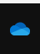

ACTIVITY 1
Using Word and the OneDrive platform
Go to Onedrive on your computer
Create a specific folder for your dissertation (Onedrive)
Download and save the Word dissertation template in your OneDrive
Create your dissertation structure (headings)
Submit your Dissertation structure in Tasks Folder: https://forms.office.com/e/szwKn8Va7w

Slide 27
Activity 2
Writing your Research Protocol
Find on Moodle the accurate Research Protocol Template (Word document)
  Primary research Quan/Qual
  Systematic review
Complete the document including the PICO section
  45 minutes
Save the document on your Onedrive
  And present it during the next workshop in class
Submit your Research Protocol in Tasks Folder: https://forms.office.com/e/szwKn8Va7w

Slide 28
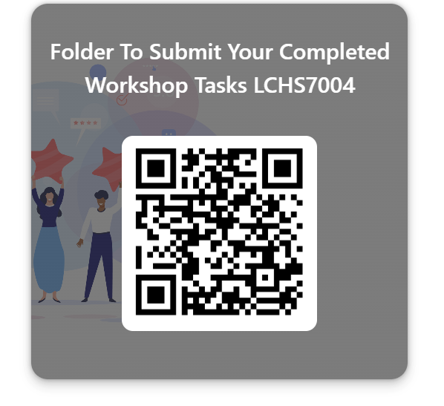
Alternatively
Scan the QR code
Task folder
Scan the QR code to access the Task folder and submit your documents

Slide 29
References
Greetham, B. (2014). How to write your undergraduate dissertation. How to Write Your Undergraduate Dissertation (Macmillan Study Skills) (Greetham, Bryan) (z-lib.org) (1).pdf
Jansen, D. (2019). Dissertation Structure & Layout 101: How to structure your dissertation, thesis or research project. Dissertation Structure & Layout 101 (+ Examples) - Grad Coach
Joyner, R. L., Rouse, W. A., & Glatthorn, A. A. (2018). Writing the winning Thesis or Dissertation: A Step-by-Step Guide. https://doi.org/10.4135/9781544317229.
Morley, J. (2014). Academic Phrasebank. Academiv-Phrase-Bank UNI Machester.pdf
Paltridge, B. (2002). Thesis and dissertation writing: An examination of published advice and actual practice. English for Specific Purposes. Vol. 21 Issue 2, pp. 125–14.

