Slide 1
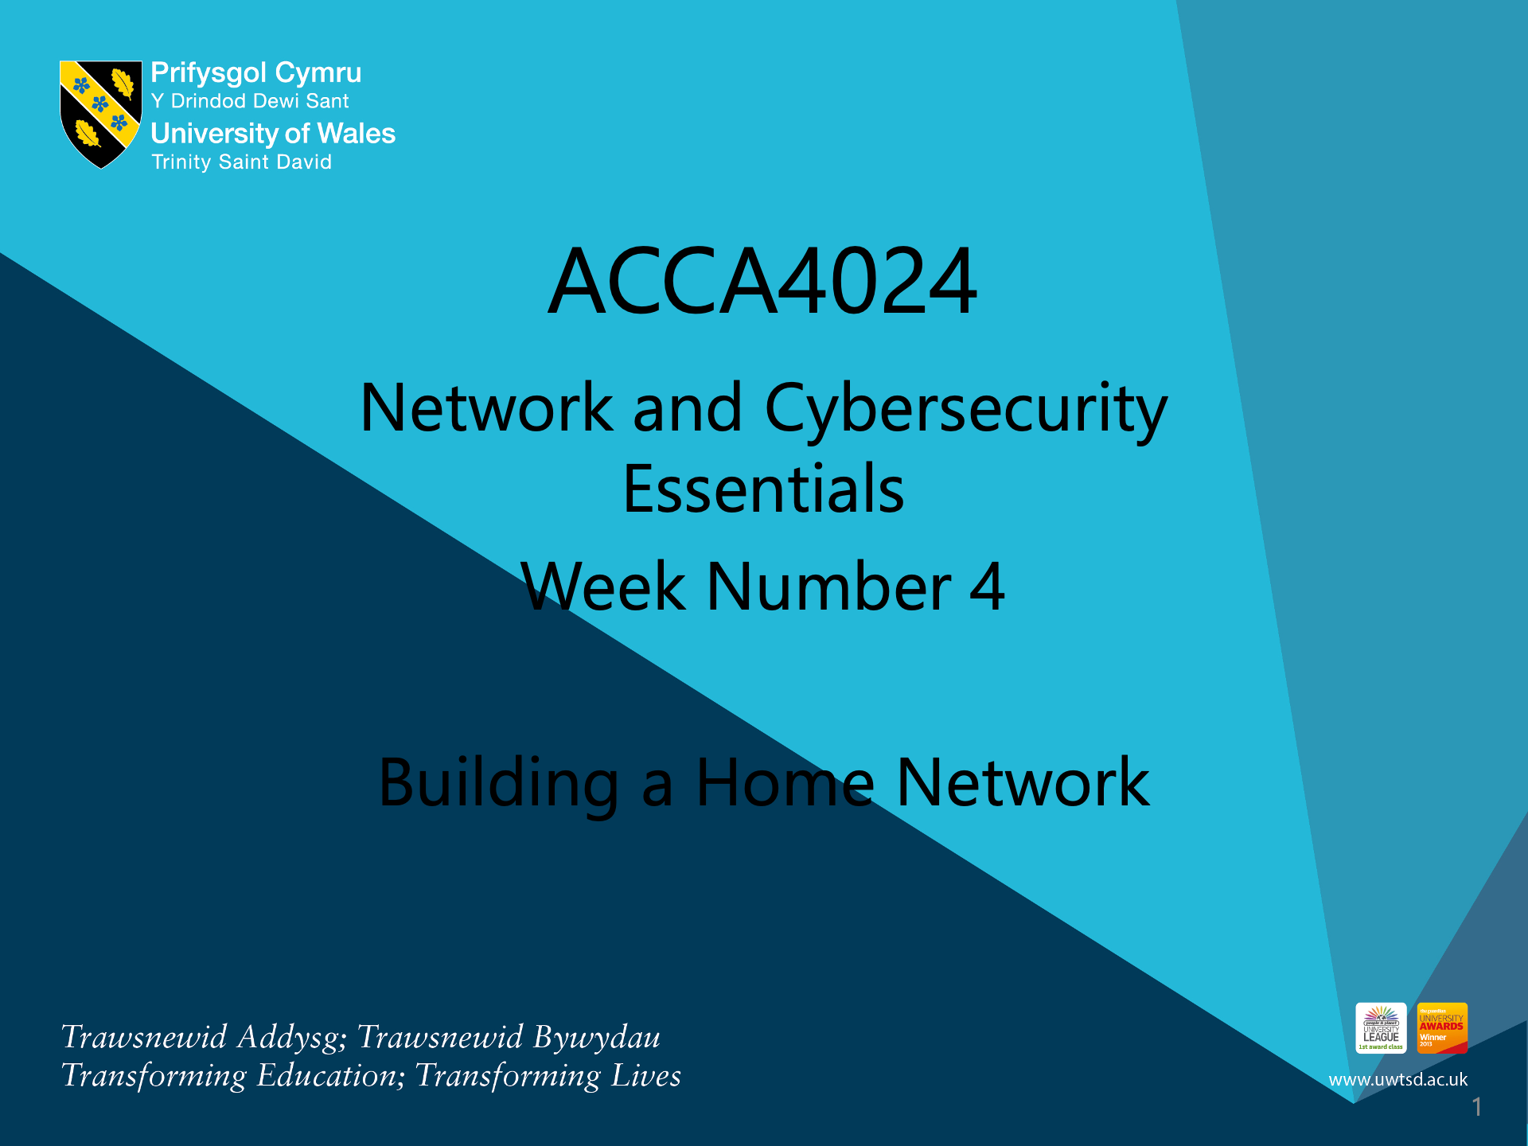
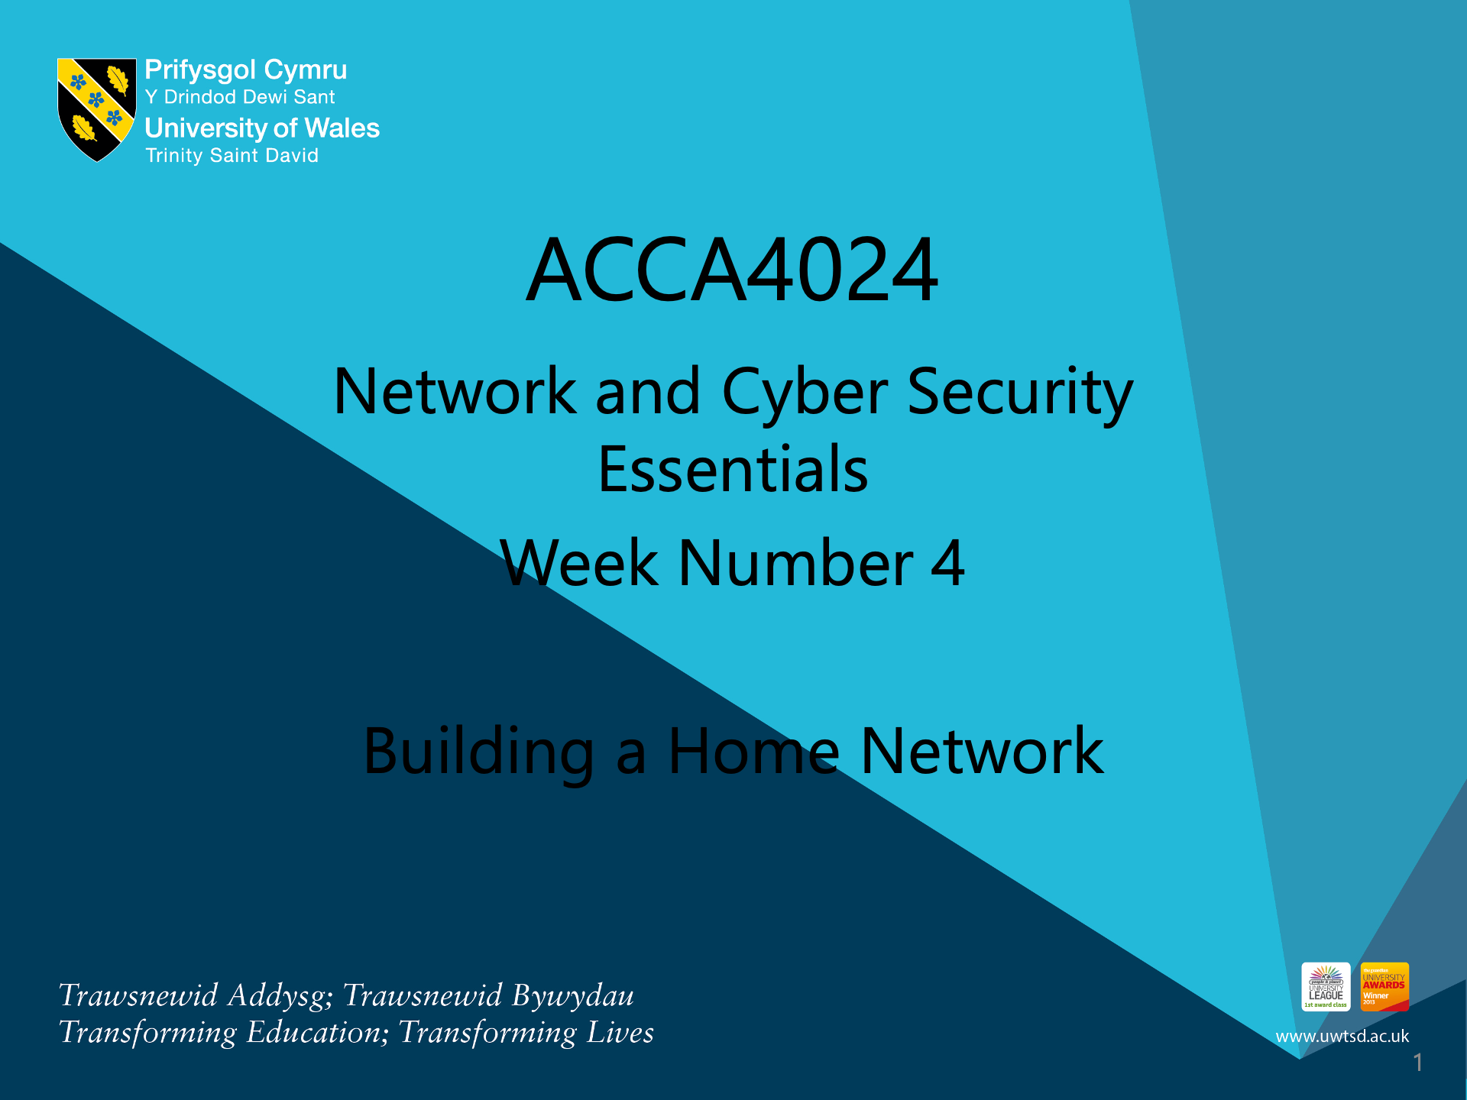

Slide 2
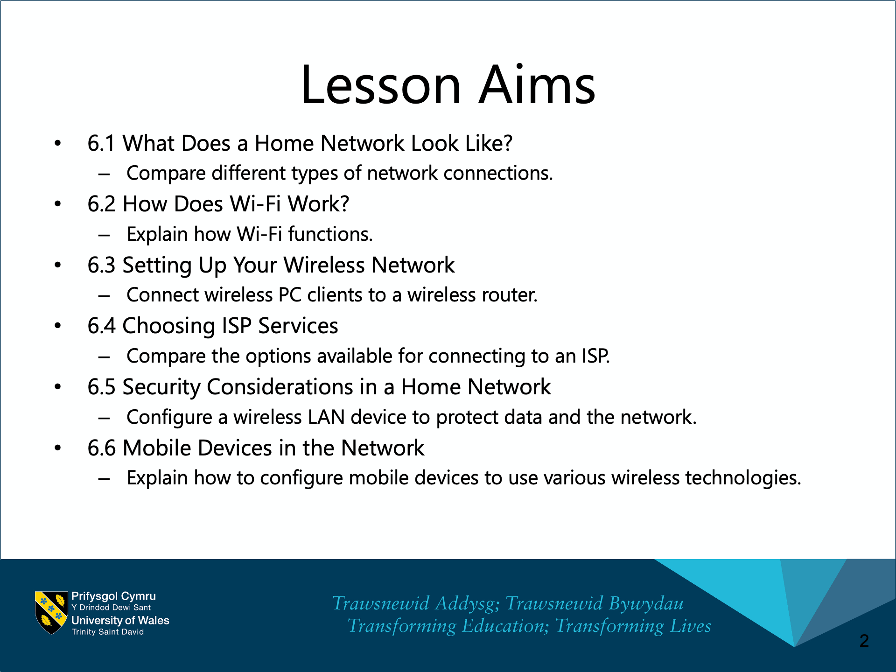

Slide 3
Chapter 6: Building a Home Network
Networking Essentials
Notes:
Cisco Networking Academy Program
Networking Essentials
Chapter 6: Building a Home Network

Slide 4
Chapter 6 - Sections & Objectives
6.1 What Does a Home Network Look Like?
  Compare different types of network connections.
6.2 How Does Wi-Fi Work?
  Explain how Wi-Fi functions.
6.3 Setting Up Your Wireless Network
  Connect wireless PC clients to a wireless router.
6.4 Choosing ISP Services
  Compare the options available for connecting to an ISP.
6.5 Security Considerations in a Home Network
  Configure a wireless LAN device to protect data and the network.
6.6 Mobile Devices in the Network
  Explain how to configure mobile devices to use various wireless technologies.
Notes:
4

Slide 5
6.1 What Does a Home Network Look Like?
Notes:
Cisco Networking Academy Program
Networking Essentials
Chapter 6: Building a Home Network

Slide 6
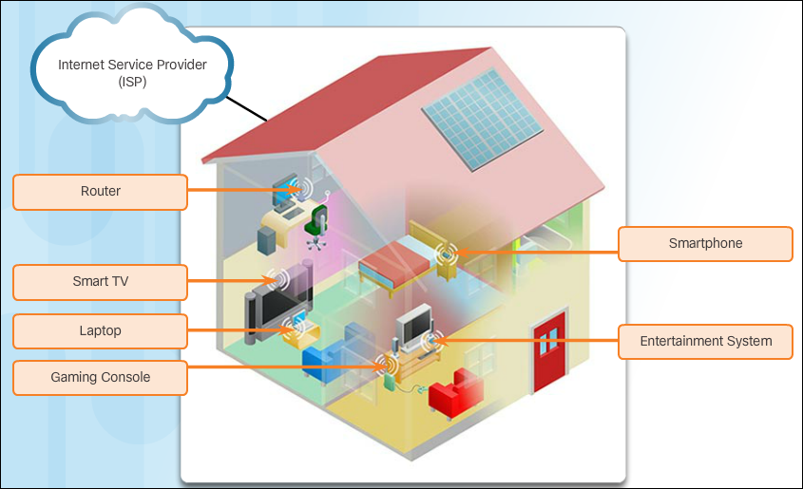
What Does a Home Network Look Like?
Home Network Basics
A home network is a small LAN with devices that connect to an integrated router. The router is connected to the Internet. Most likely, the home router is equipped with both wired and wireless capabilities.
As new technologies come on the market, more and more household functions will rely on the network to provide
connectivity and
control.
Small business and
home routers typically
have two primary
types of ports:
Ethernet ports and
an Internet port.
Notes:
6.1 – What Does a Home Network Look Like?
6.1.1 – Home Network Basics

Slide 7
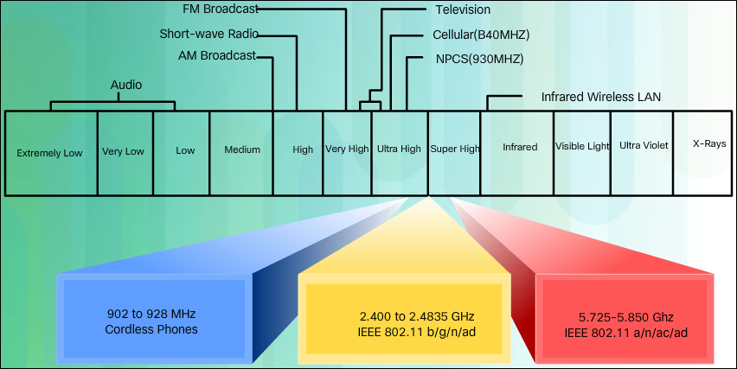
What Does a Home Network Look Like?
Network Technologies in the Home
Wireless technologies use electromagnetic waves to carry information between devices.
The wireless technologies most frequently used in home networks are in the unlicensed 2.4 GHz and 5 GHz frequency ranges.
The most commonly implemented wired protocol is the Ethernet protocol. Ethernet uses a suite of protocols that allow network devices to communicate over a wired LAN connection.
Notes:
6.1 – What Does a Home Network Look Like?
6.1.2 – Network Technologies in the Home

Slide 8
6.2 How Does Wi-Fi Work?
Notes:
Cisco Networking Academy Program
Networking Essentials
Chapter 6: Building a Home Network

Slide 9
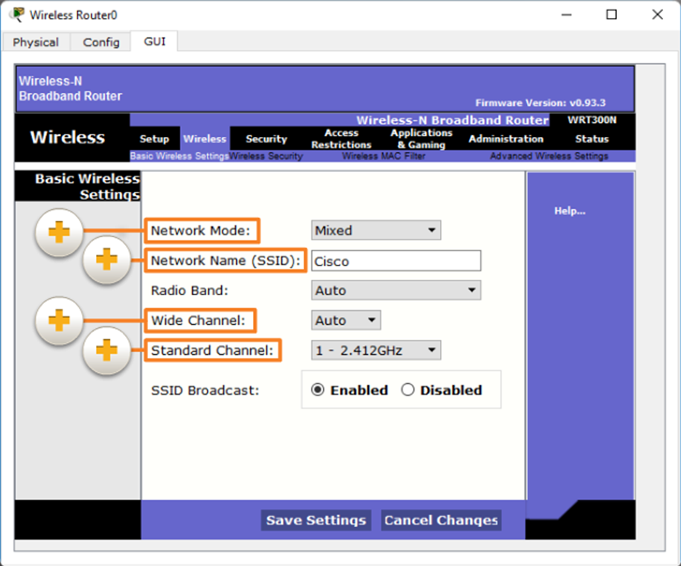
How Does Wi-Fi Work?
Wireless Standards
Many standards have been developed to ensure that wireless devices can communicate. The IEEE 802.11 standard governs the WLAN environment.
Wireless routers using the 802.11 standards have many settings that have to be configured, including:
  Network mode
  Network Name (SSID)
  Standard Channel
  SSID Broadcast
Note: SSID stands for Service Set Identifier.
Notes:
6.2 – How Does Wi-Fi Work?
6.2.1 – Wireless Standards

Slide 10
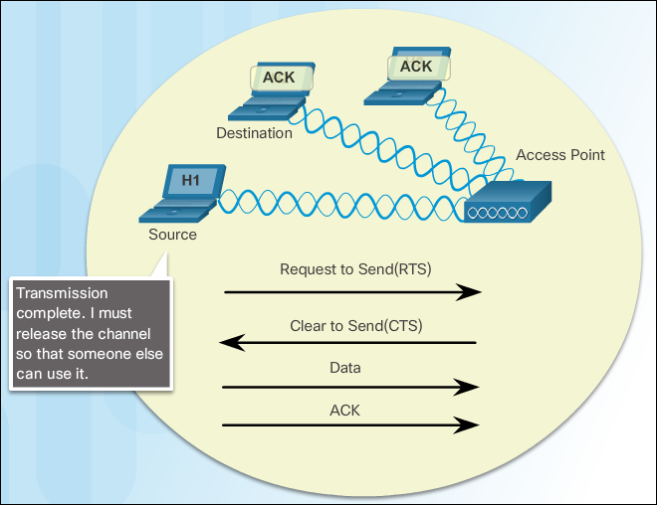
How Does Wi-Fi Work?
Controlling Wireless Traffic
Wireless devices that transmit over the same frequency range create interference in a Wi-Fi network. Channels are created by dividing up the available RF spectrum. Each channel is capable of carrying a different conversation.
Wireless technology uses an access method called Carrier Sense Multiple Access with Collision Avoidance (CSMA/CA). CSMA/CA creates a reservation on the channel for a specific conversation between devices.
Notes:
6.2 – How Does Wi-Fi Work?
6.2.2 – Controlling Wireless Traffic

Slide 11
6.3 Setting Up Your Wireless Network
Notes:
Cisco Networking Academy Program
Networking Essentials
Chapter 6: Building a Home Network

Slide 12
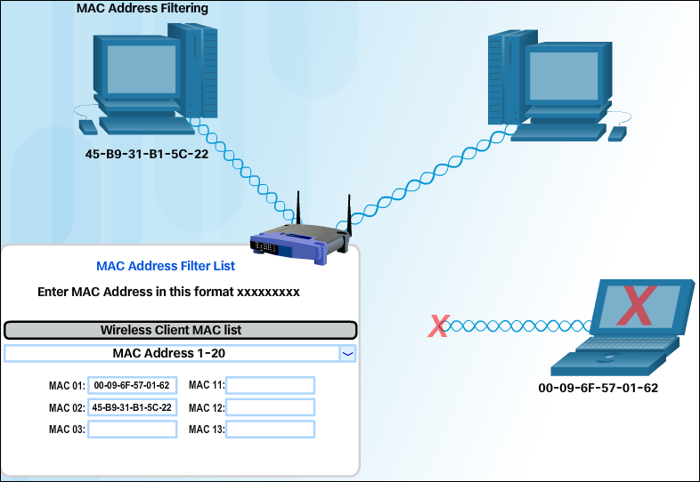
Setting Up Your Wireless Network
Accessing the Wireless Router
Many wireless routers designed for home use have an automatic setup utility that can be used to configure the basic settings on the router.
If SSID broadcasting is on, the SSID name will be seen by all wireless clients within your signal range.
The decision regarding who can access your home network should be determined by how you plan to use the network. Many routers support MAC address filtering.
Notes:
6.3 – Setting Up Your Wireless Network
6.3.1 – Accessing the Wireless Router

Slide 13
6.4 Choosing ISP Services
Notes:
Cisco Networking Academy Program
Networking Essentials
Chapter 6: Building a Home Network

Slide 14
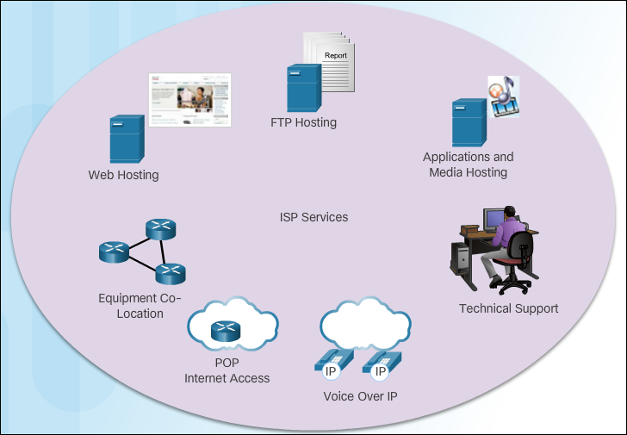
Choosing ISP Services
Internet Service Providers
An Internet Service Provider (ISP) provides the link between the home network and the global Internet. ISPs are critical to communications across the Internet. Each ISP connects to other ISPs to form a network of links that interconnect users all over the world.
A router is required to securely connect a computer to an ISP. The router includes a switch to connect wired hosts and a wireless AP to connect wireless hosts. The router also provides client addresses and security for inside hosts.
Notes:
6.4 – Choosing ISP Services
6.4.1 – Internet Service Providers

Slide 15
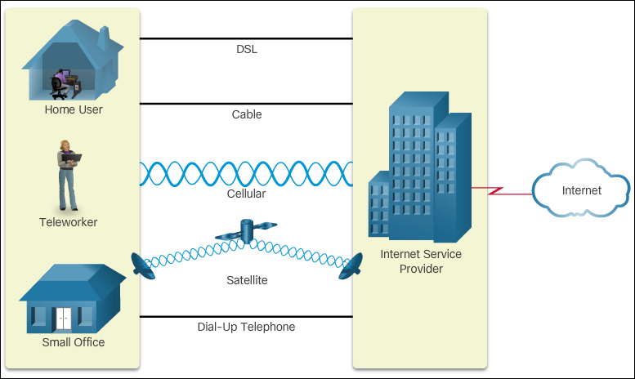
Choosing ISP Services
ISP Connectivity Options
The two most common methods to connect to an ISP are Cable and Digital Subscriber Line (DSL).
Other ISP connectivity options are Satellite, Cellular, and Dial-up Telephone.
Notes:
6.4 – Choosing ISP Services
6.4.2 – ISP Connectivity Options

Slide 16
6.5 Security Considerations in a Home Network
Notes:
Cisco Networking Academy Program
Networking Essentials
Chapter 6: Building a Home Network

Slide 17
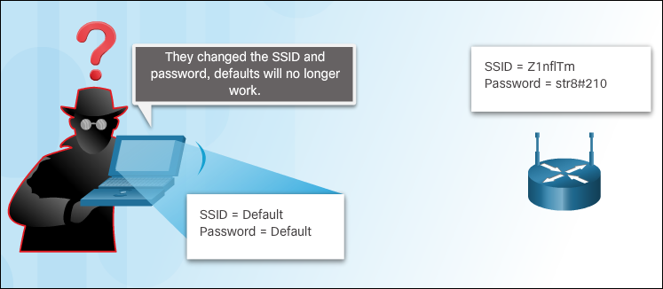
Security Considerations in a Home Network
Is My Network Safe?
It is possible for an attacker to tune into signals from your wireless network, much like tuning into a radio station.
The SSID broadcast feature can be turned off. Any computer trying to connect to the network must already know the SSID. Turning off SSID broadcast alone does not protect the wireless network from experienced hackers.
Changing the default settings on a wireless router will not protect your network by itself. It takes a combination of several methods to protect your WLAN.
MAC address filtering uses the MAC address to identify which devices are allowed to connect to the wireless network.
Notes:
6.5 – Security Considerations in a Home Network
6.5.1 – Is My Network Safe?

Slide 18
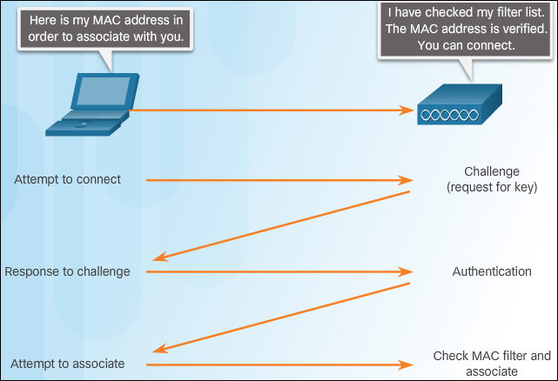
Security Considerations in a Home Network
Authenticating Users
Authentication is the process of permitting entry to a network based on a set of credentials. It is used to verify that the device attempting to connect to the network is trusted.
After authentication is enabled, the client must successfully pass authentication before it can associate with the AP and join the network. When authentication is successful, the AP will then check the MAC address against the MAC address table. When verified, the AP adds the host MAC address into its host table.
Notes:
6.5 – Security Considerations in a Home Network
6.5.2 – Authenticating Users

Slide 19
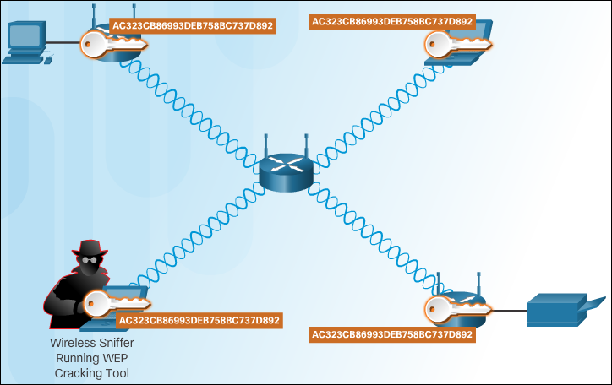
Security Considerations in a Home Network
Encrypting Data So It Cannot Be Read
An advanced and secure form of encryption is Wi-Fi Protected Access (WPA). WPA2 uses encryption keys from 64 bits up to 256 bits. However, WPA2, unlike WEP, generates new, dynamic keys each time a client establishes a connection with the AP.
Notes:
6.5 – Security Considerations in a Home Network
6.5.3 – Encrypting Data So It Cannot Be Read

Slide 20
Security Considerations in a Home Network
Security Planning
Security measures should be planned and configured before connecting the AP to the network or ISP.
Some of the more basic security measures include:
  Change default values for the SSID, usernames and passwords
  Disable broadcast SSID
  Configure MAC Address Filtering
Some of the more advanced security measures include:
  Configure encryption using WPA2
  Configure authentication
  Configure traffic filtering
No single security measure will keep your wireless network completely secure. Combining multiple techniques will strengthen the integrity of your security plan.
Notes:
6.5 – Security Considerations in a Home Network
6.5.4 – Security Planning

Slide 21
6.6 Mobile Devices in the Network
Notes:
Cisco Networking Academy Program
Networking Essentials
Chapter 6: Building a Home Network

Slide 22
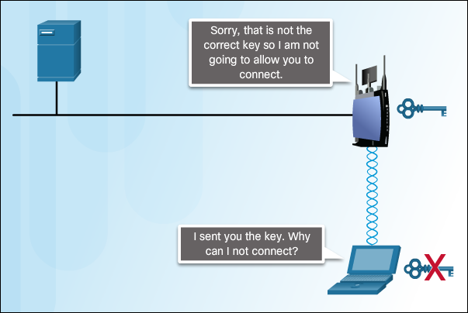
Mobile Devices in the Network
Network Connectivity
These precautions should be taken to protect Wi-Fi communications on mobile devices:
  Never send login or password information using unencrypted text (plaintext).
  Use a VPN connection when possible if you are sending sensitive data.
  Enable security on home networks.
  Use WPA2 encryption for security.
When a mobile device is out of the range of the Wi-Fi network, it attempts to connect to another Wi-Fi network in range. If no Wi-Fi networks are in range, the mobile device connects to the cellular data network.
Notes:
6.6 – Mobile Devices in the Network
6.6.1 – Network Connectivity

Slide 23
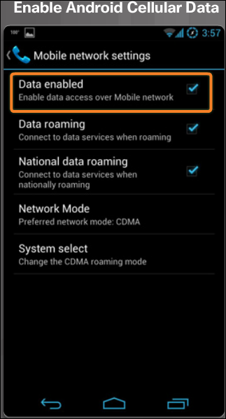
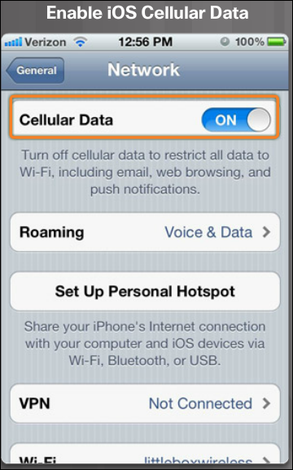
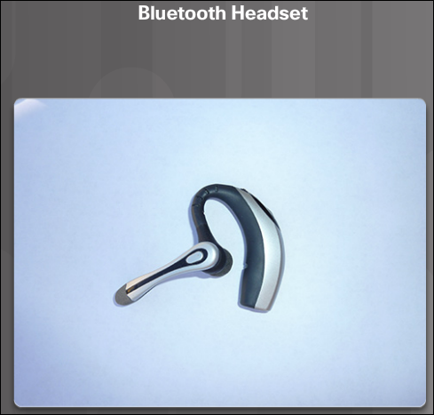
Mobile Devices in the Network
Cellular Data and Bluetooth
Mobile devices are preprogrammed to use a Wi-Fi network for Internet if one is available and the device can connect to the access point and receive an IP address. If no Wi-Fi network is available, the device uses the cellular data capability if it is configured.
Bluetooth is wireless, automatic, and uses very little power, which helps conserve battery life. Up to eight Bluetooth devices can be connected together at any one time.
Notes:
6.6 – Mobile Devices in the Network
6.6.2 – Cellular Data and Bluetooth

Slide 24
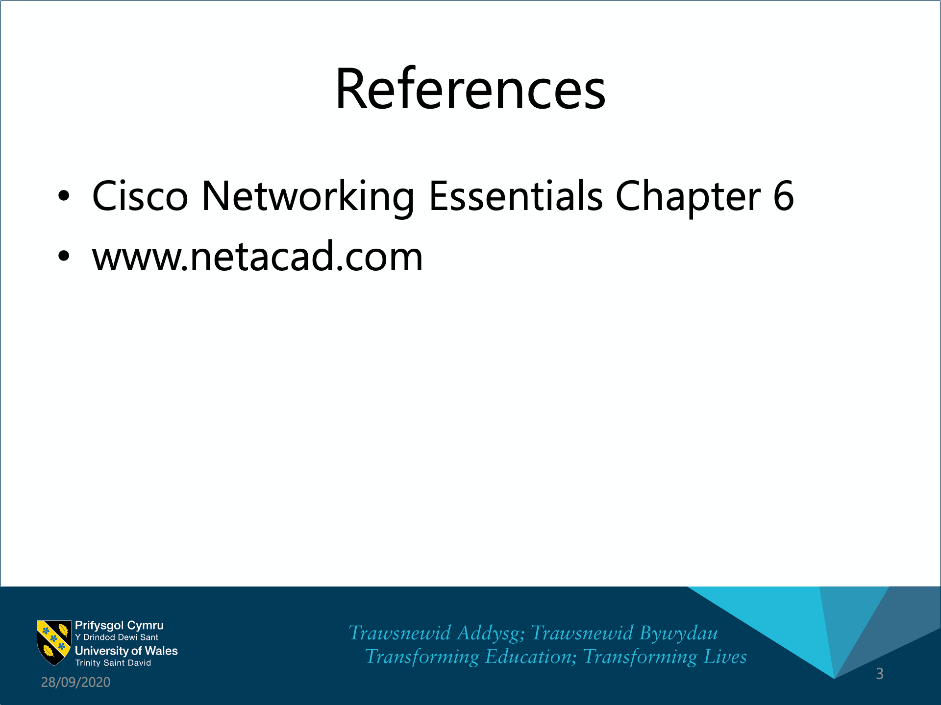

Slide 25


Slide 26


