Slide 1
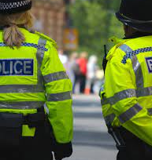

Introduction to
Criminal Justice
A recap from level 4 module: Legal Process…..

Slide 2

Aims and Objectives
Explain the purpose of the criminal justice system and the police roles within it.
Identify legislation and processes that support it.
Understand best practice when conducting an investigation

Slide 3

Discuss: Purpose of the Criminal Justice System…
Don’t worry, there is a lot of information here.
All we want you to do is read over it and make a few notes.
We will be going through all of this information in class over the next couple of weeks.

Slide 4
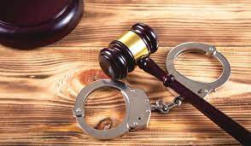
The Purpose of the Criminal Justice System (CJS)
According to www.cjsonline.gov.uk the purpose of the CJS is ‘to deliver justice for all, by convicting & punishing the guilty & helping them to stop offending, while protecting the innocent’
Alternatively, the Working Together to Cut Crime & Deliver Justice (2007), Criminal Justice Strategic Plan states that, ‘the central purpose of the CJS is to deliver an efficient, effective, accountable & fair justice process for the public.’

Slide 5
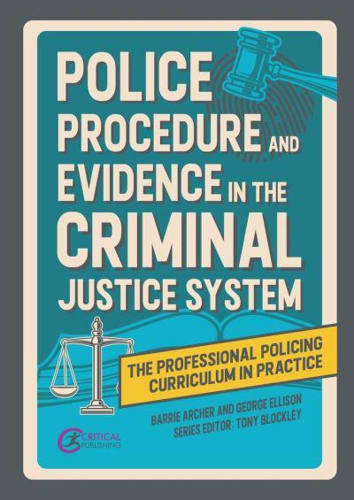
What do you think the Police role is within the CJS?

Slide 6

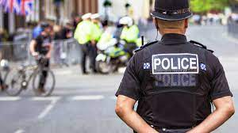
The Police Role within the CJS
According to the CPS:
‘The police are responsible for the investigation of crime, collection of evidence & the arrest or detention of suspected offenders.’
The Policing Vision 2025 states that the policing mission is:
‘To make communities safer by upholding the law fairly & firmly; preventing crime & antisocial behaviour; keeping the peace; protecting & reassuring communities; investigating crime & bringing offenders to justice.’

Slide 7

The Law in England and Wales

Slide 8
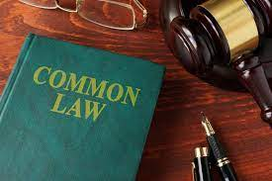
Common Law : The law that has been created over the centuries by judicial decisions and not by legislation from Parliament.
(Source : PNLDB) These decisions were passed by word of mouth)
Examples of Common Law offences are :-
Murder/Manslaughter
Breach of the Peace
Perverting the course of justice
Contempt of court
False imprisonment/Kidnapping
Refuse to assist a constable
Misconduct in a public office
Bribery and corruption – public offices
Keeping a disorderly house

Slide 9
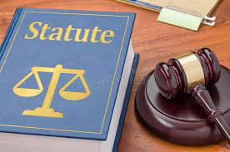
Statute Law:
Law enabled by Acts of Parliament through legislation e.g. Theft Act 1968 and Police And Criminal Evidence Act 1984.
Acts of Parliament are prime statute law.
Acts of parliament are divided into sections that may contain definitions, offences, powers of arrest and interpretations of words and expressions used.
An act is a complex document that often requires technical details such as fines and penalties.

Slide 10
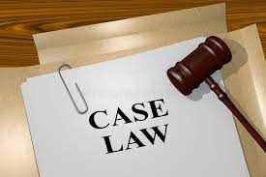
Case Law
Sets Judicial Precedent:
The decision of one case where circumstances are similar is binding on others. E.g
R v Turnball (1976) 3 All ER 549
Stated Cases are the ‘benchmark’ by which all other SIMILAR cases are tried
Put simply, they are guidelines as to ‘best practice’ for legal practitioners

Slide 11

Case Law
Based on a question of law not a question of fact.
Form a significant part of the case i.e. the reason or ground on which it is based
The decision must be made in a court higher in the court structure
There must be no material difference between the fact of the cases, in this case, R v Turnbull, 1976, the case involved two persons putting signs on a bank stating the night safe was not working and to deposit the money through the door into the bag. They would then steal the money. He was seen by the bank manger and an off-duty officer. Turnbull was found guilty, and he appealed. The case was upheld. An example of this would be decision that was made about identification evidence in the case.

Slide 12
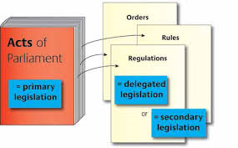
Discuss: What is Secondary Legislation?
Secondary legislation is usually concerned with detailed changes to the law made under powers from an existing Act of Parliament
Statutory instruments form the majority of secondary legislation but it can also include Rules, Regulations or Codes of Practice

Slide 13
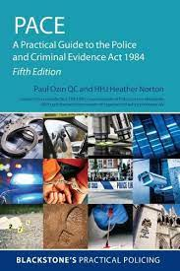
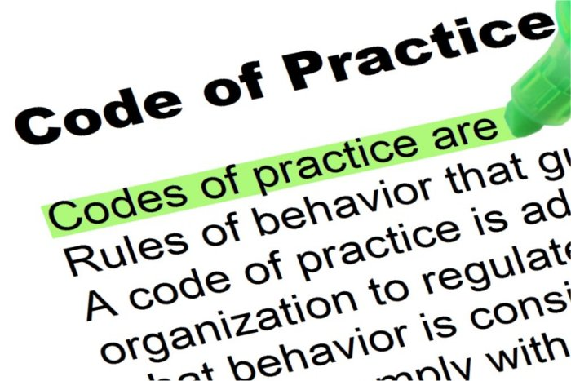
What are Codes of Practice?
An example, S66 of PACE requires the Secretary of State to issue Codes of Practice in connection with the exercise of a wide range of powers by police officers
Highway Code – produced by the Department for Transport
Byelaws – local laws made by a local council under an enabling power contained in a public general act or a local act requiring something to be done or not done in a specified area. They are accompanied by some sanction or penalty for their non-observance

Slide 14
Terminology….. Prosecution Vs Defence
The Police
The Crown Prosecution Service (CPS)
The Defendant, Legal representatives(s) – solicitor or barrister
The Probation Service/ Social Services
The Prison Service

Slide 15
Discuss: The Criminal Courts
What’s the difference?
Magistrates Court
Youth Court
Crown Court

Slide 16
The Courts
Courts | Types of Cases | Features | Appeals go to
Youth | Defendants aged 10 to 17 years | Not usually open to the public | Crown Court
Magistrates’ | Offences triable: Summarily only Offences triable either way | Usually open to the public | Crown Court or High Court
Crown | Offences triable: Only on indictment Either way referred from Magistrates’ Court Appeals from Magistrates’ Court and Youth Court | Judge and jury | Court of Appeal (Criminal division)
Appeal | Appeals from Crown Courts | Criminal and Civil divisions | Supreme Court
Supreme | Appeals from Court of Appeals | Replaced the House of Lords in 2009 | Final point of appeal

Slide 17
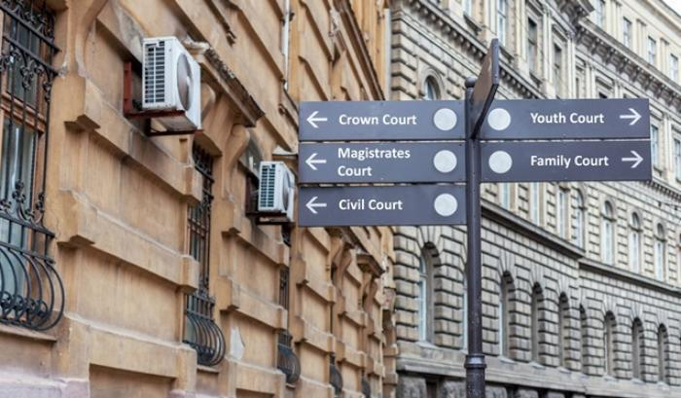
Other Courts
Coroner’s Court
Family Court
Court Martial (Military)
High Court (Civil Court)
County Court
Admiralty Court
Clerical Court (Church)
Small Claims Court

Slide 18

The Categories of Offence
1. Summary only offences
2. Either way offences
4. Indictable offences (consists of 2 & 3)
3. Indictment only offences

Slide 19

Different types of offences….
Summary only
Can only be tried in Mags court.
Indictment only
Can only be heard in Crown court
Either Way
Cases that can be heard in either Mags court or crown court.
Initially the Mags will decide which is the most suitable court for the case in question.
Even if the Mags decide that the case is suitable for them to hear the defendant can still elect to go before a jury at Crown Court.
Indictable offences
Collective term for indictment only and either way offences. Term used extensively in legislation

Slide 20
Sentencing
Community Orders
Fines
Custodial sentences
There are three primary options at the courts disposal once a defendant has been found guilty:
What are your thoughts about these disposal options?
When do you think the courts would opt for these disposal methods?
These options can be used separately or together

