Slide 1

Sustainable Enterprise

Slide 2
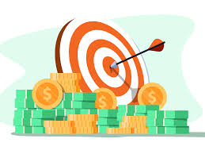
Research an opportunity for a product or service
What is a target market?
A target market refers to a group of potential customers to whom a company wants to sell its products and services. This group also includes specific customers to whom a company directs its marketing efforts. A target market is one part of the total market for a good or service.

Slide 3

Identifying Customer Needs
To identify needs, you must both listen and ask the right questions. After identifying needs, always check for additional or related needs. Use your knowledge and experience to identify and present the right products, services, and solutions to meet your customers' needs.

Slide 4

Identifying a gap in the market
Market gaps are opportunities disguised as voids. A gap in the market is a place or area that current businesses aren't serving. For example, Netflix has filled several market gaps over the years.

Slide 5

Opportunities for a product or service
A product opportunity exists when there is a gap between what is currently on the market and the possibility for new or significantly improved products that result from emerging trends.

Slide 6

Current market trends
A market trend is a perceived tendency of financial markets to move in a particular direction over time. ... A trend can only be determined in hindsight, since at any time prices in the future are not known.

Slide 7

What is potential demand?
Future demand for a product in a market niche.

Slide 8
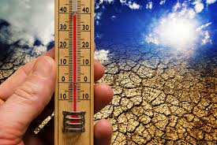
What is economic climate?
The economy includes all activities in a country concerned with the manufacturing, distribution and the use of goods and services. The economic climate has a big impact on businesses. The level of consumer spending affects prices, investment decisions and the number of workers that businesses employ.

Slide 9

Identifying Business risks, including a competitor analysis
The term business risks refers to the possibility of a commercial business making inadequate profits (or even losses) due to uncertainties - for example: changes in tastes, changing preferences of consumers, strikes, increased competition, changes in government policy
Competitor analysis - is a strategy where you identify major competitors and research their products, sales, and marketing strategies. By doing this, you can create solid business strategies that improve upon your competitor's.

Slide 10
Task:
Chose a product of your choice and outline each of the areas outlined below in relation to your product.
Target market.
Identifying customer needs.
Identifying a gap in the market.
Opportunities for a product/service.
Current market trends.
Potential demand.
Economic climate.
Identifying business risks, including a competitor analysis.

