Slide 1
Shabina Ditta : 2129537
Module code : LCHSC4006_BIRM
Lecturer: Kenneddy Obohwemu
Working with Children in a social care setting
As a lead volunteer at a woman’s refuge centre, you have been asked to provide two creche activities for children while their mothers’ attend a weekly one-hour support session

Slide 2
Importance of age-appropriate activities
There will always be times when children of various ages need to be kept occupied whilst mothers' attend support sessions
Children can be split into different age groups which will help utilise age-appropriate activities to occupy their time
Through various activities and playing with other children, they can gain knowledge and key skills (Family Fostering Partners, 2016)
Sharing
Cooperating
Respecting the property of others
Interaction / Working in groups
Communication
Concentrating on tasks / Using self-control
Cognitive and Motor Skills

Slide 3
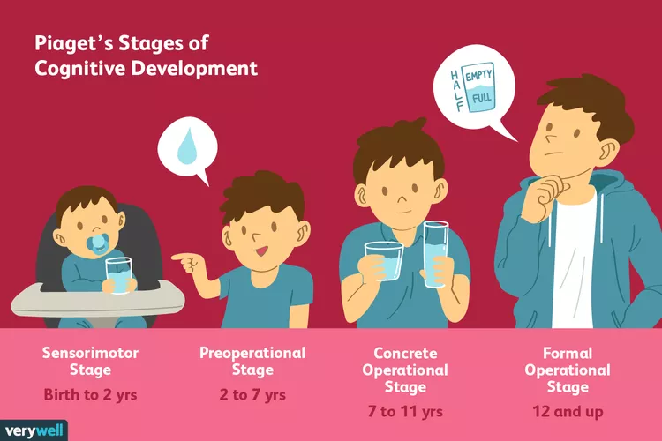
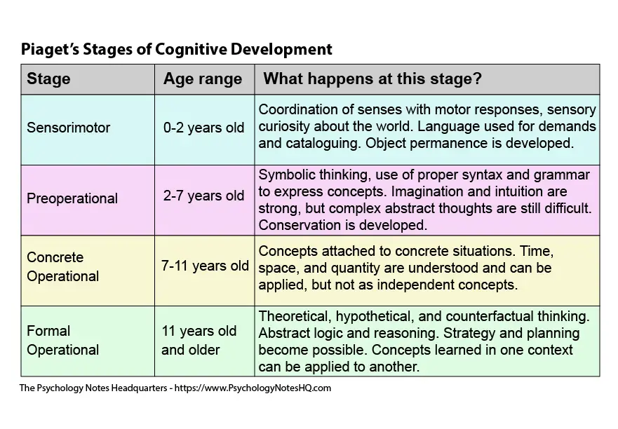
Jean Piagets Theory of
Cognitive Development
Born in Switzerland in the late 1800's (Main, 2011)
Suggests that children's intelligence undergoes changes as they grow and think differently from adults and are born with an inherited basic mental state which is partly evolved
4 stages of intellectual development for a child can be split into 4 age groups
All children pass through these stages regardless of social or cultural background
Children learn by 'doing things' and not just by listening or reading about them
Children have their own ways of learning and that they don’t always follow the same rules as adults do
Children need to participate actively with their world and people in it.
They must be exposed to new experiences and information for learning to occur, and importantly, they must have the opportunities to make mistakes.(Nortje, 2021)
There are 3 components to his theory, 1) schemas ( the building blocks of knowledge), 2) adaption processes ( equilibrium, assimilation & accommodation) 3) 4 stages of development

Slide 4
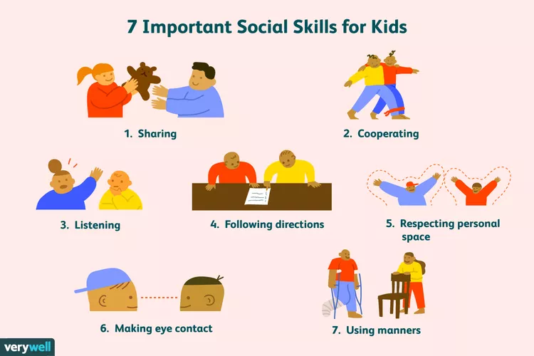
Activities for
7-11 Year Olds
Music
Writing & Reading
Painting / Art-Work / Drawing
Group / Task Work
Interactive discussions
Expressing themselves whilst playing with characters / toys / stuffed animals & dolls
Role Play
Board Games
(Positive Action Staff, 2020)

Slide 5

Activity One
Painting / Art Work Drawing
Helps their creative development
Stimulates the brain
Stimulating the brain can help other areas of development
Promotes a sense of mastery, self-esteem & creativity
Art engages children’s senses in open-ended play
Develop cognitive skills – objects and the shape, colour and size, experiment mixing paint & problem solve with cause and effect
Helps improve hand to eye co-ordination and improve control in hand muscles and self control and patience
Chance to make decisions and make choices of self expression
Supports the development of social-emotional and multisensory skills
(Mincemoyer, 2016)

Slide 6

Activity Two – Reading & Writing
Supports cognitive & language development
Strong literacy skills reflect well into independent learning
Encourages growth in and out of the classroom
Helps children communicate and problem solve
Helps with patience, concentration, discipline and improve their attention span
Supports social and emotional development
Helps children be more creative, stimulate their brain using their imagination
Can be a stress relief and time for self-reflection and understand their feelings and thoughts when they put pen to paper
Can help with their well being and their moods
Helps stimulate the brain with memory
As children grow older through these stages they develop how to better communicate more effectively with all age groups as their vocabulary expands and their knowledge base widens
Children get to read, talk & write about real world situations and how it can affect them in everyday life
(Learning Without Tears, 2021) & (Lavoie, 2020)

Slide 7
Conclusion & Thank you
As expressed in Jean Piagets theory, children have various stages of mentally growing in their life and learn in various stages according to their ages
Children take in all types of knowledge & information and process that according to what stage of their life they are in and build on that when going on to the next stage
Care workers can utilise activities to help children take in information and process it, helping them communicate and promote self confidence in children and make them feel better about themselves and also learn about them and how they feel or what they maybe be going through in terms of emotions by the way they may paint, draw, write and communicate amongst other children
It is key to understand that all children may respond to different activities to stimulate their brain and will as they grow enhance their knowledge and better express themselves
Thank you for your attention, and I hope you found this presentation helpful.

Slide 8
References
Amy Morin (2019). 7 Social Skills You Should Start Teaching Your Child Now. [online] Verywell Family. Available at: https://www.verywellfamily.com/seven-social-skills-for-kids-4589865 [Accessed 22 Mar. 2023].
Cherry, K. (2022). The 4 Stages of Cognitive Development. [online] Verywell Mind. Available at: https://www.verywellmind.com/piagets-stages-of-cognitive-development-2795457 [Accessed 22 Mar. 2023].
CHOC (2021). Growth & Development: 6 to 12 Years (School Age) | CHOC. [online] CHOC Children’s. Available at: https://www.choc.org/primary-care/ages-stages/6-to-12-years/ [Accessed 23 Mar. 2023].
Family Fostering Partners. (2016). The importance of social activities for children in care | Family Fostering Partners. [online] Available at: https://www.familyfosteringpartners.co.uk/the-importance-of-social-activities-for-children-in-care/#:~:text=Through%20playing%20with%20others%2C%20children [Accessed 22 Mar. 2023].
Lavoie, M. (2020). 5 Surprising Benefits of Writing By Hand. [online] GradePower Learning. Available at: https://gradepowerlearning.com/5-surprising-benefits-of-writing-by-hand/ [Accessed 23 Mar. 2023].
Learning Without Tears. (2021). Why is Literacy Development Important for Children? [online] Available at: https://www.lwtears.com/blog/literacy-development-stages#:~:text=Strong%20literacy%20skills%20translate%20well [Accessed 23 Mar. 2023].
Main, P. (2011). Jean Piagets theory of Cognitive Development. [online] www.structural-learning.com. Available at: https://www.structural-learning.com/post/jean-piagets-theory-of-cognitive-development-and-active-classrooms#:~:text=The%20Theory%20of%20Cognitive%20Development [Accessed 22 Mar. 2023].
Mincemoyer, C. (2016). Art - an opportunity to develop children’s skills. [online] extension.psu.edu/youth/betterkidcare. Available at: http://bkc-od-media.vmhost.psu.edu/documents/HO_Art_AnOpportunity.pdf [Accessed 23 Mar. 2023].
Nortje, A. (2021). Piaget’s 4 Cognitive Development Stages: Exploring the Theory. [online] PositivePsychology.com. Available at: https://positivepsychology.com/piaget-stages-theory/ [Accessed 22 Mar. 2023].
Positive Action Staff (2020). 20 Evidence-Based Social Skills Activities and Games for Kids. [online] www.positiveaction.net. Available at: https://www.positiveaction.net/blog/social-skills-activities-and-games-for-kids [Accessed 22 Mar. 2023].

