Slide 1
Speed of Processing (fast and slow) on Attentional Capacity and Working Memory
Nicole Moon: 1602489

Slide 2
Speed of processing is the primary function of cognitive processing
(McFarland, 2017).
Cognitive processing is the capability to carry out a mental task
(Levitt, Fugelsang, & Crossley, 2006).
Ability influences mental processes, such as attending, storing and retrieving information.
Introduction:

Slide 3
Speed of Processing (SOP)
SOP = how rapidly an individual can process, react, and respond to information
(Kalmer & Chiaravalloti, 2008).
Vital to learning and performance
(Salthouse, 1996).
SOP interferes with executive functioning =
Deficits = planning, attention, decision making
(Cepeda, Blackwell & Munakata, 2013).

Slide 4


Theoretical underpinning of SOP:
Thinking Fast and Slow
(Daniel Kahneman, 2011).
Dual process model = Thought occurs in two ways’..
(Kahnman & Egan, 2011).
‘System 1’ = FAST,
Automatic – no effort – prone to error
‘System 2’ = SLOW,
Controlled – activation of brain – tires easily
Thinking fast and slow dictates ones perception & reactions, like - RT
(time to perceive an respond to a stimulus) (Salthouse, 1994).
Fast processor - react danger quicker = system 1 -
‘innate response’.
Slow processor - slower RT = more time to process danger
& respond.

Slide 5
Automatic (fast) and controlled (slow) Processing
Automatic and controlled processes = determine individual behaviour (Shiffrin & Schneider, 1977).
Controlled = limited capacity – one must pay attention and make conscious effort to process information,
Assumption = very dominant (Ashby & Crossley, 2012)
Limitations = automatic processes do not place demands on attentional capacity.
Automaticity = hard to change once learnt – therefore – in changing circumstances, this may interfere with performance (Keane & Eysenck, 2015).
whereas,
Automatic = no limited capacity - no need pay attention.

Slide 6
Memory and Attention:
Vital to learning new information
Memory - to process and interpret information (Gazzaniga, Ivry & Mangun, 2009).
WM = to retain information accessible for cognition (Oberauer & Hein, 2012).
Attention - mechanism to select and prioritise processed information (Groome et al, 2014).
When individuals executes tasks – depends vitally on ability to retain information over time (WM), & to selectively process stimuli in environment (Attention) (Fougnie, 2008).
Salthouse (1996) proposed the longer it takes to process information = quicker it decays.

Slide 7
Literature Review:
SOP on Memory:
Baddeley, Thomson, & Buchanan (1975) -performance - WM tasks = poorer, if longer words - recalled, compared to shorter words.
Memory = Limited capacity
Results - faster readers = better memory.
Tam & Schmitter-Edgecombe (2013) identified a significant link between SOP, learning and memory performance.
Notes:
Baddeley et al,. (1975) found individual performance – WM tasks – poor – longer words recalled, compared to shorter words.

Slide 8
SOP on Attention:
Kail & Sathouse (1994) = limited attentional capacity restricts SOP =
If information is not processed rapidly = decays or encounters interference.
Haung & Pashler (2005) found despite complexity of visual tasks = not always true indicator of attentional capacity.
Capacity - depends on the task itself.

Slide 9
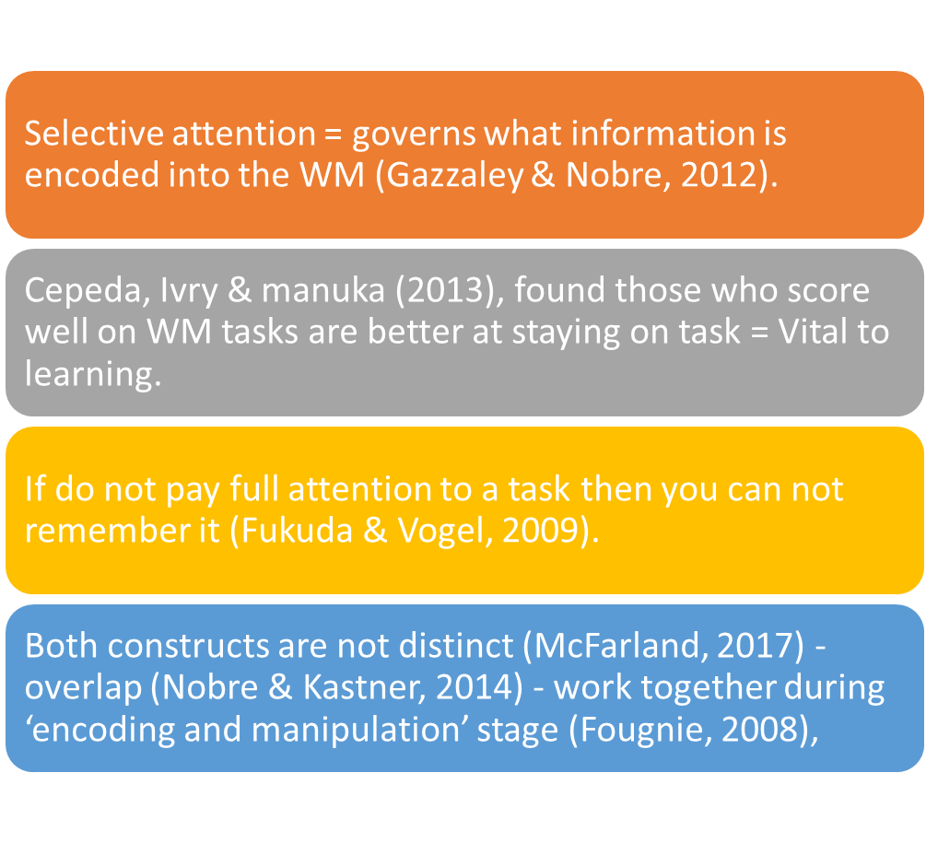
SOP on Memory and Attention

Slide 10
Cognitive load
Argued cognitive load = reduces attentional control
(Lavie, 2005).
Those low attentional control = vulnerable to distraction – to those - high attentional control.
Many implications - cognitive load theory - ability to predict how much capacity is available.
E.g- if - too high cog load = may struggle to follow. Yet, too low may result in inadequate engagement (Cowan, 2014).
Cognitive load varies for each individual
(Lavie, 2005).

Slide 11
Rationale
Examine cognitive abilities – speed one can process stimuli; fast (automatic) or slow (controlled)
How this impacts on other mental processes like WM & attentional capacity.
SOP determines how an individual may learn =
Ability to learn = relies on WM capacity to store, manipulate and retain information (Levitt, Fugelsang, & Crossley, 2006).
SOP impacts on memory and attention = consequently- both processes affect learning.
Vital to examine the impact of SOP on individual memory and attention to predict learning and performance.
Academic institutions - fail to identify individual processing speed = resulting in impaired learning and under achievement.

Slide 12

Hypothesis:
Faster processors to score better on the memory tasks, and score better on the attention tasks, compared to the slow processors.
Slow processors expected to do better on the hard tasks in both the memory and attention tasks, compared to the fast processors.

Slide 13
Methodology
Design:
Experimental procedure
Data analysed – two 2X2 mixed ANOVA
IV- cognitive load – (easy and hard)
DV – The scores of memory and attention tasks.
Participants:
Opportunity sample
Internal recruitment
Staff and students (18-55)
Total 116
analysed

Slide 14
Methodology
Procedure
Laboratory setting
Experimental generator
‘Super-Lab 4.5’ software
Consent
Debrief
Materials
RT & CRT
tasks
Paper
Computer and monitor
Pen

Slide 15
Ethical approval
Granted by the researchers university.
Participants debriefed in accordance to BPS guidelines of ethical code of conduct (2014).
Offered right to withdraw at any time and opportunity to request results.

Slide 16
Results: 2 x two-way-mixed- ANOVA
Attention
Measured - SOP (fast and slow) and cognitive load (easy and hard)
Mean scores- m/s = the lower the score, the faster at processing information.
SOP X Load interaction = non significant
Load made no difference to SOP –
despite tasks being
easy or hard.
Means & SD
Interaction
SOP and Cognitive load
SOP (fast and slow) and attention
Condition | Mean | SD
Fast
Easy | 15367.37 | 11431.28
Hard | 7099.48 | 5214.15
Slow
Easy | 26371.46 | 32240.62
Hard | 14379.74 | 25263.04
Condition | Mean
Fast | 11233.43
Slow | 20375.60
In the fast and slow hard= Score significantly lower – fast and slow = no interference occurred .
2x2 ANOVA revealed- non-significant main effect for SOP.
Greatest score = Slow/easy
Poorest = fast/hard.
Notes:
SOP did not significantly affect attention.
Slow processors took longer on attention tasks, to the fast processors… the increase cognitive load made no difference to individual SOP – despite tasks being easy or hard.

Slide 17
Memory
Measured - SOP (fast and slow) and cognitive load (easy and hard)
Mean score - Lower the score, the slower at processing information.
Interaction
Means & SD
SOP and Cognitive load
SOP X load interaction = non significant
Fast processors recalled more words than slow processors in hard condition
Whereas in hard condition results revealed
fast processors scored marginally more than slow processors.
SOP (fast and slow) and Memory
Condition | Mean | SD
Fast
Easy | 4.63 | 1.67
Hard | 2.93 | 1.52
Slow
Easy | 3.94 | 1.56
Hard | 2.51 | 1.81
Condition | Mean
Fast | 3.78
Slow | 3.23
Fast processors recalled more words
2x2 ANOVA revealed a significant main effect for SOP.
Greatest score =fast/easy
Poorest = slow/hard.
Notes:
However, in the memory condition, there was a significant difference, which revealed the lower the score, the longer it took participants to process stimuli.

Slide 18
Discussion:
Therefore – supports the prediction.
Results - in line - Baddeley, Thomson, & Buchanan (1975) – faster processors - better at memorising information = information active – longer period of time.
Whereas – Attention task = findings did not support the prediction – faster processor score better in attention tasks.
Results - no significant difference between fast and slow processors, despite the cognitive load (easy and hard).
Therefore, results refute previous literature - Kail (1993) - SOP increases with greater demand.
Findings = fast processors slightly recalled more words than the slow processors in both easy and hard memory tasks.
Predictions
Faster processors to score better in both the memory and attention tasks, to the slow processors.

Slide 19
Discussion 2
Findings – Slow = less well – both hard memory and attention tasks.
Hard task = Variation between fast and slow processors =
less significant
Therefore, SOP did directly affect memory.
Similarly, found by Kail & Salthouse (1994) - due to the sensitivity to articulatory rehearsal, the quicker the rehearsal of words, the better the recall.
Showing link between SOP and memory.
Predictions
Slow processors do better on the hard tasks in the memory and attention tasks, than the fast processors.

Slide 20
SOP does appear to influence aspects of cognition – memory and attention.
Differences - SOP reflect variation in individual capabilities
(Cepeda, Blackwell & Manakata, 2013).
For slow processors = hinder capability to learn, gain new knowledge and skills.
Yet, does not mean can not learn new skills.
Need to overlearn, repeat, rehearse and consolidate their learning.
Given time can improve intellectual capabilities . E.g = (mental exercises).
Practised skills = inevitable ‘automatic process’ (Keane & Esyenck, 2015).
No demand on attentional capacity -
in line –Shiffrin & Schneider, (1977) =
quicker and more accurate performance.
Yet, the inflexibility can impact on individual performance.
Implications

Slide 21
Limitations
Study did not examine if participants correctly answered SOP task questions
Only measured RT response ( yes and no) – m/s
Incorrectly categorised into wrong condition (fast & slow) ?
Did not investigate impact on ‘system 1’ and ‘system 2’
Argue - Scoring unreliable as PPS may have guessed answers
Did not paid full attention = or process information or respond accordingly when being assessed - RT task
Notes:
Did not examine - Accuracy of SOP questions
Only measured RT response
##

Slide 22
Future research
Task development & design methods - to analyse the interaction among the three constructs; SOP, attention and memory.
To examine the accuracy of SOP scores and RT in tasks as the current study only examined the RT.
To investigate why individuals may have fast and slow processing.

Slide 23
Conclusion
SOP
Learning, performance and improving skills
Capacity for information processing and cognitive load competence
Effects attention and memory in daily functioning
Findings:
Implication for teaching and learning - academic and training institutions.
Research:
A need to establish fast and slow processors = differentiate teaching, improve performance, and promote learning.

Slide 24
References
Gazzaniga, M. S., Ivry, R. B., & Mangun, G. R. (2009). Learning and memory. Cognitive neuroscience: The biology of the mind, 312-363.
Kail, R., & Salthouse, T. A. (1994). Processing speed as a mental capacity. Acta psychologica, 86(2-3), 199-225.
Keane, T. M., & Eysenck.W, M. (2015). Cognitive Psychology: A students Handbook (7th Edition). New York : Psychology Press .
Fukuda, K., & Vogel, E. K. (2009). Human variation in overriding attentional capture. Journal of Neuroscience, 29(27), 8726-8733.
Gazzaley, A., & Nobre, A. C. (2012). Top-down modulation: bridging selective attention and working memory. Trends in cognitive sciences, 16(2), 129-135.
Nobre, A. C., & Kastner, S. (2014). Oxford library of psychology.
Cowan N. (2014). Working Memory Underpins Cognitive Development, Learning, and Education. Educational psychology review, 26(2), 197-223.
Lavie, N. (2005). Distracted and confused?: Selective attention under load. Trends in cognitive sciences, 9(2), 75-82.
Cepeda, N. J., Blackwell, K. A., & Munakata, Y. (2013). Speed isn't everything: Complex processing speed measures mask individual differences and developmental changes in executive control. Developmental Science, 16(2), 269-286.
Baddeley, A. D., Thomson, N., & Buchanan, M. (1975). Word length and the structure of short-term memory. Journal of verbal learning and verbal behavior, 14(6), 575-589.
Huang, L., & Pashler, H. (2005). Attention capacity and task difficulty in visual search. Cognition, 94(3), B101-B111
Fougnie, D. (2008). The relationship between attention and working memory. New research on short-term memory, 1, 45.
Kahneman, D., (2011). Thinking, fast and slow (Vol. 1). New York: Farrar, Straus and Giroux. Penguin Books. Great Britain GB & United States of America,USA. (084).
Levitt, T., Fugelsang, J., & Crossley, M. (2006). Processing speed, attentional capacity, and age-related memory change. Experimental Aging Research, 32(3), 263-295.
Oberauer, K., & Hein, L. (2012). Attention to information in working memory. Current Directions in Psychological Science, 21(3), 164-169.
Salthouse, T. A. (1996). The processing-speed theory of adult age differences in cognition. Psychological review, 103(3), 403.

Slide 25
BPS (2014) Code of Human Research Ethics. Available at: https://www.bps.org.uk/sites/bps.org.uk/files/Policy/Policy%20-%20Files/BPS%20Code%20of%20Human%20Research%20Ethics.pdf.
Salthouse, T. A. (1996). The processing-speed theory of adult age differences in cognition. Psychological review, 103(3), 403.
Kahneman, D., & Egan, P. (2011). Thinking, fast and slow (Vol. 1). New York: Farrar, Straus and Giroux.
Tam, J. W., & Schmitter-Edgecombe, M. (2013). The role of processing speed in the Brief Visuospatial Memory Test–Revised. The Clinical Neuropsychologist, 27(6), 962-972
Kail, R. (1993). The role of a global mechanism in developmental change in speed of processing. In Emerging themes in cognitive development (pp. 97-119). Springer, New York, NY.
Groome, D., Brace, N., Edgar, G., Edgar.H, M, E., Manly, T., Styles, E. (2014). An Introduction to Cognitive psychology: Processes and Disorders (3rd edition). Hove and New York: Psychology Press.
Ashby, F. G., & Crossley, M. J. (2012). Automaticity and multiple memory systems. Wiley Interdisciplinary Reviews: Cognitive Science, 3(3), 363-376.
Scasserra, D. (2008). The influence of perceived task difficulty on task performance. Educational Psychology Commons, Rowan University. 756.
Shiffrin, R. M., & Schneider, W. (1977). Controlled and automatic human information processing: II. Perceptual learning, automatic attending and a general theory. Psychological review, 84(2), 127.
Kalmar, J. H., & Chiaravalloti, N. D. (2008). Information processing speed in multiple sclerosis: A primary deficit. Information processing speed in clinical populations. New York: Taylor and Francis.
McFarland D. J. (2017). How neuroscience can inform the study of individual differences in cognitive abilities. Reviews in the neurosciences, 28(4), 343–362. doi:10.1515/revneuro-2016-0073

