Slide 1
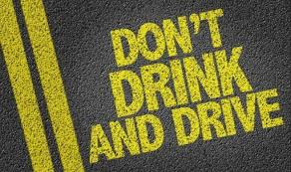
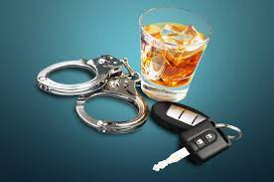
BMPL4010 – Response Policing
Drink/ Drug Driving

Slide 2
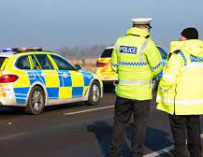
First – Recap!

Slide 3
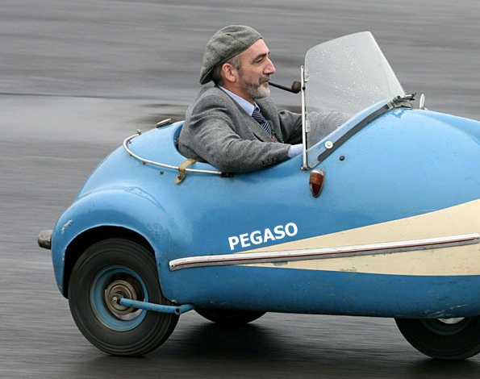
Driver
Includes a person who takes a vehicle out on a road, and remains the driver until s/he finishes their journey
A person can still be a driver even though they have stopped and switched off the engine

Slide 4
Driving
Not defined under Road Traffic Act 1988
… means in control of the propulsion AND the steering of the vehicle

Slide 5
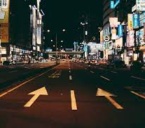

Public Place
Any place to which the public have access whether on payment or otherwise

Slide 6
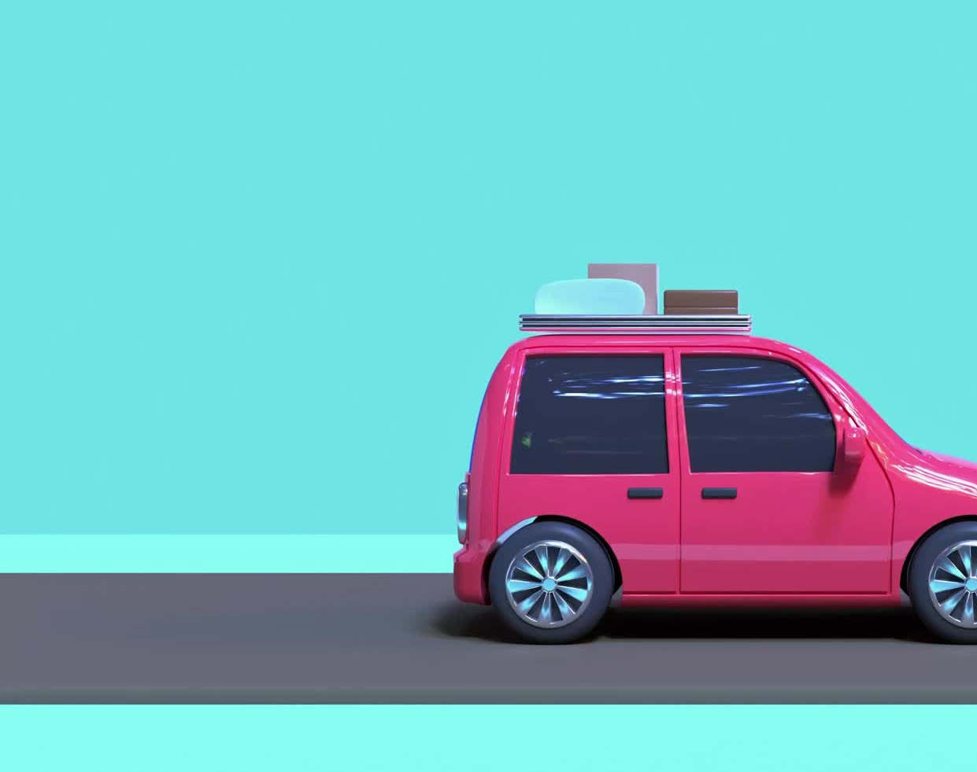
Vehicle
A vehicle is any kind of carriage or conveyance, and includes:
Coach
Car
Motorcycle
Bicycle
Horse Drawn Cart

Slide 7
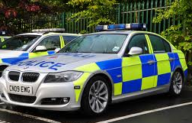
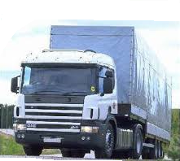
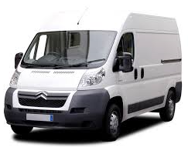
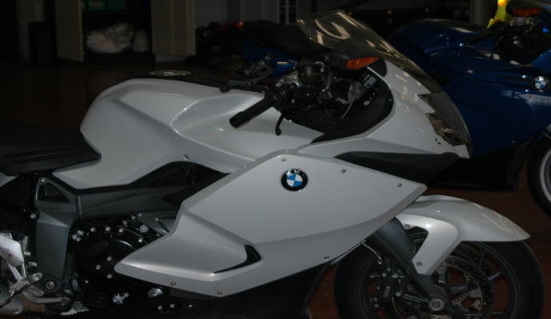
Motor Vehicle
A mechanically propelled vehicle intended or adapted for use on roads

Slide 8

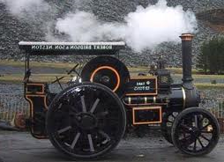
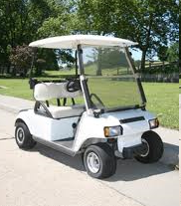
Mechanically Propelled Vehicle
A vehicle that is constructed so that it can be propelled mechanically
Steam
Electric
Petrol
Diesel
Oil
Gas

Slide 9
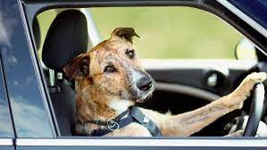
Mechanically Propelled Vehicle
This refers to any source of mechanical power:
S - Steam
E - Electricity
P - Petrol
D - Diesel
O - Oil
G - Gas
Remember ‘SEP the DOG’

Slide 10
Road
…any highway and any other road to which the public has access, and includes bridges over which a road passes.
Sec.192(1) of the Road Traffic Act 1988.

Slide 11
Definition: Road Traffic Collisions
Owing to the presence of a mechanically propelled vehicle (MPV) on a road or other public place, an accident occurs whereby;
personal injury is caused to a person (other than the driver of that MPV)
OR
damage is caused to:
a vehicle (other than the MPV or any trailer drawn by it)
OR
an animal (other than one in or on that MPV or any trailer drawn by it)
OR
any other property, constructed on, fixed to, growing in or otherwise forming part of the land on which the road or other place in question is situated or land adjacent to such land.
Section 170(1) Road Traffic Act 1988

Slide 12
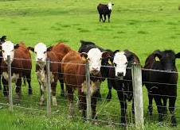
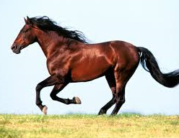
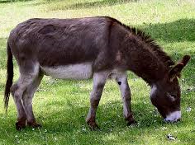
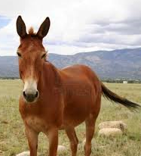
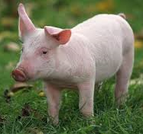
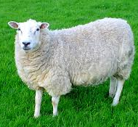
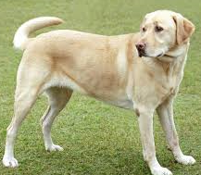
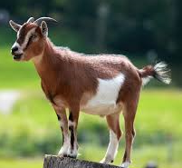
Damage is caused to an animal other than one in or on the MPV or trailer
Cattle
Horse
Ass
Mule
Pig
Sheep
Dog
Goat

Slide 13
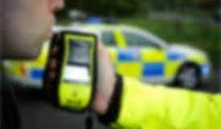
Today’s Learning Outcomes
Identify the principles of legislation under Section 4 Road Traffic Act 1988, Section 5 Road Traffic Act 1988 and Section 6 Road Traffic Act 1988.
State the Powers of Arrest that are available to officers under Section 6 Road Traffic Act 1988.
Explain the Police Station procedure including blood and urine samples should they be required under Section 7 Road Traffic Act 1988.
Explain the Hospital Procedure in relation to persons suspected of drink or drug driving.
Describe the Powers of Entry that are available to officers under Section 6 Road Traffic Act 1988.

Slide 14
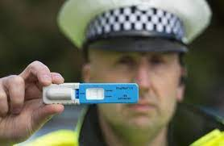
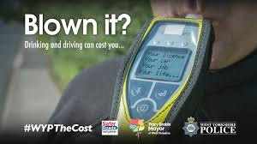
Drink / Drug Driving Investigations
What do we already know?

Slide 15
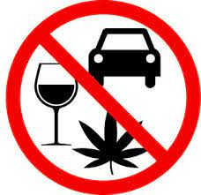
Group A: Section 4 of the Road Traffic Act 1988
Task: To research the principles of Section 4 Road Traffic Act 1988, including points to prove and any defences that may exist.
Research Task
Group B: Section 5/5A of the Road Traffic Act 1988
Task: To research the principles of Section 5 Road Traffic Act 1988, including points to prove, prescribed limits and any defences or case law that may be relevant.
Group C: Section 6 of the Road Traffic Act 1988
Task: To research all aspects of Section 6 Road Traffic Act 1988 and what action police officers can take under this Section.

Slide 16
Attempt to Drive
Intention + Actions
Not necessary to prove person was capable of achieving it
A person sitting at the wheel of a car trying to get a key into the ignition, could be ‘attempting’, even if the keys being used were the wrong ones for the car.
(Kelly v Hogan (1982)
A motorcyclist could be convicted of ‘attempting’ to drive whilst disqualified when he pushed his motor cycle 6 yards towards the entrance of a public road where he was about to ride it
(Shaw v Knill (1974).
The fact that a vehicle is incapable of being driven, say because of a mechanical fault, will not prevent a charge involving an attempt to drive (R v Farrance 1978)
‘…more than merely preparatory…’

Slide 17
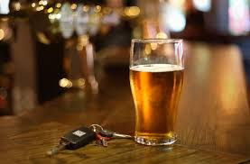
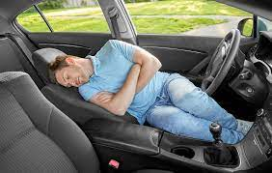
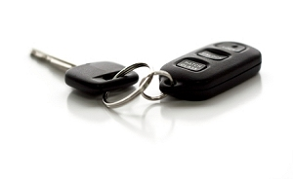
In Charge
Not clearly defined under
Road Traffic Act 1988
A close connection between the defendant and control of the vehicle is required
To determine whether a person can be deemed to be ‘in charge’ of a vehicle the following would be relevant:
Whether the defendant had the keys for the vehicle
Where the defendant was in relation to the vehicle at the time
What evidence there is of the defendant’s intention to take control of the vehicle

Slide 18
Mechanically Propelled Vehicle
A vehicle that is constructed so that it can be propelled mechanically:
Steam
Electric
Petrol
Diesel
Oil
Gas

Slide 19
Motor Vehicle
A mechanically propelled vehicle
intended or adapted for use on roads

Slide 20
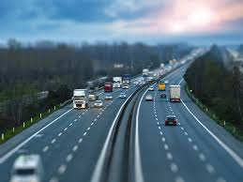
Road
‘Any highway and any other road to which the public has access, and includes bridges over which the road passes’
Notes:
.

Slide 21
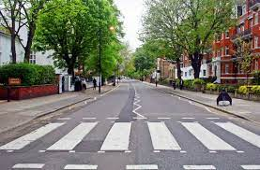
Public Place
‘Any place to which the public have access whether on payment or otherwise’

Slide 22
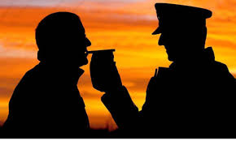
‘Unfit through Drink or Drugs’
A person who drives or
attempts to drive or
is in charge
of a mechanically propelled vehicle
on a road or other public place,
whilst unfit to drive through
drink or drugs
commits an offence
Section 4(1) Road Traffic Act 1988

Slide 23
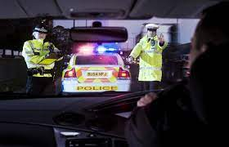
Points to Prove
Sufficient to prove that the person’s ability to drive was impaired because of consumption of drink (alcohol) or drugs
Evidence required is similar to that required to prove drunkenness
Doctor’s opinion and your observations will be important

Slide 24
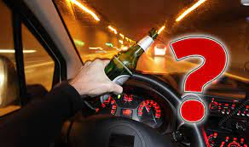
Being over the prescribed limit: Alcohol
A person who drives
or
attempts to drive
or
is in charge of a motor vehicle on
a road or other public place
after consuming so much alcohol
that the proportion of it in their
breath, blood or urine exceeds the
prescribed limit commits an offence
Section 5 Road Traffic Act 1988

Slide 25
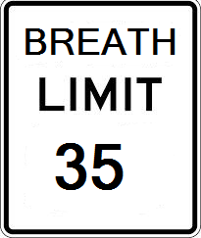
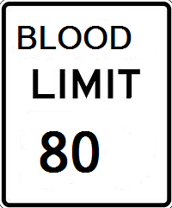
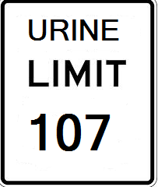
Prescribed Limit: Alcohol
Breath – 35 microgrammes of alcohol in 100 millilitres of breath
Blood – 80 milligrammes of alcohol in 100 millilitres of blood
Urine – 107 milligrammes of alcohol in 100 millilitres of urine

Slide 26

Section 5 Road Traffic Act 1988: Defence
It is a defence for a person charged with an offence to prove that at the time he is alleged to have committed the offence the circumstances were such that there was no likelihood of him driving the vehicle whilst the proportion of alcohol in his breath, blood or urine remained likely to exceed the prescribed limit.

Slide 27
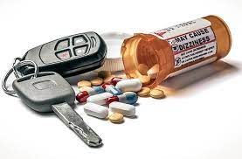
Being over the prescribed limit: Drugs
Where a person drives
or
attempts to drive
or
is in charge of a motor vehicle on
a road or other public place
and there is in that person’s body a specified controlled drug,
they are guilty of an offence if
the proportion of the drug in their blood or urine exceeds the specified limit for that drug
Section 5A Road Traffic Act 1988

Slide 28
Section 5A Road Traffic Act 1988: Defences
It is a defence for a person charged with an offence under this section to show that –
The specified controlled drug had been prescribed or supplied to him for medical or dental purposes,
b) He took the drug in accordance with any directions given by the person whom the drug was prescribed or supplied, and with any accompanying instructions given by the manufacturer or distributor of the drug, and
c) His possession of the drug immediately before taking it was not unlawful under Section 5(1) of the Misuse of Drugs Act 1971 (restriction of possession of controlled drugs) because of an exemption in regulations made under Section 7 of that Act (authorisation of activities otherwise unlawful under foregoing provisions).

Slide 29
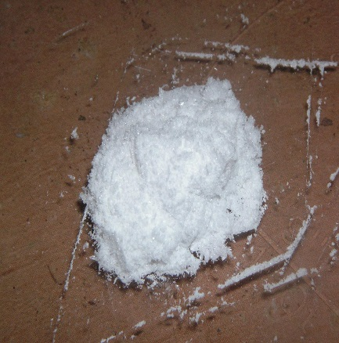
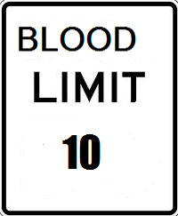
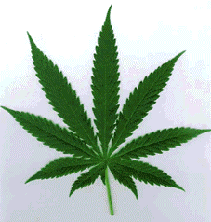
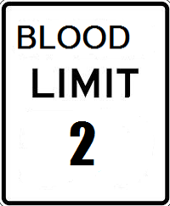
Prescribed Limit: Drugs
Cocaine
Delta-9 Tetrahydrocannabinol (THC)
‘Cannabis’

Slide 30
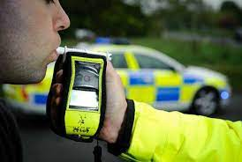
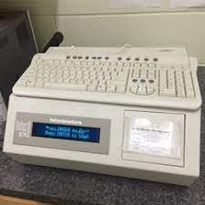
Power to Require Preliminary Tests
Breath specimens at the road side give a preliminary reading and are not evidential to the case.
Breath samples for evidence are analysed by approved devices at designated police stations and operated by specially trained staff.
Section 6 Road Traffic Act 1988

Slide 31
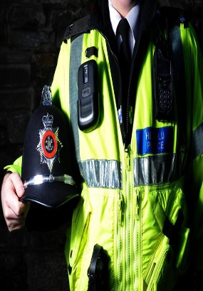
Require a test in 4 circumstances - Section 6 (2),(3),(4),(5) Road Traffic Act 1988
R
E
A
S
O
N
A
B
L
E
G
R
O
U
N
D
S
SUSPECT
(Uniform)
BELIEVE
(Non uniform)
6(2) Driving with alcohol/drug in body
6(3) Has been driving with alcohol /drug in body
6(4) Is or has been driving and committed a moving traffic offence
6(5) Driving at the time an accident occurred

Slide 32
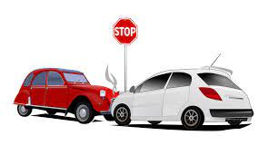
Police Officers can only test a person for alcohol or drugs if:
Suspect driver may be under the influence of alcohol/drugs
Accident occurs where the vehicle has been involved in a Road Traffic Collision (RTC)
Moving traffic offence has been committed

Slide 33
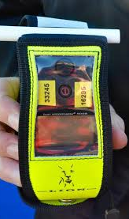
Preliminary Tests
Roadside breath test
Approved by Secretary of State
Indicates if proportion of alcohol in breath exceeds the prescribed limit

Slide 34
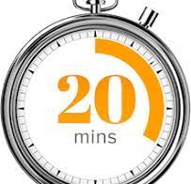
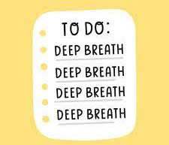
Considerations
When did they last consume alcohol?
Have they used any ‘breath freshening’ sprays recently?
Have they smoked recently?

Slide 35
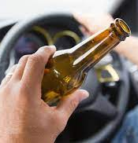
Alcohol Consumed after the Event
If the driver drinks alcohol while still driving
(**Remember to wait 20 mins from time of last drink**)
If person has stopped driving then try and prevent them from drinking.
If person alleges they have had a drink since the incident gather evidence to assist with ‘back calculation’.

Slide 36
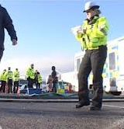
Preliminary Impairment Tests
Unfit to drive through drink or drugs
Series of physical and psychomotor tests administered by specially trained officers
Test may be carried out at the scene or at a police station

Slide 37

Preliminary Drug Tests
Sweat or saliva samples
Test may be administered at the scene or at a police station

Slide 38


Section 6(6) Road Traffic Act 1988
A person commits an offence if, without reasonable excuse, they fail to co-operate with a preliminary test in pursuance of a requirement imposed under this section.
A person may not be arrested under Section 6D while at hospital as a patient.

Slide 39

‘Reasonable Excuse’
Physical or mental inability to undertake the test
Unable to understand the requirement to take the test

Slide 40

Powers of Arrest
A constable may arrest a person without warrant if, as a result of a preliminary breath test, the constable reasonably suspects that the proportion of alcohol in the person’s breath or blood exceeds the prescribed limit
Section 6D(1) Road Traffic Act 1988

Slide 41

Powers of Arrest
A constable may arrest a person without warrant if,
the person fails to co-operate with a preliminary test in pursuance of a requirement imposed under Sec 6
and
the constable reasonably suspects that the person has alcohol or a drug in his body or is under the influence of a drug
Section 6D(2) Road Traffic Act 1988

Slide 42

Police Station Procedure
BLOOD or URINE can only be required where:
The constable making the requirement has reasonable cause to believe that for medical reasons a specimen of breath could/should not be provided
An approved device is not available at the police station or is not practical to use such a device
An approved device has been used but the constable has reasonable cause to believe that the readings produced are unreliable
Notes:
,

Slide 43

Police Station Procedure
BLOOD or URINE can only be required where:
A preliminary drug test has been administered and the constable has reasonable cause to believe that the person has a drug in his/her body
The suspected offence is one under Sec 3A, 4 or 5A and a medical practitioner has advised that the condition of person required to provide a specimen might be due to some drug.
Notes:
,

Slide 44

Police Station Procedure
If a specimen of breath is provided and the reading is in excess of the prescribed limit (35 micrograms) but contains NO MORE THAN 50 micrograms of alcohol in 100 milliliters of breath.
The suspect will be given the option of replacing the breath test reading with a specimen of blood or urine.
Notes:
,
It is for the Constable to decide whether the specimen will be BLOOD or URINE, UNLESS, in a doctor’s opinion, there are medical grounds for not providing blood, such as anaemia -
However, the following stated cases should be borne in mind –
Joseph v DPP (2003)
J, a Rastafarian , provided two specimens of breath for analysis having been arrested on suspicion of driving a motor vehicle after consuming alcohol in excess of the statutory limit. The lower reading was 40 microgrammes in 100ml of breath, it was indicated that he would have to follow the statutory option of requiring an alternative sample. J indicated, before the formal process began that he would not be able to give blood due to his religion and the officer then stated that if that was the case then there would be no option left but to charge him.
The formal process then began and due to the previous conversation J restated that he could not give blood because of his religion, and as this could not be seen as a medical reason he was charged, using the lower of the two breath tests as the reason.
No mention was made of the alternative of a sample of urine. J was found guilty at Magistrates Court and the decision was supported by the Crown Court. J appealed by way of case stated:-
HELD (allowing the appeal) the court gave the following reasons in these exceptional circumstances:-
In a case brought under section 8(2) of the Road Traffic Act 1988 there is no reason for a driver to be invited to state whether he wishes to give blood or urine. The choice is the constable's, it is a statutory discretion and if tested should be done on the basis of the Wednesbury Principles.
However the present case is unusual in that before the officer made his choice he was aware that J would not be able to give blood, regardless of whether or not Rastafarianism is a religion and these reasons should have been taken into consideration when requesting the alternative. In those circumstances the officer, not having any reason not to choose urine, should have chosen urine instead of blood.
Blood will ALWAYS be taken by a DOCTOR – the POLICE SURGEON
The suspect MUST CONSENT to the blood being taken, otherwise it is an ASSAULT
Urine MAY be taken by a POLICE OFFICER
The suspect will be required to provide 2 SAMPLES within ONE HOUR. The first sample will be discarded, and the second one used
If this option is NOT taken then the suspect will be charged with the appropriate offence.
If the option is taken the suspect will be bailed pending the results of the analysis of the blood/urine sample provided.

Slide 45


Section 9 -
Road Traffic Act 1988
The provision of samples for analysis under hospital procedure is covered by Section 9 Road Traffic Act 1988.

Slide 46

Hospital Procedure
Welfare of patient takes precedence
Consent required from doctor in charge of patient
If doctor consents – continue with procedure
If doctor does not consent to preliminary breath test, they may still allow a request for blood or urine sample
It is the decision of the doctor in charge of the patient to allow samples to be taken
The police surgeon will obtain blood samples if required, NOT the hospital doctor

Slide 47

Hospital Procedure
Following an accident, a constable can request
that a blood specimen be taken without the
consent of the casualty who is a patient in
hospital, if the officer believes that the patient
cannot give a valid consent because of his/her
medical condition

Slide 48

Important Considerations
Consent must be obtained from the medical practitioner in charge of the casualty
Sample must be obtained by a Police Surgeon unless impractical to do so
If sample is obtained by another medical practitioner it MUST NOT be the person in charge of and responsible for the care of the casualty

Slide 49



Completed Module Feedback Form
=
Coffee Break & Ticket to my Christmas Quiz
DIOLCH!!

Slide 50






BMPL4010 Response Policing
Annual Christmas Quiz

