Slide 1
High Intensity Interval Training
By Ross Morgan

Slide 2
What is High Intensity Interval Training?
Short intense exercise
Short periods of recovery
Series
In-between series rest periods
More time at or close to VO₂max (>90%)
Time saving
Modalities
<40 minutes
Cipryan, Tschakert and Hofman (2017)
Notes:
Short intense exercise
Mixed with short periods of rest
Repeated in intervals known as series
A series is followed by a longer rest period
Sessions last no longer than 30 minutes
HIIT allows us to spend more time above 90% of VO2max, to improve our aerobic and anaerobic capacity

Slide 3
Types of HIIT
Short intervals <45 seconds
Long intervals ≥ 45 seconds
Repeated sprint training ≤10 seconds (all out sprints, with recovery periods)
Sprint interval training 20-30 seconds (all out sprints, with recovery periods)
Notes:
The most common types of HIIT are.....

Slide 4
Benefits of HIIT
Burns calories
Increases metabolism
Improve oxygen consumption
Lower resting heart rate
Increase resistance to fatigue
Improves performance
Quality of life
De Oliveira-Nunes, S.G. et al. (2021)
Notes:
A study compared 20 min HIIT vs 40 minutes of cycling and found similar changes to the number of calories burned and VO2max.
HIIT increases our metabolism whilst exercising and our metabolism stays elevated after exercise.
It improves the body's ability to transport oxygen to the working muscles.
And increases our resistance to fatigue
Therefore improving our performance
Its time efficient
And improves our quality of life by improving our sleep, energy levels, focus and well-being.

Slide 5
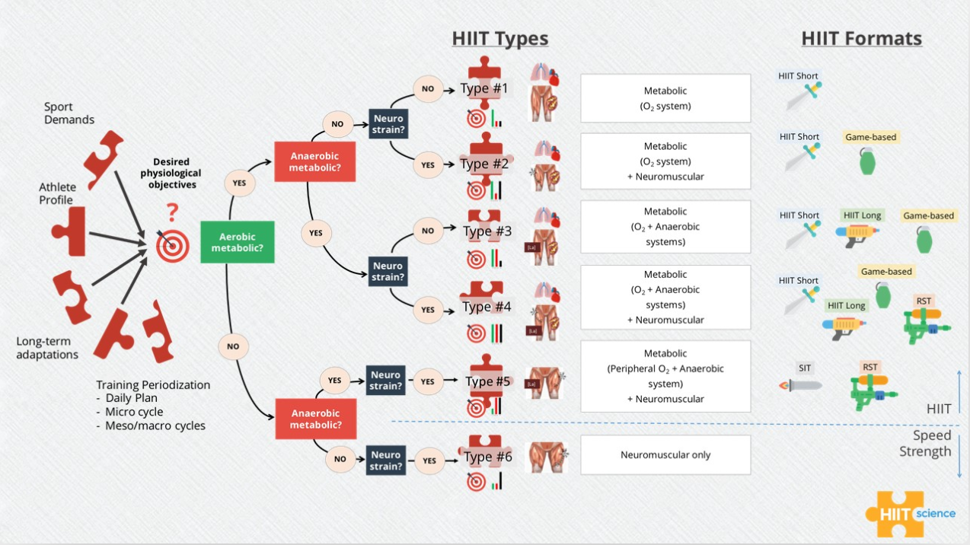
HIIT Selection
Buchheit and Laurson (2022)
Notes:
Define our objective
Understand the adaptations we require (aerobic, anaerobic, neuromuscular or combination of all 3)
Choose the right HIIT format to support our goals

Slide 6
Client profile
Gender: Male
Age: 35
Weight: 77kg
Height: 176cm
Maximum heart rate: 183bpm (208-0.7 x age)
Roy and Mccrory (2015)
Training age: 10+ years
Retired semi-professional football player
Goal: start playing football again
Notes:
Max HR = 208-(0.7x age) Roy and Mccrory (2015)

Slide 7
Objectives
Improve aerobic and anaerobic capacity
Improve neuromuscular responses
Increase resistance to fatigue

Slide 8
Pre-Intervention Test Protocol.
5-minute time trial
Rosenblatt, Perrotta and Thomas (2020)
Ski ergometer
Concept2 Erg data app
Heart rate monitor (chest strap)
Viccarri, Giovanelli and Lazzer (2020)
Rate of perceived exertion (RPE)
Notes:
*time trial has a 0.94 correlation with VO2max (ref)
*HR to review time spent >90% of HR max, correlation between HR and VO2max (ref)

Slide 9
5-minute Time Trial Data
Distance (M) | Max Watts | pVO2max | Average Watts | Max Heart Rate | Average Heart Rate
1307 | 350 | 198 | 232 | 183 | 142
Notes:
pVO2max is the slowest velocity at which VO2max occurs.

Slide 10
Short Intervals
Maximum Aerobic Speed = Distance/Time
1307/300 = 4.35 m/s
Maximum aerobic speed x Intensity x Duration = Interval Distance
4.35 x 1.2 (120%) x 30 = 156m
Buchheit and Laursen (2013b)
Notes:
Research shows that 120% of MAS is effective for improving aerobic and anaerobic systems (ref)

Slide 11
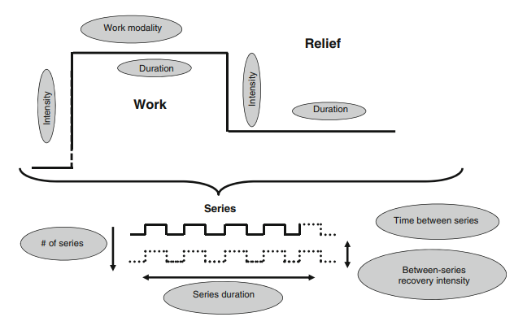
Training Method
9 Variables
120% of MAS (156m)
Ratio of 1:1 (30:30)
Passive rest
A series of 6 intervals (3 minutes) progressing to 12 intervals (6 minutes)
4-minute passive rest between series
1 session per week
48 hours of rest
4-week Mesocycle
Buchheit and Laursen (2013)
Notes:
Reseason for intervals was due to illness

Slide 12
Monday | Tuesday | Wednesday | Thursday | Friday | Saturday | Sunday
HIIT 156m:30 3-minute series x2 | Rest | Full body weight training circuit | Football training | Rest | Football game | Mobility and foam rolling
Week 1
Monday | Tuesday | Wednesday | Thursday | Friday | Saturday | Sunday
HIIT 30:30 @ 237 watts 3-minute series x3 | Rest | Full body weight training circuit | Football training | Rest | Football game | Mobility and foam rolling
Week 2
Monday | Tuesday | Wednesday | Thursday | Friday | Saturday | Sunday
HIIT 30:30 @ 237 watts 3-minute series x3 | Rest | Full body weight training circuit | Football training | Rest | Football game | Mobility and foam rolling
Week 3
Monday | Tuesday | Wednesday | Thursday | Friday | Saturday | Sunday
HIIT 30:30 @ 237 watts 6-minute series x2 | Rest | Full body weight training circuit | Football training | Rest | Football game | Mobility and foam rolling
Week 4

Slide 13
Training Data: Week 1 via distance of 156m
Series 1
 | Time | Average Watts | Average HR | Max HR | Heart Rate Zones | Time >90% HR
Interval 1 | 29.6 | 308 | 127 | 156 | 1,2,3 | 0
Interval 2 | 31.1 | 308 | 176 | 183 | 4,5 | 31
Interval 3 | 32 | 308 | 178 | 182 | 4,5 | 31
Interval 4 | 32.8 | 308 | 179 | 183 | 4,5 | 34
Interval 5 | 35.3 | 308 | 180 | 182 | 4,5 | 35
Interval 6 | 34.2 | 308 | 178 | 183 | 4,5 | 33
Mean | 32.5 | 308 | 170 | 178 | 4,5 | 164
Series 2
 | Time | Average Watts | Average HR | Max HR | Heart Rate Zones | Time >90% HR
Interval 1 | 34.7 | 247 | 147 | 160 | 2,3 | 0
Interval 2 | 35.6 | 247 | 172 | 176 | 4 | 35
Interval 3 | 35.1 | 247 | 174 | 181 | 4,5 | 34
Interval 4 | 34.7 | 247 | 103 | 174* | 4,5 | 21
Interval 5 | 35.7 | 247 | 177 | 184 | 4,5 | 34
Interval 6 | 34.3 | 247 | 133 | 178* | 4,5 | 26
Mean | 35.0 | 247 | 151 | 175 | 4,5 | 150
*HR monitor failed
RPE: 10
Total time spent >90% of HR max = 5:14​ out of 6 minutes

Slide 14
Test Results
Distance (M) | Max Watts | pVO2max | Average Watts | Max Heart Rate | Average Heart Rate
1307 | 350 | 198 | 232 | 183 | 142
New calculations- pVO2max x intensity
198 x 1.2 = 237 watts
Anaerobic Speed Reserve (ASR) = MAP – pVO2max = 152 watts
25% of ASR= 152 x 25/100 = 38 watts
198 + 38 = 236 watts
Wen et al (2019)
Notes:
Wen et al suggests that 25% of ASR is roughly 120% MAS (ref).

Slide 15
Training Data: Week 2 (237watts)
Series 1
 | Average Watts | Average HR | Max HR | Heart Rate Zones | Time >90% HR
Interval 1 | 237 | 150 | 157 | 3 | 0
Interval 2 | 237 | 169 | 172 | 4 | 29
Interval 3 | 237 | 177 | 179 | 4 | 30
Interval 4 | 237 | 178 | 180 | 4 | 29
Interval 5 | 237 | 177 | 182 | 4,5 | 29
Interval 6 | 237 | 177 | 181 | 4,5 | 30
Mean | 237 | 171 | 175 | 4 | 147
Series 2
 | Average Watts | Average HR | Max HR | Heart Rate Zones | Time >90% HR
Interval 1 | 249 | 154 | 170 | 3,4 | 8
Interval 2 | 249 | 172 | 178 | 4 | 28
Interval 3 | 249 | 176 | 180 | 4 | 27
Interval 4 | 249 | 177 | 180 | 4 | 29
Interval 5 | 249 | 178 | 186 | 4,5 | 29
Interval 6 | 249 | 181 | 186 | 4,5 | 28
Mean | 249 | 173 | 180 | 4 | 149
Series 3
 | Average Watts | Average HR | Max HR | Heart Rate Zones | Time >90% HR
Interval 1 | 252 | 154 | 169 | 3,4 | 7
Interval 2 | 252 | 174 | 179 | 4 | 29
Interval 3 | 252 | 176 | 185 | 4,5 | 29
Interval 4 | 252 | 178 | 186 | 4,5 | 27
Interval 5 | 252 | 179 | 187 | 4,5 | 28
Interval 6 | 252 | 183 | 188 | 4,5 | 29
Mean | 252 | 174 | 182 | 4 | 149
RPE: 8
Total time spent >90% of HR max = 7:41 out of 9 minutes

Slide 16

Training Data: Week 3 (237watts)
3 x 3 minutes series
Average HR: 157
Average max HR: 165
Time >90% HR max: 5:44 out of 9 minutes
Recovered from illness
Adapted to the training method
Improved aerobic capacity

Slide 17
Training Data: Week 4 (237 watts)
Series 1 | Average Watts | Average HR | Max HR | Heart Rate Zones | Time >90% HR
Interval 1 | 242 | 118 | 137 | 1,2 | 0
Interval 2 | 242 | 160 | 166 | 3,4 | 9
Interval 3 | 242 | 164 | 168 | 4 | 29
Interval 4 | 242 | 164 | 167 | 4 | 30
Interval 5 | 242 | 162 | 166 | 3,4 | 21
Interval 6 | 242 | 172 | 174 | 4 | 29
Interval 7 | 242 | 169 | 174 | 4 | 29
Interval 8 | 242 | 170 | 176 | 4 | 30
Interval 9 | 242 | 170 | 177 | 4 | 29
Interval 10 | 242 | 168 | 177 | 4 | 29
Interval 11 | 242 | 173 | 179 | 4 | 29
Interval 12 | 242 | 242 | 178 | 4 | 30
Mean | 242 | 169 | 170 | 4 | 294
Series 2 | Average Watts | Average HR | Max HR | Heart Rate Zones | Time >90% HR
Interval 1 | 244 | 136 | 152 | 2,3 | 0
Interval 2 | 244 | 162 | 167 | 4 | 29
Interval 3 | 244 | 165 | 173 | 3,4 | 21
Interval 4 | 244 | 174 | 177 | 4 | 29
Interval 5 | 244 | 170 | 177 | 4 | 29
Interval 6 | 244 | 174 | 181 | 4,5 | 30
Interval 7 | 244 | 175 | 182 | 4,5 | 29
Interval 8 | 244 | 176 | 183 | 4,5 | 29
Interval 9 | 244 | 177 | 185 | 4,5 | 29
Interval 10 | 244 | 178 | 185 | 4,5 | 30
Interval 11 | 244 | 179 | 185 | 4,5 | 29
Interval 12 | 244 | 179 | 185 | 4,5 | 28
Mean | 244 | 170 | 178 | 4 | 312
RPE: 9
Total time spent >90% of HR max = 10:06 of 12 minutes

Slide 18
Post- Intervention Test Data (5minute time trial)
Distance (M) | Max Watts | pVO2max | Average Watts | Max Heart Rate | Average Heart Rate
1347 | 347 | 217 | 253 | 185 | 183

Slide 19
Pre and Post Intervention Comparison
Distance (M) | Max Watts | pVO2max | Average Watts | Max Heart Rate | Average Heart Rate
1307 | 350 | 198 | 232 | 183 | 142
PRE
Distance (M) | Max Watts | pVO2max | Average Watts | Max Heart Rate | Average Heart Rate
1347 | 347 | 217 | 253 | 185 | 183
POST
Notes:
Produced more power at the point of VO2max
Able to sustain a harder effort for longer
I was expecting a lower average heart rate but this could be due to the harder effort or the invention design

Slide 20
Limitations
5-minute time trial
Not sport specific
Upper body workout
Notes:
*overestimate or underestimate HIIT data based on 5 minute time trail.

Slide 21
My Observations
Include a measure of VO2max specific to the sport
Measure of body fat percentage
Switch up the training equipment
Quick and intense
Enjoyed the process
Notes:
30-15 IFT, includes acceleration, deceleration and turns.
Bodyfat is can impact performance

Slide 22

Questions & Answers

Slide 23
Reference List
Buchheit, M. and Laursen, P.B. (2013a) ‘High-Intensity Interval Training, Solutions to the Programming Puzzle: Part I: Cardiopulmonary Emphasis’, Sports Medicine, 43(5), pp. 313-38.
Buchheit, M. and Laursen, P.B. (2013b) ‘High-Intensity Interval Training, Solutions to the Programming Puzzle: Part II: Anaerobic Energy, Neuromuscular Load and Practical Applications’ Sports Medicine, 43(10), pp. 927-54.
Cipryan, L., Tschakert, G. and Hofmann, P. (2017) ‘Acute and Post-Exercise Physiological Responses to High-Intensity Interval Training in Endurance and Sprint Athletes’, Journal of Sports Science & Medicine, 16(2), pp. 219-229.
De Oliveira-Nunes, S.G. et al. (2021) ‘HIIT vs. SIT: What Is the Better to Improve V˙O₂max? A Systematic Review and Meta-Analysis' International Journal of Environmental Research and Public Health, 18(24), pp. 13120.
Menz, V. et al. (2019) ‘Functional Vs. Running Low-Volume High-Intensity Interval Training: Effects on VO2max and Muscular Endurance’, Journal of Sports Science & Medicine, 18(3), pp. 497-504.
Rhibi, F. et al. (2022) ‘Effects of different training intensities in high-intensity interval training (HIIT) on maximal aerobic velocity, hematological and muscle-damage markers in healthy young adults’, BMC Sports Science, Medicine & Rehabilitation, 14, pp. 1-12.
Rosenblatt, M.A., Perrotta, A.S. and Thomas, S.G. (2020) ‘Effect of High‑Intensity Interval Training Versus Sprint Interval Training on Time‑Trial Performance: A Systematic Review and Meta‑analysis’, Sports Medicine, 50(6), pp. 1145-1161.
Roy, s. and Mccrory, J. (2015) 'Validation of maximal heart rate prediction equations based on sex and physical activity status', International journal of exercise science, 8(4), p318.
Vaccari Filippo, Giovanelli, N. and Lazzer, S. (2020) ‘High-intensity decreasing interval training (HIDIT) increases time above 90% V˙O₂peak’, European journal of applied physiology, 120(11), pp. 2397-2405.
Wen, D. et al. (2019) ‘Effects of different protocols of high intensity interval training for VO2 max improvements in adults: A meta-analysis of randomised controlled trials’, Journal of Science and Medicine in Sport, 22(8), pp. 941-947.

