Slide 1
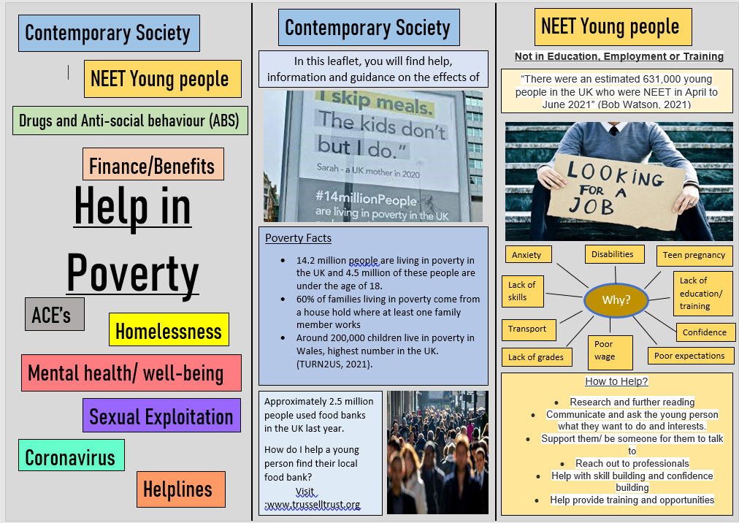
POVERTY
By Ashlie Day, Lyndsey Rees, Dana Jones and Laura John

Slide 2
Presentation
Incorporating issues studied in this module, students are required to work in small groups and design an advisory leaflet for parents and guardians focusing on an issue faced by young people in contemporary society. Students will be required to ‘present’ their advisory leaflet, ensuring they demonstrate how youth workers can best support at risk young people. Your presentation should be supported by wider reading, and linked to the Youth Work National Occupational Standards (CLD Standards Council Scotland, 2019).
Dana Jones

Slide 3
Presentation will discuss:
What poverty looks like in contemporary society for young people
NEET Young people
Drugs
Anti-social Behaviour
Finance and benefits
Adverse childhood experiences
Homelessness
Mental health and well-being
Sexual Exploitation
Coronavirus
Helplines
Conclusion
Dana Jones

Slide 4
What Poverty Looks Like in Contemporary Society for Young People
‘Poverty in Wales isn’t about drought, war, or starvation – as it can be in developing countries – but it’s every bit as real’
(Oxfam Cymru , 2021).
Dana Jones

Slide 5
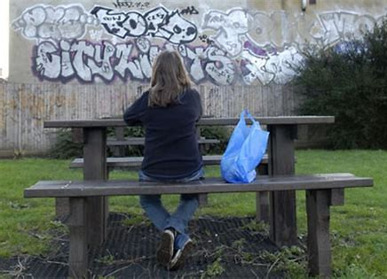
What Poverty Looks Like in Contemporary Society for Young People
14.2 million people living in poverty in the United Kingdom
4.5 Million children in the United Kingdom living in poverty
(Turn2Us, 2020).
(Oxfarm Cymru , 2021).
Dana Jones

Slide 6
What Poverty Looks Like in Contemporary Society for Young People
Definition of Poverty
Individuals, families and groups in the population can be said to be in poverty when they lack resources to obtain the type of diet, participate in the activities and have the living conditions and amenities which are customary, or at least
widely encouraged and approved, in the
societies in which they belong (Townsend, 1979, p.31).
Dana Jones

Slide 7
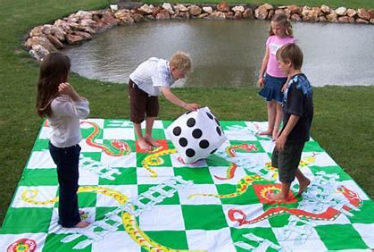
What Poverty Looks Like in Contemporary Society for Young People
( Fun filled events, 2019).
Dana Jones

Slide 8
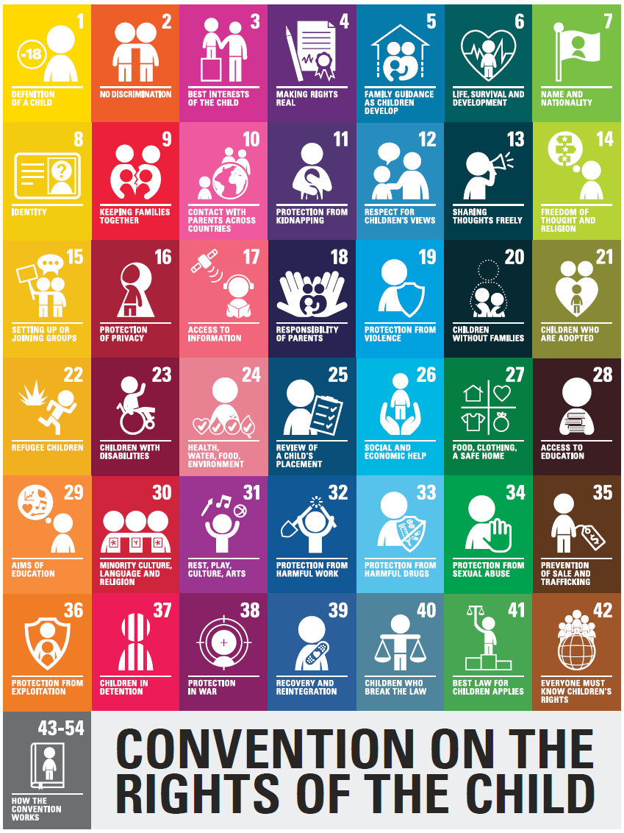
What Poverty Looks Like in Contemporary Society for Young People
Every child has the right to rest and leisure, to engage in play and recreational activities appropriate to the age of the child and to participate freely in cultural life and the arts.
(Children’s Commissioner Wales, 2015 p2).
(Woodhouse Primary Academy. 2021).
Dana Jones

Slide 9
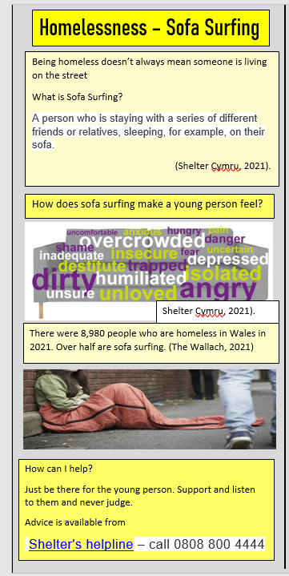
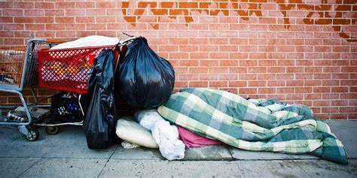
Homelessness and Poverty
What is the definition of homelessness?
(Shelter Cymru, 2020).
Dana Jones

Slide 10
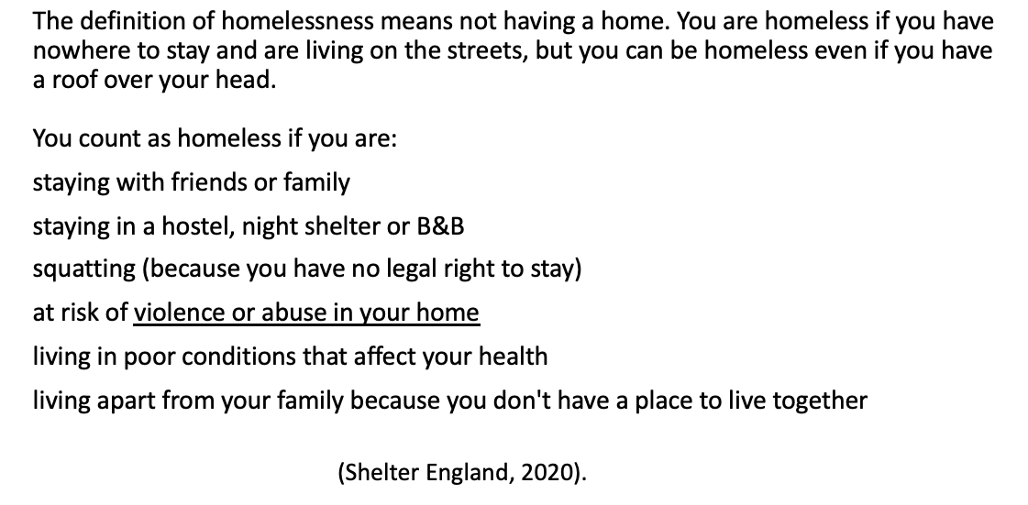
Homelessness and Poverty
What is the definition of homelessness?
Dana Jones

Slide 11
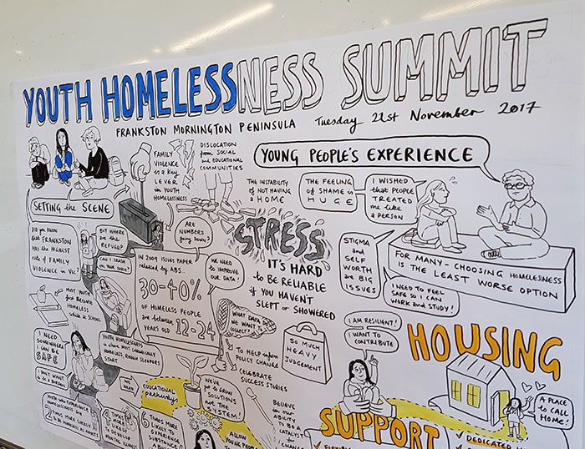
Homelessness and Poverty
Young people are now the group most likely to be living in poverty
(Wales Youth Agency, 2018).
Dana Jones

Slide 12
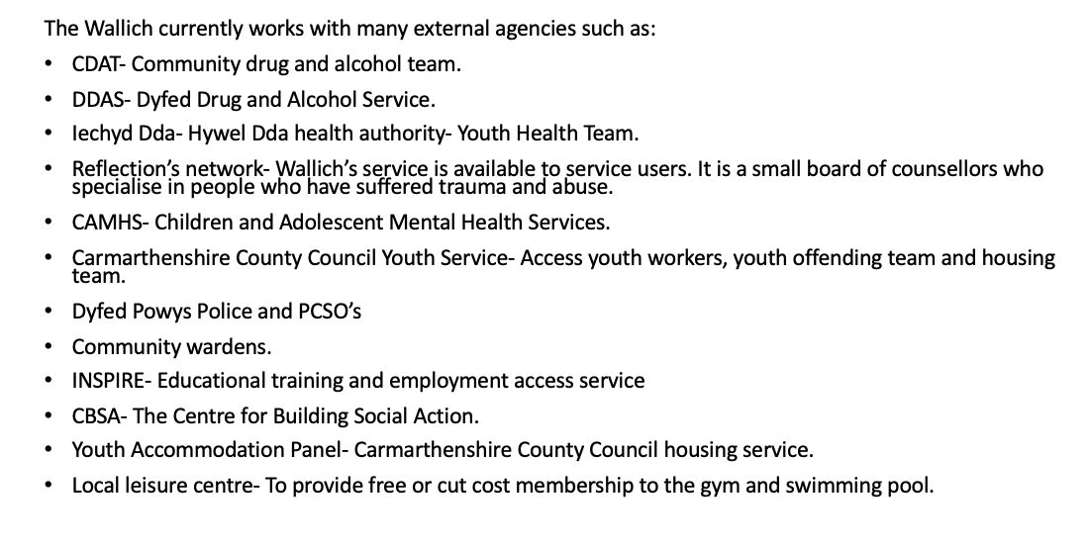

Homelessness and Poverty
Dana Jones
(The Wallich, 2021).

Slide 13
Thank You For Listening

Slide 14
Bandura, A. (1997) Social Learning Theory. Englewood Cliffs, NJ: Prentice Hall.
CLD Standards Council Scotland, (2019) Youth Work National Occupational Standards. London: CLD Standards Council Scotland.
Coles, B. (1995) Youth and Social Policy. London: UCL Press.
Crisis (2019), Cover the Costs: How gaps in Local Housing Allowance are impacting homelessness
Available at: www.crisis.org.uk/media/240377/cover_the_cost_2019.pdf
(Accessed: 22nd February 2022).
Dashiff, C., Dimicco, W., Myers B. and Sheppard, K. (2009) ‘Poverty and adolescent mental health’, Journal of child and adolescent psychiatric nursing, 22(1), pp. 23-32.
DOI: https://doi.org/10.1111/j.1744-6171.2008.00166.x
Equality and Human Rights Committee (2015), Is Britain Fairer? The state of equality and
human rights 2015
Available at: www.equalityhumanrights.com/sites/default/files/is-britain-fairer-2015.pdf
(Accessed: 22nd February 2022).
Free Design File (2016) Young person sitting alone on the stairs
Available at: https://freedesignfile.com/upload/2018/04/Young-people-sitting-alone-on-the-stairs-Stock-Photo.jpg
(Accessed 17th February 2022).
Freire, P. (1993). Pedagogy of the oppressed (30th anniversary edition. New York: Continuum.
Fun Filled Events (2019) Giant Snake and Ladder
Available at: https://www.funfilledevents.com.au/images/services/Games_and_activity/Giant-Snakes-Ladders.jpg
(Accessed 17th February 2022).
Homeless Link (2018), Young & Homeless 2018
Available at: www.homeless.org.uk/facts/our-research/young-and-homeless-research
(Accessed: 22nd February 2022).
Ingram, G. and Harris, J. (2001) Delivering GOOD Youth Work: A Working Guide to Surviving and Thriving. Dorset: Russell House Publishing Ltd.
Mackle, A. (2019) ‘Standing at the crossroads: What future for youth work’, The journal of contemporary community education practice theory, 10(2) pp. 1-12.
Main, G. (2013) Department of Social Policy and Social Work: A child-derived martial deprivation index. York: The University of York.
McCormick, J. and Philo, C. (1991) Off the map: The social geography of poverty in the UK. London: CPAG.

Slide 15
Mind Cymru (2020) Mind Cymru is Mind in Wales
Available at: https://www.mind.org.uk/about-us/mind-cymru/
(Accessed: 22nd February 2022).
Oxfam Cymru. (2020) Poverty in Wales.
Available at: https://oxfamapps.org/cymru/poverty-in-wales/
(Accessed on 18th February 2022)
Robinson, D., & Coward, S. (2003). Hidden Homelessness: Your Place, Not Mine.
Available at: http://www4.shu.ac.uk/research/cresr/sites/shu.ac.uk/files/hidden-homelessness-your-place-not-mine.pdf
(Accessed: 22nd February 2022).
Rogers, V. (2016) An Independent Evaluation of Youth Work in Schools in Wales
Available at: https://gov.wales/sites/default/files/publications/2018-02/an-independent-evaluation-of-youth-work-in-schools-in-wales-vanessa-rogers-may-2016.pdf
(Accessed 17th February 2022).
Sapin, K. (2013) Essential Skills for Youth work Practice 2nd Ed. London: SAGA.
Snowden. C. (2020) The South Wales Guardian. Support for homelessness in Carmarthenshire.
Available at: https://www.southwalesguardian.co.uk/news/18768823.support-homelessness-carmarthenshire/
(Accessed: 22nd February 2022).
Shelter England, (2020) Help us be there
Available at: https://england.shelter.org.uk
(Accessed: 22nd February 2022).
Shelter Cymru, (2021) Homeless What Can I Do?
Available at: https://sheltercymru.org.uk/wp-content/uploads/2021/11/Homeless_what-can-I-do-2021.pdf
(Accessed: 22nd February 2022).
Street photo 24 (2013) No Title
Available at: http://cdn.streetphoto24.com/wp-content/uploads/2016/09/DSC06937.jpg
(Accessed 17th February 2022).
Townsend, P. (1979) Poverty in the United Kingdom: a survey of a household resources and standards of living. Middlesex: Penguin Books.
The Wallich. (2021) Getting People off the Streets.
Available at: https://thewallich.com
(Accessed: 22nd February 2022).
Turn2us (2018) UK Poverty: facts and figures.
Available at: https://www.turn2us.org.uk/About-Us/News/UK-Poverty-Facts-and-figures.
(Accessed: 7th November 2019).

Slide 16
United Nations Convention on the Rights of the Child. (1989) Convention on the right of the child
Available at: https://ico.org.uk/for-organisations/childrens-code-hub/additional-resources/the-united-nations-convention-on-the-rights-of-the-child/
(Accessed:17th Feburary 2022).
Young, K. (2006) The Art of Youth Work 2nd ed. Dorset: Russell House Publishing.
Wales Youth Agency, (2018) Young People & Homelessness in Wales
Available at: http://www.youthworkwales.org.uk/wp-content/uploads/2017/11/Homelessness.pdf#:~:text=The%20%EE%80%80Wales%EE%80%81%20Young%20%EE%80%80Homelessness%EE%80%81%20Group%20notes%20that%20according,figures%20however%2C%20may%20not%20represent%20a%20true%20
(Accessed 22nd February 2022)
Watts, B., Johnsen, S., & Sosenko, F. (2015) Youth homelessness in the UK: A review for The OVO Foundation,
Available at: https://pureapps2.hw.ac.uk/ws/portalfiles/portal/9258335
(Accessed: 22nd February 2022).
Weale, S. (2020) ‘Youth Services suffer 70% funding cut in less than a decade. The Guardian
20th January 2020
Available at: https://www.theguardian.com/society/2020/jan/20/youth-services-suffer-70-funding-cut-in-less-than-a-decade
(Accessed: 22nd February 2022).
Welsh Assembly Government. (2014) Program for Children and Young people. Cardiff: Welsh Assembly Government.
Welsh Assembly Government. (2014) National Youth Work Strategy. Cardiff: Welsh Assembly Government.
Woodhouse Primary Academy (2021). Dream, Believe, Aspire and Achieve.
Available athttps://www.woodhouse.priacademy.co.uk/pupils/unicef
(Accessed:17th February 2022).

