Slide 1

PART 2 – SECURING THE ENTERPRISE NETWORK
Student Name: Darshan Nareshbhai Sheliya
Student Number: 2530070
Subject Name: Enterprise Network Security
Module Code: ACCA7032
Lecturer: Renuga Jayakumar

Slide 2
Task 1 – Gaia Infrastructure Configuration
Task 1 focused on setting up the Check Point Gaia security infrastructure for the enterprise network. A-GW, A-SMS and A-GUI/SmartConsole were configured for centralised security management. The required IP addresses and user accounts were configured, and the Check Point licence was applied and verified. Finally, the connection between the Swansea network and A-SMS was tested to confirm successful communication and management.
Configured A-GW Security Gateway
Set up A-SMS Security Management Server
Configured A-GUI / SmartConsole
Configured IP addresses and user accounts
Applied and verified Check Point licensing
Tested connectivity between Swansea Network and A-SMS

Slide 3
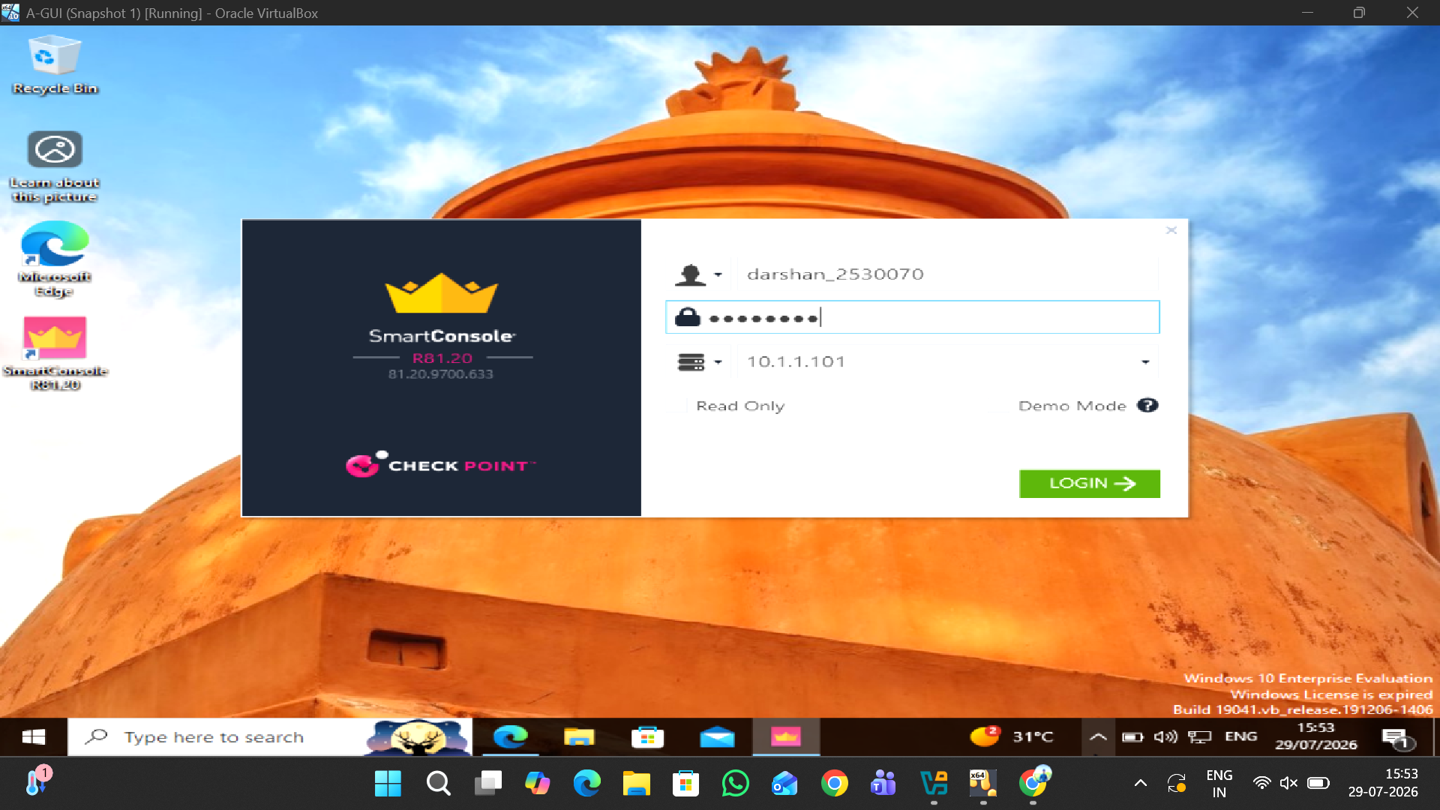
SmartConsole Login
This screenshot shows the SmartConsole login used to access the Check Point Security Management Server.

Slide 4
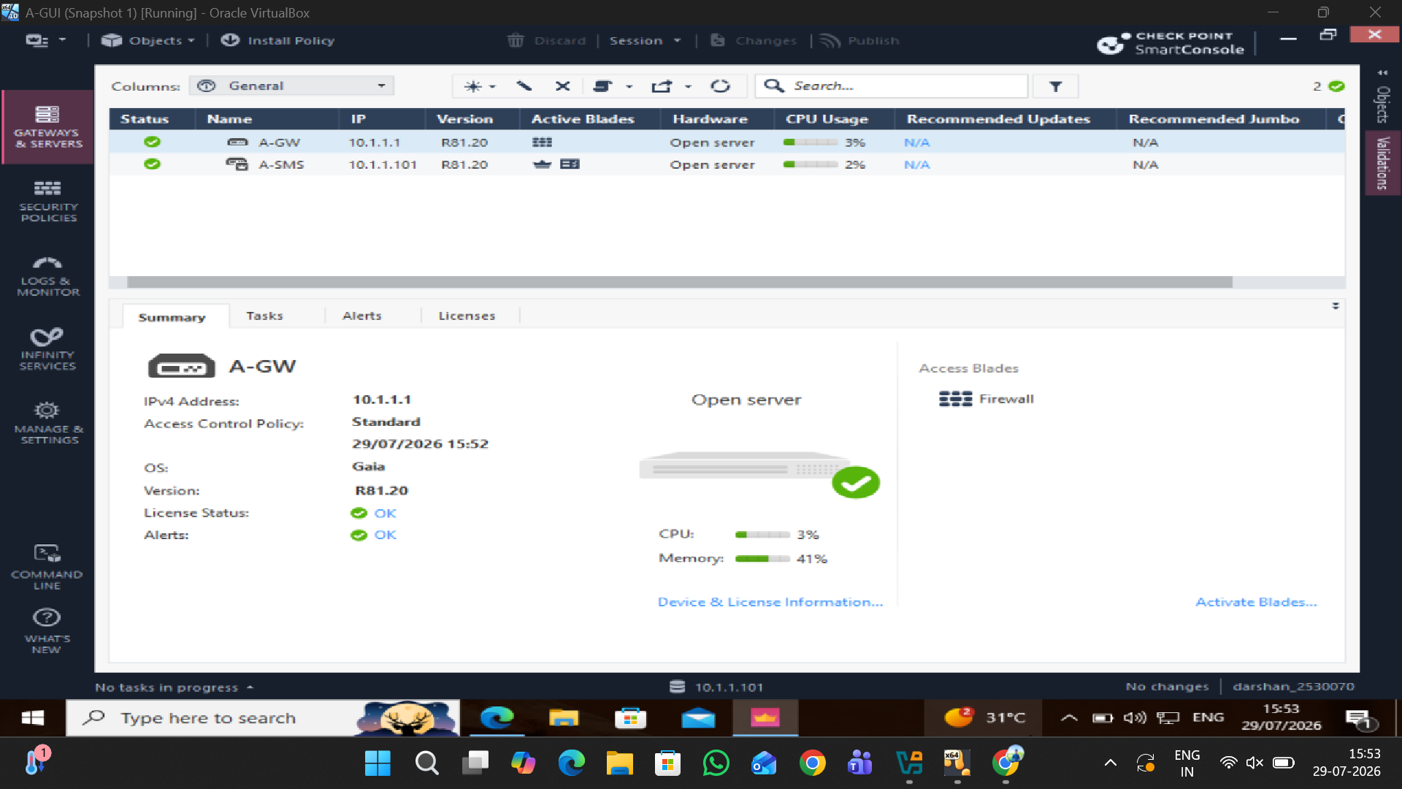
A-GW and A-SMS Configuration
A-GW was configured as the Check Point Security Gateway with IP address 10.1.1.1.
A-SMS was configured as the Security Management Server with IP address 10.1.1.101.
Both systems are running Gaia R81.20 and are visible in SmartConsole with a healthy status.
The Firewall blade and licence status were verified successfully on A-GW.

Slide 5
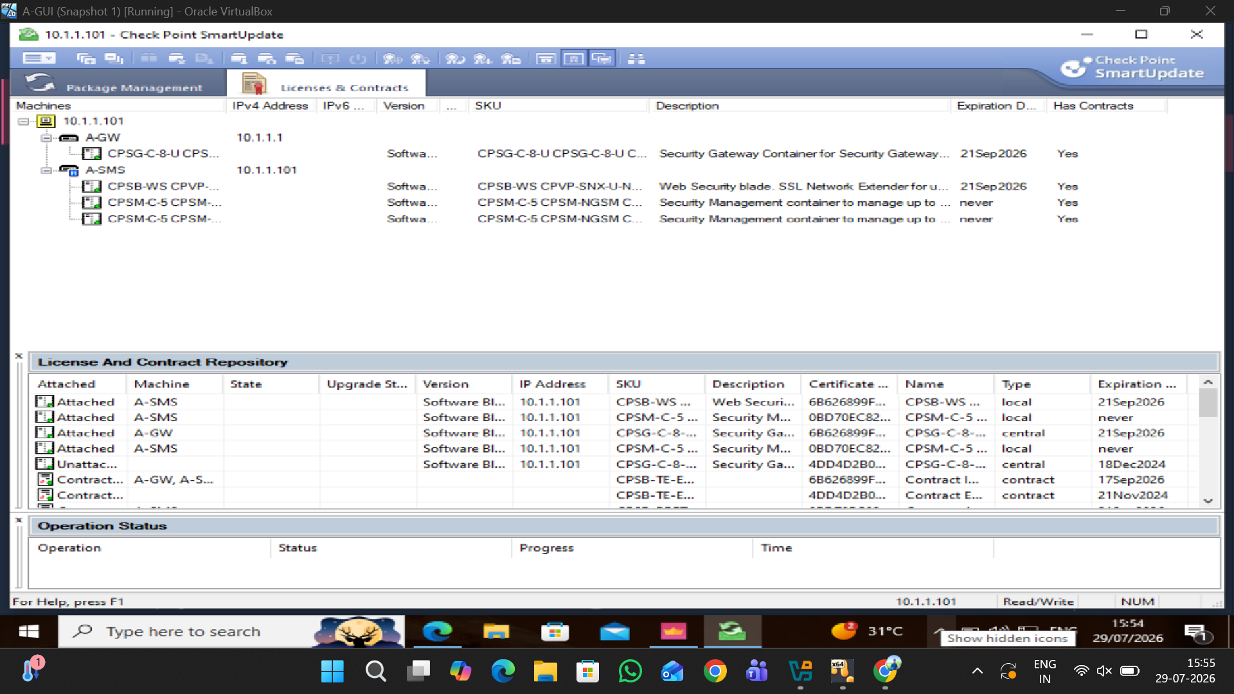
Check Point Licensing Verification
A-GW is listed with IP address 10.1.1.1 and a Security Gateway licence.
A-SMS is listed with IP address 10.1.1.101 and Security Management Server licences.
The Licenses & Contracts section shows the available Check Point software licences and contract information.
The licence entries show attached/available status and expiry information, confirming that the licensing information was checked.

Slide 6
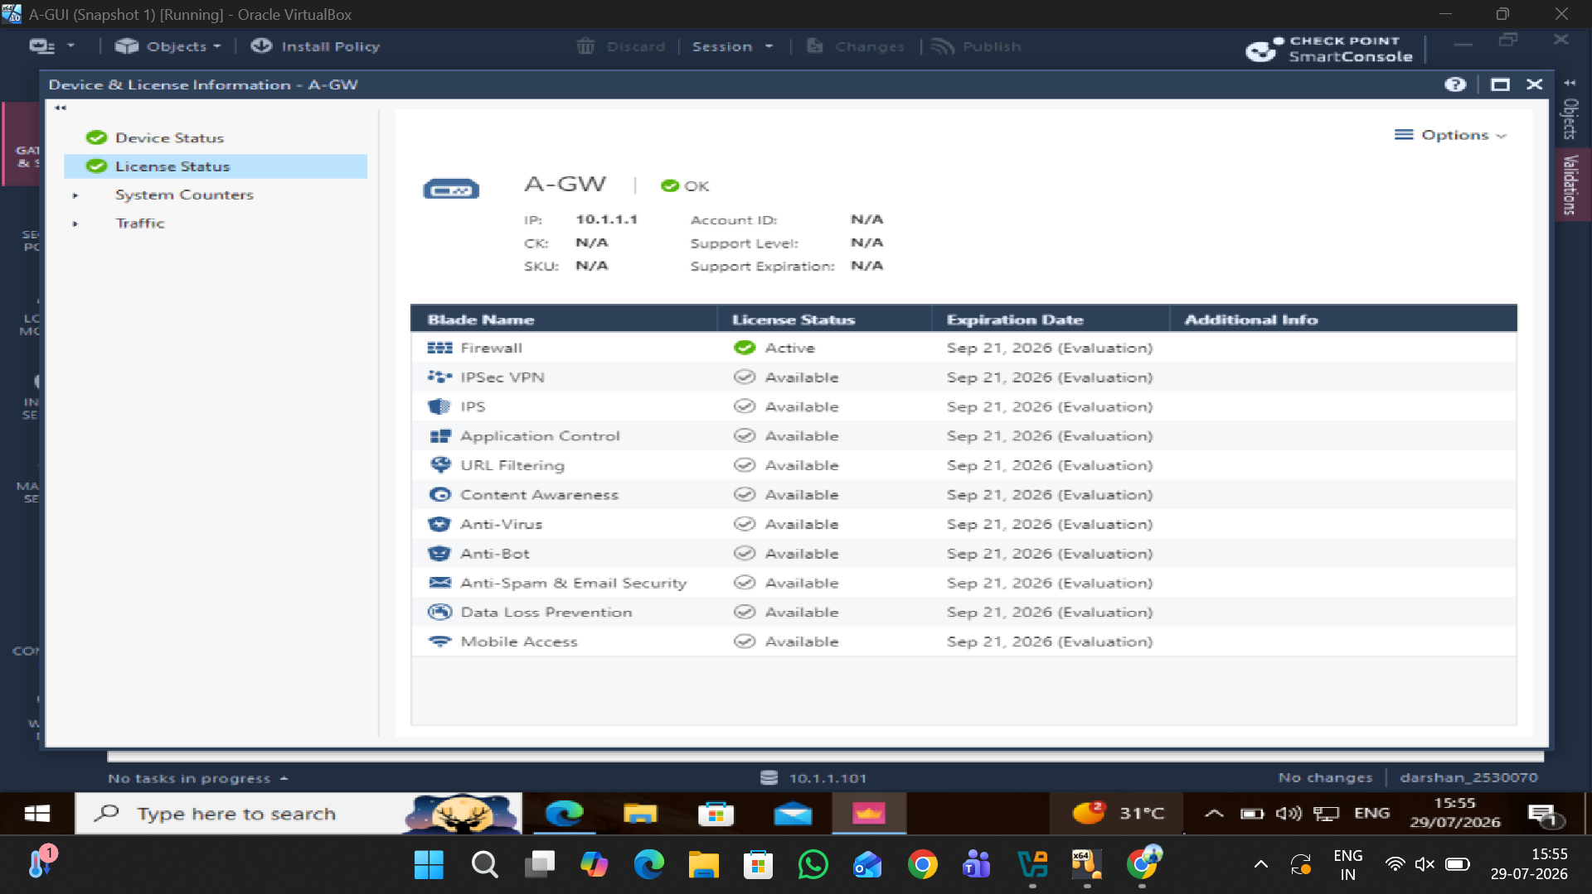
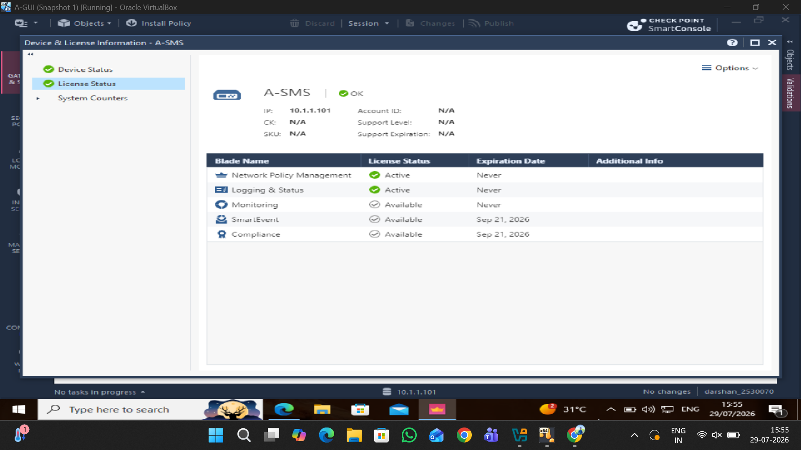
A-GW and A-SMS Licence Status
A-GW licence status: Verified successfully for the Security Gateway.
A-SMS licence status: Verified successfully for the Security Management Server.
Security blades: The available/licensed security features are displayed in SmartConsole.
Verification: Licence information and feature availability were checked before continuing with the security configuration.

Slide 7
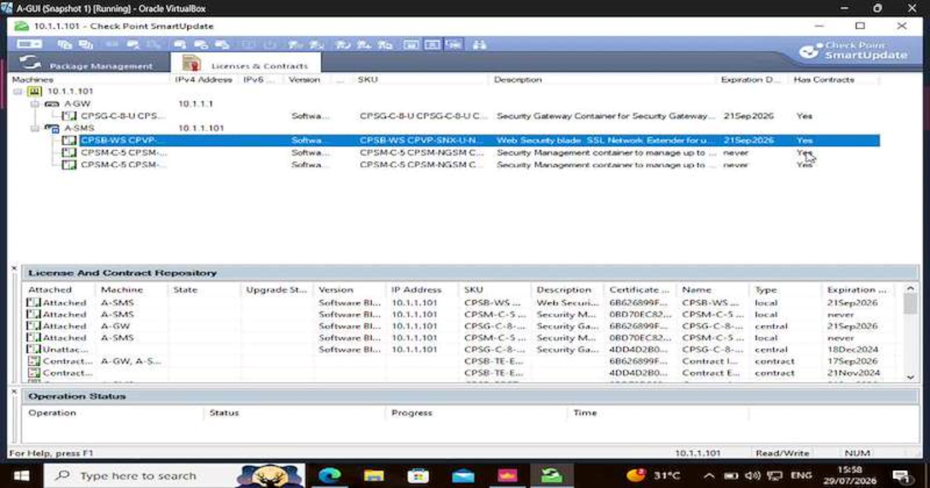
Check Point Licence Verification
Check Point Licence Verification – Demonstration.mp4
SmartUpdate was used to review the Check Point licence information.
The licences associated with A-GW and A-SMS were checked.
The demonstration confirms that the required licence information was available for the configured environment.

Slide 8
TASK 2 – SECURING THE ENTERPRISE NETWORK
Implementation of a Network Security Solution
This part focuses on securing the enterprise network using Check Point Gaia appliances. The work includes configuring the security gateway and management server, creating and applying firewall security rules, and implementing additional security features to improve network protection.

Slide 9
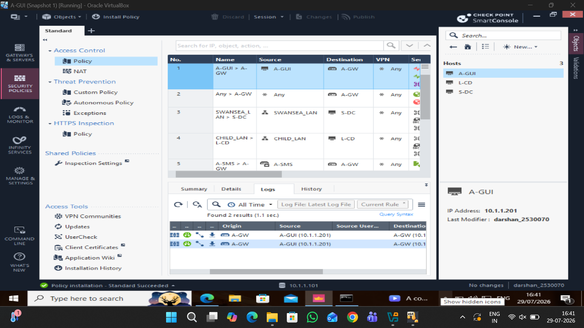
HOST OVERVIEW
A-GUI – Management workstation
L-CD – London Child Domain Controller
S-DC – Swansea Domain Controller
A-GUI IP address: 10.1.1.201

Slide 10
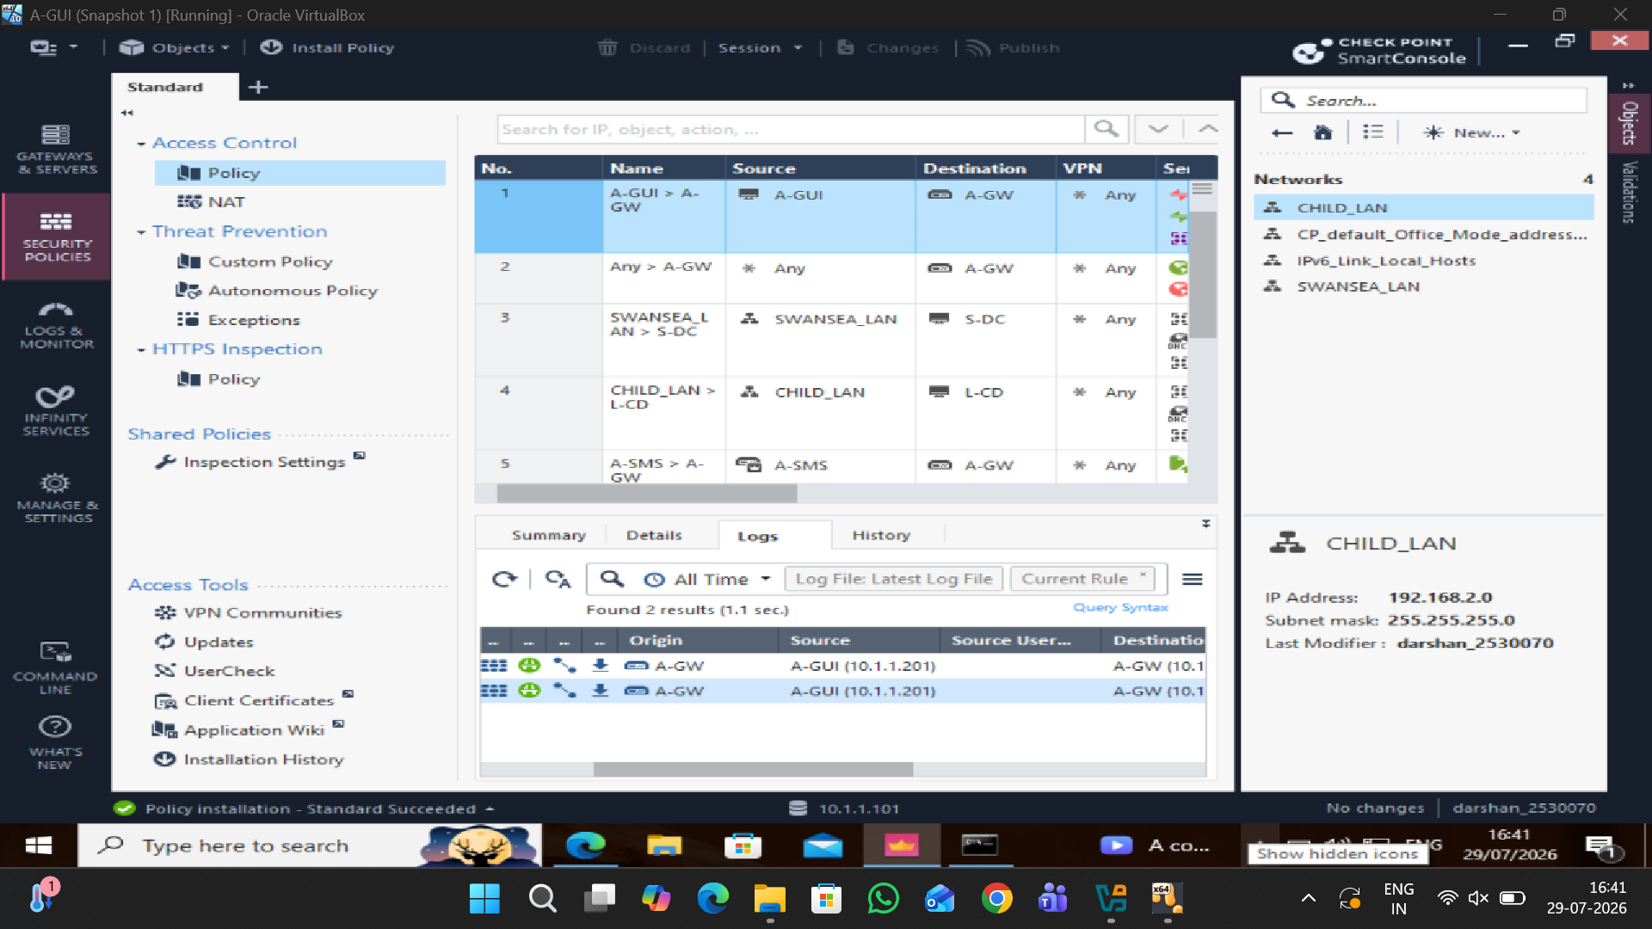
NETWORK OBJECTS
SWANSEA_LAN – Swansea network segment
CHILD_LAN – Child/London network segment
CHILD_LAN address: 192.168.2.0/24
These objects are used as sources and destinations in firewall rules.

Slide 11
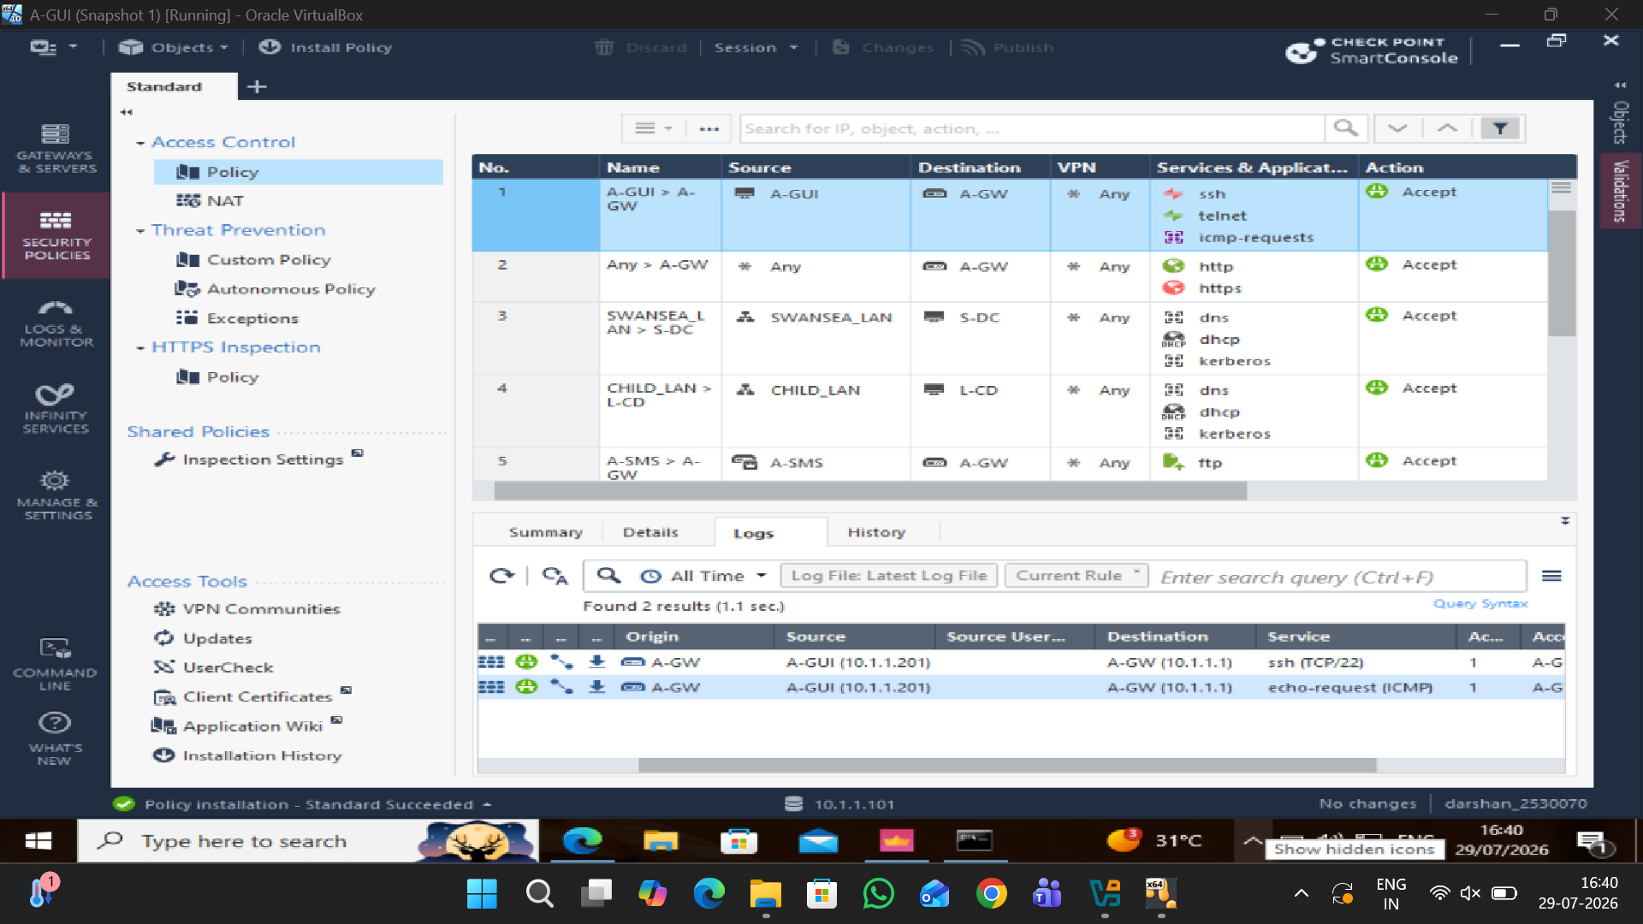
Firewall Security Policy Configuration
Firewall security rules were created in SmartConsole.
Different source and destination networks were defined.
Specific services were selected for each rule.
Rules include SSH, Telnet, ICMP, HTTP, HTTPS, DNS, DHCP, Kerberos and FTP.
The rules use Accept actions for the required traffic.
The configured firewall policy was prepared and applied to the A-GW Security Gateway.
The firewall policy provides controlled access between the defined networks and services.

Slide 12
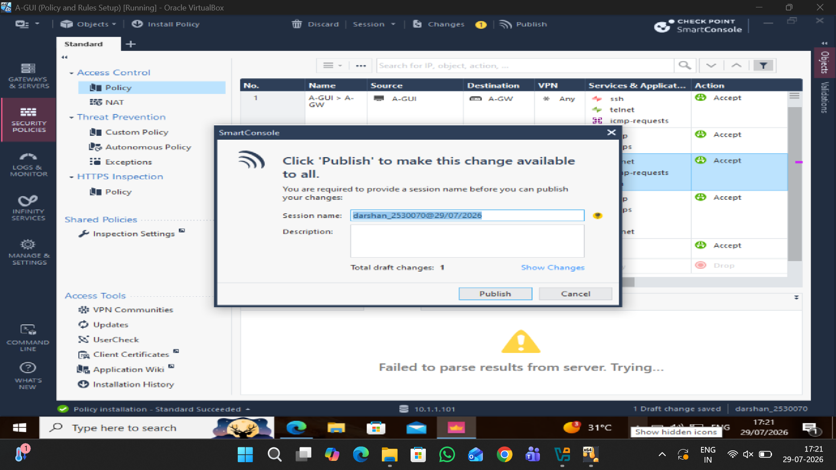
Publish
The configured firewall changes were published through SmartConsole so that the updated policy could be applied to the Security Gateway.

Slide 13
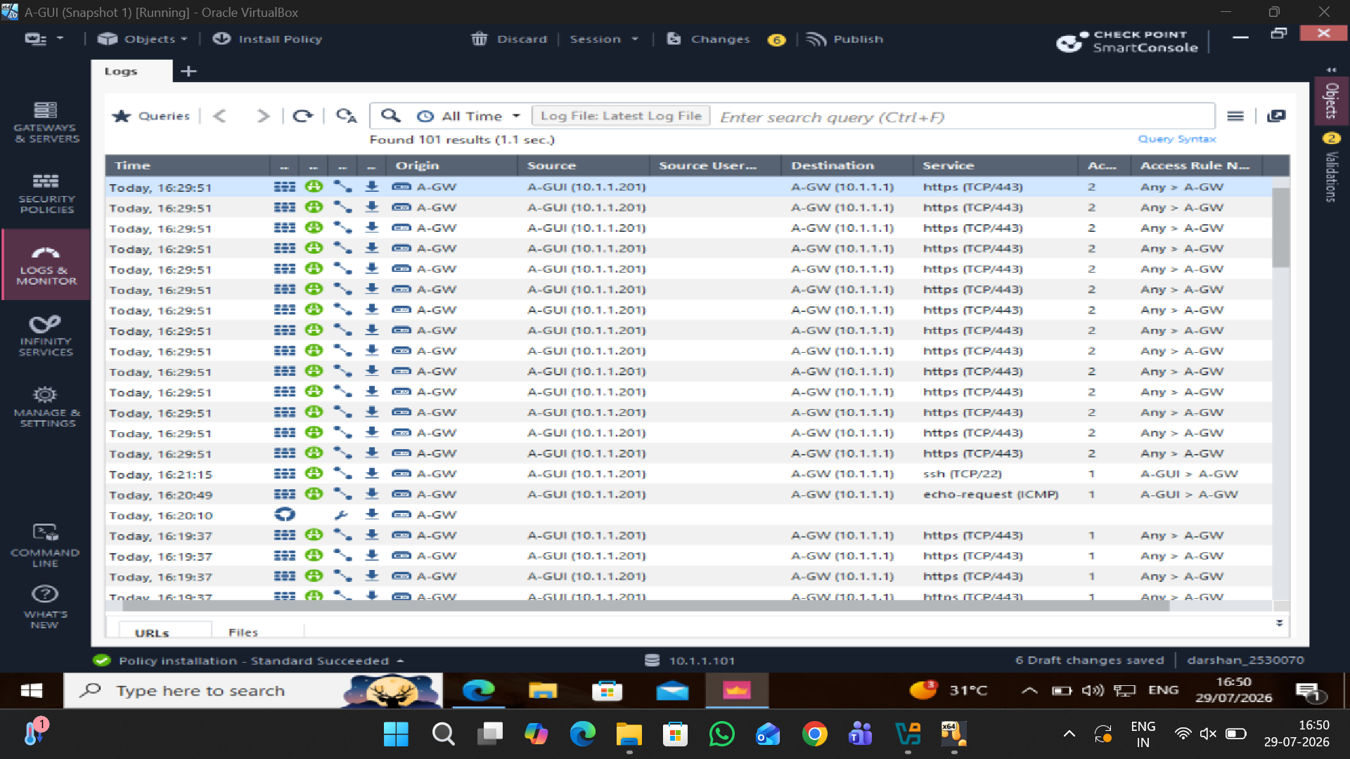
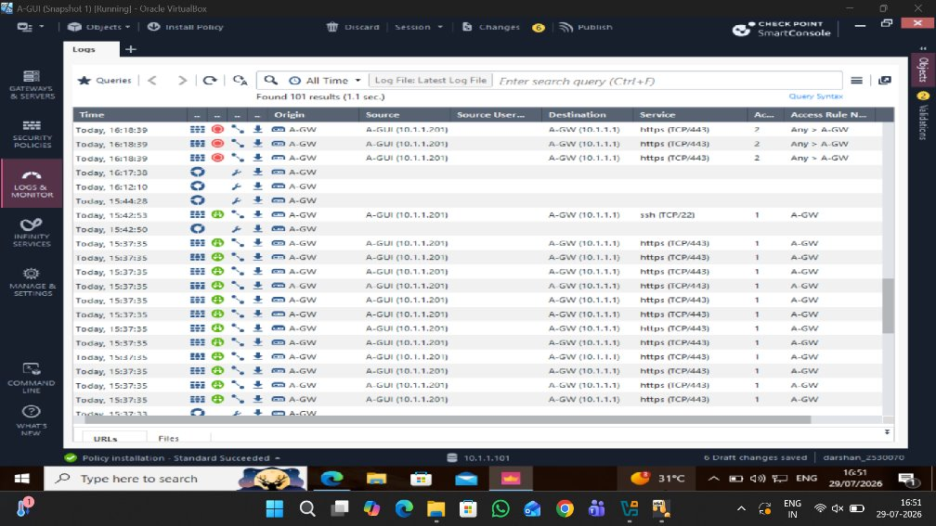
Firewall Traffic Monitoring and Logs
SmartConsole Logs & Monitor was used to review network traffic.
Allowed traffic can be identified from the log entries.
The logs provide evidence of firewall rule activity.

Slide 14
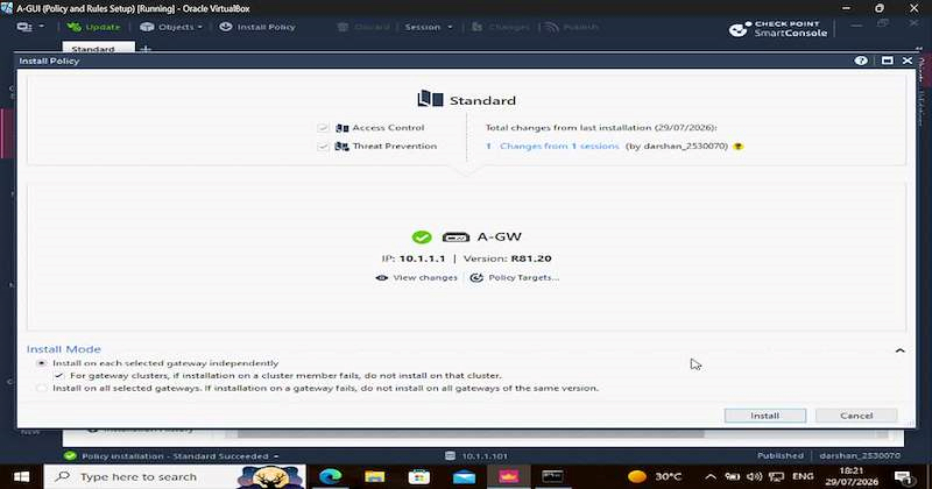
Policy and Rule Setup Demonstration
Policy and Rules (Log Monitor).mp4
Access Control rules were configured in Check Point SmartConsole.
The required source, destination and services were defined for network communication.
The configured policy was installed on the Security Gateway.
Logs and monitoring were used to observe the resulting network activity.

Slide 15
TASK 3 – Proposed Additional Security Feature: IPS
Task 3 proposes an Intrusion Prevention System (IPS) as an additional security layer for the existing Check Point firewall. IPS would inspect network traffic for suspicious activity and known attack patterns. If implemented, the IPS feature could work with the existing Threat Prevention policy and provide additional protection for the enterprise network.

Slide 16
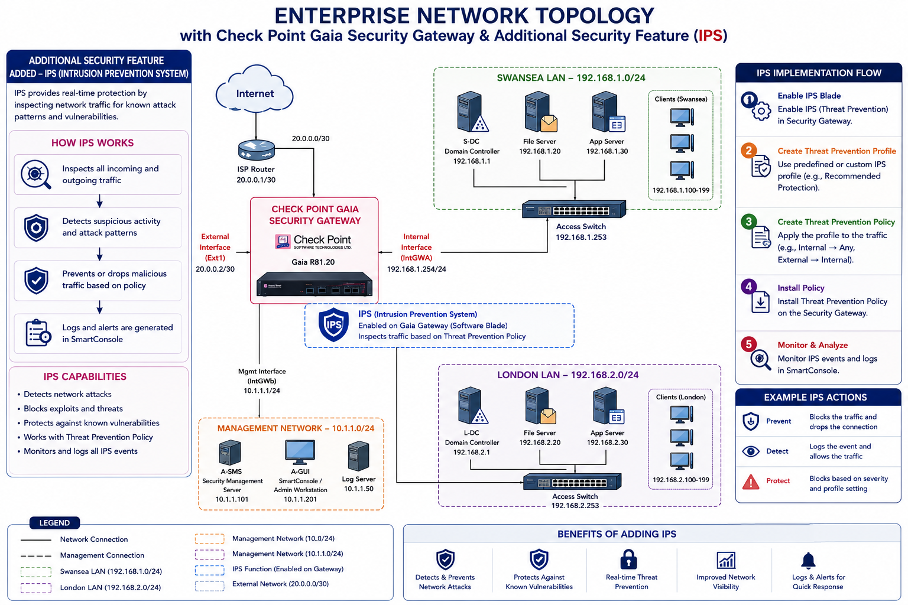
Proposed IPS Security Enhancement
Enable IPS on A-GW to provide additional protection against network attacks.
Apply a Threat Prevention profile to inspect traffic for suspicious or malicious activity.
Protect both Swansea and London LAN traffic through the Check Point Security Gateway.
Detect and prevent known threats based on the selected security policy.
Monitor IPS events and alerts through SmartConsole for better visibility.
Expected benefit: improved threat detection and stronger protection for the enterprise network.
The existing Check Point firewall provides network access control. IPS is proposed as an additional security layer to inspect traffic, identify suspicious activity and provide threat prevention.

Slide 17
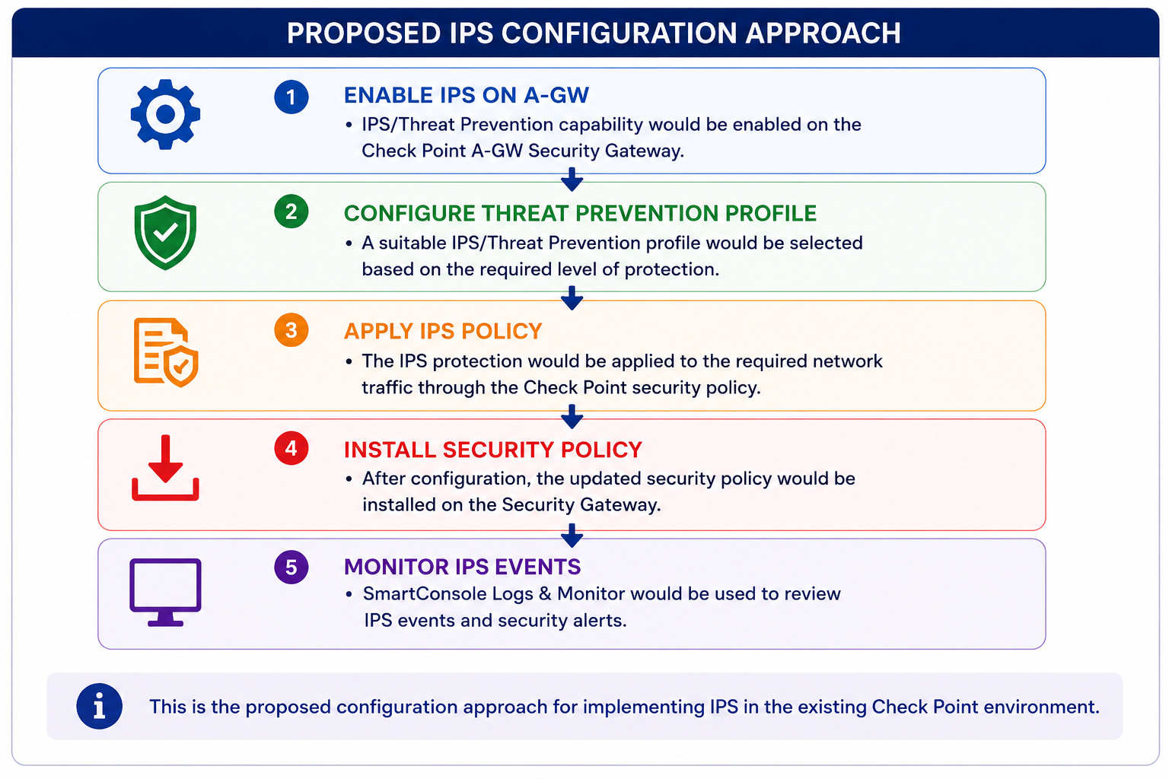

Slide 18
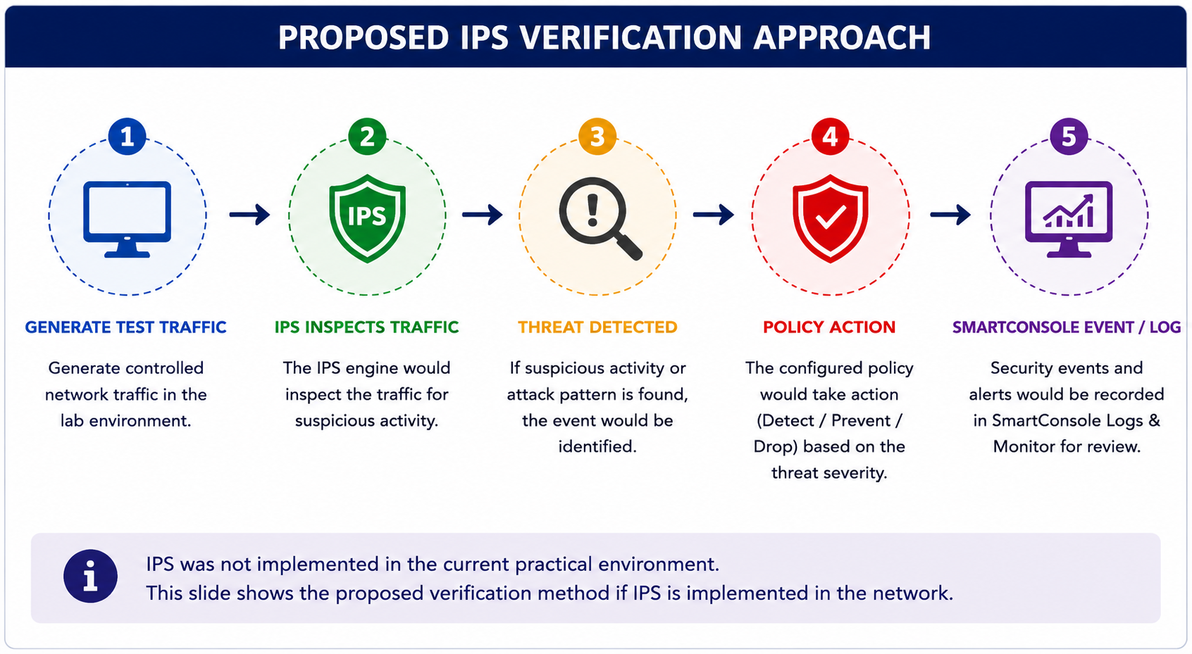

Slide 19
Thank you

