Slide 1


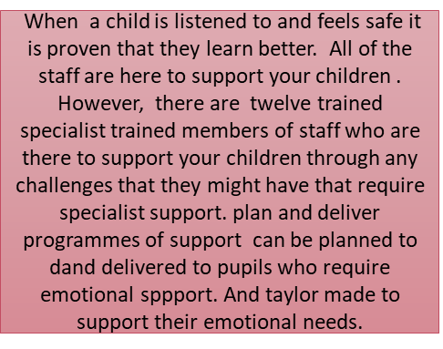
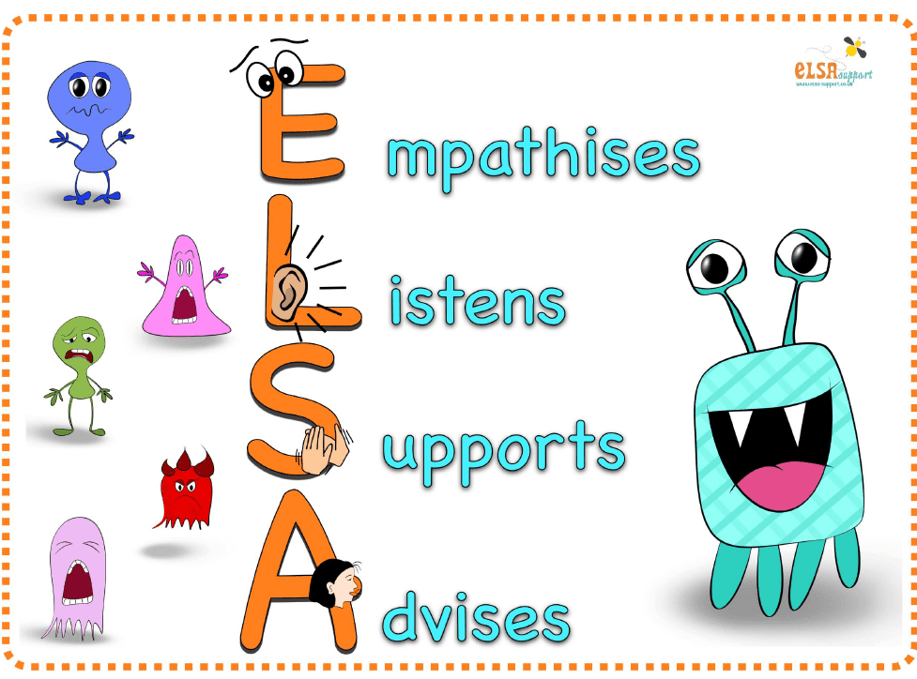
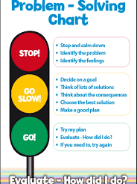






Start a my feet
Drawing and talking therapy sessions.
These sessions are run over a twelve week period and last for thirty minutes. This is a therapeutic play approach which focusses on prevention, early intervention and recovery for any pupil that has suffered or is suffering from trauma or emotional difficulties. There are five members of staff who have been trained to plan and deliver drawing and talking sessions to your children if they require and additional support.
PATHS
Is an holistic therapy used in the schools classrooms which is centered around helping pupils to manage their emotions, independently problem solve and to enable the pupils to communicate effectively.
Schools mission statement:
Proud to be a community school and striving for success for all.
Design to smile
Tooth brushing is carried out at the school daily in accordance with the design to smile project. children are supplied with toothbrushes and toothpaste and will received a visit from the design to smile team who teach toothbrushing techniques, apply of fluoride to your child's teeth twice a year.
Support for pupils and their families
The school provides toiletries, nappies, toys, books, games and offers a food bank to families. These items are gifted to the school from surrounding business. These items can be found in the foyer and are free of charge.
Children can attend the school from three years old full time. It is the only school in the area that offers this. Support is available to complete the admissions forms if required.
Do you want to become a teaching support assistant? Paid courses are provided by the school with employment opportunities on completion.
Healthy School
Th school achieved the National Quality Award (NQA) in 2009 and NQA
reassessments in 2011, 2013, 2015, 2017 and 2019.
Breakfast club and fruit provided daily
Promote healthy eating
Promote water intake through the school
Promote Safety
Promote Hygiene
Promote Fitness
Promote health and well being
Promote personal development and well being
Numeracy and literacy
Parents are encouraged to be a part of their child's education. Sessions are held at the school to provide parents with any support and knowledge that they require.
to be involved in their children’s learning .
Support is available if requiring the use of a chrome book or dongle to aid your child's education whist at home.
Family engagement activities such as cooking lessons, coffee mornings , parent and child bonding sessions are run weekly at the school.
Parent and toddler mornings
Parent and toddler sessions are held weekly at the school for ages two and above
A chance to meet other parents
Your toddler will have a chance to meet other children that they might attend school with which will make the transition to nursey easier for them
Have access to provisions such as speech and language
Meet with other parents and discuss any challenges that you or your toddler might be facing.
Forrest school
Outdoor learning
Outdoor learning promotes and instills in children the importance of fresh air and teaches pupils about the beauty that surrounds them. Changing classroom learning to engaging in outdoor learning is beneficial for the mind, body and soul. This style of education provides the pupils with a different learning experience. Mud kitchens, sandpits, nature reserve, messy play, vegetable patches are used at the school to provide this outdoor learning experience.

