Slide 1

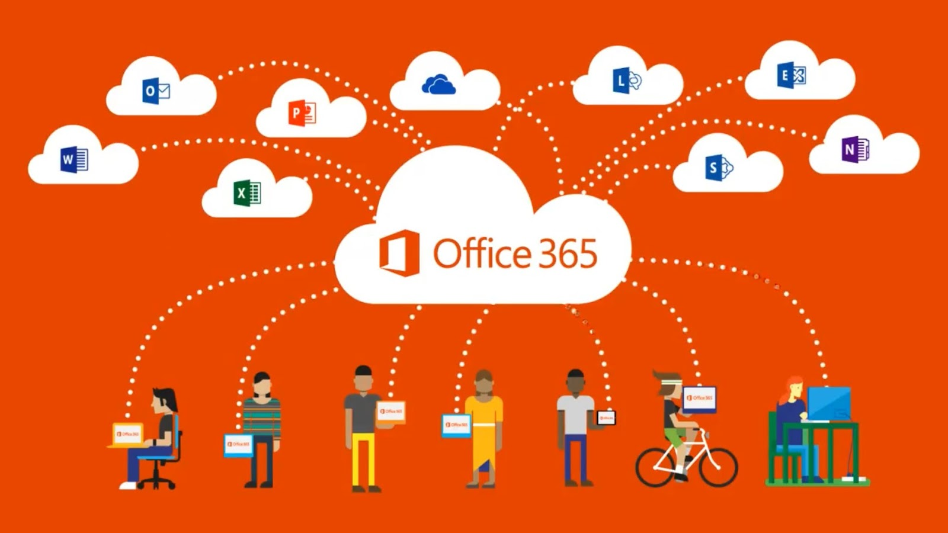
Using Microsoft apps to improve efficiency in Riverdale Nursing Home
Serena Sandhu – 2535411
Rozina Iqbal – 2533717
Saira Fidah – 2354184
Module – LCHS4007
Lecturer – Markus Klingelfuss
ThePhoto by PhotoAuthor is licensed under CCYYSA.
ThePhoto by PhotoAuthor is licensed under CCYYSA.

Slide 2
Contents
Introduction
Introduction to Microsoft Excel (Serena) | Introduction to Microsoft Teams (Rozina) | Introduction to Microsoft Word (Saira)
Intro to Excel | Intro to Teams | Intro to Word
Staff scheduling with Excel | Communication using teams | Writing care related documents with Word
Rationale for choosing Excel | Rationale for choosing Teams | Rationale for choosing Word
Excel – benefits and limitations | Teams – benefits and limitations | Word – benefits and limitations
Conclusion
Reference List

Slide 3
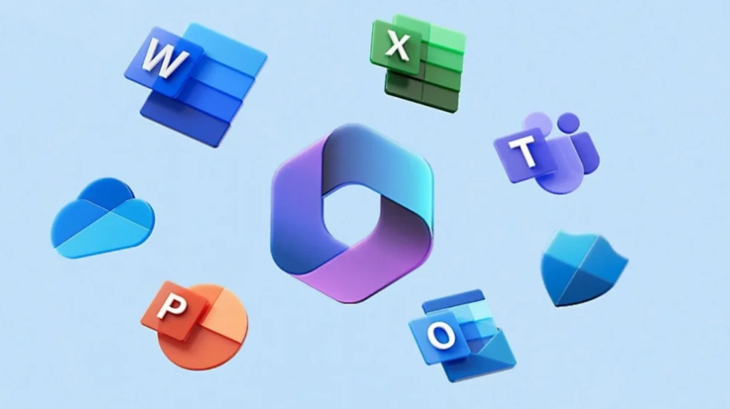
Presentation Introduction
Hi my name is Serena, today we are working as a group, in this group we also have Rozina and Saira. We will be talking about how different tools could be used within Riverdale nursing home and why they are recommended to use in the workplace. We will be covering Microsoft Excel, Microsoft Teams and Microsoft Word.

Slide 4
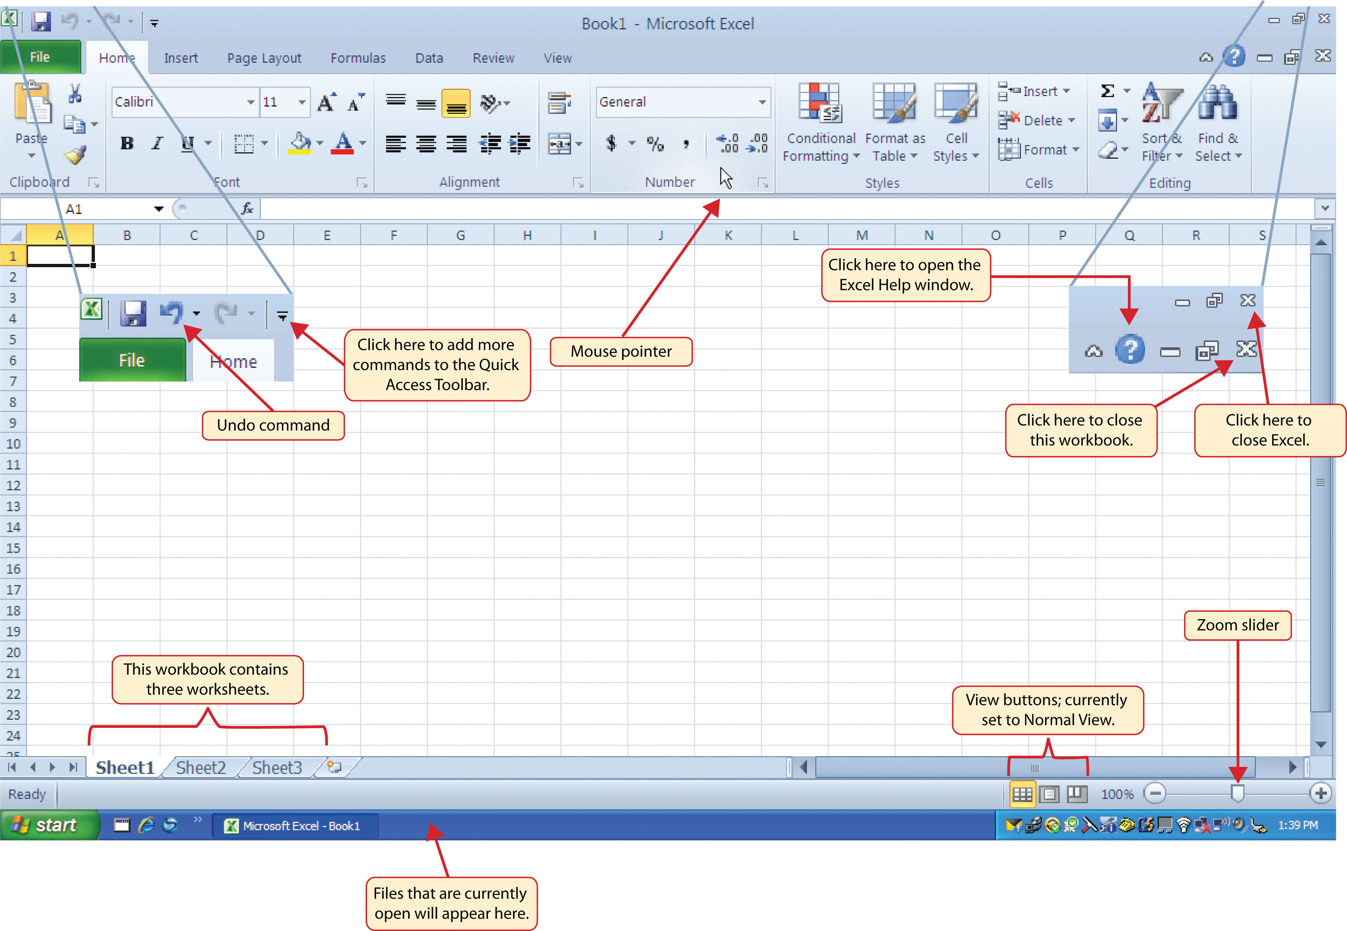

Microsoft Excel
We will explain how it can be used in the case study.
Microsoft Excel is used for storing data and works around numbers/analytics.
(For example, professionals who would use Excel would be Accountants, Project Managers etc.)
In this presentation we will explain how we can use Microsoft Excel in our designated setting and how else it could be used.
How to structure Microsoft Excel documents for systematic reviews. (nurse researcher, 2023)
ThePhoto by PhotoAuthor is licensed under CCYYSA.
ThePhoto by PhotoAuthor is licensed under CCYYSA.

Slide 5

Staff Scheduling/ Rota's
Excel would be a good tool to use for scheduling in staff for their shifts and rota's. It can be quicker than sending individual emails or messages. Excel can be used as a live file, therefore very time efficient when sending to staff, regarding schedules, rota's, and even wages.
Short video - Using excel for rotas
Here is a journal piece that talks about "development and testing of an Excel-based scheduling solution for the flexible allocation and reallocation of nurses to cover sudden, unplanned absences among permanent nursing staff"
ThePhoto by PhotoAuthor is licensed under CCYYSA.

Slide 6



How excel improves efficiency in the workplace (care home)
Before diving into specific benefits, it helps to understand the context: Excel is used everywhere. From startups to multinational corporations — and even nonprofits — professionals rely on Excel to handle data, make decisions, and communicate results. Here are a few examples of where and why Excel is used:
Finance and accounting teams use Excel for forecasting, budgeting, and cash‑flow analysis.
Marketing professionals analyze campaign performance, customer data trends, and ROI.
Operations teams track supply chains, inventory, and scheduling.
Human resources manage employee data, payroll processing, and workforce planning, (Next gen learning, 2026).
Excel can help improve time efficiency as it does recalculations for you, there are shortcuts you can use via your keyboard. Also you are able to set your excel file(rota) to automated setting, this means in one click you can issue the same rota every week and make alterations as you please. Another benefit of Excel is that it can reduce errors and improve the accuracy of your spreadsheet.

Slide 7

Why is this tool suitable to use in Riverdale Nursing Home
Microsoft Excel is the best tool suitable to use in Riverdale Nursing Home as it is very strategic, when it comes to scheduling staff in for their shift's. If for example there were 50 members of staff, all staff can get there rota's in one place. It is convenient because excel can also be used as a live file, so in future schedules or errors, this can easily be edited or mended. Excel can also add a security feature so only staff can view the rota by entering a password. Not only can Excel be used for rota's within the care home, it may also be used for storing employee data, payroll processing, and important calender dates. Excel is widely used to process such data, it is also used in larger organisations such as hospitals (Farah and Esther, 2024).

Slide 8
Advantages and Limitations of using Excel
ADVANTAGES
Data management
Very versatile - performs various tasks like calculations, data analysis, charting.
Can be customized
Used worldwide
Recalculating tool / shortcut
Security available to secure files (passwords)
LIMITATIONS
Internet access needed
Live files can be edited by any one
Potential data loss
Slow performance on larger files
Have to pay a fee to get Microsoft 365

Slide 9

What is Microsoft Teams
Microsoft Teams is a collaboration platform by Microsoft 365 suite. It provides workspace chat, video meetings, file storage and seamless integration with Microsoft and third-party apps and care homes services. The platform grew rapidly during the pandemic covid-19 as it was the most beneficial platform to communicate effectively . Examples of where Microsoft is used:
Work places
Education purposes
Microsoft soft teams is used in Riverdale Nursing Home on an everyday basis this is to have meetings with the staff, appointments reminders in calendars, replying to emails etc.
ThePhoto by PhotoAuthor is licensed under CCYYSA.

Slide 10
What is Staff communication
The sharing of ideas and information among an organization's employees is known as staff communications. These interactions can occur at any level of the company, including between managers and employees, and they can be official or casual. Employees can communicate verbally, in writing, and electronically, all of which can improve the efficiency and speed of information sharing. At Riverdale Nursing Home staff communication is important and done in many ways.

Slide 11

Why We have chosen Microsoft Teams for staff communication
Why this is suitable for The Nursing Home
Microsoft Teams is a strong choice for staff communication because it offers tools for collaboration, messaging, and meetings all in one platform. It is a easy way of communication between staff. Facilitates quick sharing of updates and Important information. It also supports group chats for team coordination.
Microsoft Teams is suitable for staff at Riverdale Nursing Home for sharing calendars, for managing shifts and appointments. Also used for sharing documents and co-editing for care plans and reports. At Riverdale Nursing Home Microsoft Teams is used to send reminders of duties and track tasks. It covers all administration tasks all in one application making it easier for the manager and the employees for a smother work life. Riverdale Nursing Home has two buildings so it is a easy way of communication between staff.
ThePhoto by PhotoAuthor is licensed under CCYYSA.

Slide 12
How Team's Improves Efficiency And communication
Team's Improves efficiency and communication between staff.
At Riverdale nursing home we use Teams to resolve conflicts Quietly, encourage engagements between staff. We Also schedule One-On-One meetings and provide consistent feedback.
Conflicts at work can start small but can escalate when left unaddressed. When conflicts go unresolved, tension builds and work performance suffers.
Team Communication occurs in group setting's, team members who connect one-on-one bring a positive energy to a group. Regular one-on-one meetings give you a chance to address issues. We encourage our team at Riverdale Nursing home to schedule one-on-one meetings with each other, so we can build a collaborative relationship.
How our Team Member's communicate helps us to manage our team as a whole, also understanding leadership styles can help adapt our approach.

Slide 13
ADVANTAGES AND LIMITATIONS FOR MICROSOFT TEAMS
ADVANTAGES
LIMITATIONS
Strong Integration with Microsoft 365.
Smooth data sharing.
Easy to use.
Teams offers High Quality Video Sharing.
Enhanced Collaboration Features.
Increased Productivity.
Microsoft Invests heavily in security.
Steep Learning Curve.
AI – Powered Features.
Focus On Security and Privacy.
Limited Offline Access.
Compatibility.
Cost of Additional Features.

Slide 14
What Is Care Documentation?
Care documentation means recording important information about residents.
Examples include:
Care Plans
Daily Care Notes
Incident Reports
Risk Assessments
Medication Records
Why is it important?
Helps staff understand the residents needs
Keeps information accurate and up-to-date
Supports safe and high-quality care
Riverdale Nursing Home
Staff work in two different buildings and on different shifts so clear documentation is very important for communication. (NMC,2018)

Slide 15
Why I Chose Microsoft Word
Microsoft Word is the best tool for creating and managing care documents.
It allows staff to:
Write documents clearly
Edit information easily
Use templates for consistency
Organise information professionally
Share documents with other staff
Why it suits Riverdale?
Word helps the staff to keep accurate records that can be updated whenever a resident’s needs change. (Microsoft,2024)

Slide 16
How Can Word Be Used At Riverdale?
A nurse can:
Create a care plan for a resident
Record changes in health conditions
Write incident reports
Update medication information
Benefits
All staff can access the latest information, helping them to provide the right care.

Slide 17
How Microsoft Words Improves Efficiency
Microsoft Word can save time by:
Staff using readymade templates
Easy to update documents
Clearly organised templates
Producing less paperwork
Riverdale
Staff can spend less time creating documents and more time caring for residents.
(WHO, 2021)

Slide 18
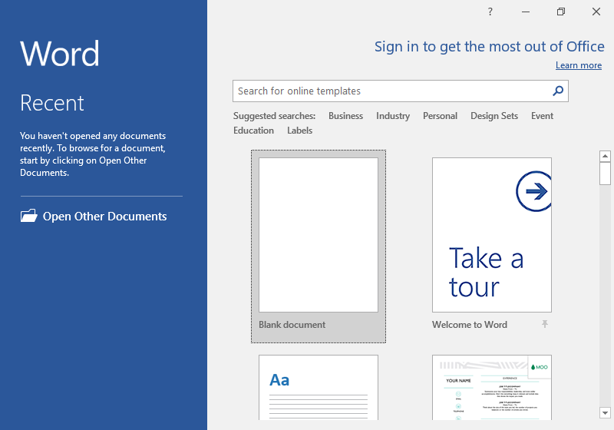
How Microsoft Word Improves Communication
Microsoft Word helps staff:
Share information clearly
Record important updates
Support smooth shift handovers
Reduce misunderstandings
For Example:
A morning-shift carer records information in Word and the evening-shift carer can read it and continue care without missing important details crucial to the resident’s needs.
This Photo by Unknown Author is licensed under CC BY

Slide 19
Advantages & Limitations
Advantages
Easy to use
Creates professional documents
Helps keep records organised
Can be shared with authorised staff
Works well with other Microsoft 365 tools
Limitations
Staff needs some training
Mistakes can still happen if information is entered incorrectly
Documents must be stored securely to protect the resident's privacy

Slide 20
Conclusion
Recommendation
We would recommend Excel at Riverdale Nursing Home, as it has shown to be very time efficient and convenient for all staff. It can be edited and be set to an automated file, making it easier doing future schedules / rota's.
Microsoft Excel would certainly be beneficial to use in the nursing home, it also gives nurses / staff more time to care for their patients.
Microsoft Word is the most suitable Microsoft 365 tool for care documentation at Riverdale Nursing Home.
It helps staff:
Create accurate records
Share information effectively
Improve communication
Saves time
Provides better care for residents
Therefore, Microsoft Word can help Riverdale improve both efficiency and increase the quality of care.
Microsoft Teams at Riverdale Nursing Home is a part of a modern Environment.
Microsoft Teams is a very easy tool to use for staff at Riverdale Nursing Home
. Microsoft Teams is a collaboration platform developed to combine workplace chat, video conferencing, file storage and application integration, this is the reason why Microsoft Teams is a suitable and reliable Tool to use at Riverside Nursing Home.

Slide 21
Harvard Referencing
Asana (2026) Team communication. Available at: https://asana.com/resources/team-communication (asana.com in Bing) (Accessed: 11 June 2026).
FARAH, G. and ESTHER, O., (2024) Implementing a live rota in the Paediatric department in a busy District General Hospital. Archives of Disease in Childhood, 109, pp. A420-A421.
Indeed (2025) What are staff communications (types and importance). Available at: https://uk.indeed.com/career-advice/career-development/staff-communications (Accessed: 2 June 2026).
Microsoft teams (2026) Wikipedia. Available at: https://en.wikipedia.org/wiki/Microsoft_Teams (Accessed: 02 June 2026).
Microsoft (n.d.). Microsoft Word | Create & Edit Word Docs with Microsoft 365. [online] Available at: https://www.microsoft.com/en-gb/microsoft-365/word (Accessed 11 June 2026)
Nurse researcher, (2023), How to structure microsoft excel documents for systematic reviews. Nurse researcher, 2023, vol.31(1), p.40-46).
Next gen learning (2026) available at: https://nextgenlearning.org.uk/benefits-of-learning-excel-for-career-growth-and-productivity/ Accessed: 11 June 2026).
(No date a) Microsoft teams logo, symbol, meaning, history, PNG, Brand. Available at: https://logos-world.net/microsoft-teams-logo/ (Accessed: 02 June 2026).
The Code: Professional standards of practice and behaviour for nurses, midwives and nursing associates - The Nursing and Midwifery Council.
World Health Organization (2021). Global strategy on digital health 2020-2025. [online] World Health Organization. Available at: https://www.who.int/publications/i/item/9789240020924.
https://learn.microsoft.com/en-us/answers/questions/4419754/what-are-the-pros-and-cons-with-microsoft-teams (Accessed: 14 June 2026).

