Slide 1
NIST Security Models and Their Advantages
Group 3

Slide 2
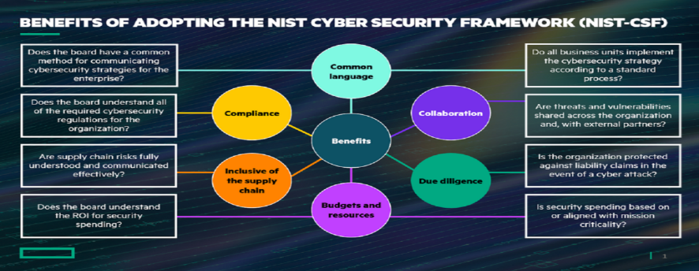
NIST Security Models and Their Advantages
NIST Security Models: These are frameworks and guidelines developed by the National Institute of Standards and Technology (NIST) to assist organizations in managing and mitigating cybersecurity risks. They provide comprehensive standards, best practices, and guidelines for ensuring information security.
Notes:
Committee on National Security Systems (CNSS), formerly known as the National Security Telecommunications and Information Systems Security Committee (NSTISSC), chaired by the U.S. Secretary of Defense.
“National Training Standard for Information Systems Security (InfoSec) Professionals,” presents a comprehensive model of InfoSec known as the McCumber Cube, which is named after its developer, John McCumber. Shown in Figure 1-2, which is an adaptation of the NSTISSI model, the McCumber Cube serves as the standard for understanding many aspects of InfoSec, and shows the three dimensions that are central to the discussion of InfoSec: information characteristics, information location, and security control categories. If you extend the relationship among the three dimensions that are represented by the axes in the figure, you end up with a 3 × 3 × 3 cube with 27 cells. Each cell represents an area of intersection among these three dimensions, which must be addressed to secure information. When using this model to design or review any InfoSec program, you must make sure that each of the 27 cells is properly addressed by each of the three communities of interest.
It’s the role of management to ensure that each strategy is properly planned, organised, staffed, directed, and controlled.
Specialised areas include:
Physical security—The protection of physical items, objects, or areas from unauthorized access and misuse.
Operations security—The protection of the details of an organization’s operations and activities.
Communications security—The protection of all communications media, technology, and content.
Cyber (or computer) security—The protection of computerized information processing systems and the data they contain and process. The term cybersecurity is relatively new, so its use might be slightly ambiguous in coming years as the definition gets sorted out.
Network security—A subset of communications security and cybersecurity; the protection of voice and data networking components, connections, and content.

Slide 3
Comprehensive Frameworks
NIST security models, developed by the National Institute of Standards and Technology, are comprehensive frameworks that provide extensive guidance on various aspects of information security. These models encompass an array of standards, guidelines, and best practices to manage and mitigate cybersecurity risks effectively. One of their primary advantages is their detailed and thorough approach to covering key areas like risk management, cybersecurity controls, and incident response. This comprehensive nature ensures that organizations are well-equipped to handle a wide range of security challenges, from identifying and assessing risks to implementing robust security measures and managing security incidents.
Notes:
Committee on National Security Systems (CNSS), formerly known as the National Security Telecommunications and Information Systems Security Committee (NSTISSC), chaired by the U.S. Secretary of Defense.
“National Training Standard for Information Systems Security (InfoSec) Professionals,” presents a comprehensive model of InfoSec known as the McCumber Cube, which is named after its developer, John McCumber. Shown in Figure 1-2, which is an adaptation of the NSTISSI model, the McCumber Cube serves as the standard for understanding many aspects of InfoSec, and shows the three dimensions that are central to the discussion of InfoSec: information characteristics, information location, and security control categories. If you extend the relationship among the three dimensions that are represented by the axes in the figure, you end up with a 3 × 3 × 3 cube with 27 cells. Each cell represents an area of intersection among these three dimensions, which must be addressed to secure information. When using this model to design or review any InfoSec program, you must make sure that each of the 27 cells is properly addressed by each of the three communities of interest.
It’s the role of management to ensure that each strategy is properly planned, organised, staffed, directed, and controlled.
Specialised areas include:
Physical security—The protection of physical items, objects, or areas from unauthorized access and misuse.
Operations security—The protection of the details of an organization’s operations and activities.
Communications security—The protection of all communications media, technology, and content.
Cyber (or computer) security—The protection of computerized information processing systems and the data they contain and process. The term cybersecurity is relatively new, so its use might be slightly ambiguous in coming years as the definition gets sorted out.
Network security—A subset of communications security and cybersecurity; the protection of voice and data networking components, connections, and content.

Slide 4
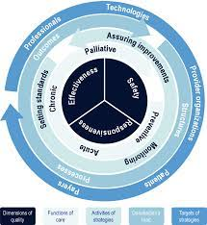
Flexibility and Adaptability
Another significant advantage of NIST models is their flexibility and adaptability. These models are not one-size-fits-all solutions; instead, they are designed to be adaptable to different organizations, regardless of their size or industry. This versatility allows organizations to tailor the NIST guidelines to meet their specific security needs and requirements. Furthermore, the NIST models are regularly updated to reflect emerging threats and evolving technologies in the cybersecurity landscape. This ensures that the guidelines remain relevant and effective in addressing current and future security challenges. By offering a flexible framework that can adapt to the unique needs of each organization, NIST models provide a reliable and dynamic approach to cybersecurity, making them invaluable resources for organizations seeking to strengthen their security posture.
Notes:
Committee on National Security Systems (CNSS), formerly known as the National Security Telecommunications and Information Systems Security Committee (NSTISSC), chaired by the U.S. Secretary of Defense.
“National Training Standard for Information Systems Security (InfoSec) Professionals,” presents a comprehensive model of InfoSec known as the McCumber Cube, which is named after its developer, John McCumber. Shown in Figure 1-2, which is an adaptation of the NSTISSI model, the McCumber Cube serves as the standard for understanding many aspects of InfoSec, and shows the three dimensions that are central to the discussion of InfoSec: information characteristics, information location, and security control categories. If you extend the relationship among the three dimensions that are represented by the axes in the figure, you end up with a 3 × 3 × 3 cube with 27 cells. Each cell represents an area of intersection among these three dimensions, which must be addressed to secure information. When using this model to design or review any InfoSec program, you must make sure that each of the 27 cells is properly addressed by each of the three communities of interest.
It’s the role of management to ensure that each strategy is properly planned, organised, staffed, directed, and controlled.
Specialised areas include:
Physical security—The protection of physical items, objects, or areas from unauthorized access and misuse.
Operations security—The protection of the details of an organization’s operations and activities.
Communications security—The protection of all communications media, technology, and content.
Cyber (or computer) security—The protection of computerized information processing systems and the data they contain and process. The term cybersecurity is relatively new, so its use might be slightly ambiguous in coming years as the definition gets sorted out.
Network security—A subset of communications security and cybersecurity; the protection of voice and data networking components, connections, and content.

Slide 5
NIST Special Publications 800-12 and 800-14
Group 3

Slide 6
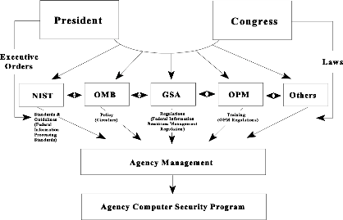
NIST SP 800-12
Common Name: "An Introduction to Computer Security: The NIST Handbook."
Purpose: Provides a comprehensive overview of computer security, covering essential aspects such as policy, hardware, software, and personnel security.
Resources Provided: It includes guidelines on security controls, risk management strategies, and best practices for protecting computer systems.
Notes:
Committee on National Security Systems (CNSS), formerly known as the National Security Telecommunications and Information Systems Security Committee (NSTISSC), chaired by the U.S. Secretary of Defense.
“National Training Standard for Information Systems Security (InfoSec) Professionals,” presents a comprehensive model of InfoSec known as the McCumber Cube, which is named after its developer, John McCumber. Shown in Figure 1-2, which is an adaptation of the NSTISSI model, the McCumber Cube serves as the standard for understanding many aspects of InfoSec, and shows the three dimensions that are central to the discussion of InfoSec: information characteristics, information location, and security control categories. If you extend the relationship among the three dimensions that are represented by the axes in the figure, you end up with a 3 × 3 × 3 cube with 27 cells. Each cell represents an area of intersection among these three dimensions, which must be addressed to secure information. When using this model to design or review any InfoSec program, you must make sure that each of the 27 cells is properly addressed by each of the three communities of interest.
It’s the role of management to ensure that each strategy is properly planned, organised, staffed, directed, and controlled.
Specialised areas include:
Physical security—The protection of physical items, objects, or areas from unauthorized access and misuse.
Operations security—The protection of the details of an organization’s operations and activities.
Communications security—The protection of all communications media, technology, and content.
Cyber (or computer) security—The protection of computerized information processing systems and the data they contain and process. The term cybersecurity is relatively new, so its use might be slightly ambiguous in coming years as the definition gets sorted out.
Network security—A subset of communications security and cybersecurity; the protection of voice and data networking components, connections, and content.

Slide 7
NIST SP 800-12
"An Introduction to Computer Security: The NIST Handbook" provides an array of resources crucial for computer system security. It includes detailed guidelines on implementing diverse security controls to protect against various threats, focusing on both preventative and reactive measures. The handbook also offers strategic risk management strategies, assisting organizations in identifying, assessing, and mitigating potential security risks effectively. Furthermore, it presents best practices for system protection, encompassing secure configuration, regular security audits, and comprehensive employee training. These resources combine to offer a practical and thorough approach to cybersecurity, catering to the needs of IT professionals and organizations seeking to bolster their security infrastructure.
Notes:
Committee on National Security Systems (CNSS), formerly known as the National Security Telecommunications and Information Systems Security Committee (NSTISSC), chaired by the U.S. Secretary of Defense.
“National Training Standard for Information Systems Security (InfoSec) Professionals,” presents a comprehensive model of InfoSec known as the McCumber Cube, which is named after its developer, John McCumber. Shown in Figure 1-2, which is an adaptation of the NSTISSI model, the McCumber Cube serves as the standard for understanding many aspects of InfoSec, and shows the three dimensions that are central to the discussion of InfoSec: information characteristics, information location, and security control categories. If you extend the relationship among the three dimensions that are represented by the axes in the figure, you end up with a 3 × 3 × 3 cube with 27 cells. Each cell represents an area of intersection among these three dimensions, which must be addressed to secure information. When using this model to design or review any InfoSec program, you must make sure that each of the 27 cells is properly addressed by each of the three communities of interest.
It’s the role of management to ensure that each strategy is properly planned, organised, staffed, directed, and controlled.
Specialised areas include:
Physical security—The protection of physical items, objects, or areas from unauthorized access and misuse.
Operations security—The protection of the details of an organization’s operations and activities.
Communications security—The protection of all communications media, technology, and content.
Cyber (or computer) security—The protection of computerized information processing systems and the data they contain and process. The term cybersecurity is relatively new, so its use might be slightly ambiguous in coming years as the definition gets sorted out.
Network security—A subset of communications security and cybersecurity; the protection of voice and data networking components, connections, and content.

Slide 8
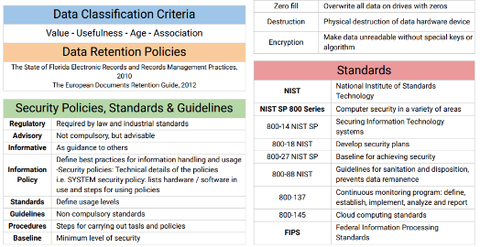
NIST SP 800-14
Common Name: "Generally Accepted Principles and Practices for Securing Information Technology Systems."
Purpose: Offers a broad framework for understanding and implementing sound security principles in IT systems.
Resources Provided: This document provides a set of general security principles to guide organizations in developing, implementing, and maintaining secure IT systems. It covers topics like security planning, policy, and program management.
Notes:
Committee on National Security Systems (CNSS), formerly known as the National Security Telecommunications and Information Systems Security Committee (NSTISSC), chaired by the U.S. Secretary of Defense.
“National Training Standard for Information Systems Security (InfoSec) Professionals,” presents a comprehensive model of InfoSec known as the McCumber Cube, which is named after its developer, John McCumber. Shown in Figure 1-2, which is an adaptation of the NSTISSI model, the McCumber Cube serves as the standard for understanding many aspects of InfoSec, and shows the three dimensions that are central to the discussion of InfoSec: information characteristics, information location, and security control categories. If you extend the relationship among the three dimensions that are represented by the axes in the figure, you end up with a 3 × 3 × 3 cube with 27 cells. Each cell represents an area of intersection among these three dimensions, which must be addressed to secure information. When using this model to design or review any InfoSec program, you must make sure that each of the 27 cells is properly addressed by each of the three communities of interest.
It’s the role of management to ensure that each strategy is properly planned, organised, staffed, directed, and controlled.
Specialised areas include:
Physical security—The protection of physical items, objects, or areas from unauthorized access and misuse.
Operations security—The protection of the details of an organization’s operations and activities.
Communications security—The protection of all communications media, technology, and content.
Cyber (or computer) security—The protection of computerized information processing systems and the data they contain and process. The term cybersecurity is relatively new, so its use might be slightly ambiguous in coming years as the definition gets sorted out.
Network security—A subset of communications security and cybersecurity; the protection of voice and data networking components, connections, and content.

Slide 9
NIST SP 800-14
The document "Generally Accepted Principles and Practices for Securing Information Technology Systems" provides comprehensive guidance to organizations for securing their IT systems. It encompasses general security principles essential for developing, implementing, and maintaining robust IT security. The document covers crucial topics like security planning, which involves strategizing and integrating security measures into all IT operations. It also emphasizes the importance of establishing clear, effective security policies that dictate procedures and protocols for safeguarding IT resources. Additionally, it addresses program management, guiding organizations in overseeing and coordinating security efforts effectively. This holistic approach ensures that all aspects of IT security, from policy formulation to practical implementation and management, are robustly covered, making it an invaluable resource for organizations aiming to enhance their cybersecurity framework.
Notes:
Committee on National Security Systems (CNSS), formerly known as the National Security Telecommunications and Information Systems Security Committee (NSTISSC), chaired by the U.S. Secretary of Defense.
“National Training Standard for Information Systems Security (InfoSec) Professionals,” presents a comprehensive model of InfoSec known as the McCumber Cube, which is named after its developer, John McCumber. Shown in Figure 1-2, which is an adaptation of the NSTISSI model, the McCumber Cube serves as the standard for understanding many aspects of InfoSec, and shows the three dimensions that are central to the discussion of InfoSec: information characteristics, information location, and security control categories. If you extend the relationship among the three dimensions that are represented by the axes in the figure, you end up with a 3 × 3 × 3 cube with 27 cells. Each cell represents an area of intersection among these three dimensions, which must be addressed to secure information. When using this model to design or review any InfoSec program, you must make sure that each of the 27 cells is properly addressed by each of the three communities of interest.
It’s the role of management to ensure that each strategy is properly planned, organised, staffed, directed, and controlled.
Specialised areas include:
Physical security—The protection of physical items, objects, or areas from unauthorized access and misuse.
Operations security—The protection of the details of an organization’s operations and activities.
Communications security—The protection of all communications media, technology, and content.
Cyber (or computer) security—The protection of computerized information processing systems and the data they contain and process. The term cybersecurity is relatively new, so its use might be slightly ambiguous in coming years as the definition gets sorted out.
Network security—A subset of communications security and cybersecurity; the protection of voice and data networking components, connections, and content.

Slide 10
Summary
  In summary, the National Institute of Standards and Technology (NIST) plays a critical role in guiding organizations in cybersecurity and risk management through its comprehensive security models and specialized publications. The NIST security models are extensive frameworks that provide in-depth guidance on various aspects of information security, including risk management, cybersecurity controls, and incident response. They are celebrated for two primary advantages: their comprehensive nature and their flexibility and adaptability. The comprehensive frameworks offer detailed coverage of essential security aspects, ensuring organizations are equipped to handle diverse security challenges. Meanwhile, the flexibility and adaptability of these models allow them to be tailored to different organizations, regardless of size or industry, and they are regularly updated to address emerging threats and technologies.

Slide 11
Summary
  Key NIST publications, such as "An Introduction to Computer Security: The NIST Handbook" (NIST SP 800-12) and "Generally Accepted Principles and Practices for Securing Information Technology Systems" (NIST SP 800-14), provide valuable resources. SP 800-12 offers a comprehensive overview of computer security, covering policy, hardware, software, and personnel security, along with guidelines on security controls and risk management strategies. SP 800-14 presents a broad framework for securing IT systems, focusing on general security principles. These documents are instrumental in shaping the cybersecurity strategies of organizations, offering a robust foundation for protecting against and managing digital threats in an ever-evolving technological landscape.

Slide 12
Questions

