Slide 1
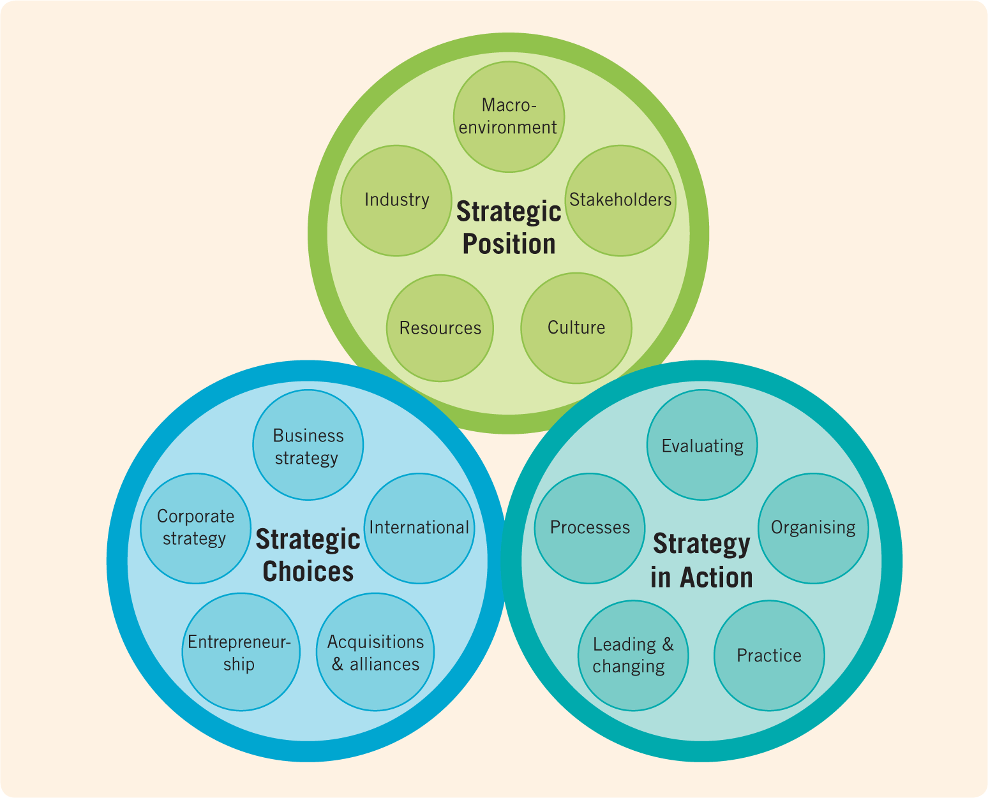
The exploring
Strategy framework
&
Strategic Analysis
Strategic Analysis
Identifying
strategic
options
Evaluating
options
Developing
strategy
Johnson, Whittington, Scholes, Angwin, Regner (2017)

Slide 2
Learning objectives
The Macroenvironment

Slide 3

Strategic Analysis – the importance of the context
For Strategic Analysis to add value and to be relevant, the Context must be clearly defined.
Context defines the lens through which to view the organisation, their opportunities and challenges.
It relates to the organisation’s strategic goals.
The ‘lens’ changes with a changing context, for example:
  Customers
  Industry
  Products
  Geography
  Competition
  Capabilities

Slide 4
The nature of customer value
Customer Value
Perceived Sacrifice
Monetary costs
Time costs
Energy costs
Psychological costs (not making the right decision, perception of risk)
Perceived Benefits
Product benefits
Service benefits
Image benefits
Value offered should exceed that of competitors
Notes:
Customer value is the consumer's perception of the difference between the perceived benefits (gains like quality, emotion, convenience) they receive from a product or service and the perceived sacrifices (costs like money, time, effort, risk) they make to obtain it. This "trade-off" is subjective and varies between individuals, forming the basis of customer satisfaction, loyalty, and a company's long-term profitability.
Perceived Benefits
These are the positive outcomes or gains a customer experiences from a product or service. They can include:
Functional Benefits: The actual usefulness of the product or service.
Emotional Benefits: The positive feelings a customer experiences.
Social Benefits: The way a product or service helps a customer in their social interactions or status.
Epistemic Benefits: The knowledge or understanding a customer gains.
Conditional Benefits: Benefits related to specific circumstances.
Perceived Sacrifices
These are the costs or downsides a customer believes they incur in the process of obtaining the product or service. They can include:
Monetary Costs: The financial price paid for the offering.
Time Costs: The time spent acquiring the product or service.
Psychic Costs: Psychological costs such as effort, mental strain, and the risk of making the wrong choice.
The Trade-Off
Customer value is created when the perceived benefits outweigh the perceived sacrifices.
A High Ratio is Key:
A product or service offers higher value when customers perceive a large gap between the benefits they receive and the sacrifices they make.
Subjectivity:
What constitutes a benefit or sacrifice is highly subjective and personal to each customer.
Influences Behavior:
A customer's perception of value directly influences their purchasing decisions and overall loyalty to a brand.

Slide 5
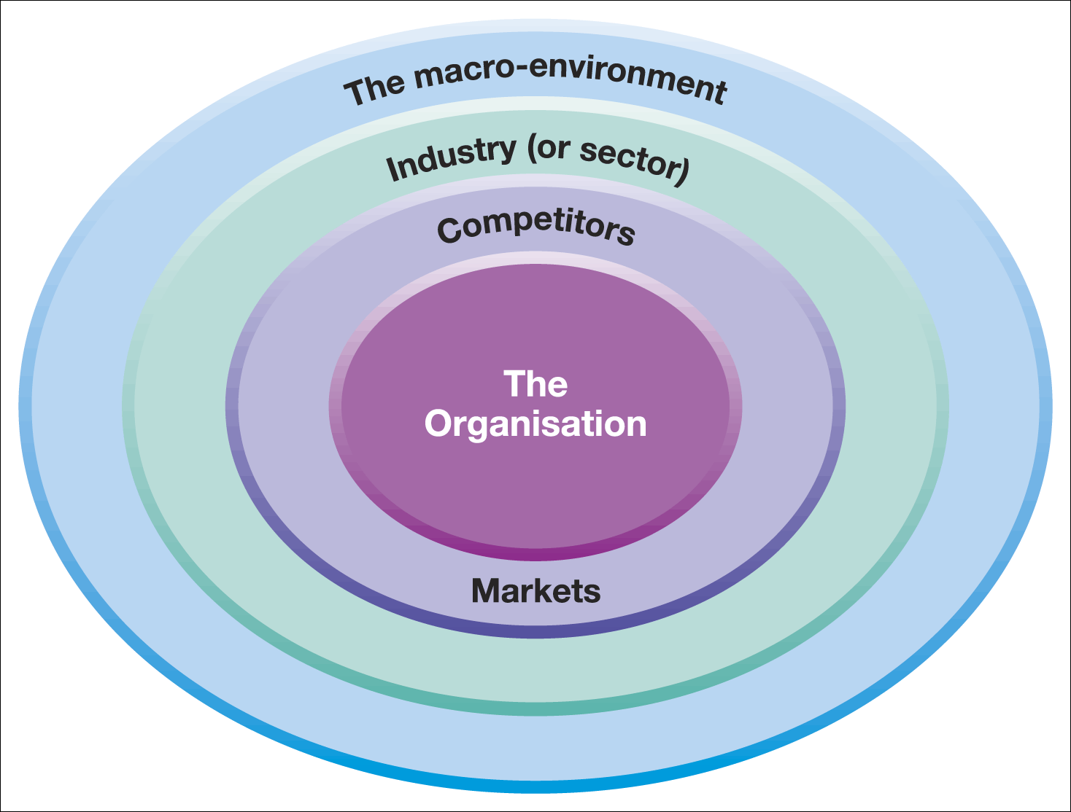
Layers of business environment
The organisation is surrounded by several layers of business environment
The outer layer is the Macro-Environment – PESTEL
The second layer is the Micro environment - Micro-Environment – Porters Five Forces
Elements that are close to the organisation and affect its performance and decision-making such as Customers, Competitors, Suppliers, Employees, Shareholders etc. are defined as the– Resource Capability, Value Chain and Stakeholder Analysis
Notes:
The layers of the business environment are typically divided into three main categories: the Internal Environment, the Micro Environment, and the Macro Environment. The internal environment includes an organization's resources and culture, the micro environment consists of factors closest to the business like suppliers and competitors, and the macro environment encompasses broad societal and global forces such as economic trends, technology, and political policies that affect all businesses.
1. Internal Environment
This layer refers to factors within the organization that it can control.
Examples: Corporate culture, mission and vision, company policies, management philosophy, resources (financial, human, technological), and organizational structure.
2. Micro Environment
This layer includes external factors that directly influence the business and are unique to the specific industry.
Examples:
Suppliers: Entities providing resources needed for production.
Customers: The market demand and needs.
Competitors: Other companies in the same market.
Market Intermediaries: Organizations that help a company promote, sell, and distribute its products (e.g., wholesalers, retailers).
Publics: Any group with an actual or potential interest in or impact on an organization's ability to achieve its objectives.
3. Macro Environment
This is the broadest layer, comprising large-scale societal forces that affect the micro environment and the organization itself.
Examples (often categorized by the PESTEL framework):
Political: Government stability, legislation, and policies.
Economic: Inflation, interest rates, GDP, economic growth, and employment levels.
Social: Demographics, societal values, lifestyles, and trends.
Technological: Innovations, automation, and advancements in information technology.
Environmental (Ecological): Natural resources, climate, pollution, and environmental concerns.
Legal: Specific laws and regulations governing business operations

Slide 6
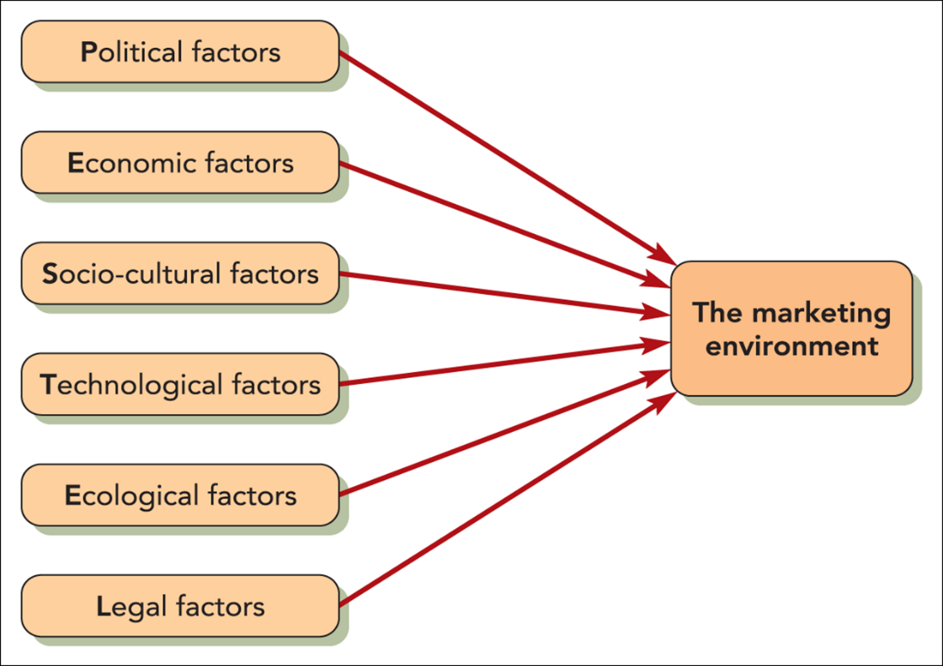
Analysing the macro environment with Pestel
PESTEL OR PESTLE is a strategic framework
Guides analysis of macro-environment
Encompasses six external sources of influence
In addition to a PESTLE analysis, analysis of competitors should also occur
Influence Organisation’s Environment
Notes:
A PESTEL analysis is a strategic tool for examining the external macro-environment to identify opportunities and threats that can impact an organization, using Political, Economic, Social, Technological, Environmental, and Legal factors as a framework. By understanding these broad influences, businesses can refine their strategies, make informed decisions, and develop tactics to navigate challenges and capitalize on emerging trends.
How to Conduct a PESTEL Analysis
Understand the PESTEL Factors
Political: Government policies, stability, regulatory frameworks, tax policies, trade policies, and international relations.
Economic: Economic growth, inflation, interest rates, exchange rates, unemployment rates, disposable income, and resource availability.
Social (Socio-cultural): Demographic shifts, population growth rates, changing social attitudes, cultural trends, consumer lifestyles, education levels, and awareness of social issues.
Technological: Innovation, research and development activities, automation, digital transformation, and new technological infrastructure.
Environmental: Climate change, weather patterns, natural resource availability, pollution, sustainability, waste management, and climate-related risks.
Legal: Laws related to advertising, consumer protection, health and safety, employment, and data protection.
Gather Information
Collect relevant data and information for each of the six factors.
Identify key trends, developments, and changes within each domain.
Analyze and Identify
Analyze the gathered information to determine how each factor might present opportunities or threats for your organization.
Consider the potential positive or negative impact of each factor and its strength.
Look for cross-influences between factors (e.g., a political decision might impact environmental regulations).
Prioritize and Draw Conclusions
Prioritize the factors that have the most significant impact on your business.
Summarize your key findings to identify potential strengths and weaknesses exposed by the external environment, and to list opportunities and threats in a ranked order.
Take Action
Integrate these insights into your strategic planning to develop relevant business strategies, tactics, and measures for success.
Establish a process to monitor and re-evaluate the PESTEL factors on an ongoing basis.

Slide 7


Pestle: political factors
Political factors include:
Government policies
Taxation changes
Foreign trade regulations
Political risk in foreign markets
Changes in trade blocks (e.g. BREXIT)
Exposure to civil society organisations
(e.g. lobbyists, campaign groups, social media)
Notes:
In PESTLE analysis, political factors encompass how government intervention, policy, and stability affect businesses. Key elements include tax policies, trade regulations, labor laws, political stability (or instability), government intervention in the economy, and international relations, all of which can impact business operations and opportunities.
Specific examples of PESTLE political factors
Government Policies:
Governments implement policies that can directly influence business operations, such as changes to taxes, interest rates, and subsidies, notes Cambridge Professional Academy and BBC.
Trade Regulations and Tariffs:
Policies on international trade, including tariffs and import restrictions, can affect a company's ability to import or export goods, notes Indeed and CIPD.
Labor Laws:
Legislation such as minimum wage laws, health and safety standards, and working conditions are set by governments and must be adhered to by businesses, according to Indeed and BBC.
Political Stability:
A government's stability or instability, and its relationship with other nations, can create opportunities or risks for businesses.
Government Intervention:
The degree and form of government intervention in the economy, whether through regulation or support, are crucial political factors.
Geopolitical Events:
Broader political events, such as international conflicts or major political shifts like Brexit, can have a significant impact on markets and trade, according to the BBC.

Slide 8
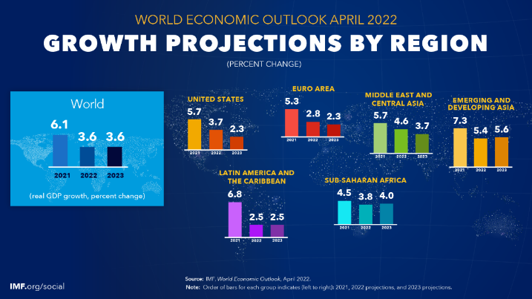
Pestle: Economic factors
The general state of both national and international economies can have a profound effect on an individual organisation’s prosperity
Three major economic influences on the organisation’s environment of companies:
  Economic growth and unemployment
  Interest and exchange rates
  Taxation and inflation
Notes:
PESTLE's economic factors are external macro-economic conditions that affect a business, including economic growth, inflation, interest rates, employment rates, exchange rates, and consumer spending power. These factors determine a country's economic health and influence a business's profitability and operational viability, impacting everything from input costs and supply chains to consumer demand and market entry decisions.
Key Economic Factors in a PESTLE Analysis
Economic Growth:
The rate at which a country's economy expands or contracts, affecting market opportunities and investment.
Inflation:
The rise in the general price of goods and services, which reduces consumer purchasing power and can increase operating costs.
Interest Rates:
The cost of borrowing money, which influences consumer spending, business investment, and overall economic activity.
Employment Rates:
The availability of jobs and unemployment levels, which directly impact consumer income and spending patterns.
Foreign Exchange Rates:
The value of one country's currency against another, impacting the costs of imports and the price of exports.
Consumer Spending & Disposable Income:
The amount of money consumers have to spend after taxes, a key driver of demand for goods and services.
Labor Costs:
The cost of employing workers, a significant factor in operational expenses and productivity.
Input Costs:
The prices of raw materials and other components, which can affect a business's production costs and pricing strategies.
Why These Factors Matter
Market Viability:
They help assess whether a market is economically attractive for operation or investment.
Business Planning:
They inform strategic decisions, allowing businesses to anticipate changes and adapt to economic shifts.
Profitability:
They can directly influence a company's revenues, costs, and overall financial performance.

Slide 9
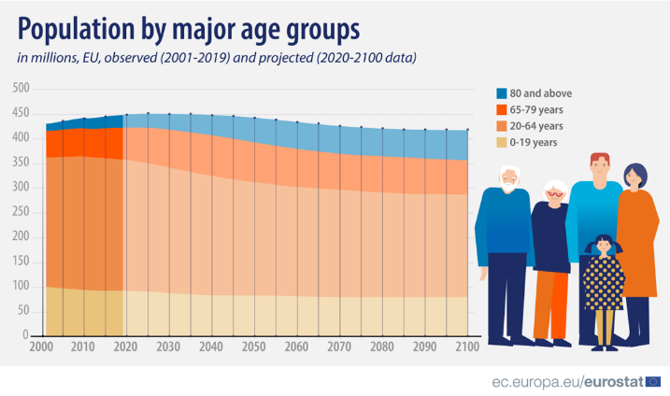

Pestle: Socio-cultural factors
To understand your market, you have to understand socio-cultural trends
Including factors such as:
  seasonal shifts in demand based on cultural peculiarities or
  age of a population
  income level
  health concerns
Notes:
In a PESTLE analysis, "socio-cultural factors" refer to the societal and cultural aspects of an environment that influence a business, including demographic characteristics like age and population growth, cultural values, lifestyle trends, education, income levels, and buying habits. By analyzing these factors, an organization can better understand its target customers, anticipate changes in consumer behavior, and align its products and strategies to meet the evolving needs of the local population.
Key Aspects of Socio-cultural Factors
Demographics:
This includes aspects like population growth rates, age distribution (e.g., an aging population), income levels, education levels, and family structures.
Culture:
Shared beliefs, values, traditions, and attitudes of the population play a crucial role in influencing consumer behavior and market preferences.
Lifestyles and Trends:
Popular lifestyle choices, attitudes toward health, career attitudes, and emerging social trends all shape demand for goods and services.
Consumer Buying Habits:
Understanding how and why people purchase products is critical. This includes their buying patterns, brand preferences, and general consumer behavior.
Social Norms and Attitudes:
Societal norms, attitudes towards social issues, and the prevalence of certain beliefs can affect the acceptance of products, services, and marketing campaigns.
Media Popularity:
The types of media consumed by a population can influence advertising effectiveness and brand visibility.
Why Analyze Socio-cultural Factors?
Understand Customers:
These factors provide insights into what motivates customers, their needs, and their preferences.
Strategic Planning:
Analyzing these factors helps businesses develop effective strategies, create suitable products, and tailor marketing messages.
Anticipate Change:
By monitoring socio-cultural trends, organizations can proactively adapt to changes in the market and maintain their competitiveness.
Product Development:
Insights into consumer behavior and lifestyles can guide the development of products and services that are relevant to the target market.

Slide 10

More on cultural factors
What do you think CULTURE is?
How would you define it?

Slide 11

More on cultural factors
Culture is the combination of values, beliefs, and attitudes that is possessed by a national group or sub-group
Rapid movement of global population has meant that ethnically based subcultures have sprung up in most developed countries
This has created potentially lucrative niche markets for products and services

Slide 12

Technological factors
Technological innovations are of growing concern
Can be highly disruptive and lead to big increases in profit margins
Automation is a cornerstone of technological considerations
  car-assembling robots
  self-service scanners in supermarkets
  online shopping
Not all innovations are guaranteed to be beneficial!
Notes:
PESTLE's technological factors examine advancements in areas like artificial intelligence (AI), automation, digital communication platforms, and data management, as well as changes in distribution and manufacturing techniques. These factors significantly influence how a business operates, communicates with customers, manages logistics, and maintains its competitive edge by shaping market trends, operational efficiency, and customer expectations. Key examples include the impact of smartphones, e-commerce, robotics, and the ongoing growth of remote technologies.
Examples of technological factors
Emerging Technologies:
Innovations like AI, machine learning, blockchain, and 3D printing can create new opportunities or disrupt existing markets.
Automation and Robotics:
The increasing use of automated systems and robots can change production methods, increase efficiency, and impact employment.
Digital Communication:
The growth of social media, mobile apps, and online platforms influences how businesses market, interact with customers, and gather information.
Data and Analytics:
Big data, cloud computing, and advanced data management practices allow for better insights into customer behavior and market trends.
E-commerce:
Online shopping and digital sales channels change how businesses reach customers and conduct sales.
Logistics and Distribution:
New technologies in transportation, such as drones and driverless vehicles, can impact supply chains.
Research and Development (R&D):
Investment in R&D can lead to technological advancements that give a business a competitive advantage.
How to assess them
Identify Innovations:
Look for new technologies and advancements that have the potential to impact your industry.
Analyze Their Impact:
Consider how these technologies might affect your business's products, services, operations, and overall strategy.
Consider Opportunities and Threats:
Determine if these technological factors present new opportunities for growth or pose potential threats to your existing business model.
Track Trends:
Stay informed about emerging technologies and changing customer expectations related to technology to remain competitive.

Slide 13

Ecological factors
Climate change
Pollution
Conservation of scarce resources
Recyclable and non-wasteful packaging
Use of environmentally friendly ingredients
Animal testing of new products
Use of environmentally friendly ingredients
Corporate Social Responsibility (CSR)
Marketing ethics
Consumer movement
Notes:
In PESTLE analysis, Environmental factors are the aspects of the physical environment that can impact an organization's operations and strategy, such as climate change, pollution, resource availability, waste management, sustainability practices, and attitudes toward green products. These factors can pose risks, like resource scarcity, or present opportunities, such as the development of new renewable energy technologies.
Examples of Environmental Factors
Climate and Weather:
Changes in climate patterns and extreme weather events can affect operations, resource availability, and supply chains.
Resource Availability:
Scarcity or availability of raw materials, water, and energy influences production costs and strategic sourcing.
Pollution:
Regulations and public concern over air, water, and land pollution affect operational costs, waste disposal, and a company's reputation.
Waste Management:
Government policies, regulations, and consumer attitudes regarding recycling and waste disposal influence how businesses manage their waste streams.
Sustainability:
The increasing global focus on sustainability drives demand for green products, renewable energy, and corporate social responsibility initiatives.
Environmental Regulations:
Laws and policies related to carbon emissions, environmental protection, and resource conservation directly impact business operations.
Consumer and Stakeholder Attitudes:
Evolving public attitudes toward environmental issues can influence purchasing decisions and stakeholder support for businesses.

Slide 14

Legal factors
Health and safety
Equal opportunities
Access to resources
Consumer rights
Standards policies
Etc.
Notes:
PESTLE's legal factors are the various laws, regulations, and court decisions that businesses must comply with, which can affect profitability, operations, and strategic planning. Key areas include health and safety laws, employment laws (like minimum wage and discrimination), consumer protection laws (including product safety and liability), intellectual property laws (copyrights, patents), data protection and antitrust laws, and industry-specific regulations.
Types of Legal Factors
Health and Safety Laws:
Regulations that ensure a safe workplace and safe products for customers and the public.
Employment Laws:
Legislation covering areas such as fair wages, non-discrimination in hiring, working conditions, and employee rights.
Consumer Protection Laws:
Rules that protect consumers from misleading advertising, ensure product quality, and provide rights regarding faulty goods and data privacy.
Intellectual Property (IP) Laws:
Regulations that protect a company's intangible assets, such as copyrights, patents, and trademarks.
Data Protection Laws:
Regulations governing the collection, use, and storage of personal data, such as the GDPR in Europe.
Antitrust Laws:
Laws designed to prevent monopolies and promote fair competition within industries.
Advertising Standards:
Laws that require truthful and accurate advertising, setting standards for what businesses can claim about their products and services.
Product Labeling and Product Safety Laws:
Regulations mandating that products are labeled correctly and are safe for their intended use.
How Legal Factors Impact Businesses
Compliance Costs:
Businesses incur costs to understand and comply with legal requirements.
Operational Changes:
Laws can dictate how businesses hire, market, sell, and handle products and customer data.
Market Access:
Regulations may limit or enable market access, especially in international trade.
Reputation:
Non-compliance can lead to fines, lawsuits, and damage to a company's public image.
Strategic Opportunities:
New laws or regulatory changes can sometimes create new business opportunities.

Slide 15
Using the PESTEL framework
Apply selectively – identify specific factors which impact on the industry, market and organisation in question.
Identify factors which are important currently but also consider which will become more important in the next few years.
Use data to support the points and analyse trends using up-to-date information.
Identify opportunities and threats – the main point of the exercise.
Notes:
To use the PESTEL framework, analyze an organization's macro-environment by evaluating six key external factors: Political (government policy, stability), Economic (growth, inflation), Social (cultural trends, demographics), Technological (innovation, automation), Environmental (climate change, sustainability) and Legal (laws, regulations). Gather information for each category, assess how these factors present opportunities or threats, and then use the findings to inform strategic decisions, product development, and risk mitigatio

Slide 16
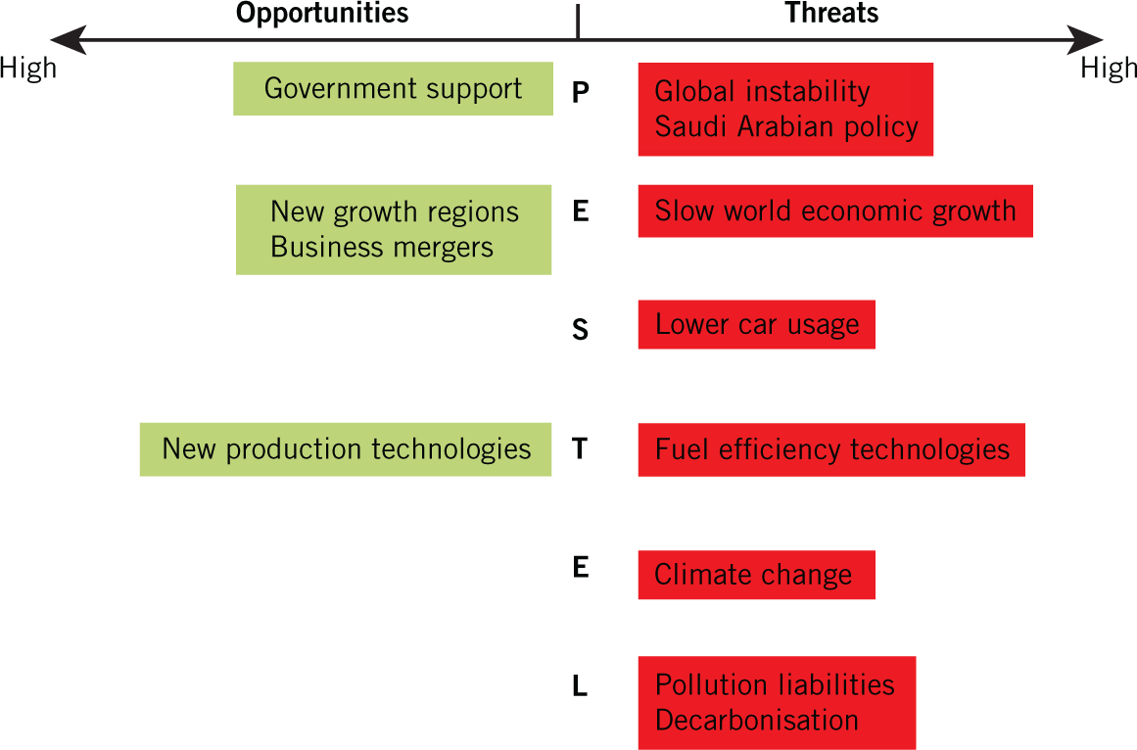
PESTEL example
This is an example of PESTEL for the oil industry

Slide 17
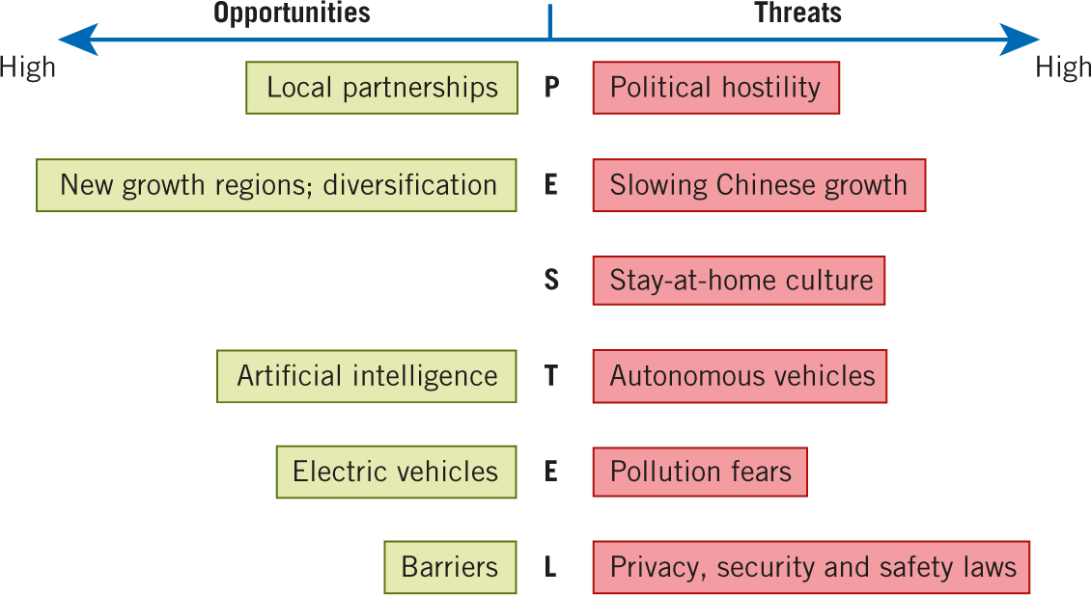
A PESTEL for DiDi
Notes:
DiDi is China's leading ride-hailing service, similar to Uber. It's fully integrated into WeChat as a mini program, making it incredibly convenient for foreigners who already use WeChat for daily life in China.

Slide 18

Pestel analysis – using amazon as an example
Watch this video and take notes:
  What are the key messages that you take away from this?
  We will discuss this together after the video.
https://youtu.be/F0KQ-h6v3-s

Slide 19
summary
The Macroenvironment

Slide 20
Reference
Whittington, R., Regnér, P., Angwin, D., Johnson, G., & Scholes, K. (2023). Exploring strategy: Text and cases (13th ed.). Pearson.

