Slide 1
Historical Writing and the Creation of a Monastic Identity: the Cistercian Abbeys of Byland and Jervaulx
Janet Burton
UWTSD Lampeter
j.burton@uwtsd.ac.uk

Slide 2

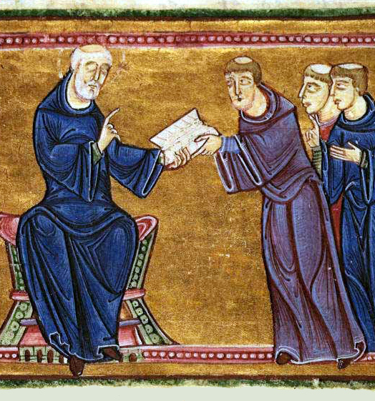
Monasteries as communities
Identity can be defined by RULE or ORDER (e.g. The Rule of St Benedict (monks/nuns); the Rule of St Augustine (canons/canonesses)
The constitutions of the Cistercian Order etc
May be reinforced by dress (habits), material culture, visual culture, literature, history

Slide 3
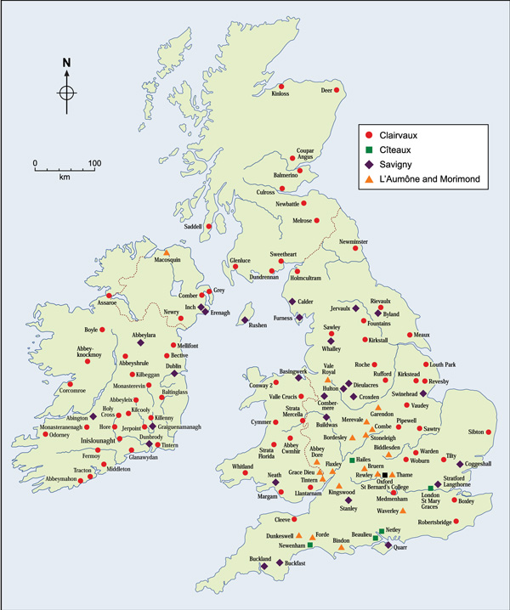
The source
The Historia Fundationis (foundation history) of Byland and Jervaulx, compiled in 1197 by the third abbot of Byland, Philip. The only surviving manuscript is of seventeenth-century date (Oxford, Bodleian Library MS 63). The text was copied by the antiquarian Roger Dodsworth from a copy in the cartulary of Byland, London, BL MS Egerton 2823, from where it is now missing. This was probably copied from the original text or an intermediary.

Slide 4
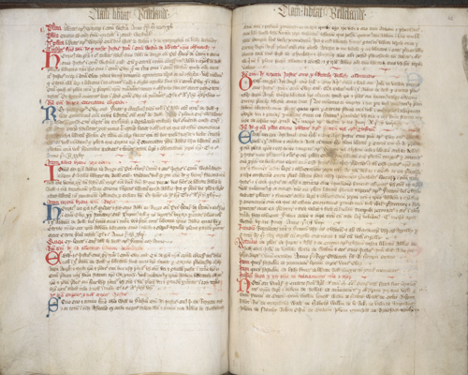
Themes
The origin myth: the ‘golden age’ of pioneering monks
A Cistercian identity: affiliation and the order
A local identity: founders and patrons
Consolidation: the landed estate
Marian associations
BL Egerton 2823, cartulary of Byland Abbey

Slide 5
REASONS FOR WRITING
…. human memory becomes so blurred and confused that whatever is done or happens in this earthly life – unless it is deliberately committed to writing – slips away and withers within a short space of time as if it had never been. Thus we have considered it timely to make known to our successors, in a brief account, the origin of the house of Byland, the manner in which it was founded and the method and process of foundation, just as we have often heard it from our elders, who were reliably informed by that man of holy reputation, Lord Roger, our predecessor and many others who came from Calder. This, they maintain was the origin of the monastery.

Slide 6
TRIALS AND TRIBULATIONS
Henceforward our successors may see what kind of worldly cares there are to be encountered and will carefully recall these writings. For our predecessors, from the time that they went out from Calder to the present day have patiently suffered worldly tribulations and oppressions, very serious losses and hardships in the hope of reward and the glory of heaven.

Slide 7
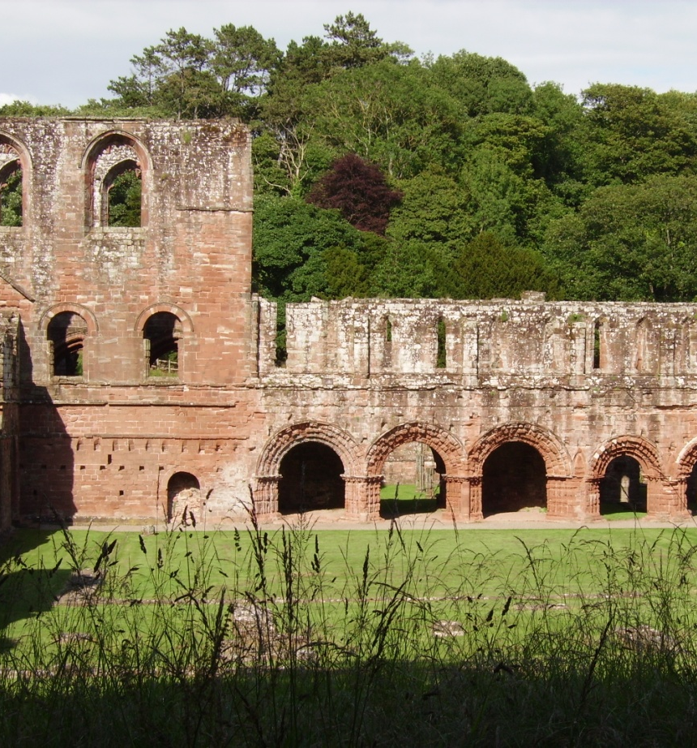
Byland: key dates
1135: founded as a Savigniac house from Furness, King Stephen’s Abbey
1138 destroyed by the armies of William fitz Duncan during the Scottish and Galwegian invasion of NW England
Monks return to Furness but are refused entry

Slide 8
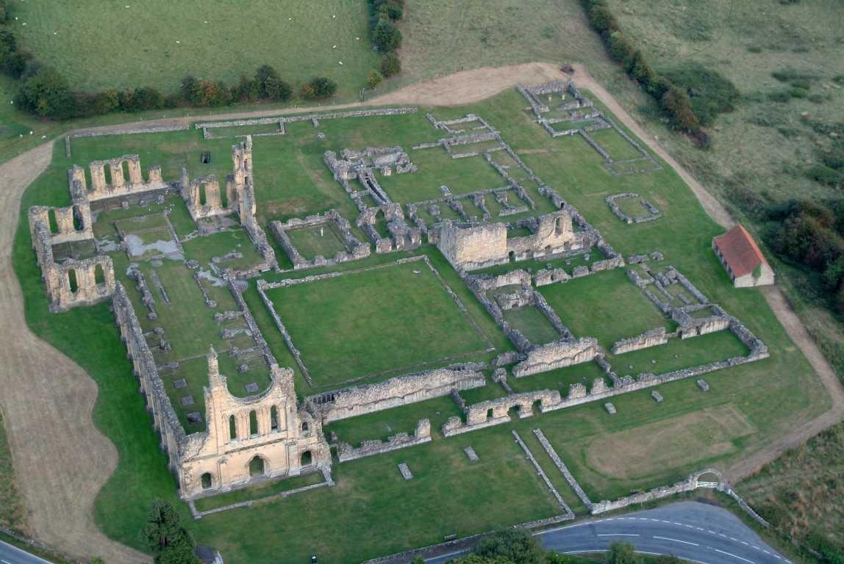
Wandering monks
There they are inconvenienced because they can hear the bells of nearby Rievaulx Abbey, so in 1147 they move again to Stocking, also known as Oldstead. While there they construct a new church, also called Byland (below)
1177 The move to their final site.
The monks cross the Pennines and seek help from the archbishop of York
He persuades a young magnate, Roger de Mowbray to take pity on the monks
Roger grants the first of four sites in Yorkshire at Hood in 1138
In 1142 the monks ask him for another site as Hood is too restricted
They move to Old Byland

Slide 9
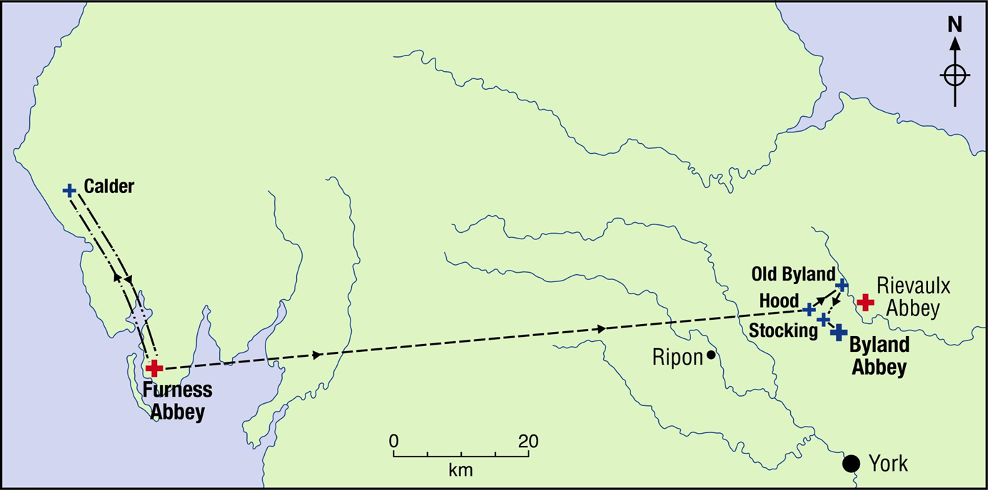

Slide 10
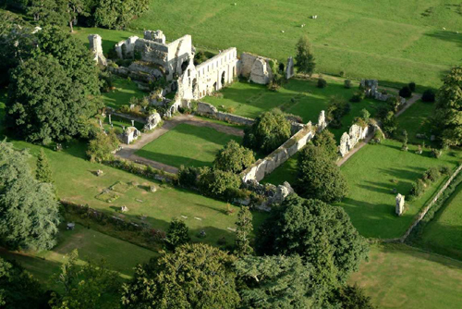
The origins of Jervaulx
He delays and for years nothing happens
The abbot of Byland offers to act as father abbot and the foundation goes ahead
In 1156 the monastery is moved to Jervaulx (below)
In 1145 a group of monks of Savigny are apparently wandering around Richmond in Yorkshire, collecting alms and healing the sick
A knight of the earl of Richmond gives them land for an abbey at Fors
The abbot of Savigny is reluctant to see another abbey of the order in England (or Wales)

Slide 11

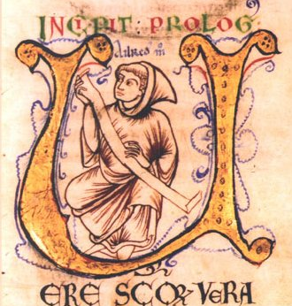
AFFILIATION AND LEGITIMACY
Mothers and daughters
Furness and Hood (Byland)?
Savigny and Hood?
Calder II and Byland?
Furness and Byland?
The delegation of the case by the General Chapter of the Cistercian Order to Aelred, abbot of Rievaulx (left)
Byland and Jervaulx?

Slide 12
LOCAL IDENTITIES AND PATRONS
Byland: Roger de Mowbray, son of Nigel d’Aubigny and Gundreda de Gournay: provision for the monks refused entry at Furness; added endowments; a ‘model patron’.
Jervaulx: Acaris son of Bardolf (tenant of Earl Alan)
Alan, earl of Richmond, count of Brittany: negotiations with Savigny
Conan, his son: provision of second site at Jervaulx

Slide 13
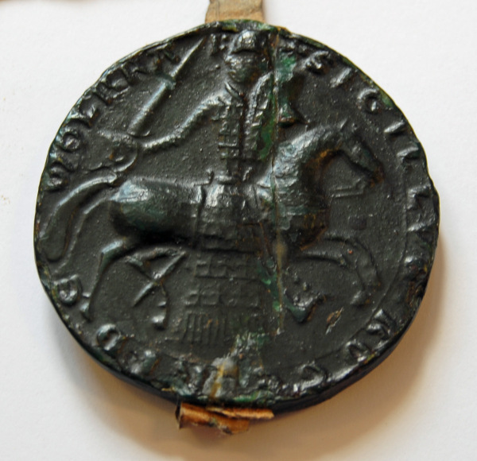
THE MOWBRAY FAMILY
Roger de Mowbray: left on Third Crusade, 1186, died there 1188.
Nigel: died at Acre 1191
William (d. 1124) – not a keen patron
Seal of Roger de Mowbray

Slide 14
CONSOLIDATION OF THE ESTATE
Incorporation of charters into the text of the Historia (see also the Øm Book and the Søro Donation Book from Denmark)
List of lands acquired: ‘Now we shall speak of the grants made in alms to Abbot Roger and his monks’ (see also list of benefactions in the cartulary of Rievaulx)
The tenurial disputes between the Mowbrays and the Stutevilles affects the third site at Oldstead
The charter of William son of Robert de Stuteville, issued between 1183 and 1201
Walter Map and accusations about boundaries

Slide 15
CISTERCIANS AND THE BLESSED VIRGIN MARY, QUEEN OF HEAVEN AND EARTH
The Book of Wonderful Happenings by Herbert of Clairvaux
The Dialogue on Miracles by Caesarius of Heisterbach
Exordium Magnum by Conrad of Eberbach (begun between 1177 and 1193 and completed between 1206 and 1221)

Slide 16
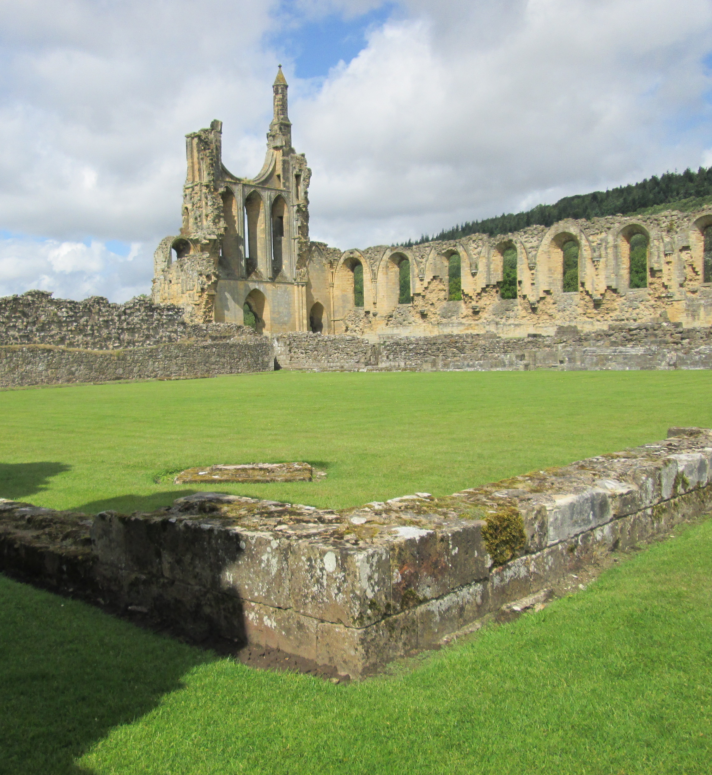
CISTERCIAN IDENTITY IN THE HISTORIA
Marian guidance in the selection of the second site of Jervaulx, as Mary as a ‘special friend’ of the Cistercians of Byland, Rievaulx, and Jervaulx; the vision of the beautiful woman and her son in the cloister of Byland as the monks prepare to leave for Jervaulx

Slide 17
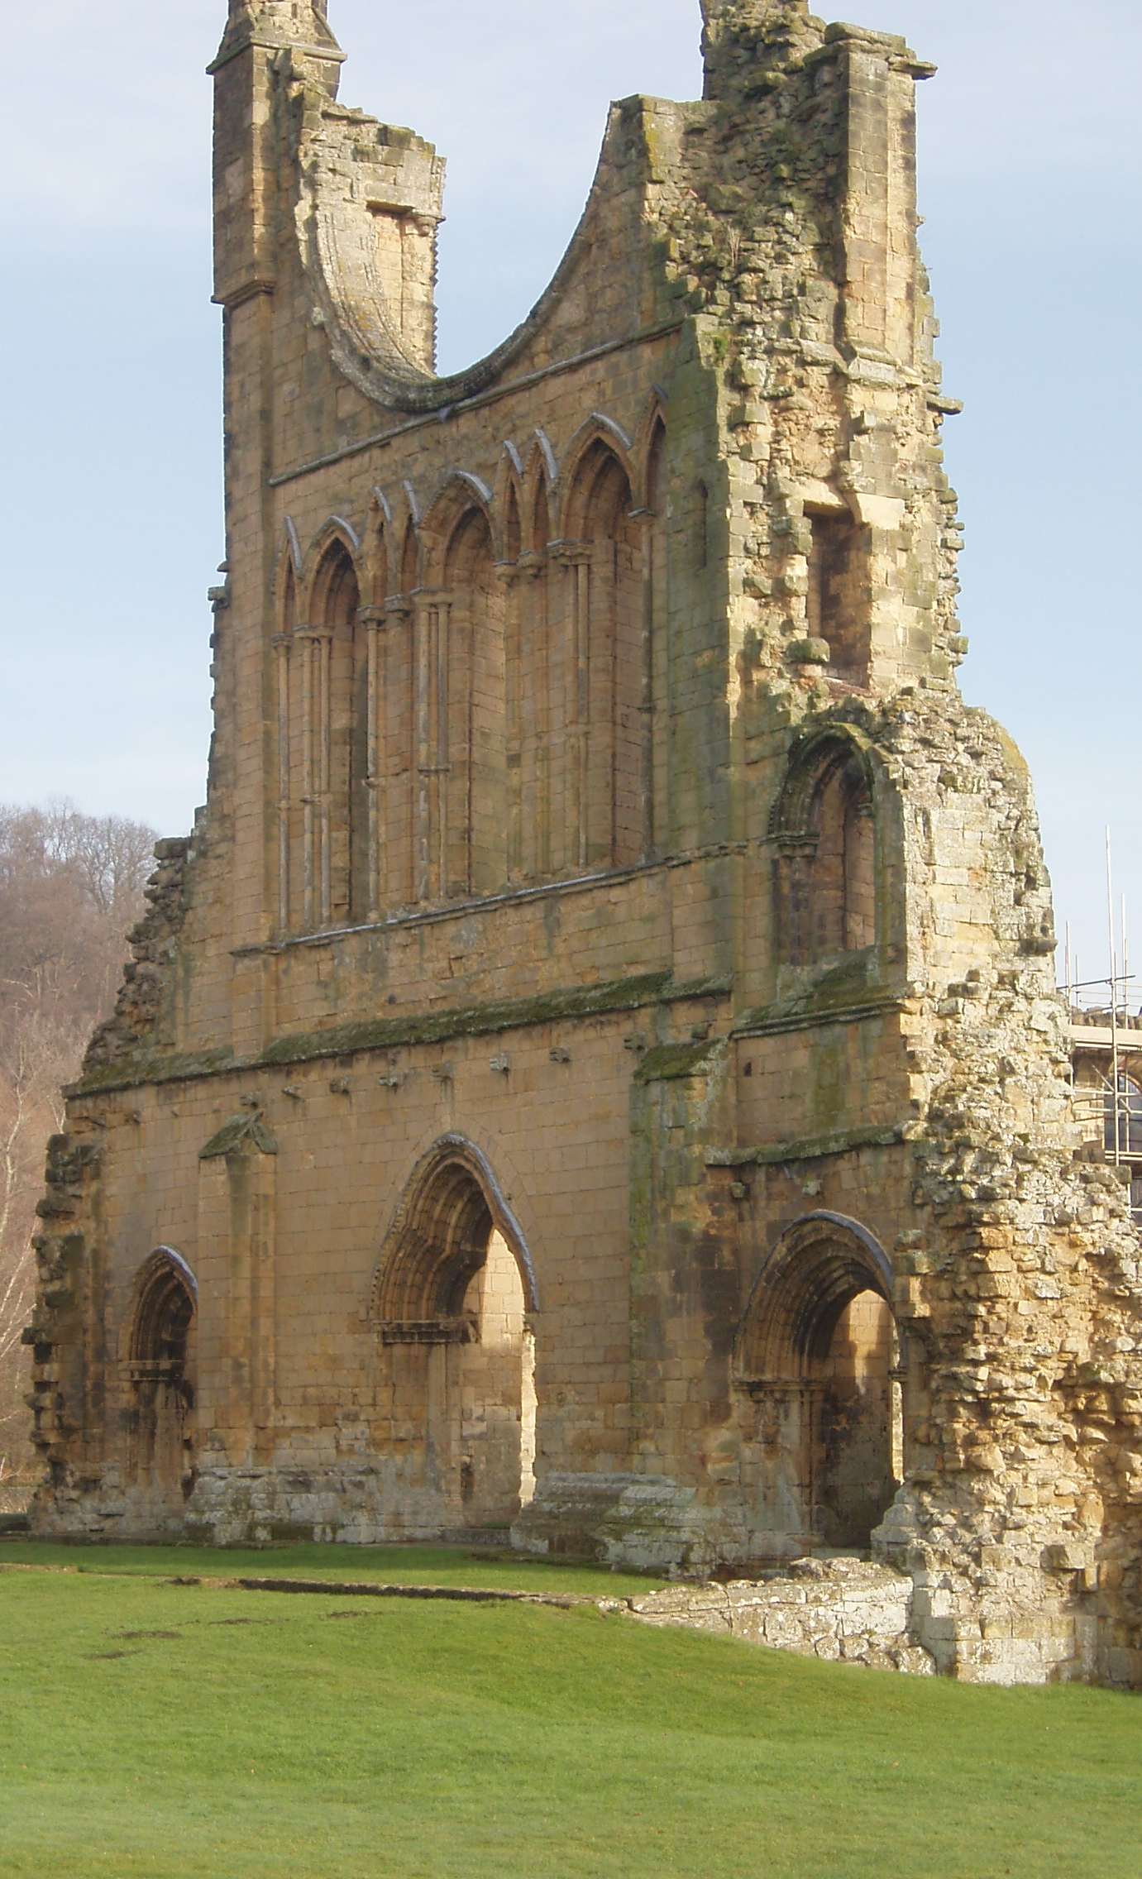
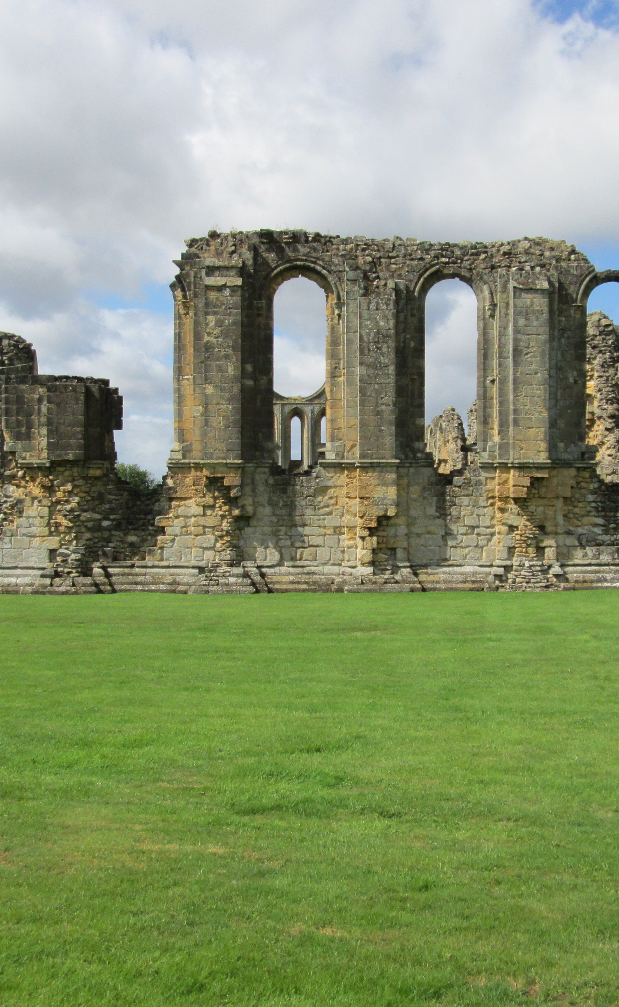
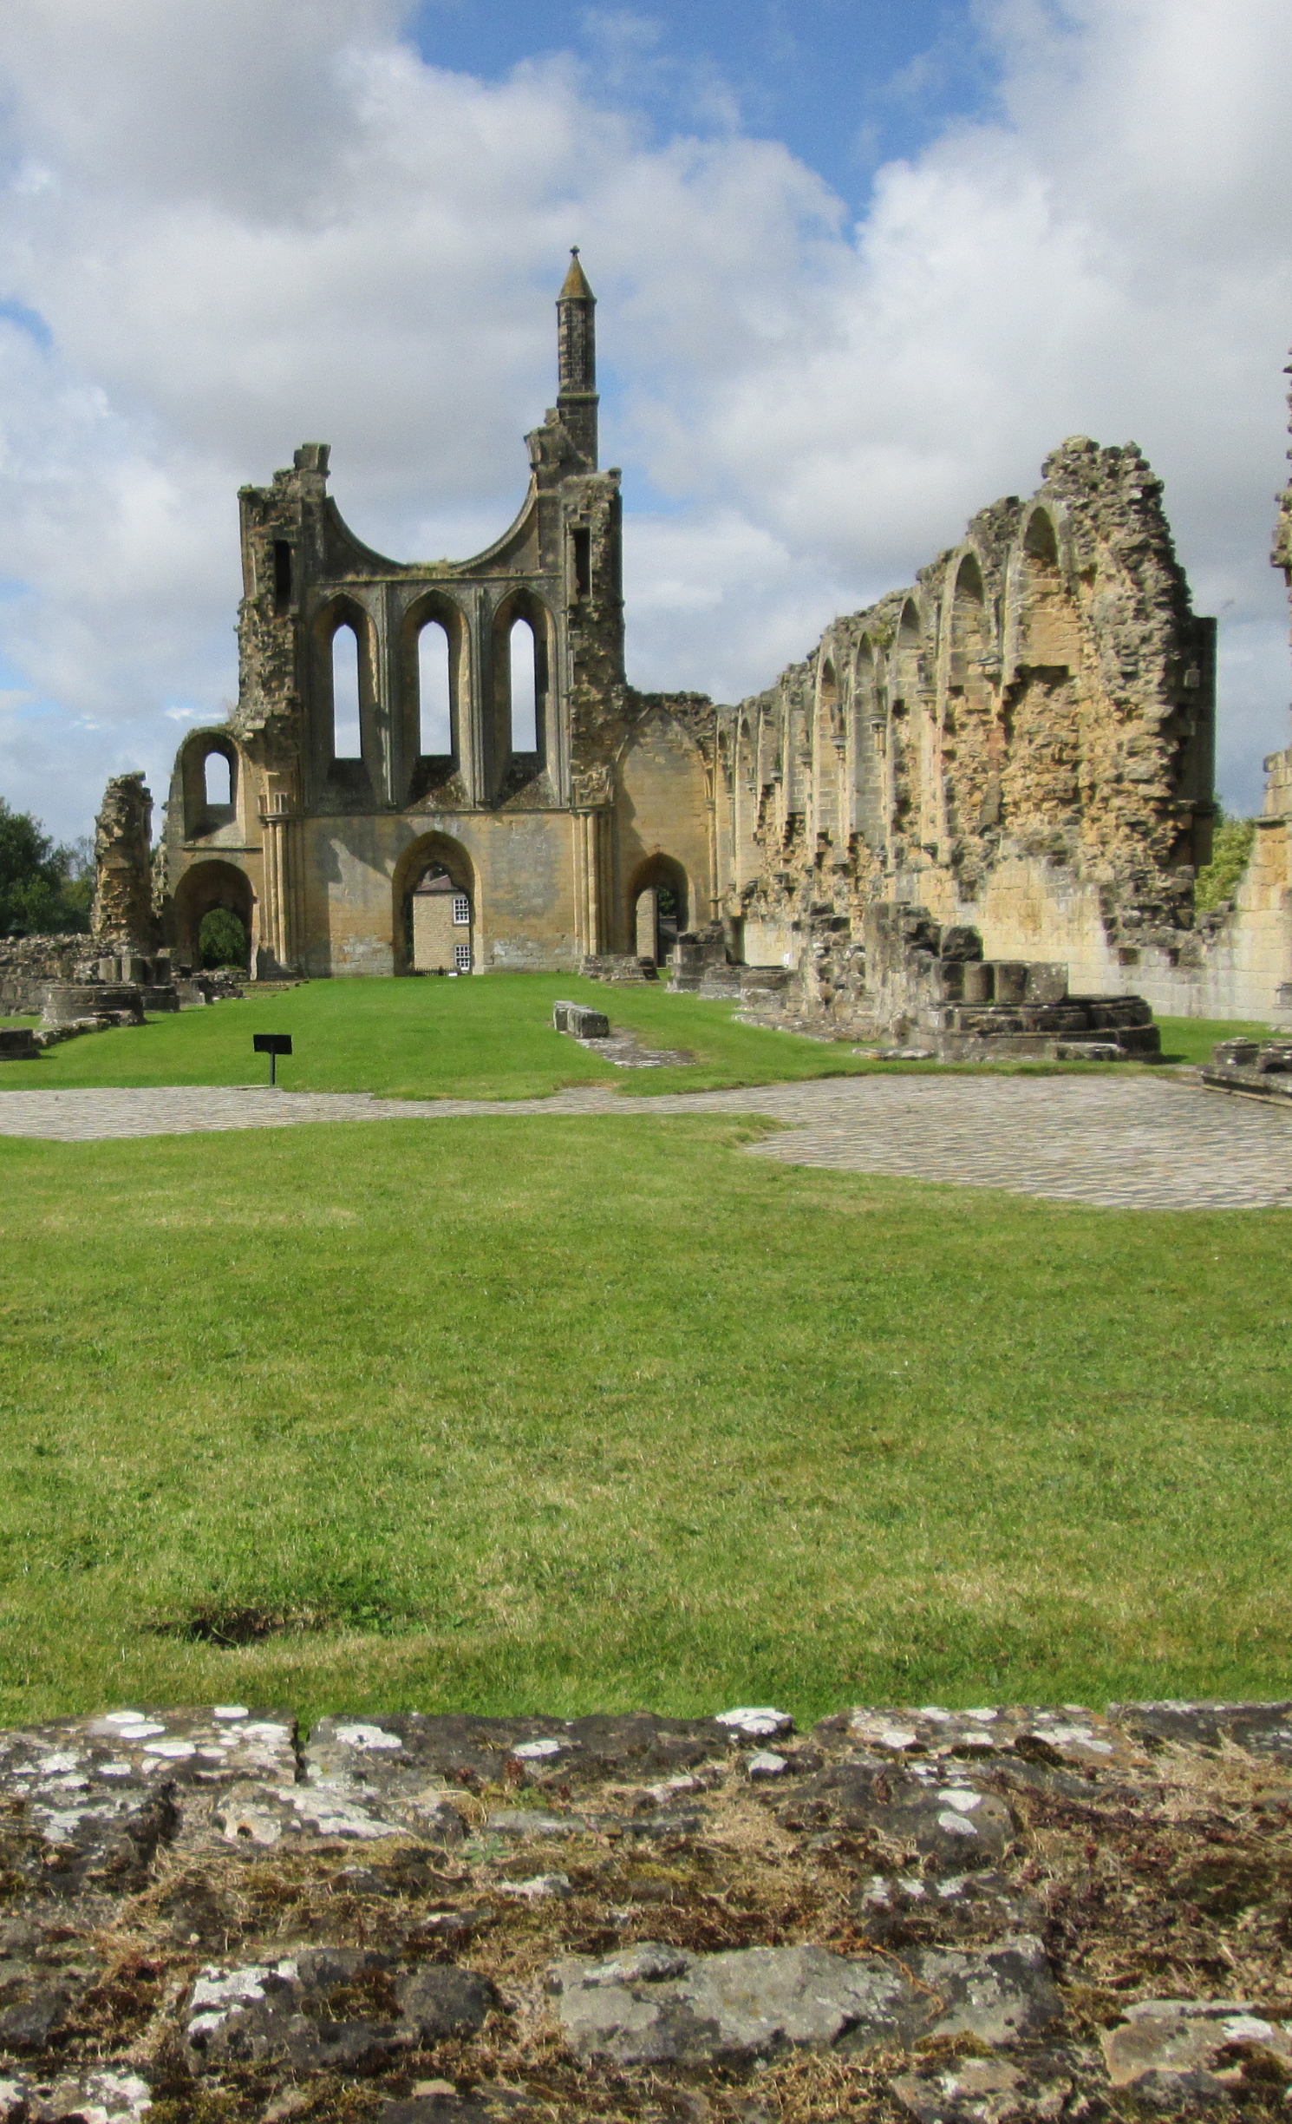
‘There they built their fine, great church from now, as may now be seen: may the Almighty bless and keep it throughout the ages’.

