Slide 1



Theory of Change and Logical Framework: Principles and Examples
The Digital Professional for Health and Care
Dr Taiwo Adedeji BSc MSc MRes PhD

Slide 2

Learning outcomes
Understand the frameworks and models for planning and evaluating change
Apply the Theory of Change to digital health implementation

Slide 3
Outline
Logical framework (Logframe)
Theory of Change (ToC)
ToC case study

Slide 4
Logical Framework (Logframe)
Logframes involve designing, monitoring, and evaluating inputs, activities, outputs, and outcomes logically to achieve desired results
Logframes are linear and easier to model with less difficulty
Notes:
A logic model is a theory-based framework used in evaluating and summarising how an intervention works by identifying pathways from inputs/activities to intended outcomes (Rogers, 2008). Logic models are usually graphical representations that outline the inputs, activities, outputs, outcomes and impact of complex interventions (Maden et al., 2017).

Slide 5
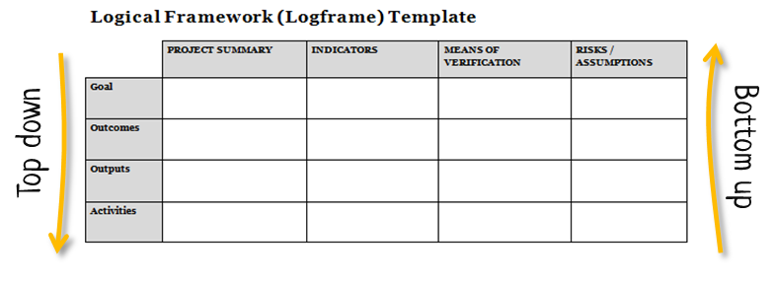
Logframe Matrix
(Bullen, 2021)

Slide 6
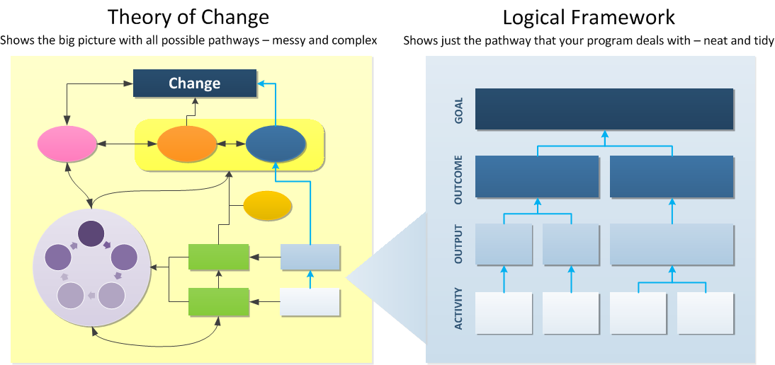
Logframe components
Goal
Outcome
Output
Activity
(Bullen, 2021)

Slide 7
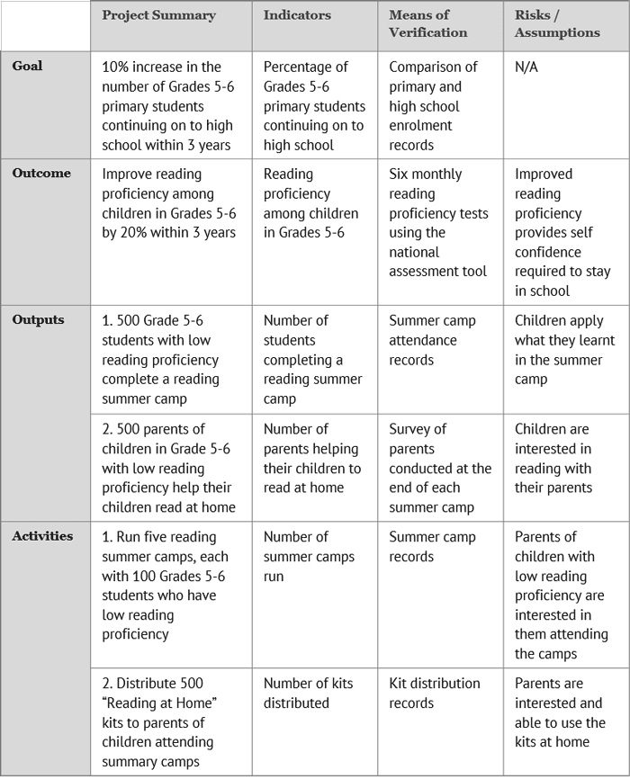
Logframe Matrix
Example
(Bullen, 2021)

Slide 8
Theory of Change (ToC)
Origins in Theory-Based Evaluation (TBE)
Similar to Logframe but complex
Start with long-term goal(s) and map backwards
Revision of maps (1st, 2nd, 3rd…n^{th} versions)
Stakeholder engagement

Slide 9
ToC definitions
Weiss popularised the term and modestly defined a ‘theory of change’ as:
a theory of how and why an initiative will work (Weiss, 1995).
UK’s Department for International Development (DFID) defined ToC as:
“an outcomes-based approach which applies critical thinking to the design, implementation and evaluation of initiatives and programmes intended to support change in their contexts” (Vogel, 2012).
Notes:
This definition seems simplistic, yet it is foundational.
ToC has evolved over the years, considering the ever-changing complexities in international development programmes.

Slide 10
ToC map
Long-term change
Assumptions
Measurable outcomes
Interventions
Outputs
Inputs
Notes:
Despite not having a single way of designing ToCs, good quality ToCs should entail specific components such as long-term goals, assumptions, interventions, measurable outcomes, inputs and outputs (Connell & Kubisch, 1998).

Slide 11
ToC Components
Component | Definition
Long-term change | The desired goal the stakeholders want to achieve.
Problems | The challenges facing the current paper-based health records workflow as highlighted by the stakeholders.
Stakeholders | The people directly or indirectly involved or affected by the success or failure of the EHR implementation.
Assumptions | The beliefs that specify the underlying reasons for the logical connections that exist between the ToC elements.
Inputs | The activities/tasks carried out around the intervention.
Interventions | The initiatives or programmes embarked on to influence the desired outcomes; in this study, the EHR implementation and sustainability arrangements.
Outputs | The tangibles resulting from the inputs and the intervention.
Measurable effects | The immediate indicators that could be traced to the implementation process and are readily usable for evaluation. These measures can be quantitative or qualitative.
Wider benefits | The generalisable pointers that could guide the stakeholders as to how possible is the long-term change.
Notes:
In the context of this study, the ToC components have the following definitions

Slide 12
ToC as a process and product
A process that articulates the mechanisms of change
The process involves setting out a long-term goal and go in a reverse direction to specify assumptions and identify preconditions to bring about the desired outcomes (Taplin et al., 2013)
The process leads to the product (ToC map), usually in versions
Notes:
ToC process articulates the mechanisms of change. The process begins when stakeholders set out a long-term goal and go in a reverse direction to specify assumptions and identify preconditions to bring about the desired outcomes (Taplin, Clark, Collins, & Colby, 2013)
The process leads to the product (ToC map), which is usually developed in versions before, during and after programme implementations.

Slide 13
ToC vs Logframe
ToC | Logframe
Messy and complex | Neat and tidy
Shows all pathways | Shows programme-specific pathways
Gives the big picture | Gives a detailed description of the programme
Flexible map | Linear diagram
Detailed assumptions | Basic assumptions
Tool for planning, design and evaluation | Tool for mainly monitoring

Slide 14
ToC Case Study
Move from paper to electronic records
Electronic Health Record (EHR) implementation @ Festac Primary Health Centre, Lagos
Theory of Change (ToC) approach
  Interviews
  EHR system selection and evaluation
  Workshop

Slide 15
Initial ToC
Pre-Implementation
An initial version of the Theory of Change for the scheduled EHR implementation in Festac PHC (Adedeji, 2021).

Slide 16
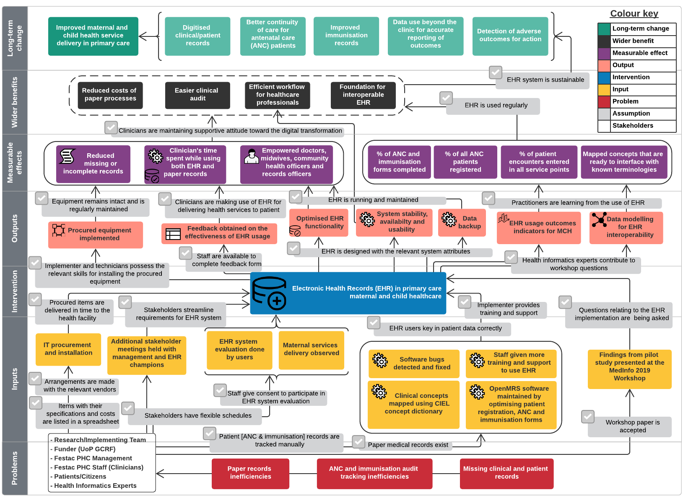
Revised ToC
Actual Implementation
A revised version of the Theory of Change for EHR implementation in Festac PHC, including a workshop at MedInfo Conference 2019 (Adedeji, 2021).
Notes:
A revised version of the Theory of Change for Electronic Health Records implementation in Festac PHC, including a workshop at MedInfo Conference 2019.

Slide 17
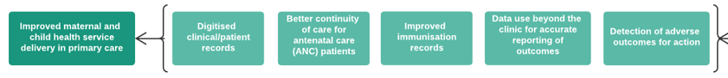
Long-term change
Assumption | Source
EHR system is sustainable | Policymakers, Practitioners, Programme designer

Slide 18

Wider benefits
Assumption | Source
EHR is used regularly | Policymakers, Practitioners, Programme designer
Clinicians are maintaining supportive attitude towards digital transformation | Policymakers, Practitioners, Programme designer

Slide 19
Measurable effects
Assumption | Source
Hardware equipment and EHR software remain intact and is maintained regularly | Policymakers, Practitioners, Programme designer
Clinicians are making use of EHR regularly for delivering health services to patients | Practitioners, Policymakers
Stakeholders are learning from EHR usage and data | Policymakers, Practitioners, Programme designer, Health informatics experts

Slide 20



Outputs
Assumption | Source
Implementer and technicians possess the relevant skills for installing the equipment | Policymakers, Programme designer
Staff are available to complete a feedback form | Practitioners
EHR is designed with the relevant system attributes | Practitioners, Programme designer
Health informatics experts contribute to workshop questions | Health informatics experts, Programme designer

Slide 21

Intervention
Assumption | Source
Procured items are delivered in time to the health facility | EHR implementation
Stakeholders streamline requirements for EHR system | Practitioners, Programme designer
EHR users key in patient data correctly
Implementer provides training and support | …Policymakers
Questions relating to the EHR implementation are being asked by workshop participants | Health informatics experts, Programme designer

Slide 22
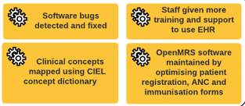


Inputs
Assumption | Source
Arrangements are made with the relevant vendors | Programme designer
Items with their specifications and costs are listed in a spreadsheet | EHR implementation
Stakeholders have flexible schedules | Practitioners
Staff give consent to participate in the EHR system evaluation
ANC and immunisation records are tracked manually (paper)
Workshop paper is accepted | Programme designer

Slide 23
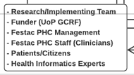

Stakeholders & Problems

Slide 24
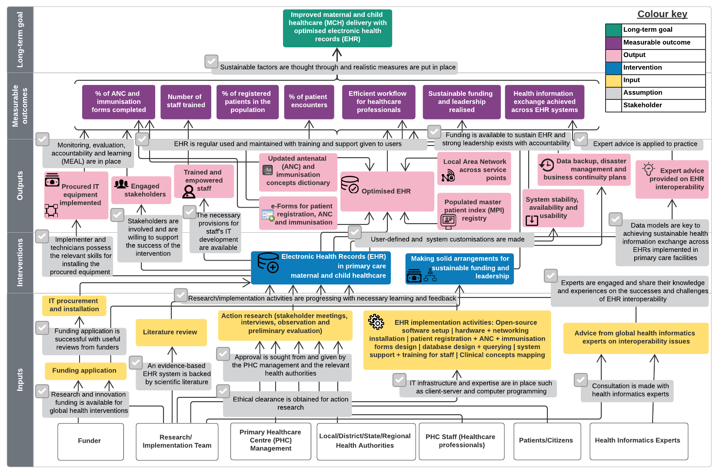
Generic ToC
Future Implementation
A generic version of Theory of Change for Electronic Health Records implementation, without context-specific details (Adedeji, 2021)

Slide 25
Findings
ToC maps
  Initial
  Revised
  Generic
Interview themes
  Readiness
  Expectations
  Sustainability
Technical implementation
Workshop

Slide 26
Study conclusions
Impact summary
  Research dissemination
  Benefits realisation through the case study
  Collaboration with global community.
What was previously known
  ToC approach is effective in engaging stakeholders
  ToC is both a process and a product
  ToC has little public use in health informatics projects.

Slide 27
Study contributions
ToC is useful in formulating the preconditions to achieve the long-term goal to improve the delivery of MCH.
ToC is a powerful tool to guide the implementation of health informatics projects.
Development of ToC maps to guide new EHR implementations in LMICs.

Slide 28
Summary
Logframes are useful frameworks to design and monitor change projects
ToC approach is helpful in understanding the bigger picture of digital health interventions

Slide 29
References
Adedeji, T. A. (2021) Realising the benefits of digital health implementation in a middle-income country: Applying Theory of Change in Nigerian primary care. University of Portsmouth. Available at: https://researchportal.port.ac.uk/en/persons/taiwo-adedeji/studentTheses/
Bullen, P. B. (2021) How to write a logical framework (logframe). Available at: https://tools4dev.org/resources/how-to-write-a-logical-framework-logframe/ (Accessed: 24 November 2021).
Taplin, D. H. et al. (2013) Theory of Change Technical Papers: A series of papers to support development of theories of change based on practice in the field. New York: ActKnowledge. Available at: http://www.theoryofchange.org/wp-content/uploads/toco_library/pdf/ToC-Tech-Papers.pdf.
Vogel, I. (2012) Review of the use of ‘Theory of Change’ in international development. London: GOV.UK. Available at: https://www.gov.uk/government/news/dfid-research-review-of-the-use-of-theory-of-change-in-international-development.
Weiss, C. H. (1995) ‘Nothing as Practical as Good Theory: Exploring Theory-Based Evaluation for Comprehensive Community Initiatives for Children and Families’, New Approaches to Evaluating Community Initiatives: Concepts, Methods, and Contexts. doi: 10.1177/1356389003094007.

