Slide 1
Welcome to the Presentation
Title: Elevating Luxury: Grand Hyatt Hotel Marketing Strategy
Student's Name: Gabriela Rujala
Student Number:2243925

Slide 2
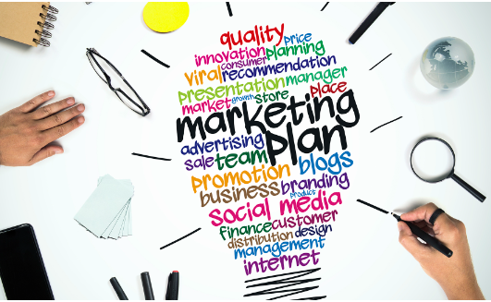
Introduction
The purpose of this marketing plan is to identify and capitalise on a lucrative marketing opportunity
Target audience: Grand Hyatt's managerial personnel and stakeholders
Frameworks Used: SOSTAC, 4Ps, Ansoff's Matrix
Notes:
The purpose of this marketing strategy is to identify a profitable marketing opportunity and create a comprehensive communication plan specifically for the Grand Hyatt Hotel in light of the current international situation. The management team at the hotel and other interested parties are the plan's intended audience. This strategy will make use of well-known frameworks like SOSTAC, 4Ps, and Ansoff's Matrix in order to provide a clear and informative path for the organisation (Brassington & Pettitt, 2021). The strategy will provide a route for navigating the modern hospitality landscape and capitalising on the potential that has been recognised via their application.

Slide 3
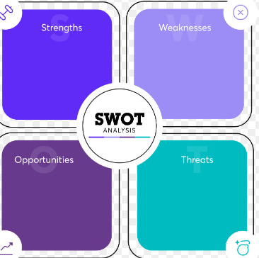
Situation Analysis (5 'C's)
Company (SWOT Analysis)
Strengths:
Global reach and brand recognition
Luxury hospitality expertise
Opportunities:
Expand services
Create unique experiences
Weaknesses:
Location-specific issues
Amenities not meeting brand standards
Threats:
Monitor new competitors
Safeguard market position
Notes:
Company (SWOT Analysis):
The Grand Hyatt Hotel benefits from its worldwide reach and well-known brand identity to excel in the field of upscale hospitality. The development of competitive advantages can be facilitated by using these qualities. There are many chances to expand service offerings and create distinctive experiences that might appeal to a changing consumer base (Clow & Baack, 2013). To improve the entire customer experience, it is essential to address flaws, particularly in specific areas or facilities that might not adhere to brand standards. To protect the hotel's position in the market, vigilance is necessary to keep an eye out for any dangers, particularly from new competitors.

Slide 4

Situation Analysis (5 'C's)
Customers (Segmentation and Targeting)
Target Audience:
Affluent tourists seeking luxury
Discerning business travelers
Meticulous event planners
Strategies:
Detailed consumer profiles
Demographics, interests, travel habits
Utilising SimilarWeb insights for precise targeting
Notes:
Rich tourists seeking lavish experiences, discriminating business visitors, and fastidious event planners should be the primary focus of attention for the Grand Hyatt (Ghauri, 2014). Creating thorough consumer profiles that include demographics, interests, and travel habits is essential. Information gleaned from sites like SimilarWeb can help target audiences more successfully by enhancing the targeting approach.

Slide 5
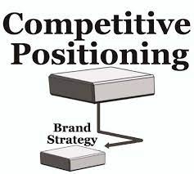
Situation Analysis (5 'C's)
Competitors (Positioning and Strategy)
Utilising Frameworks:
Bowman's Strategy Clock
Perceptual Positioning Map
Strategies:
Visual comparison of price and perceived value
Emphasising differentiation through exceptional services and curated experiences
Notes:
The Grand Hyatt can use Bowman's strategy clock and a perceptual positioning map to get an advantage over rival hotels. This will make it easier to visually compare the hotel's rate and perceived value to those of its rivals. Its distinct position in the industry will be further cemented by a deliberate focus on distinguishing through great services and carefully selected experiences (McDonald and Malcolm, 2016).

Slide 6

Situation Analysis (5 'C's)
Collaborators
Collaborative Avenues:
Strategic alliances
B2B partnerships
Franchise relationships
Benefits:
Diversify product offerings
Strengthen brand reputation
Reach new customer segments
Notes:
Strategic alliances, B2B partnerships, and franchises with Grand Hyatt offer priceless growth opportunities. Collaborations can broaden the hotel's product options, strengthen its brand reputation, and reach new client demographics (Armstrong et al., 2021). These alliances may play a key role in growing the hotel's market reach and broadening its range of services.

Slide 7
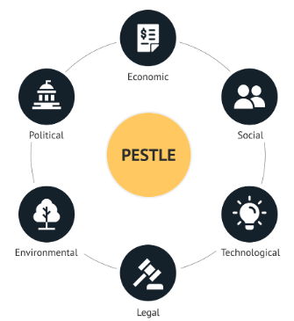
Situation Analysis (5 'C's)
Climate (PESTLE Analysis) (Macro analysis) :
Macro-environmental Factors:
Political stability
Economic fluctuations
Evolving social norms
Technological advancements
Legal regulations
Environmental considerations
Insights for Robust Strategy:
Understand and adapt to these influencing factors
Notes:
The macroenvironmental variables affecting the hotel business may be understood through a thorough PESTLE analysis. The landscape of the sector is significantly influenced by political stability, economic changes, shifting social standards, technological breakthroughs, regulatory restrictions, and environmental concerns (Kokemuller and Neil, 2013). Forging a robust and flexible corporate strategy requires gaining an understanding of these factors.

Slide 8
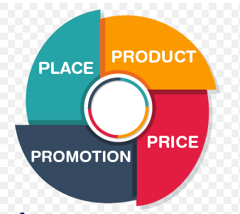
Marketing Mix
Product:
Tailor offerings to luxury-seeking clientele
Price:
Reflect value and exclusivity
Place:
Optimise distribution channels
Promotion:
Craft compelling campaigns showcasing uniqueness
Notes:
The 4Ps (product, price, place, and promotion) must be thoroughly reviewed and adjusted in light of the opportunities and client preferences revealed. Grand Hyatt's competitive position will improve with the adaptation of the product and service offerings to meet the needs of the luxury-seeking clientele, pricing strategies that reflect value, distribution channel optimisation for maximum reach, and the creation of effective promotional campaigns (Spear and Carl, 2018).

Slide 9

Objective
Primary Objective:
Increase occupancy by 15% in the upcoming year
Target Audience:
Affluent leisure tourists
Discerning business clients
Strategic Outcome:
Establish Grand Hyatt as the pinnacle of opulent hospitality
Notes:
The primary objective is to increase overall occupancy by 15% in the forthcoming year, focusing in particular on affluent leisure tourists and selective business clientele. By reaching this goal, Grand Hyatt hopes to become recognized as the region's premier example of opulent hospitality. This tactical move not only strengthens the hotel's position in the market but also secures its standing as the ideal option for guests seeking unrivaled elegance and first-rate service.

Slide 10
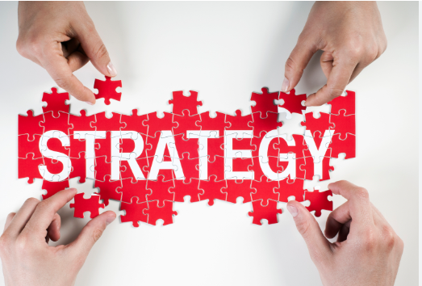
Strategy
Value Proposition:
Emphasize transformative and exclusive guest experiences
Market Development:
Expand services into new markets
Utilise global reach for strategic growth
Reputation Management:
Address negative reviews and enhance service
Strategies: Product, Price, Place, Promotion
Ansoff's Matrix Approach:
Leverage strengths while reducing risk
Notes:
A redesigned value proposition will place a focus on developing transformational and exclusive guest experiences in order to increase Grand Hyatt's attractiveness and address any issues (Housden, 2008). High-end guests seeking unrivalled luxury will be drawn to accommodations that emphasise distinctive features like specialised concierge services and bespoke facilities.
A market development approach will be used, following Ansoff's matrix. Utilising the hotel's worldwide reach, this entails expanding current services into new markets—both geographically and by consumer group. This strategy leverages current strengths while reducing risk (Trott, 2021).
A reputation strategy for management might be used, for instance, if it were essential to repair a bad reputation brought on by unfavorable evaluations. Addressing issues, raising service standards, and aggressively seeking out input from customers are all part of this. The introduction of unique packages (product), a review of pricing tactics (price), the optimisation of distribution channels (place), and the promotion of these enhancements through targeted campaigns (promotion) are examples of changes to the marketing mix (Kotler et al., 2017). This all-encompassing plan guarantees a unified and successful method to overcome obstacles and improve the Grand Hyatt's reputation.

Slide 11
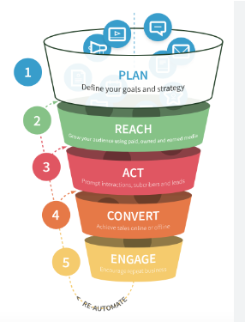
Tactics: RACE Model Execution
Reach: Targeted Social Media Campaigns
Instagram, Facebook, Twitter
Showcasing lavish facilities, curated experiences
Entice potential visitors
Act: Personalized Email Marketing
Data-driven customization
Compelling subject lines, enticing visuals
Motivate recipients to explore services
Convert: Interactive Content for Bookings
Immersive videos of accommodations, dining, spa
Strategically placed calls-to-action
Engage: Seamlessly Integrated Interactions
Social media as a dialogue platform
Rapid response, user-generated content
Email follow-ups for information and queries
Analytics: Assessing Channel Effectiveness
SimilarWeb evaluation
Identify and close engagement gaps
Content Strategy: Showcasing Opulent Amenities
Visual posts, concise captions
Aspirational connection with the audience
Email Strategy: Targeted Offers for Return Guests
Utilising past interactions
Fostering familiarity and appreciation
Result: Strengthened Audience Connection
Unified isuals, content, interaction
Encourage engagement with Grand Hyatt's opulent hospitality
Notes:
Grand Hyatt's communication plan will orchestrate a comprehensive strategy for engaging its target audience by utilising the RACE model, which stands for Reach, Act, Convert, and Engage.
Reach: Targeted social media campaigns will be developed on websites like Instagram, Facebook, and Twitter to increase visibility (Bowie et al., 2017). The information will highlight the hotel's lavish facilities, carefully chosen experiences, and scenic settings to entice prospective visitors to learn more.
Act: A key component of engagement will be personalised email marketing. Data analysis will reveal visitor preferences and previous actions, enabling the development of customised messaging (Smith & Zook, 2020). With appealing subject lines and alluring images, you may entice recipients to investigate the hotel's services and motivate them to proceed.
Convert: To convert attention into bookings, interactive material will be essential. Immersive movies highlighting opulent accommodations, fine restaurants, and spa centres will inspire a sense of exclusivity and desire (Kotler et al., 2020). The reservation procedure will be prompted by calls-to-action that have been thoughtfully positioned across the material.
Engage: Online and offline interactions will be seamlessly integrated during the engagement phase. Social media will serve as a forum for conversation, rapid responses to questions and comments, and the dissemination of user-generated material. Parallel to this, targeted email follow-ups will give further details and a way to address queries and concerns (Chaffey and Ellis-Chadwick, 2019).
Through SimilarWeb analytics, the efficiency of the current communication channels will be evaluated. To ensure a coherent and effective communication strategy, engagement gaps will be found and closed.
Social media posts will be carefully chosen to highlight the hotel's opulent amenities. Posts that are visually appealing will be complemented by concise subtitles that weave stories of indulgence and refinement (Ghauri, 2014). The objective is to establish an aspirational connection with the audience and match their needs with Grand Hyatt's offers.
In addition, email marketing will send targeted offers to past visitors based on their choices. This specialised strategy makes use of data-driven insights to deliver alluring offers that are consistent with their prior interactions and stays, generating a feeling of familiarity and gratitude (Housden, 2008).
The Grand Hyatt's communication mix will create a lasting connection with its audience through the union of alluring graphics, tailored content, and purposeful interaction, encouraging them to partake in the hotel's highest calibre of opulent hospitality.

Slide 12
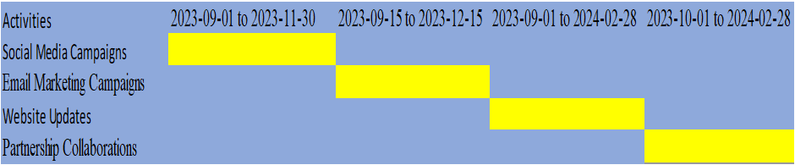
Action and Progress
Gantt Chart: Visual roadmap
Planned social media posts, email campaigns, website updates, collaborations
Data-driven channel decisions: past performance, market research, target audience understanding
Notes:
A precisely constructed Gantt chart will work as a visual roadmap, outlining a timeframe for important marketing operations. This all-encompassing strategy includes pre-planned social media postings, clever email campaigns, frequent website updates, and cooperative relationships (Jobber and Ellis-Chadwick, 2020). A combination of previous performance data, insightful market research findings, and a thorough comprehension of the discovered tastes and behaviours of the selected target group will serve as the foundation for decisions on the choice of marketing channels.

Slide 13
Control
Solid KPIs for measuring strategy effectiveness
Metrics: Client growth, brand perception enhancement, increased profits
New reservations, higher occupancy rates for client base expansion
Sentiment analysis, online reviews for brand perception
Success indicator: Rise in earnings, showcasing plan effectiveness and financial growth
Notes:
A solid set of measurements and key performance indicators (KPIs) will serve as the foundation for measuring the effectiveness of our marketing strategy. We will use a variety of metrics to evaluate our progress, such as attracting more clients, boosting brand perception, and generating higher profits (Brassington & Pettitt, 2021). Metrics will include the expansion of the client base, which is demonstrated by an increase in new reservations and higher occupancy rates. Sentiment analysis and the monitoring of internet reviews will be used to measure improvements in brand perception. The ultimate indicator of success is the rise in earnings, which not only shows how effective the plan was but also how it helped Grand Hyatt continue to develop and succeed financially.

Slide 14
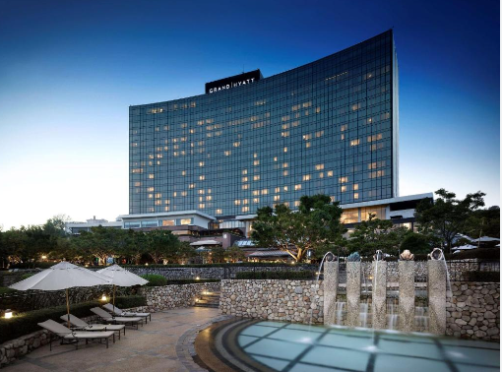
Conclusion
Comprehensive approach for Grand Hyatt
Emphasis on utilizing opportunities, enhancing premium character
Skillful communication strategies and enhanced client experiences ensure growth
Positioning as leading luxury brand, radiating quality and elegance
Notes:
In conclusion, this marketing strategy painstakingly lays out a comprehensive approach for the Grand Hyatt Hotel. The strategy emphasises the hotel's route to success by carefully utilising opportunities, enhancing its premium character, and successfully overcoming hurdles. Grand Hyatt is well-positioned to achieve its growth goals because of the skillful application of cutting-edge communication strategies and a zealous commitment to upgrading client experiences. With this deliberate effort, it is positioned to solidify its status as the leading luxury hotel brand in the sector, exuding an air of quality and elegance.

Slide 15
References
Armstrong, G., Adam, S., Denize, S., & Kotler, P. (2021). Principles of Marketing. Pearson Australia.
Bowie,D. Buttle,F. Brookes,M & Mariussen,A (2017), Hospitality Marketing. 3rd ed, Routledge, London
Brassington, F., & Pettitt, S. (2021). Principles of Marketing. Pearson.
Chaffey, D and Ellis- Chadwick, F. (2019) Digital Marketing. 7th ed, Pearsons, London.
Clow, K & Baack, D (2013), Integrated Advertising, Promotion and Marketing Communications. 6th ed, Pearson, London
Ghauri, P N (2014) International Marketing, 4th Ed, McGraw Hill, London
Housden M (2008), Marketing Research & Information, Butterworth Heinemann, Oxford.
Jobber, D. and Ellis-Chadwick, F (2020), Principles and practice of marketing. 9th ed. London:
Kokemuller, Neil (February 2013). "Purposes of a Marketing Plan". Houston Chronicle. Archived from the original on January 15, 2021. Retrieved May 7, 2021.
Kotler, P., Armstrong, G., Harris, L. and He, H., 2020. Principles of marketing. 8th European ed, London: Pearson Education Limited.
Kotler,P and Kartajaya, H. Marketing 4.0 Moving from Traditional to Digital (2017) Wiley. New York.
McDonald, Malcolm (2016). Marketing plans : how to prepare them, how to profit from them. Hugh Wilson (Eighth ed.). Hoboken.
Ryan, D. (2012) Understanding Digital marketing: Marketing Strategies for Engaging The Digital Generation. Kogan Page, London.
Smith PR & Zook ZE (2020) Marketing Communications. 7th ed, Kogan Page, London
Spear, Carl H. (March 22, 2018). "Why it's important to have a marketing plan". Optometry Times Journal. 10 (4). Archived from the original on April 12, 2021. Retrieved April 12, 2021.
Trott, P. (2021). Innovation Management and New Product Development. Pearson.
Westwood, John (2002). The Marketing Plan: A Step-by-step Guide (3rd ed.). London: Kogan Page.

Slide 16
Thank You

