Slide 1
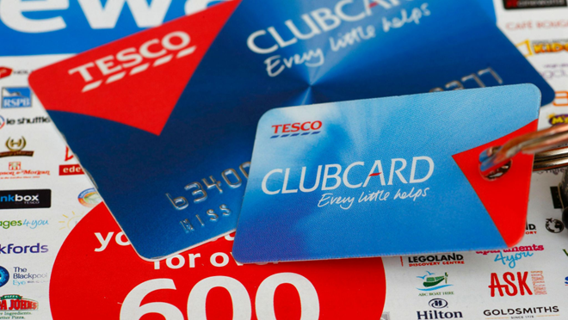



Research Process and Key Findings
Customer Dissatisfaction in Tesco’s Clubcard across Tesco Supermarkets
“EVERY LITTLE HELPS” (Tesco, 2024)
Introduction
This research poster examines customer dissatisfaction with Tesco’s Clubcard across UK supermarkets, focusing on issues such as technical access problems, inconsistent rewards value, price discrepancies, and uncertainty around the scheme’s overall benefits. Understanding these factors is important because such problems can undermine customer trust and engagement. Although dissatisfaction exists, many argue that the Clubcard still provides value. For example, Butler (2024) reports that supermarket loyalty cards can offer genuine savings, while Cannon (2003) highlights that Tesco’s Clubcard has long been recognised as one of the most influential loyalty programmes in the grocery sector, with widespread customer adoption. However, concerns have also been raised; (Jolly, 2023) notes that Tesco has faced criticism for inflating regular prices to make Clubcard discounts appear more significant, while (BBC News, 2023) reports customer frustration with inconsistent pricing between in-store and online Clubcard deals. Together, these contrasting perspectives underline the importance of evaluating how the scheme shapes customer satisfaction and overall shopping experience.
Approach
Method
A secondary research approach was used, as a substantial amount of relevant and credible information about Tesco’s Clubcard was already available online through reports, customer reviews, academic literature, and industry publications.
Secondary data is also less time-consuming to collect compared to primary methods, making it well suited to the project timeframe and the need for efficient data gathering (Saunders, Lewis and Thornhill, 2019). This approach also allows researchers to draw on existing, validated data, providing wider context and supporting a more comprehensive understanding of the topic (Johnston, 2014).
A mixed-methods perspective was adopted by combining secondary, qualitative and quantitative insights. Qualitative analysis was used to explore customer experiences and identify recurring themes of dissatisfaction, which is valuable for understanding perceptions and behaviour (Creswell and Creswell, 2018).
Quantitative information from survey statistics, market reports, and publicly available datasets helped clarify the scale and frequency of issues faced by shoppers (Bryman, 2016). Using both forms of data strengthened the research by providing both depth and breadth, combining detailed customer perspectives with measurable patterns (Tashakkori and Teddlie, 1998).
Key findings
References
Technical issues such as login failures, app glitches and problems activating offers
Pricing inconsistencies often occur between shelf labels, online listings and check totals.
Perceived poor rewards value, with customers monitoring and noting slow points accumulation and limited voucher benefits.
Concerns about non Clubcard prices, many believe regular prices are inflated just to make discounts look better
Butler, S. (2024). Supermarket loyalty cards give genuine savings, says watchdog. [online] the Guardian. Available at: https://www.theguardian.com/business/2024/nov/27/supermarket-loyalty-cards-genuine-savings-watchdog? [Accessed 7 Nov. 2025].
Braun, V. and Clarke, V. (2006) ‘Using thematic analysis in psychology’, Qualitative Research in Psychology, 3(2), pp. 77–101. [Accessed 6 Nov. 2025]
Bryman, A. (2016) Social Research Methods. 5th edn. Oxford: Oxford University Press. [Accessed 6 Nov. 2025]
Cannon, J. (2003), “How a supermarket can be a corner shop?”, pp. 1-6, available at: www. crmguru.com/features/2003a/0123jc.php [Accessed 4 Nov. 2025]
Creswell, J.W. and Creswell, J.D. (2018) Research Design: Qualitative, Quantitative, and Mixed Methods Approaches. 5th edn. London: Sage. [Accessed 6 Nov. 2025]
Johnston, M.P. (2014) ‘Secondary data analysis: A method of which the time has come’, Qualitative and Quantitative Methods in Libraries, 3(3), pp. 619–626. [Accessed 6 Nov. 2025]
Krippendorff, K. (2018) Content Analysis: An Introduction to its Methodology. 4th edn. Thousand Oaks: Sage. [Accessed 6 Nov. 2025]
Saunders, M., Lewis, P. and Thornhill, A. (2019) Research Methods for Business Students. 8th edn. Harlow: Pearson. Accessed 6 Nov. 2025]
[Tesco (2023). About Clubcard. [online] secure.tesco.com. Available at: https://secure.tesco.com/clubcard/about [Accessed 6 Nov. 2025]
Tashakkori, A. and Teddlie, C. (1998) Mixed Methodology: Combining Qualitative and Quantitative Approaches. Vol. 46. Thousand Oaks, CA: Sage. [Accessed 6 Nov. 2025]
Conclusion
Overall, the research shows that customer dissatisfaction with Tesco’s Clubcard is shaped more by operational and communication issues than by the value of the rewards themselves. Technical failures, confusing pricing, and weak omnichannel integration undermine trust, despite evidence that the scheme can provide genuine savings. The findings highlight the need for clearer communication, improved app reliability, and more consistent reward structures. Addressing these issues would not only enhance customer experience but also strengthen loyalty and engagement with the programme.
Created By Brandon Webster 2220766

