Slide 1
Learning Theory and Practice
Link to our PowerPoint Presentation:
https://uowtsd.sharepoint.com/teams/LearningTheoryandPracticeECES4010C_GRP-Group3/_layouts/15/stream.aspx?id=%2Fteams%2FLearningTheoryandPracticeECES4010C%5FGRP%2DGroup3%2FShared%20Documents%2FRecordings%2FNew%20channel%20meeting%2D20240301%5F144241%2DMeeting%20Recording%2Emp4&referrer=StreamWebApp%2EWeb&referrerScenario=AddressBarCopied%2Eview
Piaget by Ellie Davies (2303876)
Montessori by Lydia Manley (2307320)

Slide 2
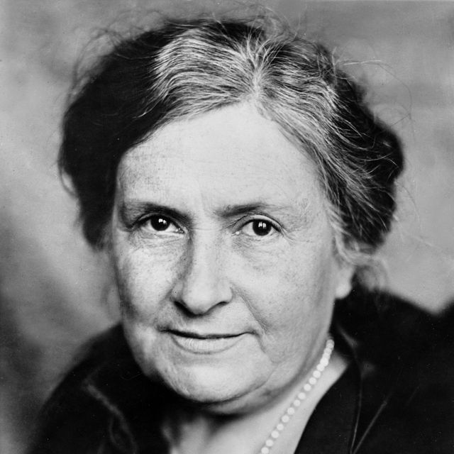
Introduction
Maria Montessori is a huge & influential figure in the field of child-hood education (Macblain, 2014).
She opened a children home in Rome and equipped children to develop their learning in a natural and individual way (Arthur and Peterson, 2013).
Education is child-centred, hands-on and collaborative (Ruhl, 2021).
Learning is a journey not a task (Macblain, 2014).
Freedom within limits (Rathunde, 2014).
Holistic learning theory
  physical, social, emotional and cognitive growth are equally important (Murray et al., 2022).
(Ulstein, 2014)

Slide 3
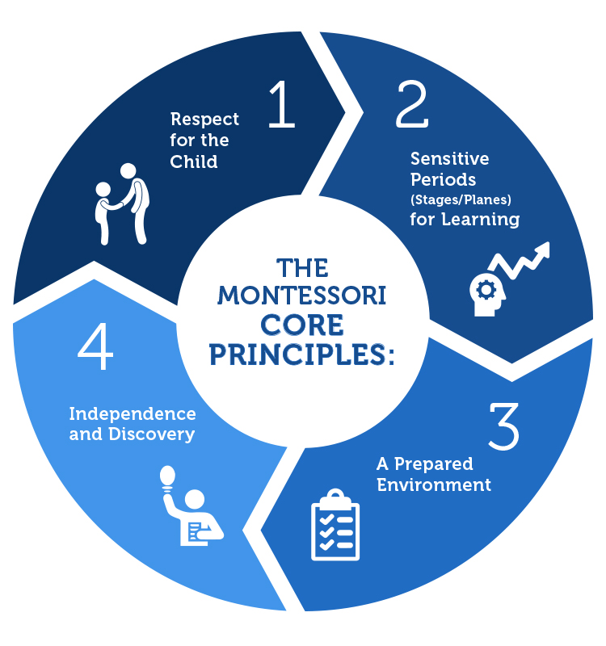
]
1. Child directed work – respect for the child.
Creating an interest + having a sense of control = improves children's learning (Özerem and Kavaz, 2013).
2. Sensitive period of learning
Children pass through four main stages/planes of development (May, n.d.).
Each stage provides a window for the child to develop a particular skill.
Window = sensitive period of learning (Wetherley, 2017).
3. A prepared environment
Environment can support their learning naturally (Arthur and Peterson, 2013).
Teachers = guardians of these environments. Changing and adjusting it to the individual needs and interests (Arthur and Peterson, 2013).
Natural environment = vital resource in Montessori education (Gray and Macblain, 2015).
4. Independence and discovery
Children are naturally interested and desire to become independent learners (Wetherley, 2017).
Created her own furniture and toys (Macblain, 2014).
1st plane = age 0-6 | 2nd plane = age 6-12 | 3rd plane = age 12-18 | 4th plane = age 18-24
Four core principles
of Montessori
(Sapientia, 2024)

Slide 4
How does Montessori’s theory support the development of skills and knowledge?
Aim 1:
Motor education
daily practical skills, that are essential for a child’s physical development
Repeated observation + demonstration = flawless movements (Özerem and Kavaz, 2013).
Aligns with the 3rd and 4th progression step of the Health and Wellbeing section of the Curriculum for Wales (Welsh Government, 2020).
Aim 2:
Affective Education
Children learn through their senses as well as cognitive stimulation (Arthur and Peterson, 2013).
Specific designed learning tools focused on the development of senses (Özerem and Kavaz, 2013).
Compare materials = observer, making decisions based on their experience and observation (Özerem and Kavaz, 2013).
Aligns with the 3rd and 4th progression step of the Expressive Art section of the curriculum for Wales (Welsh Government, 2020).
Aim 3:
Language Education
Creating an awareness - questioning the meaning = leading to better understanding & correct usage (Özerem and Kavaz, 2013).
Language development through structured questions, rather than casual conversation (Özerem and Kavaz, 2013).
Aligns with the 4th progression step in the Language, Literacy and Communication section of the curriculum for Wales. (Welsh Government, 2020).
(dressing, bathing, sweeping, nurturing pets and plants) (Özerem and Kavaz, 2013).

Slide 5
Criticisms of Montessori’s Theory
Some schools may simply be following a trend
  which can hugely influence the child's outcome (Robson and Franco, 2023).
Montessori's theory needs to adapt to social and technological change (Robson and Franco, 2023).
The open-ended structure of the classroom = intimidating for some children
  some children prefer routine and structure (Robson and Franco, 2023).
Montessori’s theory is not promoting children’s imaginations and creativity
  as she did not support role-play activities (Isaacs, 2018).

Slide 6
How is Montessori applying to the classroom
Individualised Instruction
Teachers observe each child individually
Multi-age grouping
Children ages 3-6 / 6-9 are grouped together
Uninterrupted blocks
Montessori day = broken into two- to three-hour chunks of time.
Fine motor skills & hand-eye coordination
Children are encouraged to:
It encourages leadership and social skills (Ruhl, 2021).
Engage in the learning process and master a variety of concepts (Sapientia, 2024).
create individual lessons (Cole, 2019).
wash their own dishes, dress themselves, do gardening, cleaning, and washing up (Ruhl, 2021).

Slide 7
How learning is assessed and planned - Montessori
The Welsh Governments intention is that the learners will become young adults that are : (Welsh government, 2017)
ambitious, capable learners, ready to learn throughout their lives
  Children are born with a natural ability and readiness to learn (Wetherley, 2017).
  Learning is something to be embraced and enjoyed (Gray and Macblain, 2015).
    Constantly adjust the environment - as that will awaken the child’s curiosity, interests and encourage independency (Arthur and Peterson, 2013).
enterprising, creative contributors, ready to play a full part in life and work.
  Children can explore using their imagination to build confidence, creativity and self-expression (Berg, 2021).
  The Montessori involves using Arts, Music, drama, poetry (Toadhall, 2024).
ethical, informed citizens of Wales and the world
  One whole section of the Montessori curriculum is just focussing on Culture & Understanding of the World (Toadhall, 2024).
healthy, confident individuals, ready to lead fulfilling lives as valued members of society
  holistic approach (physical, social, emotional and cognitive growth are equally important) (Wetherley, 2017)
  Independence and the ability to care for oneself = key principles of the Montessori philosophy (Macblain, 2014).

Slide 8
Conclusion
PIAGET | MONTESSORI
Cognitive constructivist | Child-centered Education
Encourages open-ended exploration, spontaneity, unstructured play | Specially designed furniture and hands-on material in a prepared environment will enhance the child’s sensory and cognitive development.
Emphasized the importance of cognitive development of the child. | Holistic learning theory – physical, social, emotional and cognitive growth – equally important.
Piaget identified distinct cognitive stages, highlighting the importance of age-appropriate learning experiences. | Montessori suggests four planes of development. Children pass them individually and progress at their own pace.

Slide 9
Reference list (Ludi)
Arthur, J. and Peterson, A. (2013). The Routledge Companion to Education. Routledge.
Berg, V. (2021). The Montessori method of education: A child-led approach. [online] Daynurseries.co.uk. Available at: https://www.daynurseries.co.uk/advice/the-montessori-method-of-education-a-child-led-approach [Accessed 27 Feb. 2024].
Cole, S. (2019). Reasons the Montessori Method Continues a Century after Being Developed. [online] blog.fms.org. Available at: https://blog.fms.org/reasons-the-montessori-method-continues-a-century-after-being-developed [Accessed 27 Feb. 2024].
Gray, C. and Macblain, S. (2015). Learning theories in childhood. 2nd ed. London: Sage.
Isaacs, B. (2018). Understanding the Montessori approach : early years education in practice. 2nd ed. Abingdon, Oxon ; New York, Ny: Routledge, p.99.
Macblain, S. (2014). How children learn. London: Sage Publications.
May, S. (n.d.). Maria Montessori. [online] Biola University. Available at: https://www.biola.edu/talbot/ce20/database/maria-montessori#:~:text=Montessori%20noted%20four%20planes%20of [Accessed 27 Feb. 2024].
Murray, A.K., Miller, M., Postlewaite, E.L. and Clark, K. (2022). Implementing the Montessori approach in an undergraduate marketing course: A case study. Frontiers in Education, [online] 7. doi:https://doi.org/10.3389/feduc.2022.1033752.
Özerem, A. and Kavaz, R. (2013). Montessori Approach in Pre-School Education and Its Effects. The Online Journal of New Horizons in Education, [online] 3(3). Available at: https://www.tojsat.net/journals/tojned/volumes/tojned-volume03-i03.pdf#page=18 [Accessed 27 Feb. 2024].
Rathunde, K. (2014). Understanding Optimal School Experience: Contributions from Montessori Education. Teachers College Record: the Voice of Scholarship in Education, 116(13), pp.253–274. doi:https://doi.org/10.1177/016146811411601317.
Robson, D. and Franco, A. (2023). Montessori: The world’s most influential school? [online] www.bbc.com. Available at: https://www.bbc.com/future/article/20230131-does-the-montessori-method-actually-work [Accessed 27 Feb. 2024].
Ruhl, C. (2021). Montessori method of education. [online] www.simplypsychology.org. Available at: https://www.simplypsychology.org/montessori-method-of-education.html [Accessed 27 Feb. 2024].
Sapientia (2024). What is Montessori? | Montessori Method. [online] Sapientia Montessori. Available at: https://sapientiamontessori.com/montessori/about-montessori/ [Accessed 27 Feb. 2024].
Toadhall (2024). Nursery 2-4 Years. [online] Toadhall Montessori Nurseries and Out Of School Academy. Available at: https://www.toadhallmontessorinurseries.co.uk/nursery-2-4-years/ [Accessed 27 Feb. 2024].
Ulstein (2014). Maria Montessori. Biography. Available at: https://www.biography.com/scholar/maria-montessori [Accessed 29 Feb. 2024].
Welsh Government (2020). Curriculum for Wales - Hwb. [online] hwb.gov.wales. Available at: https://hwb.gov.wales/curriculum-for-wales/ [Accessed 27 Feb. 2024].
Welsh government (2017). Education in Wales: Our national mission. Education Wales .
Wetherley, E. (2017). Montessori approach to learning · Grantham Farm Montessori School & The Children’s House. [online] Grantham Farm Montessori School & The Children’s House. Available at: https://montessorigranthamfarm.co.uk/about-us/montessori-approach-to-learning/ [Accessed 27 Feb. 2024].

