Slide 1
Electrical Engineering
(ACDA5001)
Lecture - 1

Slide 2
Content
What is Electricity?
Differentiate Electrical and Electronics
Voltage / Potential Difference
Current
Types of Current

Slide 3
Learning Outcome
The student upon completion of the lecture will be able to:
Define Electricity, Electronics, charge, Voltage and Current.
Differentiate Electrical and Electronics.
Define the types of current.
Define Voltage, current rating.

Slide 4
What is electricity?
A type of energy that occurs due to the movement of electrons or protons in an oscillating pattern.
It is the energy transported by the motion of electrons.
We do not make electricity; we convert other form of energy into electrical energy.

Slide 5
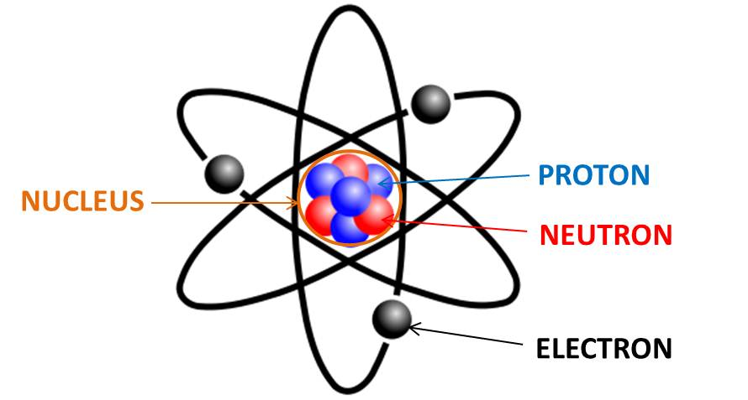
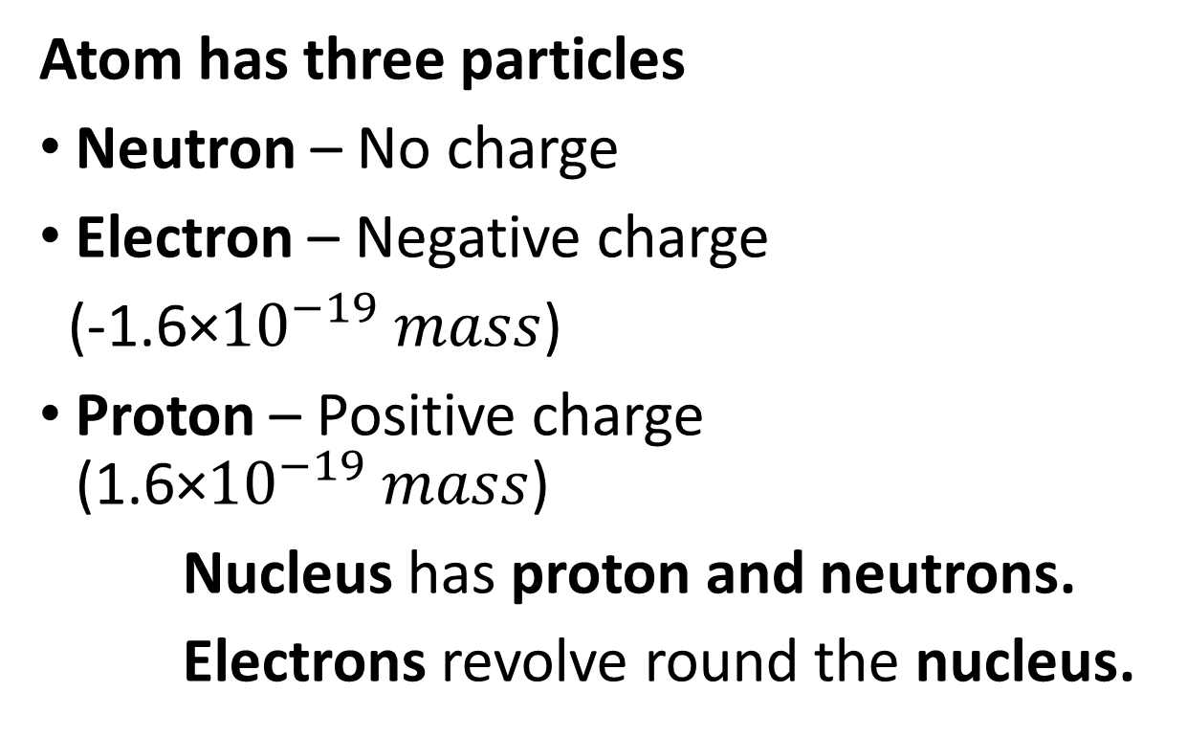
Atom
Atom has three particles
Neutron – No charge
Electron – Negative charge
(-1.6×${10}^{−19} mass$)
Proton – Positive charge (1.6×${10}^{−19} mass$)
Nucleus has proton and neutrons.
Electrons revolve round the nucleus.

Slide 6
Electric Charge
Charge (q)
Electric charge is the physical property of matter that causes it to experience a force when placed in an electromagnetic field.
Two basic charges
  - Positive and Negative
The unit of electric charge is Coulomb

Slide 7
Differentiate Electrical and Electronics
Sl. No | Electrical | Electronics
1 | Electrical devices work with high voltage and current (110V or 220 V or 420V etc) | Electronics devices work with low voltage and current. (3V, 5V, 8V, 12V etc.)
2 | Electrical devices does not control current and voltage | Electronic devices control current and voltage
3 | Electrical devices work with AC | Electronic devices work with DC
4 | Eg: Fan, Iron, Mixer grinder, Air conditioner, Refrigerator Microwave oven, etc.., | Eg: Mobile phone, laptop, etc

Slide 8
Voltage
Voltage is also called as electromotive force (EMF) or Potential difference
It is the quantitative expression of the potential difference in charge between two points in an electrical field.
Voltage is represented by (V) or (E)
The unit of voltage is Volts
The higher the voltage, the greater the flow of electrical current.

Slide 9
Voltage Rating
Voltage rating is defined as the maximum voltage an electrical appliances can withstand for a duration of time.
All the electrical equipments and components can withstand a particular amount of voltage, which is mentioned in the equipment.
WSJ Lecture

Slide 10
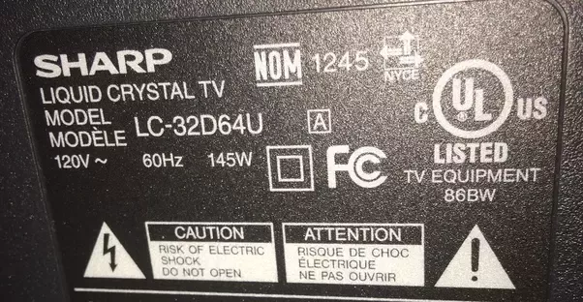
Voltage Rating
The Voltage rating of the SHARP TV is 120V Alternate Current.
If the Voltage increases above 120V, this projector may get damaged. So, it must be supplied with the rated voltage.

Slide 11
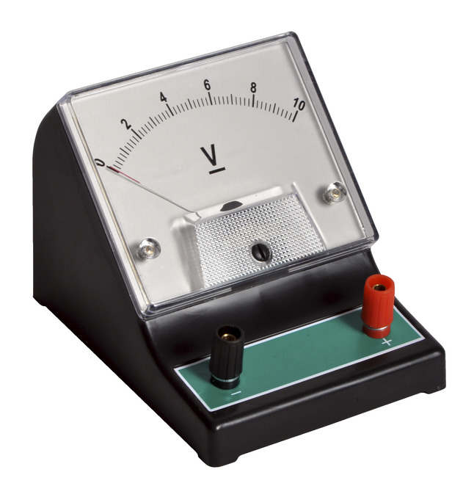
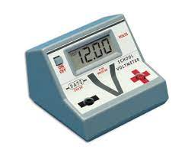
Voltmeter
Voltmeter is used for measuring the Voltage.
The voltage can be calculated using the formula
V=IR

Slide 12
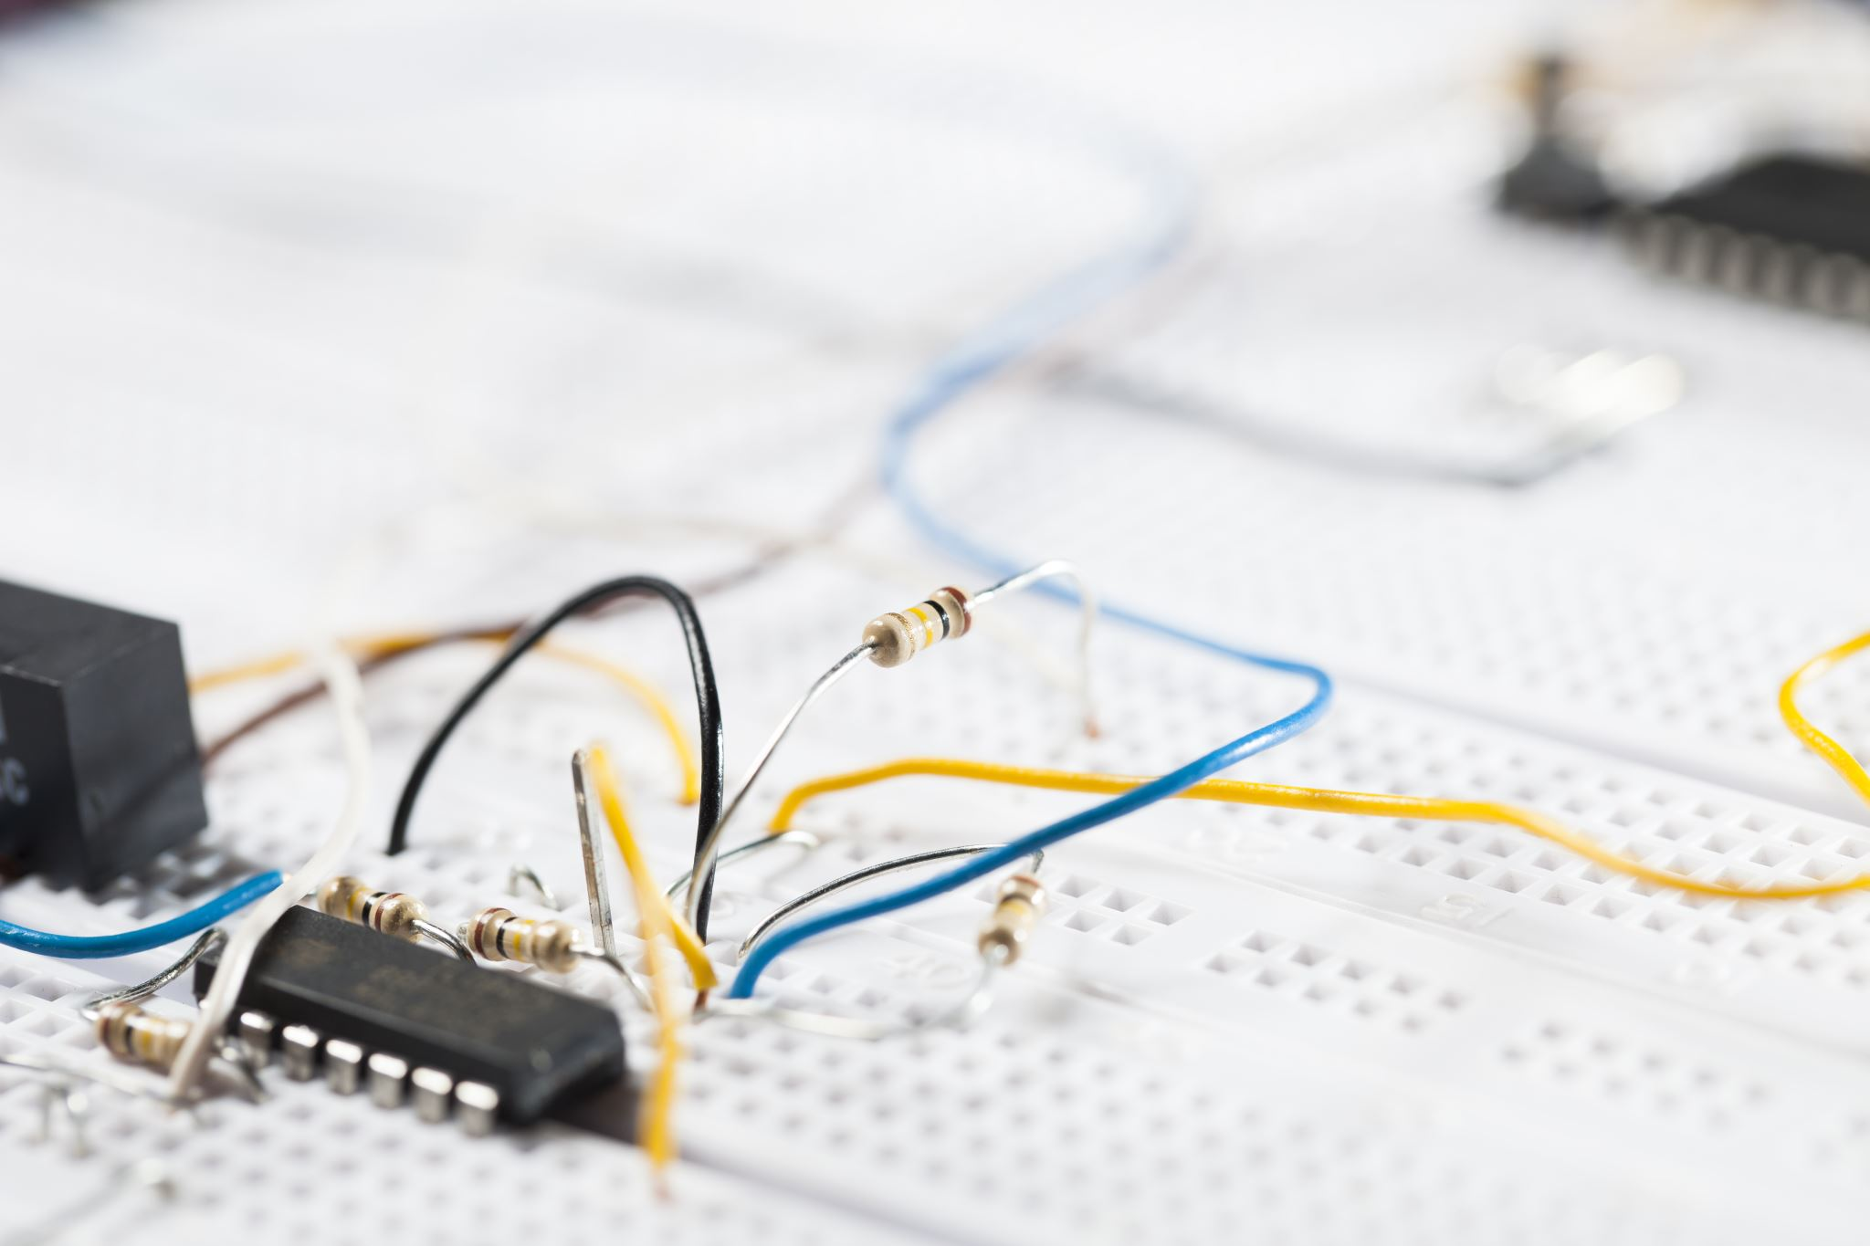
What is Electric Current?
Electric Current is defined as the flow of electric charge carriers in an electric circuit.
The charge carriers are usually electrons (negative charge) or holes (Positive charge).
The electric current is represented by (I).
The unit of Electric Current is ampere (A).

Slide 13
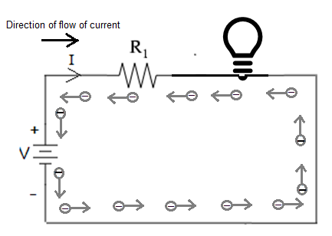
Direction of current flow
The direction of current flow is opposite to that of the direction of flow of charge particles.
WSJ Lecture

Slide 14
Types of Current
AC current (Alternating current)
DC current (Direct current)

Slide 15
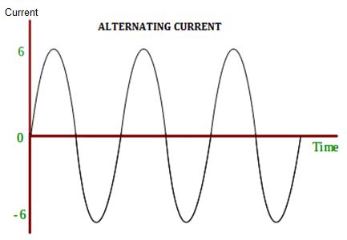
Alternating current
Alternating current is an electric current in which the flow of electric charge periodically reverses direction.
An AC waveform can be sinusoidal, square, or sawtooth-shaped. Some AC waveforms are irregular or complicated.
An example of sine-wave AC is common household utility current.

Slide 16
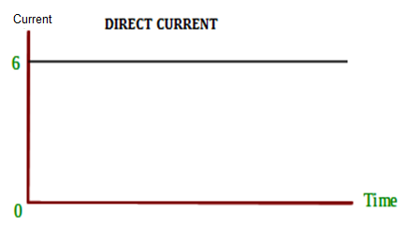
Direct Current
DC is the unidirectional flow or movement of electric charge carriers
The intensity of the current can vary with time, but the general direction of movement always stays the same.

Slide 17
Current Rating
Current rating is defined as the maximum current an electrical appliances can carry continuously for a duration of time with complete safety.
All the electrical equipment's and components can withstand a particular amount of current, which is mentioned in the equipment.

Slide 18
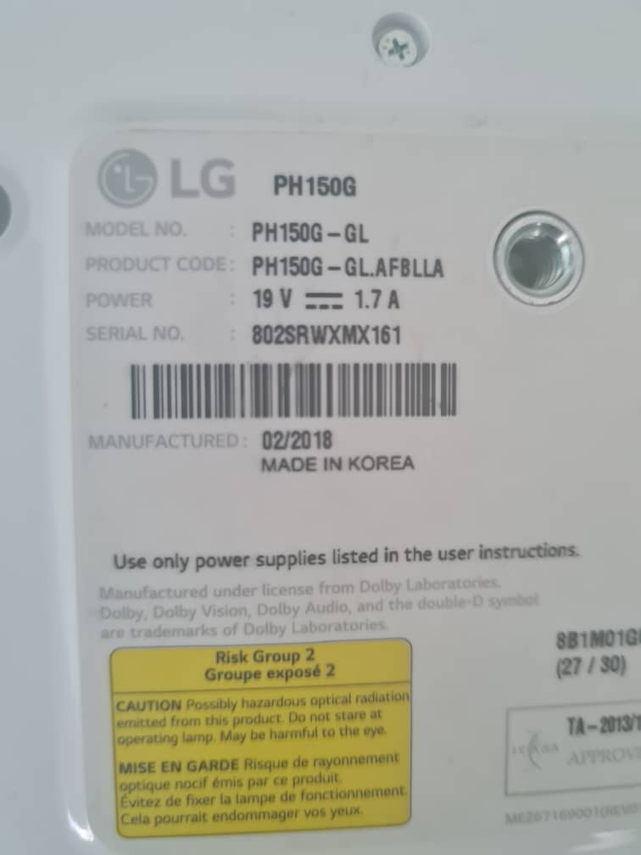
Current Rating
The Current rating of the LG projector is 1.7A Direct Current.
If the current increases above 1.7A, this projector may get damaged. So, it must be supplied with the rated current.
Resister are used to resist the flow of current, which helps the current to be with in the rated range.

Slide 19
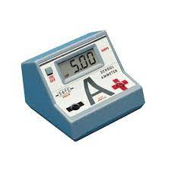
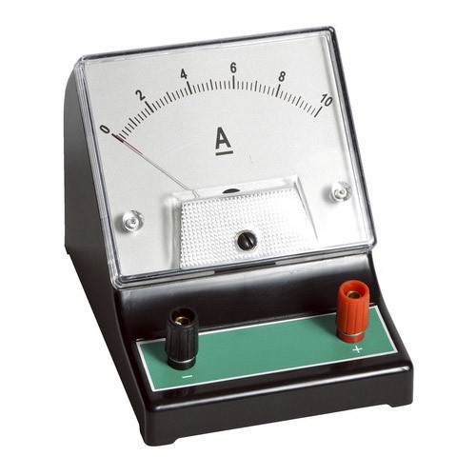
Ammeter
Ammeter is used for measuring the current .
The current can be calculated using the formula
I=V/R

Slide 20

Thank You
Notes:
Health and Safety module – coming soon on Moodle

