Slide 1
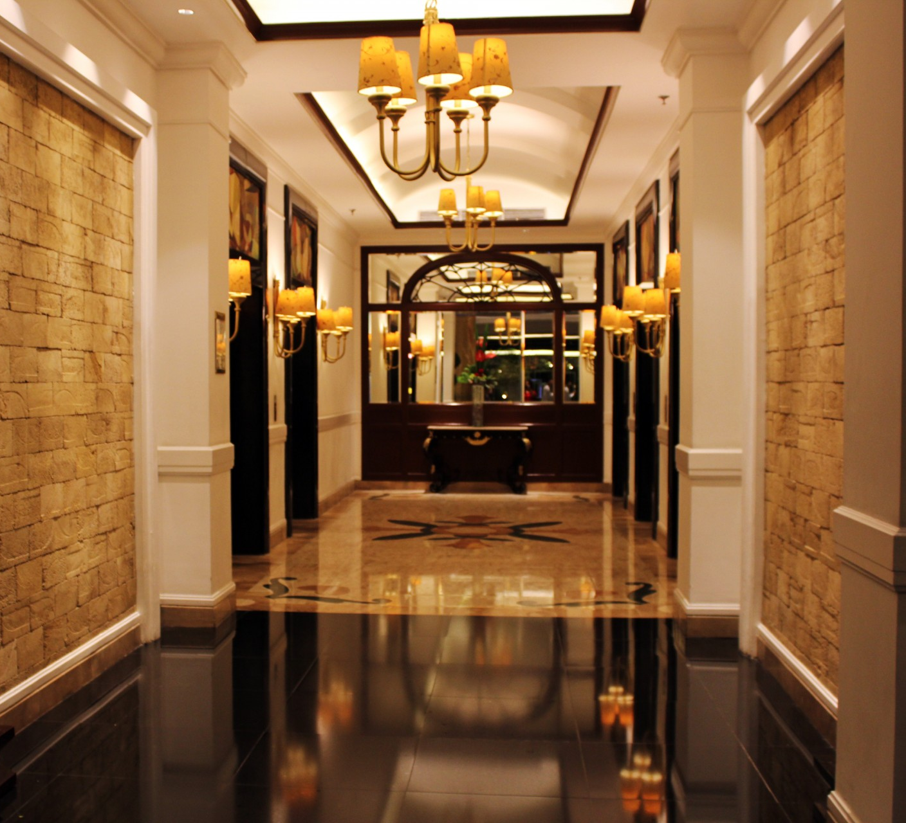
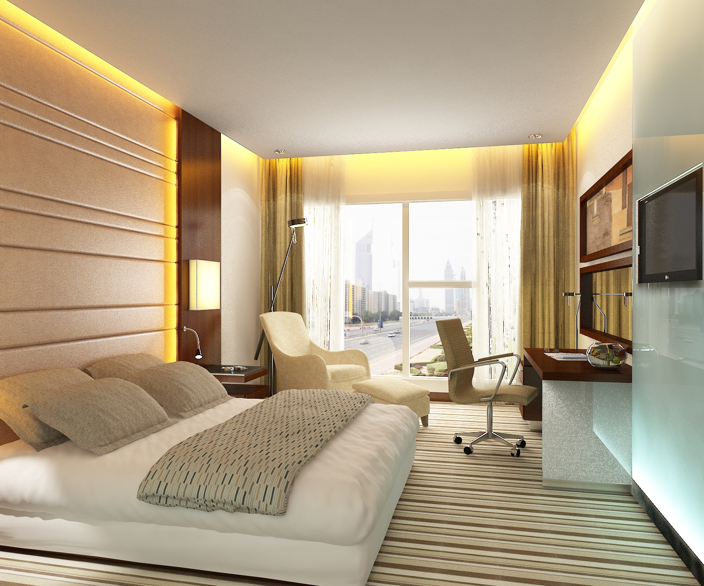
Operating Hotel Facilities
Presentation

Slide 2

Operating Hotel Facilities
Introduction
Setting up the welcoming products
Preparing clean bathrooms
Refilling the essentials
Making the bed properly
Cleaning mirrors, sinks, and showers
Mopping the floors
Going through cleaning and safety guidelines finally
Conclusion
References
TABLE OF CONTENTS
1…………………..Operating Hotel Facilities
3…………………..Introduction
4…………………..Setting up the welcoming products
5…………………..Preparing clean bathrooms
6…………………..Refilling the essentials
7…………………..Making the bed properly
8…………………..Cleaning mirrors, sinks, and showers
9…………………..Mopping the floors
10………..............Going through cleaning and safety guidelines finally
11…………………Conclusion
12…………………References

Slide 3
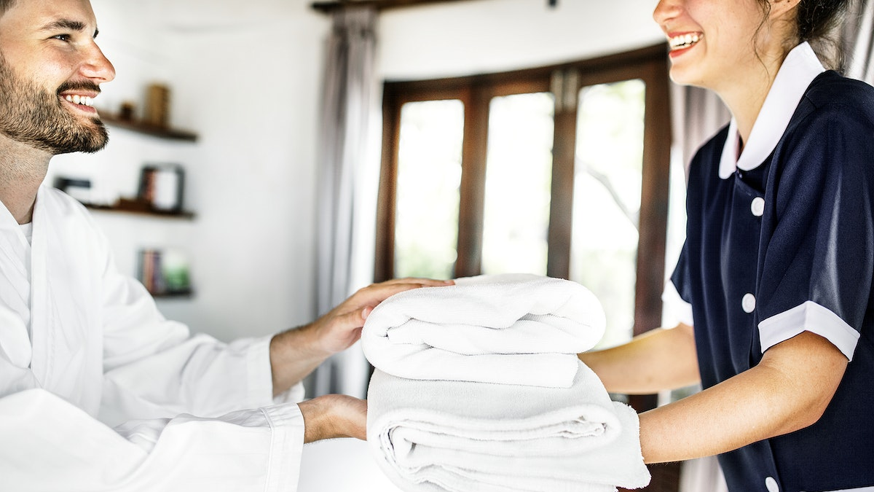
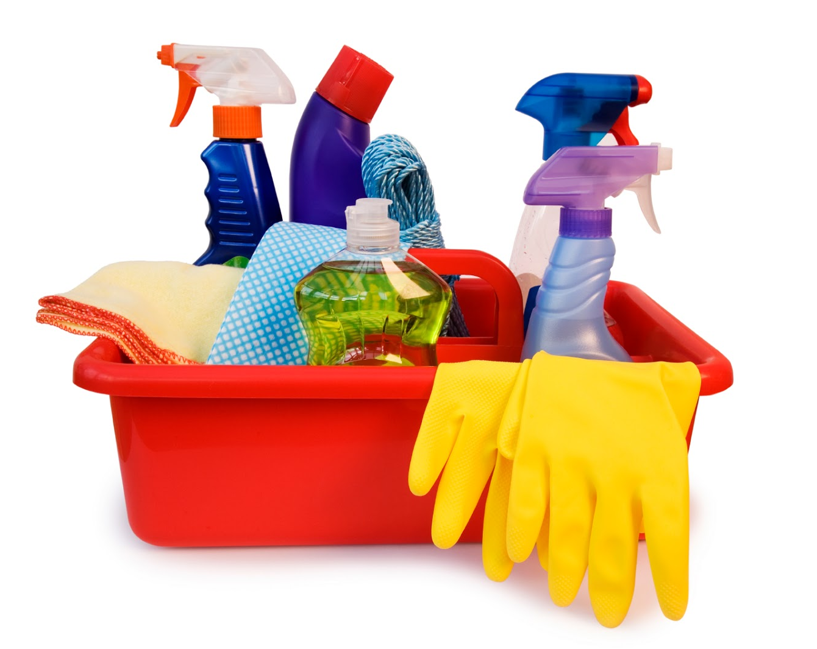
Introduction
Housekeeping within the hotel is one of the most important tasks for individuals.
It needs to be mentioned that the safety measures and hygiene level of the customers depend on this process.
It will analyse the effectiveness of the housekeeping checklist as well as the required actions thoroughly.
Sharon, 2022
Notes:
While the guests acknowledge any hotel, they basically look for enhanced customer service as well as an effective housekeeping process that will help the guests get an increased hygiene level within this process. The satisfaction level of individuals can be enhanced with the help of these operations. Here, the steps of a previously developed housekeeping checklist will be portrayed to understand its effectiveness.

Slide 4
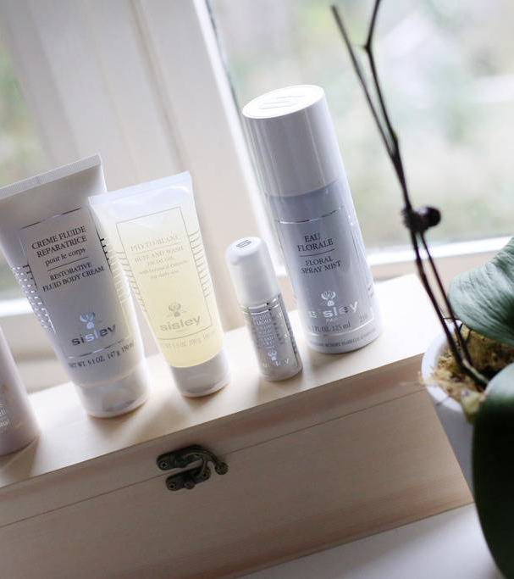
Setting up the welcoming products
The main aim of the hotels is to provide some innovative yet comfortable experiences for the guests.
Providing welcoming gifts can keep up the interest of the customers to get efficient service from the hotels (Charest, 2022).
However, after a guest’s check-out the employees need to be conscious of setting up various welcoming products particularly.
(Charest, 2022)
Notes:
The welcoming gifts from the part of the hotel are complimentary and special treatment for individuals. It needs to be mentioned that the hotels basically provide welcoming gifts in an innovative way so that it can attract the concern of individuals within the hotel effectively (Charest, 2022). The housekeeping needs to be concerned regarding the check-ins and check-outs of individuals so that they can set up the welcoming gifts according to the time.

Slide 5
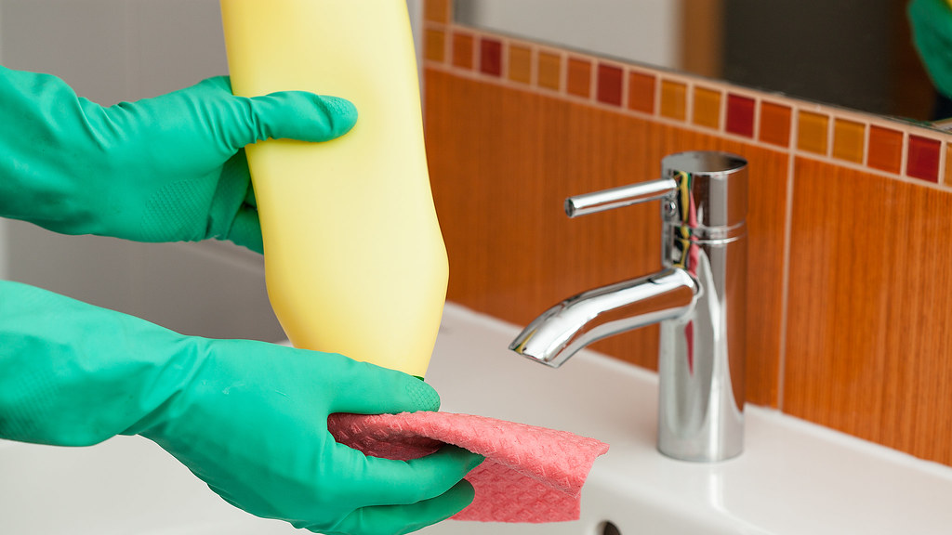
Preparing clean bathrooms
The maintenance of hygiene is one of the most important factors for housekeeping hotels.
The hygiene level in the bathroom needs to be maintained in an enhanced way.
It is the responsibility of the housekeeping teams to go through every area of the bathroom and make sure that everything is sealed before any guests enter the room (Sharon, 2023).
(Sharon, 2023)
Notes:
The bathrooms are the most essential part for every guest and it needs to be enhanced from the hygiene level of the hotel particularly (Sharon, 2023). The preparation of clean bathrooms and sealing them need to be done within time so that there will be no safety measures deficiency on the part of the housekeeping teams of the hotel.

Slide 6
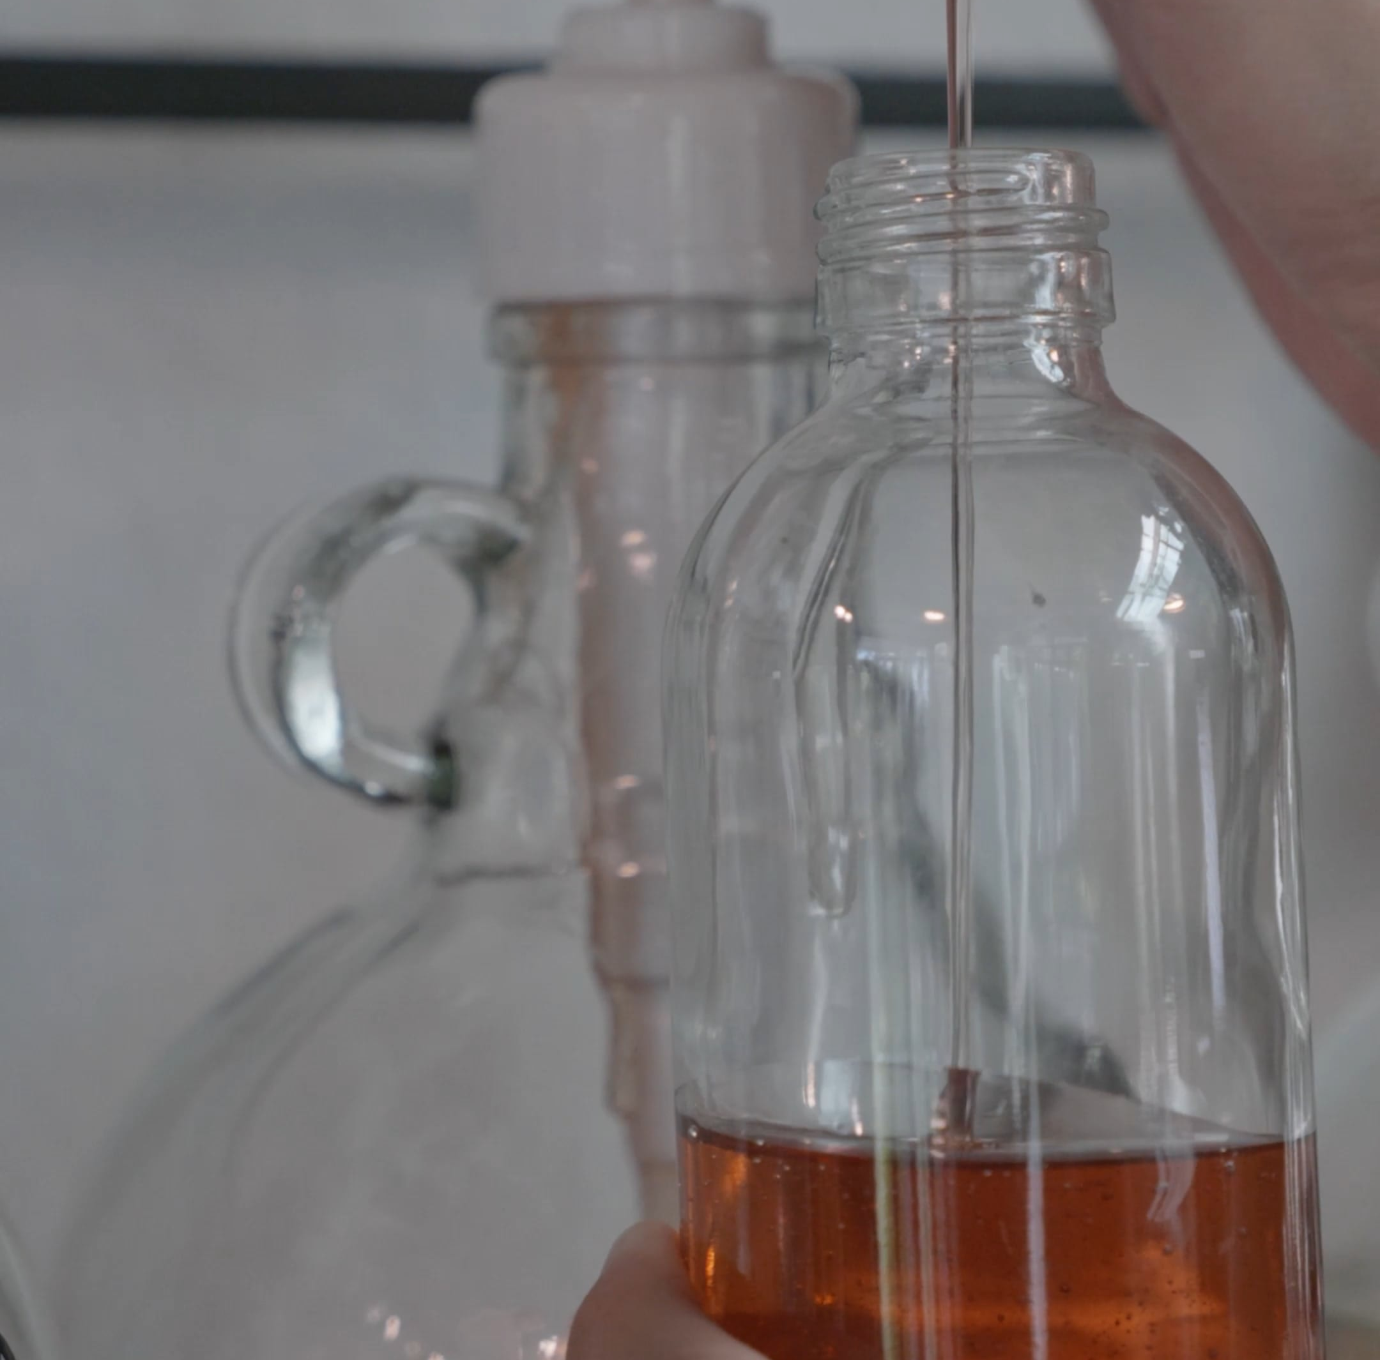
Refilling the essentials
First of all the quality of essentials provided by the hotels need to be enhanced in its nature (LePack, 2020).
These essentials should not contain any harmful ingredients in it.
Before entering the rooms, it is essential to get all provided essential to be filled up properly.
(LePack, 2020)
Notes:
All products provided by the hotels need to meet the requirements of the guests such as shampoo, soaps, and others. Thus, the housekeeping teams need to refill these essentials before handing over the rooms to the guests particularly. It will develop a periodic housekeeping service for individuals whenever they need any of the essentials (LePack, 2020).

Slide 7
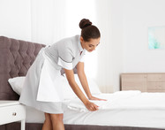
Making the bed properly
The beds need to be clean in nature significantly.
The bedsheet needs to be tucked in and the pillows have to be arranged in an effective way.
The bedsheets should be clean so that it can maintain the hygiene level of the room particularly (Crown Linen Services, 2018).
(Crown Linen Services, 2018)
Notes:
It is important that after the departure of every guest, the housekeeping team should take a certain time to make the beds in a neat and clean way. The bed sheets also need to be fresh and cleaned so that there will be no hygiene issues for the guests (Crown Linen Services, 2018). Every pillow must be in its place properly and arranged in an effective way.

Slide 8
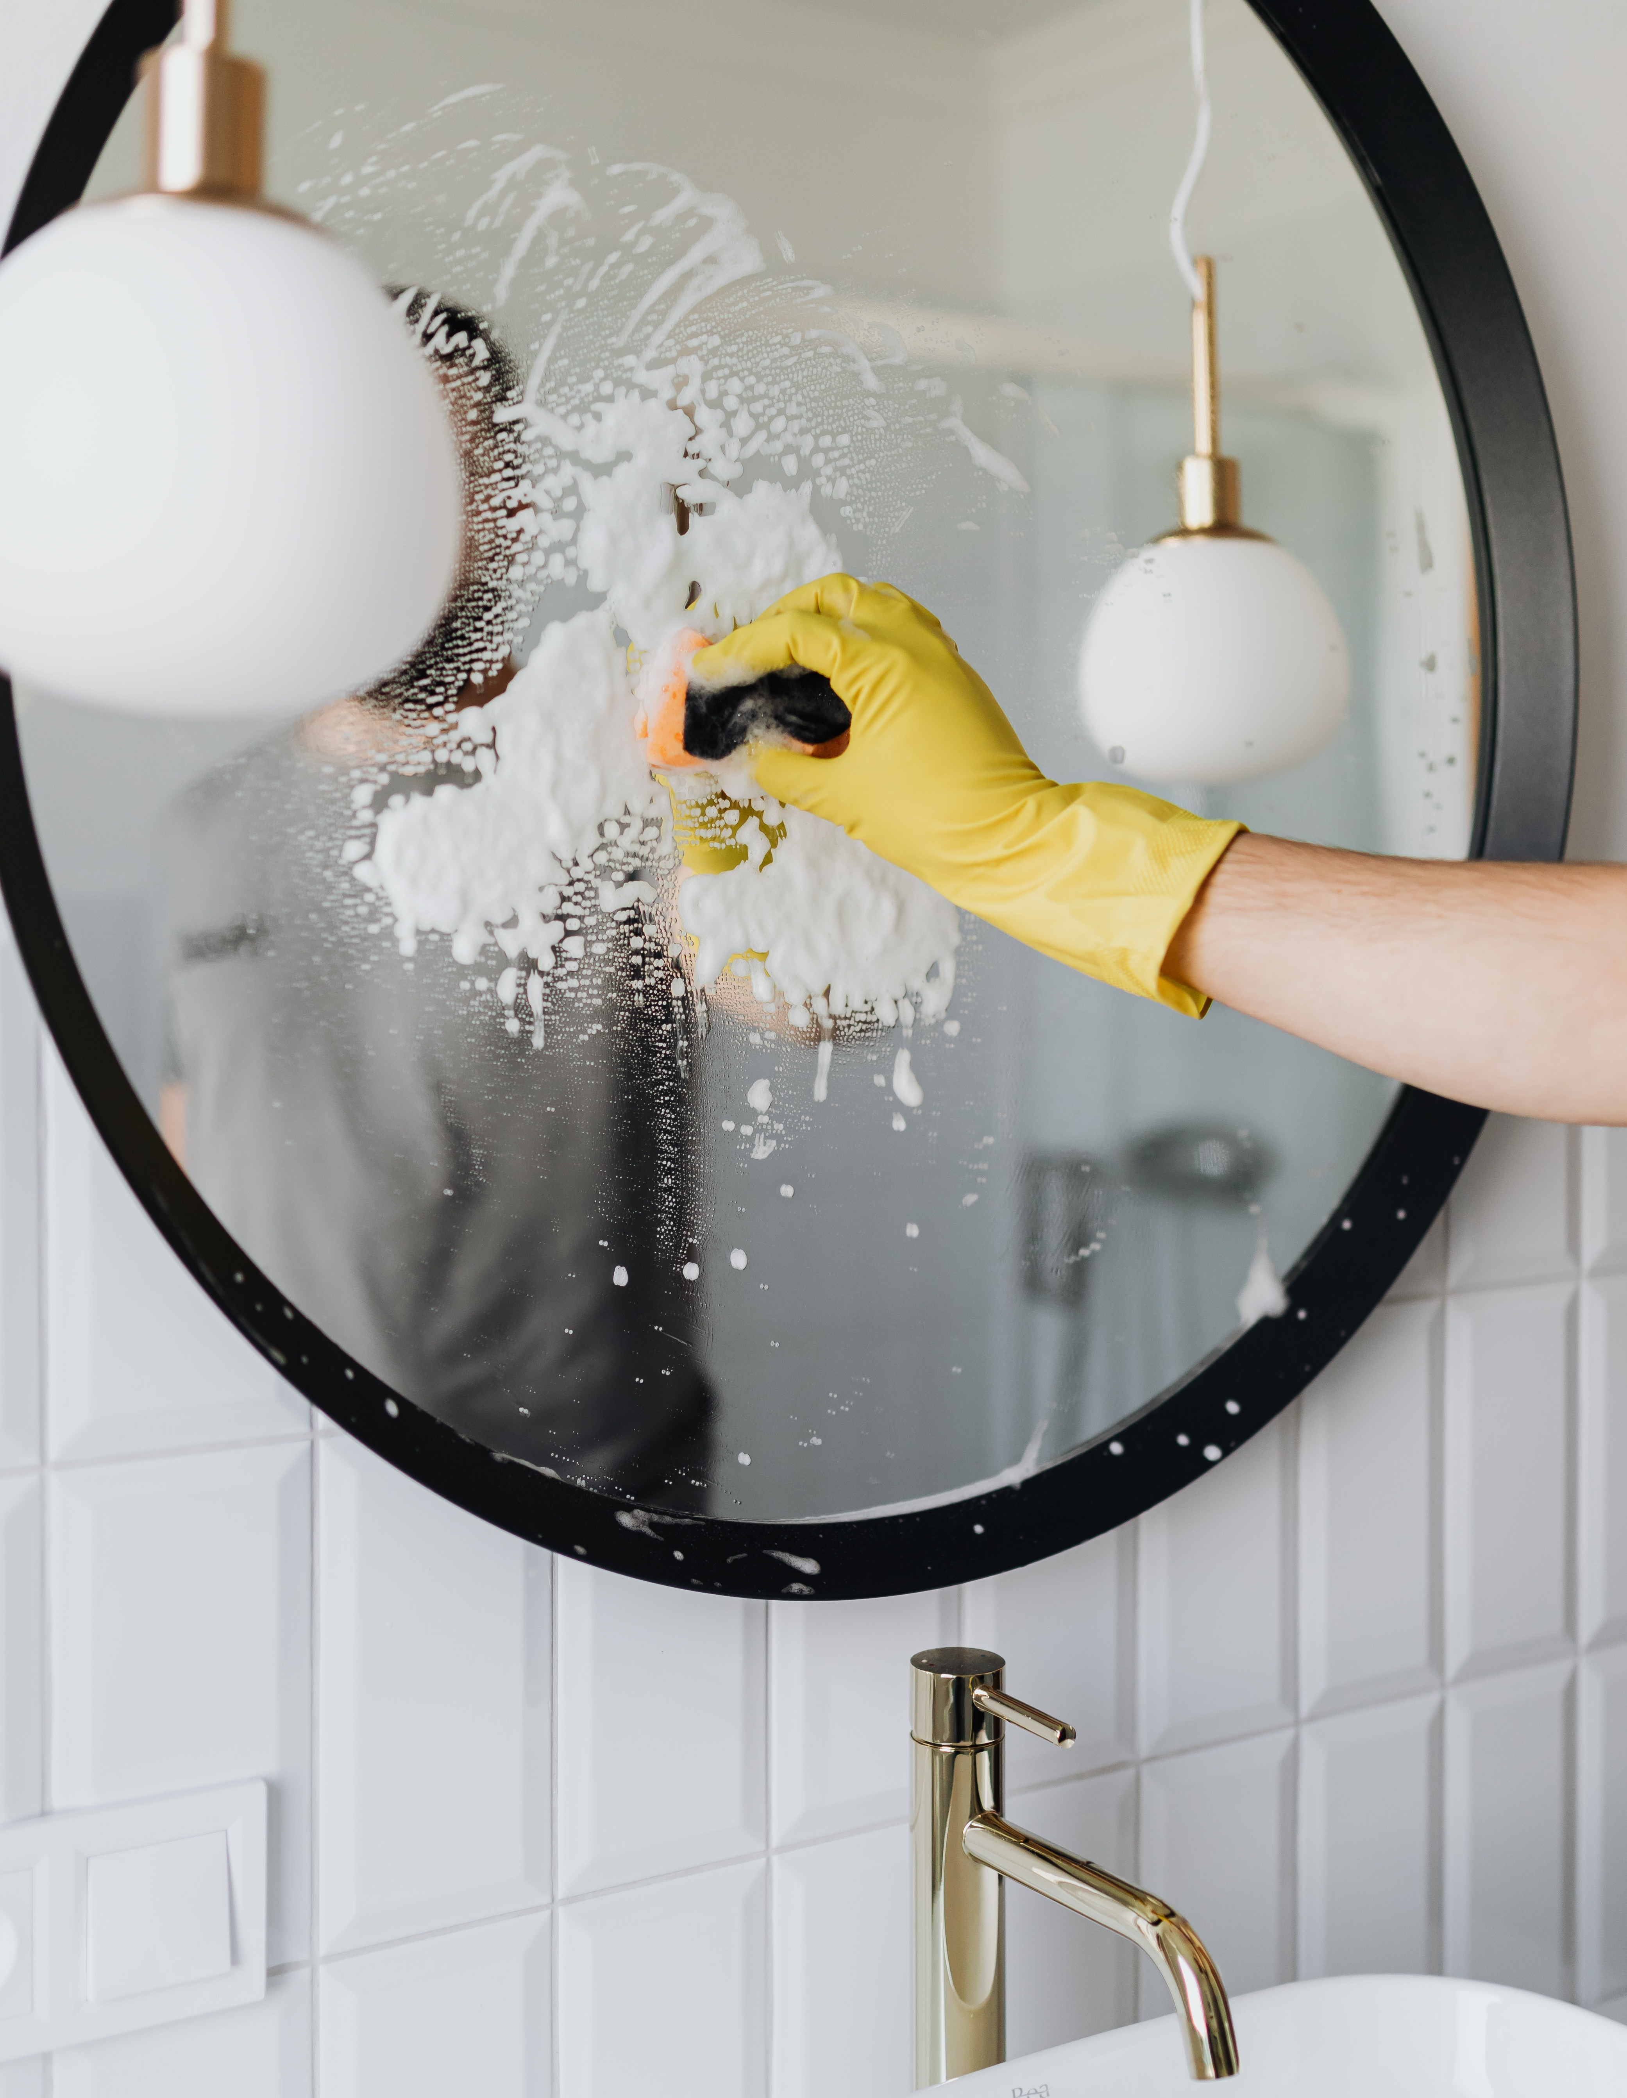
Cleaning mirrors, sinks, and showers
There should be a thorough cleaning process in every aspect that will reflect an active housekeeping process.
The showers and sinks need to be cleaned in an effective way (Hergiandari and Purnomo, 2023).
Additionally, there should not be any such marks on the mirrors and it should be maintained or altered accordingly.
(Hergiandari and Purnomo, 2023)
Notes:
Every aspect of the hotel needs to be observed in an enhanced way especially the cleaning process of every product (Hergiandari and Purnomo, 2023). It needs to be mentioned that the use of different aspects differs as per the guests so it is important to clean all the factors including showers and sinks properly. The mirrors need to be altered whenever there is a huge scratch or the reflection is not so effective.

Slide 9
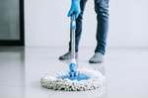
Mopping the floors
The floors of the corridor from where the guests will enter need to be vacuumed and mopped properly.
It needs to be mentioned that there should not be any dust on the floors of the hotel rooms.
The carpets also need to be vacuumed properly so that there will be no trash (Allread and Vossenas, 2022).
(Allread and Vossenas, 2022)
Notes:
Mopping the floors can ensure the disinfection process within the hotels as well as in the corridors. It needs to be mentioned that there can be children of guests and they can be on the surface of the hotel rooms. Hence, it is essential for the housekeeping teams to ensure the disinfection process of the floors effectively (Allread and Vossenas, 2022).

Slide 10
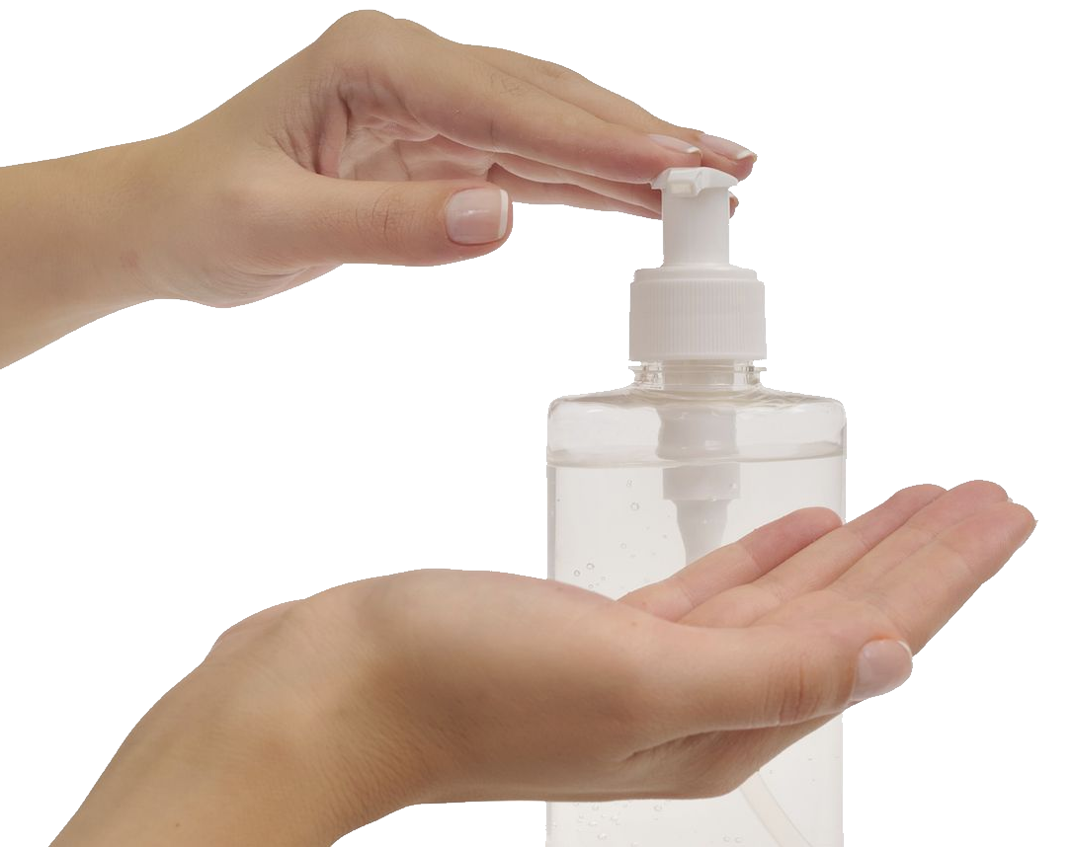
Sanitising different products
After the pandemic situation, sanitisation is one of the most important activities within the hotel rooms (Aguilar-Escobar et al., 2021).
The housekeepers need to provide sanitiser in the rooms previously.
In addition to this, every product and essential needs to be sanitised before any guests enter the room.
(Aguilar-Escobar et al., 2021)
Notes:
The maintenance of hygiene standards is the major objective of any hotel particularly. However, there should be sanitizer in the hotel rooms along with sanitisation process needs to be observed effectively within every area of the room (Aguilar-Escobar et al., 2021).

Slide 11
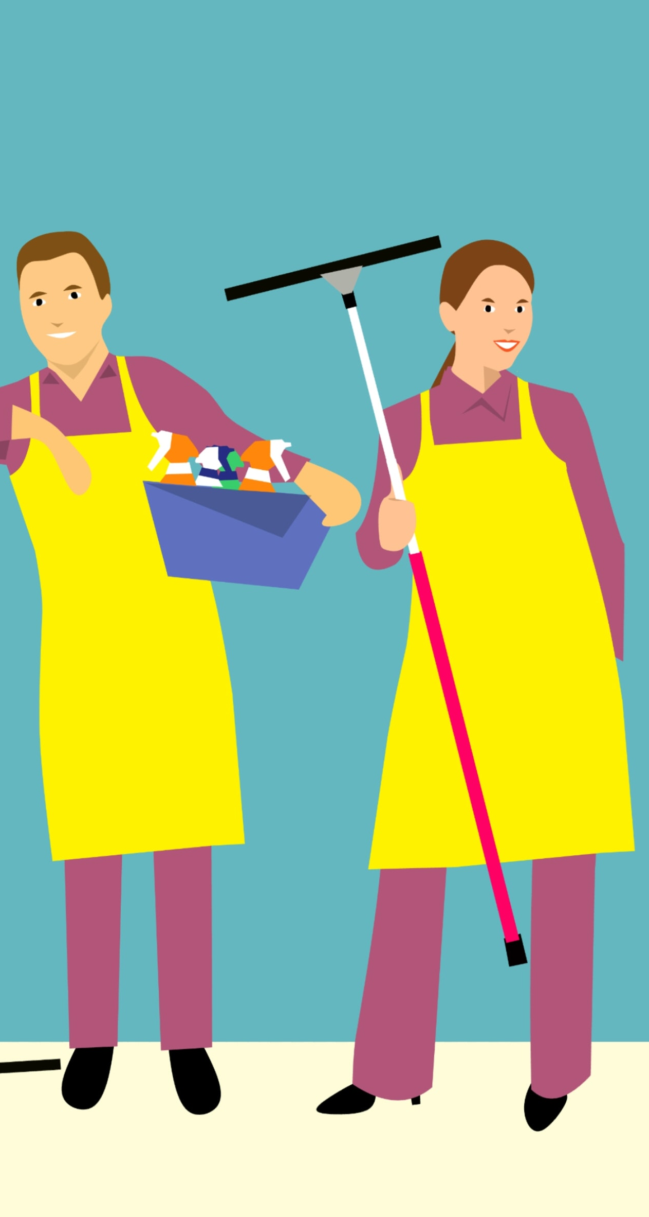

Conclusion
There are many activities included within the housekeeping checklist.
It is important to observe every part of the hotel rooms properly.
The satisfaction level of the guests is directly associated with this process.
(Pillai et al., 2021)
Notes:
The above analysis has mentioned the required actions for every area of the hotel rooms including the corridors. There should be safety hazards so that the safety and hygiene standard can be catered as per the requirements of the guests.

Slide 12

References
Aguilar-Escobar, V.G., Garrido-Vega, P., Majado-Márquez, J. and Camuñez-Ruiz, J.A., (2021). Hotel room cleaning: Time study and analysis of influential variables in a Spanish hotel. Journal of Industrial Engineering and Management, 14(3), pp.645-660.
Allread, W.G. and Vossenas, P., (2022). Comparisons of Trunk Motions and Low Back Injury Risk between Alternative Hotel Room Cleaning Methods. International Journal of Environmental Research and Public Health, 19(22), p.14907.
Charest, D. (2022). How to Set Up an Effective Automated Welcome Email Series | Constant Contact. [online] Available at: https://www.constantcontact.com/blog/automated-welcome-series/ [Accessed 15 Oct. 2023].
Sharon (2023). 15 Reasons Why You Should Deep Clean Your Bathroom. [online] Available at: https://howtogetorganizedathome.com/15-reasons-why-you-should-deep-clean-your-bathroom/ [Accessed 15 Oct. 2023]
LePack (2020). All The Essentials A Hotel Room Should Provide [online] Available at: https://www.lepack.com.au/all-the-essentials-a-hotel-room-should-provide/ [Accessed 15 Oct. 2023].
Crown Linen Services (2018). Hotel Bed Making Tips - Crown Hospitality Linen Services. [online] Available at: https://crownlinen.com/blog/hotel-bed-making-tips/ [Accessed 15 Oct. 2023].
Hergiandari, G. and Purnomo, D.J., (2023). The Role Of Room Attendants In Increasing The Comfort Quality Of Guest Rooms At Artotel Gajahmada Hotel Semarang. International Journal of Education, Language, Literature, Arts, Culture, and Social Humanities, 1(3), pp.156-167.
Pillai, S.G., Haldorai, K., Seo, W.S. and Kim, W.G., (2021). COVID-19 and hospitality 5.0: Redefining hospitality operations. International Journal of Hospitality Management, 94, p.102869
(Allread and Vossenas, 2022)
Notes:
Pillai, S.G., Haldorai, K., Seo, W.S. and Kim, W.G., (2021). COVID-19 and hospitality 5.0: Redefining hospitality operations. International Journal of Hospitality Management, 94, p.102869.
Aguilar-Escobar, V.G., Garrido-Vega, P., Majado-Márquez, J. and Camuñez-Ruiz, J.A., (2021). Hotel room cleaning: Time study and analysis of influential variables in a Spanish hotel. Journal of Industrial Engineering and Management, 14(3), pp.645-660.
Allread, W.G. and Vossenas, P., (2022). Comparisons of Trunk Motions and Low Back Injury Risk between Alternative Hotel Room Cleaning Methods. International Journal of Environmental Research and Public Health, 19(22), p.14907.
Charest, D. (2022). How to Set Up an Effective Automated Welcome Email Series | Constant Contact. [online] Available at: https://www.constantcontact.com/blog/automated-welcome-series/ [Accessed 15 Oct. 2023].
Sharon (2023). 15 Reasons Why You Should Deep Clean Your Bathroom. [online] Available at: https://howtogetorganizedathome.com/15-reasons-why-you-should-deep-clean-your-bathroom/ [Accessed 15 Oct. 2023]
LePack (2020). All The Essentials A Hotel Room Should Provide [online] Available at: https://www.lepack.com.au/all-the-essentials-a-hotel-room-should-provide/ [Accessed 15 Oct. 2023].
Crown Linen Services (2018). Hotel Bed Making Tips - Crown Hospitality Linen Services. [online] Available at: https://crownlinen.com/blog/hotel-bed-making-tips/ [Accessed 15 Oct. 2023].
Hergiandari, G. and Purnomo, D.J., (2023). The Role Of Room Attendants In Increasing The Comfort Quality Of Guest Rooms At Artotel Gajahmada Hotel Semarang. International Journal of Education, Language, Literature, Arts, Culture, and Social Humanities, 1(3), pp.156-167.

