Slide 1
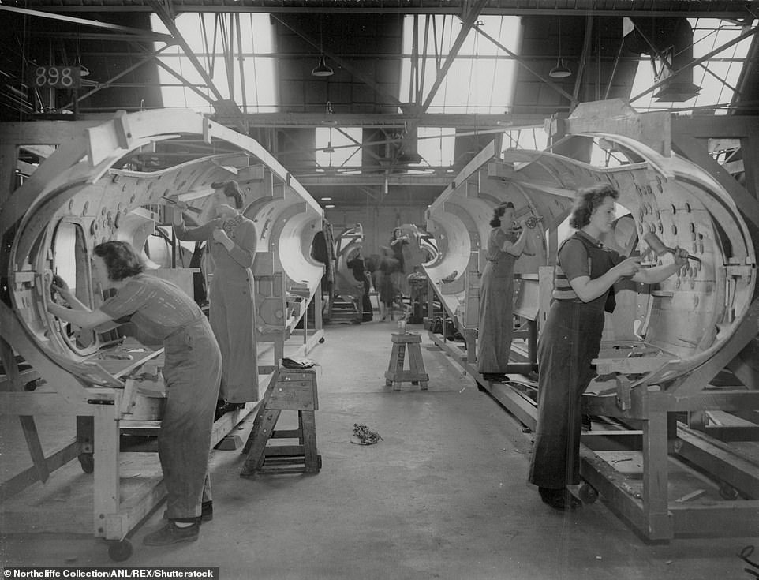
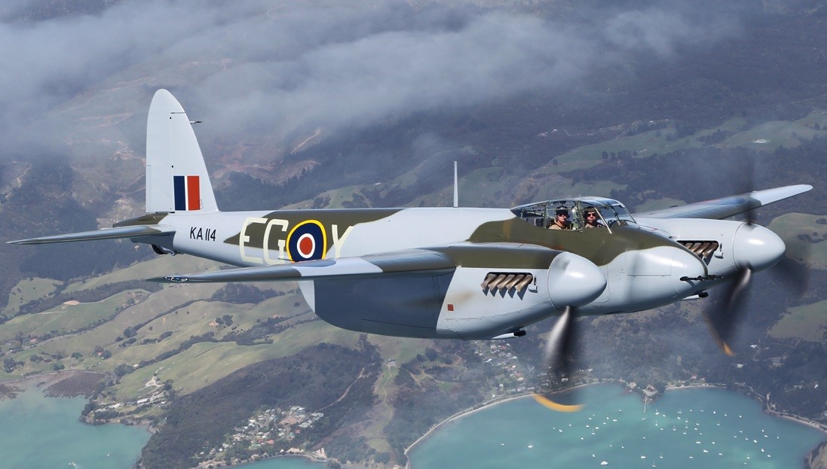
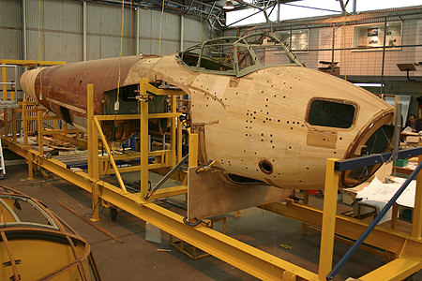
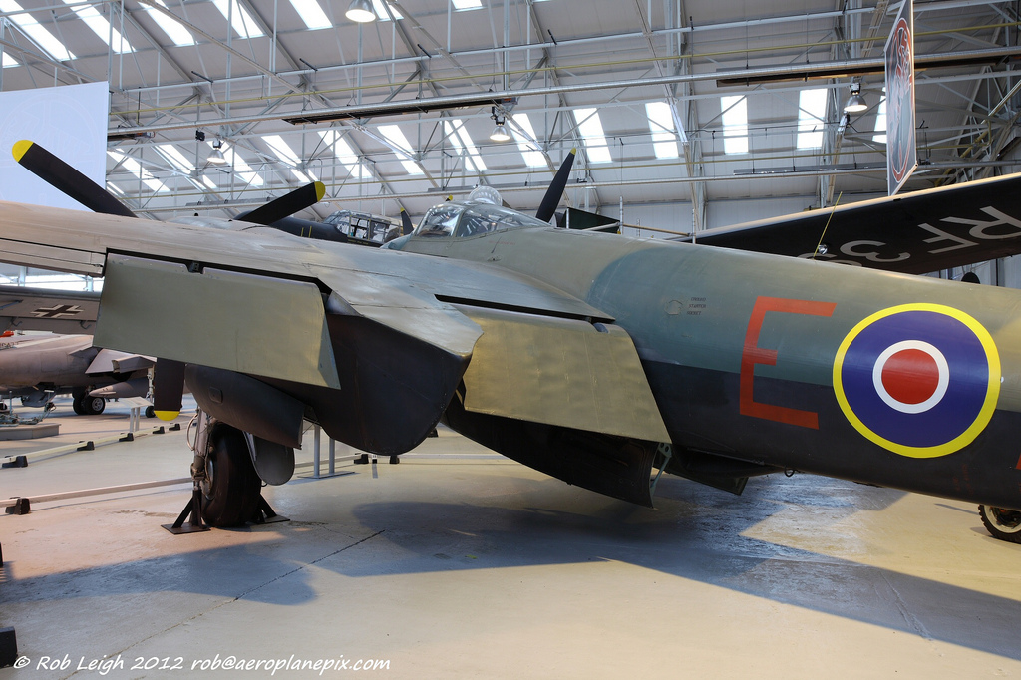

De Havilland Mosquito
How important is Authenticity in the Restoration of Historic Aircraft as Memorials?
How does value change with time?
  1940 1950 1960 1970 1980 1990 2000 2010 2020
___________________________________________________________________________________________
£5000 £10000 £7 £5Million £5-8 Million
(fuselage)
Cost of Aircraft over time
Restoration to Flight with New-Build Airframe
Composite Restoration
Static restoration with original parts
2012
1990
Name: Tim Kirk
Student No: 1710839
Module: HPHE5003
1965

