Slide 1
Flowcharts and Control Structures
Lecture 4: Analysing and Solving Problems (ASP)

Slide 2
So far
Problem solving cycle
Computational thinking
Pseudocode

Slide 3
Today’s Lecture
Combining Strings in Pseudocode
Flowcharts
Control Structures
Using Trace Tables

Slide 4
Combining Strings in Pseudocode
Here is the pseudocode to the Bank Deposit problem:
Display “What is your account number?”
Input accountNumber
Set customerBalance = 50.00
Display “Your current balance is:”
Display customerBalance
Display “How much would you like to deposit?”
Input depositAmount
Set newBalance = customerBalance + depositAmount
Display “You paid in:”
Display depositAmount
Display “Your new balance is:”
Display newBalance
What is your account number?
123456 [Enter]
Your current balance is:
50.00
How much would you like to deposit?
20.00 [Enter]
You paid in:
20.00
Your new balance is:
70.00

Slide 5
Combining Strings in Pseudocode
You can combine a message string and a variable value on one line in pseudocode.
  As long as both lines are for output i.e. Display …
For example, for the following pseudocode:
    Display “How much would you like to deposit?”
    Input depositAmount
    Display “You paid in: ”
    Display depositAmount
Lines 3 and 4 can be combined by separating the strings with a comma as follows:
    Display “You paid in: ”, depositAmount

Slide 6
Combining Strings in Pseudocode
Shorter example, combining strings:
    Display “What is your account number?”
    Input accountNumber
    Set customerBalance = 50.00
    Display “Your current balance is: ”, customerBalance
    Display “How much would you like to deposit?”
    Input depositAmount
    Set newBalance = customerBalance + depositAmount
    Display “You paid in: ”, depositAmount
    Display “Your new balance is: ”, newBalance

Slide 7
Combining Strings in Pseudocode
Shorter example, combining strings:
    …
    Display “Your current balance is: ”, customerBalance
    Display “How much would you like to deposit?”
    Input depositAmount
    Set newBalance = customerBalance + depositAmount
    Display “You paid in: ”, depositAmount
    Display “Your new balance is: ”, newBalance
What is your account number?
123456 [Enter]
Your current balance is: 50.00
How much would you like to deposit?
20.00 [Enter]
You paid in: 20.00
Your new balance is: 70.00

Slide 8
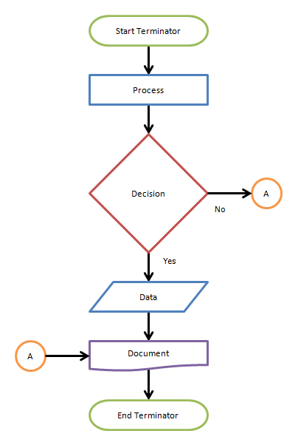
What is a Flowchart?
A flowchart is a visual representation of a process or algorithm.
It shows the sequence of steps to solve a problem.
Helps programmers and non-programmers understand logic flow easily.

Slide 9
Flowcharts
A diagram that visually shows the steps to take in a computer problem solution.
It is an alternative method of showing the logical flow of steps for a solution.
It uses connected symbols to show the sequence of steps, any repetition and alternative steps.
Some people find flowcharts easier than writing pseudocode for algorithms.
And many use a combination of both.

Slide 10
Importance of Flowcharts
Simplifies complex problems.
Facilitates program design and debugging.
Serves as documentation for program logic.
Enables collaboration among developers.
Helps in tracing logic errors before coding.

Slide 11
Rules for Drawing Flowcharts
Start from top to bottom or left to right.
Use arrows to show flow direction.
Keep it simple and readable.
Use decision diamonds for branching (Yes/No).
Always have a Start and End.

Slide 12
Basic Flowchart Symbols
Symbol | Name | Description
 | Terminator | Used to indicate the start or end
 | Input/output | Represents an input or output operation
 | Process | Represents processes e.g. a calculation, initialising (setting) variables
 | Decision | Represents a branch point i.e. different alternatives
 | Connector | An entry to, or from a particular step. Commonly used if the flowchart cannot fit on one page.

Slide 13
Flowchart Examples
We will look at creating flowcharts for the pseudocode examples and exercises from the last lecture.

Slide 14
Pseudocode: Tip Calculator Problem
Pseudocode
Possible output (input shown in bold)
Display “What is the Bill Amount?”
Input billAmount
Display “What tip amount would you like to give?”
Input tipAmount
Set totalBillAmount = billAmount + tipAmount
Display “You chose to pay the following tip:”
Display tipAmount
Display “Your final, total bill amount to pay is:”
Display totalBillAmount
What is the Bill Amount?
500 [Enter]
What tip amount would you like to give?
10 [Enter]
You chose to pay the following tip:
10
Your final, total bill amount to pay is:
510

Slide 15
Exercises
Walkthrough Demonstration

Slide 16
Control Structures

Slide 17
Comparison Operators
It is common practice to compare things in computing.
Comparison operators enable us to do that, they return a True or False value.
Enable logic in the computer

Slide 18
Comparison Operators
Operator | Name
= | Equals | True if two values are the same 5 = 5 is True, 4 = 5 is False
> | Greater than | True if value on left is greater than value on the right. 4 > 5 = True, 5 > 4 is False
< | Less than | True if value on left is smaller than value on the right. 4 < 5 = True, 5 < 4 is False
>= | Greater than or equal to | True if value on left is greater than or equal to value on the right.
<= | Less than or equal to | True if value on left is smaller than or the same as the value on the right.
<> | Not equal to | True if the two values are not the same. 5 <> 4 is True, 5 <> 5 is False

Slide 19
What are Control Structures?
Control structures determine the order in which instructions are executed.
They define the logical flow of a program.
Three main types:
Sequence
Selection
Iteration (Looping)

Slide 20
Control Structures
What if we wanted to make the following changes to the simple algorithms we have been writing:
  In the Student Credits problem, if student has a enough credits display a congratulations message, otherwise display credits left
  The Shopping Basket Calculator: allow the user to enter any number of Item prices they want.
We need control structures!

Slide 21
Control Structures
So far we have looked at simple solutions to problems.
They start at a beginning and continue in a sequential order (one-step after the other).
In computing, this is usually not enough to describe the steps of a solution.
There are three main types of control when defining the order of steps in a computer solution:
  Sequence
  Selection
  Repetition

Slide 22
Sequence
This is what we have been doing so far.
Start at a beginning and execute steps one after the other in sequence (serial) order.
Statement 1
Statement 2
Statement 3

Slide 23
Selection (Decision)
Choose the statement (branch) to executive is selected based on a condition.
The Selection statement is also called a Branch or Decision
Condition = True?
if Condition = True:
print(”Statement 2")
Eles if Condition = Fales:
print(”Statement 1")
No
Yes
Statement 1
Statement 2

Slide 24
Selection (Decision) A Simple Example
Start
Is it Raining?
No
Yes
Go to the Cinema
Go to the Beach
Finish

Slide 25
Selection
You can have multiple branches in a Selection control statement.
For example
Option = A, B or C?
A
C
B
Statement 1
Statement 2
Statement 3

Slide 26
Pseudocode and Control Structures
We know how to write pseudocode for Sequence statements.
What about for Selection and Repetition?

Slide 27
Pseudo code - Selection
Scenario 1
  A system prompts for a number and the then display whether it is an odd or an even

Slide 28
Possible Answer
Display “Enter a number ?”
Input num
IF (num%2) ==0 THEN
Display “Even number”
ELSE
Display “Odd number”
END IF
condition

Slide 29
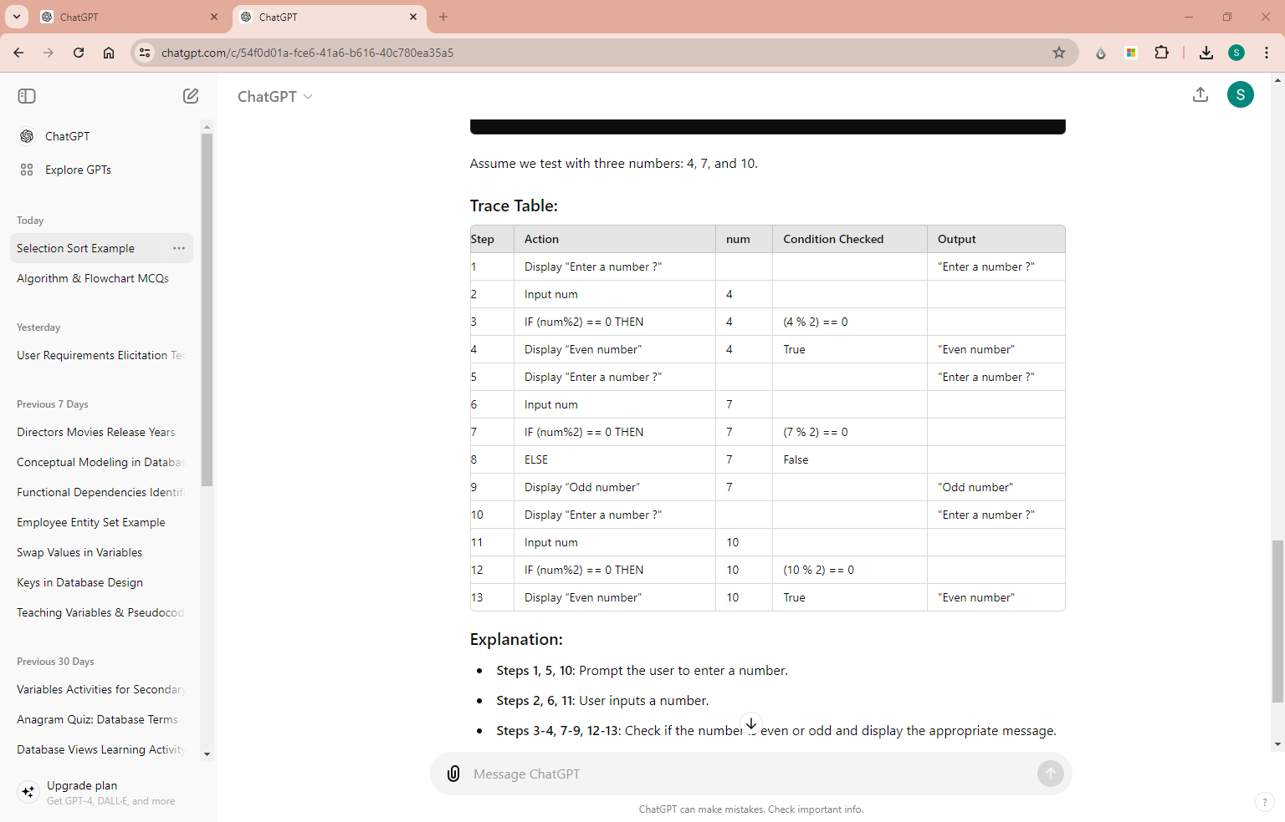
Possible Answer & Trace Table
Display “Enter a number ?”
Input num
IF (num%2) ==0 THEN
Display “Even number”
ELSE
Display “Odd number”
END IF
test with three numbers: 4, 7, and 10

Slide 30
Possible Answer & Trace Table
test with three numbers: 4, 7, and 10.
Display “Enter a number ?”
Input num
IF (num%2) ==0 THEN
Display “Even number”
ELSE
Display “Odd number”
END IF

Slide 31
Possible Answer & Trace Table
test with three numbers: 4, 7, and 10.
Display “Enter a number ?”
Input num
IF (num%2) ==0 THEN
Display “Even number”
ELSE
Display “Odd number”
END IF

Slide 32
Possible Answer & Trace Table
test with three numbers: 4, 7, and 10.
Display “Enter a number ?”
Input num
IF (num%2) ==0 THEN
Display “Even number”
ELSE
Display “Odd number”
END IF

Slide 33
Possible Answer & Trace Table
test with three numbers: 4, 7, and 10.
Display “Enter a number ?”
Input num
IF (num%2) ==0 THEN
Display “Even number”
ELSE
Display “Odd number”
END IF

Slide 34
Possible Answer & Trace Table
test with three numbers: 4, 7, and 10.
Display “Enter a number ?”
Input num
IF (num%2) ==0 THEN
Display “Even number”
ELSE
Display “Odd number”
END IF

Slide 35
Possible Answer & Trace Table
test with three numbers: 4, 7, and 10.
Display “Enter a number ?”
Input num
IF (num%2) ==0 THEN
Display “Even number”
ELSE
Display “Odd number”
END IF

Slide 36
Pseudo code - Selection
Scenario 2
  A student enters a mark and system predicts the grade based on the following scheme
  0 to 40 -> F
  41 to 60 ->D
  61 to 70 -> C
  71 to 80 -> B
  81 to 100 -> A

Slide 37
Possible Answer
Display “Enter a mark ?”
Input mark
IF (mark >= 0 and mark <=40)
Display “F”
ELSE IF (mark >= 41 and mark <=60) THEN
Display “D”
ELSE IF (mark >= 61 and mark <=70) THEN
Display “C”
ELSE IF (mark >= 71 and mark <=80) THEN
Display “B”
ELSE IF (mark >= 81 and mark <=100) THEN
Display “A”
END IF
Condition 1
Condition 2
Condition 3
Condition 4
Condition 5
Notes:
Now what happens if the user enters ‘105’ or a negative number?

Slide 38
Possible Answer
Display “Enter a mark ?”
Input mark
IF (mark >= 0 and mark <=40)
Display “F”
ELSE IF (mark >= 41 and mark <=60) THEN
Display “D”
ELSE IF (mark >= 61 and mark <=70) THEN
Display “C”
ELSE IF (mark >= 71 and mark <=80) THEN
Display “B”
ELSE IF (mark >= 81 and mark <=100) THEN
Display “A”
END IF
Now what happens if the user enters ‘105’ or a negative number?
Notes:
Now what happens if the user enters ‘105’ or a negative number?
range from causing syntax errors in some languages

Slide 39
Possible Answer
Display “Enter a mark ?”
Input mark
IF (mark >= 0 and mark <=40)
Display “F”
ELSE IF (mark >= 41 and mark <=60) THEN
Display “D”
ELSE IF (mark >= 61 and mark <=70) THEN
Display “C”
ELSE IF (mark >= 71 and mark <=80) THEN
Display “B”
ELSE IF (mark >= 81 and mark <=100) THEN
Display “A”
ELSE
Display "Invalid mark"
END IF
Now what happens if the user enters ‘105’ or a negative number?
Notes:
Now what happens if the user enters ‘105’ or a negative number?
range from causing syntax errors in some languages

Slide 40
Possible Answer
Display “Enter a mark ?”
Input mark
IF (mark >= 0 and mark <=40)
Display “F”
ELSE IF (mark >= 41 and mark <=60) THEN
Display “D”
ELSE IF (mark >= 61 and mark <=70) THEN
Display “C”
ELSE IF (mark >= 71 and mark <=80) THEN
Display “B”
ELSE IF (mark >= 81 and mark <=100) THEN
Display “A”
ELSE
Display "Invalid mark"
END IF
consider various inputs to cover all cases: 35, 50, 65, 75, 90, and an invalid mark 105 and complete the trace table
Notes:
Now what happens if the user enters ‘105’ or a negative number?
range from causing syntax errors in some languages

Slide 41
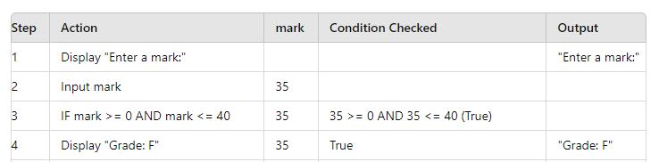
Possible Answer
Display “Enter a mark ?”
Input mark
IF (mark >= 0 and mark <=40)
Display “F”
ELSE IF (mark >= 41 and mark <=60) THEN
Display “D”
ELSE IF (mark >= 61 and mark <=70) THEN
Display “C”
ELSE IF (mark >= 71 and mark <=80) THEN
Display “B”
ELSE IF (mark >= 81 and mark <=100) THEN
Display “A”
ELSE
Display "Invalid mark"
END IF
consider various inputs to cover all cases: 35, 50, 65, 75, 90, and an invalid mark 105 and complete the trace table
Notes:
Now what happens if the user enters ‘105’ or a negative number?
range from causing syntax errors in some languages

Slide 42
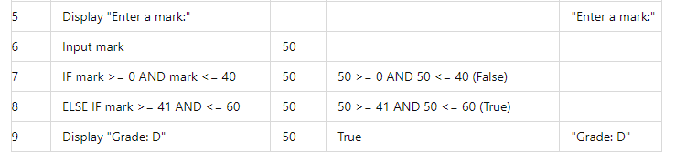
Possible Answer
Display “Enter a mark ?”
Input mark
IF (mark >= 0 and mark <=40)
Display “F”
ELSE IF (mark >= 41 and mark <=60) THEN
Display “D”
ELSE IF (mark >= 61 and mark <=70) THEN
Display “C”
ELSE IF (mark >= 71 and mark <=80) THEN
Display “B”
ELSE IF (mark >= 81 and mark <=100) THEN
Display “A”
ELSE
Display "Invalid mark"
END IF
consider various inputs to cover all cases: 35, 50, 65, 75, 90, and an invalid mark 105 and complete the trace table
Notes:
Now what happens if the user enters ‘105’ or a negative number?
range from causing syntax errors in some languages

Slide 43
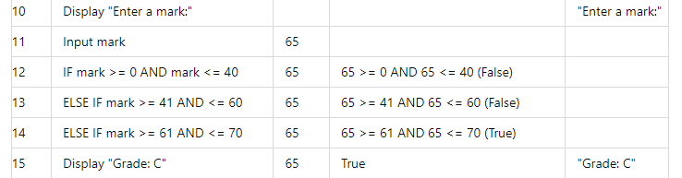
Possible Answer
Display “Enter a mark ?”
Input mark
IF (mark >= 0 and mark <=40)
Display “F”
ELSE IF (mark >= 41 and mark <=60) THEN
Display “D”
ELSE IF (mark >= 61 and mark <=70) THEN
Display “C”
ELSE IF (mark >= 71 and mark <=80) THEN
Display “B”
ELSE IF (mark >= 81 and mark <=100) THEN
Display “A”
ELSE
Display "Invalid mark"
END IF
consider various inputs to cover all cases: 35, 50, 65, 75, 90, and an invalid mark 105 and complete the trace table
Notes:
Now what happens if the user enters ‘105’ or a negative number?
range from causing syntax errors in some languages

Slide 44
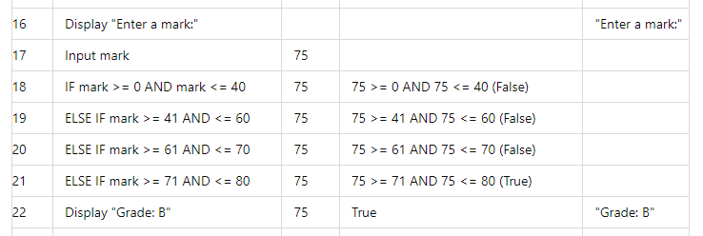
Possible Answer
Display “Enter a mark ?”
Input mark
IF (mark >= 0 and mark <=40)
Display “F”
ELSE IF (mark >= 41 and mark <=60) THEN
Display “D”
ELSE IF (mark >= 61 and mark <=70) THEN
Display “C”
ELSE IF (mark >= 71 and mark <=80) THEN
Display “B”
ELSE IF (mark >= 81 and mark <=100) THEN
Display “A”
ELSE
Display "Invalid mark"
END IF
consider various inputs to cover all cases: 35, 50, 65, 75, 90, and an invalid mark 105 and complete the trace table
Notes:
Now what happens if the user enters ‘105’ or a negative number?
range from causing syntax errors in some languages

Slide 45
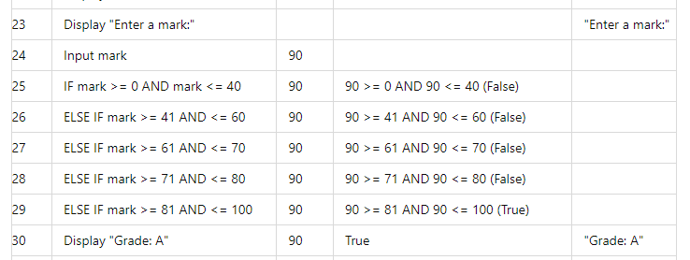
Possible Answer
Display “Enter a mark ?”
Input mark
IF (mark >= 0 and mark <=40)
Display “F”
ELSE IF (mark >= 41 and mark <=60) THEN
Display “D”
ELSE IF (mark >= 61 and mark <=70) THEN
Display “C”
ELSE IF (mark >= 71 and mark <=80) THEN
Display “B”
ELSE IF (mark >= 81 and mark <=100) THEN
Display “A”
ELSE
Display "Invalid mark"
END IF
consider various inputs to cover all cases: 35, 50, 65, 75, 90, and an invalid mark 105 and complete the trace table
Notes:
Now what happens if the user enters ‘105’ or a negative number?
range from causing syntax errors in some languages

Slide 46
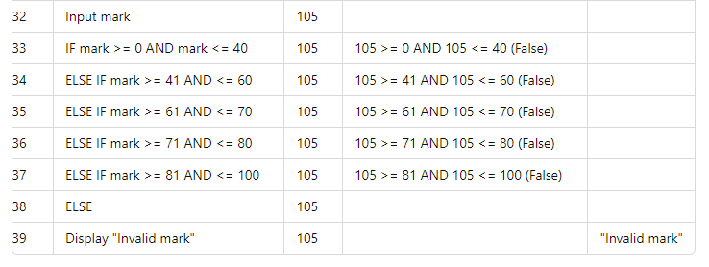
Possible Answer
Display “Enter a mark ?”
Input mark
IF (mark >= 0 and mark <=40)
Display “F”
ELSE IF (mark >= 41 and mark <=60) THEN
Display “D”
ELSE IF (mark >= 61 and mark <=70) THEN
Display “C”
ELSE IF (mark >= 71 and mark <=80) THEN
Display “B”
ELSE IF (mark >= 81 and mark <=100) THEN
Display “A”
ELSE
Display "Invalid mark"
END IF
consider various inputs to cover all cases: 35, 50, 65, 75, 90, and an invalid mark 105 and complete the trace table
Notes:
Why the validation check is not an efficient code?

Slide 47
Possible Answer
Display “Enter a mark ?”
Input mark
IF mark < 0 OR mark > 100 THEN
Display "Invalid mark"
ELSE IF (mark >= 0 and mark <=40)
Display “F”
ELSE IF (mark >= 41 and mark <=60) THEN
Display “D”
ELSE IF (mark >= 61 and mark <=70) THEN
Display “C”
ELSE IF (mark >= 71 and mark <=80) THEN
Display “B”
ELSE IF (mark >= 81 and mark <=100) THEN
Display “A”
END IF
consider various inputs to cover all cases: 35, 50, 65, 75, 90, and an invalid mark 105 and complete the trace table
Notes:
The first IF statement checks if the entered mark is less than 0 or greater than 100. If true, it displays "Invalid mark" and the program ends there without proceeding to check for grades.

Slide 48
Repetition
Repeat statements one or more times
Also called a Loop
Needs a stop condition i.e. when to stop repeating the loop
Two types:
Statement 1
Condition = True?
Yes
Statement 1
Condition = True?
Yes
No
No

Slide 49
Repetition A Simple Example
Start
Pick Film to Watch
Is Film Rating > 4*?
Yes
No
Pay to watch film
Pick Another Film to Watch
Stop

Slide 50
Guess the Output using trace table
Display(“Enter a text you like to repeat”)
Input text
Set counter = 0
While counter < 5
Display text
counter = counter + 1
END While

Slide 51
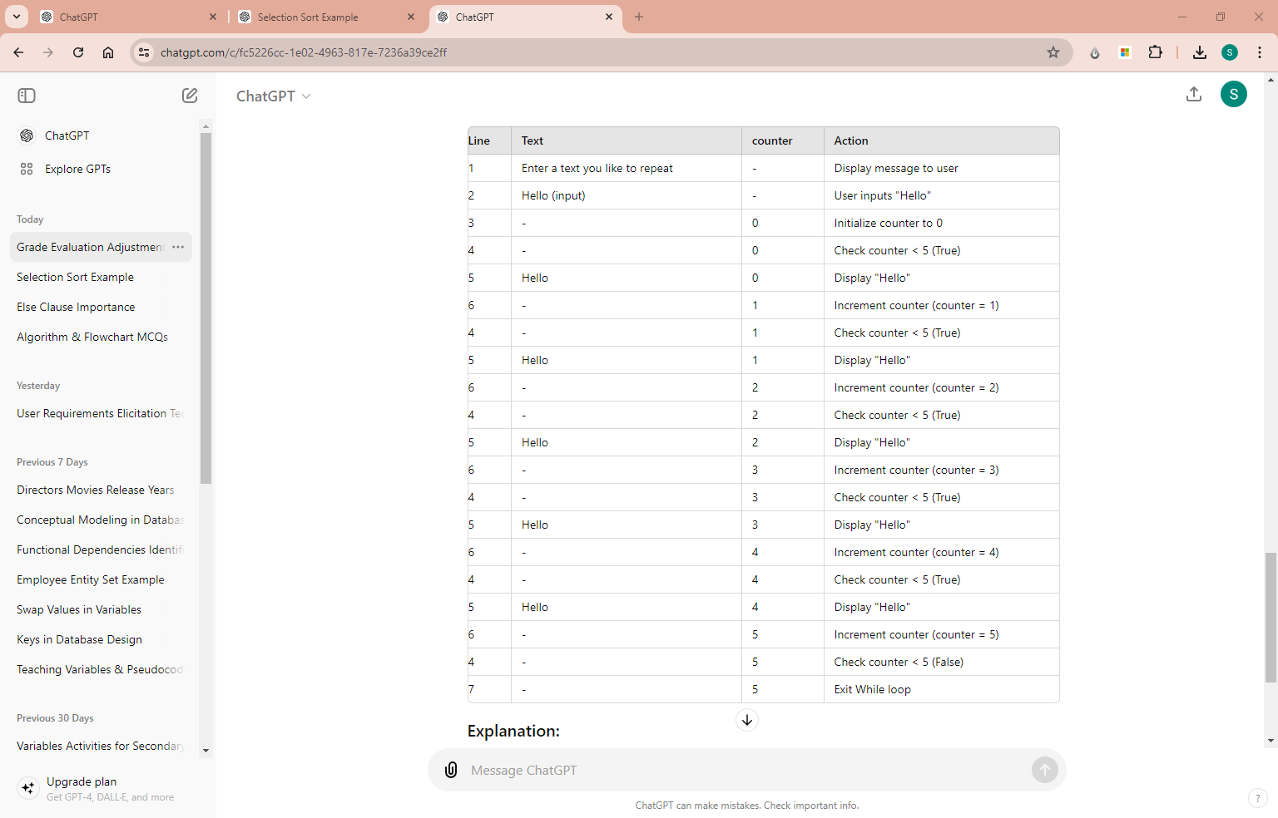
Guess the Output using trace table
Display(“Enter a text you like to repeat”)
Input text
Set counter = 0
While counter < 5
Display text
counter = counter + 1
END While

Slide 52
Guess the Output using trace table
Display(“Enter a text you like to repeat”)
Input text
Set counter = 0
While counter < 5
Display text
counter = counter + 1
END While
Notes:
each iteration of the loop until it terminates after displaying "Hello" five times.

Slide 53
Pseudo Code - Repetition
Ask use to enter 5 numbers and system print the average
Discuss the approach here

Slide 54
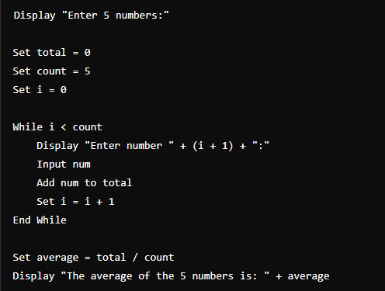
Pseudo Code - Repetition
Ask use to enter 5 numbers and system print the average
Notes:
Set total = 0: Initializes a variable to store the sum of the entered numbers.
Set count = 5: Specifies the number of numbers to be entered.
Set i = 0: Initializes a counter i to keep track of the number of inputs.

Slide 55
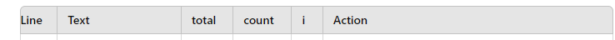
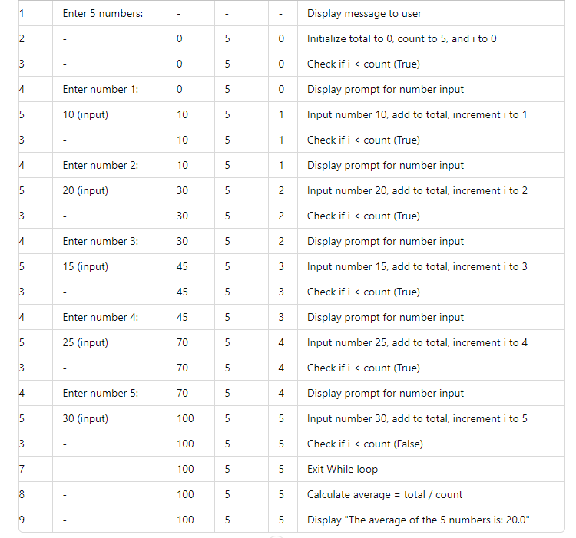
Trace Table
Notes:
Set total = 0: Initializes a variable to store the sum of the entered numbers.
Set count = 5: Specifies the number of numbers to be entered.
Set i = 0: Initializes a counter i to keep track of the number of inputs.

Slide 56
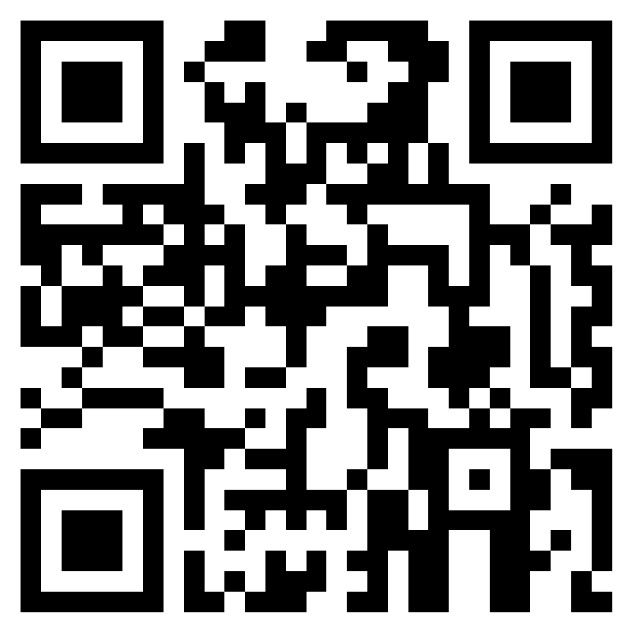
Submit the solutions for activity
https://forms.office.com/e/
e6b82cAkH7

