Slide 1
Reflecting on Assignment Feedback and Setting Improvement Targets
Myfyrio ar Adborth o Aseiniad a
Gosod Tragedau ar gyfer Gwella
Level / Lefel 4​
Study Skills / Sgiliau Astudio ​ BMSH4200C

Slide 2
Objectives
Amcanion
To analyse assignment feedback
Identify areas for improvement
Establish targets for future assignments (and Part 2) to enhance academic performance
Dadansoddi adborth aseiniad
Adnabod mannau i wella
Sefydlu targedau ar gyfer aseiniadau (a Rhan 2) i'r dyfodol i sicrhau gwelliant ym mherfformiad academaidd

Slide 3
Step 1: Reviewing Assignment Feedback
Access Turnitin and carefully read through your feedback
Pay close attention to comments, suggestions, and areas highlighted for improvement.
Awareness of how to download copy with all marking comments
Understand what all the buttons in Turnitin provide (on the right-hand side and on written assignments)

Slide 4
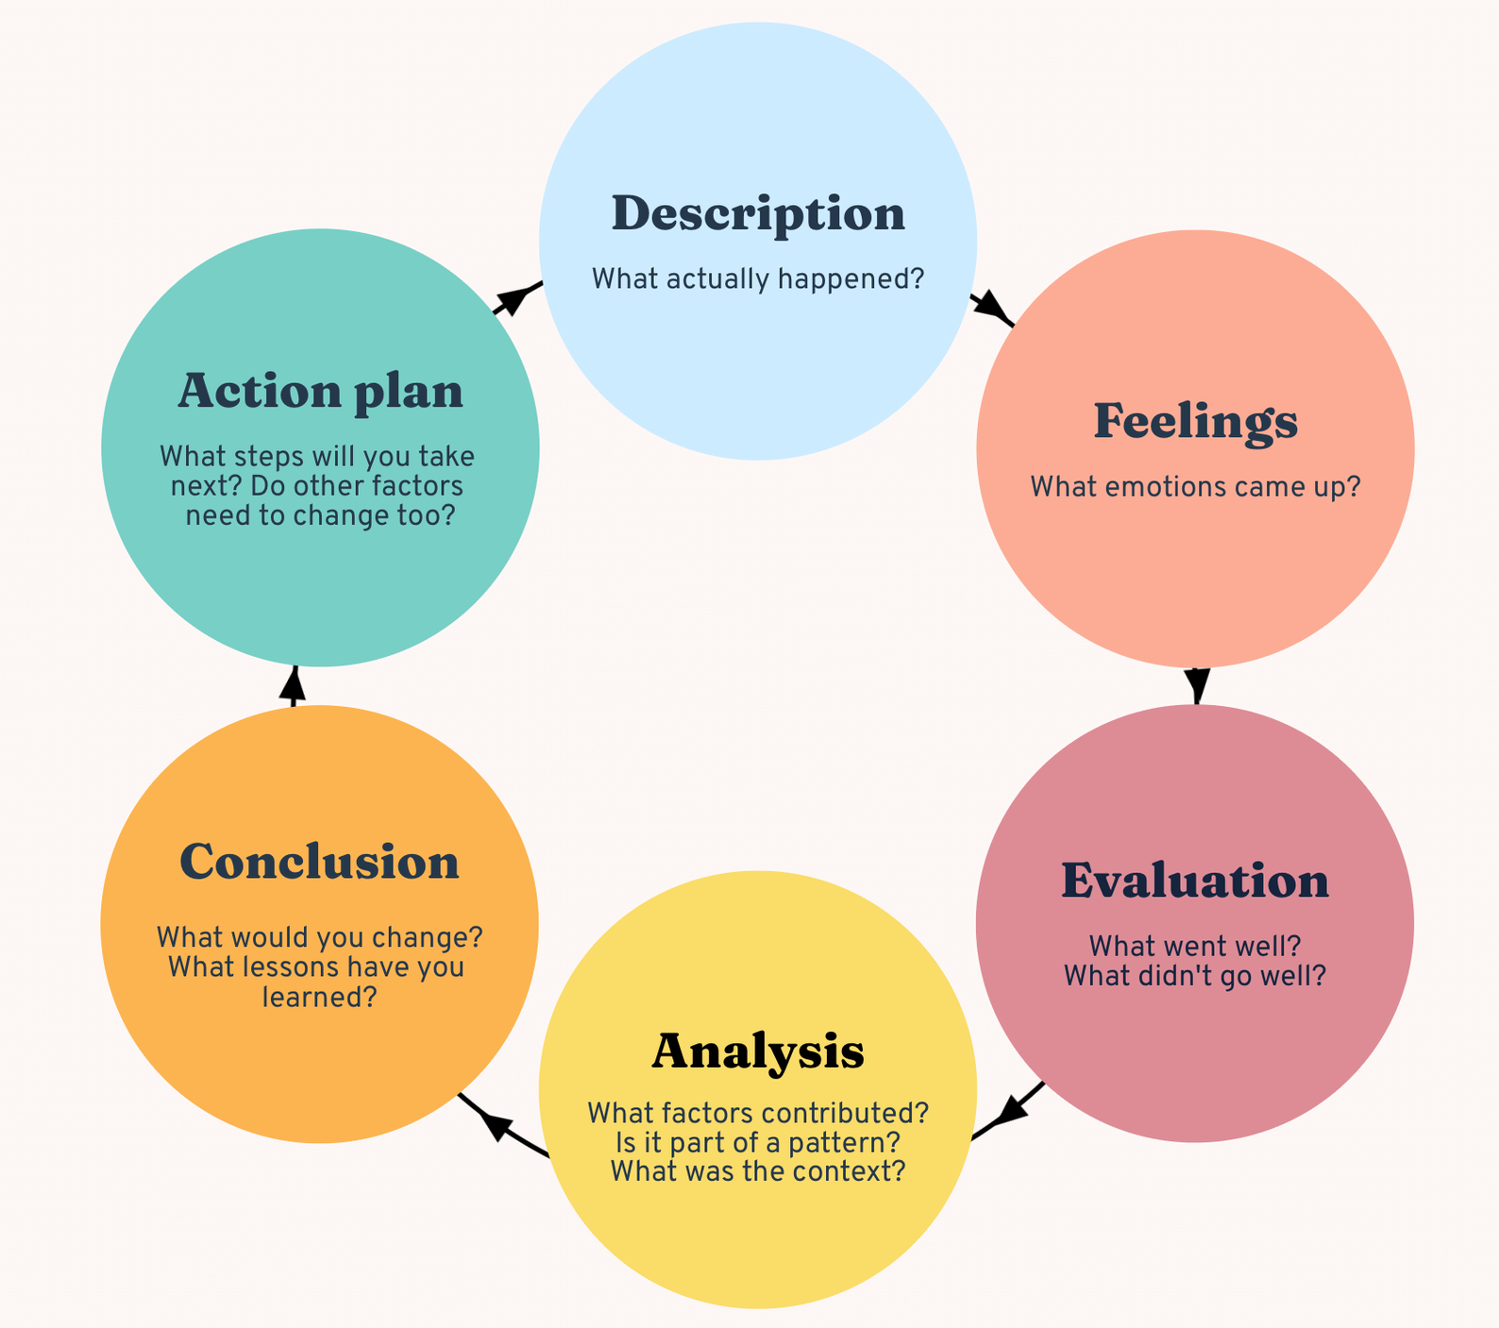
1
6
What happened? What was my assessment result?
2
Reflect
Myfyrio
What are my next steps? How can I ensure that I stick to my plan?
How do I feel about it?
5
3
4
What can I change? What have I learned?
Gibbs’s reflective cycle (1988)
Why did things go/didn’t go well? What factors contributed?

Slide 5
Step 2: Identifying Improvement Areas
Make notes on recurring feedback themes or areas needing improvement (e.g., referencing, structure, argument coherence, grammar, clarity).
Reflect on specific examples or instances where improvement is necessary, based on your feedback.

Slide 6
Cam 2: Adnabod Gwelliannu sydd Angen
Gwnewch nodiadau am gamgymeriadau chi'n gwneud yn gyson sydd angen gwella e.e. cyfeirnodi, strwythur, llunio dadl, gramadeg neu eglurder.
Yn dilyn yr adborth chi wedi derbyn - myfyriwch ar agweddau penodol ble mae rhaid gwella.

Slide 7
Breakdown areas of the marking criteria
Engagement with Literature
Knowledge & Understanding
Cognitive & Intellectual
Practical
Transferable skills
Sgiliau Ymgysylltu a Llenyddiaeth
Sgiliau Gwybodaeth a dealltwriaeth
Sgiliau Gwybyddol a Deallusol
Ymarferol
Sgiliau Trosgwlyddadwy ar gyfer bywyd ac arfer proffesiynol

Slide 8
A common area for many students is ...
Cognitive & Intellectual Skills – i.e. How to include an argument!

Slide 9

Critical Thinking & tips on how to Structure an Argument.
.
Meddwl Beirniadol a tips sut i Strwythuro Dadleuon.

Slide 10
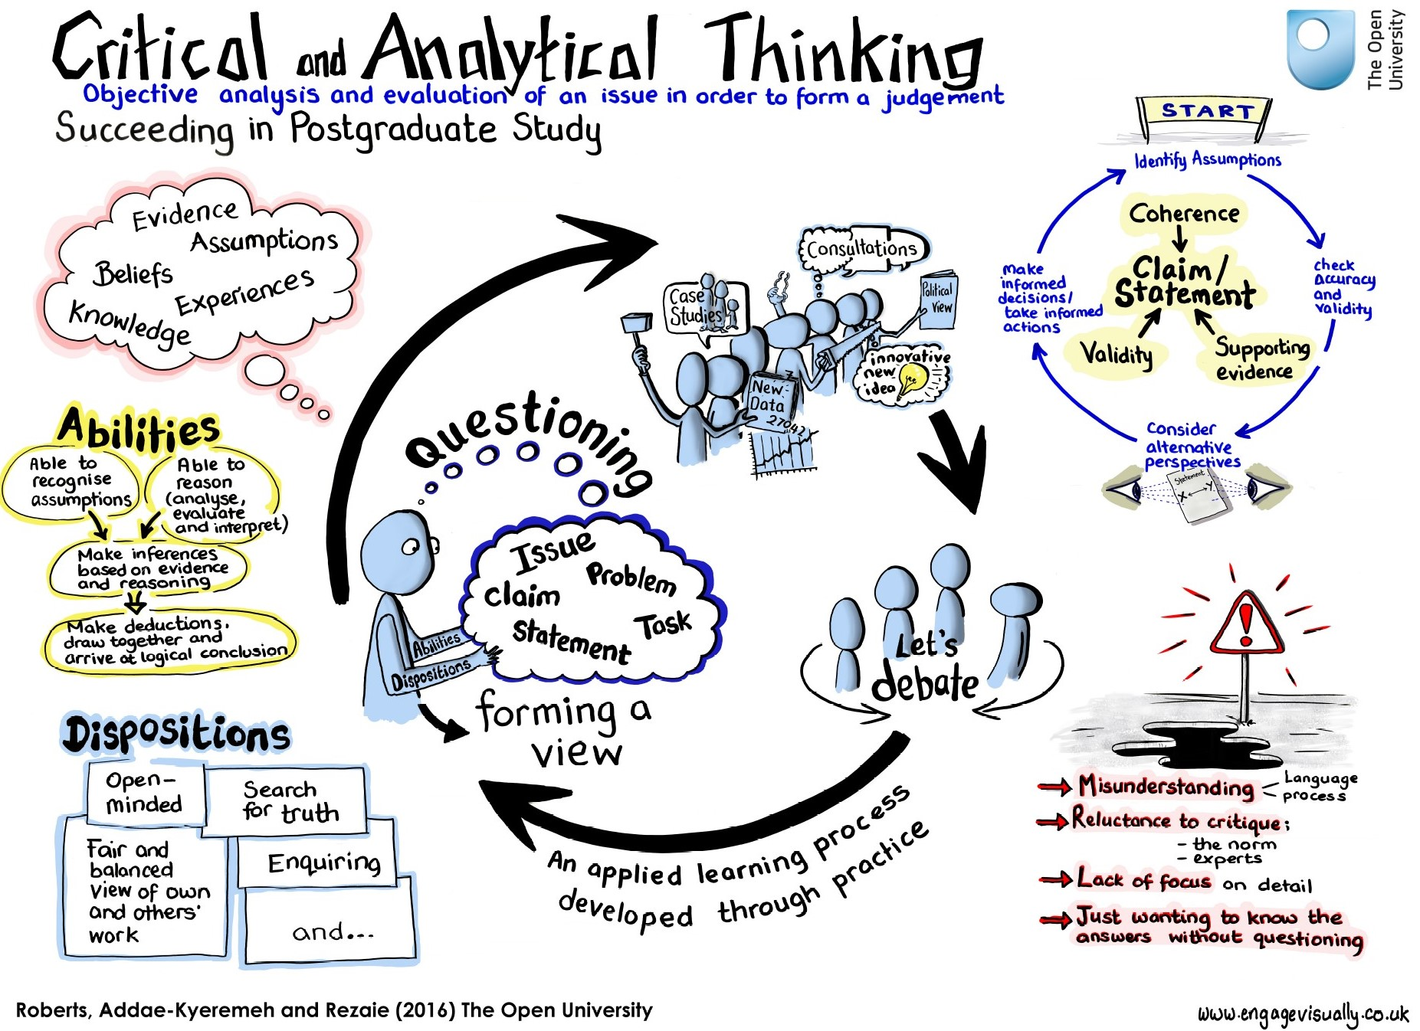

Slide 11
Tips
Pwrpas – beth i chi eisiau'r cynulleidfa i wybod amdano.
Rhestrwch y pethau chi'n gwybod
Traethawd = Dadl
Tystiolaeth chi'n defnyddio yn cefnogi'r barn
Brawddegau allweddol (dechrau a gorffen paragraffau)
Diweddglo / Crynhoi​
Purpose – What do you want your audience to know overall.
List of things you know
Essay = Argument
Evidence your points to support your opinion
Importance of key sentences (starting and finishing paragraphs)
Conclusion/ Summary
Notes:
When reading some of the work there is a certain lack of purpose to the essay.
Most have got the idea of using the assessment statement as your question and then the essay is your answer. Which has its own key information/themes/subtopics.
In this process you have read some helpful information and constructed the essay in a list of things you know. This is in someways correct but would get you the lower marks – possibly low pass.
Essay is an attempt at an argument. Because these statements are broad everyone would have different arguments and it is not that one way to argue it will be better than another – as long as you can clearly evidence your point there will be bigger marks.
Always think of purpose to your whole essay. And key sentences will help with this.
Task: Tell your partner in two sentences the key answer to the statement. Keep this in mind when you are writing.
Important sentences are the first sentence of the paragraph. First sentence readings online.
Insights – just summarise what you have told the reader.

Slide 12
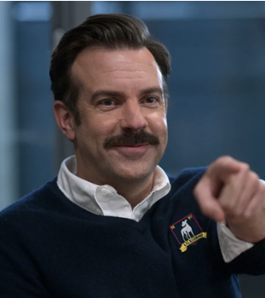
Byddwch yn chwilfrydig (ac yn gritigol)
Ystyriwch y dadleuon yma :
Mae Peldroed a Rygbi wedi gwella o ganlyniad i ddefnyddio VAR
Mae Peldroed a Tenis yn ddau enghraifft ble mae chwaraeon menywod yn "more value for money" na Peldroed a Tenis dynion.
Dylai pawb fod yn llyseuwyr (vegetarian)

Slide 13
Be Curious!
Break down these arguments:
•Football and Rugby has been made better by VAR (and equivalent)
•Football and Tennis are two examples where women's sport is more value for money than the men's game
•Everyone should be vegetarian

Slide 14
Challenge each other Heriwch eich gilydd
Critical thinking task. Debate time...
Turn to the person sitting next to you and ...
Together, make a note of what the areas of debate could be (from your Part 2 topic)
A: To make a point & challenge your partner to argue the opposing point of view.
B: Partner challenge it... ideas for critical thinking
Tasg meddwl critigol. Amser i ddadlau ...
Trowch at berson sy'n eistedd drws nesaf i chi …
Gyda'ch gilydd, gwnewch nodiadau o'r dadleuon posib(o’r eich pwnc Rhan 2)
A: Gwnewch safbwynt a heriwch eich partner i ddadlau safbwynt gwahanol
B: Herio partner – syniadau ar gyfer meddwl critigol

Slide 15
Critical thinking...
Ensure your assignment is not one sided
Question things … even those that seem obvious
Present the other side of the argument so you can fully understand it
At university we are asked to challenge, NOT JUST REPORDUCE opinions
Notes:
Be clear on your position on the issue
Construct a clear line of reasoning – the argument – to your conclusion
Present evidence to support your reasoning
Analyse issue from multiple perspectives – balanced and unbiased
Construct your position from the analysis, synthesis of information
Critical and analytical writing over descriptive and personal
Be critical of your own writing as your draft (similar to being critical of sources (reading critically) (reading list)

Slide 16
Meddwl
Critigol...
Holwch cwestiynau (yn eich meddwl)… hyd yn oed y cwestiynau hynny sy'n edrych yn amlwg
Sicrhewch bod eich aseiniad yn cynnig mwy nag un barn
Cyflwynwch ochr arall i'r dadl fel bod modd dangos dwfnder eich dealltwriaeth
Tra'n y Prifysgol rydym yn eich annog i herio NID AIL DDWEUD barn.
Notes:
Be clear on your position on the issue
Construct a clear line of reasoning – the argument – to your conclusion
Present evidence to support your reasoning
Analyse issue from multiple perspectives – balanced and unbiased
Construct your position from the analysis, synthesis of information
Critical and analytical writing over descriptive and personal
Be critical of your own writing as your draft (similar to being critical of sources (reading critically) (reading list)

Slide 17

Step 3: Defining Improvement Targets (SMART)
Specific: Choose two specific areas from the identified improvement areas that you aim to focus on.
1
Measurable: Define how you will measure improvement in these areas (e.g., number of correctly cited references, improved essay structure, coherence in arguments).
2
Achievable: Ensure that the improvement targets are realistic and feasible for you!
3
Relevant: Align the improvement targets with your overall goal of enhancing academic writing skills
4
Time-bound: Set a timeframe within which you plan to achieve these improvement targets

Slide 18
Step 4: Crafting SMART Improvement Targets
For each selected improvement area, create SMART targets using the template:
Specific Improvement Area:
Measurable Target:
Achievable Steps:
Relevance to Assessment Type:
Time-bound Deadline:

Slide 19
Step 4: Crafting SMART Improvement Targets
EXAMPLE
For each selected improvement area, create SMART targets using the template:
Specific Improvement Area: (e.g., Enhancing Referencing Skills
Measurable Target: (e.g., Increase correct use of citations by 20% in the next assignment)
Achievable Steps: (e.g., Practice citing sources using Haravard)
Relevance to Assessment Type: (e.g., Improved referencing enhances the credibility of your arguments)
Time-bound Deadline: (e.g., Achieve this improvement within the next two assignments

Slide 20
Step 5: Action Plan & Monitoring
Targets visible
Actionable steps/strategies
Implement - next assignment
Revisit & adjust
Notes:
Keep your Targets in a visible place or document them for future reference.
Outline actionable steps or strategies you intend to take to achieve these improvement targets.
Implement these strategies consistently while working on future assignments.
Regularly revisit your improvement targets and assess your progress against them.
Adjust strategies or targets if needed, based on your ongoing learning/feedback.

Slide 21
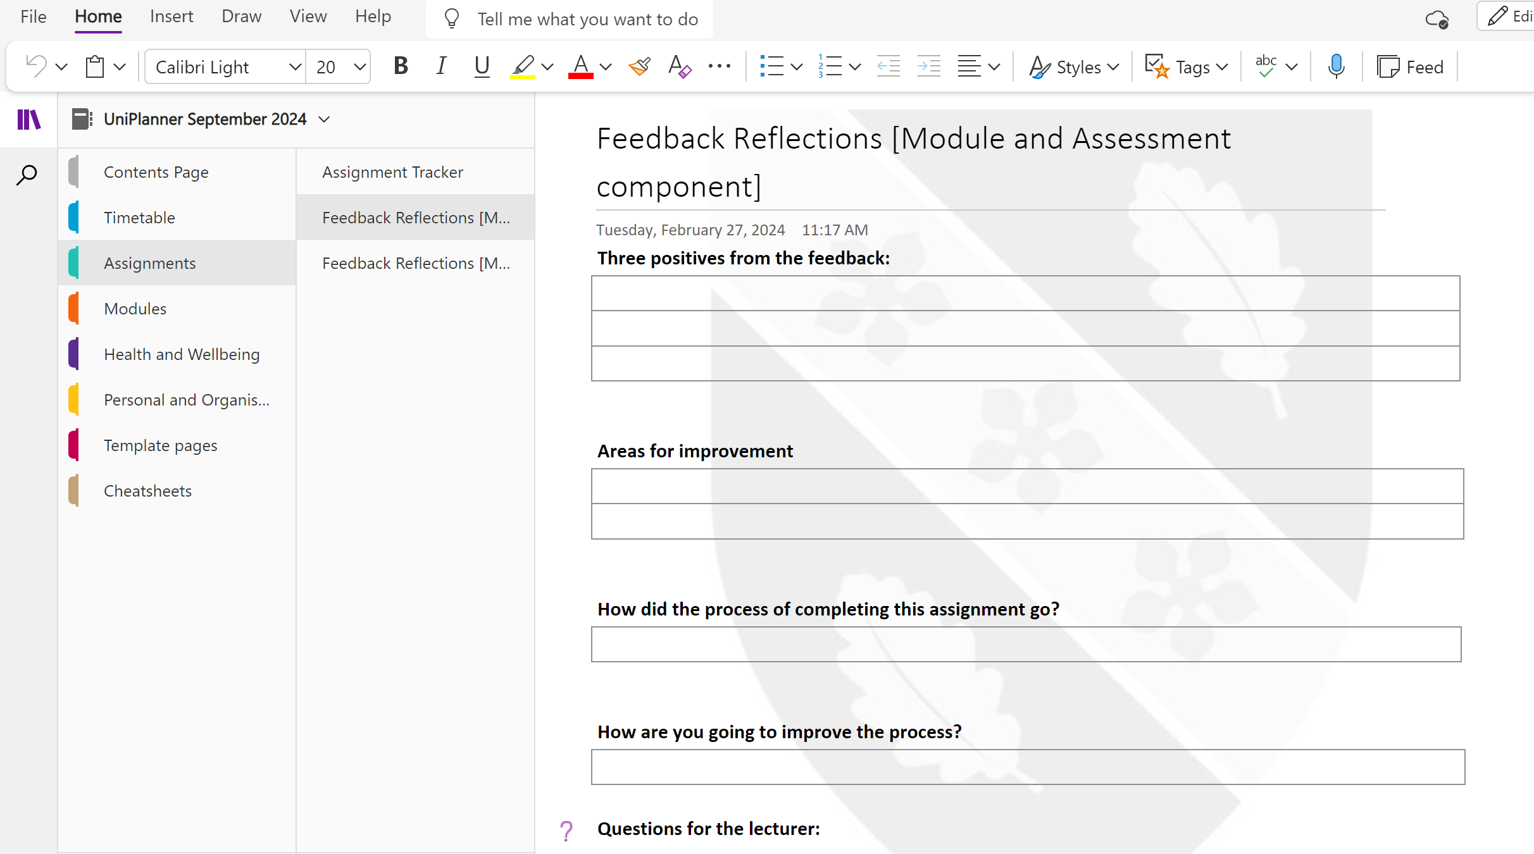
Process of the Assignment / Proses o greu'r Aseiniad

Slide 22
Plenary & Reflection.... / Clo a Myfyrdod ...
Engaged with feedback / Wedi ymddiddori gyda'r adborth
Identified areas for improvement / Wedi nodi beth sydd angen gwella
Set targets to enhance academic skills / Wedi creu targedau i wella sgiliau astudio
Notes:
Hopefully you have engaged with your feedback and identified areas needing improvement, and set specific, measurable, and achievable targets to enhance your academic writing skills for future assignments!

Slide 23
Tasgau i gwblhau dros y 6 wythnos nesaf!
Tasks to complete over the next 6 weeks!
Date next lecture / Dyddiad darlith nesaf
26th January, 2026

Slide 24
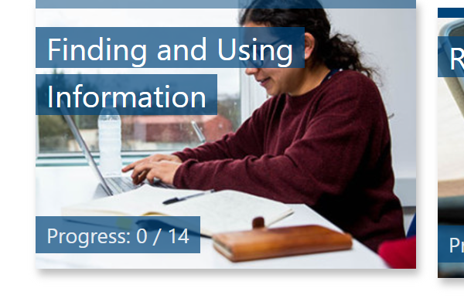
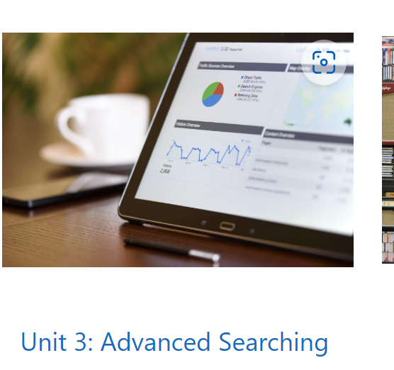
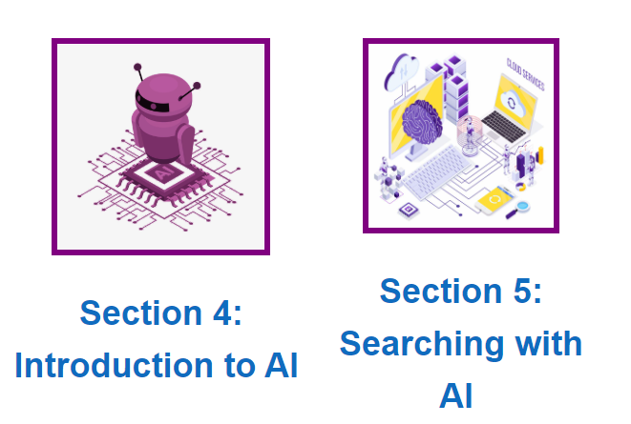
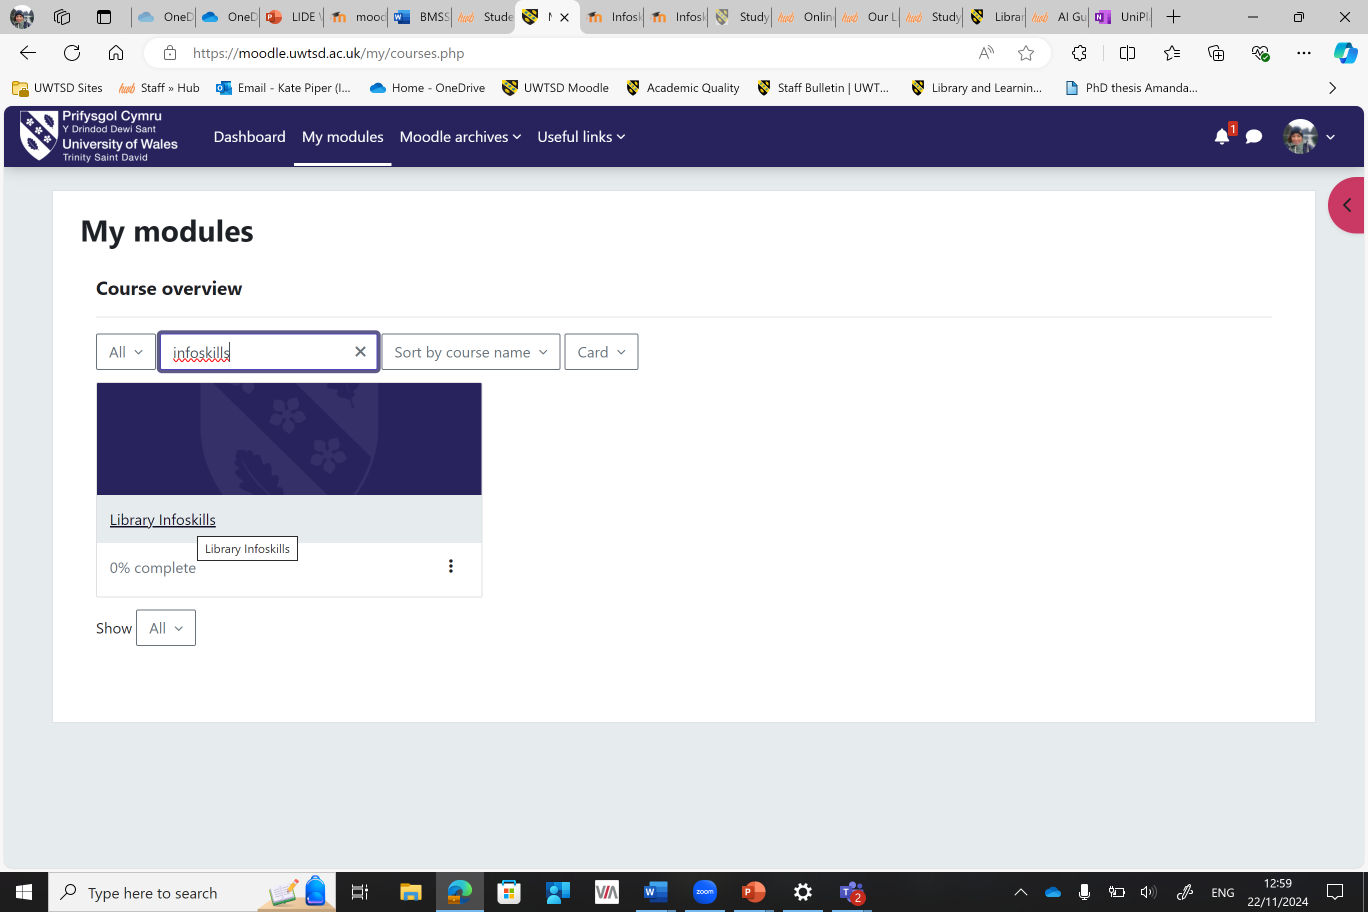
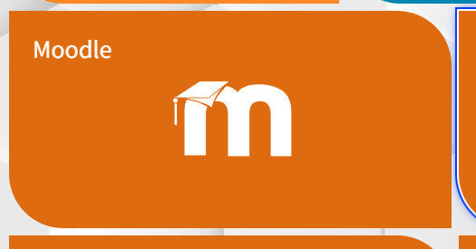
AI for future knowledge / AI ar gyfer gwybodaeth
Complete Info skills AI unit
2 sections which cover AI within the Advanced Searching Unit on our Infoskills Moodle page: Finding and Using Information Course
Introduction to AI
Searching with AI
Work through them asynchronously. There are Knowledge checks within each to test knowledge and understanding.
Cwblhewch sgiliau gwybodaeth yr uned AI
2 rhan sy'n edrych AI sy'n rhan o Advanced Searching Unit ar dudalen moodle Infoskills Moodle, sef, Finding and Using Information Course
Introduction to AI
Searching with AI
Gweithiwch trwyddynt yn anghydamserol. Mae camau gwirio yn rhan o bob adran i wirio'ch gwybodaeth a dealltwriaeth.

Slide 25
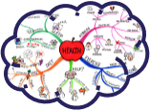
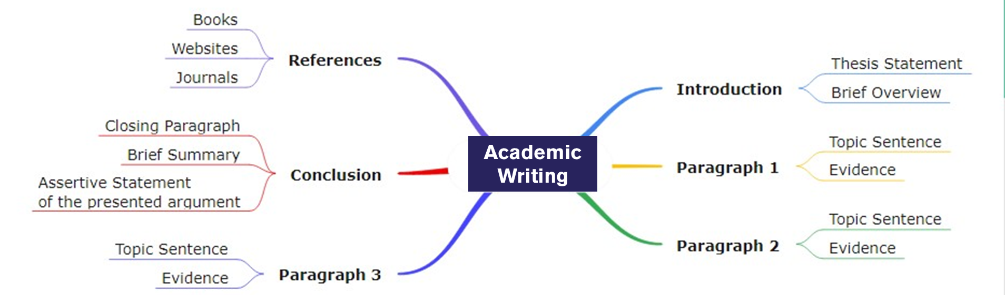
Work on your Part 2 structure //
Gweithiwch ar strwythur eich Rhan 2
From your Part 2 topic
Start your mind map
Use your learning from the
asynchronous content to plan
and draft
Apply your learning from your
feedback comments on Part 1.
Structure your arguments (your script), to bring on January 26th :
O’ch pwnc Rhan 2
Dechreuwch eich map meddwl
Defnyddiwch yr hyn rydych chi wedi'i ddysgu o'r cynnwys anghydamserol i gynllunio a drafftio
Cymhwyso'r hyn rydych chi wedi'i ddysgu o'ch sylwadau adborth ar Ran 1.
Strwythurwch eich dadleuon (eich sgript), i'w cyflwyno ar Ionawr 26ain:

