Slide 1
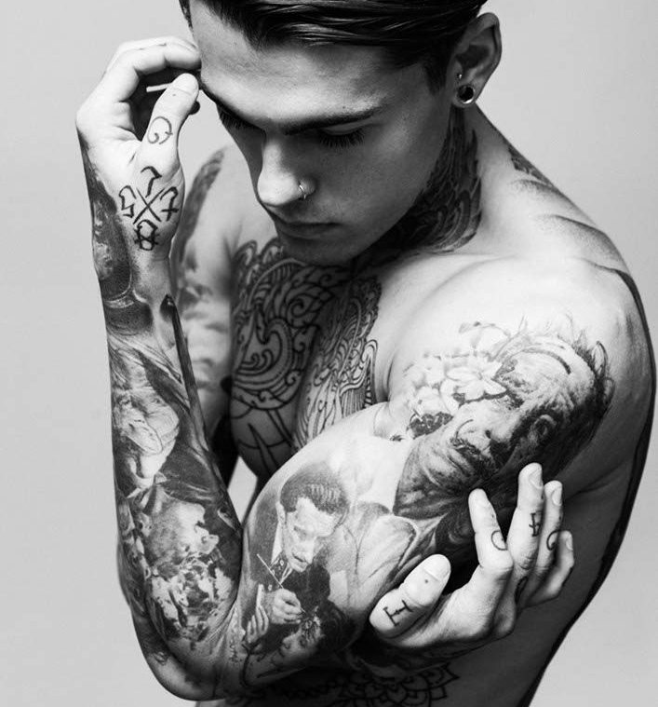
Module Title: Certificate of Higher Education Skills for the Workplace
Assignment Title: Managing Enterprise in the 21st Century
Sofiya Tupovicharska (1817125)
Simeon Yunakov (1816555)
Rosen Agushev (1818403)
Vanya Petrova (1817743)
Silviya Spasova (1817128)
Maria Stavrou (1817745)

Slide 2
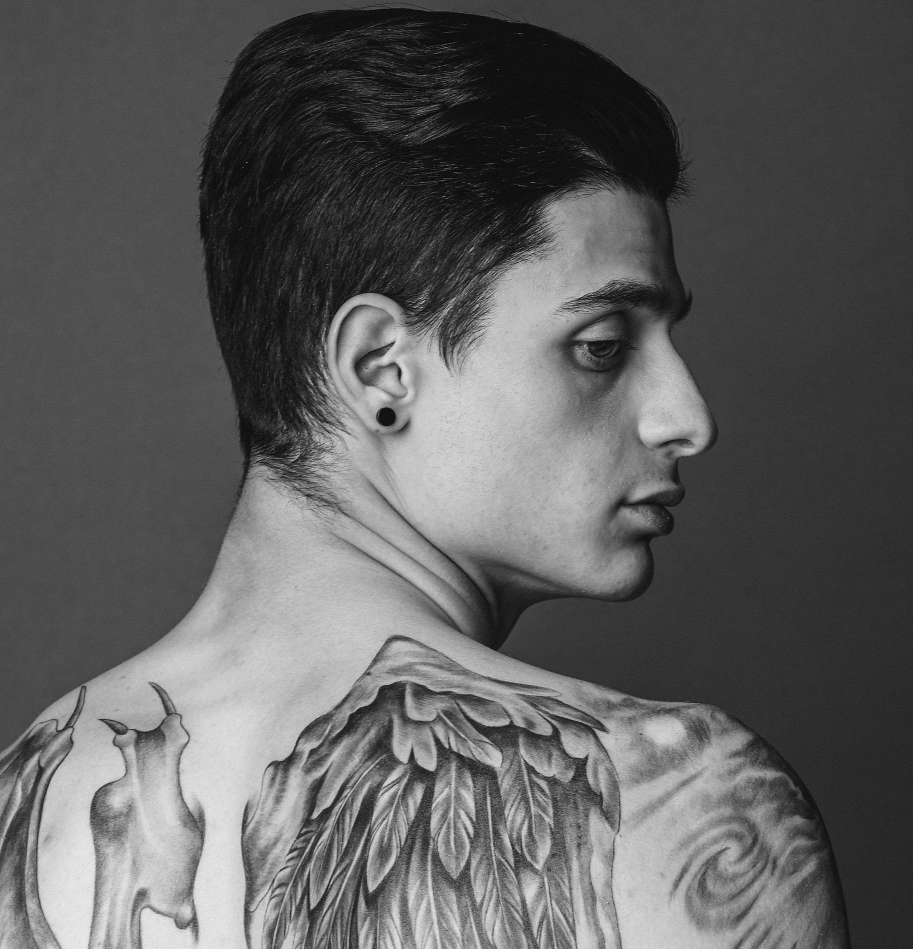
Table of content
Cover business name/logo
Mission statement and organizational objectives
Product description
Stakeholder map
PESTEL analysis
SWOT analysis
Market analyses
Sales and marketing strategies
Marketing advertising
HR planning and managing team structure
Organizational design
HR plan or year 1
Industry analysis
Operational strategies
Financial plan

Slide 3

INK ADDICTED Tattoo Studio

Slide 4

Mission statement and organizational objectives
Mission statement and organizational objectives
Today we are going to talk about our mission statement and organizational objectives
• Mission statement that means our mission is to express costumers feeling through art
• Organizational objectives that means all of techniques organization Wii use to achieve success costumer service, very good opportunities and any other

Slide 5
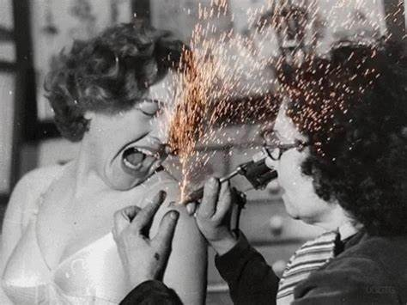
Product description
WE WOULD LIKE TO ENABLE OUR CUSTOMERS TO BE HAPPY WITH THE GOODS THEY CHOOSE TO TATTOO OUR ARTISTS ARE ALWAYS ENTHUSIASTIC TO CREATE NEW COSTUM TATTOOS A COMPLETELY ENIQUE TATTOO DESIGNS ON REQUEST

Slide 6
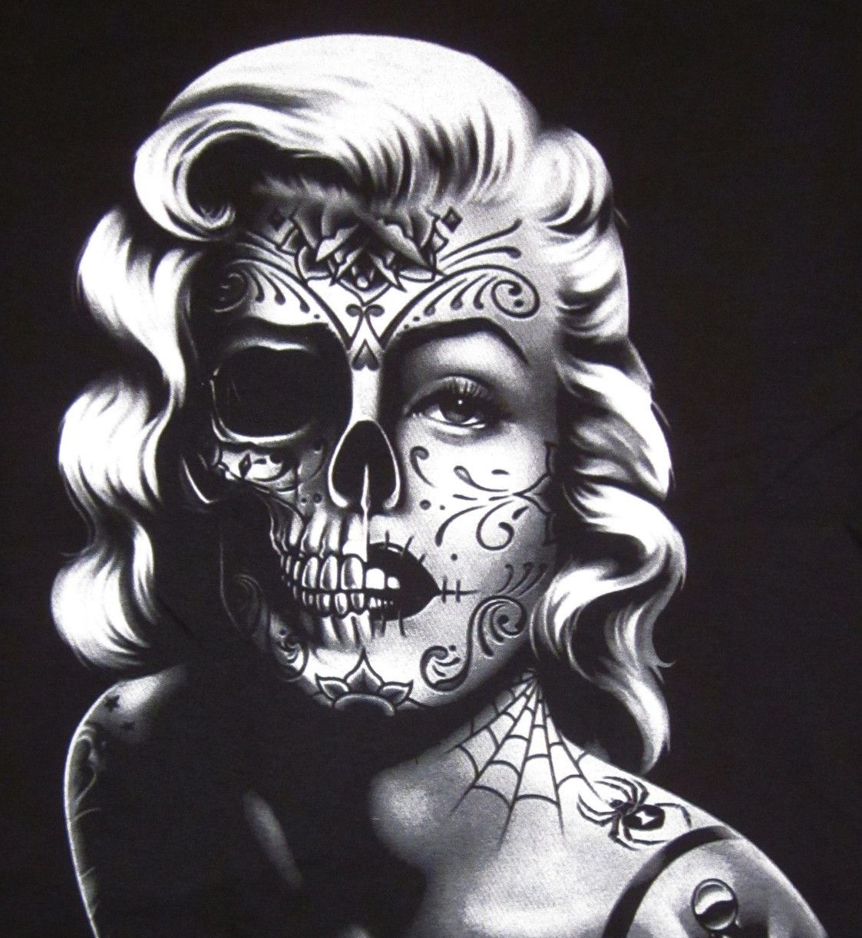
Stakeholder map
Stakeholder-describes a person organization or role that has a stakeholder interest in a task the main groups of stakeholders are:
- Internal stakeholders:
Employees
Manager
Owner
- External stakeholders:
Suppliers
Society
Government
Creditors
Stakeholder
Customers

Slide 7
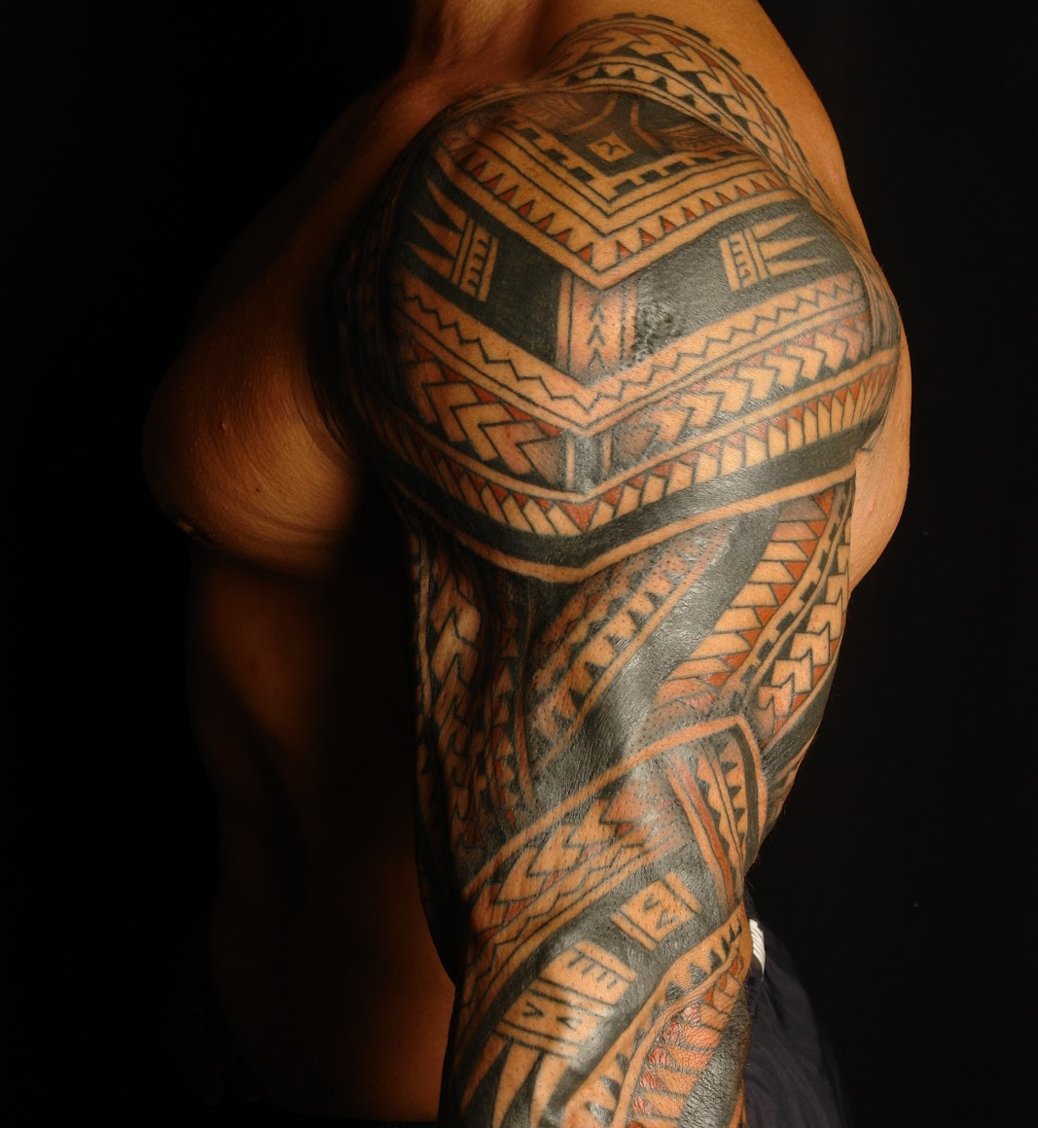
PESTEL ANALYSIS
Economic: When the economy changes you can change all the data and plans you have for the store.
Political: The politics of a country and can bring about great changes in the way of life and greatly affect your work.
Social: The best way to advertise your business the way that every person is christened and teases your life.
Technological: The technologist changes every day, so you must know new products and new applications are necessary for your business.
Legal: You mean that you should always be legally good at one of all aspects and to date one every new law.

Slide 8
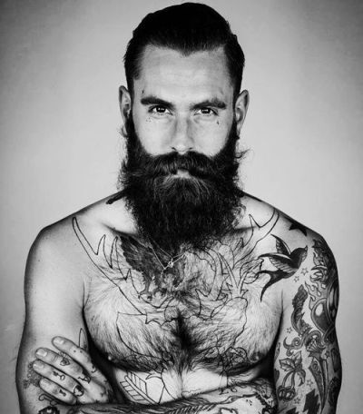
Swot Analysis
Strengths: Strong staff, professional with extensive experience, very good competitive location.
Weakness: The shop is new costumers don’t know it; the competition is great with stores that have their own customers.
Opportunities: We can start advertising the business, you can make your business known through and acquaintances.
Threats: One of the big cynic is the changing economy, also the change of fashion.

Slide 9
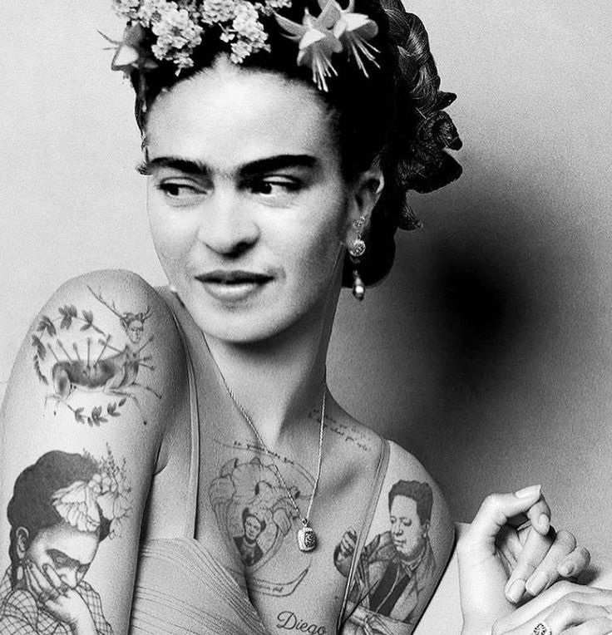
Market Analysis
Market Trends - The Tattoo Artists industry has shown development over the last five years. Mainly because of the mainstream culture, which incorporate tattoo-related unscripted tv programs, which have made tattoos less socially forbidden.
Our Target Market Tattoo Newbies, Tattoo Collectors, Celebrities / Public Figures, Students, Tourists, etc.

Slide 10
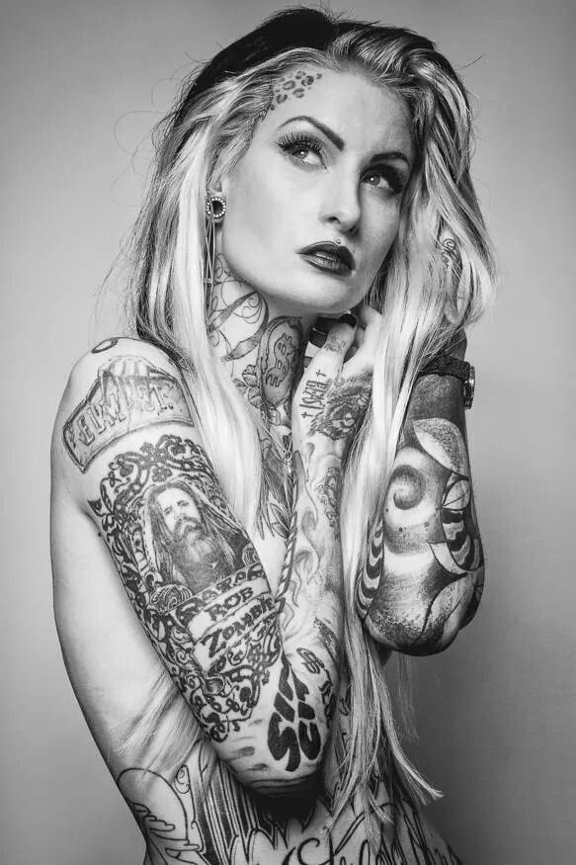
SALES AND MARKETING STRATEGY
Our Pricing Strategy - At INK Addicted® LTD we will keep the prices of our services below the average market rate for all our customers by keeping our overhead low and by collecting payment in advance from individuals and celebrities.
Branding Strategy - create a solid brand of our company
Marketing and sales strategies to attract clients - Advertise our business in relevant magazines, newspapers, TV stations, and radio station, and flyers.

Slide 11
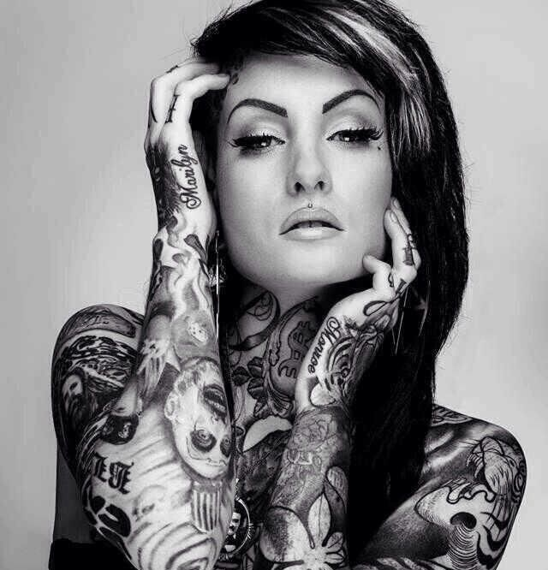
Marketing Advertising
Place adverts on both print (newspapers and magazines) and electronic media platforms
Instagram, Facebook, twitter, YouTube, Google + et al to promote our services
Install our Billboards on strategic locations all around London
Distribute our fliers and handbills in target areas
Ensure that all our staff members wear our branded shirts and all our vehicles are well branded with our company logo et al.

Slide 12

HR planning & managing team structure

Slide 13

Organizational design
CEO’s
Management
Artists
Piercer
Other

Slide 14
HR plan for Year 1
CEO’s
Year 1
In year 1 we will take the roles of the management such as (Operations, HR, Marketing, Accounting & Finance)
Artists
Year 1
In year 1 we plan to recruit one Tattoo artist and one Piercer since one of our CEO's has been an experienced tattoo artist before, he will be one of our tattoo artist in order to have less costs.
Other
Year 1
Other stans for cleaners and additional help if needed which will not be as regular as other full-time employees.

Slide 15
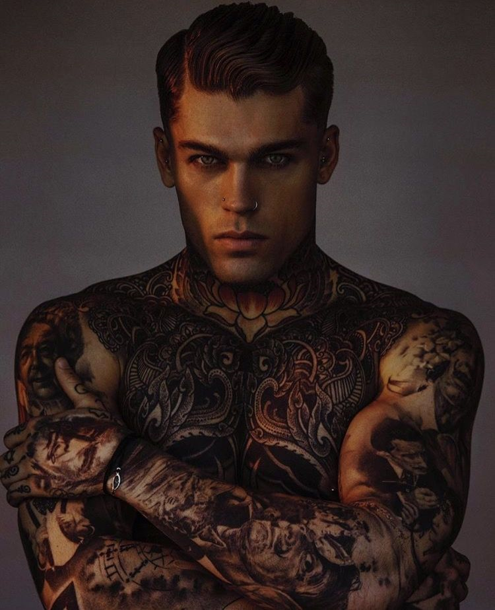
Industry analysis
The tattoo artists industry will keep on developing, as the demand of the UK’s population for “inkinging” grows. Then again, government guidelines may add to operational expenses for the business which will possibly stands as barriers to entrepreneurs who may want to start their own tattoo studio business.

Slide 16
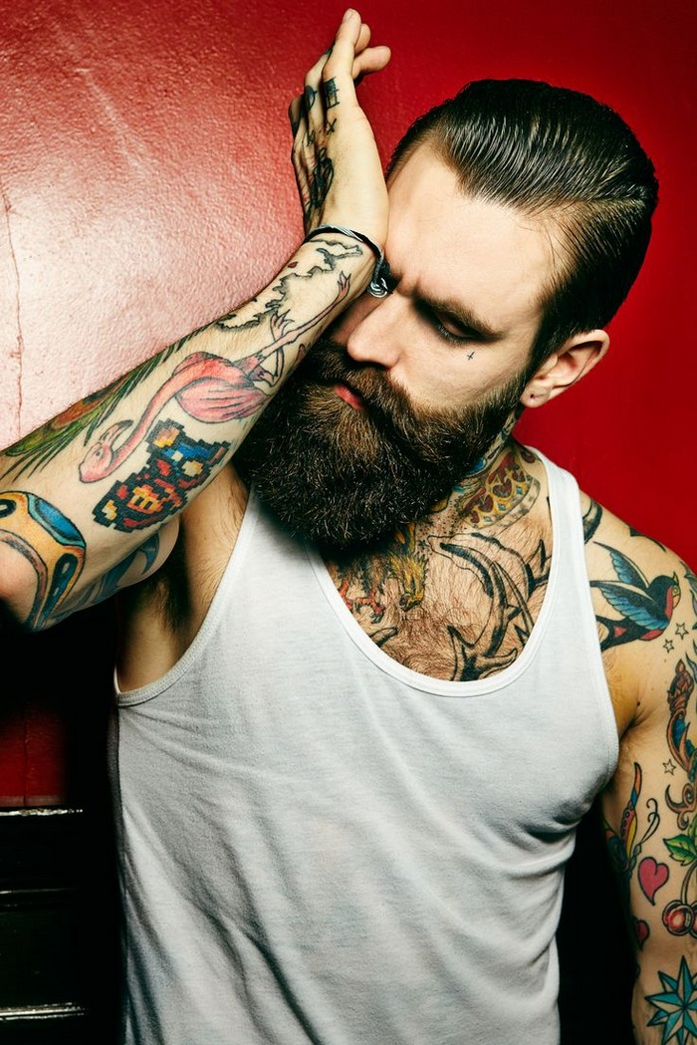
Operation strategies
- Offering competitively-priced introductory tattoos to encourage "tattoo newbies“.
- Retaining high-quality artists to retain tattoo collectors.
Offering a wide range of custom designs in different styles to broaden appeal.
Giving body piercings
Selling additional products with designs by the tattoo artists to build an additional revenue stream.

Slide 17

Financial plan for INK ADDICTED

Slide 18

5 years Financial Plan
 | Year 1 2019-2020 | Year 2 2020-2021 | Year 3 2021-2022 | Year 4 2022-2023 | Year 5 2023-2024
Sales | £307,000 | £385,000 | £503,000 | £520,000 | £700,000
Costs | £142,000 | £293,000 | £162,000 | £160,000 | £300,000
Profit/Loss | +165,000 | +82,000 | +342,000 | +360,000 | +300,000
Assets | £150,000 | £290,000 | £200,000 | £350,000 | £400,000
Liabilities | £90,000 | £140,000 | £100,000 | £50,000 | £0
Shareholder capital | £60,000 | £150,000 | £100,000 | £300,000 | £400,000

Slide 19
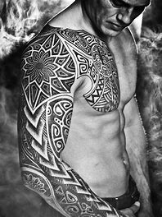
Year 1 we are we are investing £142,000 to open 1 tattoo shop in central London. This money covers the rent, all the equipment and supplies plus salary for our tattoo artists an our piercer. Year 2 we will buy a laser removal machine and we will hire a laser therapist and that is why we will invest more money. Year 3 and 4 we are not going to expand, however we will focus more on our customers and our bon with them. Year 5 we will invest in our business £300,000 so we can open a second tattoo shop in a different area.

Slide 20

Questions?

Slide 21
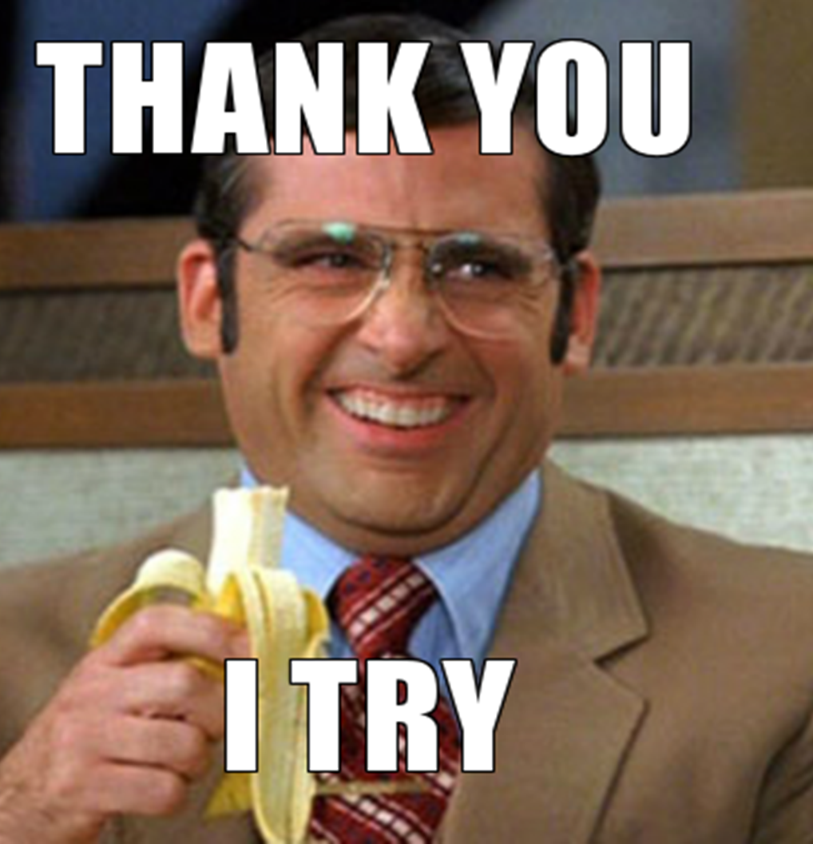
Thank you for your time!

