Slide 1

Course: MSc Engineering Project Management
Module: ACEA7006 Engineering Management Leadership
Assignment: Business Analysis & Planning
University number: 1809810
Date submitted: 23/05/2024

Slide 2

Introduction
Business Analysis & Planning
Logistics Company.
Recommending a Strategy.
Mathew Thomas

Slide 3


Summary of Current Issues
Employee Retention.
Employee Recruitment.
Decarbonisation Net Zero.
Organisation Implementing Measures.
Making required changes and remaining competitive

Slide 4
Why does Employee Retention & Recruitment Matter?
Low employee retention results in various issues for an organisation. [1]
Retention begins long before the employee’s first day on the job. [2]
High employee turnover weakens employees’ commitment. [1] [2] High employee

Slide 5
Causes of Retention & Recruitment Issues?
General
Personal vs organisational [1]
Lack of opportunity [2]
Poor management [3] [6]
Work: Life [2] [6]
Environment [1]
Logistics
Pay [4]
Upfront & ongoing costs [3]
Hours [4]
Facilities [3]
Management [4]
Brexit [4]
Covid 19 [4]
Regulation, public perception, health & wellbeing, safety, limited demographic [4][5][6]

Slide 6
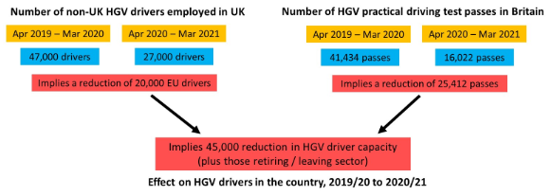
Causes of Retention & Recruitment Issues?
[4]

Slide 7

Employment Strategies for the Interim.
Competitive Work Packages. [2] [4]
Work-Life Balance. [2] [6]
Training and Development Programs. [1] [4]
Clear Expectations and Feedback. [3][4]
Strong Leadership. [1] [3]
Employee Engagement and Recognition. [2]
Enhanced Recruitment Strategies. [2]

Slide 8
Employment Strategies for the Future.
Enhanced Recruitment Strategies. [2][6]
Career Development Opportunities. [5]
Career Advancement Opportunities. [5][6]
Employee Wellness Programs. [2][3]
Feedback and Communication Channels. [1][2]
Opportunities for Input. [1][5]

Slide 9

Summary.
Recruitment & Retention is an ongoing issue across multiple sectors. [2][3]
Shortage of drivers presents significant risk to the logistics company. [4][5]
No single cause. [4]
Effective measures. [2]
Evaluation Continual improvement. [2][6]
Management Inclusion. [1][6]

Slide 10

Why does Decarbonisation Matter?
What is Decarbonisation? [7]
What is Net Zero? [7] [8]
Why Net Zero by 2050. [8][11]

Slide 11
Decarbonisation Strategies for the Intermediate.
Fleet Optimisation. [7] [10]
Route Optimisation. [7] [10]
Driver Training & Incentives. [10] [11]
Investment in Telematics. [11]
Load Consolidation. [8]
Pilot Testing of Alternative Fuels. [9]
Continuous Improvement and Innovation. [7][9]

Slide 12
Decarbonisation Strategies for the Long Term.
Transition to Zero-Emission Vehicles. [11][12]
Invest in Advanced Vehicle Technologies. [12]
Transition to Renewable Energy. [9][11]
Collaboration and Partnerships. [9]
Promote Circular Economy Practices. [10]
Embrace a Sustainable Business Model. [12][13]
Continuous Improvement and Innovation. [7][9]

Slide 13
Decarbonisation Strategies for the Future.
Synthetic Fuels. [8][10]
Advanced Vehicle Technologies. [7][11]
Carbon Capture and Utilisation (CCU). [9][13]
Carbon-Negative Technologies. [11][12]
Electric Road System (ERS). [11]
Fully Autonomous Trucks. [9]
Continuous Improvement and Innovation. [7][9]

Slide 14
Summary.
Changes to meet Decarbonisation are inevitable. [7][9]
Effective Measures. [11]
If changes aren’t made, the consequences could be catastrophic. [12][13]
Continuous Improvement and Innovation is essential. [7][9]
Evaluation Continual improvement. [9][11]

Slide 15

Thank You
Any Questions?

Slide 16
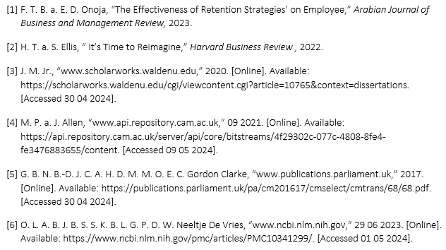
References.

Slide 17


