Slide 1

Introduction to Psychological Skills Training
Alison Connaughton

Slide 2

Learning Outcomes:
At the end of this lecture you should be able to:
  Outline the typical content and design of PST
  Evaluate previous research on PST
  Discuss factors which affect athlete adherence to PST
  Examine different ways of evaluating PST

Slide 3
What is PST?
Psychological skills training refers to the systematic and consistent practice of mental or psychological skills for the purpose of enhancing performance, increasing enjoyment, or achieving greater self-satisfaction.

Slide 4

Why Has PST Been Neglected?
Lack of knowledge
Misunderstandings about psychological skills (e.g., belief that they can’t be learned)
Lack of time

Slide 5
PST Myths
1. PST is for “problem” individuals only.
2. PST is for “elite” level performersonly.
3. PST provides “quick fix” solutions.
4. PST is not useful.

Slide 6
Techniques and Skills
Goal-setting, imagery, attentional control strategies, self-talk, relaxation are techniques which lead to psychological skills such as confidence, concentration, self-control, commitment.

Slide 7
PST Knowledge Base
Research on elite athletes shows that most successful athletes differ from less successful ones in the following ways: They have higher confidence. Self-talk and confidence (Callow et al, 2001)
They have greater self-regulation of arousal. Relaxation and anxiety control (Maynard et al, 1995)
They have better communication skills.
They have more positive thoughts and images. Imagery use in sport (Hall et al, 2001)
They have more determination or commitment.

Slide 8
Designing a PST Programme
Discuss your approach.
Assess the participant’s mental skills.
Determine which psychological skills to include.
Design a PST schedule.
Evaluate the program.

Slide 9
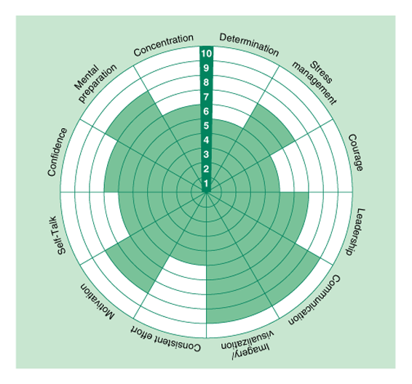
Performance Profile

Slide 10
Performance Profile Task
Outline the psychological skills that are important to you in the outer sections of the circle.
Rate yourself out of 10
Rate the best person in your activity out of 10

Slide 11
3 Phases of PST Programmes
1. Education Phase
Psychological skills need to be learned and practiced. Expect improvement as you develop these skills and refine them over time.
Increasing awareness of mental skills.

Slide 12
2. Acquisition Phase
Focus on strategies and techniques for learning the different psychological skills.
Tailor training programs to meet individual needs.
You can provide general information to the group or team, but be specific when developing an individual’s PST program.

Slide 13
3. Practice Phase
Learning psychological skills should progress from practices and simulations to actual competitions.
This phase focuses on automating skills through overlearning, integrating psychological skills, and simulating the skills you want to apply to actual competitions.

Slide 14
Implementing PST Programs
Who should conduct PST? (Sport psychologist or leader)
When should you implement PST? (In the off-season when there is more time)
How long should training last? (10 to 15 minutes a day, three to five days per week)
Mental training should continue throughout an individuals participation

Slide 15
Summary
Athletes acknowledge importance of mental skills but rarely practice them
Athletes of virtually all ages and skill levels can benefit from PST
Programmes should be tailored to individual differences and needs
Should last 3-6 months
Start during pre-season / off season
Psychologist / trained coach to implement
Links with enhanced performance

Slide 16
Review Questions
Why are PST programmes important?
Why is PST often neglected?
Discuss one way of assessing an individuals strengths and weaknesses with a view to implementing a PST.

