Slide 1



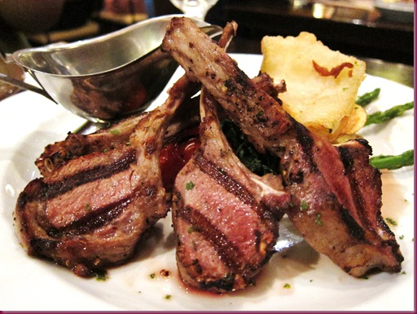
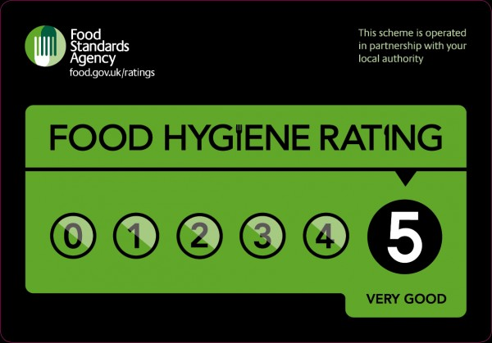
4 Star Takeaway Menu
Hotel Trinity
All ingredients locally sourced
Tel: 01792 481000 [ Collection Only]
We now receive Payments Cash or Card.
Exclusive Chef Specials are Based on 2 people sharing.
Fish
Starter. Curry clam soup (medium)
Beer battered Cod, Chips & Mushy Peas with Homemade Style Gravy.
Preferred wine of choice Sauvignon Blanc (White)
Meat
Starter. Crispy garlic pork belly with fine beans & Chorizo
Rack of Welsh lamb with Rosemary butter & Sweet Potato mash
Preferred wine of choice Cabernet Sauvignon (Red)
Bottled Wine are included with Set Meal of Choice. [Price £28.95]

