Slide 1
Electronic Health Records (EHR) in UK NHS
BMHP6026 – Digital Transformation in Health & Social Care
Student ID:2120469
Lecturer’s Name: Tati bangoura lecturer: martin svejda
Notes:
Good morning, I will be talking about my evaluation of EHRs in the United Kingdom in the NHS. Let me take a little closer look to how they impact services and patients, and this larger community healthcare arena. It's kind of interesting the ripple effects are not always clear, at first glance.

Slide 2
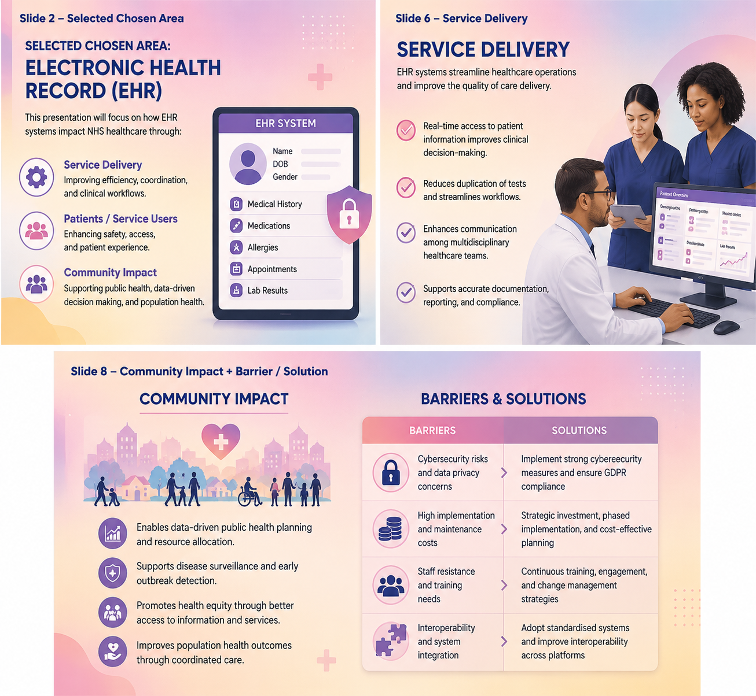
Introduction
EHR is a central digital innovation in UK healthcare, transforming how patient data is stored and accessed (NHS Digital, 2023).
It enhances patient safety, reduces medical errors, and improves the efficiency of clinical workflows.
This presentation will focus on the impact of EHR on Service Delivery, Patients/Service Users, and Community outcomes.
Notes:
One of the essential aspects of the UK's digital health agenda, EHRs are a centralised and secure repository for patient data, such as medical history, prescriptions, and test results. EHR can facilitate real-time access and boost patient safety and decrease errors, and it can also streamline clinical processes (NICE, 2019). Furthermore, the EHR can be used to support inter-hospital, GP practice and community services to support coordinated care. The impact it has on three key areas, service delivery, patient experience and wider community health outcomes, will be critically explored and benefits and challenges highlighted.

Slide 3
Overview of Electronic Health Records
EHR stores comprehensive patient data including medical history, prescriptions, and test results, replacing paper-based records.
The system is accessible across hospitals, GP practices, and community services, ensuring coordinated care for patients.
Visual representation shows data flow between departments and care settings, highlighting real-time information sharing and clinical decision support (WHO, 2021).
Notes:
An Electronic Health Record is a digital system that holds a wealth of information about patients, such as their medical history, medication details, test results, and treatment plans (NHS Digital, 2023). This means that authorised healthcare professionals in hospitals, GP practices and community services can access patient information in real time which decreases duplication of tests and improves care coordination. Visual diagrams can help to show the flow of patient information between departments, making it easier to understand how it is integrated. EHR helps to improve safer and efficient clinical decisions, which helps to promote continuity of care for patients.

Slide 4
HoW Electronic Health Records Works
EHR is a cloud-based system providing secure, real-time updates to patient records across healthcare settings.
Integrated alerts notify clinicians of medication interactions, allergies, or other safety issues, enhancing patient safety (Abu Esba et al., 2024).
The system enables seamless communication between departments and care providers, improving coordination and reducing delays in treatment.
Notes:
The EHRs are stored on a secure, cloud-based platform, with patient data being updated in real-time and accessible to authorised healthcare professionals, such as members of the hospital staff, GP surgeries and community care settings. Automated alerts for drug interactions or allergies are examples of safety features that help minimise clinical errors and improve patient safety (Bander Khalid Baurasien et al., 2023). Moreover, EHR can help to improve communication between departments, ensuring better coordination, minimizing delays, and fostering care continuity. The integrated approach showcases the potential of digital health technology in enhancing clinical efficiency and patient outcomes.

Slide 5

Chosen Focus Areas
Service Delivery: EHR improves workflow efficiency, integration, and continuity of care across NHS services.
Patients / Service Users: Enhances patient safety, engagement, and access through portals, while addressing digital literacy challenges.
Community Impact: Supports rural access, public health monitoring, and coordinated care for families and carers (NHS England, 2022).
Notes:
For this presentation, I have chosen three focus areas for evaluation of the effects of EHRs. First, Service Delivery - EHR enhances efficiency, communication and continuity of care between hospitals, GPs and community services. Second, Patients and Service Users, who want to be better engaged, have access to online records and will benefit from safer treatments, but are also facing a challenge related to their digital literacy (WHO, 2021). Third, Community Impact, a health ecosystem that enables access to healthcare in rural areas, population health monitoring, and family coordination, resulting in broader health ecosystem benefits.

Slide 6
Service Delivery Impact
EHR enables faster clinical workflows, reducing duplication of tests and documentation.
Supports integrated care across hospitals, GP practices, and community services, improving coordination and continuity (NICE, 2019).
Barrier/Solution: Interoperability challenges between different EHR systems can be mitigated through integrated NHS platforms and shared standards.
Notes:
Operational efficiency has also been improved through EHRs, which streamline workflows, minimise unnecessary testing, and provide quicker access to patient information, all of which help to deliver better services. They also facilitate the integrated care system, providing connections between hospitals, GP surgeries, and community services to ensure coordinated treatment and continuity of care for patients. Yet, there are still challenges in interoperability between different EHR platforms. This can be done through integration across the NHS, consistent standards of communication across departments and enhanced service delivery outcomes (Department of Health & Social Care, 2022).

Slide 7

Patients / Service Users Impact
EHR ensures better continuity of care and safer treatments through real-time access to patient information.
Patients can access their own health records via online portals, enhancing engagement and self-management.
Barrier/Solution: Limited digital literacy among some patients is addressed through guided support and educational resources (WHO, 2021).
Notes:
By enabling a clinician to access all patient information in real time, EHRs can significantly enhance the patient experience, improve the continuity of care, and decrease the number of medical errors (Adeniyi et al., 2024). Online portals for patients can also enable them to participate in their care, view results, monitor their treatment and communicate with care teams, supporting their ability to self-manage and take control of their care. But there are patients, especially adults, who have trouble with digital literacy. This is where tutorials, guidance, and support can help to close this gap, making sure that EHR systems can be effectively used and accessed equally. Tutorials, guidance, and support can help close this gap, ensuring equitable access and effective use of EHR systems.

Slide 8
Community Impact
EHR improves healthcare access for remote and rural communities by allowing digital consultations and record sharing.
It supports public health monitoring by enabling analysis of population-level data to inform planning and resource allocation.
Barrier/Solution: Digital exclusion in some areas can be mitigated through local outreach programs, training, and community support initiatives (Phillips et al., 2025).
Notes:
Through access for patients in rural and remote areas, digital consultation, and secure sharing of patient information across multiple services, Electronic Health Records improve community health (NHS England, 2022). They also enable public health officials to analyse aggregated data to monitor the health of populations, detect outbreaks and allocate resources appropriately. However, digital exclusion is a challenge especially for communities that don't have access to internet or technology skills. These differences can be mitigated through local outreach, training and community support efforts, and equitable benefits can be achieved from EHR implementation.

Slide 9
Challenges
Cybersecurity & GDPR compliance | EHR systems face cybersecurity threats and must comply with regulations to protect patient data.
High implementation & maintenance costs | Costs for hardware, software, and ongoing staff training can limit adoption, especially for smaller NHS trusts.
Workflow disruption | Updates, system integration, or staff adaptation may temporarily disrupt workflows (NICE 2019).
Notes:
Although there are definite advantages to implementing an Electronic Health Record, there are a number of challenges that are inherent in its implementation. Patient confidentiality is at stake in cybersecurity threats and adhering to GDPR's strict compliance is a must to safeguard sensitive information (GDPR, 2018). Developing and rolling out EHR systems, along with the hardware and software required, and the continuous training of staff can be a significant challenge for healthcare organisations, especially smaller NHS trusts. Furthermore, there can be a disruption to workflow when integrating the system or when the staff are adapting to the new digital processes, so it is important to plan, train, and support them to ensure a minimal impact on the patient care process.

Slide 10
Recommendations
1. Continuous staff training and CPD to ensure confidence and competency in using EHR.
2. Improve system integration across NHS platforms to enhance interoperability and reduce workflow disruption.
3. Implement robust cybersecurity measures and maintain GDPR compliance to protect patient data (GDPR, 2018).
4. Develop digital inclusion strategies for patients to ensure equitable access and usability.
Notes:
Continuous staff training and CPD need to be ensured to build confidence and competence in the use of digital systems and maximise the benefits of EHRs. Increasing system interoperability between NHS platforms will increase the integration of systems, minimise the risk of error and avoid the disruption of workflows (NHS Digital, 2023). Healthcare organisations need to have robust cybersecurity measures and be compliant with GDPR regulations to ensure the safety of sensitive patient information and trust in the system. Finally, digital inclusion strategies like support programmes and guidance helps patients with low digital literacy to access and effectively use EHR systems, thus supporting equitable health care delivery.

Slide 11



Conclusion
Notes:
Overall, the implementation of EHRs in healthcare delivery systems has revolutionised patient care and safety, while also boosting operational efficiency and minimizing errors in GP practices, hospitals, and community settings. Yet, there are difficulties to be faced particularly in the realms of digital literacy of staff and patients, cybersecurity risks and interoperability between different EHR platforms. In the future, the incorporation of AI tools and national interoperability within the NHS will result in further improvements to the quality, efficiency, and coordination of the healthcare system, allowing for lasting improvements in the care provided to patients and its value to healthcare professionals.

Slide 12
Reference
Abu Esba, L.C., Al Moaiseib, S., BinSabbar, N.S., Al Mardawi, G.H.S., Alkatheri, M. and Al Dekhail, S. (2024). Preventing Overrides of Severe Drug Allergy Alerts Initiative: an Implemented System Upgrade. Journal of Medical Systems, 48(1). Available at: https://doi.org/10.1007/s10916-024-02116-5.
Adeniyi, A.O., Arowoogun, J.O., Chidi, R., Okolo, C.A. and Babawarun, O. (2024). The impact of electronic health records on patient care and outcomes: A comprehensive review. World Journal of Advanced Research and Reviews, 21(2), pp.1446–1455. https://doi.org/10.30574/wjarr.2024.21.2.0592.
Bander Khalid Baurasien, Hind Saad Alareefi, Diyanah Bander Almutairi, Maserah Mubrad Alanazi, Aseel Hasson Alhasson, Alshahrani, A.D. and Sulaiman Ahmed Almansour (2023). Medical errors and patient safety: Strategies for reducing errors using artificial intelligence. International Journal of Health Sciences, [online] 7(S1), pp.3471–3487. https://doi.org/10.53730/ijhs.v7ns1.15143.
Department of Health and Social Care (2022). Data saves lives: reshaping health and social care with data. [online] GOV.UK. Available at: https://www.gov.uk/government/publications/data-saves-lives-reshaping-health-and-social-care-with-data/data-saves-lives-reshaping-health-and-social-care-with-data.
GDPR (2018). General Data Protection Regulation (GDPR). [online] GDPR. Available at: https://gdpr-info.eu/.

Slide 13
Reference
NHS England (2023a). Digital transformation. [online] England.nhs.uk. Available at: https://www.england.nhs.uk/digitaltechnology/.
NHS England (2023b). NHS England - Purpose of the GP Electronic Health Record. [online] www.england.nhs.uk. Available at: https://www.england.nhs.uk/long-read/purpose-of-the-gp-electronic-health-record/.
NICE (2019). Evidence standards framework (ESF) for digital health technologies. [online] NICE website: The National Institute for Health and Care Excellence. Available at: https://www.nice.org.uk/what-nice-does/digital-health/evidence-standards-framework-esf-for-digital-health-technologies.
Rydzewski, P. (2025). Digital Inequality and Sustainable Development. Problemy Ekorozwoju, [online] 20(1), pp.96–108. Available at: https://doi.org/10.35784/preko.6691.
Tanyanika Phillips, Tanyanika Phillips, Tanyanika Phillips, Tanyanika Phillips and Dan J. Raz (2025) 'Insights from a Patient-Centered Lung Cancer Navigation Program in a Low-Resource Community,' Current Oncology, 32(9), p. 491. Available at: https://www.mdpi.com/1718-7729/32/9/491.
World Health Organization (2021). Global strategy on digital health 2020-2025. [online] World Health Organization. Available at: https://www.who.int/publications/i/item/9789240020924.

Slide 14
Any Query

Slide 15
Thank you
Everyone

