Slide 1

ECDE7018
Session 4

Slide 2

Investigating food preference
Many theories have been offered to explain food preference in humans, some of which are biological, others due to environmental influence.
Carry out a study to investigate:
Whether more males or females are vegetarians;
How long the males and female participants have been vegetarian.
Task:
Decide whether this is a qualitative, quantitative or mixed-methods study.
Consider why we might need this information – who would use it?
What could you add to or change about the study to ‘improve’ its value?

Slide 3

observation

Slide 4
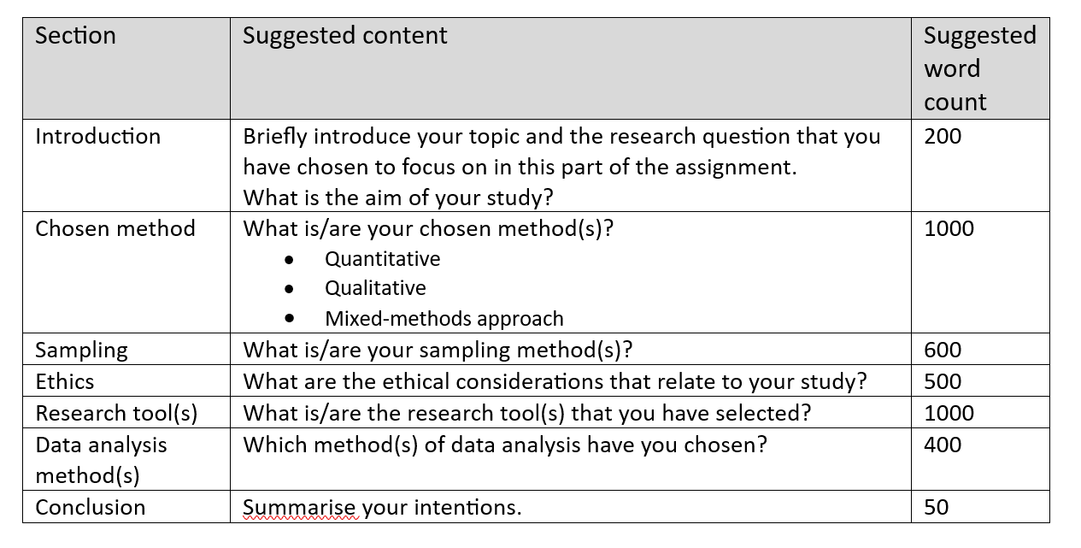
Assessment Component 2

Slide 5
Observation
It is part of a teacher/lecturer’s role
You can see things in their natural context
You can see things that may escape conscious awareness
You can learn about things that people may be unwilling to talk about
It can be inconspicuous and part of normal classroom routine
It can be the least intrusive of all methods

Slide 6
Research Evidence:
Can observers spot good teaching?
Strong et al. (2011) used value-added scores to identify ‘effective’ and ‘ineffective’ teachers, showed videos of them teaching to observers and asked them to say which teachers were in which group.
What do you think the figures showed?
Strong, M., Gargani, J. & Hacifazlioglu, O. (2011) Do We Know a Successful Teacher When We See One? Experiments in the Identification of Effective Teachers. In Journal of Teacher Education, Volume: 62 issue: 4, page(s): 367-382

Slide 7
The study found that:
In the experiments where the observers were not trained in observation, the proportion correctly identified by experienced teachers and head teachers was below the 50% that would be expected by pure chance.
At this level of accuracy, fewer than 1% of those judged to be ‘Inadequate’ are genuinely inadequate; of those rated ‘Outstanding’, only 4% are actually outstanding.
Overall, 63% of judgements will be wrong.

Slide 8

The authors concluded that:
(a) observers, no matter how experienced, are unable to identify successful teachers
(b) certain cognitive operations may be contributing to this outcome

Slide 9

In other studies:
If a lesson is judged ‘Outstanding’ by one observer, the probability that a second observer would give a different judgement is between 51% and 78%.

Slide 10
How can the research evidence be so out of line with our intuition?
Observation produces a strong emotional response (is it difficult not to think about what we ‘would have done’?);
Learning is invisible (can we ‘see’ when / what pupils are learning?);
We assume that if you can do it, you can spot it (can you describe everything you do explicitly?);
We don’t believe that our observation can miss things (in-attentional blindness).
https://www.youtube.com/watch?v=IGQmdoK_ZfY
Taken from Professor Rob Coe:
https://www.cem.org/blog/414

Slide 11

What can be observed …

Slide 12

What can be observed?
Human behaviour
Physical actions and interactions
Verbal behaviour
Expressive behaviour
Spatial locations
Temporal patterns
Physical objects

Slide 13

How can we observe?

Slide 14
How can we observe?
Qualitative observation
Quantitative observation

Slide 15


How can we observe?
Qualitative observations…
Quantitative observations…
involve observing people, events, or physical characteristics in their natural setting.
They are made when you use your senses to observe the results.
could be made with instruments such as rulers, cylinders, beakers and thermometers.
These results are measurable.
OR…..

Slide 16
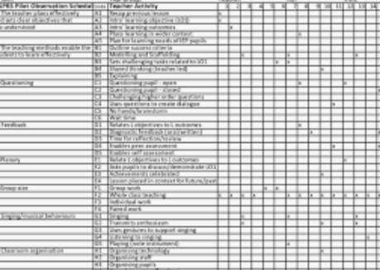
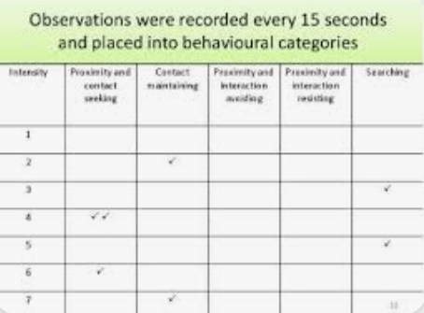
Quantitative observations…
Quantitative observation is used when the researcher wants to be able to numerically describe the phenomenon (Ellis, 2022)
could include systematic observation - used to count how often a particular phenomenon is observed.
The items and the manner of the observation are well defined; e.g. using a tick-box system or assigning a score to the observation.
Ellis P (2022) Understanding Research for Nursing Students (5th edn) London: Sage.

Slide 17
Types of Observation
Structured Unstructured
Sometimes we have something specific we want to observe – leadership skills; level of participation etc.
We use a structured, preset guide (schedule) of what to observe or a checklist.
Sometimes we want to see what is naturally occurring or exists without predetermined ideas. We use have an open-ended approach to observation and record all that we observe.
Looking for
Looking at
Observing what does not happen may be as important as observing what does happen.
Notes:
Unit 5: Collecting data

Slide 18

Your role in observation
A choice between:
*Non-participant observation - Researcher is not part of the activity taking place, but simply observes.
*Participant observation - Researcher takes part in community, organisation or activity. Researcher attempts to learn what it is like to be part of the community, organisation, or participate in the activity.

Slide 19
Your role in observation
A choice between:
*Overt observation = those being observed are aware of the fact that they are being observed.
*Covert observation = the researcher is "undercover“; i.e. the participants are unaware that they are being observed.
If you are an overt, non-participant observer (i.e. ‘fly-on-the wall), how will you deal with interested participants?

Slide 20

OBSERVATION
Strengths
Limitations

Slide 21
Advantages of Observation in Research
Provides the researcher the opportunity to watch what people actually do rather than relying on reports of what they say they do.
Can avoid biasing factors e.g. those caused by an interviewer.

Slide 22
Limitations of Observation Research
Only behaviour and physical personal characteristics can usually be examined. The researcher does not learn about motives, attitudes, intentions, or feelings.
Can be time consuming if the observed behavior occurs rather infrequently.
Interpretation of data may be a problem.
Possible invasion of privacy.

Slide 23
Limitations – the observer…

Slide 24

Observer Effect
The presence of an observer can have a considerable effect on the behaviour of those being observed.
Explaining to a participant what you are doing may affect their behaviour
Behaviour or ‘act’?
Roethlisberger and Dickson (1939)
Hawthorne effect – the presence of an observer increased productivity at the Hawthorne electrical works, Chicago

Slide 25
Observer Bias
Certain attitudes may bias what you “see”
Observer expectations
Observer emotions

Slide 26

You have 15 seconds to look at the image.
You can:
*draw a picture
*make a list / notes
How well do you observe?

Slide 27
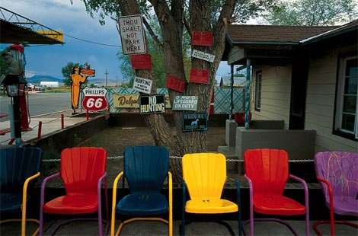

Slide 28
How well do you observe?

Slide 30

What next?

Slide 31

Steps in planning for observation
WHO: Decide who will be observed.
WHY: Establish why they are selected
WHAT: Determine aspects that will be observed (characteristics, attributes, behaviours, etc.)
WHEN: Determine when observations will be made.
WHERE: Determine where observations will be made
HOW: Develop the observation schedule
HOW: Pilot / test the observation schedule
DO: Conduct the observations
SO?: Analyse and interpret the collected information.
SHARE: Write up your findings.
Notes:
Unit 5: Collecting data

Slide 32
Discussion Points
Reliability
Validity
Representative sample
Generalisability
Notes:
Reliability is the degree to which an assessment tool produces stable and consistent results. Other researchers must be able to perform exactly the same experiment, under the same conditions and generate the same results.
Validity refers to the credibility or believability of the research. Are the findings genuine? Do your findings truly represent the phenomenon you are claiming to measure?
A representative sample is a small quantity of something that accurately reflects the larger entity. An example is when a small number of people accurately reflect the members of an entire population. In a classroom of 30 students, in which half the students are male and half are female, a representative sample might include six students: three males and three females.
“Generalisation is concerned with the application of research results to cases or situations beyond those examined in the study.” Collis and Hussey 2003
Can the results of the research be applied more generally and more widely than the study itself or are they only relevant to the specific context of the study?

Slide 33
Generalisability
the application of research results to cases or situations beyond those examined in the study
Reliability
the degree to which an assessment tool produces stable and consistent results.
Validity
the credibility or believability of the research. Are the findings genuine?
Representative sample
a small quantity of something that accurately reflects the larger entity

Slide 34

Observation schedules
Strengths and challenges???
On the next two slides, choose option 1 or option 2.
Discuss:
* For what reason(s) would you use your observation schedule?
* How would you use it?
* What type of data would you collect?

Slide 35
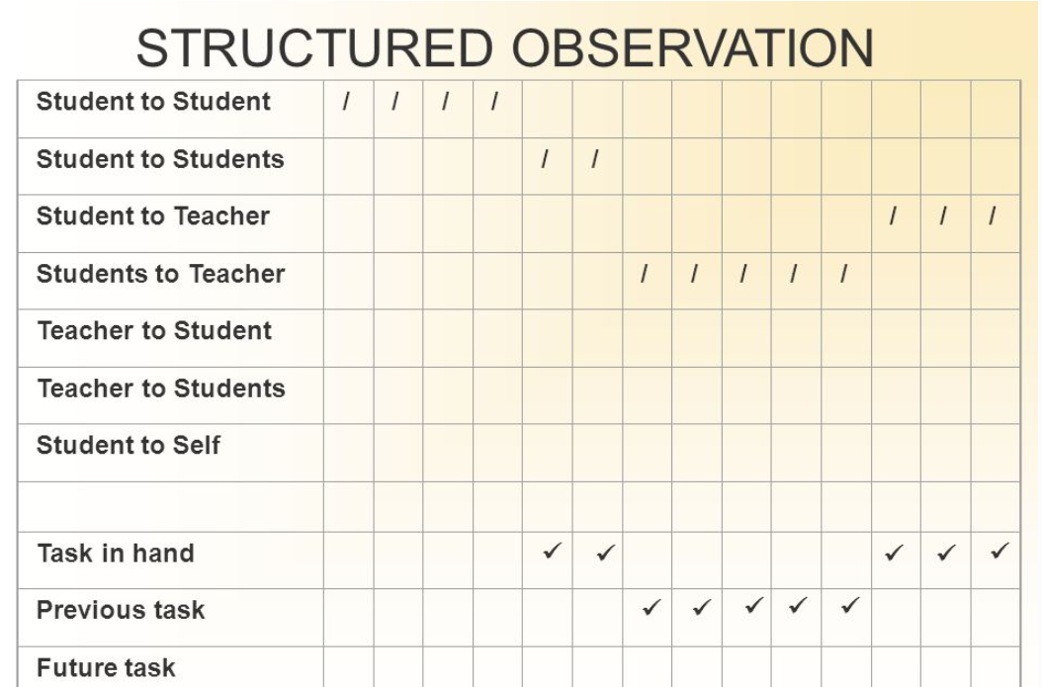
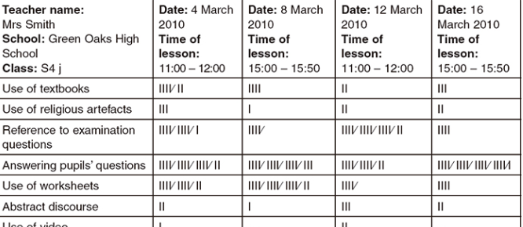
Option 1
Option 2

Slide 36
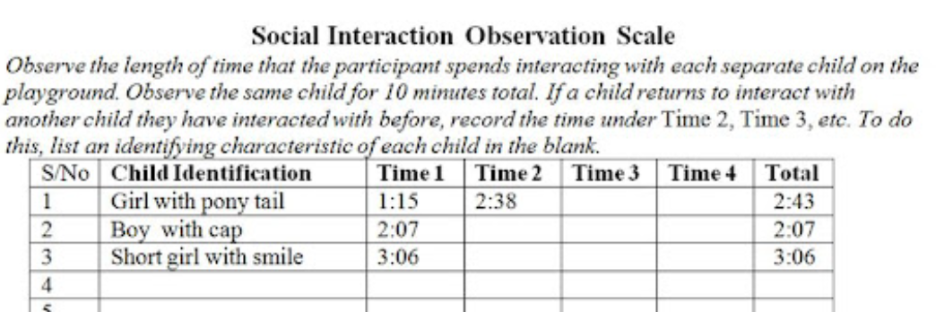
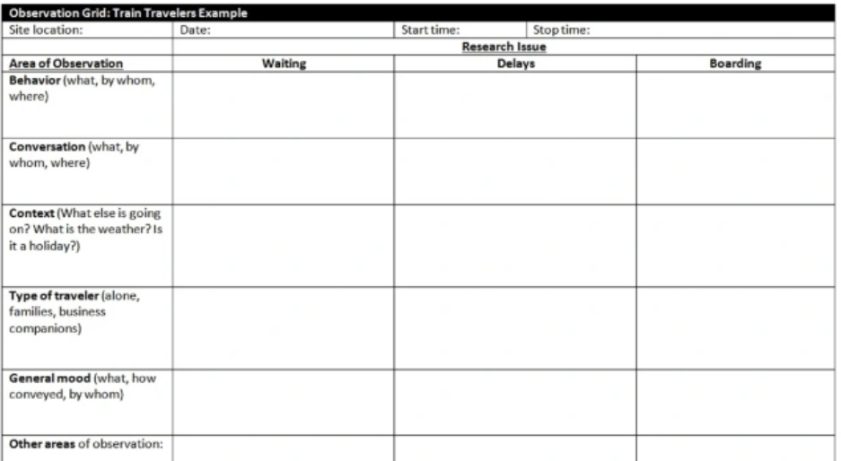
Option 1
Option 2

Slide 37
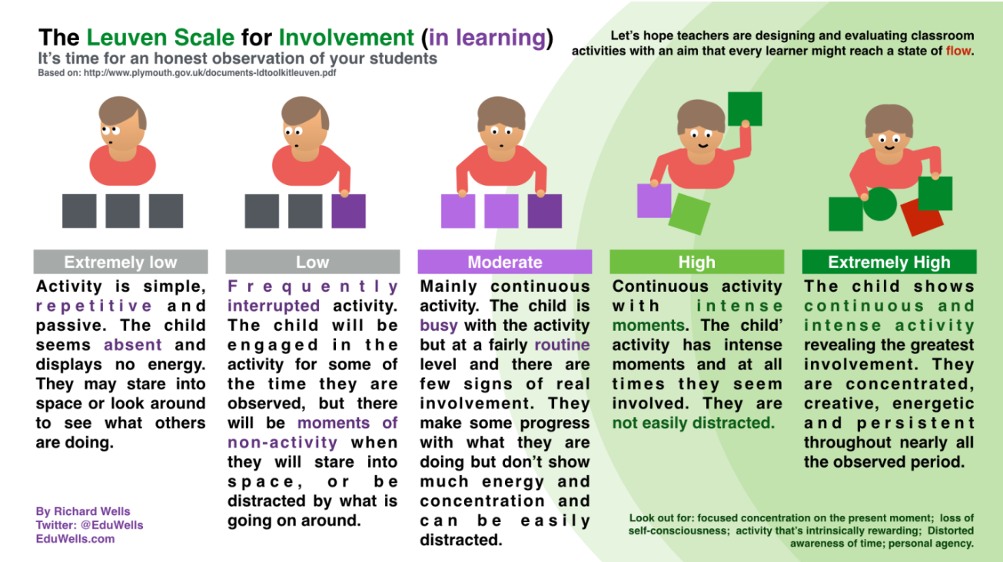
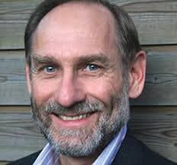
Leuven Scale
Ferré Laevers
Notes:
Using Leuven scale to judge participation

Slide 38
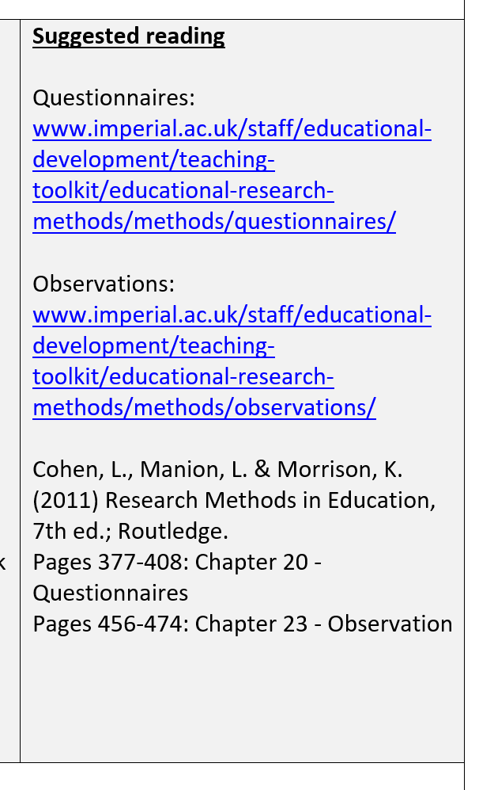
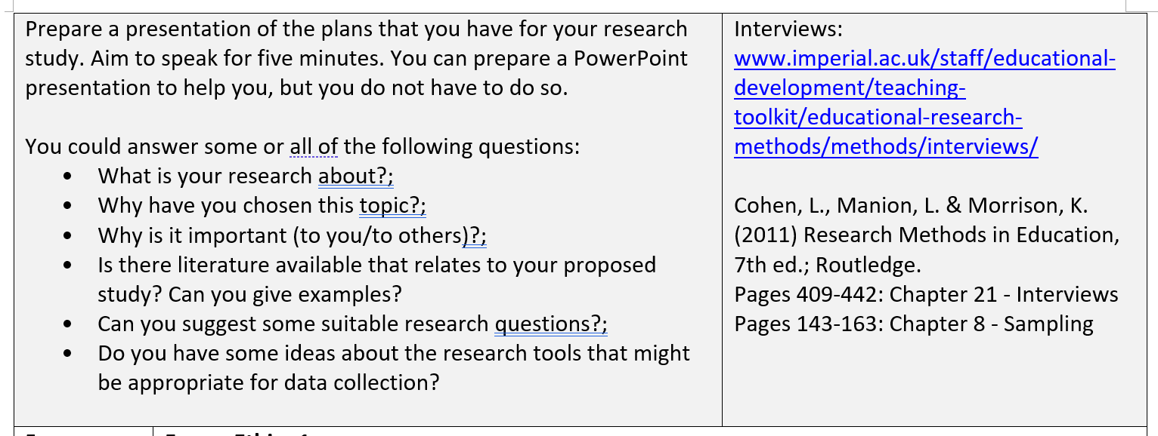
Follow-up Task(s)

Slide 39

sampling

Slide 40
Research Question:
Do university students think that they are cleverer than their peers?
(i.e. others of the same age who are not university students)
The target population is the 10,000 undergraduate students at my university.
I recruit 200 participants.
They are studying in the Faculty of Science and Engineering.
Most of them are British, male, 18–20 years old and from a high socio-economic background.
I give them a maths test.
I then ask them to rate how well they think performed compared to everyone else.
The finding show that the average participant believes that they are cleverer than 66% of the population.
Can I conclude that most people believe themselves to be cleverer than their peers?

Slide 41

What is a sample?
Why use a sample?
Should the sample always be representative?

Slide 42
Assessment Component 2

Slide 43

Random and non-random sampling techniques – which will you choose?
Flick, 2014

Slide 44
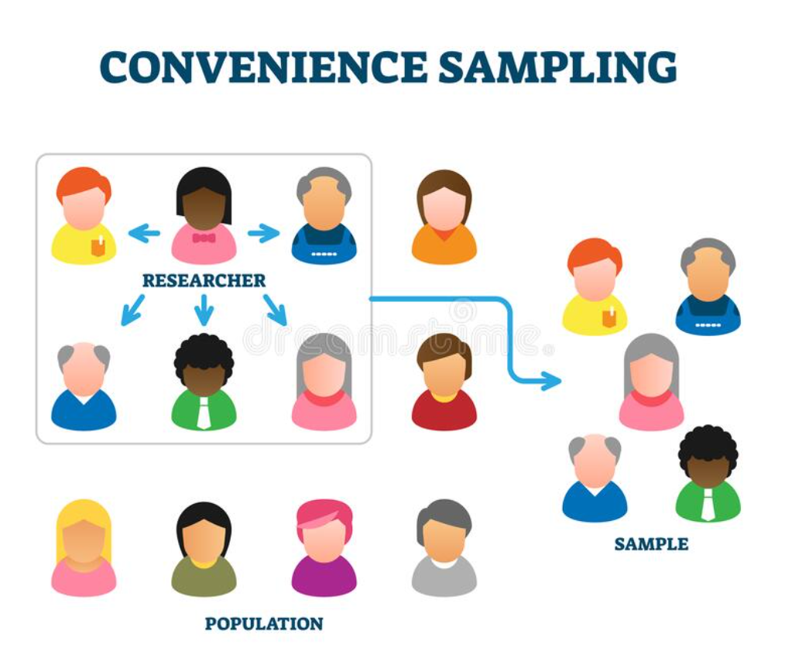
Convenience sample
(non-random sampling)
Example:
Deliberately choose a group of people who are most likely to provide information that will answer your research question (e.g. teachers from a school who you know use a specific strategy)
Benefit:
You have participants that are likely to give you the information you want to get
Limitations:
Does not produce a representative sample of the population and this can distort the results.
Findings cannot be generalised to the wider population.
Notes:
This means that you select those members of the community who you think will provide you with the best information.

Slide 45
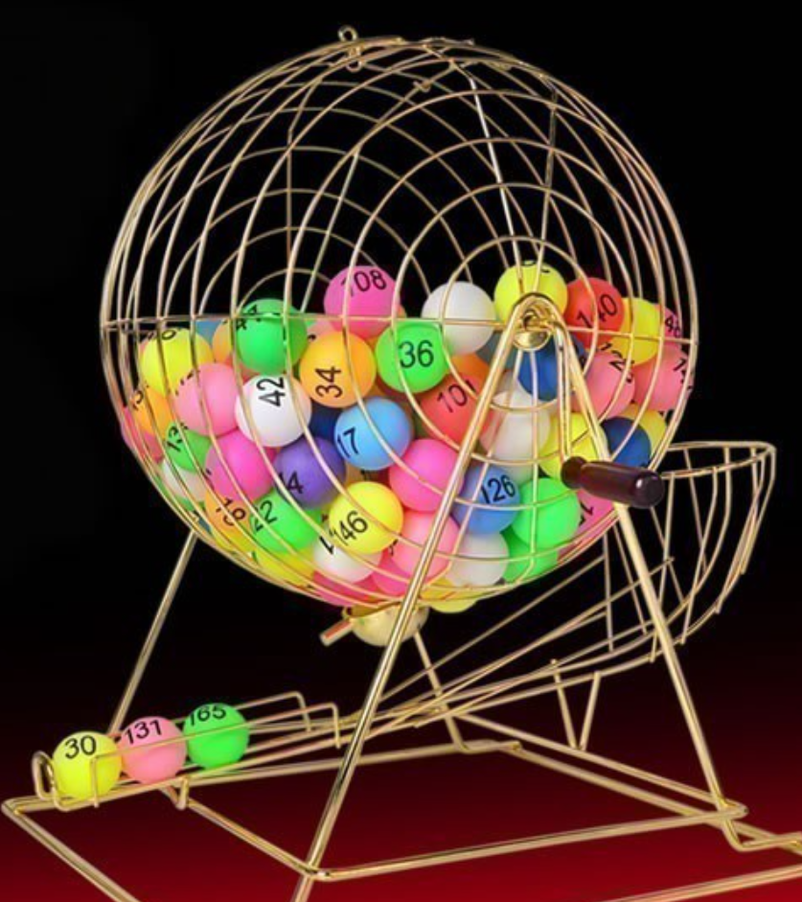
Simple random sample
Example:
Assign a number to all 100 students.
Then, use a random number generator to select 10 random numbers and use the corresponding students as members in the sample.
Benefit:
Simple random samples are usually representative of the population we are interested in since every member has an equal chance of being included in the sample.
Notes:
Randomly select individuals through the use of a random number generator or some means of random selection.
A simple random sample is used to represent the entire data population. It is often used when there is very little information available about the data population, when the data population has far too many differences to divide into various subsets, or when there is only one distinct characteristic among the data population. For example, a sweet company may want to study the buying habits of its customers to determine the future of its product line. If there are 10,000 customers, it may use choose 100 of those customers as a random sample. It can then apply what it finds from those 100 customers to the rest of its base. It will sample 100 members purely at random without any regard for their individual characteristics.

Slide 46
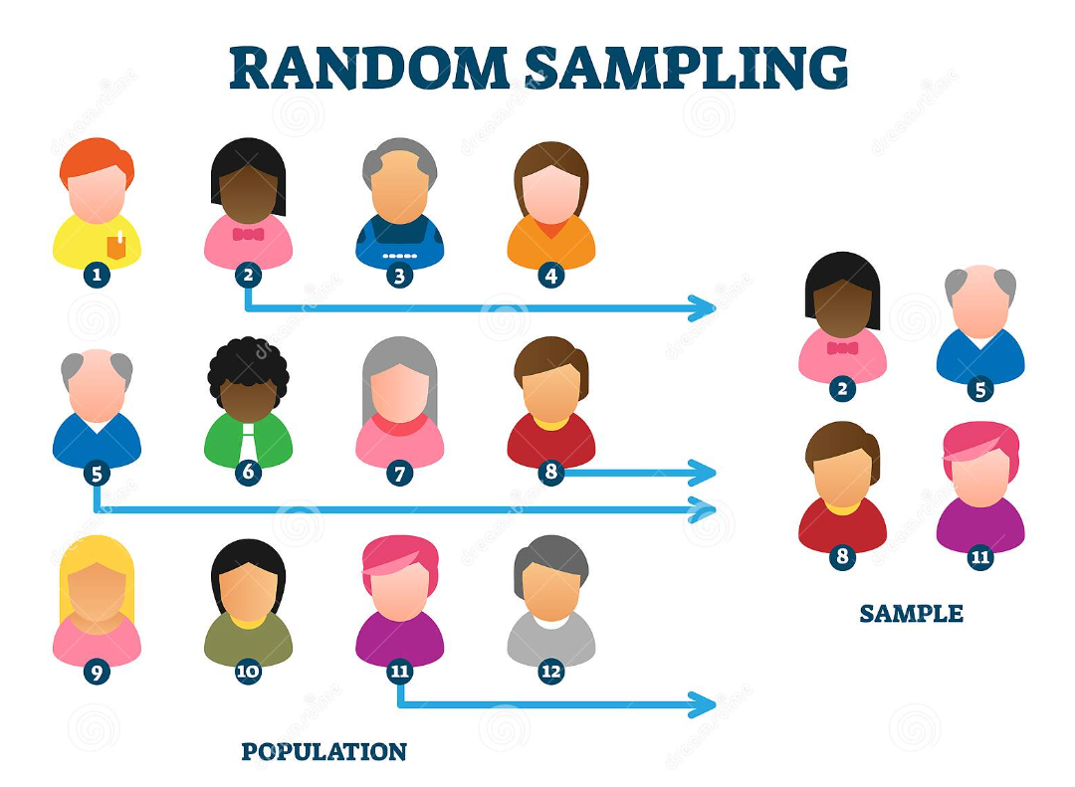
Systematic random sample
Example:
Create a list in alphabetical order based on the surname of all your students, randomly choose a starting point, and pick every 3rd student to be in the sample.
Benefit:
Systematic random samples are usually representative of the population we are interested in since every member has an equal chance of being included in the sample.
Notes:
Put every member of a population into some order. Choose a random starting point and select every n^{th} member to be in the sample.

Slide 47
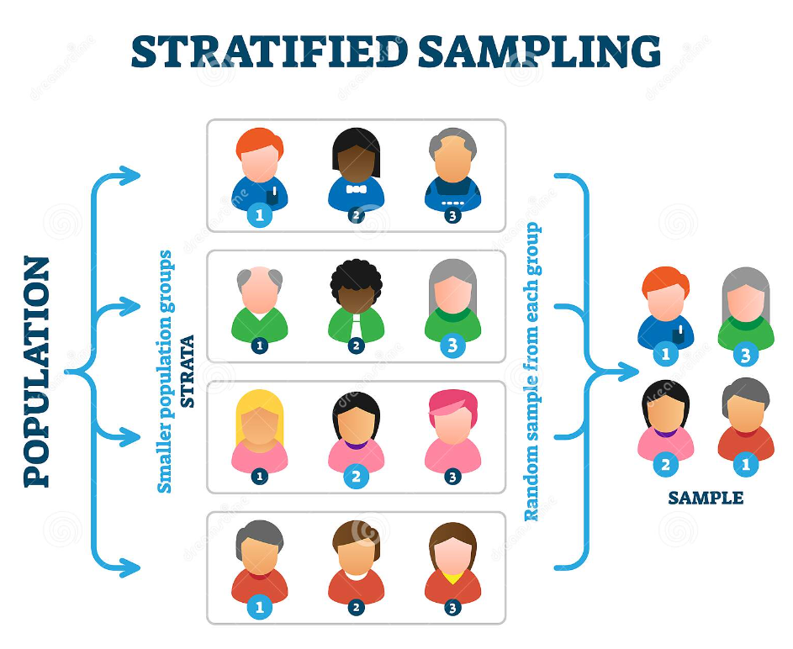
Stratified random sample
Example:
Split up all students according to their year group – Year 5, Year 7, Year 9 and Year 11. Randomly select 25 students from each grade to be in the sample.
Benefit:
Stratified random samples ensure that an equal number of students from each year group are included in the sample.
Notes:
Stratified random sampling involves dividing the entire population into homogeneous groups called strata (plural for stratum). Random samples are then selected from each stratum.
However, stratified sampling is more complicated, time consuming, and potentially more expensive to carry out than simplified random sampling.

Slide 48

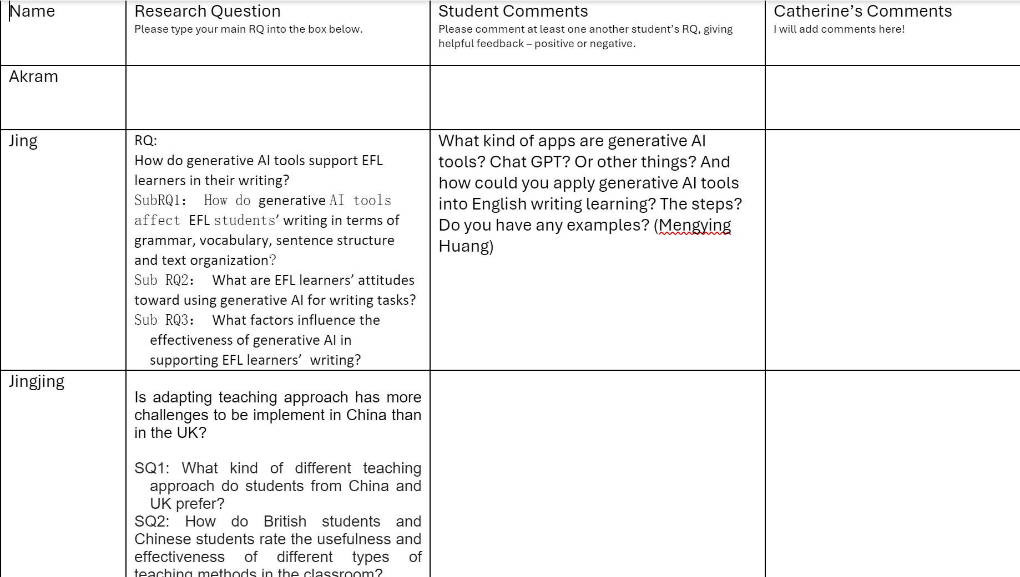
To do:
Input
your research question(s) to the shared document (if you have not already done so).
Comment
on someone else’s RQ.
Thank you
to those who have already done so.

Slide 49

Time for lunch.
See you next week.

