Slide 1
Theme: “The Role of Artificial Intelligence in Transforming Operational Efficiency in Hospitality Industry”
Student Name: Alexandra Craescu
Student ID: 2111926
Tutor:Dr Ernest Balutie Wavei

Slide 2

Introduction
AI enhances decision-making and automates repetitive tasks
Supports service speed, accuracy, and guest personalisation
Addresses labour shortages and rising cost pressures
Hospitality sector valued at $4.5 trillion globally
Increasing demand for innovation and contactless service post-COVID
Notes:
Because of AI, the hospitality business benefits from improved operations and more personalised service. Being valued at $4.5 trillion globally, the hospitality industry needs solutions that can be scaled, are reliable, and are not expensive. Because of AI, hotel operations are improved by dealing with mundane duties, making them less error-prone, and ensuring services are up to standard. Digital and contactless methods of doing business have become necessary after the pandemic to ensure safety, good operations, and to win customer trust. AI is able to read and analyse information in real time, helping hotels adapt to guests' wants and limit their spending. It looks at the ways in which AI is influencing the operations of the hospitality industry. Through AI, hospitality businesses become more flexible, tough, and competitive in the world market.

Slide 3
Theoretical Foundations Supporting AI Adoption
  Technology Acceptance Model (TAM) – predicts staff and guest adoption(Davis, 2019)
  Resource-Based View (RBV) – AI as a long-term competitive advantage(Alvarez and Thomas, 2022)
  Smart Hospitality Concept – integrates AI with service design (Gretzel et al., 2020)
  Aligns with PEST drivers: Political, Economic, Social, Technological
  Supports adaptive service models and innovation strategies
Notes:
Begin by recognising why AI is important because of the theory behind its use. The TAM explains that people judge AI to be useful and adopt it when they believe it is easy to use (Davis, 2019). On the other hand, the RBV framework indicates that AI is necessary for a hospitality business to remain ahead and competitive by adapting old processes (Alvarez and Thomas, 2022). It means that AI is important for innovative ways of interacting with guests, responding to changes in the industry, and being competitive (Gretzel et al., 2020). All of these frameworks are in line with political, economic, social, and technological aspects that shape growth (PEST). Due to political regulations, cost pressures, consumer habits changing, and fast technological changes, AI is being implemented in the industry. You can use this framework to check the effects of AI on daily operations, the satisfaction of guests, and the durability of the business, keeping up with new market demands.

Slide 4
AI Technologies in Use
  Chatbots for automated customer service and FAQs(Tuomi et al., 2021)
  Predictive analytics for demand forecasting and resource planning
  Facial and biometric recognition for secure, fast check-in
  Robotics for housekeeping and concierge tasks(Tussyadiah, 2020)
  Voice assistants for room control and multilingual support
Notes:
Chatbots respond to simple questions around the clock and handle basic language barriers, giving customer care relief. Predictive data analysis helps with resource planning, forecasting both demand and occupancy. With AI, facial recognition makes checking in safe and efficient, and robots are now in charge of repeating routine tasks at hotels. AI systems are now put to use across different parts of the hospitality sector. With chatbots in place, there is 24/7 support in several languages for guests, and the team can focus on more important tasks (Tuomi et al., 2021). Predictive analytics makes it easier to plan by predicting changes in demand and the number of guests. Face recognition systems simplify cheque-ins and ensure they are safe and secure, while robots provide the same service for cleaning and concierge workers, providing regularity and cutting costs (Tussyadiah, 2020). Voice assistants allow guests to control different aspects of their rooms without speaking English or other languages. They streamline operations and save costs by automating different fields of service. They help deal with staff shortages and wage inflation without sacrificing the high quality of service. As a result, such technologies introduce a data-driven way of hotel operations, where guest needs and performance are constantly reviewed and updated with automation and AI.

Slide 5
Efficiency Gains and Cost Reduction
  Automates manual tasks to reduce labour dependency(Ivanov & Webster, 2019)
  Enhances inventory and energy management efficiency
  Improves staff scheduling accuracy and reduces downtime
  Cuts operational costs through intelligent system monitoring
  Provides real-time performance tracking and alerts
Notes:
AI is mainly useful in the hospitality industry for making things more efficient and less costly. Through AI, hotels are able to automate housekeeping, answer customer inquiries, and manage reservations, making them less dependent on manual support and allowing for better service (Ivanov & Webster, 2019). Energy management platforms help hotels improve their energy efficiency and slash utility charges. Smart scheduling powered by AI makes sure there is not too much or too little staff on duty, boosting efficiency and cutting down on unnecessary costs in payroll. AI also enables hotels to check their progress in real-time and take action when needed. AI helps ensure customer service consistency and better decision-making by every team. Introducing AI for cost-reduction purposes is possible across all systems in a hotel. Because the industry is dealing with margin pressure, inflation, and recovering from the pandemic, these efficiencies matter a lot. When hotels use AI for cost savings, they create operations that adapt well to any changes and shortages in the market.

Slide 6
Guest Experience Enhancement
  AI enables 24/7 customer support in multiple languages(Li et al., 2019)
  Personalised service based on customer data analysis
  Reduces human error and improves satisfaction consistency(Tussyadiah, 2020)
  Fast, contactless interactions increase comfort and safety
  Builds long-term guest loyalty through tailored experiences
Notes:
AI makes sure the guest experience is improved by giving them faster and more customised assistance. Chatbots and virtual assistants make it easier and faster for guests to get the services they need in their language (Li et al., 2019). Through AI, offerings are customised to guests’ likes and dislikes as seen in their booking history. Facial and biometric recognition allows hotels to provide quick and safe services, making things more convenient for guests. This use of AI is especially needed in global chains since it offers consistency as well as reduced opportunities for mistakes (Tussyadiah, 2020). AI ensures that guests are assessed before any needs arise and solutions are presented. Because of AI’s personalised services, guests remain satisfied, trust the company, and come back repeatedly. This means that AI helps to make operations run smoothly without losing focus on satisfaction. It makes it possible for hotel staff to strengthen caring and personalised service, while machines take care of the tasks that do not require much interaction.

Slide 7

Influencing Macro Factors – P & E of PEST
  Data protection laws impact AI system design and usage
  GDPR compliance is essential for biometric and behavioural data(Zeng et al., 2020)
  Labour shortages push hotels toward automation investments
  Inflation increases pressure for cost-efficient solutions
  AI offers scalable efficiency without proportional labour increases
Notes:
AI is being adopted because of political and economic factors. Because of GDPR, AI systems used for storing biometric and behavioural data have to meet strict privacy and ethical standards (Zeng et al., 2020). Market conditions and political regulations can decide the pace of adopting digital transformation. As wages increase and there are not enough workers, hotels look to AI to save on labour while still maintaining their service quality. Inflation encourages hotels to use AI that expands their services without matching costs. Under these conditions, AI must be used as a necessary and not just an optional part of the system. Government policies or grants aimed at digital transformation boost the use of AI in hotels. Both social and economic aspects help decide where and under what conditions AI is best used in hotels.

Slide 8

Influencing Macro Factors – S & T of PEST
  Guests prefer tech-enabled, low-contact experiences post-COVID(Gretzel et al., 2020).
  Increased digital literacy encourages AI interaction adoption
  Smart technologies enable data-driven service personalisation
  Tech advancements improve AI reliability and integration speed
  Ethical concerns arise around data use and AI biases
Notes:
Such developments increase the use and acceptance of AI (both from guests and employees). More and more post-pandemic guests prefer services that use technology, like mobile cheque-in and rooms controlled by voice commands (Gretzel et al., 2020). Growing digital knowledge with all age groups boosts acceptance of AI, and this is especially noticeable in Gen Z and millennials who want and expect service tools on their travel trips. Technologically speaking, new achievements in machine learning, cloud computing, and IoT make it easier for AI to be used reliably, quickly, and on a large scale. Because of these developments, the cost of adding AI is lower, and it can be used in multiple areas of a hotel. Still, as more people realise these issues, there is more scrutiny on AI, and it must show transparency and fairness in its design. It is important to focus on ethics as well as new developments. Responsible use of AI benefits a hotel by providing top service while building trust among the guests. Satisfying society’s expectations about AI and implementing it properly are both required for AI to succeed.

Slide 9

Industry-Wide Responses
  Hotels implement chatbots, smart rooms, and robotic staff(Li et al., 2019)
  Dynamic pricing powered by real-time demand analytics(Kuo et al., 2019)
  Cloud-based AI platforms streamline cross-departmental operations
  Training programs launched to reskill employees for tech roles
  Hybrid service models combine human empathy with AI efficiency
Notes:
Hotels now take steps to capitalise on AI, including using AI in booking and support, maintenance tasks, room controls, and revenue management. Industry practices involve using chatbots for support and booking and cleaners for maintenance, along with using AI to control rooms for personalisation (Li et al., 2019). With help from machine learning-powered pricing, hotels can now use live demand data and competition to maximise revenue. By using AI, departments in a company are able to work together more effectively and reduce their service separation (Kuo et al., 2019). Efforts are underway to equip employees with the skills needed for AI-based employment, for example, operating AI programmes or being a digital concierge. By adopting AI, the hospitality industry is changing to use both human comfort and modern technology. Yet, having AI depend on a company’s preparation, financial means, and the way it welcomes innovation. Though AI isn’t perfect, it is significant for dealing with the challenges in hospitality nowadays. Thus, AI allows hospitality to quickly react to change, remain strong, and provide personalised service for guests in a competitive market.

Slide 10

Critical Reflection on AI Impact
  Strengths: speed, cost reduction, accuracy, data-driven service
  Enhances consistency and meets modern guest expectations(Tussyadiah, 2020)
  Limitations: job displacement concerns, high investment cost
  Risk of over-automation reducing human warmth in service
  Success depends on ethical deployment and staff readiness
Notes:
AI is a great asset, yet it also has pros and cons in its usage. In addition, AI automates typical tasks, allowing team members to focus on what guests value most, giving better service, and making things run more smoothly. AI automates common tasks, enabling employees to focus on more important jobs, and streamlines the whole way things are done in hotels. But some concerns are a high price, especially for smaller organisations, and cutting down on human communication is crucial to hospitality's emotional value (Tussyadiah, 2020). Another issue is that there are ethical problems related to privacy, job losses, and bias in AI. How well a company prepares its workforce for technological progress can be important for performance levels. Consequently, to succeed with AI, companies must make sure it is used for support, instead of removing human staff. In addition, firms must ensure AI does not replace human service, as this is important for hospitality. Also, organisations must make sure their AI systems are managed responsibly. Looking carefully at these issues, companies are able to make responsible and successful strategies for AI in their industry.

Slide 11
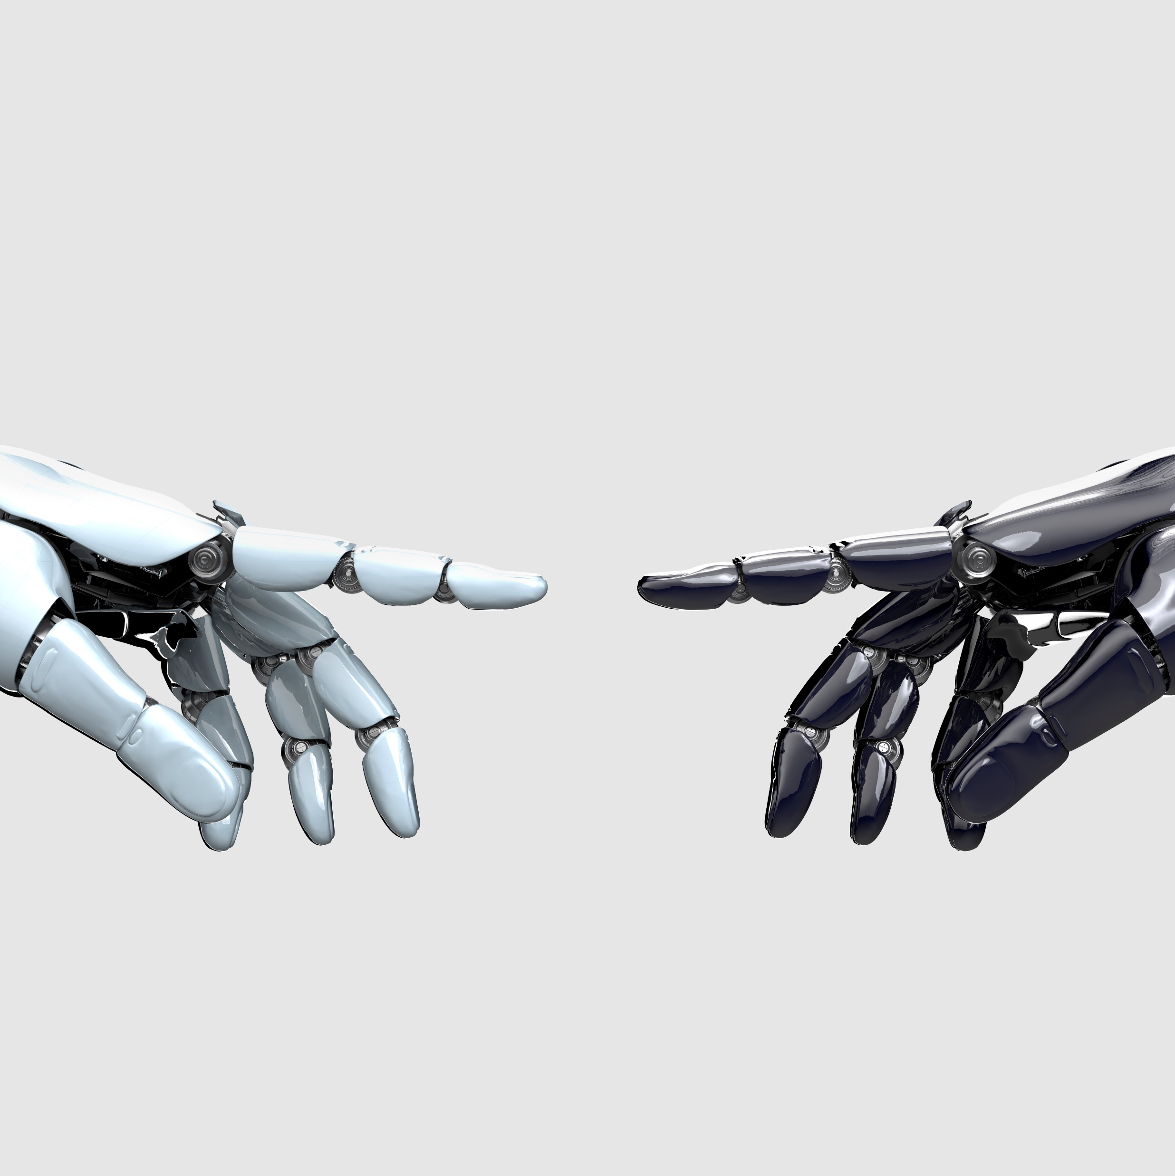
Conclusion
  AI transforms routine hospitality functions through automation
  Enhances speed, accuracy, and personalisation in guest services(Kuo et al., 2019)
  Addresses labour shortages and cost-efficiency imperatives(Gretzel et al., 2020)
  Requires ethical deployment and human-AI service balance
  A strategic necessity for long-term competitiveness and resilience
Notes:
All in all, AI changes hospitality operations and how services are delivered. AI is used to handle mundane duties, raise hospitality standards, and offer real-time personalised services to make the experience better for guests (Kuo et al., 2019). AI also helps solve staffing issues and inflation concerns, and leads to scaled operations and quality. We should not forget that human-centred design is important to ensure AI does not replace hospitality’s empathy and attention to people. It is important that strong governance addresses ethical questions such as data privacy or the risk of job loss for workers. AI cannot simply substitute human service; Because of this, AI is crucial for growth, flexibility, and surviving challenges in a tough market (Gretzel et al., 2020). AI can only benefit hotels if it supports rather than replaces human staff and helps maintain a good service level. Lean towards AI to achieve a competitive edge and to serve today’s travellers, who expect a lot of technology and convenience.

Slide 12
Recommendations
  Adopt hybrid AI-human service delivery for balance and empathy(Tussyadiah, 2020)
  Strengthen data privacy and cybersecurity measures (e.g., GDPR compliance) (Zeng et al., 2020)
  Upskill staff to align with AI-enhanced service workflows
  Invest in scalable AI infrastructure and modular platforms
  Foster ongoing innovation through academic–industry partnerships
Notes:
Make sure AI enhancements are paired with human service in hotels for a better guest experience (Tussyadiah, 2020). Focusing on data safety by conforming to the GDPR and cybersecurity rules encourages guests to trust the organisation and ensures their confidence is not misused (Zeng et al., 2020). Ensuring everyone is trained on AI is necessary, as working with AI will be much simpler for employees and will ensure good results. Organisations are advised to choose AI systems that can grow in steps and cost less to implement at first. Partnering with universities and other tech organisations helps to innovate and ensure that AI is used properly. As a result, AI is adopted heartily and fairly by everyone. This way, hospitality organisations can enhance their performance, please guests, and compete in the current market. Focusing on responsible, user-centred AI programmes can support the organisations’ long-term development and the satisfaction of both clients and the workforce.

Slide 13
References
  Alvarez, L. and Thomas, J. (2022). Regulatory impacts on AI innovation in hospitality. Journal of Hospitality Policy, 17(2), 55-70.
  Chen, H. and Zhang, M. (2024). Data privacy and AI adoption in hotel services. International Journal of Tourism and Hospitality Technology, 14(1), 89-105.
  Davis, F. D. (2019). Perceived usefulness, perceived ease of use, and user acceptance of information technology. MIS Quarterly, 13(3), 319–340.
  Gretzel, U., Sigala, M., Xiang, Z. and Koo, C. (2020). Smart tourism: foundations and developments. Electronic Markets, 30(1), 7–18.
  Ivanov, S. and Webster, C. (2019). Robots, Artificial Intelligence and Service Automation in Travel, Tourism and Hospitality. Emerald Publishing.
  Kuo, Y.-F., Chen, L.-S. and Tseng, C.-Y. (2019). Investigating an innovative service with hospitality robots. International Journal of Hospitality Management, 82, 209–219.
  Li, J., Bonn, M. A. and Ye, B. H. (2019). Hotel guest experiences with artificial intelligence. International Journal of Contemporary Hospitality Management, 31(10), 3948–3969.
  Tuomi, A., Tussyadiah, I. and Stienmetz, J. L. (2021). Applications and implications of service robots in hospitality. Tourism Management, 86, 104386.
  Tussyadiah, I. (2020). A review of research into automation in tourism: Launching the annals of tourism research curated collection on artificial intelligence and robotics in tourism. Annals of Tourism Research, 81, 102883.
  Zeng, D., Wu, J. and Xu, H. (2020). The impact of data protection regulations on AI development in hospitality. Journal of Hospitality and Tourism Technology, 11(2), 203–219.

Slide 14
Thank you
Any Questions?

