Slide 1
Professional Career Development
Session 1

Slide 2
Overview of Workshop
Increasing our self awareness
Profiling tools
VARK
Honey & Mumford
Implications for learning
Implications for training

Slide 3
Self Awareness
“Self awareness enables us to stand apart and examine even the way we “see” ourselves – our self-paradigm, the most fundamental paradigm of effectiveness. It affects not only our own attitudes and behaviours, but also how we see other people. It becomes our map of the basic nature of mankind.” Stephen Covey, 1999, P.66 -67
Notes:
Discuss this with the group. What are the implications? Self awareness helps us recognise and evaluate our own beliefs, values, motives, actions, reactions, biases and prejudices….and how we view others and their actions, etc.

Slide 4
Self Awareness - 10 mins
Self-awareness is vitally important as the foundation for maximizing our leadership and management skills.
Question: Why?
Self-awareness can improve our judgement and help us identify opportunities for our professional development and personal growth, and the development and growth of others.
Question: How?
Notes:
Facilitator to pose the questions – perhaps getting half the group to answer the first question, and the other half to answer the second part. Lead a discussion on their responses by engaging the whole group.

Slide 5
How can we improve our self awareness?
Individually, or in groups, think about what we can do to raise our levels of self awareness.
10 mins Prepare to discuss your findings.

Slide 6
Increasing Self Awareness
According to a Harvard Business Review article in 2015, there are 5 ways to increase self awareness. These are: -
Meditate
Write down your key plans and priorities
Undertake psychometric tests and profiling
Ask trusted friends
Get regular feedback at work
Notes:
Ask the group for their thoughts on each of these before examining them further in the following slides.

Slide 7
Meditate
Meditation improves your moment-by-moment awareness. A focus on, and appreciation of, inhaling and exhaling…being in the moment.
However, the key point is that greater clarity and understanding can be achieved from regular moments of pause and reflection.
During your reflections, ask yourself a set of questions, among them:
  What am I trying to achieve?
  What am I doing that is working?
  What am I doing that is slowing me down?
  What can I do to change?
The main thing is to find something that works for you, and then practice it regularly……it might be when you sit quietly in your garden, or a park, or listening to music, or by the seaside but build in some quiet time to your working week!
Notes:
Facilitate a discussion about this. Do people understand the importance of this? Do they see the value? The difference between ‘making it happen’, and hoping that they get time to do it?

Slide 8
Write down your key plans and priorities
One of the best ways to increase self-awareness is to write down what you want to do and track your progress.
Warren Buffet, the famous (sometimes infamous) investor and one of the world’s richest men, carefully records his reasons for making an investment at the time he makes it. These records help him assess whether or not future outcomes are down to his good judgment or just plain luck!

Slide 9
Write down your key plans and priorities
Benjamin Franklin kept a “balance sheet” of both the assets and liabilities of his personal traits.
By diarizing any new strength he believed he could learn from someone else, and marking down any self-perceived weaknesses, he could better assess whether the “net worth” of his character was growing over time.

Slide 10
Take Psychometric tests
Psychometric and profiling questionnaires are powerful tools for driving reflection, and subsequent discussion of the results
Among the best known of these tests are Myers-Briggs, Predictive Index and Insights Discovery, but all are aimed at serving as a data point towards greater self-awareness.
A common design point with all of them is that there are no particular right or wrong answers. Instead, they are designed to compel respondents to consider a set of traits or characteristics that most accurately describe them relative to other people.
Reflecting on forced trade-off questions help test-takers better understand their own true characters.
Notes:
Discuss the merits of such profiling and the value of discussing and debating the results – it drives true reflection, especially if facilitated by a coaching approach. The Learning Styles questionnaires that have been undertaken by the group are also profiling tools that help increase our self awareness.

Slide 11
Ask trusted friends
Have your friends play the role of the honest mirror, by letting them know when you are seeking candid, critical, objective perspectives
Make your friend or colleague feel safe to give you an informal, but direct and honest view. This can mean saying something like, “Look, I am actually asking you as a friend, please just be straight with me on this matter. Okay?“

Slide 12
Ask trusted friends
Another strategy is to ask friends to call you out when you exhibit a behaviour you already know you want to change.
For example, “Look, I know I have a habit of finishing people’s sentences for them, but do me a favour and each time I do that, let me know (preferably privately) – so I can learn to stop.”

Slide 13
Get regular feedback at work
In addition to asking friends and family, use the formal processes and mechanisms at your workplace.
If these don’t exist, see if you can establish some formal feedback loops.
Provided it is done well, constructive, formalized feedback allows us to better see our own strengths and weaknesses.
The imperative here is to not wait around for things to happen, but to proactively seek out the feedback

Slide 14
Get regular feedback at work
The key to effective formal feedback is to have a process and manage it.
Once the feedback process is completed, it is important all involved to reflect on it by writing down their top takeaways. Note both any surprising strengths and any weaknesses or blind spots……and act upon them, where appropriate.
Tjan, A.K., February 2015, 5 Ways to Become More Self-Aware. [online] Available at: <https://hbr.org/2015/02/5-ways-to-become-more-self-aware> [Accessed 15 July 2017]

Slide 15
Learning Styles
Let’s discuss the profiling instruments we have used, namely:
Honey & Mumford
VARK
What was it like completing these questionnaires? Did it make you think about yourself, and your preferences?

Slide 16
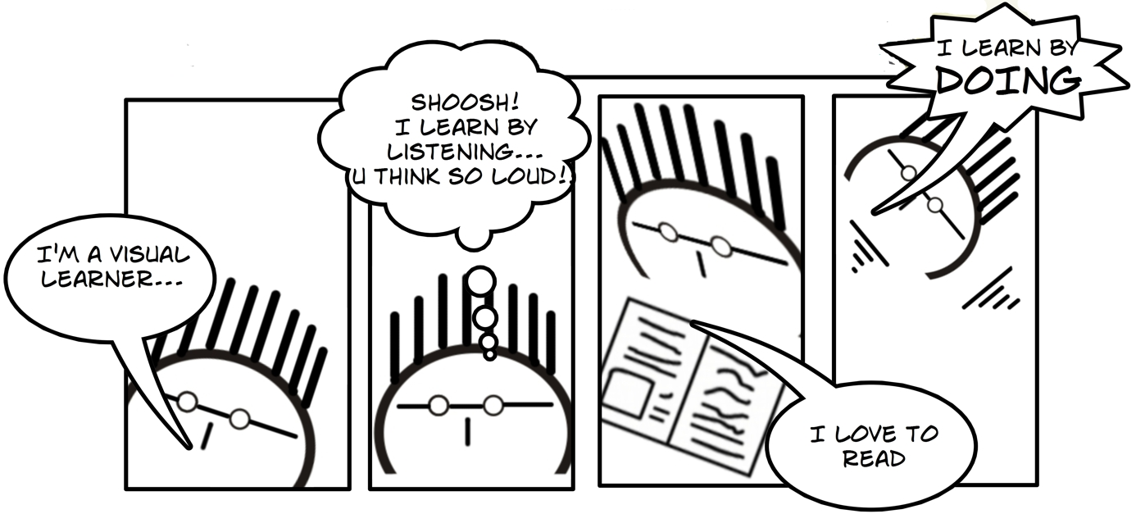
VARK
Fleming (1987)

Slide 17

Visual
Notice details
Observe rather than act or talk
Find verbal instructions difficult
Memorise by looking at pictures/videos

Slide 18
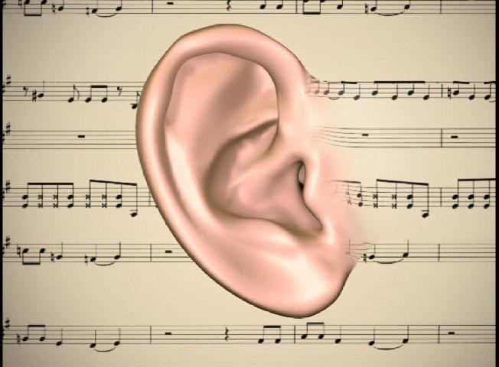
Auditory
Enjoy talking and listening to others
Like to try new things
Hum, sing and whisper or talk out loud
Easily distracted
Have difficulty with written instructions
Don’t like noisy environments

Slide 19

Read/Write
Like solitary activities
Learn best from reading & writing
Like reading and often good at spelling

Slide 20

Kinaesthetic
Like physical activities
Fidget with pens whilst studying
Like to try new things
Do not like reading and often poor at spelling
Use their hands whilst talking

Slide 21
Discussion
Take some time to review your results for VARK
  Do you agree with them?
  What have you realised about yourself?
  Talk to your colleagues – compare & contrast your profiles
  What are the challenges for teaching a group with different preferences?

Slide 22
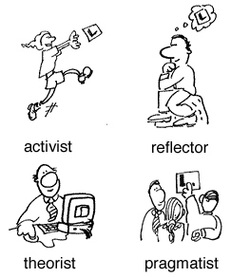
Honey & Mumford
Honey & Mumford (1986) suggest
that there are 4 types of learners:
Activist
Pragmatist
Theorist
Reflector
“Every student can learn, just not on the same day, or the same way.”
George Evans

Slide 23
Types of Learners
  Activist
Like to deal with new problems
Like new experiences
Like lots of activity's to keep them busy
They love challenges
  Pragmatist
Like to apply what they learnt to practical situations
They like logical reasons for doing something
They like to be hands on
They are enthusiastic

Slide 24
Types of Learners
Theorist
Reflector
Students need to take time to take in information
They prefer to read lots of materiel
They think about something before applying it
Students think deeply about what they are learning
They like things to be tried and tested
Tend to be reserved

Slide 25
If you were to set up a new television, What would you do?
Jump right in and press all the buttons (Activist)
Look briefly at the instructions and then have a go (Pragmatist)
Read the instructions, then think it through first (Theorist)
Read the full manual and consider ways of doing it (Reflector)

Slide 26
Discussion
Take some time to review your results for Honey & Mumford results
  Do you agree with them?
  What have you realised about yourself?
  Talk to your colleagues – compare & contrast your profiles
  What are the challenges for teaching a group with different preferences?

Slide 27
Discussion
Imagine yourself in the role of Manager. You have a team of 10 people with some common, and some individual, development needs. What different training methods could you use to address their different learning styles?
20 mins. Be prepared to discuss with the group
Notes:
Use syndicates or Buzz groups to address this. Different training approaches could include facilitated classroom/seminar experience, demonstrations, shadowing, project work, text books/procedure manuals/instruction books, coaching, mentoring, role-play, case-studies, joint problem solving, video/audio training resources. Games, etc. Draw out the different dynamics in the work environment – pressure on time versus training people properly…….Minimising cost versus addressing learning needs & styles appropriately……The Manager’s attitude towards training of their team? Etc.

Slide 28
Summary
Take 5 minutes to reflect on the day and summarise your learning from today.

Slide 29
Further Research
Morgan, P. , 2017. The business student’s guide to study and employability. London: Sage Publications Ltd
Dowson, P., 2015. Personal and professional development for business students. London: Sage Publications Ltd.
Covey, S. R., 1999. The seven habits of highly effective people. London: Simon & Schuster UK Ltd.

