Slide 1
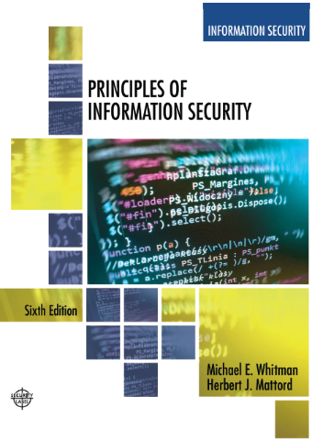
Planning for Security
Lecture 4
Lecturer: Assoc. Prof. Carlene Campbell
Email: carlene.campbell@uwtsd.ac.uk
Website: https://www.knowledgewithprofit.com/
Adapted Text
Guest Lecturer: Dr. Odayne Haughton
Email: o.haughton@uwtsd.ac.uk

Slide 2
Learning Objectives
Upon completion of this material, you should be able to:
  Describe management’s role in the development, maintenance, and enforcement of information security policy, standards, practices, procedures, and guidelines
  Explain what an information security blueprint is, identify its major components, and explain how it supports the information security program
  Discuss how an organization institutionalizes its policies, standards, and practices using education, training, and awareness programs
  Describe what contingency planning is and how it relates to incident response planning, disaster recovery planning, and business continuity plans
Notes:
Learning Objectives
Upon completion of this material, you should be able to:
Describe management’s role in the development, maintenance, and enforcement of information security policy, standards, practices, procedures, and guidelines
Explain what an information security blueprint is, identify its major components, and explain how it supports the information security program

Slide 3
Overview of key topics
  Setting up a Governance Structure
  Management’s Role in Information Security
  Information Security Blueprint
  Institutionalizing Policies
  Contingency Planning
Notes:
“Good afternoon/evening everyone! Welcome to today's lecture on 'Planning for Security,' part of our series on Data Security and Compliance. I’m Odayne, and I’ll be guiding you through some crucial aspects of information security planning today.”
In this lecture, we'll explore several key areas: setting up a governance structure, the role of management in information security, the components and importance of an information security blueprint, how to institutionalize policies through education and training, and the concept of contingency planning.
An organization’s information security effort succeeds only when it operates in conjunction with the organization’s information security policy.
Introduction
Information security program begins with policies, standards, and practices, which are the foundation for information security architecture and blueprint
Coordinated planning required to create and maintain these elements
Strategic planning for management of allocation of resources
Contingency planning for preparation of uncertain business environment

Slide 4

Introduction
Welcome to the lecture on Planning for Security.
Planning helps translate an organization's strategic plans into tactical objectives!
do we need planning?
Notes:
“Good afternoon/evening everyone! Welcome to today's lecture on 'Planning for Security,' part of our series on Data Security and Compliance. I’m Odayne, and I’ll be guiding you through some crucial aspects of information security planning today.”
Why do we need to plan for security?
Security planning is an essential aspect of protecting an organization's information assets. This transformation is essential to ensure that the broad goals set by senior management are effectively implemented through actionable steps and operational activities. Let's delve into how this planning hierarchy functions and why it is vital for robust information security.

Slide 5
PLANNING
  It is difficult to overstate how essential planning is. In a setting where there are continual constraints on resources, both human and financial, good planning enables an organisation to make the most of the materials at hand.
  Planning involves
    Representatives of the three communities of interest
      Management
      Employees
      External stakeholders
Notes:
“Good afternoon/evening everyone! Welcome to today's lecture on 'Planning for Security,' part of our series on Data Security and Compliance. I’m Odayne, and I’ll be guiding you through some crucial aspects of information security planning today.”
In this lecture, we'll explore several key areas: setting up a governance structure, the role of management in information security, the components and importance of an information security blueprint, how to institutionalize policies through education and training, and the concept of contingency planning.
An organization’s information security effort succeeds only when it operates in conjunction with the organization’s information security policy.
Introduction
Information security program begins with policies, standards, and practices, which are the foundation for information security architecture and blueprint
Coordinated planning required to create and maintain these elements
Strategic planning for management of allocation of resources
Contingency planning for preparation of uncertain business environment

Slide 6
1. Setting up a Governance Structure
Notes:
The first priority of the CISO and the information security management team is the creation of a strategic plan to accomplish the organization’s information security objectives.
Governance describes the entire function of controlling, or governing, the processes used by a group to accomplish some objective.
Information security governance then applies these principles and management structures to the information security function.
chief information security officer (CISO)
InfoSec Planning and Governance
Planning levels help translate organization’s strategic plans into tactical objectives
Planning and the CISO
Information Security Governance
Governance:
Set of responsibilities and practices exercised by the board and executive management
Goal to provide strategic direction, establishment of objectives, and measurement of progress toward objectives
Also verifies/validates that risk management practices are appropriate and assets used properly

Slide 7
Information Security Governance (1 of 2)
Information security governance
  Governance:
    Set of responsibilities and practices exercised by the board and executive management
    Goal to provide strategic direction, establishment of objectives, and measurement of progress toward objectives
    Also verifies/validates that risk management practices are appropriate and assets used properly
Notes:
IT security Governance is the system by which an organization directs and controls IT security (adapted from ISO 38500)
IT Security Management is concerned with making decisions to mitigate risks; governance determines who is authorised to make decisions.
Governance specifies the accountability framework and provides oversight to ensure that risks are adequately mitigated, while management ensures that controls are implemented to mitigate risks

Slide 8
Information Security Governance (2 of 2)
Information security governance outcomes
  Five goals:
    Strategic alignment
    Risk management
    Resource management
    Performance measurement
    Value delivery
Notes:
According to the Information Technology Governance Institute (ITGI), information security governance includes all of the accountabilities and methods undertaken by the board of
directors and executive management to provide
InfoSec Planning and Governance
Information Security Governance outcomes
Five goals
Strategic alignment
Risk management
Resource management
Performance measures
Value delivery

Slide 9
2. Management’s Role in Information Security

Slide 10
Management’s Role in Information Security
Setting Information Security Objectives
Establishing Policies and Procedures
Allocating Resources
Promoting a Culture of Security Awareness
Risk Management and Compliance
Incident Response and Business Continuity
Monitoring and Reporting
Continuous Improvement
Notes:
Setting Information Security Objectives: Management plays a crucial role in defining and setting clear information security objectives aligned with the organization's overall goals and risk appetite. This involves establishing strategic priorities, resource allocations, and performance metrics to guide the implementation of effective security measures.
Establishing Policies and Procedures: Management is responsible for developing comprehensive information security policies, standards, and procedures that outline the organization's expectations, requirements, and best practices for safeguarding sensitive data and assets. These policies should address areas such as data classification, access control, encryption, incident response, and regulatory compliance.
Allocating Resources: Management must allocate sufficient resources, including budget, personnel, and technology, to support the implementation and maintenance of robust information security programs. This involves conducting risk assessments, identifying security gaps, and investing in appropriate security controls, technologies, and training initiatives to mitigate risks effectively.
Promoting a Culture of Security Awareness: Management plays a pivotal role in fostering a culture of security awareness and accountability throughout the organization. This includes promoting regular training and awareness programs to educate employees about information security risks, threats, and best practices. Management should lead by example and prioritize security as a core organizational value.
Risk Management and Compliance: Management is responsible for overseeing the organization's risk management processes and ensuring compliance with relevant legal, regulatory, and industry standards for information security. This involves conducting regular risk assessments, audits, and compliance reviews to identify, assess, and mitigate security risks and ensure adherence to applicable requirements.
Incident Response and Business Continuity: Management must establish effective incident response and business continuity plans to mitigate the impact of security incidents, breaches, or disruptions to business operations. This includes defining roles and responsibilities, establishing communication protocols, and conducting regular drills and exercises to test the organization's readiness to respond to security incidents and maintain business continuity.
Monitoring and Reporting: Management is responsible for monitoring and reviewing the effectiveness of information security controls, processes, and policies on an ongoing basis. This involves implementing security monitoring tools, conducting security assessments, and generating reports to track key security metrics, trends, and incidents. Management should review these reports regularly to identify areas for improvement and take corrective actions as needed.
Continuous Improvement: Management should promote a culture of continuous improvement in information security by regularly reviewing and updating security policies, procedures, and controls in response to evolving threats, technologies, and business requirements. This includes conducting post-incident reviews, lessons learned sessions, and security awareness campaigns to enhance security posture and resilience over time.
Executive Leadership and Oversight: Ultimately, management, including executive leadership and the board of directors, bears ultimate responsibility for information security governance and oversight.

Slide 11
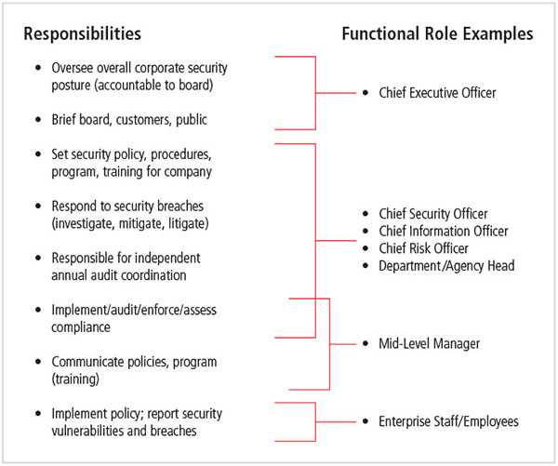
Information security governance roles and responsibilities
Data Protection Officer (DPO)
Source: Management of Information Security 5th edition
Notes:
Effective communication among stakeholders is critical to the structures and processes used in governance at every level, especially in information security governance.
This requires the development of constructive relationships, a common language, and a commitment to the objectives of the organization.

Slide 12
3. Institutionalizing Policies

Slide 13
Definitions
Policy: course of action used by organization to convey instructions from management to those who perform duties
Policies are organizational laws
Standards: more detailed statements of what must be done to comply with policy
Practices, procedures and guidelines effectively explain how to comply with policy
For a policy to be effective, must be properly disseminated, read, understood and agreed to by all members of organization
Notes:
A policy is
A plan or course of action, as of a government, political party, or business, intended to influence and determine decisions, actions, and other matters
Policies are organizational laws
Policies must contain information on what is right, and what is not; what the penalties are for violating policy, and what the appeal process is
Standards, on the other hand, are more detailed statements of what must be done to comply with policy
Practices, procedures and guidelines effectively explain how to comply with policy
For a policy to be effective it must be properly disseminated, read, understood and agreed to by all members of the organization.

Slide 14
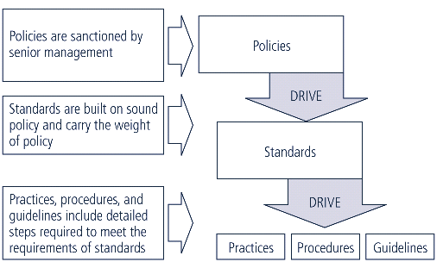
Policies, Standards, and Practices
Notes:
Types of Policy
Management defines three types of security policy:
1) General or security program policy
2) Issue-specific security policies
3) Systems-specific security policies

Slide 15
Information Security Policy, Standards, and Practices
The creation of an information security program begins with the creation and/or review of organization’s information security policies, standards, and practices
Then, the selection or creation of information security architecture and the development and use of a detailed information security blueprint (to come later)
Without policy, blueprints, and planning, organization is unable to meet information security needs of various communities of interest
Notes:
Introduction
The creation of an information security program begins with an information security blueprint, and before we can discuss the creation and development of a blueprint, it is important to look at management’s responsibility in shaping policy.
It is prudent for information security professionals to know the information security polices and how these policies contribute to the overall objectives of the organization.

Slide 16
Information Security Policy, Standards, and Practices
Management from communities of interest must make policies the basis for all information security planning, design, and deployment.
Policies direct how issues should be addressed and technologies used.
Policies should never contradict law, must be able to stand up in court, and must be properly administered.
Security policies are the least expensive controls to execute but most difficult to implement properly.
Notes:
Information Security Policy, Standards, and Practices
Management from communities of interest must make policies the basis for all information security planning, design, and deployment
Policies direct how issues should be addressed and technologies used
Policies should never contradict law, must be able to stand up in court, must be properly administered
Security policies are the least expensive controls to execute but most difficult to implement properly

Slide 17
Policy as the Foundation for Planning
Policy functions as organizational law that dictates acceptable and unacceptable behavior.
Standards: more detailed statements of what must be done to comply with policy.
Practices, procedures, and guidelines effectively explain how to comply with policy.
For a policy to be effective, it must be properly disseminated, read, understood, and agreed to by all members of the organization, and uniformly enforced.
Notes:
The meaning of the term security policy depends on the context in which it is used. Governmental agencies view security policy in terms of national security and national policies to deal
with foreign states.
Standards, on the other hand, are more detailed statements of what must be done to comply with policy
Policy as Foundation for Planning
Policy functions as organizational law that dictates acceptable and unacceptable behavior
Standards: more detailed statements of what must be done to comply with policy
Practices, procedures, and guidelines effectively explain how to comply with policy
For a policy to be effective, it must be properly disseminated, read, understood, and agreed to by all members of organization, and uniformly enforced

Slide 18
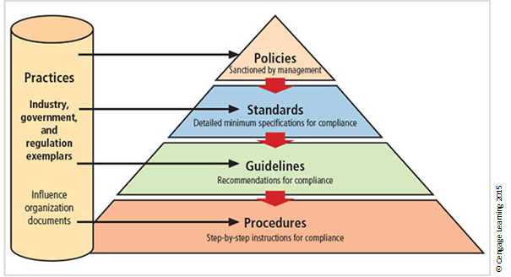
Policies, standards, guidelines, and procedures
Notes:
The Figure shows the relationships among policies, standards, guidelines, procedures, and practices.
This relationship is further examined in the nearby Offline feature.
Types of Policy
Management defines three types of security policy:
1) General or security program policy
2) Issue-specific security policies
3) Systems-specific security policies

Slide 19
Security Policies
Organizations adapts one or more:
Enterprise Information Security Policy Manual (EISPM)
  Acceptable Use Policy (AUP)
  Access Control Policy
  Data Classification Policy
  Data Handling and Protection Policy
  Incident Response Policy
  Network Security Policy
  Bring Your Own Device (BYOD) Policy
Issue-Specific Security Policy (ISSP)
Systems-Specific Security Policy (SysSP)
Notes:
Other slides outline the components (adapt them or select appropriate ones for your assignment)
An enterprise information security policy (EISP) is also known as a general security policy, organizational security policy, IT security policy, or information security policy.
EISP typically addresses compliance in two areas:
General compliance to ensure meeting of requirements to establish program and assigning responsibilities therein to various organizational components
Use of specified penalties and disciplinary action
EISP Elements should include:
Overview of the corporate security philosophy
Information on the structure of the organization and people in information security roles
Articulated responsibilities for security shared by all members of the organization
Articulated responsibilities for security unique to each role in the organization
The ISSP:
Addresses specific areas of technology e.g. email, use of Internet, BOYD, etc
Requires frequent updates
Contains statement on the organization’s position on
specific issue
Three common approaches when creating and managing ISSPs:
Create a number of independent ISSP documents
Create a single comprehensive ISSP document
Create a modular ISSP document
SysSPs often function as standards or procedures used when configuring or maintaining systems.
SysSPs fall into two groups:
Managerial guidance
Technical specifications
Access control lists (ACLs) can restrict access for a particular user, computer, time, duration—even a particular file.
Configuration rule policies govern how a security system reacts to received data.
Combination SysSPs combine managerial guidance and technical specifications.

Slide 20
Policy Management
Policies must be managed as they constantly change.
To remain viable, security policies must have:
  A responsible manager
  A schedule of reviews
  A method for making recommendations for reviews
  A policy issuance and revision date
  Automated policy management
Notes:
Good management practices for policy development and maintenance make for a more resilient organization.
For example, all policies, including security policies, undergo tremendous stress when corporate mergers and divestitures occur.
System vulnerabilities can arise, for instance, if incongruent security policies are implemented in different parts of a newly merged organization.
Policy Management
Policies must be managed as they constantly change
To remain viable, security policies must have:
Responsible manager
A schedule of reviews
Method for making recommendations for reviews
Policy issuance and revision date
Automated policy management

Slide 21
4. Information Security Blueprint

Slide 22
The Information Security Blueprint
Basis for design, selection, and implementation of all security policies, education and training programs, and technological controls.
Detailed version of security framework (outline of overall information security strategy for organization).
Specifies tasks and the order in which they are to be accomplished.
Should also serve as a scalable, upgradeable, and comprehensive plan for the current and future information security needs.
Notes:
Once an organization has developed its information security policies and standards, the information security community can begin developing the blueprint for the information
security program. If any policies, standards, or practices have not been completed, management must determine whether to proceed nonetheless with the development of the
blueprint.
This information security blueprint is the basis for the design, selection, and implementation of all security program elements, including policy implementation, ongoing policy management,
risk management programs, education and training programs, technological controls, and program maintenance.
Information Security Blueprints
Basis for design, selection, and implementation of all security policies, education and training programs, and technological controls
Detailed version of security framework (outline of overall information security strategy for organization)
Specifies tasks and order in which they are to be accomplished
Should also serve as scalable, upgradeable, and comprehensive plan for current and future information security needs
A framework is the basic skeletal structure within which additional detailed planning of the blueprint can be placed as it is developed of refined.
Experience teaches us that what works well for one organization may not precisely fit another.

Slide 23
ISO 17799/BS7799
One of the most widely referenced and often discussed security blueprints
Framework for information security that states organizational security policy is needed to provide management direction and support
Notes:
ISO 17799/BS 7799
One of the most widely referenced and often discussed security models is the Information Technology – Code of Practice for Information Security Management, which was originally published as the British Standard BS 7799.
This Code of Practice was adopted as an international standard by the International Organization for Standardization (ISO) and the International Electrotechnical Commission (IEC) as ISO/IEC 17799 in 2000 as a framework for information security.
ISO/IEC 17799
1. Organizational Security Policy is needed to provide management direction and support for information security.
2. Organizational Security Infrastructure objectives:
Manage information security within the company
Maintain the security of organizational information processing facilities and information assets accessed by third parties
Maintain the security of information when the responsibility for information processing has been outsourced to another organization
3. Asset Classification and Control is needed to maintain appropriate protection of corporate assets and to ensure that information assets receive an appropriate level of protection.
4. Personnel Security objectives:
Reduce risks of human error, theft, fraud or misuse of facilities
Ensure that users are aware of information security threats and concerns, and are equipped to support the corporate security policy in the course of their normal work
Minimize the damage from security incidents and malfunctions and learn from such incidents
5. Physical and Environmental Security objectives:
Prevent unauthorized access, damage and interference to business premises and information
Prevent loss, damage or compromise of assets and interruption to business activities
Prevent compromise or theft of information and information processing facilities
6. Communications and Operations Management objectives:
Ensure the correct and secure operation of information processing facilities
Minimize the risk of systems failures
Protect the integrity of software and information
Maintain the integrity and availability of information processing and communication
Ensure the safeguarding of information in networks and the protection of the supporting infrastructure
Prevent damage to assets and interruptions to business activities
Prevent loss, modification or misuse of information exchanged between organizations
7. System Access Control objectives in this area include:
Control access to information
Prevent unauthorized access to information systems
Ensure the protection of networked services
Prevent unauthorized computer access
Detect unauthorized activities
Ensure information security when using mobile computing and telecommunication networks
8. System Development and Maintenance objectives:
Ensure security is built into operational systems
Prevent loss, modification or misuse of user data in application systems
Protect the confidentiality, authenticity and integrity of information
Ensure IT projects and support activities are conducted in a secure manner
Maintain the security of application system software and data
9. Business Continuity Planning to counteract interruptions to business activities and to critical business processes from the effects of major failures or disasters.
10. Compliance objectives:
Avoid breaches of any criminal or civil law, statutory, regulatory or contractual obligations and of any security requirements
Ensure compliance of systems with organizational security policies and standards
Maximize the effectiveness of and minimize interference to/from the system audit process

Slide 24
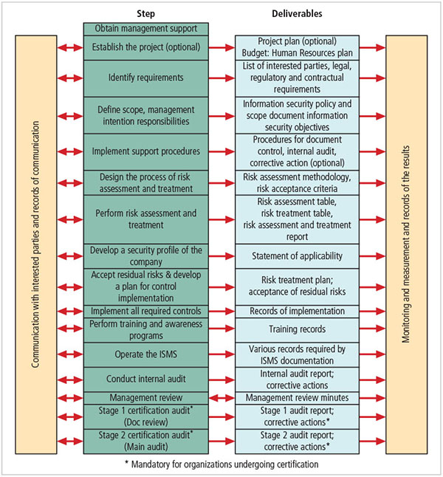
ISO/IEC 27001:2013 major process steps
Source: 27001 Academy: ISO 27001 and ISO 22301 Online Consultation Center
Notes:
As shown in the Figure ISO 27001 has moved from its previous Plan-Do-Check-Act format to a more formal and comprehensive approach to implementing
the ISO 27002 control structure.

Slide 25
NIST Security Models
Documents available from Computer Security Resource Center of NIST
  SP 800-12, The Computer Security Handbook
  SP 800-14, Generally Accepted Principles and Practices for Securing IT Systems
  SP 800-18, The Guide for Developing Security Plans for IT Systems
  SP 800-26, Security Self-Assessment Guide for Information Technology Systems
  SP 800-30, Risk Management Guide for Information Technology Systems
Notes:
NIST Security Models
Another approach available is described in the many documents available from the Computer Security Resource Center of the National Institute for Standards and Technology (csrc.nist.gov).
These are among the references cited by the government of the U.S. when deciding not to select the ISO/IEC 17799 standards.
NIST SP 800-12 - The Computer Security Handbook is an excellent reference and guide for the security manager or administrator in the routine management of information security.
NIST SP 800-14 - Generally Accepted Principles and Practices for Securing IT Systems provides best practices and security principles that can direct the development of a security blueprint.
NIST SP 800-18 - The Guide for Developing Security Plans for IT Systems is considered the foundation for a comprehensive security blueprint and framework. It provides detailed methods for assessing, designing, and implementing controls and plans for various sized applications.

Slide 26
NIST Special Publication 800-14
Security supports mission of organization; is an integral element of sound management
Security should be cost-effective; owners have security responsibilities outside their own organizations
Security responsibilities and accountability should be made explicit; security requires a comprehensive and integrated approach
Security should be periodically reassessed; security is constrained by societal factors
33 Principles enumerated
Notes:
NIST SP 800-14 Generally Accepted Principles and Practices
Security Supports the Mission of the Organization
Security is an Integral Element of Sound Mgmt
Security Should Be Cost-Effective
Systems Owners Have Security Responsibilities Outside Their Own Organizations
Security Responsibilities and Accountability Should Be Made Explicit
Security Requires a Comprehensive and Integrated Approach
Security Should Be Periodically Reassessed
Security is Constrained by Societal Factors
1. Establish a sound security policy as the “foundation” for design.
2. Treat security as an integral part of the overall system design.
3. Clearly delineate the physical and logical security boundaries governed by associated security policies.
4. Reduce risk to an acceptable level.
5. Assume that external systems are insecure.
6. Identify potential trade-offs between reducing risk and increased costs and decrease in other aspects of operational effectiveness.
7. Implement layered security (Ensure no single point of vulnerability).
8. Implement tailored system security measures to meet organizational security goals.
9. Strive for simplicity.
10. Design and operate an IT system to limit vulnerability and to be resilient in response.
11. Minimize the system elements to be trusted.
12. Implement security through a combination of measures distributed physically and logically.
13. Provide assurance that the system is, and continues to be, resilient in the face of expected threats.
14. Limit or contain vulnerabilities.
15. Formulate security measures to address multiple overlapping information domains.
16. Isolate public access systems from mission critical resources (e.g., data, processes, etc.).
17. Use boundary mechanisms to separate computing systems and network infrastructures.
18. Where possible, base security on open standards for portability and interoperability.
19. Use common language in developing security requirements.
20. Design and implement audit mechanisms to detect unauthorized use and to support incident investigations.
21. Design security to allow for regular adoption of new technology, including a secure and logical technology upgrade process.
22. Authenticate users and processes to ensure appropriate access control decisions both within and across domains.
23. Use unique identities to ensure accountability.
24. Implement least privilege.
25. Do not implement unnecessary security mechanisms.
26. Protect information while being processed, in transit, and in storage.
27. Strive for operational ease of use.
28. Develop and exercise contingency or disaster recovery procedures to ensure appropriate availability.
29. Consider custom products to achieve adequate security.
30. Ensure proper security in the shutdown or disposal of a system.
31. Protect against all likely classes of “attacks.”
32. Identify and prevent common errors and vulnerabilities.
33. Ensure that developers are trained in how to develop secure software.

Slide 27
Security Frameworks
The ISO 27000 Series
NIST Security Models
Computer Emergency Response Team Coordination Center (CERT/CC)
International Association of Professional Security Consultants
Notes:
More information/content is within other slides for referencing or assignment usage
ISO (The International Organization for Standardization) 27000 series
One of the most widely referenced security models
Standard framework for information security that states organizational security policy is needed to provide management direction and support
Purpose is to give recommendations for information security management
Provides a starting point for developing organizational security
NIST (The National Institute of Standards and Technology)
Security supports the mission of the organization and is an integral element of sound management.
Security should be cost effective; owners have security responsibilities outside their own organizations.
Security responsibilities and accountability should be made explicit; security requires a comprehensive and integrated approach.

Slide 28
5. Security Architecture
(Policy & Law, Contingency Planning, Education & Training)

Slide 29
Design of Security Architecture
Spheres of security: foundation of the security framework
Levels of controls
  Management controls : cover security processes designed by strategic planners and performed by security administration
  Operational controls deal with operational functionality of security in organization
  Technical controls address tactical and technical implementations related to designing and implementing security in organization
Notes:
Controls
Management controls cover security processes that are designed by the strategic planners and performed by security administration of the organization.
Management controls address the design and implementation of the security planning process and security program management.
Operational controls deal with the operational functionality of security in the organization.
They cover management functions and lower-level planning, such as disaster recovery and incident response planning.
Operational controls also address personnel security, physical security, and the protection of production inputs and outputs.
Technical controls address those tactical and technical issues related to designing and implementing security in the organization.
Technical controls cover logical access controls like identification, authentication, authorization, and accountability.

Slide 30
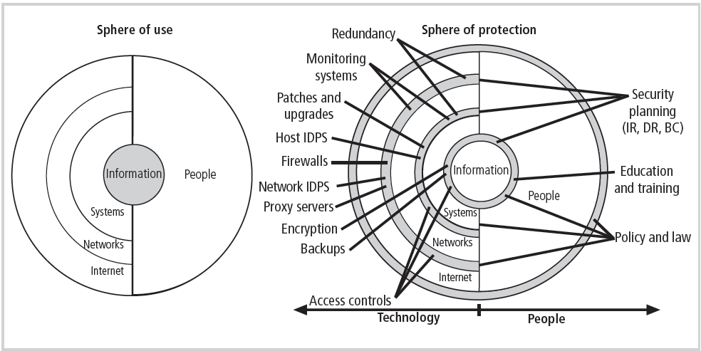
Figure 5-8 Spheres of Security
Notes:
Figure 6-16, showing the sphere of security, is the foundation of the security framework.
Generally speaking, the sphere of security represents the fact that information is under attack from a variety of sources. The sphere of use, at the left of the figure, illustrates the ways in which people can directly access information; for example, people read hard copies of documents; they also access information through systems, such as the electronic storage of information.
Information, as the most important asset to security, is illustrated at the core of the sphere. Information is always at risk from attacks through the people and computer systems that have direct access to the information. Networks and the Internet represent indirect threats, as exemplified by the fact that a person attempting to access information from the Internet must first go through the local networks and then access systems that contain the information. The sphere of protection, at the right of the figure, illustrates that between each layer of the sphere of use there must exist a layer of protection to prevent access to the inner layer from the outer layer. Each shaded band is a layer of protection and control. For example, the layer labeled “policy education and training” is located between people and the information.
Controls are also implemented between systems and the information, between networks and the computer systems, and between the Internet and internal networks. This reinforces the concept of defense in depth.
As illustrated in the sphere of protection portion of Figure 6-16, a variety of controls can be used to protect the information. The list in the figure is not intended to be comprehensive but illustrates individual safeguards that protect the various systems that are located closer to the center of the sphere. However, as people can directly access each ring as well as the information at the core of the model, people require unique approaches to security.
In fact, the resource of people must become a layer of security, a human firewall that protects the information from unauthorized access and use. The members of the organization must become a safeguard, which is effectively trained, implemented, and maintained, or else they, too, become a threat to the information.

Slide 31
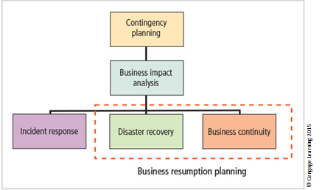
Components of contingency planning
Notes:
Contingency Planning Process
Includes following steps:
Develop CP policy statement
Conduct business impact analysis
Identify preventive controls
Create contingency strategies
Develop contingency plan
Ensure plan testing, training, and exercises
Ensure plan maintenance
CP Policy
Should contain following sections:
Introductory statement of philosophical perspective
Statement of scope/purpose
Call for periodic risk assessment/BIA
Specification of CP’s major components
Call for/guidance in selection of recover options
Requirement to test various plans regularly
Identification of key regulations and standards
Identification of key people responsible for CP operations
Challenge to organization members for support
Administrative information
Business Impact Analysis
Investigation and assessment of various adverse events that can affect organization
Assumes security controls have been bypassed, have failed, or have proven ineffective, and the attack has succeeded
Organization should consider scope, plan, balance, knowledge of objectives, and follow-ups
Three stages:
Determine mission/business processes and recovery criticality
Identify recovery priorities for system resources
Identify resource requirements
Incident Response Planning
Incident response planning covers the identification of, classification of, and response to an incident.
The IRP is made up of activities that are to be performed when an incident has been identified.
An incident is an attack against an information asset that poses a clear threat to the confidentiality, integrity, or availability of information resources.
Attacks are only classified as incidents if they have the following characteristics:
Are directed against information assets
Have a realistic chance of success
Could threaten the confidentiality, integrity, or availability of information resources.
Incident response (IR) is the set of activities taken to plan for, detect, and correct the impact of an incident on information resources.
IR is more reactive than proactive, with the exception of the planning that must occur to prepare the IR teams to be ready to react to an incident.
Planning for an incident requires a detailed understanding of the scenarios developed for the BIA.
Disaster Recovery Planning
Disaster recovery planning (DRP) is planning the preparation for and recovery from a disaster
The contingency planning team must decide which actions constitute disasters and which constitute incidents
When situations classified as disasters, plans change as to how to respond; take action to secure most valuable assets to preserve value for the longer term
DRP strives to reestablish operations at the primary site
Business Continuity Planning
Prepares organization to reestablish or relocate critical business operations during a disaster that affects operations at the primary site
If disaster has rendered current location unusable, there must be a plan to allow business to continue functioning
Development of BCP is somewhat simpler than IRP or DRP
Consists primarily of selecting a continuity strategy and integrating off-site data storage and recovery functions into this strategy

Slide 32
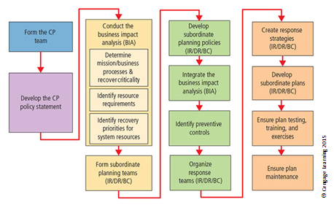
Major steps in contingency planning
Notes:
This seven-step methodology recommended by NIST for DRP and BCP has been expanded to include details of the BIA and IRP, resulting in the model shown in Figure

Slide 33
Continuity Strategies
Incident response plans (IRPs), disaster recovery plans (DRPs), and business continuity plans (BCPs)
Primary functions of above plans:
  IRP focuses on immediate response; if attack escalates or is disastrous, process changes to DRP and BCP.
  DRP typically focuses on restoring systems after disasters occur; as such, it is closely associated with BCP.
  BCP occurs concurrently with DRP when damage is major or ongoing, requiring more than simple restoration of information and information resources.
Notes:
Contingency Planning Team
Before any planning can begin, a team has to plan the effort and prepare the resulting documents
Champion - A high-level manager to support, promote, and endorse the findings of the project
Project Manager - Leads the project and makes sure a sound project planning process is used, a complete and useful project plan is developed, and project resources are prudently managed
Team Members - Should be the managers or their representatives from the various communities of interest: business, IT, and information security
Continuity Strategies
Incident response plans (IRPs); disaster recovery plans (DRPs); business continuity plans (BCPs)
Primary functions of above plans
IRP focuses on immediate response; if attack escalates or is disastrous, process changes to disaster recovery and BCP
DRP typically focuses on restoring systems after disasters occur; as such, is closely associated with BCP
BCP occurs concurrently with DRP when damage is major or ongoing, requiring more than simple restoration of information and information resources

Slide 34
Crisis Management
Actions taken in response to an emergency should minimize injury/loss of life, preserve organization’s image/market share, and complement disaster recovery/business continuity processes.
What may truly distinguish an incident from a disaster are the actions of the response teams.
Disaster recovery personnel must know their roles without any supporting documentation.
  Preparation
  Training
  Rehearsal
Notes:
Crisis management must balance the needs of employees with the needs of the business in providing personnel with support at home during disasters.
Crisis Management
Crisis management team is responsible for managing event from an enterprise perspective and covers:
Supporting personnel and families during crisis
Determining impact on normal business operations and, if necessary, making disaster declaration
Keeping the public informed
Communicating with major customers, suppliers, partners, regulatory agencies, industry organizations, the media, and other interested parties
Crisis Managment
Key areas of crisis management also include
Verifying personnel head count
Checking alert roster
Checking emergency information cards
Crisis Management
Actions taken in response to an emergency to minimize injury/loss of life, preserve organization’s image/market share, and complement disaster recovery/business continuity processes
What may truly distinguish an incident from a disaster are the actions of the response teams
Disaster recovery personnel must know their roles without any supporting documentation
Preparation
Training
Rehearsal

Slide 35
The Consolidated Contingency Plan
Single document set approach combines all aspects of contingency policy and plan, incorporating IR, DR, and BC plans.
Often created and stored electronically, it should be easily accessible by employees in time of need.
  Small- and medium-sized organizations may also store hard copies of the document.
Notes:
An organization can build a single document that combines all aspects of the contingency policy and plan, incorporating the IR, DR, and BC plans.
Consolidated Contingency Plan
Single document set approach combines all aspects of contingency policy and plan, incorporating IR, DR, and BC plans
Often created and stored electronically, should be easily accessible by employees in time of need
Small and medium-sized organizations may also store hard copies of document

Slide 36
Security Education, Training, and Awareness Program
Once general security policy exists, implement security education, training, and awareness (SETA) program.
SETA is a control measure designed to reduce accidental security breaches.
The SETA program consists of security education, security training, and security awareness.
It enhances security by improving awareness, developing skills and knowledge, and building in-depth knowledge.
Notes:
Once your organization has defined the policies that will guide its security program and selected an overall security model by creating or adapting a security framework and a corresponding
detailed implementation blueprint, it is time to implement a security education, training, and awareness (SETA) program.
Education
Everyone in an organization needs to be trained and aware of information security; not every member needs a formal degree or certificate in information security.
When formal education is deemed appropriate, an employee can investigate courses in continuing education from local institutions of higher learning.
A number of universities have formal coursework in information security.
Security Training
Provides members of organization with detailed information and hands-on instruction to prepare them to perform their duties securely
Management of information security can develop customized in-house training or outsource the training program
Alternatives to formal training include conferences and programs offered through professional organizations
Security Awareness
One of least frequently implemented but most beneficial programs is the security awareness program
Designed to keep information security at the forefront of users’ minds
Need not be complicated or expensive
If the program is not actively implemented
Security Education, Training, and Awareness Program
Once general security policy exists, implement security education, training, and awareness (SETA) program
SETA is a control measure designed to reduce accidental security breaches
The SETA program consists of: security education; security training; and security awareness
Enhances security by improving awareness, developing skills and knowledge, and building in-depth knowledge

Slide 37
Comparative Framework of SETA
 | Education | Training | Awareness
Attribute | Why | How | What
Objective | Understanding | Skill | Exposure
Teaching method | Theoretical instruction Discussion seminar Background reading Hands-on practice | Practical instruction Lecture Case study workshop Posters | Media Videos Newsletters
Test measure | Essay (interpret learning) | Problem solving (apply learning) | True or False Multiple choice (identify learning)
Impact timeframe | Long term | Intermediate | Short term
^{Source: NIST SP 800-12}
Notes:
The Table compares the features of security education, training, and awareness within the organization.

Slide 38
Next Class
Focus on:
  Risk Management

Slide 39
Summary
Management has an essential role in the development, maintenance, and enforcement of information security policy, standards, practices, procedures, and guidelines.
Information security blueprint is planning the document that is the basis for design, selection, and implementation of all security policies, education and training programs; and technological controls.
Information security education, training, and awareness (SETA) is a control measure that reduces accidental security breaches and increases organizational resistance to many other forms of attack.
Contingency planning (CP) is made up of three components: incident response planning (IRP), disaster recovery planning (DRP), and business continuity planning (BCP).

